Slide 2
Dr. Arnold G. Fruchtenbaum
The Book of Acts, 235
“This chapter in the book of Acts is a crucial turning point because the salvation of uncircumcised Gentiles began here. Notice how much it took to get Gentile salvation started: First, it took an angel coming to Cornelius; second, it took a voice out of heaven, speaking three times to Peter; third, it took the Holy Spirit speaking audibly to Peter; and, fourth, it took two visions, one for Cornelius and one for Peter.”

Slide 3
2 Peter 3:9
“The Lord is not slow about His promise, as some count slowness, but is patient toward you, not wishing for any to perish but for all to come to repentance.”

Slide 4
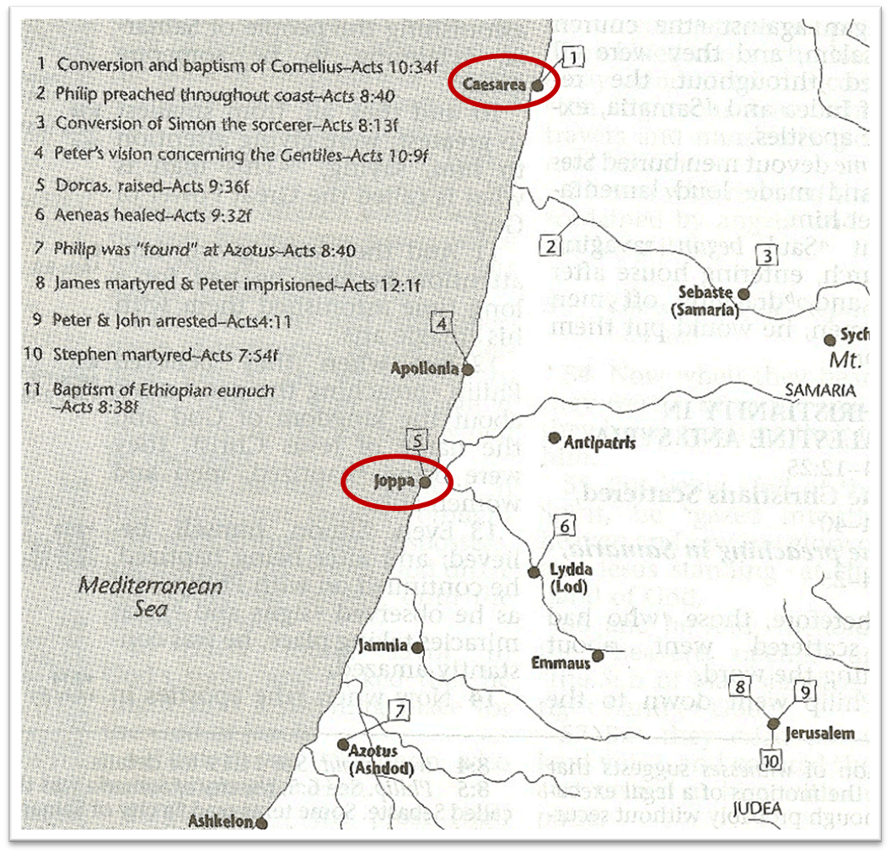

Slide 5
Acts 10:1‒11:18 Cornelius’ Salvation
Cornelius’ Vision (10:1-8)
Peter’s Vision (Acts 10:9-16)
Vision’s Application (10:17-23a)
Caesarean Ministry (10:23b-33)
Peter & The Keys of the Kingdom (10:34-43)
Gentiles’ Salvation (10:44-48)
Peter’s Defense in Jerusalem (11:1-18)

Slide 6
IV. Caesarean Ministry Acts 10:23b-33
Peter’s journey to Caesarea (23b-24a)
Cornelius’ anticipation (24b)
Peter & Cornelius’ meeting (25-27)
Peter explains his presence (28)
Peter’s question (29)
Cornelius’ response (30-33)

Slide 7
IV. Caesarean Ministry Acts 10:23b-33
Peter’s journey to Caesarea (23b-24a)
Cornelius’ anticipation (24b)
Peter & Cornelius’ meeting (25-27)
Peter explains his presence (28)
Peter’s question (29)
Cornelius’ response (30-33)

Slide 8
IV. Caesarean Ministry Acts 10:23b-33
Peter’s journey to Caesarea (23b-24a)
Cornelius’ anticipation (24b)
Peter & Cornelius’ meeting (25-27)
Peter explains his presence (28)
Peter’s question (29)
Cornelius’ response (30-33)

Slide 9
IV. Caesarean Ministry Acts 10:23b-33
Peter’s journey to Caesarea (23b-24a)
Cornelius’ anticipation (24b)
Peter & Cornelius’ meeting (25-27)
Peter explains his presence (28)
Peter’s question (29)
Cornelius’ response (30-33)

Slide 10
Acts 10:25-27 Peter & Cornelius’ Meeting
Cornelius’ reaction (25)
Peter’s reaction (26)
Peter’s enters house (27)

Slide 11
Acts 10:25-27 Peter & Cornelius’ Meeting
Cornelius’ reaction (25)
Peter’s reaction (26)
Peter’s enters house (27)

Slide 12
Acts 10:25-27 Peter & Cornelius’ Meeting
Cornelius’ reaction (25)
Peter’s reaction (26)
Peter’s enters house (27)

Slide 13
Revelation 19:10
“Then I fell at his feet to worship him. But he said to me, ‘Do not do that; I am a fellow servant of yours and your brethren who hold the testimony of Jesus; worship God. For the testimony of Jesus is the spirit of prophecy.’”

Slide 14
Acts 10:25-27 Peter & Cornelius’ Meeting
Cornelius’ reaction (25)
Peter’s reaction (26)
Peter’s enters house (27)

Slide 15
IV. Caesarean Ministry Acts 10:23b-33
Peter’s journey to Caesarea (23b-24a)
Cornelius’ anticipation (24b)
Peter & Cornelius’ meeting (25-27)
Peter explains his presence (28)
Peter’s question (29)
Cornelius’ response (30-33)

Slide 16
Dr. Arnold G. Fruchtenbaum
The Book of Acts, 239
“These were Gentiles living in a Jewish country, and they knew about the Jewish practice of not entering the home of a Gentile, as it was unlawful to do so. This practice was not part of the Mosaic Law, but it was part of Pharisaic Judaism not to associate with or visit one of another nation.”

Slide 17
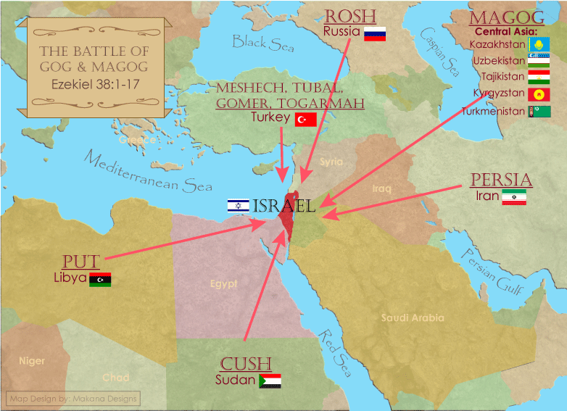

Slide 18
IV. Caesarean Ministry Acts 10:23b-33
Peter’s journey to Caesarea (23b-24a)
Cornelius’ anticipation (24b)
Peter & Cornelius’ meeting (25-27)
Peter explains his presence (28)
Peter’s question (29)
Cornelius’ response (30-33)

Slide 19
IV. Caesarean Ministry Acts 10:23b-33
Peter’s journey to Caesarea (23b-24a)
Cornelius’ anticipation (24b)
Peter & Cornelius’ meeting (25-27)
Peter explains his presence (28)
Peter’s question (29)
Cornelius’ response (30-33)

Slide 20
Acts 10:30-33 Cornelius’ Response
Angelic vision (30)
Angelic message (31-32)
Cornelius’ obedience (33a)
Cornelius ready to hear Peter (33b)

Slide 21
Acts 10:30-33 Cornelius’ Response
Angelic vision (30)
Angelic message (31-32)
Cornelius’ obedience (33a)
Cornelius ready to hear Peter (33b)

Slide 22
Shaping and Populating (Gen 1:1)
Day 1: | Light | Day 4: | Luminaries
Day 2: | Water, sky | Day 5: | Sea animals, birds
Day 3: | Land, vegetation | Day 6: | Land animals, man

Slide 23
Acts 10:30-33 Cornelius’ Response
Angelic vision (30)
Angelic message (31-32)
Cornelius’ obedience (33a)
Cornelius ready to hear Peter (33b)

Slide 24
Acts 10:31-32 Angelic Message
Concerning Cornelius (31)
Concerning Peter (32)

Slide 25
Acts 10:31-32 Angelic Message
Concerning Cornelius (31)
Concerning Peter (32)

Slide 26
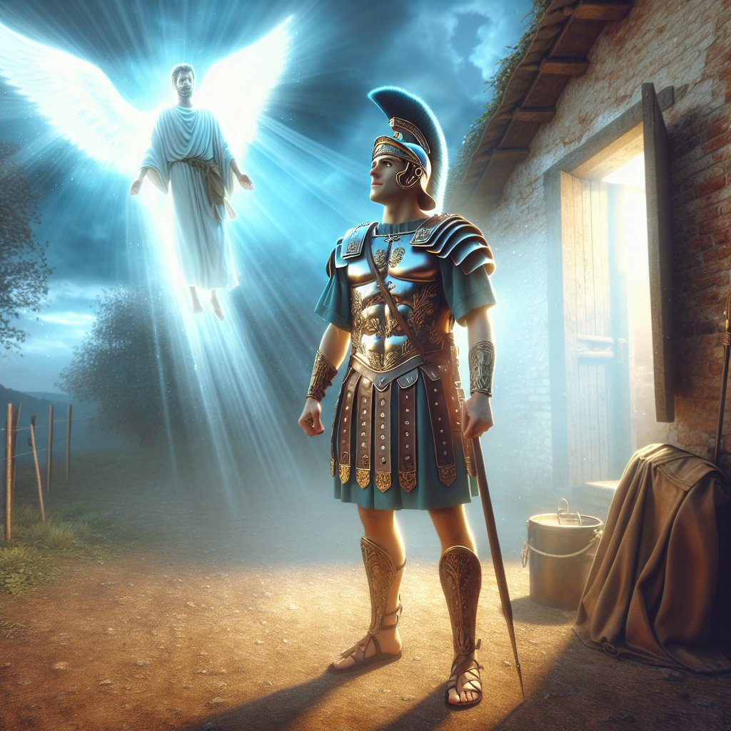
Acts 11:14
“and he will speak words to you by which you [Cornelius] will be saved, you and all your household.”

Slide 27
Acts 4:12
“And there is salvation in no one else; for there is no other name under heaven that has been given among men by which we must [dei] be saved.”

Slide 28
Acts 10:31-32 Angelic Message
Concerning Cornelius (31)
Concerning Peter (32)

Slide 29
Acts 10:30-33 Cornelius’ Response
Angelic vision (30)
Angelic message (31-32)
Cornelius’ obedience (33a)
Cornelius ready to hear Peter (33b)

Slide 30
Acts 10:30-33 Cornelius’ Response
Angelic vision (30)
Angelic message (31-32)
Cornelius’ obedience (33a)
Cornelius ready to hear Peter (33b)

Slide 31
Acts 10:1‒11:18 Cornelius’ Salvation
Cornelius’ Vision (10:1-8)
Peter’s Vision (Acts 10:9-16)
Vision’s Application (10:17-23a)
Caesarean Ministry (10:23b-33)
Peter & The Keys of the Kingdom (10:34-43)
Gentiles’ Salvation (10:44-48)
Peter’s Defense in Jerusalem (11:1-18)

Slide 32
Acts 10:1‒11:18 Cornelius’ Salvation
Cornelius’ Vision (10:1-8)
Peter’s Vision (Acts 10:9-16)
Vision’s Application (10:17-23a)
Caesarean Ministry (10:23b-33)
Peter & The Keys of the Kingdom (10:34-43)
Gentiles’ Salvation (10:44-48)
Peter’s Defense in Jerusalem (11:1-18)

Slide 33
Acts 10:1‒11:18 Cornelius’ Salvation
Cornelius’ Vision (10:1-8)
Peter’s Vision (Acts 10:9-16)
Vision’s Application (10:17-23a)
Caesarean Ministry (10:23b-33)
Peter & The Keys of the Kingdom (10:34-43)
Gentiles’ Salvation (10:44-48)
Peter’s Defense in Jerusalem (11:1-18)

Slide 34
Conclusion

Slide 35
Acts 10:1‒11:18 Cornelius’ Salvation
Cornelius’ Vision (10:1-8)
Peter’s Vision (Acts 10:9-16)
Vision’s Application (10:17-23a)
Caesarean Ministry (10:23b-33)
Peter & The Keys of the Kingdom (10:34-43)
Gentiles’ Salvation (10:44-48)
Peter’s Defense in Jerusalem (11:1-18)

