Slide 1
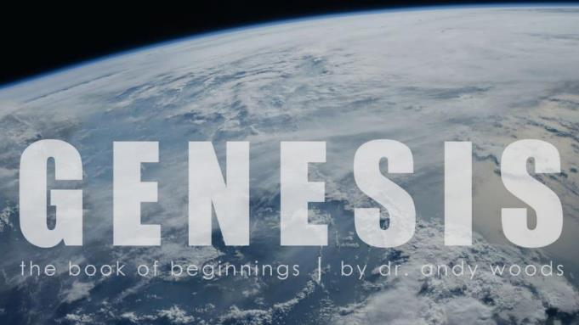
Genesis 12‒50
Israel’s Birth & Preservation

Slide 2
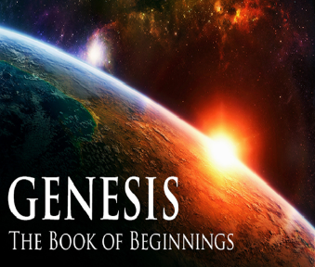
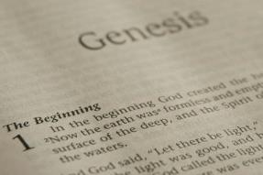
GENESIS STRUCTURE
Genesis 12-50 (four people)
Abraham (12:1–25:11)
Isaac (25:12–26:35)
Jacob (27–36)
Joseph (37–50)

Slide 3
Genesis 37‒50 Joseph
Joseph sold unto Egypt (37)
Canaan’s corruption (38)
Joseph falsely accused (39)
Joseph’s short-term predictions (40)
Joseph’s elevation (41)
Joseph’s first reunion with his brothers (42)
Joseph’s second reunion with his brothers (43‒45)
Sojourn to Egypt (46:1‒47:12)

Slide 4
Genesis 46:1‒47:12 Sojourn to Egypt
Divine Sanction (46:1-7)
House of Jacob (46:8-27)
Jacob Arrives in Egypt (46:28-34)
Jacob’s Family Before Pharaoh (47:1-10)
Settlement in Goshen (47:11-12)

Slide 5
IV. Genesis 47:1-10 Jacob’s Family Before Pharaoh
Joseph’s report to pharaoh (1)
Brothers before Pharaoh (2-6)
Jacob before Pharaoh (7-10)

Slide 6
IV. Genesis 47:1-10 Jacob’s Family Before Pharaoh
Joseph’s report to pharaoh (1)
Brothers before Pharaoh (2-6)
Jacob before Pharaoh (7-10)

Slide 8
IV. Genesis 47:1-10 Jacob’s Family Before Pharaoh
Joseph’s report to pharaoh (1)
Brothers before Pharaoh (2-6)
Jacob before Pharaoh (7-10)

Slide 9
Genesis 47:2-6 Brothers Before Pharaoh
Selection (2)
Pharaoh’s inquiry (3a)
Brothers’ response (3b)
Brothers’ request (4)
Pharaoh’s response (5-6)

Slide 10
Genesis 47:2-6 Brothers Before Pharaoh
Selection (2)
Pharaoh’s inquiry (3a)
Brothers’ response (3b)
Brothers’ request (4)
Pharaoh’s response (5-6)

Slide 12
Genesis 47:2-6 Brothers Before Pharaoh
Selection (2)
Pharaoh’s inquiry (3a)
Brothers’ response (3b)
Brothers’ request (4)
Pharaoh’s response (5-6)

Slide 13
Genesis 47:2-6 Brothers Before Pharaoh
Selection (2)
Pharaoh’s inquiry (3a)
Brothers’ response (3b)
Brothers’ request (4)
Pharaoh’s response (5-6)

Slide 14
Genesis 47:2-6 Brothers Before Pharaoh
Selection (2)
Pharaoh’s inquiry (3a)
Brothers’ response (3b)
Brothers’ request (4)
Pharaoh’s response (5-6)

Slide 15
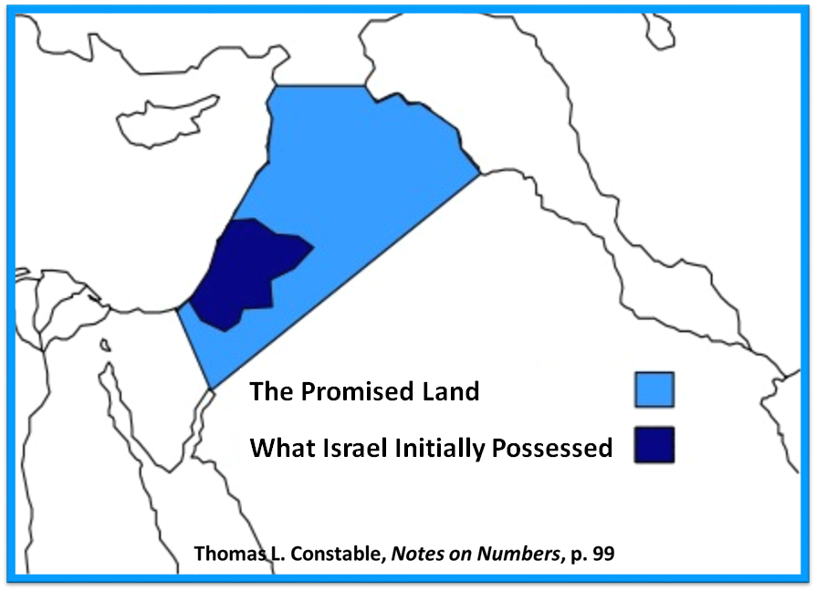

Slide 16
Evidence of Abrahamic Covenant’s Unconditional Nature
ANE covenant ratification ceremony (Gen 15)
Lack of stated conditions for Israel’s obedience (Gen 15)
Covenant's eternality (Gen 17:7, 13, 19; Ps. 90:2)
Covenant's immutability (Heb 6:13-18; Mal. 3:6)
Trans-generational reaffirmation despite perpetual national disobedience (Jer 31:35-37)
Walvoord, The Millennial Kingdom, 149-52

Slide 18
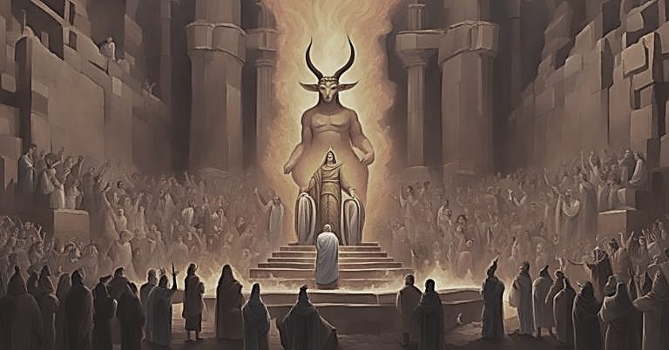
Genesis 15:16
“Then in the fourth generation they will return here, for the wrongdoing of the Amorite is not yet complete.”

Slide 19
Genesis 47:2-6 Brothers Before Pharaoh
Selection (2)
Pharaoh’s inquiry (3a)
Brothers’ response (3b)
Brothers’ request (4)
Pharaoh’s response (5-6)

Slide 20
Genesis 47:5-6 Pharaoh’s response
Pharaoh notes family’s arrival to Joseph (5)
Pharaoh’s offer (6)

Slide 21
Genesis 47:5-6 Pharaoh’s response
Pharaoh notes family’s arrival to Joseph (5)
Pharaoh’s offer (6)

Slide 22
Genesis 47:5-6 Pharaoh’s response
Pharaoh notes family’s arrival to Joseph (5)
Pharaoh’s offer (6)

Slide 23
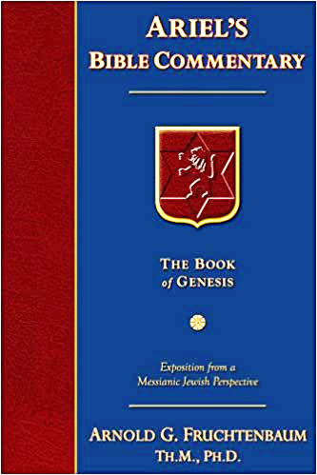
Dr. Arnold G. Fruchtenbaum
The Book of Genesis, 570
“Therefore, a total separation of twenty years existed from the time he had last seen members of his family until they were reunited in Egypt. The Hyksos Period, during which Joseph’s story unfolds, was the two-hundred-year period from 1750 until 1550 B.C. The Hyksos were Semitic rulers that conquered Egypt and ruled during the sixteenth and seventeenth dynasties. Thus, the Pharaoh at the time of Joseph was Semitic. This explains how a Semite such as Joseph could rise to the second highest position in Egypt, which had a Hamitic population.”

Slide 24
Dr. Arnold G. Fruchtenbaum
The Book of Genesis, 601
“Now this is all coming out of the initiation of Pharaoh, and all Pharaoh knew at this point was that this was Joseph’s family. He knew nothing about them per se. This shows the high regard and respect Pharaoh had for Joseph, that he was willing to issue this invitation. Such an invitation coming from an Egyptian Pharaoh for Semites was only possible during the Hyksos’s rule. Later Egyptian Pharaohs would never have allowed this to take place. However, the Hyksos being the Semitic conquerors of Egypt and ruling at this point in time made it possible for another Semitic family to be invited down.”

Slide 25
Dr. Arnold G. Fruchtenbaum
The Book of Genesis, 615
“Then came the request, which was also an offer of employment: and if you know any able men among them, then make them rulers over my cattle. This again shows that Pharaoh was a Semitic Hyksos ruler and not an Egyptian, because this would not have been the case if he were a native Egyptian.”

Slide 27
IV. Genesis 47:1-10 Jacob’s Family Before Pharaoh
Joseph’s report to pharaoh (1)
Brothers before Pharaoh (2-6)
Jacob before Pharaoh (7-10)

Slide 28
Genesis 47:7-10 Jacob Before Pharaoh
Joseph presents Jacob (7a)
Jacob blessed Pharaoh (7b)
Pharaoh’s inquiry (8)
Jacob’s answer (9)
Jacob blesses Pharaoh (10a)
Jacob’s exit (10b)

Slide 29
Genesis 47:7-10 Jacob Before Pharaoh
Joseph presents Jacob (7a)
Jacob blessed Pharaoh (7b)
Pharaoh’s inquiry (8)
Jacob’s answer (9)
Jacob blesses Pharaoh (10a)
Jacob’s exit (10b)

Slide 30
Genesis 47:7-10 Jacob Before Pharaoh
Joseph presents Jacob (7a)
Jacob blessed Pharaoh (7b)
Pharaoh’s inquiry (8)
Jacob’s answer (9)
Jacob blesses Pharaoh (10a)
Jacob’s exit (10b)

Slide 31
Genesis 47:7-10 Jacob Before Pharaoh
Joseph presents Jacob (7a)
Jacob blessed Pharaoh (7b)
Pharaoh’s inquiry (8)
Jacob’s answer (9)
Jacob blesses Pharaoh (10a)
Jacob’s exit (10b)

Slide 32
Genesis 47:7-10 Jacob Before Pharaoh
Joseph presents Jacob (7a)
Jacob blessed Pharaoh (7b)
Pharaoh’s inquiry (8)
Jacob’s answer (9)
Jacob blesses Pharaoh (10a)
Jacob’s exit (10b)

Slide 33
Genesis 47:7-10 Jacob Before Pharaoh
Joseph presents Jacob (7a)
Jacob blessed Pharaoh (7b)
Pharaoh’s inquiry (8)
Jacob’s answer (9)
Jacob blesses Pharaoh (10a)
Jacob’s exit (10b)

Slide 34
Genesis 47:7-10 Jacob Before Pharaoh
Joseph presents Jacob (7a)
Jacob blessed Pharaoh (7b)
Pharaoh’s inquiry (8)
Jacob’s answer (9)
Jacob blesses Pharaoh (10a)
Jacob’s exit (10b)

Slide 35
Conclusion

Slide 36
Genesis 46:1‒47:12 Sojourn to Egypt
Divine Sanction (46:1-7)
House of Jacob (46:8-27)
Jacob Arrives in Egypt (46:28-34)
Jacob’s Family Before Pharaoh (47:1-10)
Settlement in Goshen (47:11-12)

Slide 37
IV. Genesis 47:1-10 Jacob’s Family Before Pharaoh
Joseph’s report to pharaoh (1)
Brothers before Pharaoh (2-6)
Jacob before Pharaoh (7-10)

Slide 38
Genesis 46:1‒47:12 Sojourn to Egypt
Divine Sanction (46:1-7)
House of Jacob (46:8-27)
Jacob Arrives in Egypt (46:28-34)
Jacob’s Family Before Pharaoh (47:1-10)
Settlement in Goshen (47:11-12)

Slide 39
²⁴ The Lord bless you, and keep you; ²⁵ The Lord make His face shine on you, And be gracious to you; ²⁶ The Lord lift up His countenance on you, And give you peace.
Numbers 6:24–26 (NASB95)

