Slide 2
Acts 10:1‒11:18 Cornelius’ Salvation
Cornelius’ Vision (10:1-8)
Peter’s Vision (Acts 10:9-16)
Vision’s Application (10:17-23a)
Caesarean Ministry (10:23b-33)
Peter & The Keys of the Kingdom (10:34-43)
Gentiles’ Salvation (10:44-48)
Peter’s Defense in Jerusalem (11:1-18)

Slide 3
II. Peter’s Vision Acts 10:9-16
Occasion (9-10a)
Vision (10b-13)
Peter’s response (14)
God’s command (15)
Vision’s repetition (16a)
Vision’s conclusion (16b)

Slide 5
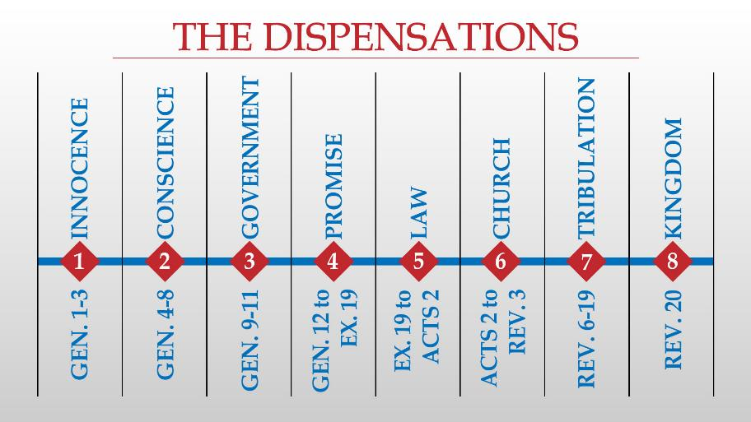

Slide 6
Levitical Feasts (Leviticus 23)
Feast | Season | Purpose | Type
Passover | Spring | Redemption | 1 Cor 5:7
Unleavened Bread | Spring | Separation | John 6:35
1st Fruits | Spring | Praise | 1 Cor 15:20
Pentecost | Spring | Praise | Acts 2:1-4
Trumpets | Fall | New Year | Matt 24:31
Atonement | Fall | Lev 16 | Zech 12:10
Booths | Fall | Wilderness provision | Zech 14:16-18

Slide 7
Dr. Arnold G. Fruchtenbaum
The Book of Acts, 237
“However, there are two dangers that must be avoided by the believer who voluntarily keeps the commandments of the Law of Moses. One danger is the idea that by doing so he is contributing to his own justification and sanctification. This is false and should be avoided. The second danger is in expecting others to keep the same commandments that he has decided to keep. This is equally wrong and borders on legalism.”

Slide 8
Acts 10:1‒11:18 Cornelius’ Salvation
Cornelius’ Vision (10:1-8)
Peter’s Vision (Acts 10:9-16)
Vision’s Application (10:17-23a)
Caesarean Ministry (10:23b-33)
Peter & The Keys of the Kingdom (10:34-43)
Gentiles’ Salvation (10:44-48)
Peter’s Defense in Jerusalem (11:1-18)

Slide 9
III. Vision’s Application Acts 10:17-23a
3 Gentiles arrive in Joppa (17-18)
Spirit’s command to Peter (19-20)
Peter’s inquiry (21-23a)

Slide 10
III. Vision’s Application Acts 10:17-23a
3 Gentiles arrive in Joppa (17-18)
Spirit’s command to Peter (19-20)
Peter’s inquiry (21-23a)

Slide 11
Acts 10:17-18 3 Gentiles Arrive in Joppa
Peter’s perplexity (17a)
3 Gentiles arrive (17b)
3 Gentiles’ inquiry (18a)

Slide 12
Acts 10:17-18 3 Gentiles Arrive in Joppa
Peter’s perplexity (17a)
3 Gentiles arrive (17b)
3 Gentiles’ inquiry (18a)

Slide 13
Acts 10:17-18 3 Gentiles Arrive in Joppa
Peter’s perplexity (17a)
3 Gentiles arrive (17b)
3 Gentiles’ inquiry (18a)

Slide 14
Acts 10:17-18 3 Gentiles Arrive in Joppa
Peter’s perplexity (17a)
3 Gentiles arrive (17b)
3 Gentiles’ inquiry (18a)

Slide 15
III. Vision’s Application Acts 10:17-23a
3 Gentiles arrive in Joppa (17-18)
Spirit’s command to Peter (19-20)
Peter’s inquiry (21-23a)

Slide 16
Acts 10:19-20 Holy Spirit’s Command to Peter
Peter’s pondering (19a)
Spirit’s command (19b-20)

Slide 17
Acts 10:19-20 Holy Spirit’s Command to Peter
Peter’s pondering (19a)
Spirit’s command (19b-20)

Slide 18
Acts 10:19-20 Holy Spirit’s Command to Peter
Peter’s pondering (19a)
Spirit’s command (19b-20)

Slide 19
III. Vision’s Application Acts 10:17-23a
3 Gentiles arrive in Joppa (17-18)
Spirit’s command to Peter (19-20)
Peter’s inquiry (21-23a)

Slide 20
Acts 10:21-23a Peter’s Inquiry
Peter’s self-dentification & question (21)
3 Gentiles answer (22)
Lodging of 3 Gentiles in Joppa (23a)

Slide 21
Acts 10:21-23a Peter’s Inquiry
Peter’s self-dentification & question (21)
3 Gentiles answer (22)
Lodging of 3 Gentiles in Joppa (23a)

Slide 22
Acts 10:21-23a Peter’s Inquiry
Peter’s self-dentification & question (21)
3 Gentiles answer (22)
Lodging of 3 Gentiles in Joppa (23a)

Slide 23
Luke 1:1–4
¹ Inasmuch as many have undertaken to compile an account of the things accomplished among us, ² just as they were handed down to us by those who from the beginning were eyewitnesses and servants of the word, ³ it seemed fitting for me as well, having investigated everything carefully from the beginning, to write it out for you in consecutive order, most excellent Theophilus; ⁴ so that you may know the exact truth about the things you have been taught.

Slide 24
Acts 1:1–2
¹ The first account I composed, Theophilus, about all that Jesus began to do and teach, ² until the day when He was taken up to heaven, after He had by the Holy Spirit given orders to the apostles whom He had chosen.

Slide 25
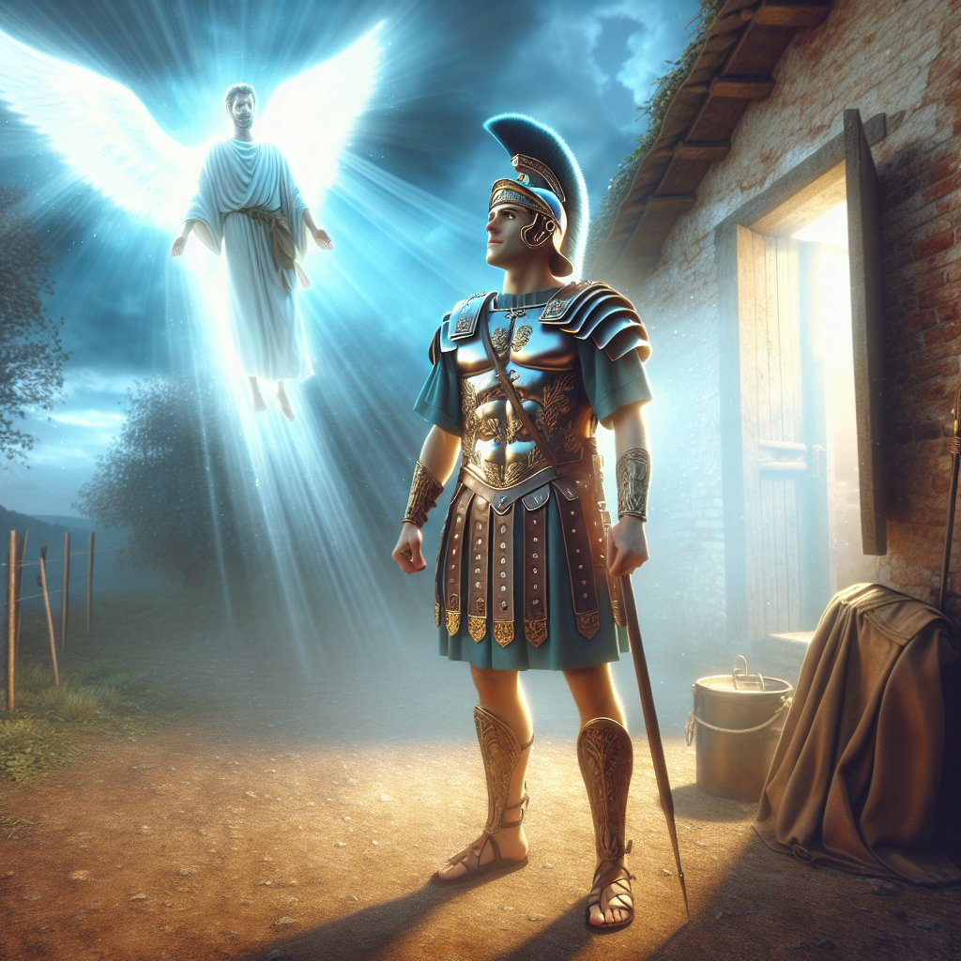
Acts 10:2
“Now there was a man at Caesarea named Cornelius, a centurion of what was called the Italian cohort, ² a devout man and one who feared God with all his household, and gave many alms to the Jewish people and prayed to God continually.”

Slide 26
Acts 10:2 Cornelius’ Spiritual State
Devout (2a)
Feared God (2b)
Generous (2c)
Prayerful (2d)

Slide 27
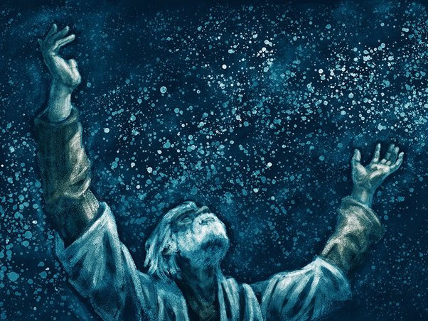
Genesis 12:3
“And I will bless those who bless you, And the one who curses you I will curse. And in you all the families of the earth will be blessed.”

Slide 28
Acts 10:21-23a Peter’s Inquiry
Peter’s self-dentification & question (21)
3 Gentiles answer (22)
Lodging of 3 Gentiles in Joppa (23a)

Slide 29
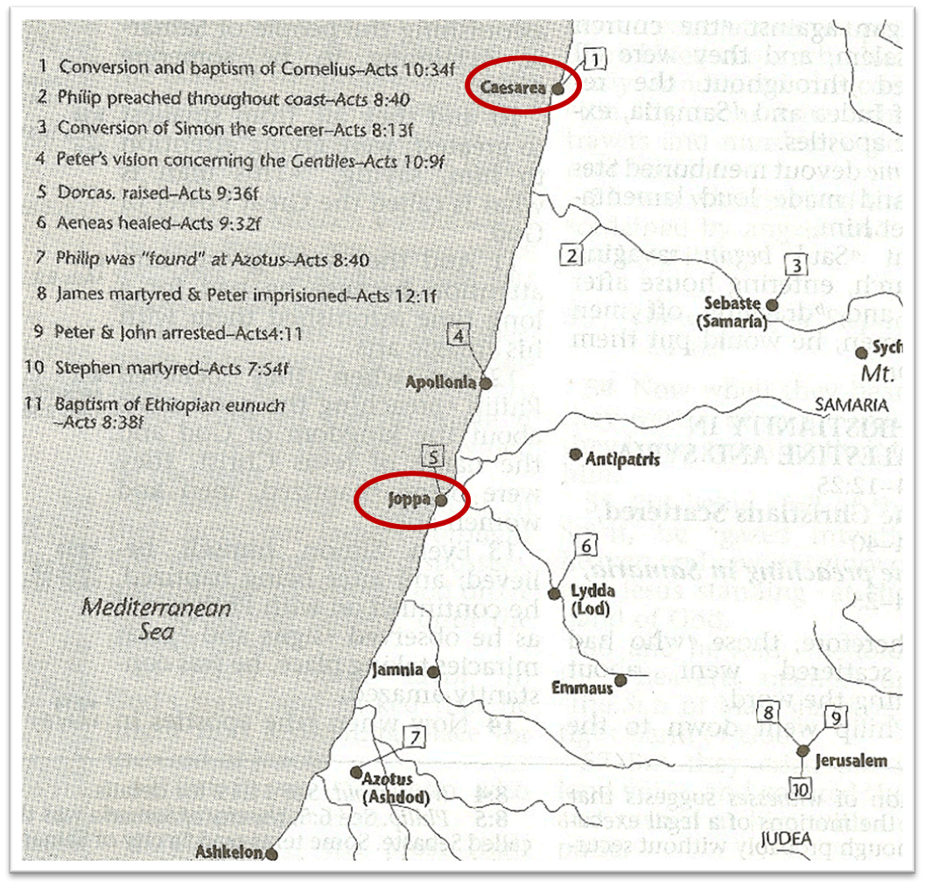

Slide 30
Dr. Arnold G. Fruchtenbaum
The Book of Acts, 235
“This chapter in the book of Acts is a crucial turning point because the salvation of uncircumcised Gentiles began here. Notice how much it took to get Gentile salvation started: First, it took an angel coming to Cornelius; second, it took a voice out of heaven, speaking three times to Peter; third, it took the Holy Spirit speaking audibly to Peter; and, fourth, it took two visions, one for Cornelius and one for Peter.”

Slide 31
2 Peter 3:9
“The Lord is not slow about His promise, as some count slowness, but is patient toward you, not wishing for any to perish but for all to come to repentance.”

Slide 32
Conclusion

Slide 33
Acts 10:1‒11:18 Cornelius’ Salvation
Cornelius’ Vision (10:1-8)
Peter’s Vision (Acts 10:9-16)
Vision’s Application (10:17-23a)
Caesarean Ministry (10:23b-33)
Peter & The Keys of the Kingdom (10:34-43)
Gentiles’ Salvation (10:44-48)
Peter’s Defense in Jerusalem (11:1-18)

