Slide 2
Outline of Jonah
Defiance (1-2)
The running prophet (1)
The praying prophet (2)
Compliance (3-4)
The preaching prophet (3)
The pouting prophet (4)

Slide 3
I. Defiance (1-2)
The running prophet (1:1-16)
Jonah's commission (1:1-2)
Jonah flees from the Lord to Tarshish (1:3)
Jonah and his shipmates are caught in a storm (1:4-6)
Jonah exposed as the culprit (1:7-9)
Jonah is thrown overboard (1:10-16)
Jonah is swallowed by a giant fish (1:17)

Slide 4
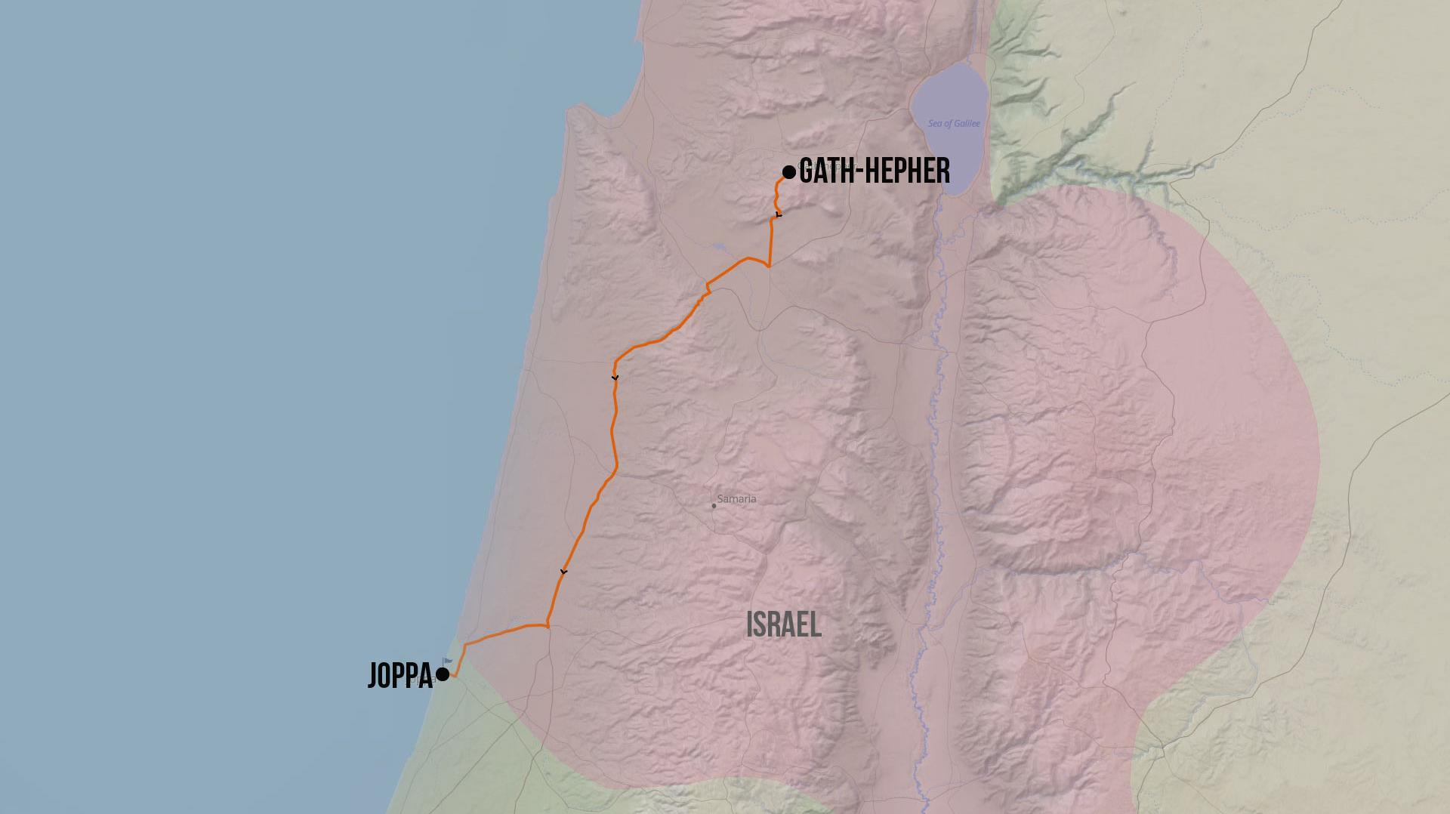
Mediterranean Sea
Jonah’s Travels

Slide 5
“The LORD hurled a great wind on the sea and there was a great storm on the sea so that the ship was about to break up. Then the sailors became afraid and every man cried to his god, and they threw the cargo which was in the ship into the sea to lighten it for them. But Jonah had gone below into the hold of the ship, lain down and fallen sound asleep.” -Jonah 1:4-5

Slide 6
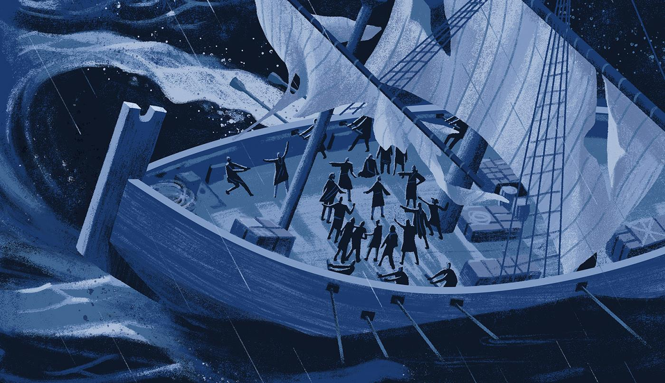

Slide 7
Casting Lots
Old Testament
New Testament
Lev 16:8
Num 26:55
Josh 7:14, 15; 18:6
1 Sam 14:42
1 Chron 24:5
Jonah 1:7
Neh 10:34
Esther 3:7
Psalm 16:5
Prov 16:33
Luke 1:5-9
Acts 1:26
“The lot is cast into the lap, But its every decision is from the LORD.”
-Prov.16:33

Slide 8
Jonah 1:15
“So, they picked up Jonah, threw him into the sea, and the sea stopped its raging.”

Slide 9
“And the LORD appointed a great fish to swallow Jonah, and Jonah was in the stomach of the fish three days and three nights.” Jonah 1:17

Slide 10
Jonah 1:17?
Practical Perspective
Theological Perspective
Historical Perspective
Typological Perspective
Exegetical Perspective

Slide 11
Jonah 1:17?
Practical Perspective
Theological Perspective
Historical Perspective
Typological Perspective
Exegetical Perspective

Slide 12
Jonah 1:17?
Practical Perspective
Theological Perspective
Historical Perspective
Typological Perspective
Exegetical Perspective

Slide 13
Jonah 1:17?
Practical Perspective
Theological Perspective
His Sovereignty
Historical Perspective
Typological Perspective
Exegetical Perspective

Slide 14
Jonah 1:17?
Practical Perspective
Theological Perspective
His Sovereignty
Election
Historical Perspective
Typological Perspective
Exegetical Perspective

Slide 15
Jonah 1:17?
Practical Perspective
Theological Perspective
His Sovereignty
Election
Love
Historical Perspective
Typological Perspective
Exegetical Perspective

Slide 16
1 John 4:7-11
Beloved, let us love one another, for love is from God; and everyone who loves is born of God and knows God. The one who does not love does not know God, for God is love. By this the love of God was manifested in us, that God has sent His only begotten Son into the world so that we might live through Him. In this is love, not that we loved God, but that He loved us and sent His Son to be the propitiation for our sins. Beloved, if God so loved us, we also ought to love one another.

Slide 17
Luke 6:35
“But love your enemies, and do good, and lend, expecting nothing in return; and your reward will be great, and you will be sons of the Most High; for He Himself is kind to ungrateful and evil men.”

Slide 18
Jonah 1:17?
Practical Perspective
Theological Perspective
Historical Perspective
Typological Perspective
Exegetical Perspective

Slide 19
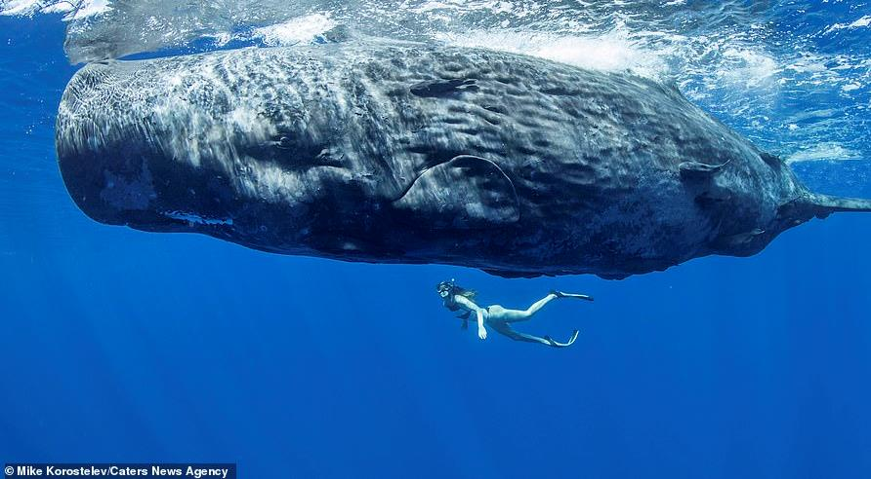

Slide 20
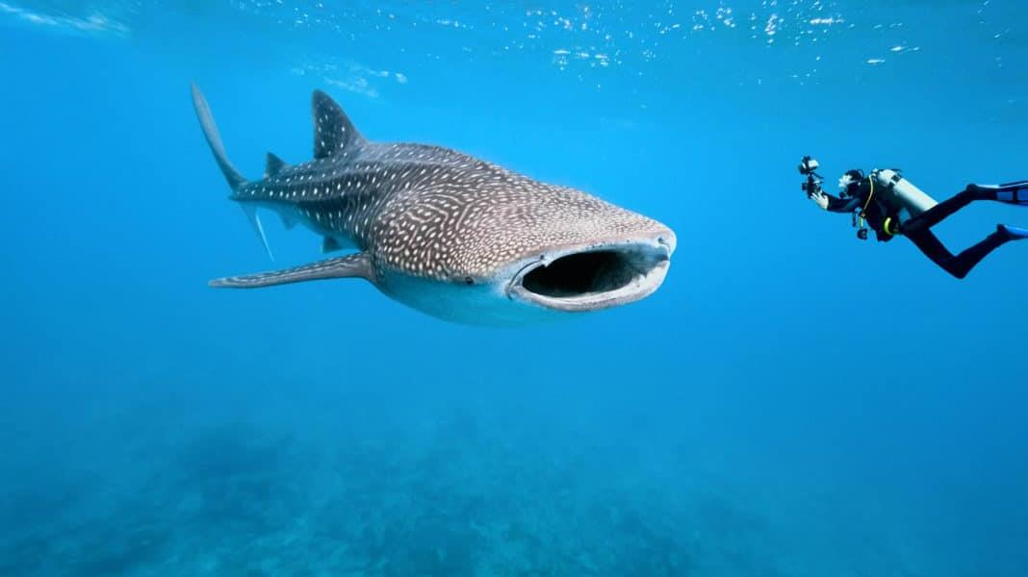

Slide 22
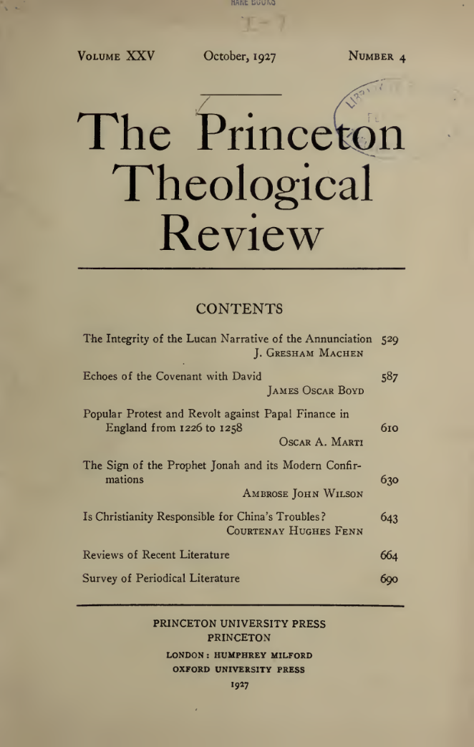
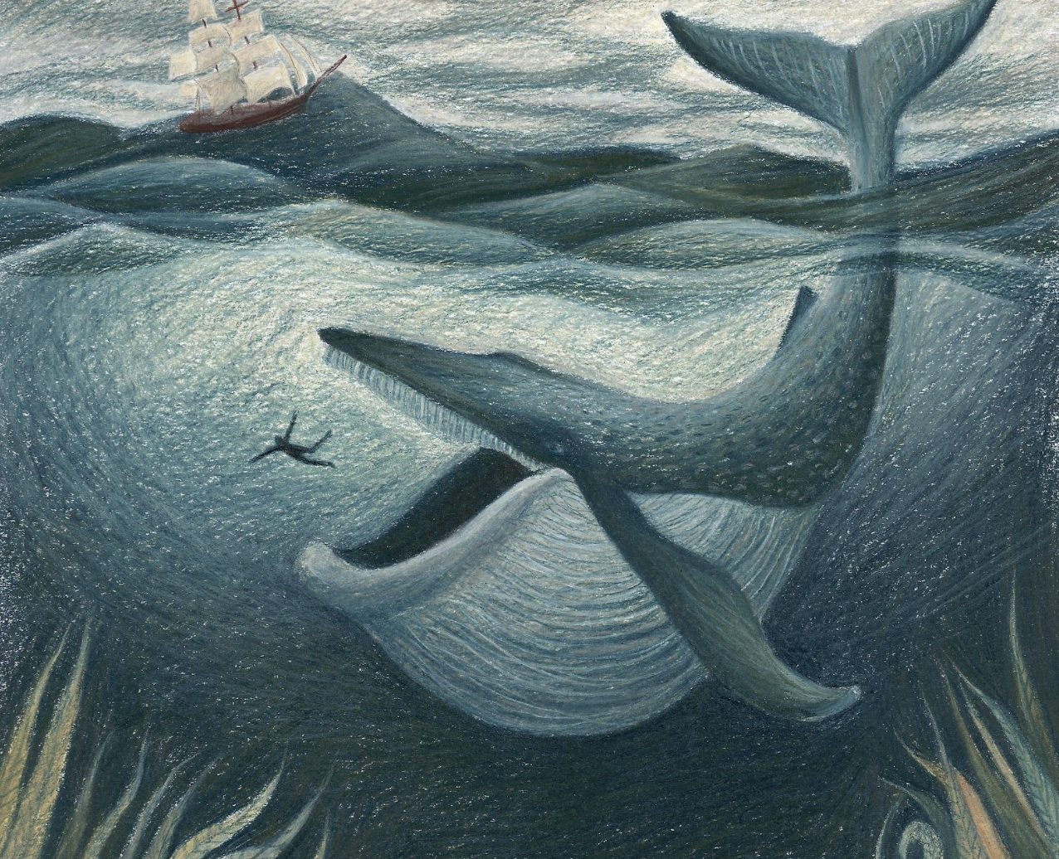

Slide 23
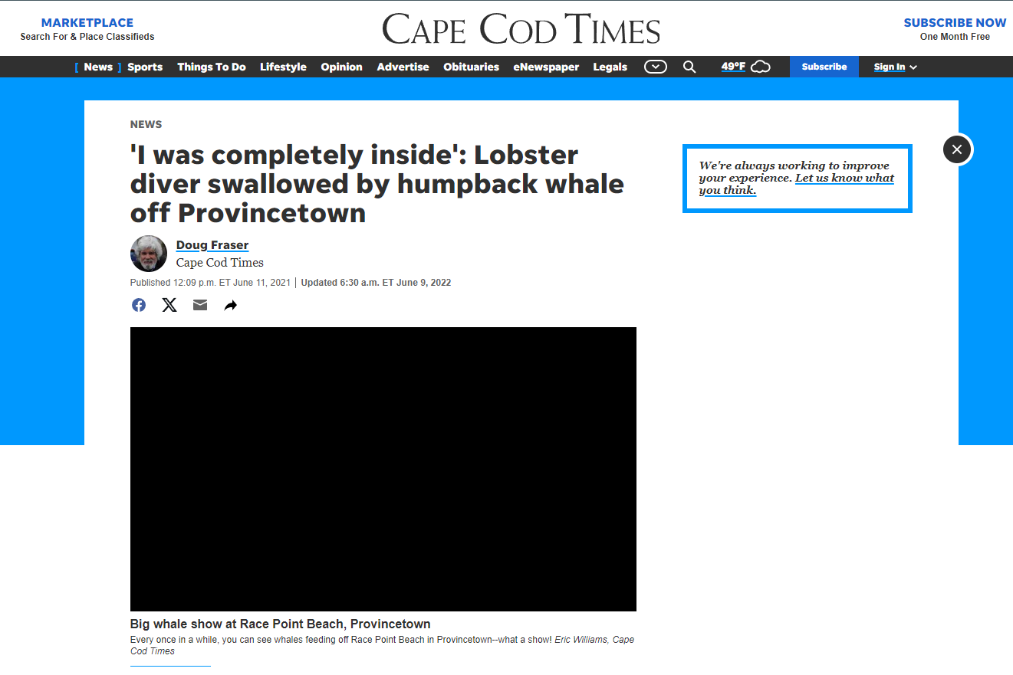

Slide 24
Jonah 1:17?
Practical Perspective
Theological Perspective
Historical Perspective
Typological Perspective
Exegetical Perspective

Slide 25
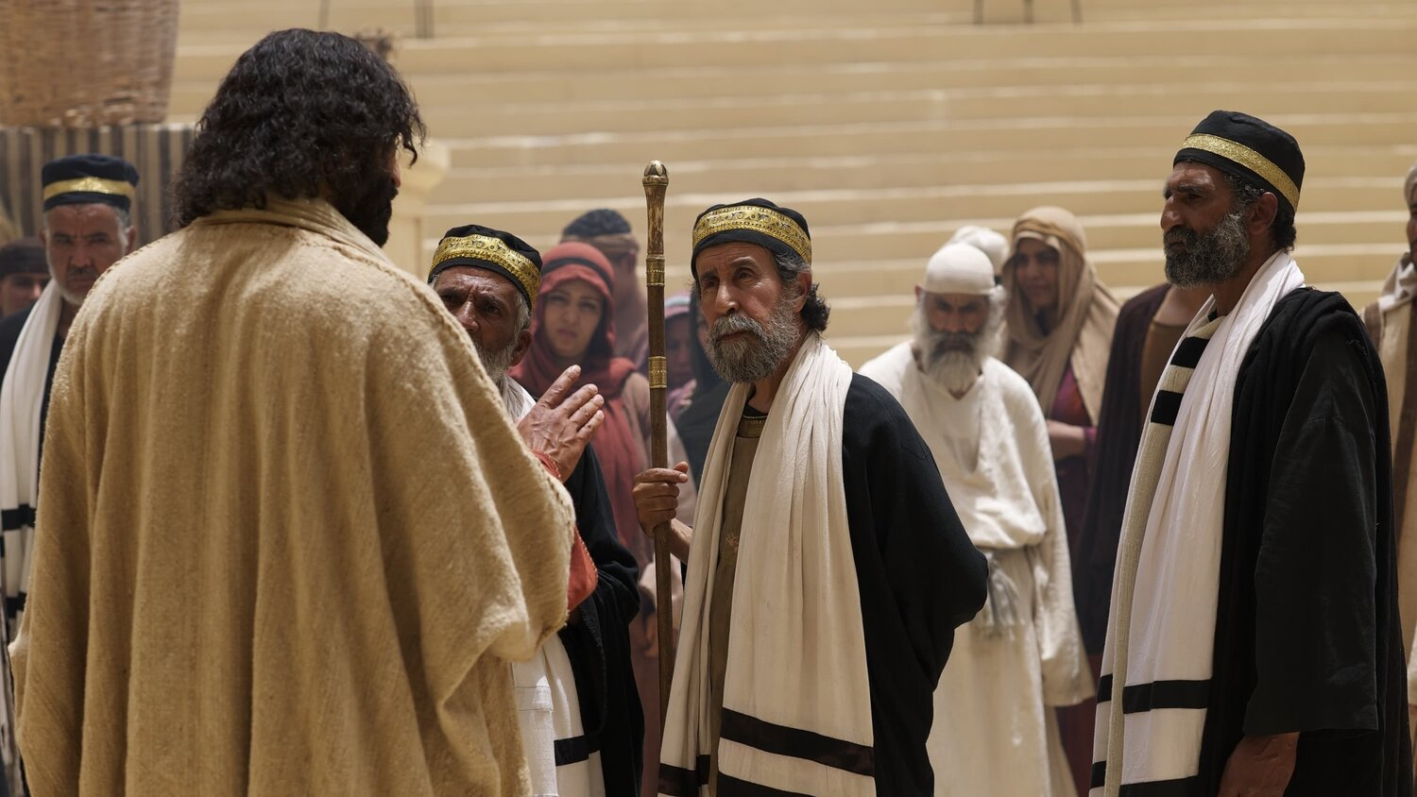
Matthew 12:39-41
39 “But He answered and said to them, ‘An evil and adulterous generation craves for a sign; and yet no sign will be given to it but the sign of Jonah the prophet; 40 for just as JONAH WAS THREE DAYS AND THREE NIGHTS IN THE BELLY OF THE SEA MONSTER, so will the Son of Man be three days and three nights in the heart of the earth. 41 The men of Nineveh will stand up with this generation at the judgment and will condemn it because they repented at the preaching of Jonah; and behold, something greater than Jonah is here.’”

Slide 26
Basic Bible Interpretation
“The basis for uniting the Old and New Testaments was typology and predictive prophecy…”

Slide 27
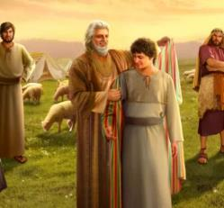
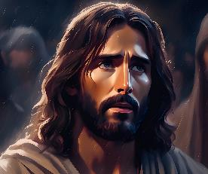
Joseph in Genesis | Jesus of Nazareth
A Shepherd (37:2) | The Good Shepherd (John 10:11)
Beloved of his father (37:3) | Beloved of His Father (Matt 3:17)
Hated by his brothers (37:4, 5, 8) | Jesus was hated by His brothers (John 15:25; Luke 19:14; John 5:18; 7:7; 8:40)
Foretold his future sovereignty (37:7-12) | Foretold His future sovereignty (Matt 26:64; John 18:37)
Sent by his father to his brothers for their welfare (37:13-14) | Jesus was sent to the ‘lost sheep of Israel,’ by His Father (John 4:34; 5:30; 6:38-40; 12:48-50; 17:21) and the world (3:16-17)
Joseph’s brothers plotted to kill Joseph (37:18-20) | The Jews also plotted to kill Christ. (Matt 12:14; 26:4)
A slave, sold for the price of redemption (37:28) | Sold for thirty pieces of silver (the price of a slave - Matt 26:15)
Became a servant (39:1) | Became a servant (Phil 2:6, 7; Luke 22:27; John 13:1-17)
Tempted by Potiphar’s wife and did not sin (39:7-12) | Tempted by Satan and did not sin (Matt 4:1-11; Heb. 2:18; 4:15)
Falsely accused (39:16-18) | Falsely accused (Matthew 26:59-61)
Attempted no defense (39:19) | Attempted no defense at His trials (Isaiah 53:7)

Slide 28
Matthew 12:39-41
39 “But He answered and said to them, ‘An evil and adulterous generation craves for a sign; and yet no sign will be given to it but the sign of Jonah the prophet; 40 for just as JONAH WAS THREE DAYS AND THREE NIGHTS IN THE BELLY OF THE SEA MONSTER, so will the Son of Man be three days and three nights in the heart of the earth. 41 The men of Nineveh will stand up with this generation at the judgment and will condemn it because they repented at the preaching of Jonah; and behold, something greater than Jonah is here.’”

Slide 29
Jonah 1:17?
Practical Perspective
Theological Perspective
Historical Perspective
Typological Perspective
Exegetical Perspective

Slide 30
“And the LORD appointed a great fish to swallow Jonah, and Jonah was in the stomach of the fish three days and three nights.” Jonah 1:17

Slide 31
Outline of Jonah
Defiance (1-2)
The running prophet (1)
The praying prophet (2)
Compliance (3-4)
The preaching prophet (3)
The pouting prophet (4)

