Slide 1
Law and Grace: An Overview Jim McGowan, Th.D. Sugar Land Bible Church 11-03-2024
…but grace and truth were realized through Jesus Christ - John 1:17
For the Law was given through Moses…
Special thanks to Dr. Vern Peterman for access to his insights and resources.

Slide 2
Session 45 Outline
Review
Purpose, Aim, and Objective
The Sermon on the Mount
A Leper, A Centurion, & Other Outcasts – Matt. 8:1-13
General Information
Matt. 8:1-13
Concluding Observations

Slide 3
OUR PURPOSE, AIM AND OBJECTIVE
Law and Grace
…is to Compare and Contrast Law and Grace so as to properly understand these two important themes and how they are related to the life of the New Testament Believer.

Slide 4
C. I. Scofield, D. D.
The Grace of God, The Fundamentals Vol. 3, Chapter VII, p. 98
We have, most of us, been reared and now live under the influence of Galatianism. Protestant theology, alas, is for the most part, thoroughly Galatianized, in that neither law nor grace are given their distinct and separated places, as in the counsels of God, but are mingled together in one incoherent system.
The law is no longer, as in the Divine intent, a ministration of death (2 Cor. 3:7), of cursing (Gal. 3:10), of conviction (Rom. 3:19), because we are taught that we must try to keep it, and that by Divine help we may.
Nor, on the other hand, does grace bring us blessed deliverance from the dominion of sin, for we are kept under the law as a rule of life despite the plain declaration, “Sin shall not have dominion over you: for ye are not under the law, but under grace” (Rom. 6:14). (emphasis mine)

Slide 5
William R. Newell
Romans Verse-by-Verse (p. 274).
Grand Rapids, MI: Christian Classics Ethereal Library.
It is because Reformed theology has kept us Gentiles under the Law,—if not as a means of righteousness, then as “a rule of life,” that all the trouble has arisen. The Law is no more a rule of life than it is a means of righteousness. Walking in the Spirit has now taken the place of walking by ordinances. God has another principle under which He has put his saints: “Ye are not under law, but, under grace! (Rom. 6:14)” (italics mine)
PDF Download Here: https://archive.org/details/Romans_Verse_By_Verse-NewellWR

Slide 6
Henry Ironside
The Continual Burnt Offering: Daily Meditations on the Word of God (p. 265). Neptune, NJ: Loizeaux Brothers.
In Romans 7 we have a man renewed by the Spirit of God, but struggling under law, hoping thereby to subdue or find deliverance from the power of the old Adamic nature. In chapter 8 we have God’s way of deliverance through the death and resurrection of Christ with which the believer is identified before God. The chapter begins with “no condemnation” and ends with “no separation.” All who are in Christ Jesus are accepted in the Beloved and as free from every charge of guilt as He is Himself. He paid our penalty on the cross. Now we are linked up with Him in resurrection, not under law but under grace.

Slide 7
Matthew’s 3-Fold Purpose
Law and Grace: Review – Matthew 5:1–8:1 (Luke 6:17–49)
To explain:
that Jesus in whom his Israelite audience had believed was indeed the long-awaited Jewish Messiah;
why the kingdom had been postponed even though the king had arrived;
God’s interim program during the King’s and the kingdom’s absence.

Slide 8
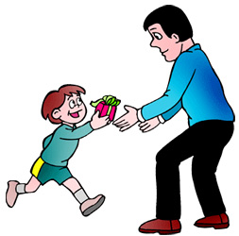
Matthew and the Kingdom
Law and Grace: Review – Matthew 5:1–8:1 (Luke 6:17–49)
 | offered
 | rejected
 | postponed Interim program
 | ultimately accepted

Slide 9
Matthew’s Message
Law and Grace: Review – Matthew 5:1–8:1 (Luke 6:17–49)
Jesus is the predicted Jewish king who ushered in an interim program by building the sons of the kingdom into the Church in between Israel’s past rejection and future acceptance of her king.

Slide 10
Session 45 Outline
Review
Purpose, Aim, and Objective
The Sermon on the Mount
A Leper, A Centurion, & Other Outcasts – Matt. 8:1-13
General Information
Matt. 8:1-13
Concluding Observations

Slide 11
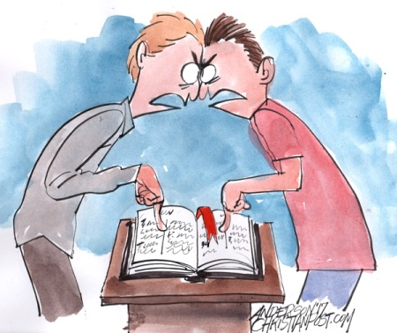
How did Christ intend for us to view the Sermon on the Mount?
Law and Grace: Session 25 Review The SOM – Matthew 5:1–8:1 (Luke 6:17–49)

Slide 12
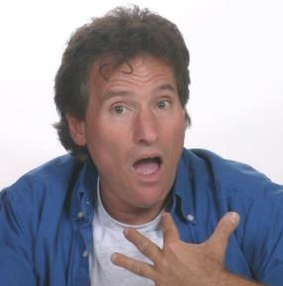
How did Christ intend for us to view the Sermon on the Mount?
Law and Grace: Session 25 Review The SOM – Matthew 5:1–8:1 (Luke 6:17–49)
Some look upon the Sermon on Mount as entirely, directly, applicable to us in the Church now, but as we have clearly pointed out, contextually it was spoken to the Jews, in the land of Israel, who were all under the Law of Moses.
What? Jesus didn’t say that to me?

Slide 13
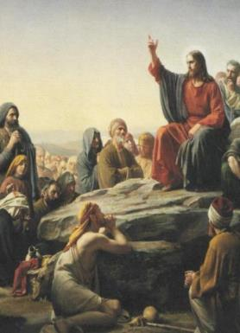
How did Christ intend for us to view the Sermon on the Mount?
Law and Grace: Session 25 Review The SOM – Matthew 5:1–8:1 (Luke 6:17–49)
The Sermon on the Mount is primarily and directly addressed to the Jews of Jesus’ day given after:
intense interest in the person of Jesus was stirred up – was He the Messiah?
the selection of the Twelve Disciples.
several conflicts with the Pharisees regarding Pharisaic Judaism and the Pharisaic interpretation of the Mosaic Law.

Slide 14
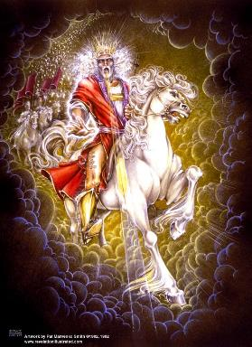
How did Christ intend for us to view the Sermon on the Mount?
Law and Grace: Session 25 Review The SOM – Matthew 5:1–8:1 (Luke 6:17–49)
The question being raised among the Jewish masses at that time, was, “What kind of righteousness is necessary for entering into the Kingdom?” Was it “Pharisaic righteousness – mere external conformity” or was it the righteousness that the OT prophets and Jesus taught?

Slide 15
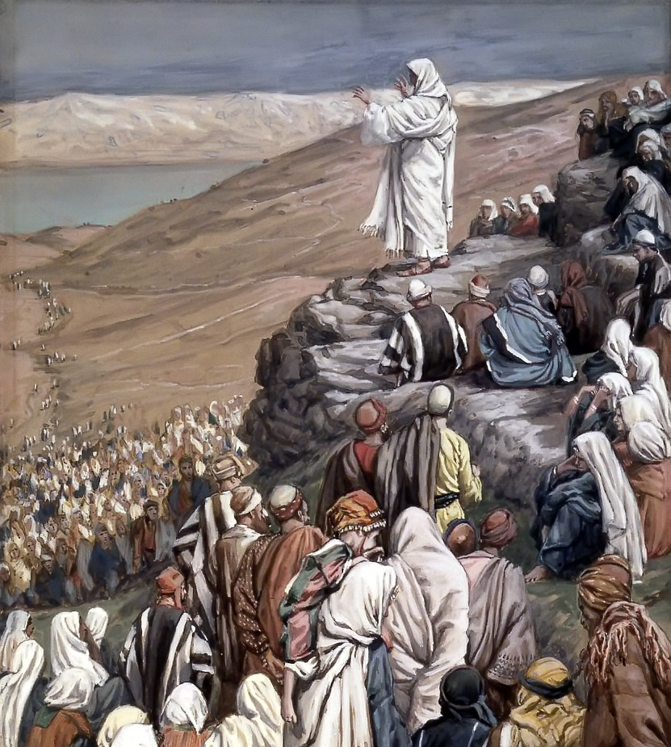
Matthew 5:20
“For I say to you that unless your righteousness surpasses that of the scribes and Pharisees, you will not enter the kingdom of heaven.

Slide 16
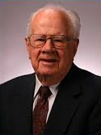
How did Christ intend for us to view the Sermon on the Mount?
Law and Grace: Session 25 Review The SOM – Matthew 5:1–8:1 (Luke 6:17–49)
The sermon was designed to lead [the Jewish] multitude away from a false concept of righteousness to a true concept of righteousness; from a false hope of entrance into the kingdom to a sure foundation for entrance into Messiah’s kingdom…the Sermon on the Mount in its historical setting was Christ’s instruction to that generation to which He was offering Himself as Saviour and Sovereign…
Pentecost, J. D. (1995). Thy Kingdom Come: Tracing God’s Kingdom Program and Covenant Promises throughout History (pp. 205–206). Grand Rapids, MI: Kregel Publications.

Slide 17
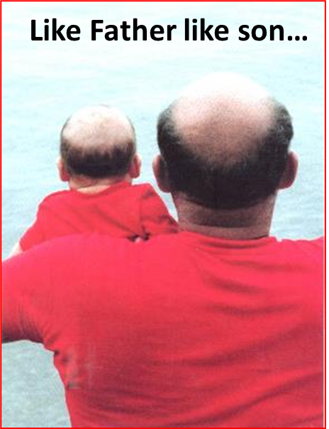
Comparison & Contrast
Law and Grace: Session 25 Review The SOM – Matthew 5:1–8:1 (Luke 6:17–49)
Knowing that we’ll find some things that are the same between ourselves and the Israelites who believe, and some that are different, we compare what is similar and contrast what is different.

Slide 18
Comparison & Contrast
Law and Grace: Session 25 Review The SOM – Matthew 5:1–8:1 (Luke 6:17–49)
An important tool in our understanding what Jesus intended to convey will be to define words that are the same for Israel and the Church, but have different meanings, such as the word ‘blessed’.
Israel can be blessed in earthly ways, in the land, if they obey the Law of Moses, but cursed in or from the land, and made subject to God’s wrath if they disobey the Law of Moses (Deut. 28:1-14).
We in the Body of Christ are blessed in the heavenly places in Christ regardless of what we do or don’t do and are also promised never to be subject to God’s wrath (Eph. 1:3; Rom. 5:9).

Slide 19
Session 45 Outline
Review
Purpose, Aim, and Objective
The Sermon on the Mount
A Leper, A Centurion, & Other Outcasts – Matt. 8:1-13
General Information
Matt. 8:1-13
Concluding Observations

Slide 20
Matthew 8:1–13
¹ When Jesus came down from the mountain, large crowds followed Him. ² And a leper came to Him and bowed down before Him, and said, “Lord, if You are willing, You can make me clean.” ³ Jesus stretched out His hand and touched him, saying, “I am willing; be cleansed.” And immediately his leprosy was cleansed. ⁴ And Jesus said to him, “See that you tell no one; but go, show yourself to the priest and present the offering that Moses commanded, as a testimony to them.” ⁵ And when Jesus entered Capernaum, a centurion came to Him, imploring Him, ⁶ and saying, “Lord, my servant is lying paralyzed at home, fearfully tormented.” ⁷ Jesus said to him, “I will come and heal him.” ⁸ But the centurion said, “Lord, I am not worthy for You to come under my roof, but just say the word, and my . . .

Slide 21
Matthew 8:1–13
…servant will be healed. ⁹ “For I also am a man under authority, with soldiers under me; and I say to this one, ‘Go!’ and he goes, and to another, ‘Come!’ and he comes, and to my slave, ‘Do this!’ and he does it.” ¹⁰ Now when Jesus heard this, He marveled and said to those who were following, “Truly I say to you, I have not found such great faith with anyone in Israel. ¹¹ “I say to you that many will come from east and west, and recline at the table with Abraham, Isaac and Jacob in the kingdom of heaven; ¹² but the sons of the kingdom will be cast out into the outer darkness; in that place there will be weeping and gnashing of teeth.” ¹³ And Jesus said to the centurion, “Go; it shall be done for you as you have believed.” And the servant was healed that very moment.

Slide 22
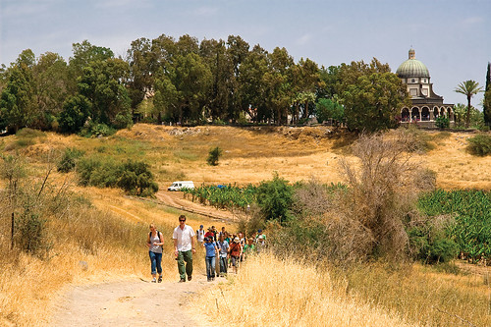
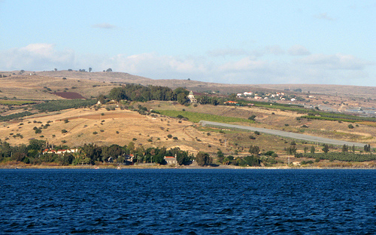
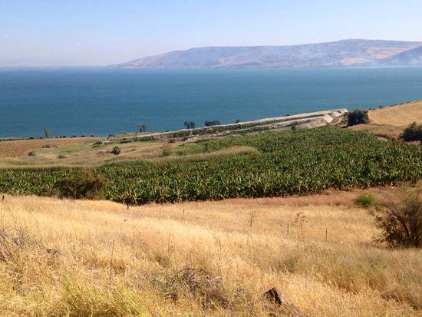
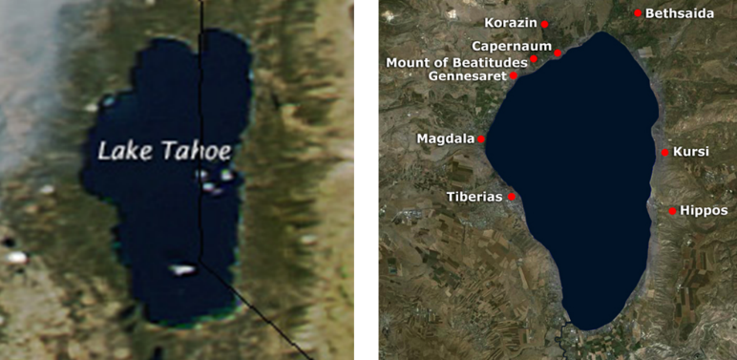
Law and Grace: Matthew 8:1-13
Just after the Sermon on the Mount
Matthew 8:1-13

Slide 23
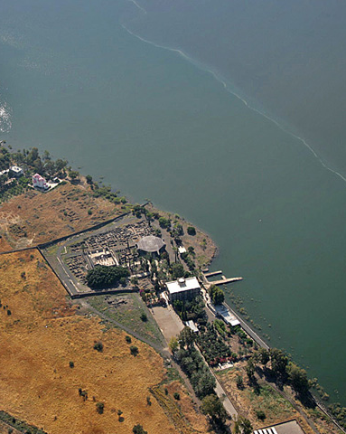
Law and Grace: Matthew 8:1-13
Just after the Sermon on the Mount
Matthew 8:1-13
Just after Jesus gave the Sermon on the Mount He came down from that place and then headed toward Capernaum.

Slide 24
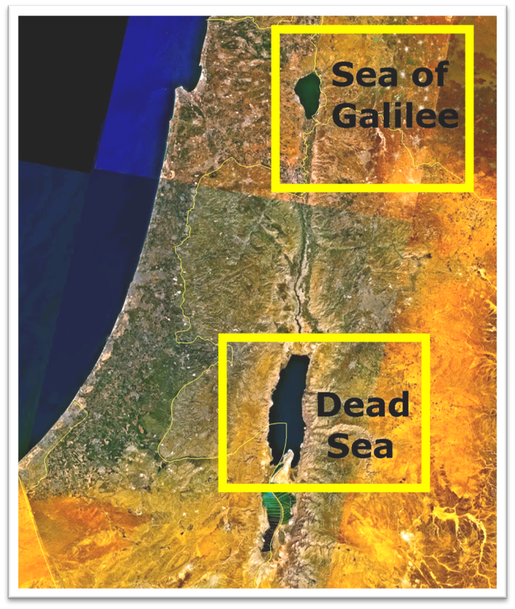
Law and Grace: Matthew 8:1-13
Just after the Sermon on the Mount
Matthew 8:1-13

Slide 25
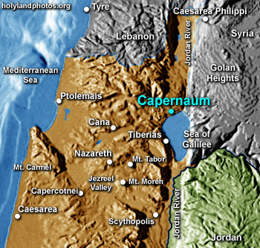
Law and Grace: Matthew 8:1-13
Just after the Sermon on the Mount
Matthew 8:1-13

Slide 26
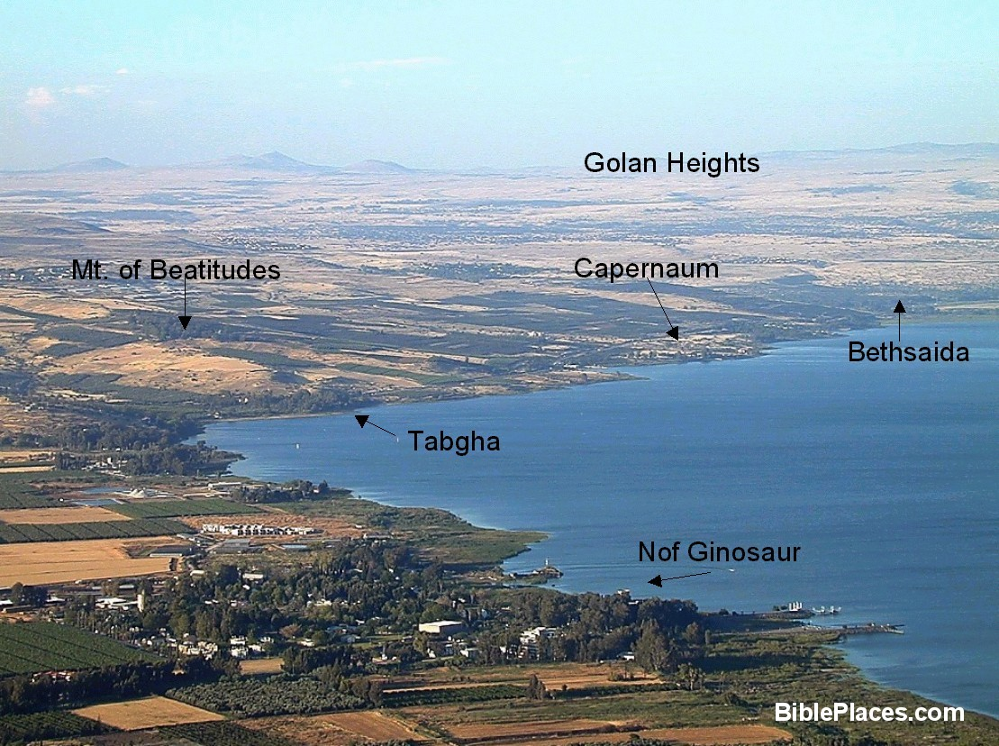
Law and Grace: Matthew 8:1-13
Just after the Sermon on the Mount
Matthew 8:1-13

Slide 27
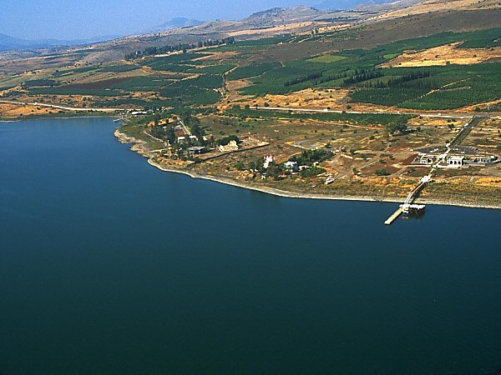
Capernaum area of the Sea of Galilee

Slide 28
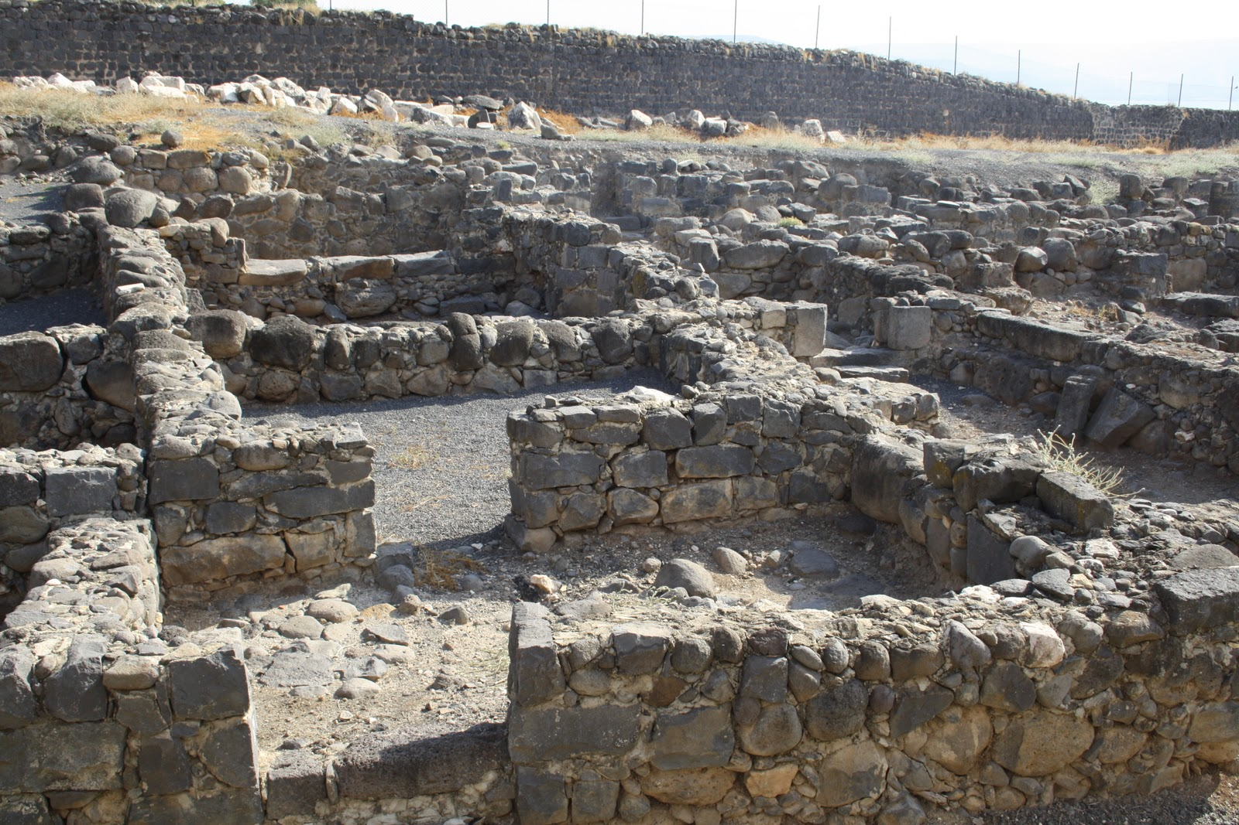
Law and Grace: Matthew 8:1-13
Just after the Sermon on the Mount
Matthew 8:1-13
Capernaum excavations

Slide 29
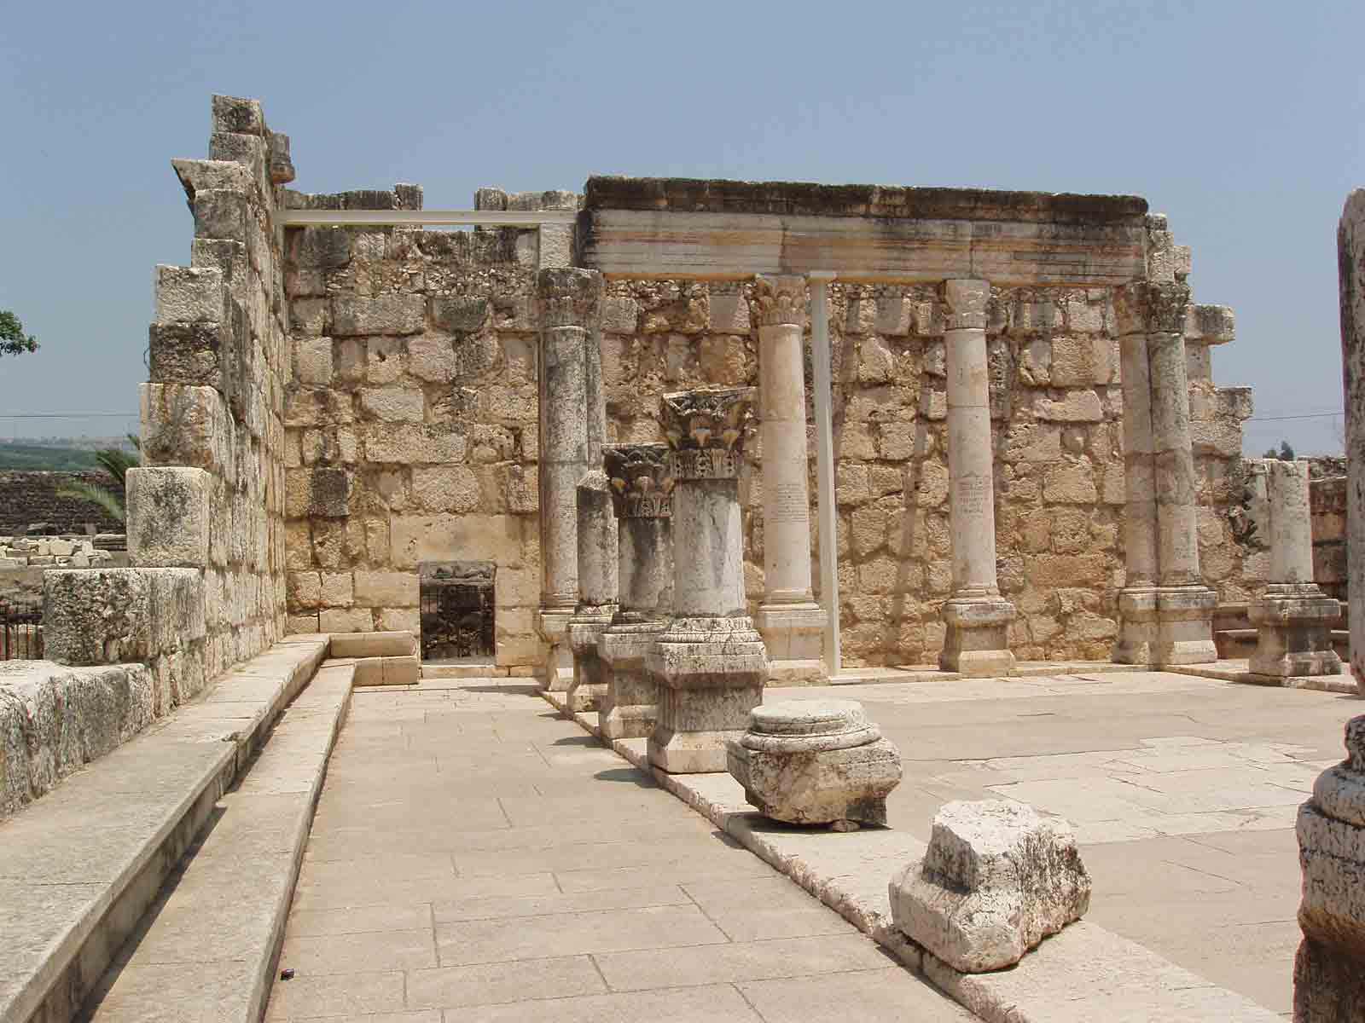
Law and Grace: Matthew 8:1-13
Just after the Sermon on the Mount
Matthew 8:1-13
Capernaum synagogue

Slide 30
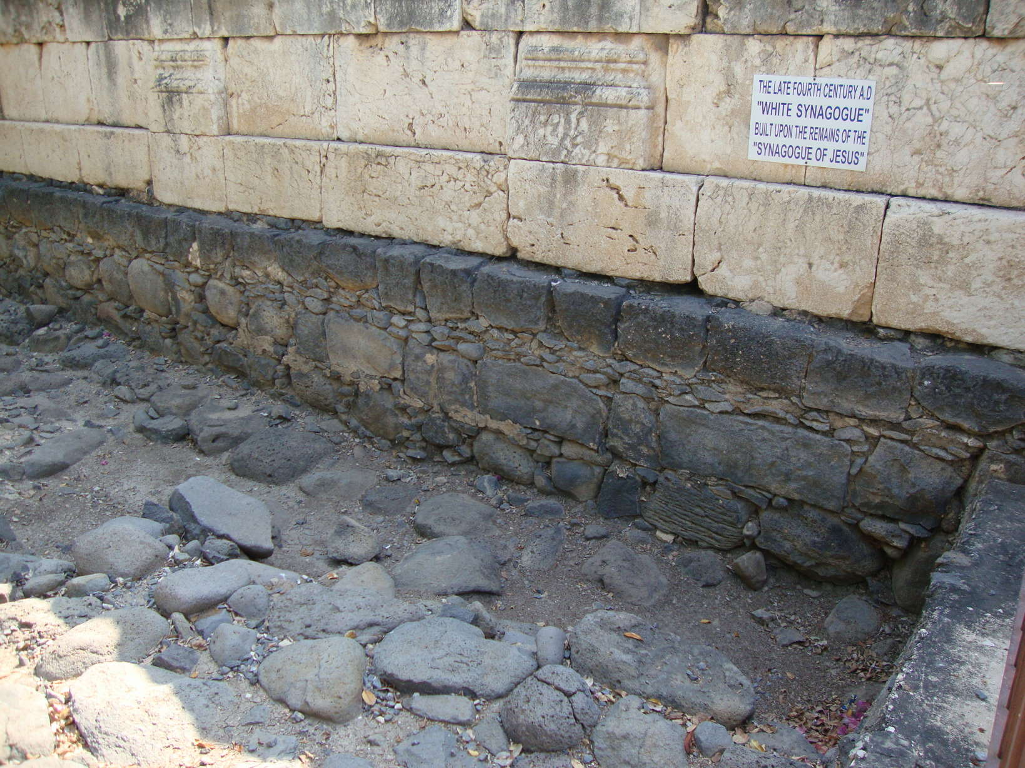
Law and Grace: Matthew 8:1-13
Just after the Sermon on the Mount
Matthew 8:1-13
Capernaum synagogue

Slide 31
Law and Grace: Matthew 8:1-13
Just after the Sermon on the Mount
Matthew 8:1-13
Capernaum served as a sort of head-quarters for His ministry in the Sea of Galilee region, named 16 times and in all four Gospels.
“…and leaving Nazareth, He came and settled in Capernaum, which is by the sea, in the region of Zebulun and Naphtali” (Matthew 4:13).

Slide 32
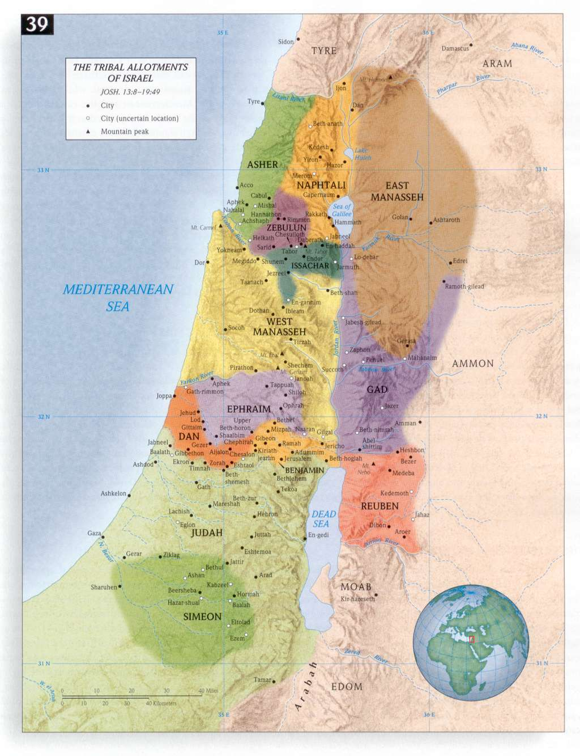
Tribal allotments of Israel ~1400 BC

Slide 33
Tribal allotments of Israel ~1400 BC

Slide 34
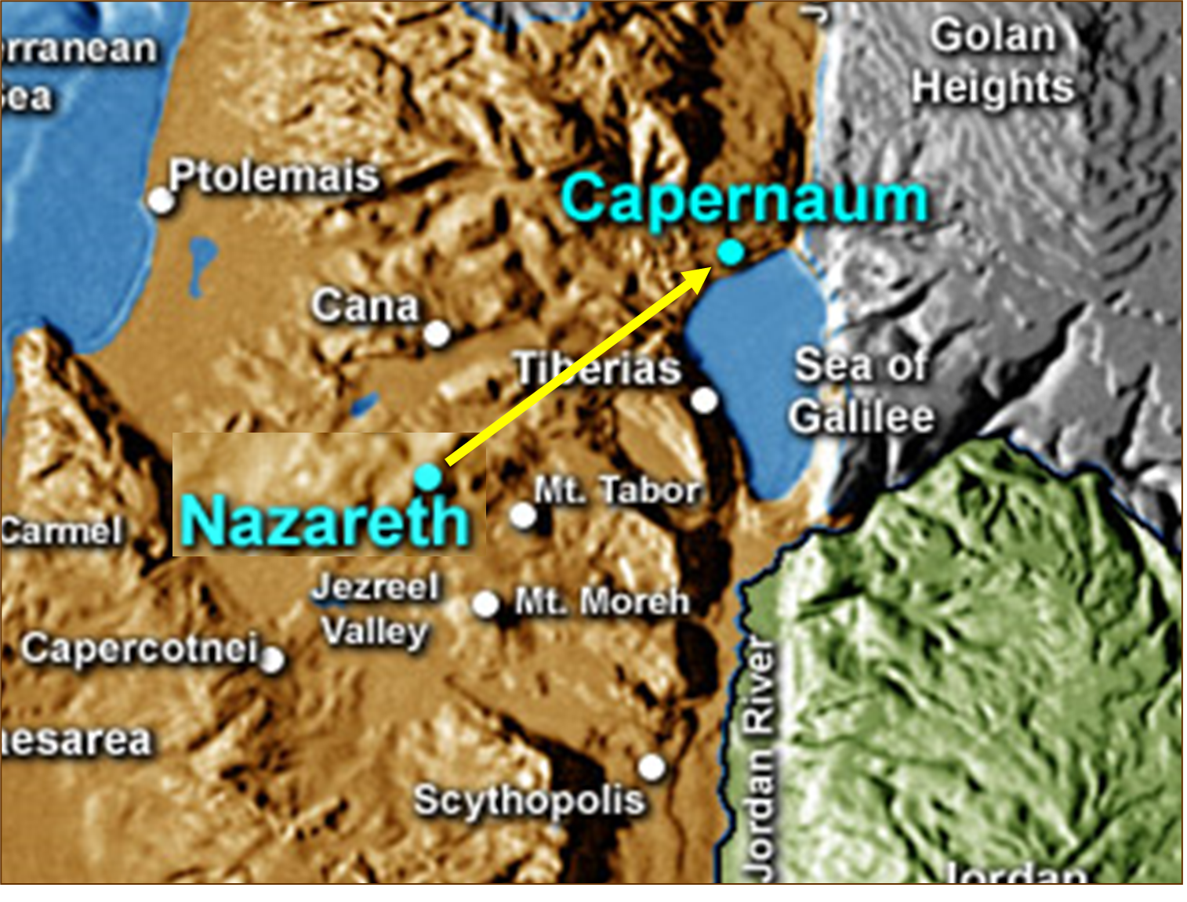
Law and Grace: Matthew 8:1-13
Just after the Sermon on the Mount
Matthew 8:1-13
“…and leaving Nazareth, He came and settled in Capernaum, which is by the sea, in the region of Zebulun and Naphtali” (Matthew 4:13).

Slide 35
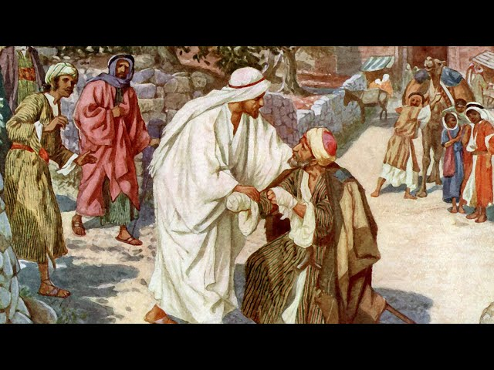
Law and Grace: Matthew 8:1-13
Two things happened on the way…
Matthew 8:1-13
As Jesus was headed from the Mount to Capernaum, He was met by a leper.

Slide 36
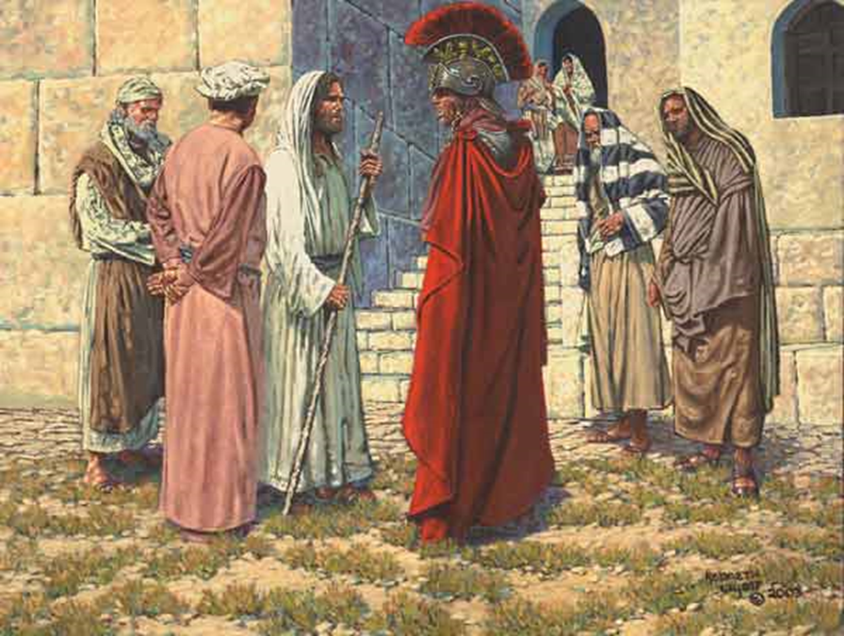
Law and Grace: Matthew 8:1-13
Two things happened on the way…
Matthew 8:1-13
And as He came into Capernaum He was met by a Roman centurion who asked that his servant be healed.

Slide 37
Law and Grace: Matthew 8:1-13
Two things happened on the way…
Matthew 8:1-13
Each will find that Christ heals, as a validation that He was the Messiah, but we’ll also find remarkable contrasts.

Slide 38
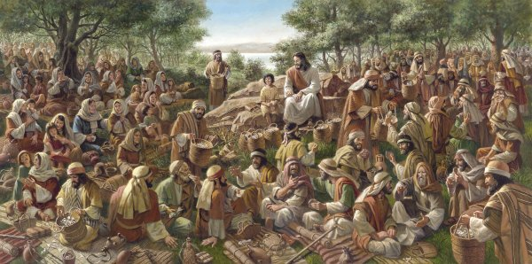
Law and Grace: Matthew 8:1-13
Large crowds followed Him
Matthew 8:1-13
In Jesus’ public ministry we will see that crowds often followed Him, & Matthew 8:1 is among the verses that makes note of the crowds, which were at times quite large.

Slide 39
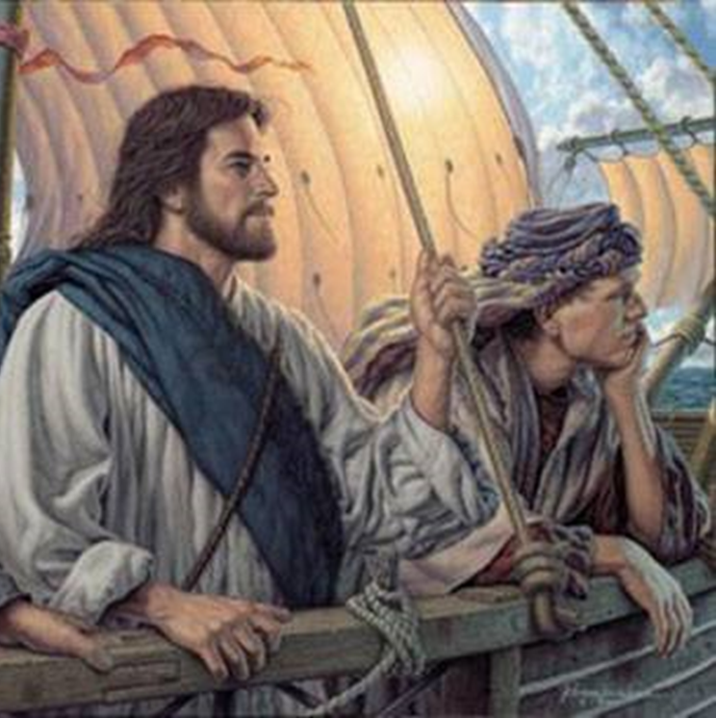
Law and Grace: Matthew 8:1-13
Large crowds followed Him
Matthew 8:1-13
But within a few chapters, we’ll see that Jesus begins:
Speaking to the crowds in parables.
Taking leave of the crowds, at times.
He’ll do these things to focus on His disciples and to pray.

Slide 40
Session 45 Outline
Review
Purpose, Aim, and Objective
The Sermon on the Mount
A Leper, A Centurion, & Other Outcasts – Matt. 8:1-13
General Information
Matt. 8:1-13
Concluding Observations

Slide 41
Matthew 8:1–4
¹ When Jesus came down from the mountain, large crowds followed Him. ² And a leper came to Him and bowed down before Him, and said, “Lord, if You are willing, You can make me clean.” ³ Jesus stretched out His hand and touched him, saying, “I am willing; be cleansed.” And immediately his leprosy was cleansed. ⁴ And Jesus said to him, “See that you tell no one; but go, show yourself to the priest and present the offering that Moses commanded, as a testimony to them.”

Slide 42
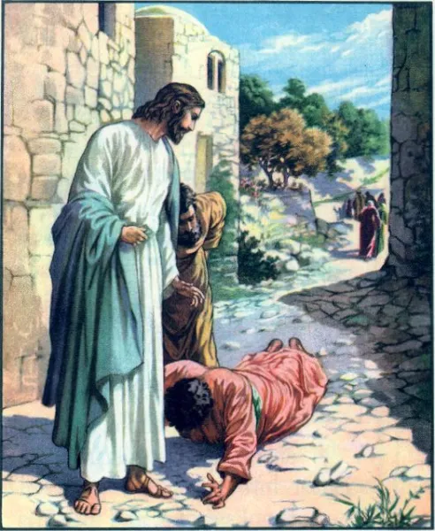
Law and Grace: Matthew 8:1-13
A leper bowed before Him
Matthew 8:2
As Jesus moved from the Mount to Capernaum, a leper *bowed before Him.
*προσκυνέω proskunéō; contracted from the preposition prós (to), and the feminine noun kunéō (to kiss, adore. To worship, do obeisance, show respect, fall or prostrate before.”

Slide 43
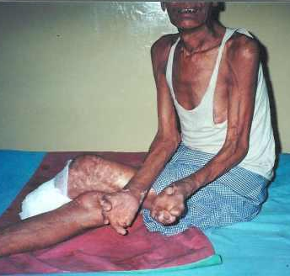
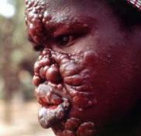
Law and Grace: Matthew 8:1-13
A leper bowed before Him
Matthew 8:2
Leprosy in biblical times was a name given to various diseases which were difficult to diagnose and treat.

Slide 44
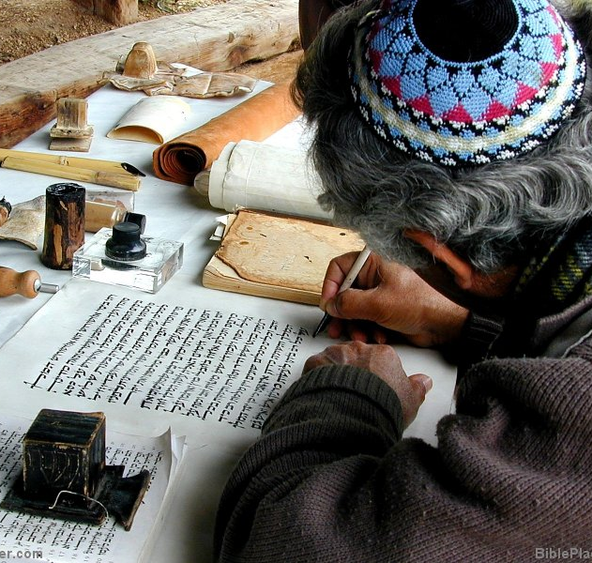
Law and Grace: Matthew 8:1-13
A leper bowed before Him
Matthew 8:2
In the Law of Moses (Leviticus 13- 14), the lawful manner of dealing with lepers was prescribed in detail and it was hard to bear but, ...
…the Law of Moses also had a procedure for declaring the leper cured.

Slide 45
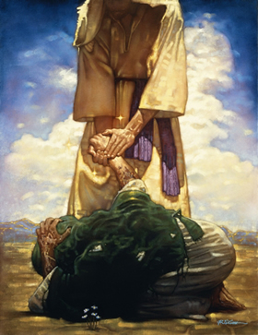
Matthew 8:2-3
“² …Lord, if You are willing, You can make me clean." ³ Jesus stretched out His hand and touched him, saying, "I am willing; be cleansed."

Slide 46
Law and Grace: Matthew 8:1-13
The brief but life-changing interaction
Matthew 8:2-3
Matthew records that the leper was immediately healed of the leprosy.
Such healing by the rabbis was rare, and then only by prayer and only as a mere possibility.
Jesus, in contrast, just directly healed.

Slide 47
Law and Grace: Matthew 8:1-13
Remarkable!
Matthew 8:2-4
So, Jesus touched the leper, violating the Law of Moses (cf. Leviticus 13:5). Then He told the man that He was willing to heal him and directly did so on the spot.
No doubt there were many observing this healing and Jesus was aware of this. So, what did He do next? Jesus told him not to tell anyone…

Slide 48
Law and Grace: Matthew 8:1-13
Remarkable!
Matthew 8:2-4
…but to take the matter to the priest, as required by the Law of Moses, as a testimony!

Slide 49
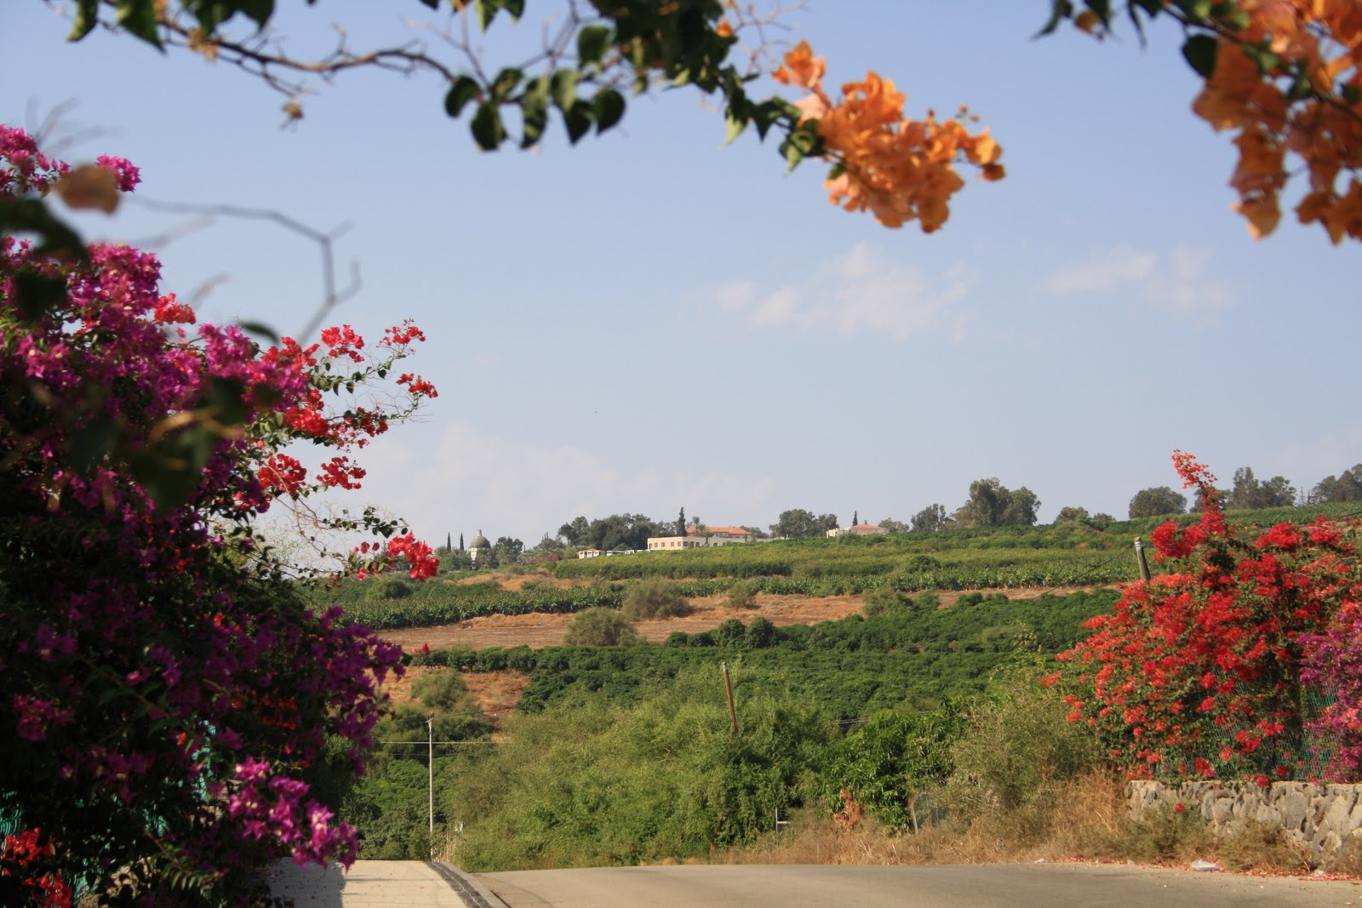
Law and Grace: Matthew 8:1-13
Jesus continued on to Capernaum
Matthew 8:5-13

Slide 50
Matthew 8:5-6 ,8-9, 13
Jesus & the Centurion
⁵ And when Jesus entered Capernaum, a centurion came to Him, imploring Him, ⁶ and saying, “Lord, the servant [pais] of mine is lying paralyzed at home, fearfully tormented.”…⁸ But the centurion said, “Lord, I am not worthy for You to come under my roof, but just say the word, and the servant [pais] of mine will be healed. ⁹ “For I also am a man under authority, with soldiers under me; and I say to this one, 'Go!' and he goes, and to another, 'Come!' and he comes, and to my slave [doulos], 'Do this!' and he does it.”…¹³ And Jesus said to the centurion, “Go; it shall be done for you as you have believed.” And the servant [pais] of his was healed that very moment.

Slide 51
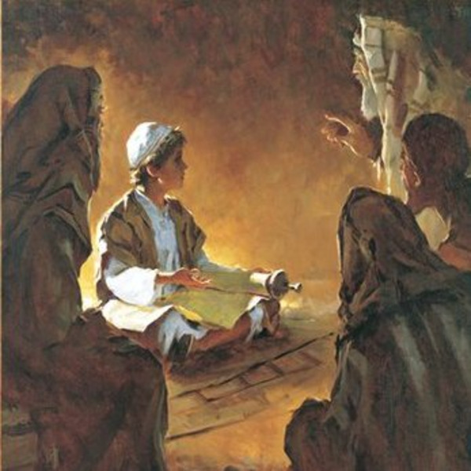
Luke 2:41-43
Jesus at the Temple at age 12
⁴¹ Now His parents went to Jerusalem every year at the Feast of the Passover. ⁴² And when He became twelve, they went up there according to the custom of the Feast; ⁴³ and as they were returning, after spending the full number of days, the boy [pais] Jesus stayed behind in Jerusalem.

Slide 52
Luke 8:49-51, 54
Jesus raises the daughter of the synagogue official
⁴⁹ While He was still speaking, someone came from the house of the synagogue official, saying, “Your daughter has died; do not trouble the Teacher anymore.” ⁵⁰ But when Jesus heard this, He answered him, “Do not be afraid any longer; only believe, and she will be made well.” ⁵¹ When He came to the house, He did not allow anyone to enter with Him, except Peter and John and James, and the girl's [pais] father and mother… ⁵⁴ He, however, took her by the hand and called, saying, “Child [pais], arise!”

Slide 53
Matthew 8:5-6 ,8-9, 13
Jesus & the Centurion
⁵ And when Jesus entered Capernaum, a centurion came to Him, imploring Him, ⁶ and saying, “Lord, the boy [pais] of mine is lying paralyzed at home, fearfully tormented.”…⁸ But the centurion said, “Lord, I am not worthy for You to come under my roof, but just say the word, and the boy [pais] of mine will be healed. ⁹ “For I also am a man under authority, with soldiers under me; and I say to this one, 'Go!' and he goes, and to another, 'Come!' and he comes, and to my slave [doulos], 'Do this!' and he does it.”…¹³ And Jesus said to the centurion, “Go; it shall be done for you as you have believed.” And the boy [pais] of his was healed that very moment.

Slide 54
Law and Grace: Matthew 8:1-13
Then, as Jesus entered Capernaum…
Matthew 8:5-6
This event is extraordinary in that the Centurion was a Gentile, to whom Jesus was not sent, nor did He send His disciples (Matt. 10:1-7; 15:21-28).
The centurion could demand Him to come (cf. Matt. 27:32; Mark 15:21; Luke 23:26).

Slide 55
Law and Grace: Matthew 8:1-13
Jesus expressed willingness, but…
Matthew 8:7-8
Jesus immediately expressed a ready willingness to go to heal the servant (or boy), but…
the centurion said that he was not worthy to have Christ come into his home, but…
just say the word, and my servant will be healed.”

Slide 56
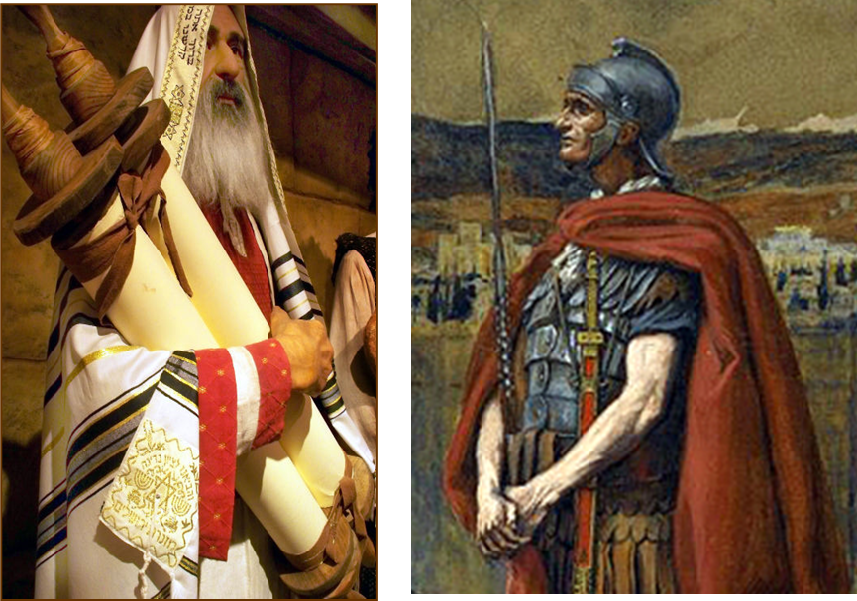
Law and Grace: Matthew 8:1-13
Jesus expressed willingness, but…
Matthew 8:7-8
The centurion most certainly knew that the Law of Moses kept Israelites from entering his home.

Slide 57
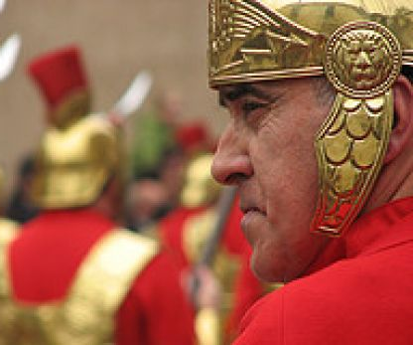
Law and Grace: Matthew 8:1-13
The centurion was under and also had authority
Matthew 8:8-9
The centurion was under the command of others and he also commanded others who were under his authority, both the ones in the military as well as his own household servants.

Slide 58
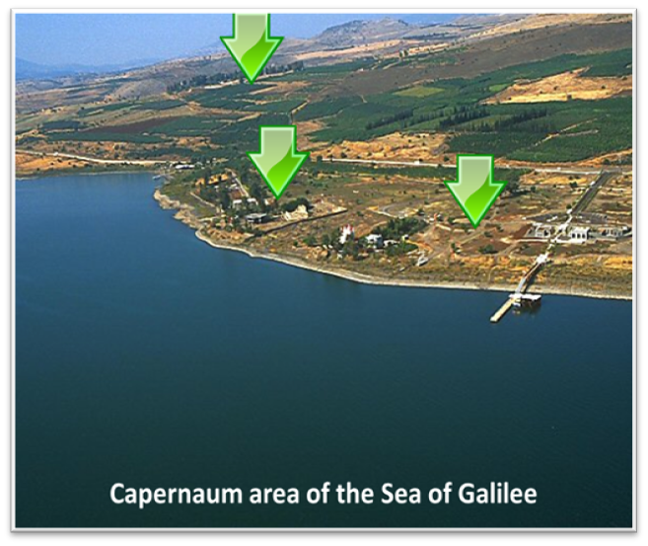
Law and Grace: Matthew 8:1-13
The centurion was under and also had authority
Matthew 8:8-9
Like the centurion’s soldiers and servants, who often carried out the centurion’s will at a distance, the centurion was quite certain that Jesus could heal from a distance.

Slide 59
Law and Grace: Matthew 8:1-13
Jesus marveled at his faith!
Matthew 8:10-12
Jesus marveled at the faith of this centurion!
He said that He had not found this kind of faith in all of Israel – the chosen nation people of God.

Slide 60
Law and Grace: Matthew 8:1-13
Jesus marveled at his faith!
Matthew 8:10-12
Then Jesus spoke of many who would come and sit down with Abraham, Isaac and Jacob in the coming kingdom of heaven, but Jews who ought to be there would be in outer darkness.
Being Jewish doesn’t get one into the kingdom!

Slide 61
Law and Grace: Matthew 8:1-13
So, Jesus told the centurion
Matthew 8:13
Based on his faith, Jesus then told this centurion that his servant (or son), would be healed, and Matthew wrote that the healing took place that very hour…

Slide 62
Session 45 Outline
Review
Purpose, Aim, and Objective
The Sermon on the Mount
A Leper, A Centurion, & Other Outcasts – Matt. 8:1-13
General Information
Matt. 8:1-13
Concluding Observations

Slide 63
Law and Grace: Matthew 8:1-13
Jesus, the Messiah, validated!
Matthew 8:1-13
The Old Testament prophets predicted that Messianic fulfillment would include both miracles and healing (cf. Isaiah 29:18, 19; 35:5, 6; 42:7; 61:1-3, et al).

Slide 64
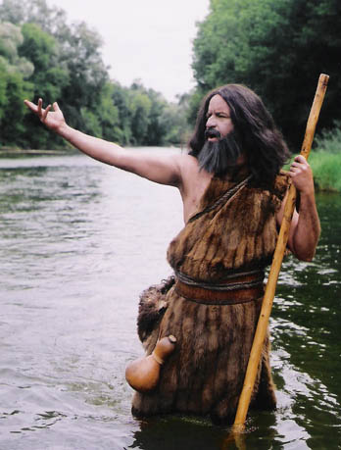
Law and Grace: Matthew 8:1-13
Jesus, the Messiah, validated!
Matthew 8:1-13
In Matthew 11:4-5, when John the Baptist who was imprisoned by Herod, sent his disciples to inquire if Jesus was really the Christ, Jesus replied,…
“Go and report to John what you see and hear: the blind receive sight and the lame walk, the lepers are cleansed and the deaf hear…”

Slide 65
Law and Grace: Matthew 8:1-13
Dr. Arnold Fruchtenbaum
The Messianic Bible Study Collection (Vol. 3, pp. 3–4). Ariel Ministries. (1983).
The purpose of all His miracles between [Matthew] chapters 4 and 12 is to authenticate His Person and His message. They are signs to force the nation of Israel to come to a decision regarding two things: first, His Person, that He is the Messiah; and secondly, His message, the gospel of the Kingdom.

Slide 66
Law and Grace: Matthew 8:1-13
We were and are…
Matthew 8:1-13
By way of application, though we are in the body of Christ, each of us was, spiritually speaking, like the leper whom Jesus touched and healed.
Romans 5:6, 8, 10
⁶ For while we were still helpless…Christ died for the ungodly….⁸…while we were yet sinners, Christ died for us…¹⁰…while we were enemies we were reconciled to God through the death of His Son…

Slide 67
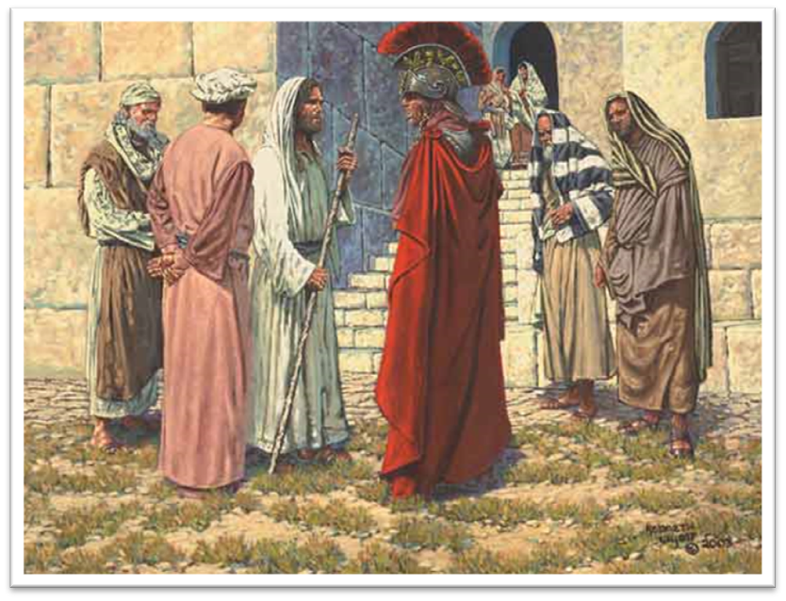
Law and Grace: Matthew 8:1-13
We were and are…
Matthew 8:1-13
Like the centurion, who was unworthy of having the Lord of glory come into his home, we also were unworthy of having Christ come into our heart’s home!

Slide 68
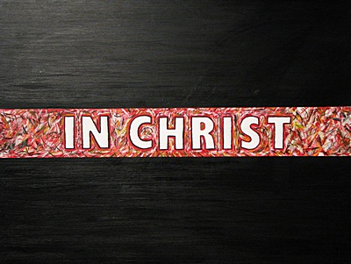
Law and Grace: Matthew 8:1-13
We were and are…
Matthew 8:1-13
But Jesus not only came into our hearts home, ABBA, Father, has also positioned us ‘in Him’. Why would He do this?

Slide 69
Law and Grace: Matthew 8:1-13
We were and are…
Matthew 8:1-13
Because we are intended for intimacy with Christ!

Slide 70
Law and Grace: An Overview Jim McGowan, Th.D. Sugar Land Bible Church 10-03-2024
…but grace and truth were realized through Jesus Christ - John 1:17
For the Law was given through Moses…
Special thanks to Dr. Vern Peterman for access to his insights and resources.

