Slide 2
Acts 10:1‒11:18 Cornelius’ Salvation
Cornelius’ Vision (10:1-8)
Peter’s Vision (Acts 10:9-16)
Vision’s Application (10:17-23a)
Caesarean Ministry (10:23b-33)
Peter & The Keys of the Kingdom (10:34-43)
Gentiles’ Salvation (10:44-48)
Peter’s Defense in Jerusalem (11:1-18)

Slide 3
Acts 10:1‒11:18 Cornelius’ Salvation
Cornelius’ Vision (10:1-8)
Peter’s Vision (Acts 10:9-16)
Vision’s Application (10:17-23a)
Caesarean Ministry (10:23b-33)
Peter & The Keys of the Kingdom (10:34-43)
Gentiles’ Salvation (10:44-48)
Peter’s Defense in Jerusalem (11:1-18)

Slide 4
I. Cornelius Introduced Acts 10:1-8
Cornelius introduced (1)
Cornelius’ spiritual state (2)
Vision (3-6)
Cornelius’ obedience (7-8)

Slide 5
I. Cornelius Introduced Acts 10:1-8
Cornelius introduced (1)
Cornelius’ spiritual state (2)
Vision (3-6)
Cornelius’ obedience (7-8)

Slide 6
Acts 10:1 Cornelius Introduced
Place (1a)
Person (1b)

Slide 7
Acts 10:1 Cornelius Introduced
Place (1a)
Person (1b)

Slide 8
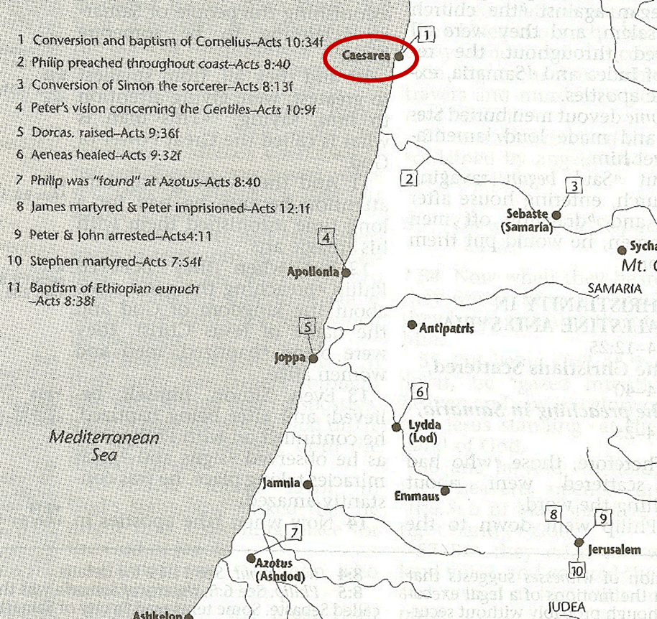

Slide 9
Acts 10:1 Cornelius Introduced
Place (1a)
Person (1b)

Slide 10
Luke 1:1–4
¹ Inasmuch as many have undertaken to compile an account of the things accomplished among us, ² just as they were handed down to us by those who from the beginning were eyewitnesses and servants of the word, ³ it seemed fitting for me as well, having investigated everything carefully from the beginning, to write it out for you in consecutive order, most excellent Theophilus; ⁴ so that you may know the exact truth about the things you have been taught.

Slide 11
Acts 1:1–2
¹ The first account I composed, Theophilus, about all that Jesus began to do and teach, ² until the day when He was taken up to heaven, after He had by the Holy Spirit given orders to the apostles whom He had chosen.

Slide 12
I. Cornelius Introduced Acts 10:1-8
Cornelius introduced (1)
Cornelius’ spiritual state (2)
Vision (3-6)
Cornelius’ obedience (7-8)

Slide 13
Acts 10:2 Cornelius’ Spiritual State
Devout (2a)
Feared God (2b)
Generous (2c)
Prayerful (2d)

Slide 14
Acts 10:2 Cornelius’ Spiritual State
Devout (2a)
Feared God (2b)
Generous (2c)
Prayerful (2d)

Slide 15
Acts 10:2 Cornelius’ Spiritual State
Devout (2a)
Feared God (2b)
Generous (2c)
Prayerful (2d)

Slide 16
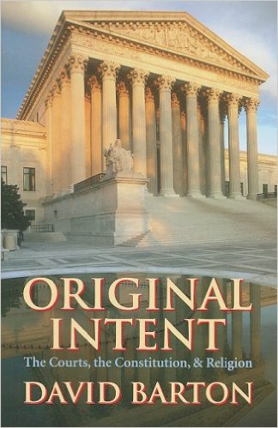
David Barton, Original Intent, p. 245

Slide 17
Acts 10:2 Cornelius’ Spiritual State
Devout (2a)
Feared God (2b)
Generous (2c)
Prayerful (2d)

Slide 18
Acts 10:2 Cornelius’ Spiritual State
Devout (2a)
Feared God (2b)
Generous (2c)
Prayerful (2d)

Slide 19
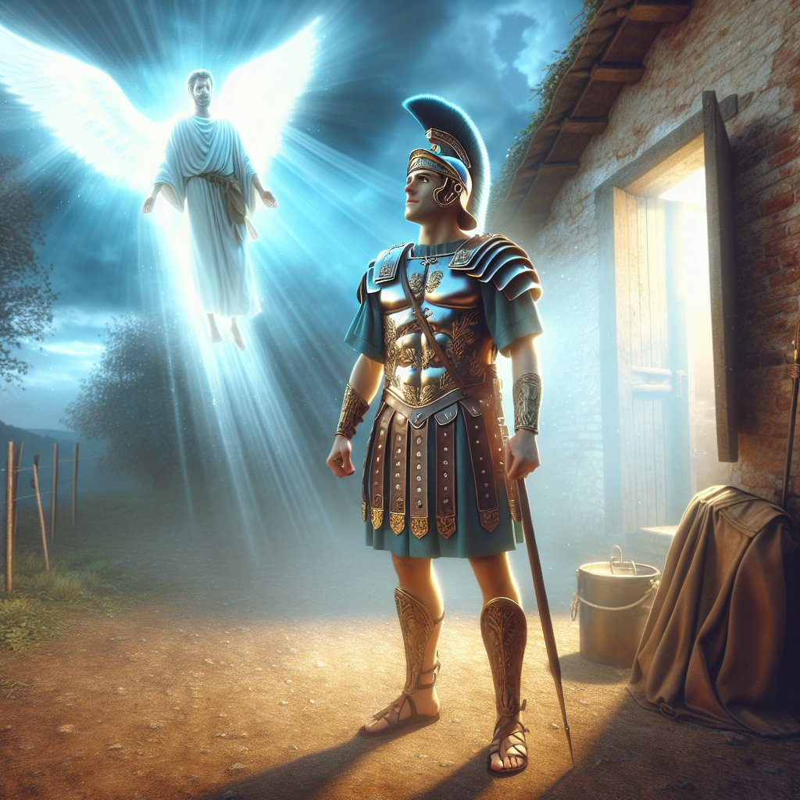
Acts 10:2
“Now there was a man at Caesarea named Cornelius, a centurion of what was called the Italian cohort, ² a devout man and one who feared God with all his household, and gave many alms to the Jewish people and prayed to God continually.”

Slide 20
Acts 11:14
“and he will speak words to you by which you will be saved, you and all your household.”

Slide 21
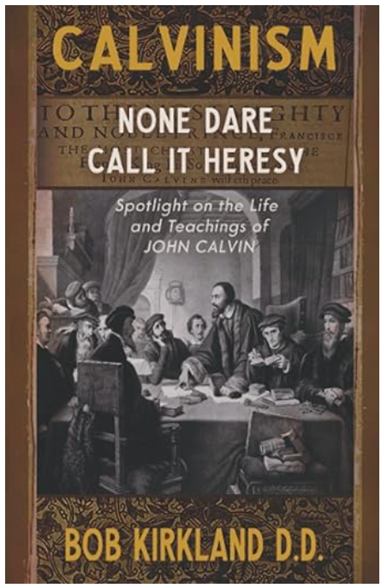
Total Depravity = Inability
“T” stands for “Total Depravity.” Man is completely and wholly depraved and has no ability whatsoever to respond (repent or believe) to God until he is first “regenerated” by God.
Bob Kirkland, Calvinism: None Dare Call It Heresy; Spotlight on the Life
and Teachings of John Calvin (Eureka, MT: Lighthouse Trails, 2018), 34.

Slide 22
John MacArthur
Faith Works, p. 64-65
“Because we were dead to God, we were dead to truth, righteousness, peace, happiness, and every other good thing, no more capable to respond to God than a cadaver” and are “spiritual zombies, death-walkers, unable even to understand the gravity of their situation. They are lifeless.”
John F. MacArthur Jr., Faith Works: The Gospel According to the Apostles (Dallas: Word, 1993), 64-65.

Slide 23
Acts 10:2
“Now there was a man at Caesarea named Cornelius, a centurion of what was called the Italian cohort, ² a devout man and one who feared God with all his household, and gave many alms to the Jewish people and prayed to God continually.”

Slide 24
“…one of the mistakes that human beings make is believing that there is only one way…We don’t accept that there are diverse ways of being in the world; that there are millions of ways to be a human being. And many ways…many paths to what you call God. That her path might be something else and when she gets there she might call it the light. But her loving, and her kindness, and her generosity brings her to the…same point that it brings you…
www.youtube.com/watch?v=Lb2RUpMDk34

Slide 25
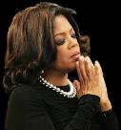
…It doesn’t matter whether she called it ‘God’ along the way or not…There couldn’t possibly be just one way!…There couldn’t possibly be only one way with millions of people in the world!...You think…if you are somewhere on the planet and you never hear the name of Jesus but yet you live with a loving heart. You lived as Jesus would have had you to live. You lived for the same purpose as Jesus came to the planet to teach us all, but you are in some remote part of the earth and you never heard the name of Jesus. You cannot get to Heaven…?”
www.youtube.com/watch?v=Lb2RUpMDk34

Slide 26
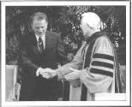
Hl9Aps://www.youtube.com/watch?v=hrf60-zHl9A
Dr. Schuller: "Tell me, what is the future of Christianity?"
Dr. Graham: "Well, Christianity and being a true believer, you know, I think there's the body of Christ which comes from all the Christian groups around the world, or outside the Christian groups. I think that everybody that loves Christ or knows Christ, whether they're conscious of it or not, they're members of the body of Christ. And I don't think that we're going to see a great sweeping revival that will turn the whole world to Christ at any time…and that’s what God is doing today. He is calling people out of the world for His name. Whether they come from the Muslim world, or the Buddhist world, or the Christian world, or the non-believing world, they are members of the body of Christ because they've been called . . .

Slide 27
Hl9Aps://www.youtube.com/watch?v=hrf60-zHl9A
…by God. They may not even know the name of Jesus, but they know in their hearts they need something that they don't have and they turn to the only light that they have and I think they're saved and they're going to be with us in heaven.”
Dr. Schuller: "This is fantastic. I'm so thrilled to hear you say that. There's a wideness in God's mercy.”
Dr. Graham: “There is."

Slide 28
Tony Evans
Totally Saved: Understanding, Experiencing and Enjoying the
Greatness of Your Salvation (Chicago: Moody, 2002), 355, 359.
“In a class I once taught at Dallas Seminary, I inadvertently asked an exam question on material I had not covered in class. One of the students brought this discrepancy to my attention. To be fair, I had to rescore all of the test papers because I could not hold the students liable for information they had never been given…So the premise is that God will not hold people accountable for a decision they cannot make, based on information they have not received…And people in faraway lands who have never heard the gospel still have their own sins to answer for. This means we need to talk about the provision God has made for those who cannot believe….Here's the spiritual principle at work: When people respond to what they do know of God, He takes personal responsibility for giving them more information about Himself.... In the case of a person…

Slide 29
Tony Evans
Totally Saved: Understanding, Experiencing and Enjoying the
Greatness of Your Salvation (Chicago: Moody, 2002), 355, 359.
…who never hears the gospel and never knows the name of Jesus, but who responds to the light he has, God, treats that person like an Old Testament saint, if you will. That is, if the person trusts in what God has revealed, God deals with that person based on the knowledge he has, not the information he never received. I call this trans-dispensationalism...By this I mean if a person is sincerely seeking God and desiring to know Him, and is responding to the truth he knows, if there is no missionary or direct manifestation of God, then God judges that person based on his faith in the light he has received. And as in the case of Abraham, God will retroactively count this person as righteous by applying the death of Christ from the dispensation of grace.”

Slide 30
Acts 11:14
“and he will speak words to you by which you will be saved, you and all your household.”

Slide 31
Acts 4:12
“And there is salvation in no one else; for there is no other name under heaven that has been given among men by which we must [dei] be saved.”

Slide 32
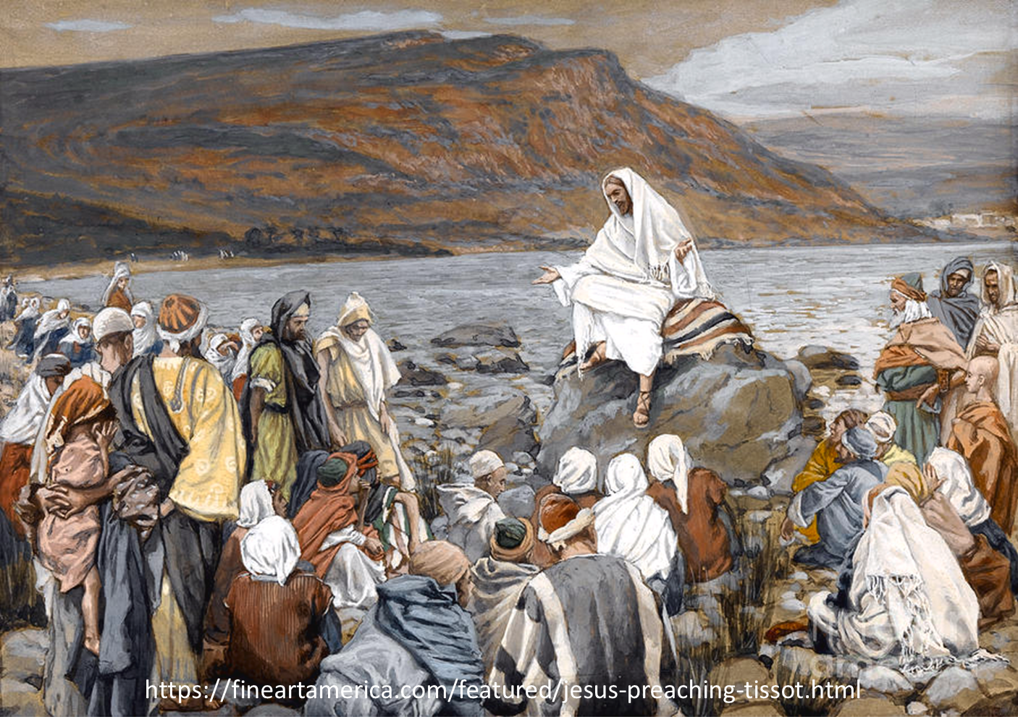
Luke 4:43
“But He said to them, “I must [dei] preach the kingdom of God to the other cities also, for I was sent for this purpose.”

Slide 33
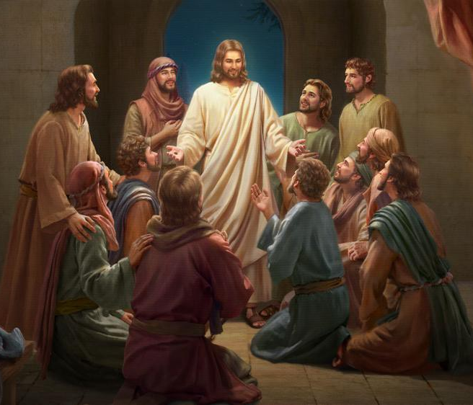
Luke 24:44
“Now He said to them, “These are My words which I spoke to you while I was still with you, that all things which are written about Me in the Law of Moses and the Prophets and the Psalms must [dei] be fulfilled.”

Slide 34
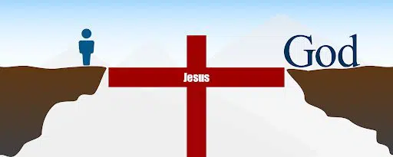
John 14:6
“Jesus said to him, ‘I am the way, and the truth, and the life; no one comes to the Father but through Me.’”

Slide 35
1 Timothy 2:5
“For there is one God, and one mediator also between God and men, the man Christ Jesus.”

Slide 36
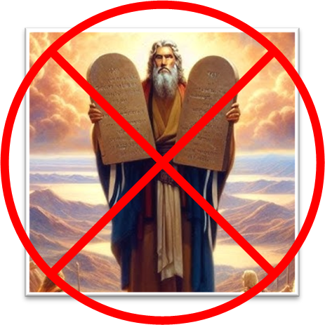
Galatians 2:21
“I do not nullify the grace of God, for if righteousness comes through the Law, then Christ died needlessly.”

Slide 37
Mathew 7:13-14
“Enter through the narrow gate; for the gate is wide and the way is broad that leads to destruction, and there are many who enter through it. ¹⁴ For the gate is small and the way is narrow that leads to life, and there are few who find it.”

Slide 38
General vs. Special Revelation
 | General | Special
Examples | Nature, conscience (Rom 1–2) | Incarnation, Scripture, miracles
Availability | All | Some
Accomplishment | Accountability (Rom 1) | Salvation (Acts 4:12; 2 Tim 3:15)
Form | Non-written or non-verbal | Written
Quality | Natural | Supernatural, miraculous

Slide 39
Romans 1:18–20
¹⁸ For the wrath of God is revealed from heaven against all ungodliness and unrighteousness of men who suppress the truth in unrighteousness, ¹⁹ because that which is known about God is evident within them; for God made it evident to them. ²⁰ For since the creation of the world His invisible attributes, His eternal power and divine nature, have been clearly seen, being understood through what has been made, so that they are without excuse.

Slide 40
I. Cornelius Introduced Acts 10:1-8
Cornelius introduced (1)
Cornelius’ spiritual state (2)
Vision (3-6)
Cornelius’ obedience (7-8)

Slide 41
Acts 10:3-6 Vision
Angel (3-4)
Commission (5-6)

Slide 42
Acts 10:3-6 Vision
Angel (3-4)
Commission (5-6)

Slide 43
Acts 10:3-4 Angel
Appearance (3)
Cornelius’ response (4)

Slide 44
Acts 10:3-4 Angel
Appearance (3)
Cornelius’ response (4)

Slide 45
Acts 10:3-4 Angel
Appearance (3)
Cornelius’ response (4)

Slide 46
Acts 10:3-6 Vision
Angel (3-4)
Commission (5-6)

Slide 47
Acts 10:5-6 Commission
Fetch Peter (5)
Location (6)

Slide 48
Acts 10:5-6 Commission
Fetch Peter (5)
Location (6)

Slide 49
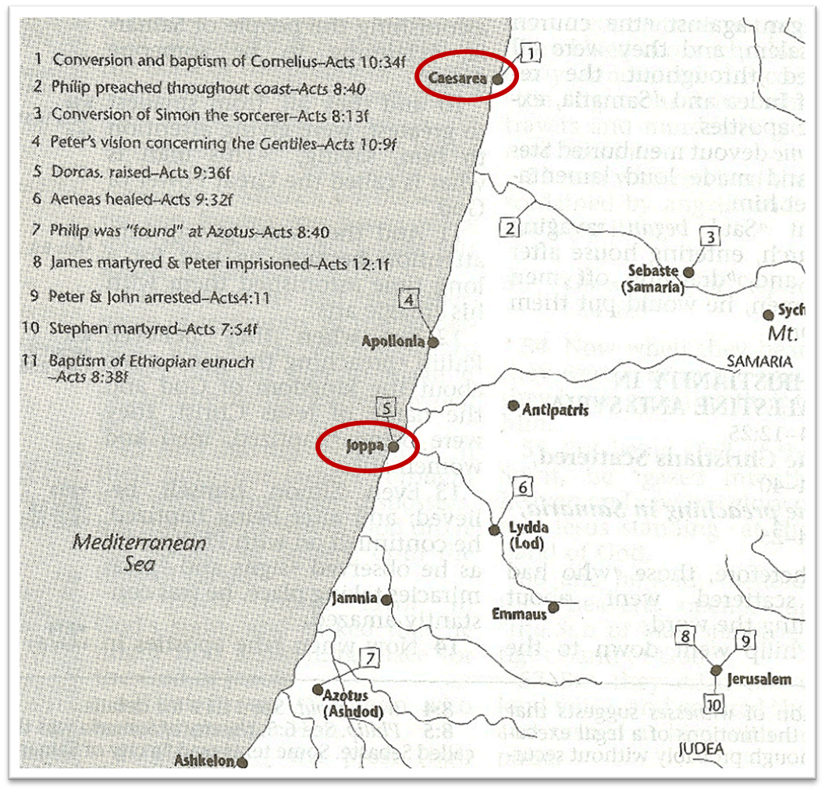

Slide 50
Acts 10:5-6 Commission
Fetch Peter (5)
Location (6)

Slide 51
I. Cornelius Introduced Acts 10:1-8
Cornelius introduced (1)
Cornelius’ spiritual state (2)
Vision (3-6)
Cornelius’ obedience (7-8)

Slide 52
Acts 10:7-8 Cornelius’ Obedience
Servants (7)
Sending to Joppa (8)

Slide 53
Acts 10:7-8 Cornelius’ Obedience
Servants (7)
Sending to Joppa (8)

Slide 54
Acts 10:7-8 Cornelius’ Obedience
Servants (7)
Sending to Joppa (8)

Slide 56
Acts 10:1‒11:18 Cornelius’ Salvation
Cornelius’ Vision (10:1-8)
Peter’s Vision (Acts 10:9-16)
Vision’s Application (10:17-23a)
Caesarean Ministry (10:23b-33)
Peter & The Keys of the Kingdom (10:34-43)
Gentiles’ Salvation (10:44-48)
Peter’s Defense in Jerusalem (11:1-18)

Slide 57
II. Peter’s Vision Acts 10:9-16
Occasion (9-10a)
Vision (10b-13)
Peter’s response (14)
God’s command (15)
Vision’s repetition (16a)
Vision’s conclusion (16b)

Slide 58
II. Peter’s Vision Acts 10:9-16
Occasion (9-10a)
Vision (10b-13)
Peter’s response (14)
God’s command (15)
Vision’s repetition (16a)
Vision’s conclusion (16b)

Slide 59
Acts 10:9-10a Occasion
Timing (9a)
Spiritual preparation (9b)
Physical preparation (10a)

Slide 60
Acts 10:9-10a Occasion
Timing (9a)
Spiritual preparation (9b)
Physical preparation (10a)

Slide 61
Acts 10:9-10a Occasion
Timing (9a)
Spiritual preparation (9b)
Physical preparation (10a)

Slide 62
Acts 10:9-10a Occasion
Timing (9a)
Spiritual preparation (9b)
Physical preparation (10a)

Slide 63
II. Peter’s Vision Acts 10:9-16
Occasion (9-10a)
Vision (10b-13)
Peter’s response (14)
God’s command (15)
Vision’s repetition (16a)
Vision’s conclusion (16b)

Slide 64
Acts 10:10b-13 Vision
Trance (10b)
Vision’s description (11)
Sheet’s content (12)
Command (13)

Slide 65
Acts 10:10b-13 Vision
Trance (10b)
Vision’s description (11)
Sheet’s content (12)
Command (13)

Slide 66
Acts 10:10b-13 Vision
Trance (10b)
Vision’s description (11)
Sheet’s content (12)
Command (13)

Slide 67
Acts 10:10b-13 Vision
Trance (10b)
Vision’s description (11)
Sheet’s content (12)
Command (13)

Slide 68
Acts 10:10b-13 Vision
Trance (10b)
Vision’s description (11)
Sheet’s content (12)
Command (13)

Slide 69
II. Peter’s Vision Acts 10:9-16
Occasion (9-10a)
Vision (10b-13)
Peter’s response (14)
God’s command (15)
Vision’s repetition (16a)
Vision’s conclusion (16b)

Slide 70
II. Peter’s Vision Acts 10:9-16
Occasion (9-10a)
Vision (10b-13)
Peter’s response (14)
God’s command (15)
Vision’s repetition (16a)
Vision’s conclusion (16b)

Slide 71
II. Peter’s Vision Acts 10:9-16
Occasion (9-10a)
Vision (10b-13)
Peter’s response (14)
God’s command (15)
Vision’s repetition (16a)
Vision’s conclusion (16b)

Slide 72
II. Peter’s Vision Acts 10:9-16
Occasion (9-10a)
Vision (10b-13)
Peter’s response (14)
God’s command (15)
Vision’s repetition (16a)
Vision’s conclusion (16b)

Slide 73
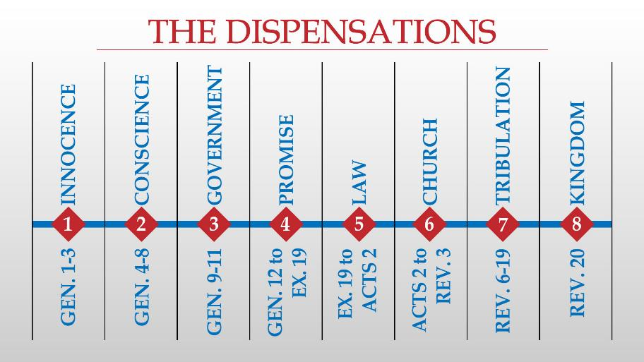

Slide 74
Acts 10:1‒11:18 Cornelius’ Salvation
Cornelius’ Vision (10:1-8)
Peter’s Vision (Acts 10:9-16)
Vision’s Application (10:17-23a)
Caesarean Ministry (10:23b-33)
Peter & The Keys of the Kingdom (10:34-43)
Gentiles’ Salvation (10:44-48)
Peter’s Defense in Jerusalem (11:1-18)

Slide 75
Acts 10:1‒11:18 Cornelius’ Salvation
Cornelius’ Vision (10:1-8)
Peter’s Vision (Acts 10:9-16)
Vision’s Application (10:17-23a)
Caesarean Ministry (10:23b-33)
Peter & The Keys of the Kingdom (10:34-43)
Gentiles’ Salvation (10:44-48)
Peter’s Defense in Jerusalem (11:1-18)

Slide 76
Acts 10:1‒11:18 Cornelius’ Salvation
Cornelius’ Vision (10:1-8)
Peter’s Vision (Acts 10:9-16)
Vision’s Application (10:17-23a)
Caesarean Ministry (10:23b-33)
Peter & The Keys of the Kingdom (10:34-43)
Gentiles’ Salvation (10:44-48)
Peter’s Defense in Jerusalem (11:1-18)

Slide 77
Acts 10:1‒11:18 Cornelius’ Salvation
Cornelius’ Vision (10:1-8)
Peter’s Vision (Acts 10:9-16)
Vision’s Application (10:17-23a)
Caesarean Ministry (10:23b-33)
Peter & The Keys of the Kingdom (10:34-43)
Gentiles’ Salvation (10:44-48)
Peter’s Defense in Jerusalem (11:1-18)

Slide 78
Acts 10:1‒11:18 Cornelius’ Salvation
Cornelius’ Vision (10:1-8)
Peter’s Vision (Acts 10:9-16)
Vision’s Application (10:17-23a)
Caesarean Ministry (10:23b-33)
Peter & The Keys of the Kingdom (10:34-43)
Gentiles’ Salvation (10:44-48)
Peter’s Defense in Jerusalem (11:1-18)

Slide 79
Conclusion

Slide 80
Acts 10:1‒11:18 Cornelius’ Salvation
Cornelius’ Vision (10:1-8)
Peter’s Vision (Acts 10:9-16)
Vision’s Application (10:17-23a)
Caesarean Ministry (10:23b-33)
Peter & The Keys of the Kingdom (10:34-43)
Gentiles’ Salvation (10:44-48)
Peter’s Defense in Jerusalem (11:1-18)

