Slide 1


Genesis 12‒50
Israel’s Birth & Preservation

Slide 2
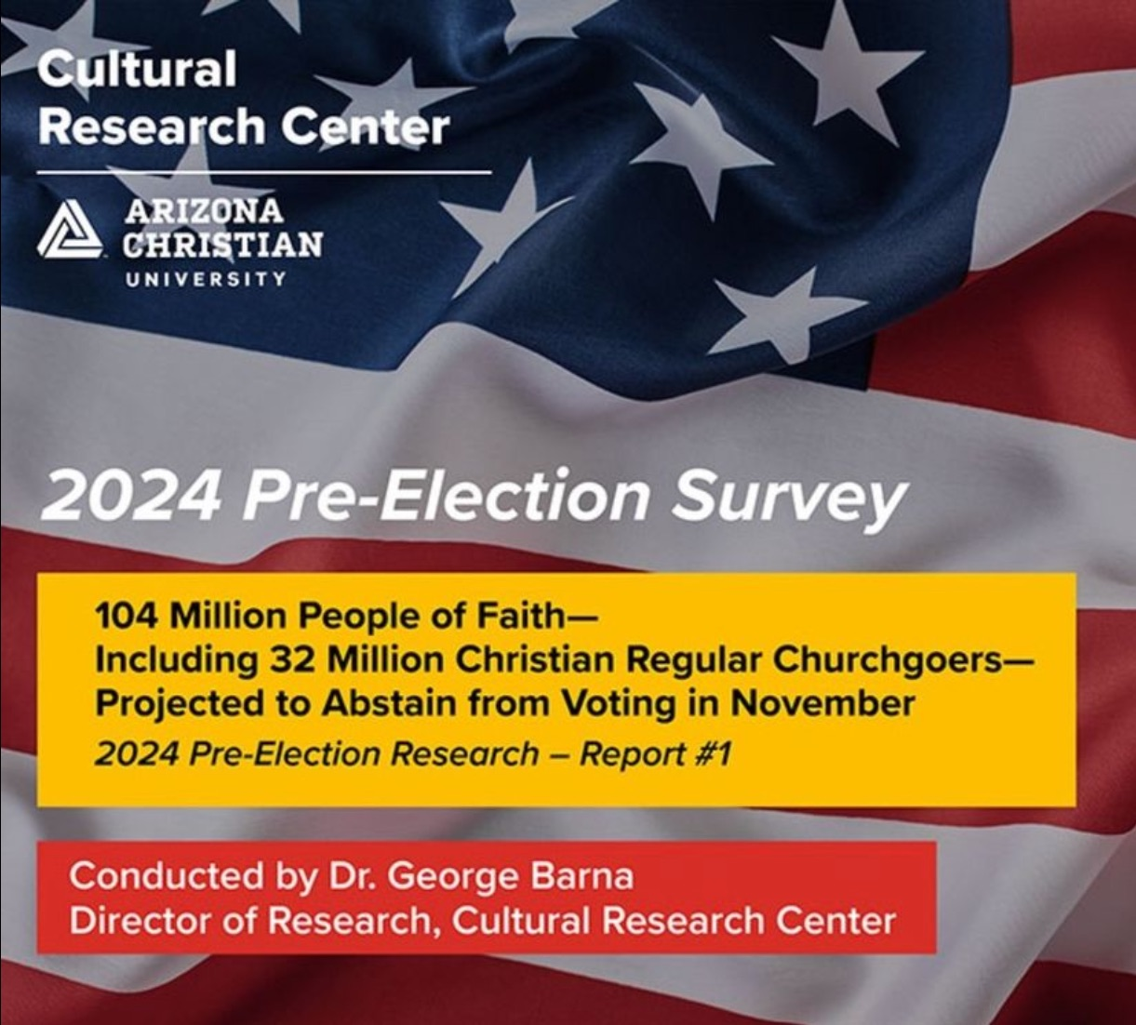

Slide 3


GENESIS STRUCTURE
  Genesis 12-50 (four people)
    Abraham (12:1–25:11)
    Isaac (25:12–26:35)
    Jacob (27–36)
    Joseph (37–50)

Slide 4
Genesis 37‒50
Joseph
  Joseph sold unto Egypt (37)
  Canaan’s corruption (38)
  Joseph falsely accused (39)
  Joseph’s short-term predictions (40)
  Joseph’s elevation (41)
  Joseph’s first reunion with his brothers (42)
  Joseph’s second reunion with his brothers (43‒45)
  Sojourn to Egypt (46:1‒47:12)

Slide 5
Genesis 46:1‒47:12
Sojourn to Egypt
  Divine Sanction (46:1-7)
  House of Jacob (46:8-27)
  Jacob Arrives in Egypt (46:28-34)
  Jacob’s Family Before Pharaoh (47:1-10)
  Settlement in Goshen (47:11-12)

Slide 6
II. Genesis 46:8-27
House of Jacob
    Introduction (8a)
    Leah’s sons (8b-15)
    Sons through Zilpah (16-18)
    Rachel’s sons (19-22)
    Sons through Bilhah (23-25)
    Grand total (26-27)

Slide 7
II. Genesis 46:8-27
House of Jacob
    Introduction (8a)
    Leah’s sons (8b-15)
    Sons through Zilpah (16-18)
    Rachel’s sons (19-22)
    Sons through Bilhah (23-25)
    Grand total (26-27)

Slide 8


Jeremiah 30:7
“Alas! for that day is great, There is none like it; And it is the time of Jacob’s distress (Gen. 32:8; 35:10), But he will be saved from it.”

Slide 9
II. Genesis 46:8-27
House of Jacob
    Introduction (8a)
    Leah’s sons (8b-15)
    Sons through Zilpah (16-18)
    Rachel’s sons (19-22)
    Sons through Bilhah (23-25)
    Grand total (26-27)

Slide 10
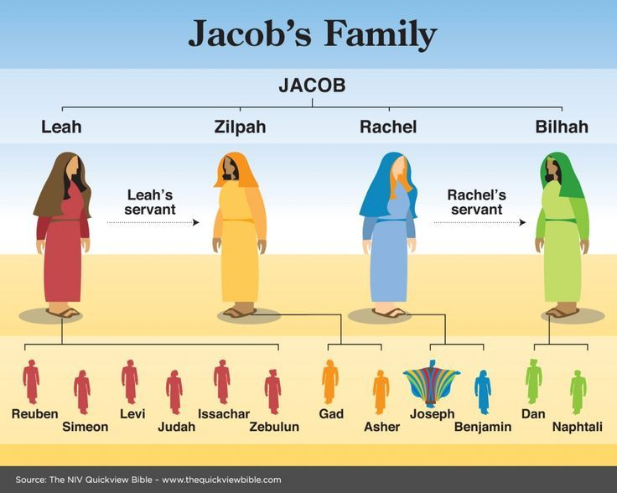

Slide 11
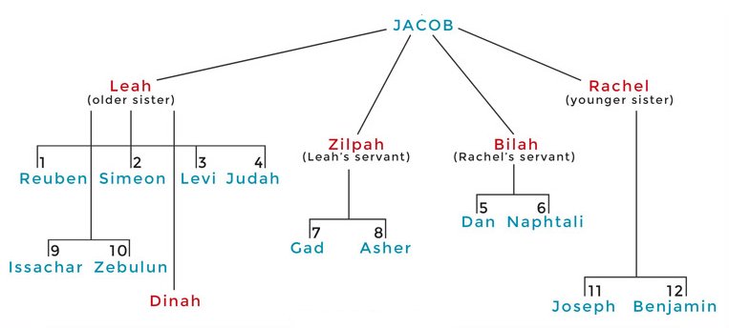

Slide 12
Genesis 46:8b-15
Leah’s Sons
      Reuben (8b-9)
      Simeon’s 6 sons (10)
      Levi’s 3 sons (11)
      Judah (12)
      Issachar’s 4 sons (13)
      Zebulun’s 3 sons (14)
      Summary statement (15)

Slide 13
Genesis 46:8b-15
Leah’s Sons
      Reuben (8b-9)
      Simeon’s 6 sons (10)
      Levi’s 3 sons (11)
      Judah (12)
      Issachar’s 4 sons (13)
      Zebulun’s 3 sons (14)
      Summary statement (15)

Slide 14
Genesis 46:8b-9
Reuben
      1st born (8b)
      4 sons (9)

Slide 15
Genesis 46:8b-9
Reuben
      1st born (8b)
      4 sons (9)

Slide 16
Genesis 46:8b-9
Reuben
      1st born (8b)
      4 sons (9)

Slide 17
Genesis 46:8b-15
Leah’s Sons
      Reuben (8b-9)
      Simeon’s 6 sons (10)
      Levi’s 3 sons (11)
      Judah (12)
      Issachar’s 4 sons (13)
      Zebulun’s 3 sons (14)
      Summary statement (15)

Slide 18
Genesis 37‒50
Joseph
  Joseph sold unto Egypt (37)
  Canaan’s corruption (38)
  Joseph falsely accused (39)
  Joseph’s short-term predictions (40)
  Joseph’s elevation (41)
  Joseph’s first reunion with his brothers (42)
  Joseph’s second reunion with his brothers (43‒45)

Slide 19
Genesis 46:8b-15
Leah’s Sons
      Reuben (8b-9)
      Simeon’s 6 sons (10)
      Levi’s 3 sons (11)
      Judah (12)
      Issachar’s 4 sons (13)
      Zebulun’s 3 sons (14)
      Summary statement (15)

Slide 20


Revelation 5:9-10
“⁹ And they sang a new song, saying, ‘Worthy are You to take the book and to break its seals; for You were slain, and purchased for God with Your blood men from every tribe and tongue and people and nation. ¹⁰ You have made them to be a kingdom and priests to our God; and they will reign upon the earth.’”

Slide 21
Genesis 46:8b-15
Leah’s Sons
      Reuben (8b-9)
      Simeon’s 6 sons (10)
      Levi’s 3 sons (11)
      Judah (12)
      Issachar’s 4 sons (13)
      Zebulun’s 3 sons (14)
      Summary statement (15)

Slide 22
Messiah must be from the tribe of Judah
Genesis 49:10
Revelation 5:5

Slide 23

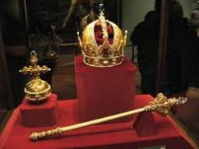
Genesis 49:10
“The scepter shall not depart from Judah, Nor the ruler’s staff from between his feet, Until Shiloh comes, And to him shall be the obedience of the peoples.”

Slide 24


Revelation 5:5
“and one of the elders said to me, “Stop weeping; behold, the Lion that is from the tribe of Judah, the Root of David, has overcome so as to open the book and its seven seals.”

Slide 25
Genesis 46:12
Judah
      3 sons through wife (12a)
      2 sons through Tamar (12b)
      2 grandsons through Perez (12c)

Slide 26
Genesis 46:12
Judah
      3 sons through wife (12a)
      2 sons through Tamar (12b)
      2 grandsons through Perez (12c)

Slide 27
Genesis 46:12
Judah
      3 sons through wife (12a)
      2 sons through Tamar (12b)
      2 grandsons through Perez (12c)

Slide 28
Genesis 37‒50
Joseph
  Joseph sold unto Egypt (37)
  Canaan’s corruption (38)
  Joseph falsely accused (39)
  Joseph’s short-term predictions (40)
  Joseph’s elevation (41)
  Joseph’s first reunion with his brothers (42)
  Joseph’s second reunion with his brothers (43‒45)
  Sojourn to Egypt (46:1‒47:12)

Slide 29
Genesis 46:12
Judah
      3 sons through wife (12a)
      2 sons through Tamar (12b)
      2 grandsons through Perez (12c)

Slide 30
Genesis 46:8b-15
Leah’s Sons
      Reuben (8b-9)
      Simeon’s 6 sons (10)
      Levi’s 3 sons (11)
      Judah (12)
      Issachar’s 4 sons (13)
      Zebulun’s 3 sons (14)
      Summary statement (15)

Slide 31
Genesis 46:8b-15
Leah’s Sons
      Reuben (8b-9)
      Simeon’s 6 sons (10)
      Levi’s 3 sons (11)
      Judah (12)
      Issachar’s 4 sons (13)
      Zebulun’s 3 sons (14)
      Summary statement (15)

Slide 32
Genesis 46:8b-15
Leah’s Sons
      Reuben (8b-9)
      Simeon’s 6 sons (10)
      Levi’s 3 sons (11)
      Judah (12)
      Issachar’s 4 sons (13)
      Zebulun’s 3 sons (14)
      Summary statement (15)

Slide 33


Slide 34


Dr. Arnold G. Fruchtenbaum
The Book of Genesis, 608
“All these names add up to thirty-two, but the figure thirty-three also counts Jacob. So the figure thirty-three includes: Jacob, six of his sons, 24 grandsons (not including the two who died), and two great grandsons.”

Slide 35
II. Genesis 46:8-27
House of Jacob
    Introduction (8a)
    Leah’s sons (8b-15)
    Sons through Zilpah (16-18)
    Rachel’s sons (19-22)
    Sons through Bilhah (23-25)
    Grand total (26-27)

Slide 38
Genesis 46:16-18
Sons Through Zilpah
      Gad’s 7 sons (16)
      Asher (17)
      Summary statement (18)

Slide 39
Genesis 46:16-18
Sons Through Zilpah
      Gad’s 7 sons (16)
      Asher (17)
      Summary statement (18)

Slide 40
Genesis 46:16-18
Sons Through Zilpah
      Gad’s 7 sons (16)
      Asher (17)
      Summary statement (18)

Slide 41
Genesis 46:17
Asher
      Asher’s 4 sons (17a)
      Daughter (17b)
      2 grandsons (17c)

Slide 42
Genesis 46:17
Asher
      Asher’s 4 sons (17a)
      Daughter (17b)
      2 grandsons (17c)

Slide 43
Genesis 46:17
Asher
      Asher’s 4 sons (17a)
      Daughter (17b)
      2 grandsons (17c)

Slide 44
Genesis 46:17
Asher
      Asher’s 4 sons (17a)
      Daughter (17b)
      2 grandsons (17c)

Slide 45
Genesis 46:16-18
Sons Through Zilpah
      Gad’s 7 sons (16)
      Asher (17)
      Summary statement (18)

Slide 48
Dr. Arnold G. Fruchtenbaum
The Book of Genesis, 609
“Verse 18 presents the summary: These are the sons of Zilpah, whom Laban gave to Leah his daughter; these she bore unto Jacob, even sixteen souls. The figure sixteen counts two sons, their eleven grandsons, one granddaughter, and two great grandsons.”

Slide 49
II. Genesis 46:8-27
House of Jacob
    Introduction (8a)
    Leah’s sons (8b-15)
    Sons through Zilpah (16-18)
    Rachel’s sons (19-22)
    Sons through Bilhah (23-25)
    Grand total (26-27)

Slide 50
Genesis 46:19-22
Rachel’s Sons
      Introductory statement (19a)
      Rachel’s 2 sons (19b)
      Joseph’s 2 sons (20)
      Benjamin’s 10 sons (21)
      Summary statement (22)

Slide 51
Genesis 46:19-22
Rachel’s Sons
      Introductory statement (19a)
      Rachel’s 2 sons (19b)
      Joseph’s 2 sons (20)
      Benjamin’s 10 sons (21)
      Summary statement (22)

Slide 54
Genesis 46:19-22
Rachel’s Sons
      Introductory statement (19a)
      Rachel’s 2 sons (19b)
      Joseph’s 2 sons (20)
      Benjamin’s 10 sons (21)
      Summary statement (22)

Slide 55
Genesis 46:19-22
Rachel’s Sons
      Introductory statement (19a)
      Rachel’s 2 sons (19b)
      Joseph’s 2 sons (20)
      Benjamin’s 10 sons (21)
      Summary statement (22)

Slide 56
Genesis 46:19-22
Rachel’s Sons
      Introductory statement (19a)
      Rachel’s 2 sons (19b)
      Joseph’s 2 sons (20)
      Benjamin’s 10 sons (21)
      Summary statement (22)

Slide 57
Genesis 46:19-22
Rachel’s Sons
      Introductory statement (19a)
      Rachel’s 2 sons (19b)
      Joseph’s 2 sons (20)
      Benjamin’s 10 sons (21)
      Summary statement (22)

Slide 58
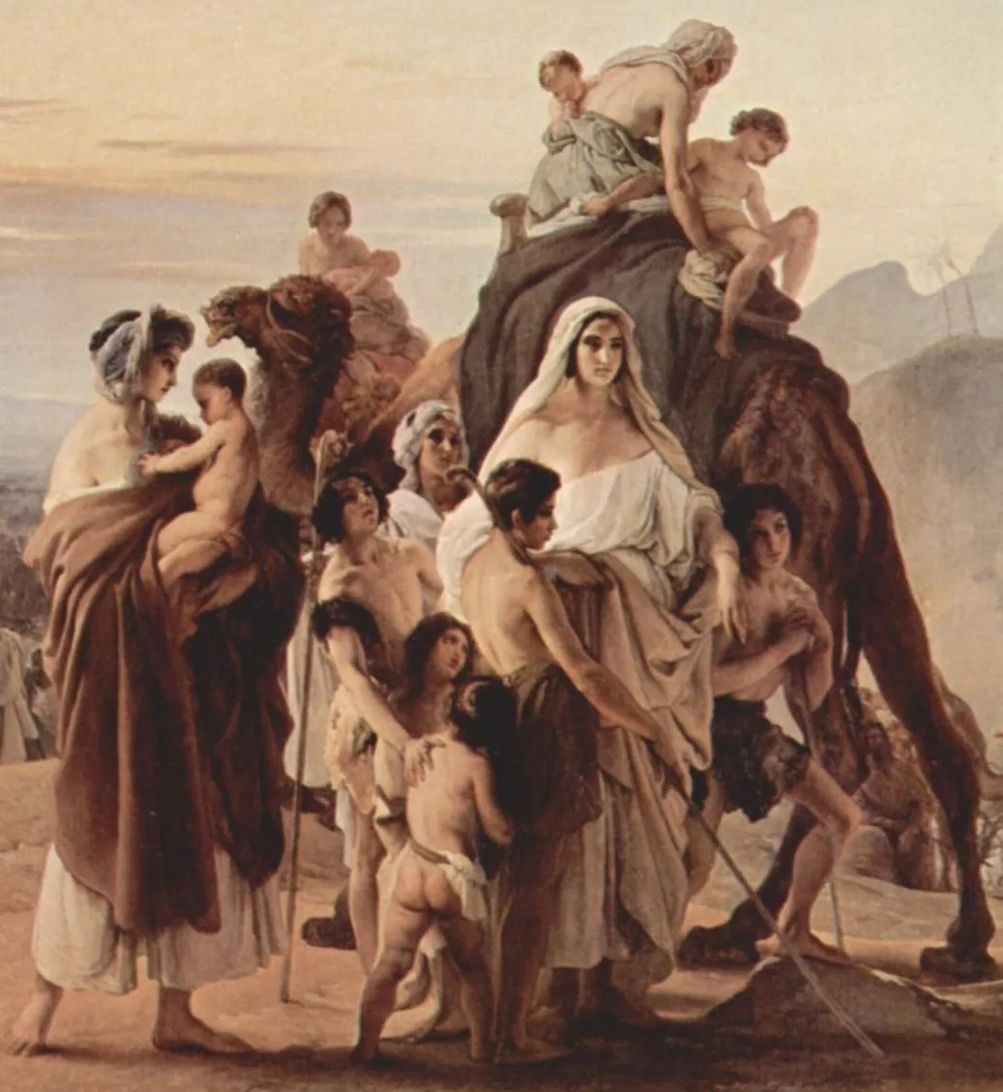
Dr. Arnold G. Fruchtenbaum
The Book of Genesis, 609
“Verse 22 makes the summary statement: These are the sons of Rachel, who were born to Jacob: all the souls were fourteen. The fourteen includes two sons and twelve grandsons.”

Slide 59
II. Genesis 46:8-27
House of Jacob
    Introduction (8a)
    Leah’s sons (8b-15)
    Sons through Zilpah (16-18)
    Rachel’s sons (19-22)
    Sons through Bilhah (23-25)
    Grand total (26-27)

Slide 62
Genesis 46:23-25
Sons Through Bilhah
      Dan’s 1 son (23)
      Naphtali’s 4 sons (24)
      Summary statement (25)

Slide 63
Genesis 46:23-25
Sons Through Bilhah
      Dan’s 1 son (23)
      Naphtali’s 4 sons (24)
      Summary statement (25)

Slide 64
Genesis 46:23-25
Sons Through Bilhah
      Dan’s 1 son (23)
      Naphtali’s 4 sons (24)
      Summary statement (25)

Slide 65
Genesis 46:23-25
Sons Through Bilhah
      Dan’s 1 son (23)
      Naphtali’s 4 sons (24)
      Summary statement (25)

Slide 68
Dr. Arnold G. Fruchtenbaum
The Book of Genesis, 610
“Then in verse 25 is the summary statement: These are the sons of Bilhah, whom Laban gave unto Rachel his daughter, and these she bore unto Jacob: all the souls were seven, counting two sons and five grandsons.”

Slide 69
II. Genesis 46:8-27
House of Jacob
    Introduction (8a)
    Leah’s sons (8b-15)
    Sons through Zilpah (16-18)
    Rachel’s sons (19-22)
    Sons through Bilhah (23-25)
    Grand total (26-27)

Slide 70
Genesis 46:26-27
Grand Total of Jacob’s Family
      Total: 66 (26)
      Total: 70 (27)

Slide 71
Genesis 46:26-27
Grand Total of Jacob’s Family
      Total: 66 (26)
      Total: 70 (27)

Slide 72
Dr. Arnold G. Fruchtenbaum
The Book of Genesis, 610
“Verse 26 gives the figure sixty-six (66): All the souls that came with Jacob into Egypt, that came out of his loins, meaning counting only those who were direct descendants of Jacob, with the exception besides Jacob’s sons’ wives, in other words, not counting the wives of his sons: all the souls were three score and six [66]. This figure counts only the children outside Egypt and excludes Jacob, Joseph, and the two sons of Joseph.”

Slide 73
Genesis 46:26-27
Grand Total of Jacob’s Family
      Total: 66 (26)
      Total: 70 (27)

Slide 74
Dr. Arnold G. Fruchtenbaum
The Book of Genesis, 610-611
“Therefore, the figure seventy includes only Jacob and his immediate descendants: Jacob, twelve sons, fifty-one grandsons, two great grandsons, one daughter, one granddaughter, one unnamed daughter of Leah, and one unnamed granddaughter. If one begins to add the servants and wives plus the women and children absorbed from Shechem (34:29), probably the entire figure would be about three hundred or more. In Acts 7:14, Stephen gave a total figure of seventy-five (75), a figure taken from the Septuagint section of Genesis 46:27 and Exodus 1:5, a…

Slide 75
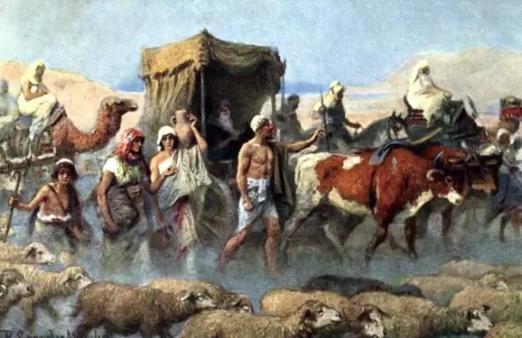
Dr. Arnold G. Fruchtenbaum
The Book of Genesis, 610-611
. . .figure also supported by the Dead Sea Scrolls. These add to the figure of seventy the five grandsons of Joseph: the son and grandson of Manasseh and the two sons of Ephraim (Num. 26:28–37, I Chron. 7:14–27).”

Slide 76
Conclusion

Slide 77
II. Genesis 46:8-27
House of Jacob
    Introduction (8a)
    Leah’s sons (8b-15)
    Sons through Zilpah (16-18)
    Rachel’s sons (19-22)
    Sons through Bilhah (23-25)
    Grand total (26-27)

Slide 78

²⁴ The Lord bless you, and keep you; ²⁵ The Lord make His face shine on you, And be gracious to you; ²⁶ The Lord lift up His countenance on you, And give you peace.
Numbers 6:24–26 (NASB95)

