Slide 2
Acts 9:1-43 Saul’s Conversion
Saul (9:1-31)
Peter (Acts 9:32-43)

Slide 3
II. Peter Acts 9:32-43
Lydda (32-35)
Joppa (36-43)

Slide 4
Acts 9:36-43 Joppa
Place (36)
Dorcas’ death (37)
Peter fetched (38)
Peter & mourners’ responses (39)
Miracle (40-41)
Word spreads (42)
Peter stays at Tanner’s home (43)

Slide 5
Acts 9:36-43 Joppa
Place (36)
Dorcas’ death (37)
Peter fetched (38)
Peter & mourners’ responses (39)
Miracle (40-41)
Word spreads (42)
Peter stays at Tanner’s home (43)

Slide 6
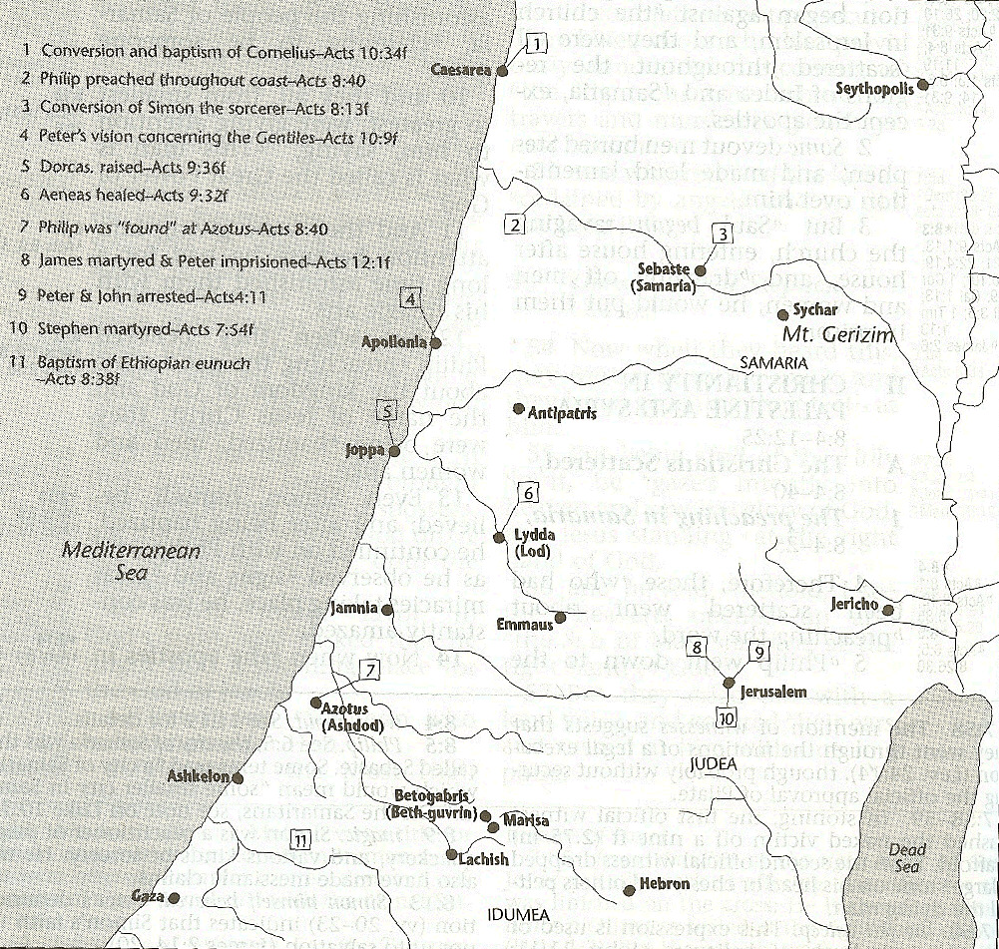

Slide 8
Luke 1:1–4
¹ Inasmuch as many have undertaken to compile an account of the things accomplished among us, ² just as they were handed down to us by those who from the beginning were eyewitnesses and servants of the word, ³ it seemed fitting for me as well, having investigated everything carefully from the beginning, to write it out for you in consecutive order, most excellent Theophilus; ⁴ so that you may know the exact truth about the things you have been taught.

Slide 9
Acts 9:36-43 Joppa
Place (36)
Dorcas’ death (37)
Peter fetched (38)
Peter & mourners’ responses (39)
Miracle (40-41)
Word spreads (42)
Peter stays at Tanner’s home (43)

Slide 10
Acts 9:36-43 Joppa
Place (36)
Dorcas’ death (37)
Peter fetched (38)
Peter & mourners’ responses (39)
Miracle (40-41)
Word spreads (42)
Peter stays at Tanner’s home (43)

Slide 12
Acts 9:36-43 Joppa
Place (36)
Dorcas’ death (37)
Peter fetched (38)
Peter & mourners’ responses (39)
Miracle (40-41)
Word spreads (42)
Peter stays at Tanner’s home (43)

Slide 13
Acts 9:36-43 Joppa
Place (36)
Dorcas’ death (37)
Peter fetched (38)
Peter & mourners’ responses (39)
Miracle (40-41)
Word spreads (42)
Peter stays at Tanner’s home (43)

Slide 14
Acts 9:40-41 Miracle
Isolation (40a)
Resuscitation (40b-41)

Slide 15
Acts 9:40-41 Miracle
Isolation (40a)
Resuscitation (40b-41)

Slide 16
Acts 9:40-41 Miracle
Isolation (40a)
Resuscitation (40b-41)

Slide 17
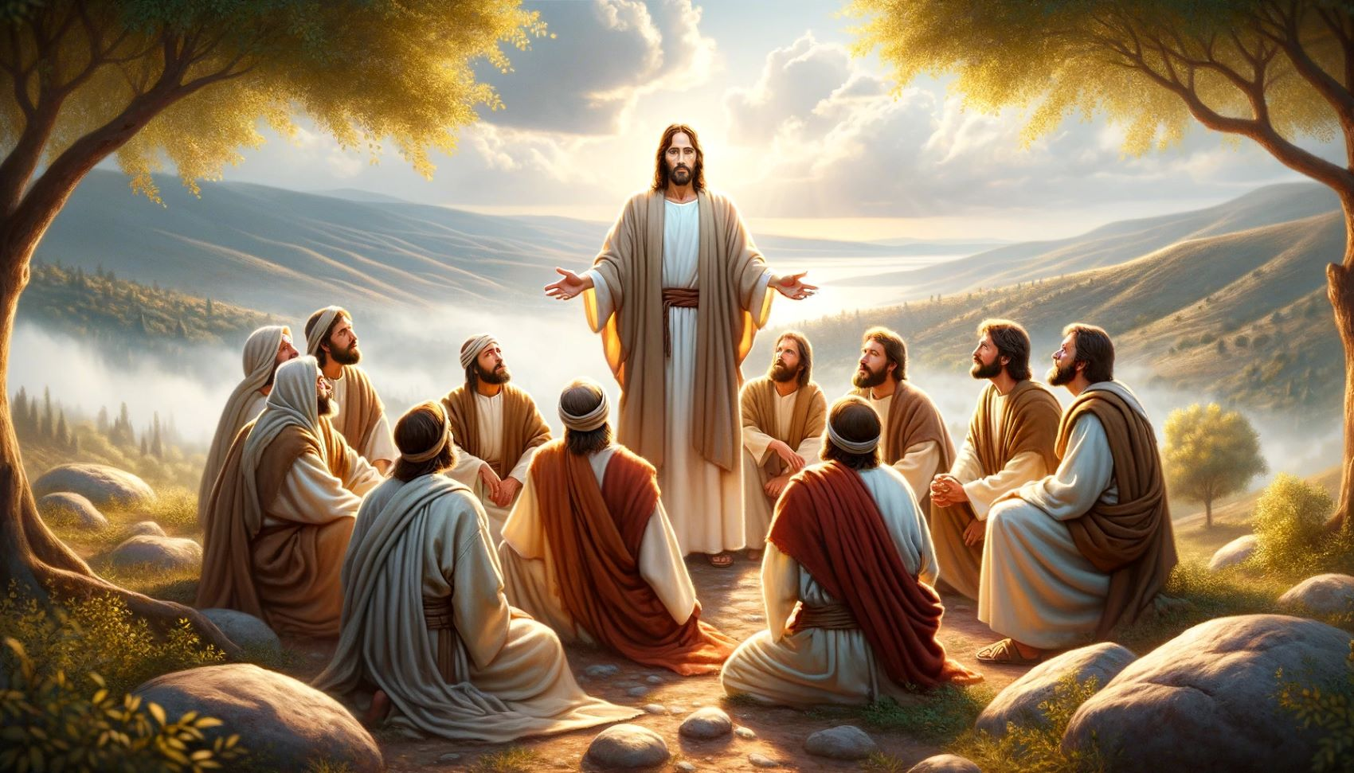
Dr. Arnold G. Fruchtenbaum
The Book of Acts, 224
“Again, it should be noted that while other believers were around, none of them performed the miracle. In Acts, only the apostles and their [de]legates (Acts 6:8; 8:6) perform signs and wonders.”

Slide 18
Acts 9:36-43 Joppa
Place (36)
Dorcas’ death (37)
Peter fetched (38)
Peter & mourners’ responses (39)
Miracle (40-41)
Word spreads (42)
Peter stays at Tanner’s home (43)

Slide 20
Acts 9:36-43 Joppa
Place (36)
Dorcas’ death (37)
Peter fetched (38)
Peter & mourners’ responses (39)
Miracle (40-41)
Word spreads (42)
Peter stays at Tanner’s home (43)

Slide 21
Conclusion

Slide 22
Acts 9:1-43 Saul’s Conversion
Saul (9:1-31)
Peter (Acts 9:32-43)

Slide 23
II. Peter Acts 9:32-43
Lydda (32-35)
Joppa (36-43)

Slide 24
Acts 9:36-43 Joppa
Place (36)
Dorcas’ death (37)
Peter fetched (38)
Peter & mourners’ responses (39)
Miracle (40-41)
Word spreads (42)
Peter stays at Tanner’s home (43)

