Slide 1
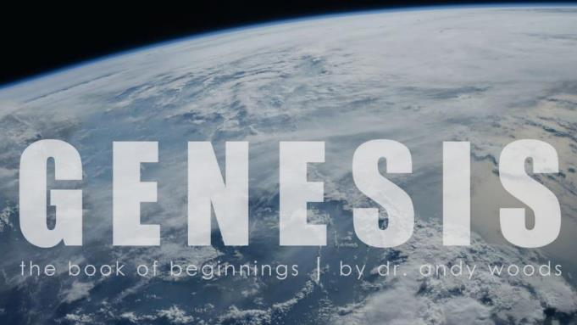
Genesis 12‒50
Israel’s Birth & Preservation

Slide 2
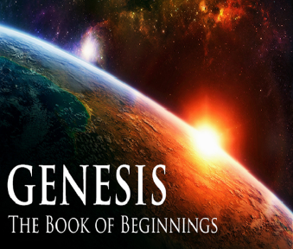
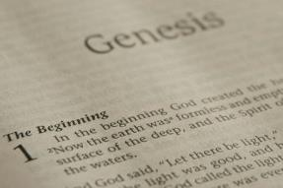
GENESIS STRUCTURE
Genesis 12-50 (four people)
Abraham (12:1–25:11)
Isaac (25:12–26:35)
Jacob (27–36)
Joseph (37–50)

Slide 3
Genesis 37‒50 Joseph
Joseph sold unto Egypt (37)
Canaan’s corruption (38)
Joseph falsely accused (39)
Joseph’s short-term predictions (40)
Joseph’s elevation (41)
Joseph’s first reunion with his brothers (42)
Joseph’s second reunion with his brothers (43‒45)
Sojourn to Egypt (46:1‒47:12)

Slide 4
Genesis 46:1‒47:12 Sojourn to Egypt
Divine Sanction (46:1-7)
House of Jacob (46:8-27)
Jacob Arrives in Egypt (46:28-34)
Jacob’s Family Before Pharaoh (47:1-10)
Settlement in Goshen (47:11-12)

Slide 5
Genesis 46:1‒47:12 Sojourn to Egypt
Divine Sanction (46:1-7)
House of Jacob (46:8-27)
Jacob Arrives in Egypt (46:28-34)
Jacob’s Family Before Pharaoh (47:1-10)
Settlement in Goshen (47:11-12)

Slide 6
I. Genesis 46:1-7 Divine Sanction
Starting point (1)
God’s revelation to Jacob (2-4)
Family arrives in Egypt (5-7)

Slide 7
I. Genesis 46:1-7 Divine Sanction
Starting point (1)
God’s revelation to Jacob (2-4)
Family arrives in Egypt (5-7)

Slide 8
Genesis 46:1 Starting Point
Family’s departure (1)
Arrival in Beersheba (1b)
Jacob’s sacrifices (1c)

Slide 9
Genesis 46:1 Starting Point
Family’s departure (1)
Arrival in Beersheba (1b)
Jacob’s sacrifices (1c)

Slide 10
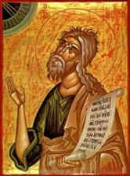
Jeremiah 30:7
“Alas! for that day is great, There is none like it; And it is the time of Jacob’s distress (Gen. 32:8; 35:10), But he will be saved from it.”

Slide 11
Genesis 46:1 Starting Point
Family’s departure (1)
Arrival in Beersheba (1b)
Jacob’s sacrifices (1c)

Slide 12
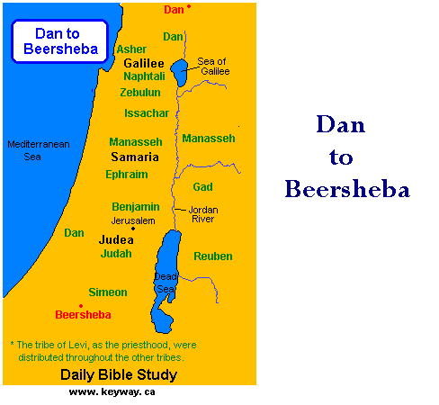

Slide 13
Genesis 46:1 Starting Point
Family’s departure (1)
Arrival in Beersheba (1b)
Jacob’s sacrifices (1c)

Slide 14
I. Genesis 46:1-7 Divine Sanction
Starting point (1)
God’s revelation to Jacob (2-4)
Family arrives in Egypt (5-7)

Slide 15
Genesis 46:2-4 God’s Revelation to Jacob
Means (2a)
Call (2b)
Response (2c)
Abrahamic Covenant Reconfirmed (3)
Exodus Promise (4)

Slide 16
Genesis 46:2-4 God’s Revelation to Jacob
Means (2a)
Call (2b)
Response (2c)
Abrahamic Covenant Reconfirmed (3)
Exodus Promise (4)

Slide 17
Zechariah Structure
Introductory call to repentance (1:1-6)
Eight-night visions (1:7–6:15)
Question and answers about fasting (7–8)
Two burdens (9–14)

Slide 18
II. Eight Night Visions (1:7‒6:15)
Riders & horses among the myrtle trees (1:7-17)
Four horns & four craftsmen (1:18-21)
Man with the measuring line (2)
Cleansing of the High Priest Joshua (3)
Lampstand & olive tree (4)
Flying scroll (5:1-4)
Woman in the basket (5:5-11)
Four chariots (6:1-8)
Conclusion: crowning of Joshua (6:9-15)

Slide 19
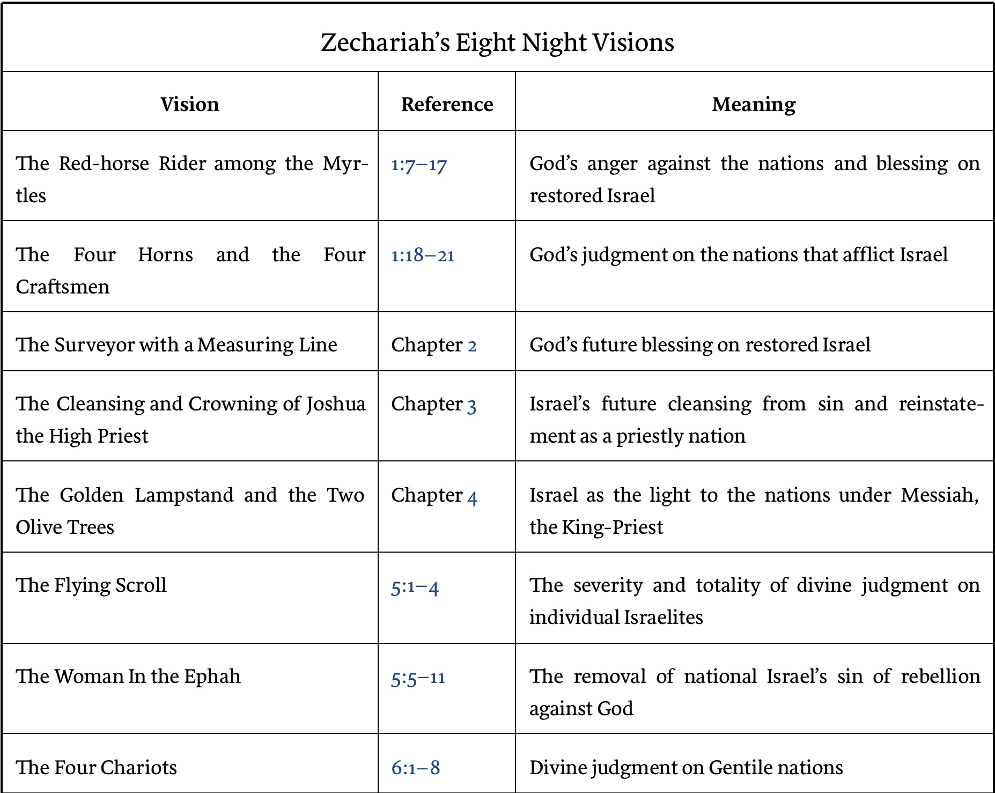

Slide 20
Genesis 46:2-4 God’s Revelation to Jacob
Means (2a)
Call (2b)
Response (2c)
Abrahamic Covenant Reconfirmed (3)
Exodus Promise (4)

Slide 21
Genesis 46:2-4 God’s Revelation to Jacob
Means (2a)
Call (2b)
Response (2c)
Abrahamic Covenant Reconfirmed (3)
Exodus Promise (4)

Slide 22
Genesis 46:2-4 God’s Revelation to Jacob
Means (2a)
Call (2b)
Response (2c)
Abrahamic Covenant Reconfirmed (3)
Exodus Promise (4)

Slide 24
Genesis 46:3 Reconfirmation of the Abrahamic Covenant
Covenant maker (3a)
Reconfirmation (3b)
Promise of a great nation (3c)

Slide 25
Genesis 46:3 Reconfirmation of the Abrahamic Covenant
Covenant maker (3a)
Reconfirmation (3b)
Promise of a great nation (3c)

Slide 26
Genesis 46:3 Reconfirmation of the Abrahamic Covenant
Covenant maker (3a)
Reconfirmation (3b)
Promise of a great nation (3c)

Slide 27
Genesis 15:16
“Then in the fourth generation they will return here, for the wrongdoing of the Amorite is not yet complete.”

Slide 28
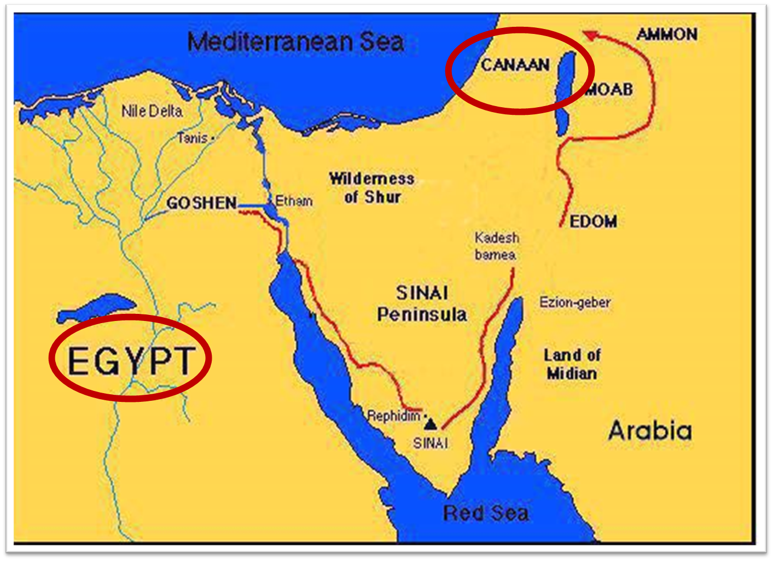

Slide 30
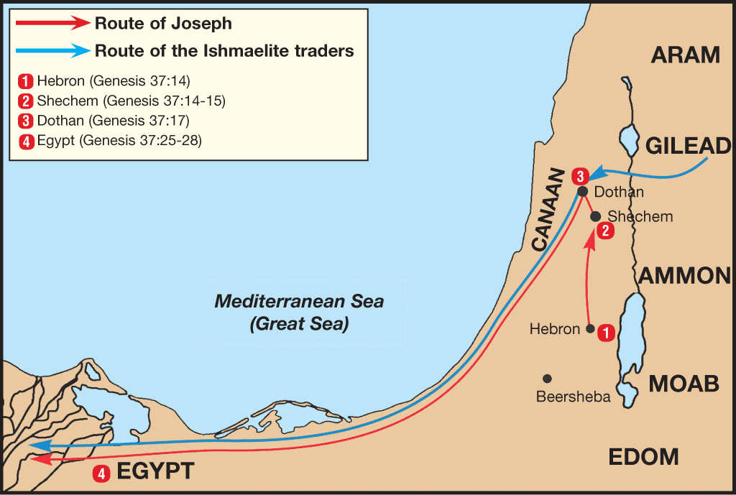

Slide 31
Genesis 46:3 Reconfirmation of the Abrahamic Covenant
Covenant maker (3a)
Reconfirmation (3b)
Promise of a great nation (3c)

Slide 32
8 New Promises Genesis 12:1-3
Land (Gen. 12:1b)
Great nation (Gen. 12:2a)
Personal blessing (Gen. 12:2b)
Great name (Gen. 12:2c)
Blessing to others (Gen. 12:2d)
Blessing to blessers (Gen. 12:3a)
Cursing to cursers (Gen. 12:3b)
Blessing to the world (Gen. 12:3c)

Slide 33
Genesis 46:2-4 God’s Revelation to Jacob
Means (2a)
Call (2b)
Response (2c)
Abrahamic Covenant Reconfirmed (3)
Exodus Promise (4)

Slide 34
Genesis 46:4 Exodus Promise
God’s presence (4a)
God will bring you back (4b)
Promise of comfort (4c)

Slide 35
Genesis 46:4 Exodus Promise
God’s presence (4a)
God will bring you back (4b)
Promise of comfort (4c)

Slide 36
John 14:16-17
¹⁶ I will ask the Father, and He will give you another Helper, that He may be with you forever; ¹⁷ that is the Spirit of truth, whom the world cannot receive, because it does not see Him or know Him, but you know Him because He abides with you and will be in you.

Slide 37
Genesis 46:4 Exodus Promise
God’s presence (4a)
God will bring you back (4b)
Promise of comfort (4c)

Slide 38
Genesis 15:16
“Then in the fourth generation they will return here, for the wrongdoing of the Amorite is not yet complete.”

Slide 39
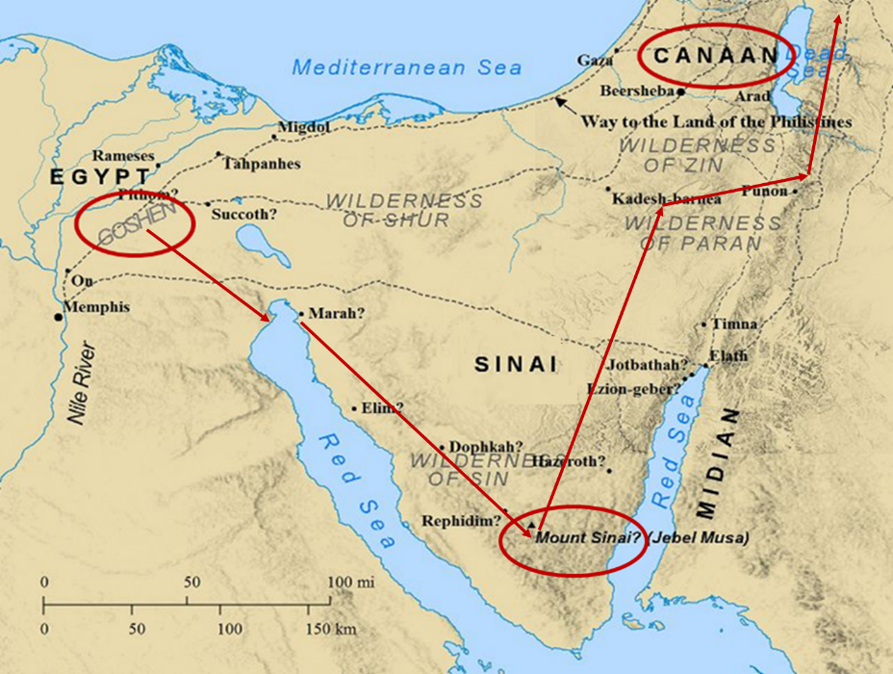

Slide 40
Genesis 46:4 Exodus Promise
God’s presence (4a)
God will bring you back (4b)
Promise of comfort (4c)

Slide 41
I. Genesis 46:1-7 Divine Sanction
Starting point (1)
God’s revelation to Jacob (2-4)
Family arrives in Egypt (5-7)

Slide 42
Genesis 46:5-7 Family’s Arrival in Egypt
Departure to Egypt from Beersheba (5a)
Means: wagon (5b)
Goods (6a)
Arrival in Egypt (6b)
Family (6c-7)

Slide 43
Genesis 46:5-7 Family’s Arrival in Egypt
Departure to Egypt from Beersheba (5a)
Means: wagon (5b)
Goods (6a)
Arrival in Egypt (6b)
Family (6c-7)

Slide 48
Genesis 46:5-7 Family’s Arrival in Egypt
Departure to Egypt from Beersheba (5a)
Means: wagon (5b)
Goods (6a)
Arrival in Egypt (6b)
Family (6c-7)

Slide 49
Genesis 46:5-7 Family’s Arrival in Egypt
Departure to Egypt from Beersheba (5a)
Means: wagon (5b)
Goods (6a)
Arrival in Egypt (6b)
Family (6c-7)

Slide 50
Genesis 46:5-7 Family’s Arrival in Egypt
Departure to Egypt from Beersheba (5a)
Means: wagon (5b)
Goods (6a)
Arrival in Egypt (6b)
Family (6c-7)

Slide 54
Genesis 46:5-7 Family’s Arrival in Egypt
Departure to Egypt from Beersheba (5a)
Means: wagon (5b)
Goods (6a)
Arrival in Egypt (6b)
Family (6c-7)

Slide 55
Age of the Earth?
971-931 BC = Solomonic reign
966 = Solomon rebuilds temple (1 Kgs 6:1b)
- 480 years for the Exodus’ date (1 Kgs 6:1a)
= 1446 BC for Exodus’ date
- 430 years for Jacob’s migration to Egypt (Exod 12:40)
= 1876 BC for Jacob’s migration to Egypt (Gen 46)
Genealogies of Gen 5; 11
= 4000 BC for the earth’s age

Slide 56
1 Kings 6:1
“Now it came about in the four hundred and eightieth year after the sons of Israel came out of the land of Egypt, in the fourth year of Solomon’s reign over Israel, in the month of Ziv which is the second month, that he began to build the house of the Lord.”

Slide 57
Exodus 12:40-41
“⁴⁰ Now the time that the sons of Israel lived in Egypt was four hundred and thirty years. ⁴¹ And at the end of four hundred and thirty years, to the very day, all the hosts of the Lord went out from the land of Egypt.”

Slide 58
Conclusion

Slide 59
Genesis 46:1‒47:12 Sojourn to Egypt
Divine Sanction (46:1-7)
House of Jacob (46:8-27)
Jacob Arrives in Egypt (46:28-34)
Jacob’s Family Before Pharaoh (47:1-10)
Settlement in Goshen (47:11-12)

Slide 60
I. Genesis 46:1-7 Divine Sanction
Starting point (1)
God’s revelation to Jacob (2-4)
Family arrives in Egypt (5-7)

Slide 61
²⁴ The Lord bless you, and keep you; ²⁵ The Lord make His face shine on you, And be gracious to you; ²⁶ The Lord lift up His countenance on you, And give you peace.
Numbers 6:24–26 (NASB95)

