Slide 2
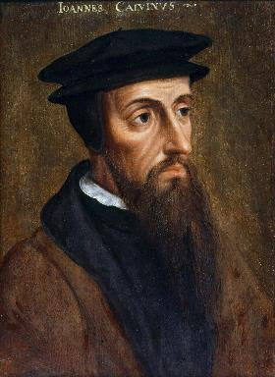
Neo-Calvinism vs. The Bible
Calvinism’s Mixed Blessing
Why Critique Calvinism?
The Source of Calvin’s Theology
Calvin’s Manner of Life
TULIP Through the Grid of Scripture
Conclusion

Slide 3
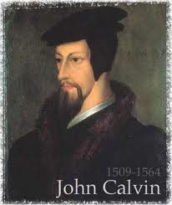
II. Why Critique Calvinism?
General calling to defend the faith (Jude 3)
The call to admonish fellow believers (2 Thess. 3:15)
Calvinism is a serious issue
The prophetic implications of Calvinism

Slide 4
The Prophetic Implications of Calvinism
De-emphasis of Biblical Eschatology
Calvin’s mishandling of prophetic texts
Anti-Semitism
Implications of a lack of an Israel‒Church distinction
Neo-Calvinism as a fulfillment of Bible prophecy

Slide 5
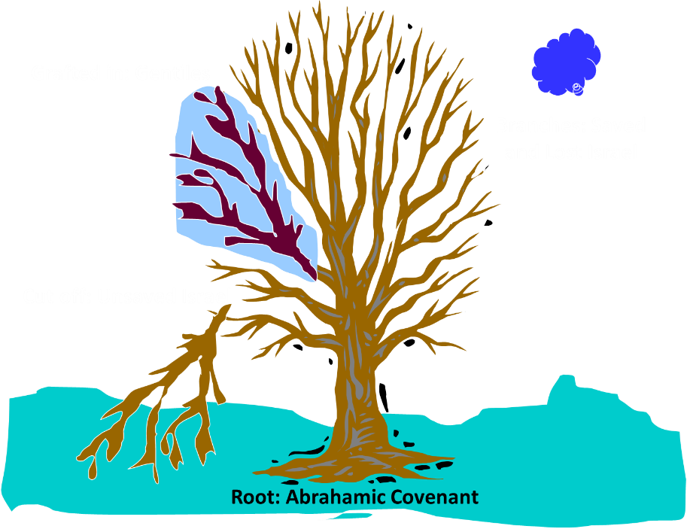
Notes:
5

Slide 6
Romans 11:13, 17-21
“But I am speaking to you who are Gentiles. Inasmuch then as I am an apostle of Gentiles, I magnify my ministry…But if some of the branches were broken off, and you, being a wild olive, were grafted in among them and became partaker with them of the rich root of the olive tree, ¹⁸ do not be arrogant toward the branches; but if you are arrogant, remember that it is not you who. . .

Slide 7
Romans 11:13, 17-21
. . . supports the root, but the root supports you. ¹⁹ You will say then, “Branches were broken off so that I might be grafted in.” ²⁰ Quite right, they were broken off for their unbelief, but you stand by your faith. Do not be conceited, but fear; ²¹ for if God did not spare the natural branches, He will not spare you, either.”

Slide 8
Romans 11:28-29
“²⁸ From the standpoint of the gospel they are enemies for your sake, but from the standpoint of God’s choice they are beloved for the sake of the fathers; ²⁹ for the gifts and the calling of God are irrevocable.”

Slide 9
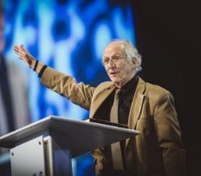
John Piper
John Piper, cited in Paul R. Wilkinson, Israel Betrayed: Volume 2: The Rise of Christian Palestinianism (San Antonio, TX: Ariel, 2018), 331-32.
“[God] has a saving purpose for Israel. All Israel will someday turn to the Lord Christ as a group. This is my deep understanding in belief of Romans 11. The broken off branches will be grafted in one day to the people of God, the bride of Christ, His church.”

Slide 10
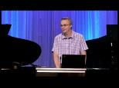
Paul Wilkinson
Paul R. Wilkinson, Israel Betrayed: Volume 2: The Rise of Christian Palestinianism (San Antonio, TX: Ariel, 2018), 332.
“On the basis of this kind of statement, many in the church are being misled into believing that Piper stands with Israel, but he does not. What Piper said is not what Paul taught. Israel’s destiny as a nation is not one of spiritual incorporation into the church, which is the classic Reformed, Calvinistic teaching. The church comprises individual Jews and Gentiles, not ‘Israel,’ which is a distinct national entity. The appointed destiny for Israel is for her to remain a nation in the sight of God and in the midst of all the nations, for as long as God’s ‘fixed order’ of creation endures (Jer. 31:36).”

Slide 11
Jeremiah 31:35-37
“Thus says the Lord, Who gives the sun for light by day And the fixed order of the moon and the stars for light by night, Who stirs up the sea so that its waves roar; The Lord of hosts is His name:³⁶ “If this fixed order departs From before Me,” declares the Lord, “Then the offspring of Israel also will cease From being a nation before Me forever.”³⁷ Thus says the Lord, “If the heavens above can be measured And the foundations of the earth searched out below, Then I will also cast off all the offspring of Israel For all that they have done,” declares the Lord.”

Slide 12
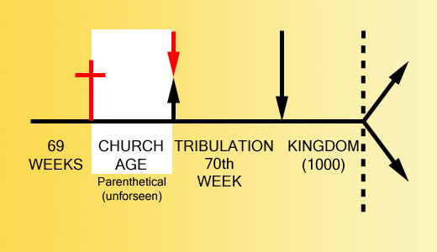

Slide 13
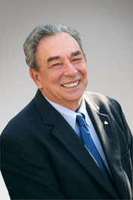
THE NEW ISRAEL?
“We’re not dispensationalists here....We believe that the church is essentially Israel. We believe that the answer to, ‘What about the Jews?’ is, ‘Here we are.’ We deny that the church is God’s ‘plan B.’ We deny that we are living in God’s redemptive parenthesis. There, we are again one people. In His holy and heavenly temple there is neither Jew nor Greek, male nor female, pre-mil nor post-mil. There, we are all together, the Israel of God, princes with God, and the ekklesia, the set apart ones.”
From Table Talk magazine, Spring of 1999, p. 2 (inside cover), by R. C. Sproul Jr., editor, emphasis is mine

Slide 14
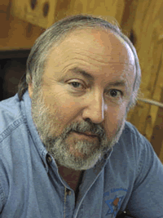
Arnold G. Fruchtenbaum George Zeller, “Is R. C. Sproul Jr. Really A Jew?,” online: http://www.middletownbiblechurch.org/reformed/sprouljr.htm, accessed 17 February 2018.
“We believe that the answer to, ‘What about the Jews?’ is, ‘Here we are.’ I shared this comment with a friend of mine who is a converted Jew. He was born in Russia after his parents were released from a Communist prison. With the help of the Israeli underground, his family escaped from behind the Iron Curtain. He received Orthodox Jewish training while living in Germany from 1947 to 1951 and then his family immigrated to New York. He is a dedicated servant of Christ and a respected author. When told about Sproul Jr.’s comment ‘Here we are. [We are the Jews]’ he commented, ‘It’s a good thing he was not declaring this on the streets of Berlin, Germany around 1941!’”

Slide 15
Preterism Advocates
Recent Preterist Commentators
R.C. Sproul
N.T. Wright
Scott Hahn
J. Massyngbaerde Ford
David Chilton
Hank Hanegraaff
Kenneth Gentry

Slide 16
The Prophetic Implications of Calvinism
De-emphasis of Biblical Eschatology
Calvin’s mishandling of prophetic texts
Anti-Semitism
Implications of a lack of an Israel‒Church distinction
Neo-Calvinism as a fulfillment of Bible prophecy

Slide 17
Dispensational Theology is a System of Theology
Traditional-normative dispensational theology is a system that embodies three essential, fundamental concepts called the sine qua non (lit. “without which is not”):
The consistent use of a plain, normal, literal, grammatical-historical method of interpretation;
Which reveals that the Church is distinct from Israel;
God’s overall purpose is to bring glory to Himself (Eph. 1:6, 12, 14).
Dr. Charles Ryrie, Dispensationalism, pp. 38-41

Slide 19
Augustine
The City of God, trans., Marcus Dods (NY: Random House, 1950), Book XX, chap. 9, p. 725-26.
Augustine wrote, “the saints reign with Christ during the same thousand years, understood in the same way, that is, of the time of His first coming” and “Therefore the Church even now is the kingdom of Christ, and the kingdom of heaven. Accordingly, even now His saints reign with Him.”

Slide 20
Augustine
The City of God, trans., Marcus Dods (NY: Random House, 1950), Book XX, chap. 7, p. 719.
“And this opinion would not be objectionable…for I myself, too, once held this opinion. But, as they assert that those who then rise again shall enjoy the leisure of immoderate carnal banquets, furnished with an amount of meat and drink such as not only to shock the feeling of the temperate, but even to surpass the measure of credulity itself, such assertions can be believed only by the carnal. They who do believe them are called by the spiritual Chiliasts, which we may literally reproduce by the name Millenarians.”

Slide 21
John Calvin
Institutes of the Christian Religion, III, xxv, 5.
“But Satan has not only befuddled men’s senses to make them bury with the corpses the memory of resurrection; he has also attempted to corrupt this part of the doctrine with various falsifications…Now their fiction is too childish either to need or to be worth a refutation. And the Apocalypse, from which they undoubtedly drew a pretext for their error, does not support them. For the number ‘one thousand’ [Rev. 20:4] does not apply to the eternal blessedness of the church but only to the various disturbances that awaited the church, while still toiling on earth…Those who assign the children of God a thousand years in which to enjoy the inheritance of the life to come do not realize how much reproach they are casting upon Christ and his Kingdom.”

Slide 22
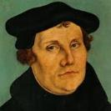
Martin Luther
Alister E. McGrath, Reformation Thought: An Introduction (Grand Rapids: Baker, 1995), 179.
He believed that “such sacraments could generate faith; and hence baptism could generate faith of an infant.”
Notes:
Outline

Slide 23
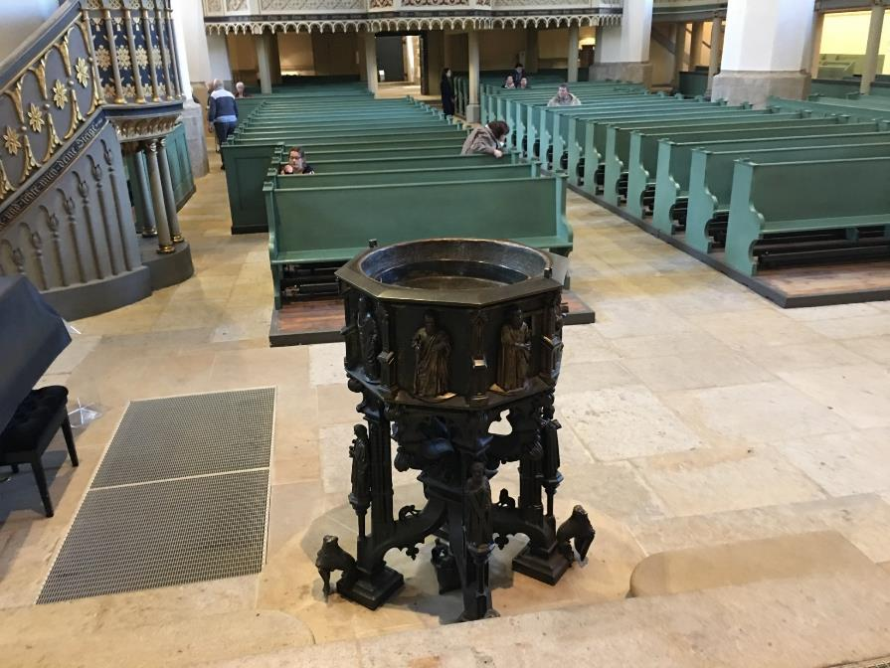

Slide 24
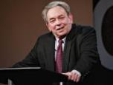
R.C. Sproul
https://www.ligonier.org/learn/devotionals/the-infant-baptism-question/
“The Eastern Orthodox, Roman Catholic, Lutheran, Anglican, and Reformed churches all practice infant baptism. Today we want to look at…lines of evidence that show the validity of this practice. …just as baptism is the sign of entrance into the community of the new covenant, so circumcision was the sign of entrance into the core community of the old covenant (the people of Israel; God-fearing Gentiles did not have to be circumcised).…The absence of controversy anywhere in the early church indicates that the church was comfortable with infant baptism, and was carrying on the apostolic tradition of the New Testament.”

Slide 25
Alva J. McClain Alva J. McClain, The Greatness of the Kingdom: An Inductive Study of the Kingdom of God as Set Forth in the Scriptures (Grand Rapids: Zondervan, 1959), 438-39.
“Theological confusion, especially in matters which have to do with the church, will inevitably produce consequences which are of grave practical concern. The identification of the Kingdom with the church has led historically to ecclesiastical policies and programs which, even when not positively evil, have been far removed from the original simplicity of the New Testament ekklēssia. It is easy to claim that in the ‘present kingdom of grace’ that the rule of the saints is wholly ‘spiritual,’ exerted only through moral principles and influence. But practically, once the church becomes the Kingdom in any realistic theological sense, it is impossible to draw any clear line between principles and their implementation through political and social devices. For the logical implications of a present ecclesiastical kingdom are unmistakable, and historically have always led in one direction, i.e., political control of the state by the church.”

Slide 26
Alva J. McClain Alva J. McClain, The Greatness of the Kingdom: An Inductive Study of the Kingdom of God as Set Forth in the Scriptures (Grand Rapids: Zondervan, 1959), 438-39.
“The distances traveled down this road by various religious movements, and the forms of control which were developed, have been widely different. The difference is very great between the Roman Catholic system and modern Protestant efforts to control the state; also between the ecclesiastical rule of Calvin in Geneva and the fanaticism of Münster and the English ‘fifth-monarchy.’ But the basic assumption is always the same: The church in some sense is the kingdom, and therefore has a divine right to rule; or it is the business of the church to ‘establish’ fully the Kingdom of God among men. Thus the church loses its pilgrim character and the sharp edge of its divinely commissioned ‘witness’ is blunted. It becomes an ekklēssia which is not only in the world, but also of the world. It forgets that just as in the regeneration of the soul only God can effect the miracle, even so the ‘regeneration’ of the world can only be wrought by the intrusion of regal power from on high (Matt. 19:28).”

Slide 27
Philip Schaff
History of the Christian Church, vol. 8 , p. 700.
“The Reformers inherited the doctrine of persecution from their mother Church, and practiced it as far as they had the power. They fought intolerance with intolerance. They differed favorably from their opponents in the degree and extent, but not in the principle, of intolerance. They broke down the tyranny of popery, and thus opened the way for the development of religious freedom; but they denied to others the liberty which they exercised themselves. The Protestant governments in Germany and Switzerland excluded, within the limits of their jurisdiction, the Roman Catholics from all religious and civil rights, and took exclusive possession of their churches, convents, and other property. They banished, imprisoned, drowned, beheaded, hanged, and burned Anabaptists, Antitrinitarians, Schwenkfeldians, and other dissenters.”

Slide 28
Edward Gibbon
Decline and Fall, ch. LIV.
“The Reformers came out of Roman Catholicism which was known for its intolerance and persecution of anyone who differed from Catholic dogma, as anyone who has studied the Spanish Inquisition fully knows. The tragedy is that John Calvin and some of the other Reformers, became shamefully intolerant of those who differed from their doctrinal position, even to the point of executing the offender!” “The Reformers were ambitious of succeeding the tyrants whom they had dethroned. They imposed with equal rigor their creeds and confessions; they asserted the right of the magistrate to punish heretics with death. The nature of the tiger was the same...”
Initial quote by George Zeller, “Should We Go Back to the Reformation?” online: www.middletownbiblechurch.org/reformed/backto.htm, accessed 22 November 2019

Slide 29
Dave Hunt
“Calvinism Denied,” in Debating Calvinism: Five Points, Two Views, ed. Dave Hunt and James White (Sisters, OR: Multnomah, 2004), pp. 23-24.
“In February of 1555, Calvin’s supporters gained the absolute majority on the council [in Geneva]. On May 16, there was an attempted uprising because Calvin had excluded certain libertarian civic officials from the Lord’s Supper. Leaders of the rebellion who fled to Bern were sentenced to death in abstentia. Four who failed to escape were beheaded, quartered, and their body parts hung in strategic locations as a warning. Evoking the phrase ‘henchmen of Satan,’ which he had used years earlier against the Anabaptists, Calvin justified this barbarity by saying, ‘Those who do not correct evil when they can do so and their office requires it are guilty of it.’ From 1554 until his death in 1564, ‘no one any longer dared oppose the Reformer [Calvin] openly.’”

Slide 31
Dispensational Theology is a System of Theology
Traditional-normative dispensational theology is a system that embodies three essential, fundamental concepts called the sine qua non (lit. “without which is not”):
The consistent use of a plain, normal, literal, grammatical-historical method of interpretation;
Which reveals that the Church is distinct from Israel;
God’s overall purpose is to bring glory to Himself (Eph. 1:6, 12, 14).
Dr. Charles Ryrie, Dispensationalism, pp. 38-41

Slide 32
Premillennialism and Racism
“To understand this, we must account for the pre-millennial view that had come to dominate the American evangelical worldview and played a role in limiting evangelical social action on the race issues. According to this view, the present world is evil and will inevitably suffer moral decline until Christ comes again. Thus, to devote oneself to social reform is futile. The implications of this view were clearly expressed by Billy Graham. In response to King’s famous ‘I have a dream’ speech that his children might one day play together with white children, …
Michael O. Emerson and Christian Smith, Divided by Faith: Evangelical Religion and the Problem of Race in America (New York: Oxford University Press, 2000), 47.

Slide 33
Premillennialism and Racism (cont’d)
…Graham, who had been invited but did not attend the 1963 march on Washington, said: ‘only when Christ comes again will little white children of Alabama walk hand-in-hand with little black children.’ This was not meant to be harsh, but rather what he and most white evangelicals perceived to be realistic.”
Michael O. Emerson and Christian Smith, Divided by Faith: Evangelical Religion and the Problem of Race in America (New York: Oxford University Press, 2000), 47.

Slide 34
John MacArthur
John MacArthur Jr. writes:
“There is a tendency, however, for dispensationalists to get carried away with compartmentalizing truth to the point that they make unbiblical differentiations. An almost obsessive desire to categorize and contrast related truths has carried various dispensationalist interpreters (Chafer, Ryrie, Hodges, etc.) far beyond the legitimate distinctions between Israel and the Church. Many would also draw hard lines between salvation and discipleship (justification and sanctification), the church and the kingdom, Christ's preaching and the apostolic message, faith and repentance, and the age of law and the age of grace." (bold & emphasis mine) The Gospel According to Jesus, page 31

Slide 35
John MacArthur
“I was raised in a dispensational environment; there’s no question… But, as I got into seminary, I began to test some of those things. I have been perhaps aptly designated as a leaky dispensationalist…. Here’s my dispensationalism – I’ll give it to you in one sentence: there’s a difference between the church and Israel – period!...
At the same time in seminary, I began to be exposed to reading among more Reformed theologians… And over the years of exegeting the scripture, it has again yielded to me a Reformed theology….”

Slide 36
John MacArthur
“I was convinced of it (Reformed theology) when I started and I’m more convinced of it now as I’ve gone through the text. I was convinced of it when I started because I read so many noble men who have held that view (Reformed Theology). It was more at that point hero worship, and now it’s become my own.” (bold mine)
Transcribed from tape, #GC 70-15, entitled "Bible Questions and Answers." A copy of the tape can be obtained by writing, Word of Grace, P.O. Box 4000, Panorama City, CA 91412. Copyright 1994 by John MacArthur Jr., All Rights Reserved.
(My point here is only to demonstrate how John MacArthur, who claims to be a dispensationalist, has arrived at his position on Lordship salvation.)

Slide 37
John MacArthur
“When I wrote [GAJ] I didn’t know anybody outside of my circles really, and I didn’t know how this book would be received. But Jim Boice agreed to write the foreword, and John Piper wrote an endorsement that was absolutely stunning to me, because I was really not moving in Reformed circles at that time. I was a leaky dispensationalist. That was my world, and I realized that I was much more one of you than I was one of them.” Interview with John Piper and Justin Taylor, Stand, p. 129.

Slide 38
John MacArthur
“The lordship debate has had a devastating effect on dispensationalism. Because no-lordship theology [a pejorative term for Free Grace] is so closely associated with dispensationalism, many have imagined a cause-and-effect relationship between the two...Frankly, some mongrel species of dispensationalism [which he has defined as the Dispensationalism of Ryrie, Chafer, and others] ought to die, and I will be happy to join the cortege.” “The Gospel According to the Apostles,” page 221

Slide 39
John MacArthur
“Who are the defenders of no-lordship dispensationalism? Nearly all of them stand in a tradition that has its roots in the teaching of Lewis Sperry Chafer. I will show…that Dr. Chafer is the father of modern no-lordship teaching. Every prominent figure on the no-lordship side descends from Dr. Chafer’s spiritual lineage. Though Dr. Chafer did not invent or originate any of the key elements of no-lordship teaching, he codified the system of dispensationalism on which all contemporary no-lordship doctrine is founded. That system is the common link between those who attempt to defend no-lordship doctrine on theological grounds.” “The Gospel According to the Apostles,” page 35

Slide 40
The Prophetic Implications of Calvinism
De-emphasis of Biblical Eschatology
Calvin’s mishandling of prophetic texts
Anti-Semitism
Implications of a lack of an Israel‒Church distinction
Neo-Calvinism as a fulfillment of Bible prophecy

Slide 41
Calvinism as a Prophetic Fulfillment
Apostasy (1 Tim. 4:1; 2 Tim. 3:1-13)
Holds to a Form of Godliness (2 Tim. 3:5)
Works based salvation (2 Tim. 4:3-4)
Divides churches and families (Matt. 10:36)

Slide 42
Calvinism as a Prophetic Fulfillment
Apostasy (1 Tim. 4:1; 2 Tim. 3:1-13)
Holds to a Form of Godliness (2 Tim. 3:5)
Works based salvation (2 Tim. 4:3-4)
Divides churches and families (Matt. 10:36)

Slide 43
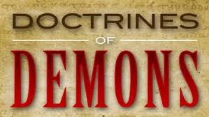
1 Timothy 4:1
“But the Spirit explicitly says that in later times some will fall away from the faith, paying attention to deceitful spirits and doctrines of demons.”

Slide 44
Calvinism as a Prophetic Fulfillment
Apostasy (1 Tim. 4:1; 2 Tim. 3:1-13)
Holds to a Form of Godliness (2 Tim. 3:5)
Works based salvation (2 Tim. 4:3-4)
Divides churches and families (Matt. 10:36)

Slide 45
2 Timothy 3:5
“holding to a form of godliness, although they have denied its power; Avoid such men as these.”

Slide 46
Calvinism as a Prophetic Fulfillment
Apostasy (1 Tim. 4:1; 2 Tim. 3:1-13)
Holds to a Form of Godliness (2 Tim. 3:5)
Works based salvation (2 Tim. 4:3-4)
Divides churches and families (Matt. 10:36)

Slide 47
2 Timothy 4:3-4
“³ For the time will come when they will not endure sound doctrine; but wanting to have their ears tickled, they will accumulate for themselves teachers in accordance to their own desires, ⁴ and will turn away their ears from the truth and will turn aside to myths.”

Slide 48
Calvinism as a Prophetic Fulfillment
Apostasy (1 Tim. 4:1; 2 Tim. 3:1-13)
Holds to a Form of Godliness (2 Tim. 3:5)
Works based salvation (2 Tim. 4:3-4)
Divides churches and families (Matt. 10:36)

Slide 49
Matthew 10:34-36
“³⁴ “Do not think that I came to bring peace on the earth; I did not come to bring peace, but a sword. ³⁵ For I came to set a man against his father, and a daughter against her mother, and a daughter-in-law against her mother-in-law; ³⁶ and a man’s enemies will be the members of his household.”

Slide 50
Conclusion

Slide 51
Neo-Calvinism vs. The Bible
Calvinism’s Mixed Blessing
Why Critique Calvinism?
The Source of Calvin’s Theology
Calvin’s Manner of Life
TULIP Through the Grid of Scripture
Conclusion

Slide 52
II. Why Critique Calvinism?
General calling to defend the faith (Jude 3)
The call to admonish fellow believers (2 Thess. 3:15)
Calvinism is a serious issue
The prophetic implications of Calvinism

Slide 53
II. Why Critique Calvinism?
General calling to defend the faith (Jude 3)
The call to admonish fellow believers (2 Thess. 3:15)
Calvinism is a serious issue
The prophetic implications of Calvinism

Slide 54
The Prophetic Implications of Calvinism
De-emphasis of Biblical Eschatology
Calvin’s mishandling of prophetic texts
Anti-Semitism
Implications of a lack of an Israel‒Church distinction
Neo-Calvinism as a fulfillment of Bible prophecy

Slide 55
Neo-Calvinism vs. The Bible
Calvinism’s Mixed Blessing
Why Critique Calvinism?
The Source of Calvin’s Theology
Calvin’s Manner of Life
TULIP Through the Grid of Scripture
Conclusion

