Slide 2
Acts 9:1-43 Saul’s Conversion
Saul (9:1-31)
Peter (Acts 9:32-43)

Slide 3
I. Saul Acts 9:1-31
Revelation (1-9)
Healing (10-19a)
Preaching (19b-22)
Conspiracy against Saul (23-25)
Return to Jerusalem (26-30)
Saul’s progress (31)

Slide 4
Acts 9:26-30 Saul’s Return to Jerusalem
Jerusalem believers’ response (26)
Barnabas takes Saul to apostles (27)
Saul’s Jerusalem ministry (28-29)
Saul’s escape (30)

Slide 5
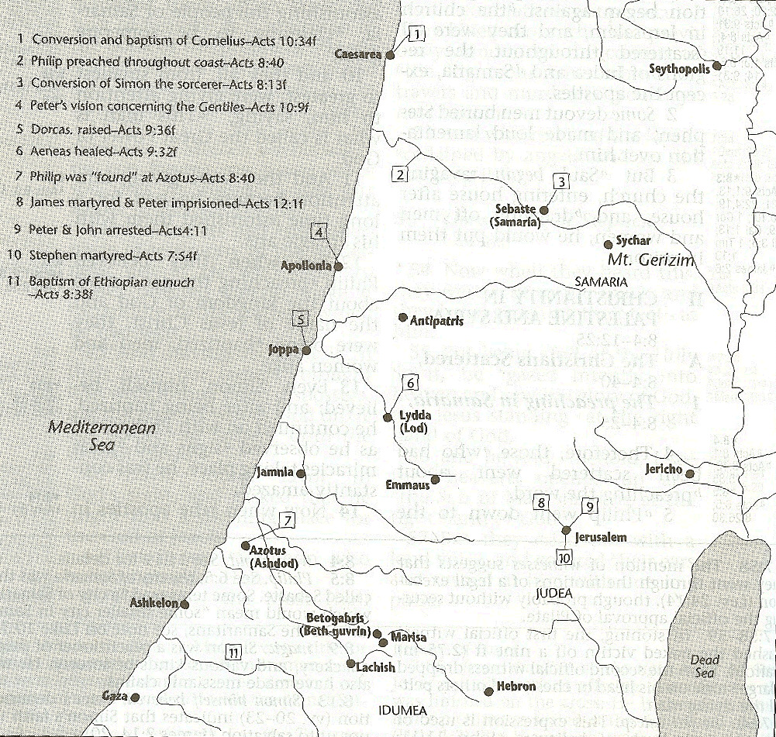

Slide 6
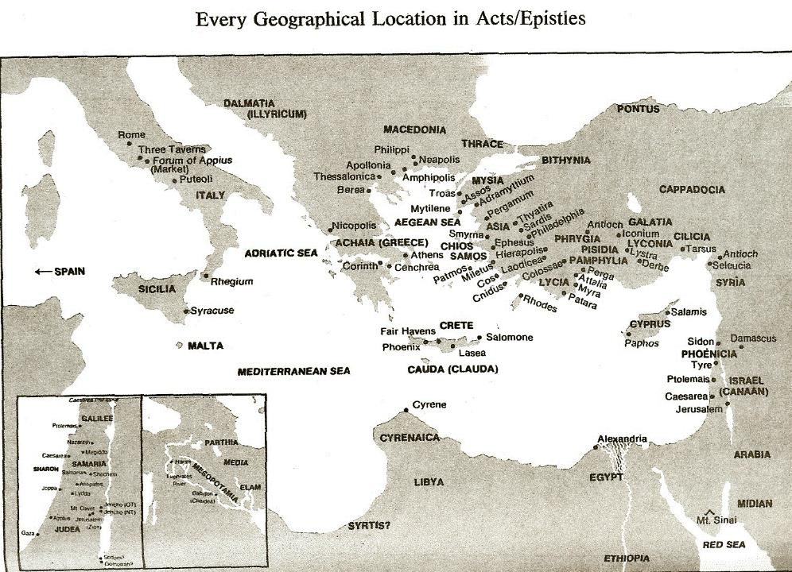

Slide 7
I. Saul Acts 9:1-31
Revelation (1-9)
Healing (10-19a)
Preaching (19b-22)
Conspiracy against Saul (23-25)
Return to Jerusalem (26-30)
Saul’s progress (31)

Slide 8
Acts 9:31 Saul’s Progress
Geography (31a)
Edification (31b)
Walk (31c)
Comfort (31d)
Numerical growth (31e)

Slide 9
Acts 9:31 Saul’s Progress
Geography (31a)
Edification (31b)
Walk (31c)
Comfort (31d)
Numerical growth (31e)

Slide 10
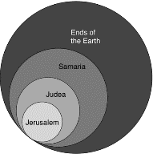
Acts 1:8
“but you will receive power when the Holy Spirit has come upon you; and you shall be My witnesses both in Jerusalem, and in all Judea and Samaria, and even to the remotest part of the earth.”

Slide 11
Acts 9:31 Saul’s Progress
Geography (31a)
Edification (31b)
Walk (31c)
Comfort (31d)
Numerical growth (31e)

Slide 12
Acts 9:31 Saul’s Progress
Geography (31a)
Edification (31b)
Walk (31c)
Comfort (31d)
Numerical growth (31e)

Slide 13
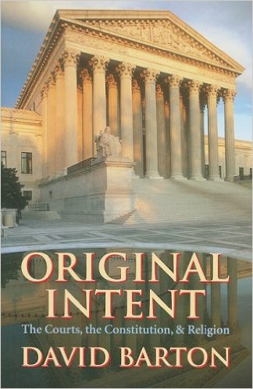
David Barton, Original Intent, p. 245

Slide 14
Acts 9:31 Saul’s Progress
Geography (31a)
Edification (31b)
Walk (31c)
Comfort (31d)
Numerical growth (31e)

Slide 15
Acts 9:31 Saul’s Progress
Geography (31a)
Edification (31b)
Walk (31c)
Comfort (31d)
Numerical growth (31e)

Slide 16
Message
Birth and growth of the church numerically, geographically, ethnically.
Components
Numerically (progress reports)
Geographically (From Jerusalem to Rome)
Ethnically (From Judaism to Gentile domination)

Slide 17
Progress Reports
Clearest: Acts 2:47; 6:7; 9:31; 12:24; 16:5; 19:20; 28:30-31
Less clear: Acts 1:15; 2:41; 4:4, 31; 5:14, 42; 8:25, 40; 11:21; 13:49; 17:6

Slide 18
Acts 9:1-43 Saul’s Conversion
Saul (9:1-31)
Peter (Acts 9:32-43)

Slide 19
II. Peter Acts 9:32-43
Lydda (32-35)
Joppa (36-43)

Slide 20
II. Peter Acts 9:32-43
Lydda (32-35)
Joppa (36-43)

Slide 21
Acts 9:32-35 Lydda
Place (32)
Aeneas’ healing (33-34)
Word spreads (35)

Slide 22
Acts 9:32-35 Lydda
Place (32)
Aeneas’ healing (33-34)
Word spreads (35)

Slide 24
Acts 1:8
“but you will receive power when the Holy Spirit has come upon you; and you shall be My witnesses both in Jerusalem, and in all Judea and Samaria, and even to the remotest part of the earth.”

Slide 25
Acts 8:3-4; 11:19
“³ But Saul began ravaging the church, entering house after house, and dragging off men and women, he would put them in prison. ⁴ Therefore, those who had been scattered went about preaching the word…¹⁹ So then those who were scattered because of the persecution that occurred in connection with Stephen made their way to Phoenicia and Cyprus and Antioch, speaking the word to no one except to Jews alone.”

Slide 26
Acts 9:32-35 Lydda
Place (32)
Aeneas’ healing (33-34)
Word spreads (35)

Slide 27
Acts 9:33-34 Aeneas’ Healing
Aeneas introduced (33)
Healing (34)

Slide 28
Acts 9:33-34 Aeneas’ Healing
Aeneas introduced (33)
Healing (34)

Slide 29
Acts 9:33-34 Aeneas’ Healing
Aeneas introduced (33)
Healing (34)

Slide 30
Acts 9:32-35 Lydda
Place (32)
Aeneas’ healing (33-34)
Word spreads (35)

Slide 31
II. Peter Acts 9:32-43
Lydda (32-35)
Joppa (36-43)

Slide 32
Acts 9:36-43 Joppa
Place (36)
Dorcas’ death (37)
Peter fetched (38)
Peter & mourners’ responses (39)
Miracle (40-41)
Word spreads (42)
Peter stays at Tanner’s home (43)

Slide 33
Acts 9:36-43 Joppa
Place (36)
Dorcas’ death (37)
Peter fetched (38)
Peter & mourners’ responses (39)
Miracle (40-41)
Word spreads (42)
Peter stays at Tanner’s home (43)

Slide 35
Luke 1:1–4
¹ Inasmuch as many have undertaken to compile an account of the things accomplished among us, ² just as they were handed down to us by those who from the beginning were eyewitnesses and servants of the word, ³ it seemed fitting for me as well, having investigated everything carefully from the beginning, to write it out for you in consecutive order, most excellent Theophilus; ⁴ so that you may know the exact truth about the things you have been taught.

Slide 36
Acts 9:36-43 Joppa
Place (36)
Dorcas’ death (37)
Peter fetched (38)
Peter & mourners’ responses (39)
Miracle (40-41)
Word spreads (42)
Peter stays at Tanner’s home (43)

Slide 37
Acts 9:36-43 Joppa
Place (36)
Dorcas’ death (37)
Peter fetched (38)
Peter & mourners’ responses (39)
Miracle (40-41)
Word spreads (42)
Peter stays at Tanner’s home (43)

Slide 39
Acts 9:36-43 Joppa
Place (36)
Dorcas’ death (37)
Peter fetched (38)
Peter & mourners’ responses (39)
Miracle (40-41)
Word spreads (42)
Peter stays at Tanner’s home (43)

Slide 40
Acts 9:36-43 Joppa
Place (36)
Dorcas’ death (37)
Peter fetched (38)
Peter & mourners’ responses (39)
Miracle (40-41)
Word spreads (42)
Peter stays at Tanner’s home (43)

Slide 41
Acts 9:40-41 Miracle
Isolation (40a)
Resuscitation (40b-41)

Slide 42
Acts 9:40-41 Miracle
Isolation (40a)
Resuscitation (40b-41)

Slide 43
Acts 9:40-41 Miracle
Isolation (40a)
Resuscitation (40b-41)

Slide 44
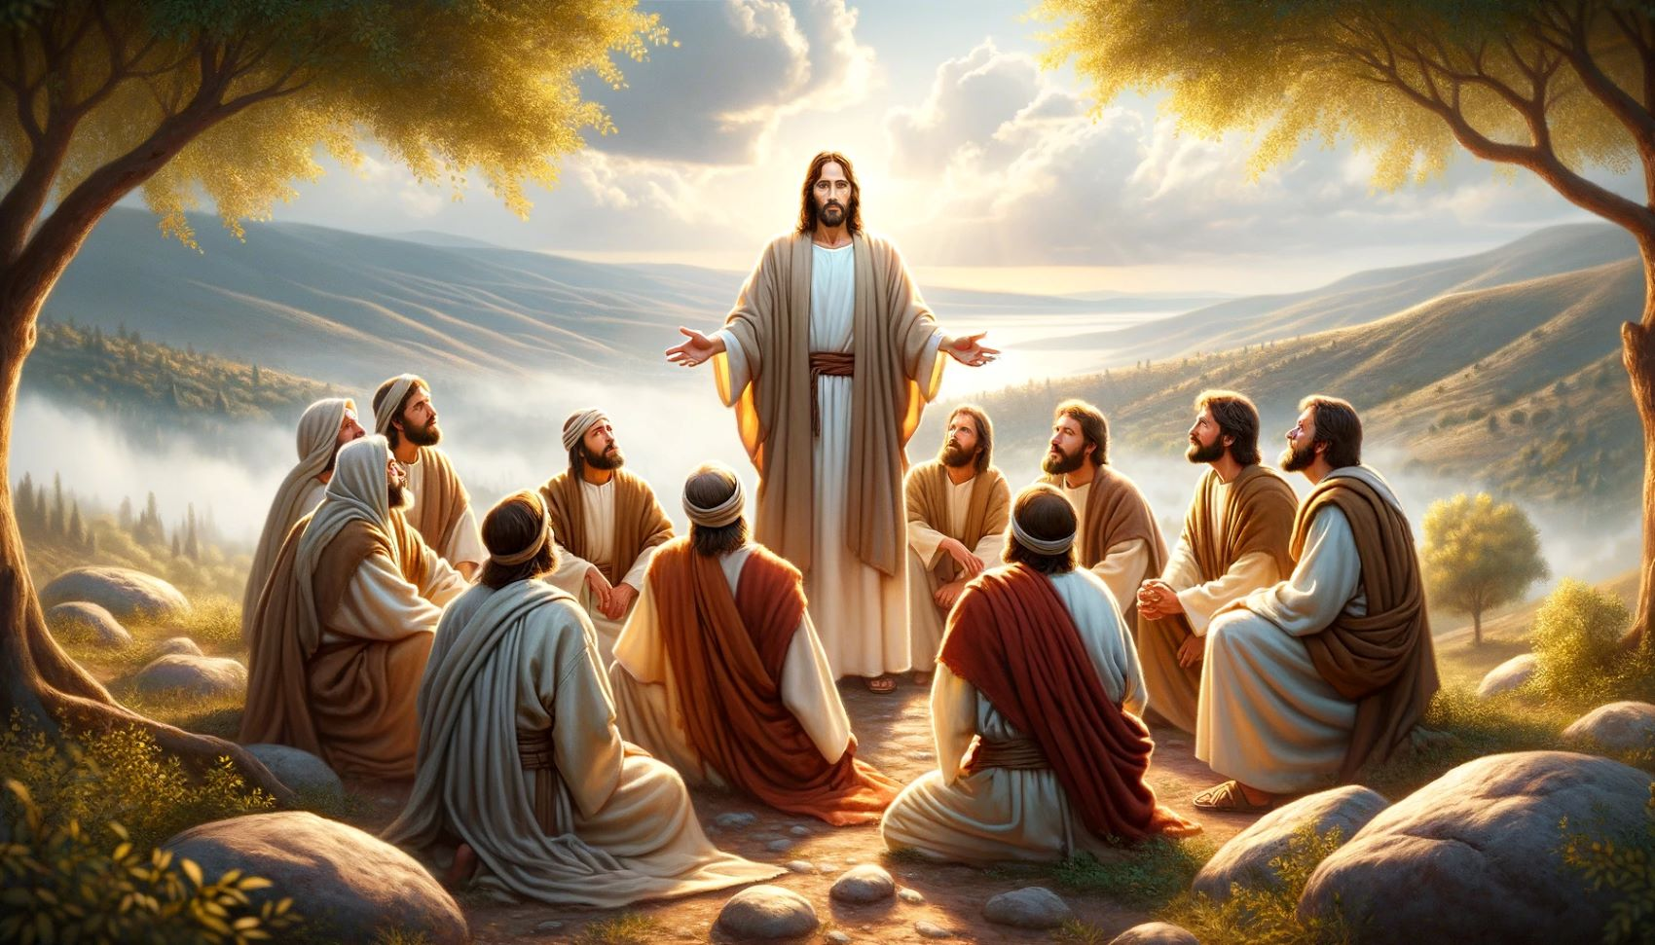
Dr. Arnold G. Fruchtenbaum
The Book of Acts, 224
“Again, it should be noted that while other believers were around, none of them performed the miracle. In Acts, only the apostles and their [de]legates (Acts 6:8; 8:6) perform signs and wonders.”

Slide 45
Acts 9:36-43 Joppa
Place (36)
Dorcas’ death (37)
Peter fetched (38)
Peter & mourners’ responses (39)
Miracle (40-41)
Word spreads (42)
Peter stays at Tanner’s home (43)

Slide 47
Acts 9:36-43 Joppa
Place (36)
Dorcas’ death (37)
Peter fetched (38)
Peter & mourners’ responses (39)
Miracle (40-41)
Word spreads (42)
Peter stays at Tanner’s home (43)

Slide 48
Conclusion

Slide 49
Acts 9:1-43 Saul’s Conversion
Saul (9:1-31)
Peter (Acts 9:32-43)

