Slide 1
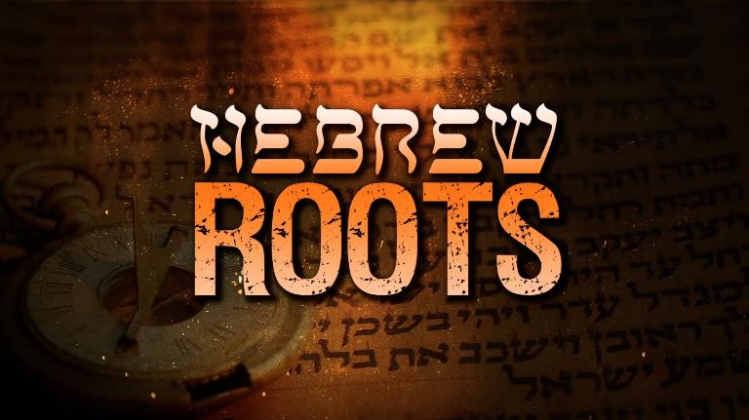
THE HEBREW ROOTS MOVEMENT
Jim McGowan, Th.D. Sugar Land Bible Church 10-02-2024

Slide 2
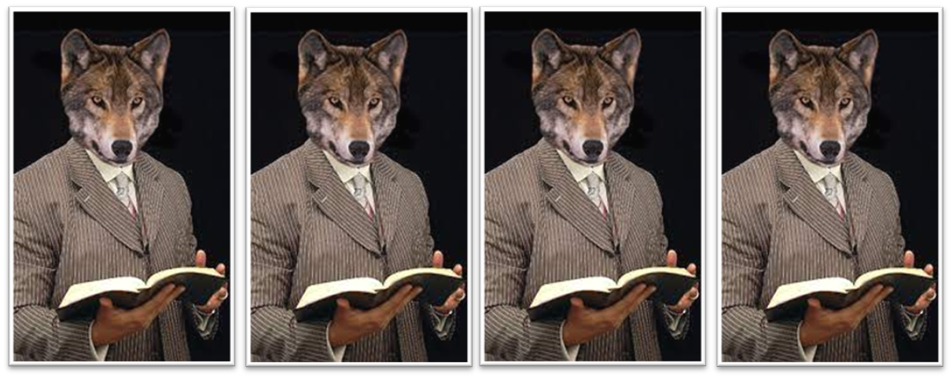
Romans 16:17
“Now I urge you, brethren, keep your eye on those who cause dissensions and hindrances contrary to the teaching which you learned, and turn away from them.” (cf. Matt 7:15; Gal 1:8f; 2 Thess 3:6, 14; Titus 3:10; 2 John 10)

Slide 3
Basic Definitions

Slide 4
Basic Definitions
Orthodox Doctrine – Orthodox means “right belief” and generally refers to the essentials of the historic Christian faith as taught by Jesus and the Apostles including:
Monotheism (God is one)
The Trinity (God is a triunity)
The deity of Christ (Jesus is the 2nd Person of the Trinity)
The virgin birth
The resurrection
The Gospel (the death, burial, resurrection, and ascension of Christ.

Slide 5
Basic Definitions
False Religion – rules or ritual based; not relationship based.
Cult – A deviation from orthodoxy (right belief).
Heresy – A denial of orthodoxy (right belief). “Heresy,” refers to false teachings that are destructive because they overturn the basic elements which make up the historic Christian faith, substituting in their place doctrines which distort or contradict the teachings found in the Bible.
Aberrant – a doctrine that does not overtly deny basic biblical theology, but is dangerously inconsistent with orthodoxy (right belief). A group may be orthodox in its central theology while at the same time maintain teachings and practices that are clearly at odds with essential Christian theology.

Slide 6
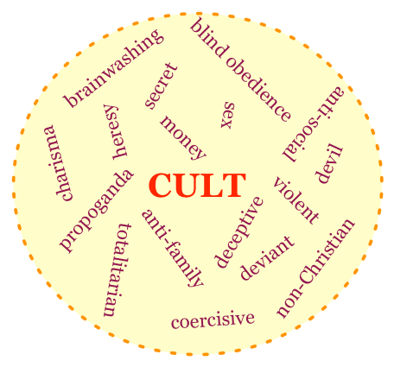
Basic signs of a cult

Slide 7
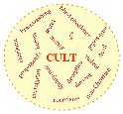
Basic signs of a cult
DEVIATIONS FROM ORTHODOXY (CORRECT TEACHING)
Monotheism – (Exo. 20:3-6; Isa. 43:10; 44:6, 8).
Trinity – (Matt. 3:16-17; 28:19; 1 Cor. 12:4-6; 2 Cor. 13:14; Eph. 4:4-6).
Virgin Birth – (Matt. 1:23).
The Deity of Christ – (Jesus is God in flesh (John 8:58 with Exo. 3:14). See also John 1:1, 14; 8:24; 10:30-33; 20:28; Col. 2:9; Phil. 2:5-8; Heb. 1:8).

Slide 8
Basic signs of a cult
DEVIATIONS FROM ORTHODOXY (CORRECT TEACHING)
The physical resurrection of Christ – (John 2:19-21; 1 Cor. 15:14, 17; John 20:25-28; Luke 24:39).
The Gospel, as the death, burial, and resurrection of Jesus – (1 Cor. 15:1-4; Gal. 1:8-9).
Salvation by grace through faith alone – (Rom. 3:28; 4:1-5; 5:1; Eph. 2:8-9; Gal. 3:21;5:3-5).

Slide 9
What is the Hebrew Roots movement?

Slide 10
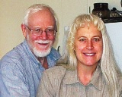
Hebrew Roots: Its Origin
The modern HRM is a grassroots movement lacking an organizational structure but which has been influenced by Seventh-Day Adventism and the Worldwide Church of God (Armstrongism), both well-known documented cults.
Hebrew Roots (aka Hebraic Roots) is a grassroots movement without an ecclesiastical superstructure.
In 1994, Dean (1939-2022) and Susan Wheelock Trademarked the term Hebrew Roots and in 1998 began publishing the Hebrew Roots® magazine and created a website: Hebrewroots.net.

Slide 11
Hebrew Roots: Its Origin
In 1997, a prophecy titled "The Hebrew Movement“ was published by Dean Cozzens of Open Church Ministries, which declared that God had foreordained 4 major moves for the 20th century:
Pentecostalism
Faith-healing
the Charismatic Movement and,
the Hebrew Roots Movement.

Slide 12
Hebrew Roots: Its Premise & Goal
The premise of the Hebrew Roots movement is the belief that the Church has veered far from the true teachings and Hebrew concepts of the Bible.
The movement maintains that Christianity has been indoctrinated with the culture and beliefs of Greek and Roman philosophy and that ultimately biblical Christianity, taught in churches today, has been corrupted with a pagan imitation of the New Testament gospels.
The stated goal of this group is “Exploring and Recovering the Hebrew Roots of the Faith”.

Slide 13
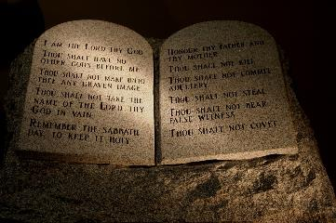
Hebrew Roots: Its Theology & Tenets
The Trinity is a fundamental violation of scripture.
The belief that Yeshua is God in the flesh is a fundamental violation of scripture.
Yeshua the Messiah did not come to establish a new religion or to “do away” with the Mosaic Law.

Slide 14
Hebrew Roots: Its Theology & Tenets
Yeshua 's death on the cross did not end the Mosaic Covenant, but instead renewed it, expanded its message, and wrote it on the hearts of His true followers.
Gentile believers are grafted into the Judaism of the Mosaic Covenant.

Slide 15
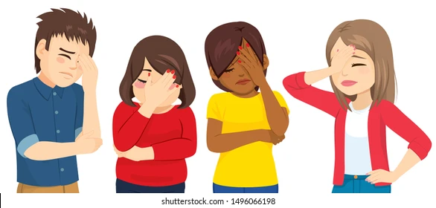
Hebrew Roots: Its Theology & Tenets
The Torah is equally binding on Gentiles and Jews alike so a Torah-observant walk (including Feast Day observances) must be part of the life of every believer.
Some teach that failure to keep the Mosaic Law reveals that you are not truly born of God.

Slide 16
Hebrew Roots: Its Theology & Tenets
Since the Torah is the foundational teaching for the Church, the New Testament becomes secondary in importance. Only a ‘supposed’ original Hebrew New Testament is accurate.
The original Greek manuscripts are unreliable and corrupted, so the Church no longer has a standard of truth.

Slide 17
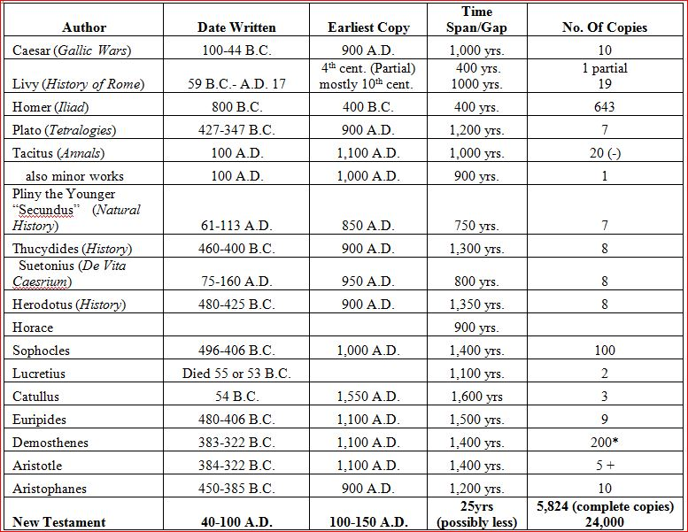
Reliability of the New Testament Compared to Other Ancient Texts

Slide 18
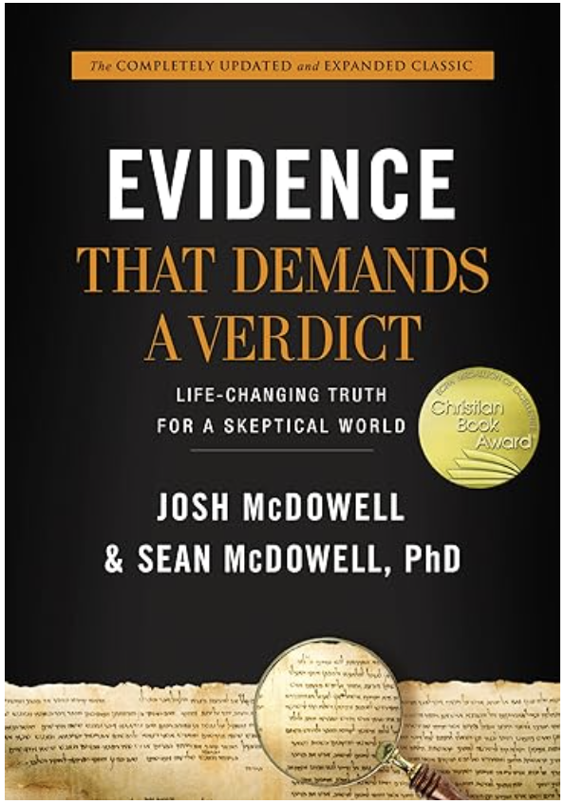
Reliability of the New Testament Compared to Other Ancient Texts
Greek Manuscript total:…………………………………………………….5,856
Non-Greek Manuscripts (Armenian, Latin, etc.):……………..18,130+
Total Manuscripts:…………………………………………………………..23,986
Earliest manuscript: AD 130 (John Rylands Papyrus: P52)

Slide 19
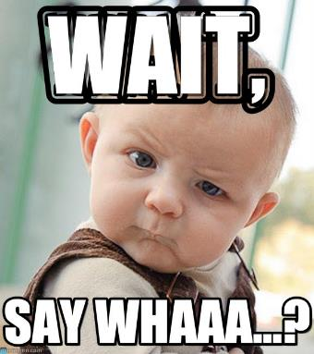
Hebrew Roots: Its Theology & Tenets
The teachings of the Apostle Paul’s epistles are dismissed as either not understood clearly or taught incorrectly by ‘Christian’ pastors today.

Slide 20
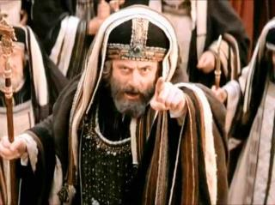
Hebrew Roots: Critical Errors
God gave the Mosaic Law to the people of Israel (the physical descendants of Abraham, Isaac, and Jacob), only (Ex. 19:3-6; Deu. 5:-3; 29:1)!
Hebrew Roots repeats the heresy of the Judaizers (Acts 15:1-5, 10-11).

Slide 21
Hebrew Roots: Critical Errors
Continuing to teach that the Old Covenant is still in effect in spite of what the New Testament teaches, or twisting the New Testament to agree with the Hebrew Roots beliefs, is false teaching.
It teaches a false gospel by promoting “works salvation” when they argue that believers must keep the Mosaic law (Eph. 2:8-9).

Slide 22
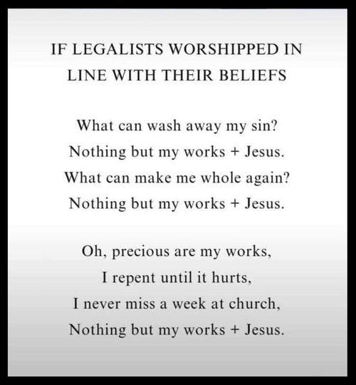
Hebrew Roots = LEGALISM

Slide 23
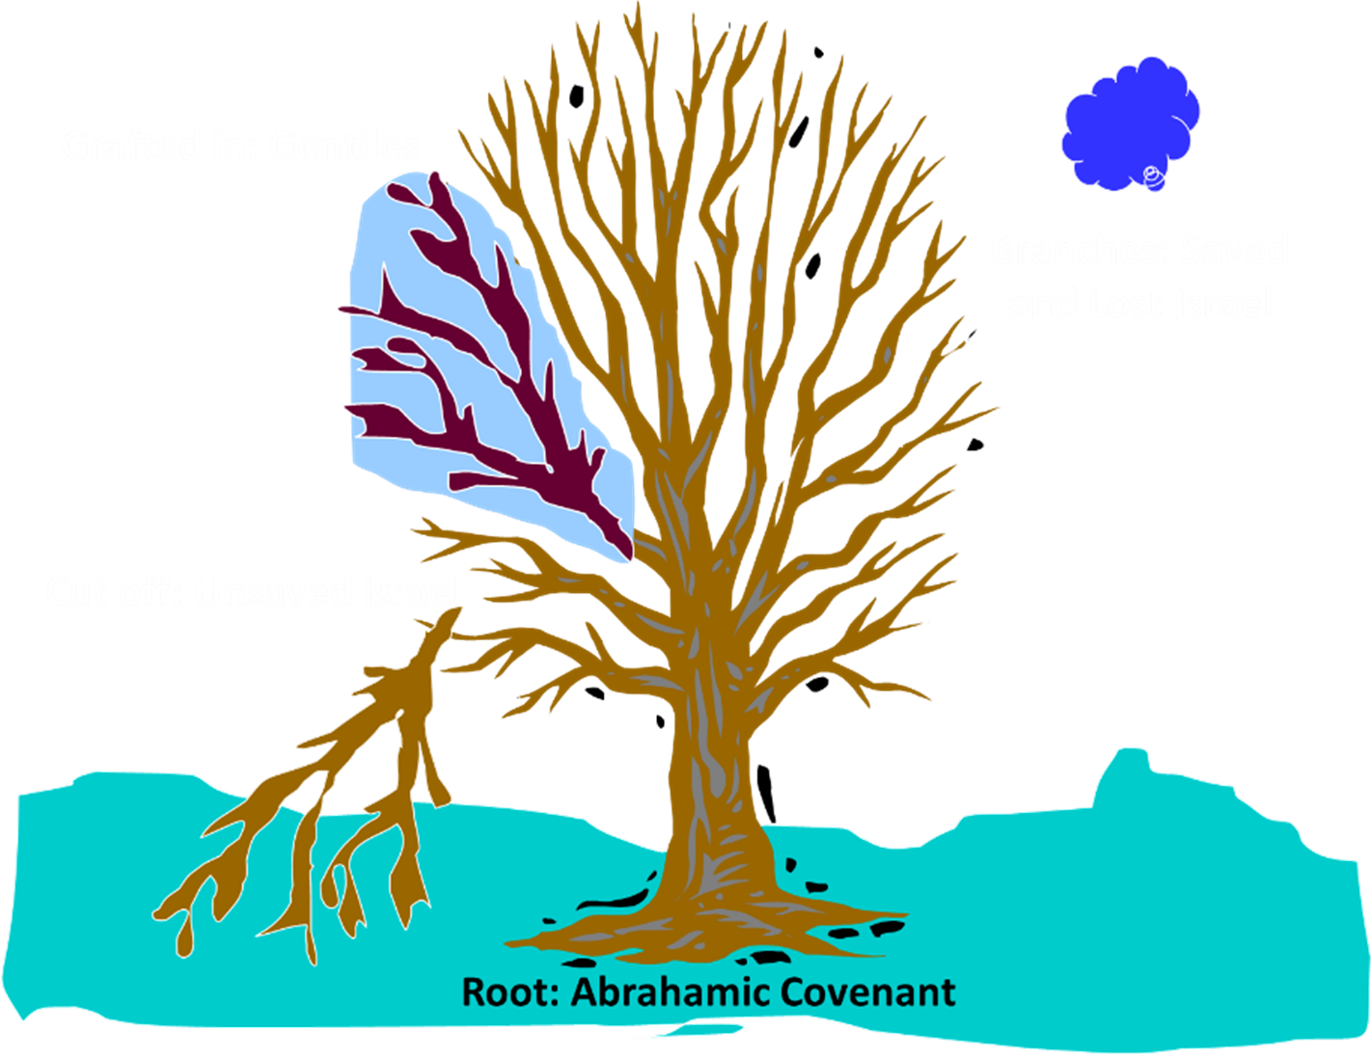
Hebrew Roots: A Biblical Response
The Mosaic Laws and ordinances have ended having already been fulfilled by Christ (Col: 2:13-17; Rom. 14:5).
Gentile believers are not grafted into the Judaism of the Mosaic Covenant; they are grafted into Abraham Covenant, which preceded both the Law and Jewish customs. Gentile believers are fellow citizens with the saints (Ephesians 2:19), but they are not Jews (1 Cor. 7:18).

Slide 24
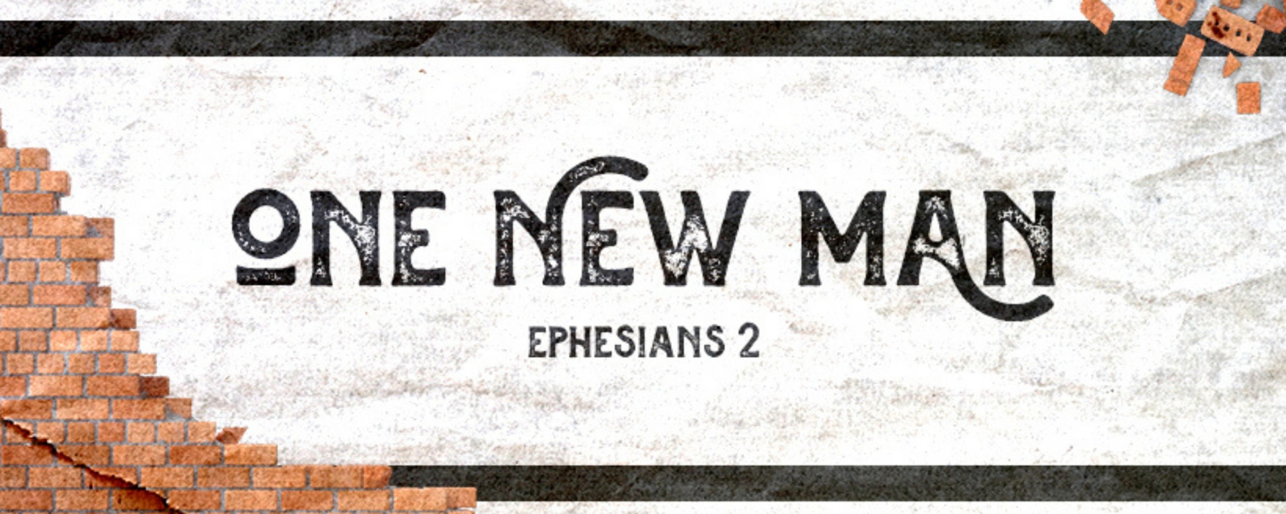
Hebrew Roots: A Biblical Response
God has made saved Jews and Gentiles into "one new man" in Christ Jesus (Eph. 2:15). This "new man" refers to the Church, the body of Christ, which is made up of neither Jew nor Gentile (Gal. 3:27-29).

Slide 25
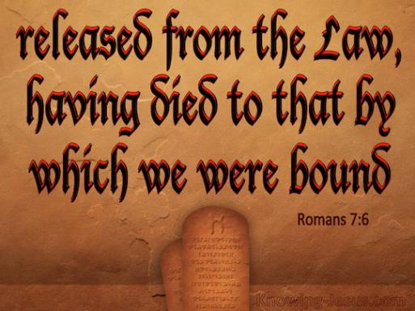
Hebrew Roots: A Biblical Response
Nowhere in the Bible do we find Gentile believers being instructed to follow Levitical laws or Jewish customs; in fact, the opposite is taught in Rom. 7:6.

Slide 26
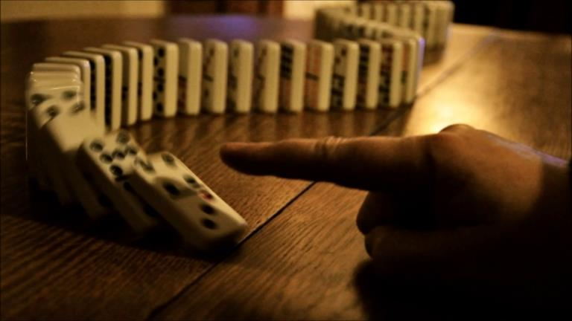
Error always begets error!
An error in basic theology at any point creates a domino effect.

Slide 27
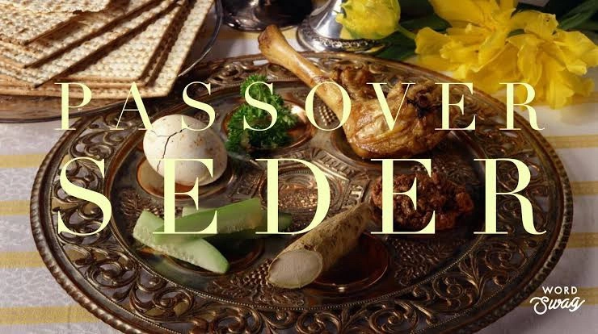
Hebrew Roots: Positives
Seeking to explore the Jewish culture and perspective, within which most of the Bible was written, opens and enriches our understanding of the Scriptures, adding insight and depth to many of the passages, parables and idioms.
There is nothing wrong with Gentiles and Jews joining together in celebrating the feasts and enjoying a Messianic style of worship.

Slide 28
Hebrew Roots: Positives
Learning the way in which the Jews understood the teachings of our Lord can be a tool, giving us greater effectiveness in reaching the unbelieving Jew with the gospel.

Slide 29
References
https://en.wikipedia.org/wiki/Hebrew_Roots
https://www.gotquestions.org/Hebrew-roots.html
https://answersingenesis.org/presuppositions/dangers-hebrew-roots-movement/
http://www.middletownbiblechurch.org/doctrine/doctrine.htm
http://faithfacts.org/world-religions-and-theology/cults-and-heresies#Heresy

