Slide 1
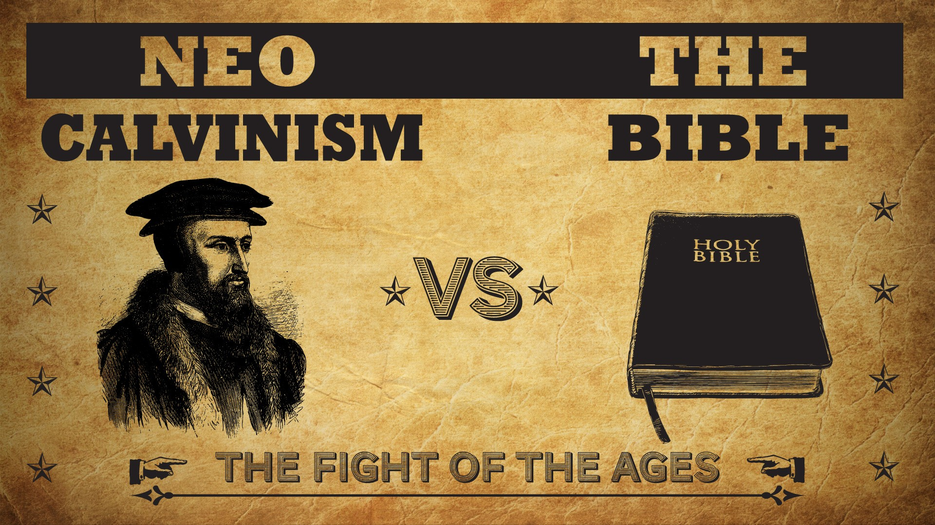


Slide 2
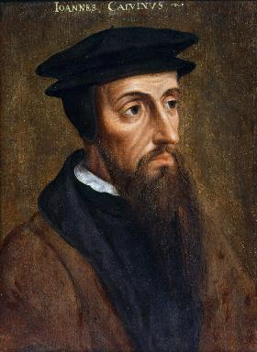
Neo-Calvinism vs. The Bible
Calvinism’s Mixed Blessing
Why Critique Calvinism?
The Source of Calvin’s Theology
Calvin’s Manner of Life
TULIP Through the Grid of Scripture
Conclusion

Slide 3
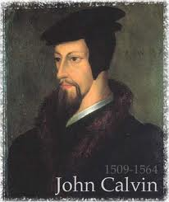
II. Why Critique Calvinism?
General calling to defend the faith (Jude 3)
The call to admonish fellow believers (2 Thess. 3:15)
Calvinism is a serious issue
The prophetic implications of Calvinism

Slide 4

The Prophetic Implications of Calvinism
De-emphasis of Biblical Eschatology
Calvin’s mishandling of prophetic texts
Anti-Semitism
Implications of a lack of an Israel‒Church distinction
Neo-Calvinism as a fulfillment of Bible prophecy

Slide 5

“For as we are dull and entangled in earthly thoughts, our minds can hardly rise up to heaven, though the Lord with a clear voice invites us to himself. The Prophet then, in order to aid our weakness, adds a vivid representation, as though God stood before their eyes. Stand, he says, shall his feet on the mount of Olives. He does not here promise a miracle, such as even the ignorant might conceive to be literal; nor does he do this in what follows, when he says, The mount shall be rent…half…to the east and half to the west. This has never happened, that mount has never been rent: but as the Prophet could not, under those grievous trials, which might have overwhelmed the minds of the godly a hundred times, have extolled the power of God…without employing a highly figurative language, he therefore accommodates himself, as I have said, to the capacity of our flesh.”
John Calvin
Commentary on Zechariah 14:4
Zechariah 14:4—“And his feet shall stand in that day upon the mount of Olives…and the mount of Olives shall cleave in the midst thereof toward the east and toward the west….”

Slide 6
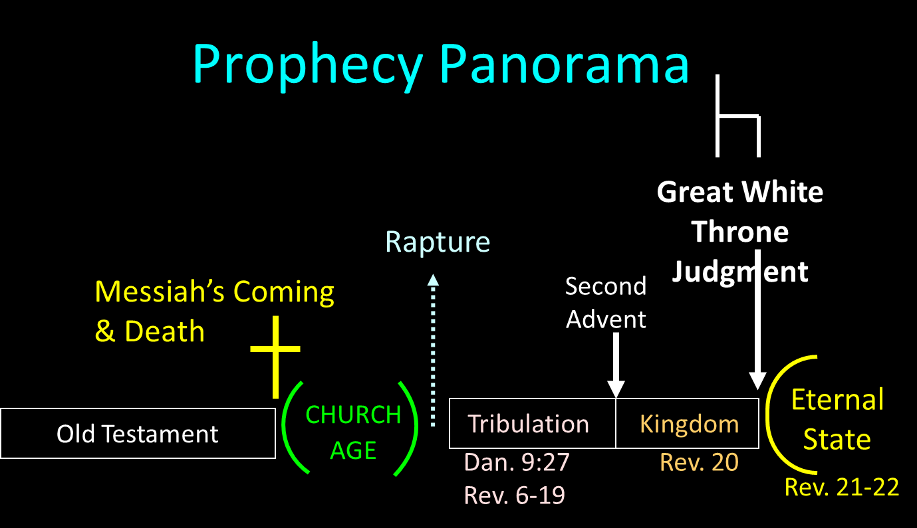

Slide 7

Revelation 20:1-3
“¹ Then I saw an angel coming down from heaven, holding the key of the abyss and a great chain in his hand. ² And he laid hold of the dragon, the serpent of old, who is the devil and Satan, and bound him for a thousand years; ³ and he threw him into the abyss, and shut it and sealed it over him, so that he would not deceive the nations any longer, until the thousand years were completed; after these things he must be released for a short time.”

Slide 8

Revelation 20:4-6
“⁴ Then I saw thrones, and they sat on them, and judgment was given to them. And I saw the souls of those who had been beheaded because of their testimony of Jesus and because of the word of God, and those who had not worshiped the beast or his image, and had not received the mark on their forehead and on their hand; and they came to life [zaō] and reigned with Christ for a thousand years….

Slide 9
Revelation 20:4-6
…⁵ The rest of the dead did not come to life [zaō] until the thousand years were completed. This is the first resurrection [anastasis]. ⁶ Blessed [makarios] and holy is the one who has a part in the first resurrection [anastasis]; over these the second death has no power, but they will be priests of God and of Christ and will reign with Him for a thousand years.”

Slide 10
Revelation 20:7-9
“⁷ When the thousand years are completed, Satan will be released from his prison, ⁸ and will come out to deceive the nations which are in the four corners of the earth, Gog and Magog, to gather them together for the war; the number of them is like the sand of the seashore. ⁹ And they came up on the broad plain of the earth and surrounded the camp of the saints and the beloved city, and fire came down from heaven and devoured them.

Slide 11

Revelation 20:10
“And the devil who deceived them was thrown into the lake of fire and brimstone, where the beast and the false prophet are also; and they will be tormented day and night forever and ever.”

Slide 12
Reasons for Understanding 1000 Literally
John’s use of indefinite concepts elsewhere
  Revelation 20:8, 20:3
Exception to the “# of years” examples?
Other numbers are taken literally
  Two witnesses (11:3), 7000 people (11:13), 4 Angels (7:1) 7 Angels (8:6),144,000 Jews (7:4), 42 months (11:2), 1260 days (11:3)
Not always a symbolic interpretation
  (Rev. 17:18)

Slide 13

Robert Thomas
Revelation 8 to 22: An Exegetical Commentary (Chicago: Moody Press, 1992), 408.
Robert Thomas observes that, "no number in Revelation is verifiably a symbolic number.”

Slide 14
John Calvin
Institutes of the Christian Religion, III, xxv, 5.
“But Satan has not only befuddled men’s senses to make them bury with the corpses the memory of resurrection; he has also attempted to corrupt this part of the doctrine with various falsifications…Now their fiction is too childish either to need or to be worth a refutation. And the Apocalypse, from which they undoubtedly drew a pretext for their error, does not support them. For the number ‘one thousand’ [Rev. 20:4] does not apply to the eternal blessedness of the church but only to the various disturbances that awaited the church, while still toiling on earth…Those who assign the children of God a thousand years in which to enjoy the inheritance of the life to come do not realize how much reproach they are casting upon Christ and his Kingdom.”

Slide 15
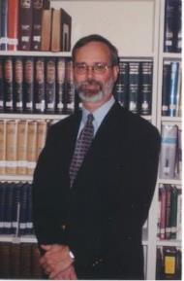
Kenneth L. Gentry
He Shall Have Dominion: A Post Millennial Eschatology (Tyler, Texas: Institute for Christian economics, 1992), page 335.
“The proper understanding of the thousand-year time frame in Revelation 20 is that it is representative of a long and glorious era and is not limited to a literal 365,000 days. The figure represents a perfect cube of 10, which is the number of quantitative perfection.”

Slide 16


Matthew 24:13
“But the one who endures to the end, he will be saved [sōzō].”

Slide 17
Philippians 1:19
“for I know that this will turn out for my deliverance [sōtēria] through your prayers and the provision of the Spirit of Jesus Christ.”

Slide 18
Hebrews 11:7
“By faith Noah, being warned by God about things not yet seen, in reverence prepared an ark for the salvation [sōtēria] of his household, by which he condemned the world, and became an heir of the righteousness which is according to faith.”

Slide 19
Matt 24 / Rev 6 Parallels
Prediction | Birth pangs (Matt 24) | Seal judgments (Rev 6)
False Christ | 24:5 | 6:2
War | 24:6 | 6:3-4
Famine | 24:7 | 6:5-6
Death | 24:6-7 | 6:7-8
Martyrs | 24:9-13 | 6:9-11
Earthquakes | 24:7 | 6:12-17
Evangelism | 24:14 | 7:1-9

Slide 20
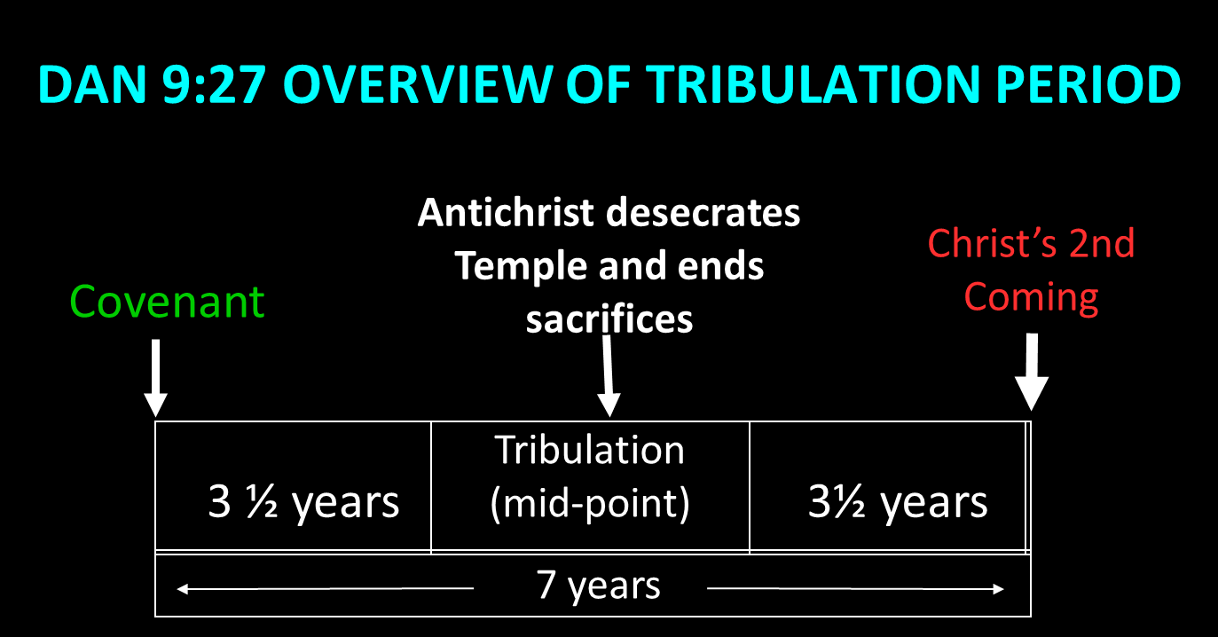

Slide 21
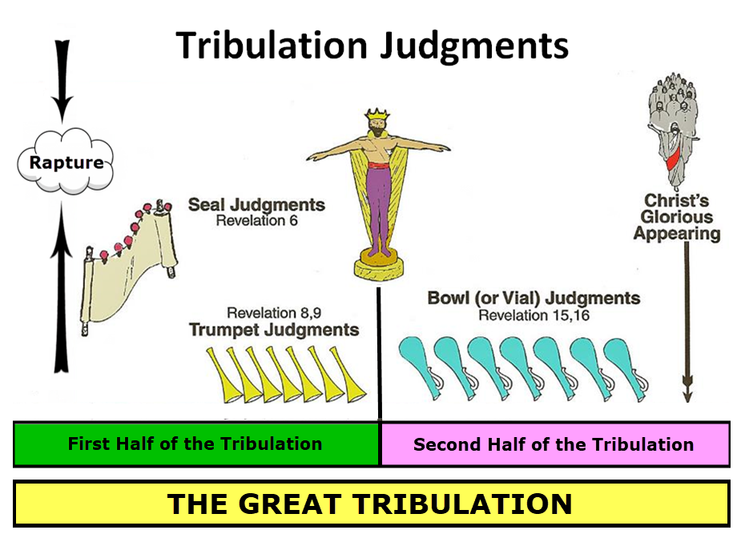

Slide 22

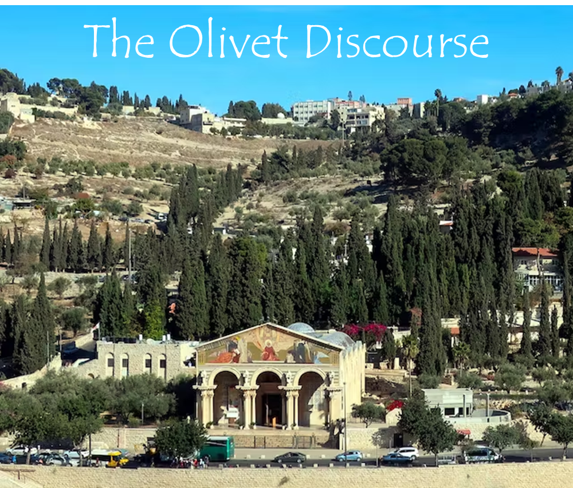
Matthew 24:31
“And He will send forth His angels with a great trumpet and they will gather together [episynagō] His elect from the four winds, from one end of the sky to the other.”

Slide 23

Isaiah 27:13
“It will come about also in that day that a great trumpet will be blown, and those who were perishing in the land of Assyria and who were scattered in the land of Egypt will come and worship the Lord in the holy mountain at Jerusalem.”

Slide 24
Matthew 23:37-39
³⁷ “Jerusalem, Jerusalem, who kills the prophets and stones those who are sent to her! How often I wanted to gather [episynagō] your children together, the way a hen gathers [episynagō] her chicks under her wings, and you were unwilling. ³⁸ Behold, your house is being left to you desolate! ³⁹ For I say to you, from now on you will not see Me until you say, ‘Blessed is He who comes in the name of the Lord!’”

Slide 25

John MacArthur
Matthew 24‒25, The Macarthur New Testament Commentary (Chicago: Moody, 1989), 28.
"But the one who endures to the end, he shall be saved…his endurance will be a Spirit-empowered product and proof of the reality that he is saved. Neither the high cost of discipleship nor the deception of false prophets nor the enticement of sin will cause true believers to renounce Christ, because He Himself will protect them from defection. Endurance is always a mark of salvation…The perseverance of the saints in faith is a very basic element of salvation teaching in the New Testament. It states that people who are genuinely saved do not depart from the faith (see John 8: 31; 1 Cor. 15: 1-2; Col. 1: 21-23; Heb. 2: 1-3; 3: 14; 4: 14; 6: 11-12; 10: 39; 12: 14; James 1: 2-4)…Endurance…does give evidence of the spiritual life that resides in the believer...”

Slide 26
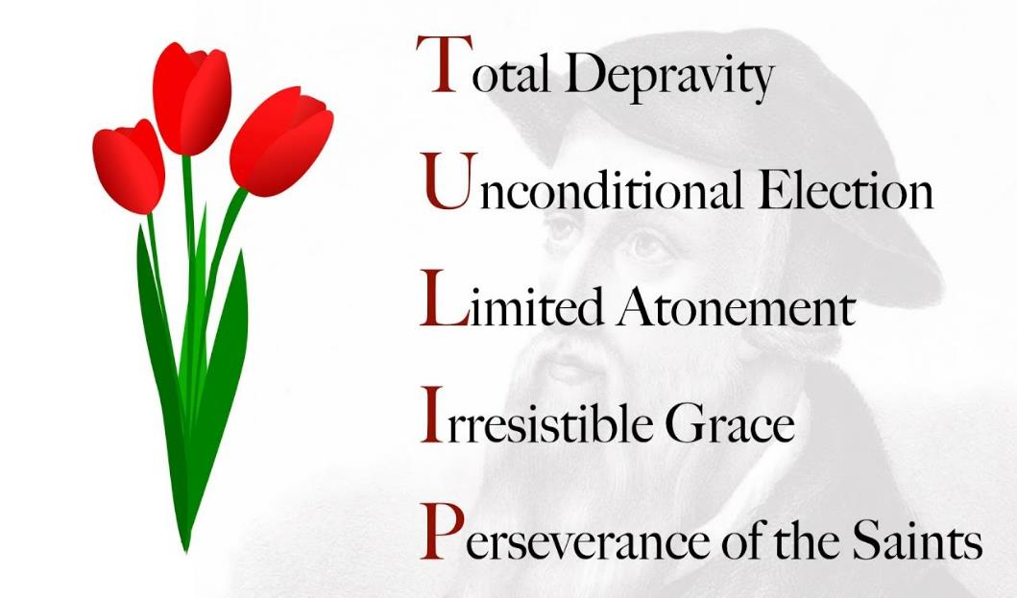

Slide 27

Dave Anderson
David R. Anderson, “The Soteriological Impact of Augustine’s Change from Premillennialism to Amillennialism: Part One,” Journal of the Grace Evangelical Society Volume 15, no. 28 (2002): 25.and Part Two is in no 29, Autumn, 2002.
“﻿...we chose Augustine as a case in point...Specifically, his reinterpretation of Matt 24:13 (‘he who endures to the end will be saved’) as a spiritual salvation instead of a physical salvation (to enter and populate the Millennium) caused drastic changes in his soteriology. Perseverance of the saints (faithfulness until the end of one’s physical life) became the sine qua non of his soteriology. One could believe in Christ, have the fruit of the elect, but prove he was not elect if he should not persevere in faithfulness until the end of his physical life.”

Slide 28
Scripture’s Four Judgments
Name | Sheep and Goat | Judgment of the Jews | Bema Seat | Great White Throne
Scripture | Matt 25:31-46 | Ezek 20:33-44 | 1 Cor 3:10-15 | Rev 20:11-15
Place | Earth, Jerusalem | Earth, wilderness | Heaven | After Earth
Audience | Gentile Tribulation survivors | Jewish Tribulation survivors | Church Age believers | All unsaved
When | After Tribulation | After Tribulation | After rapture | After Millennium
Purpose | Saved Gentiles enter kingdom | Saved Jews enter kingdom | Reward believers | Degree of punishment in hell
Evaluation | Treatment of Christ’s brethren | Passing under shepherd’s rod | Works taken through fire | Not in the book; judged by books

Slide 29

Dr. Robert R. Congdon
Robert R. Congdon, How Calvinism Serves Satan's Purposes (Greer, SC: Congdon Ministries International, 2014), 29.
“Most new Calvinists do not believe that Christ will return and reign on this earth for one thousand years, nor do they understand that those of the church age will return to rule with Him following a review time before His judgment seat or bema seat when our roles and responsibilities will be determined. Most Calvinists believe the Great White Throne judgment is for everyone of all ages and it will determine whether one is truly saved or not.”

Slide 30
The Prophetic Implications of Calvinism
De-emphasis of Biblical Eschatology
Calvin’s mishandling of prophetic texts
Anti-Semitism
Implications of a lack of an Israel‒Church distinction
Neo-Calvinism as a fulfillment of Bible prophecy

Slide 31

  “First, their synagogues should be set on fire…Secondly, their homes should likewise be broken down and destroyed…Thirdly, they should be deprived of their prayer books and Talmuds…”

Slide 32
  “…Fourthly, their rabbis must be forbidden under threat of death to teach any more…Fifthly, passport and traveling privileges should be absolutely forbidden to the Jews…Sixthly, they ought to be stopped from usury (charging interest on loans…”

Slide 33
  “Seventhly, let the young and strong Jews and Jewesses be given the flail, the ax, the hoe, the spade, the distaff, and spindle, and let the earn their bread by the sweat of their noses…We ought to drive the rascally lazy bones out of our system...”
Martin Luther, Concerning the Jews and Their Lies, cited in Michael Brown’s Our Hands Are Stained with Blood, pp. 14-15.

Slide 34
  “…Therefore away with them… To sum up, dear princes and nobles who have Jews in your domains, if this advice of mine does not suit you, then find a better one so that you and we may all be free of this insufferable devilish burden–the Jews.”
Martin Luther, Concerning the Jews and Their Lies, cited in Michael Brown’s Our Hands Are Stained with Blood, pp. 14-15.

Slide 35
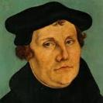
The Encyclopaedia Judaica says “Short of the Auschwitz oven and the extermination, the whole Nazi holocaust is pre-outlined here.”
Martin Luther
“Luther, Martin,” in Encyclopaedia Judaica, Vol. 8, 693.

Slide 36
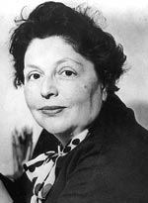
“…both Luther and Hitler were obsessed by the ‘demonologized universe’ inhabited by the Jews.”
Lucy Dawidowicz
“Luther, Martin,” in Encyclopaedia Judaica, Vol. 8, 693.

Slide 37

Martin Luther
Rabbi Joseph Telushkin, "Martin Luther and the Protestant Reformation" in Jewish Literacy--The Most Important Things to Know About the Jewish Religion, Its People and Its History, [William Morrow and Company, NY, 1991], pages 204-206.
Telushkin likens Luther to Mohammed, because both men initially had a love for the Jews but later turned in hate against the Jews when the Jews would not convert. Here are some of Rabbi Telushkin's shocking quotes:
“[Luther] was to pen the most anti-Semitic writings produced in Germany until the time of Hitler.”
“On one occasion, this earlier exponent of Christian love said: ‘I would threaten to cut their tongues out from their throats, if they refuse to acknowledge the truth that God is a trinity and not a plain unity.’”

Slide 38
Martin Luther
Rabbi Joseph Telushkin, "Martin Luther and the Protestant Reformation" in Jewish Literacy--The Most Important Things to Know About the Jewish Religion, Its People and Its History, [William Morrow and Company, NY, 1991], pages 204-206.
“At the Nuremberg trials, Nazi propagandist Julius Streicher defended himself with the claim that he had not said anything worse about the Jews than had Martin Luther.”
“Hitler proudly claimed Luther as an ally: ‘He saw the Jew as we are only beginning to see him today.’”

Slide 39

Olivier J. Melnick
Oliver J. Melnick, End-Times Antisemitism: A New Chapter in the Longest Hatred (Tustin, CA: Hope For Today Publications, 2017), 89, 92.
  “In 1543, when the Jewish community didn't meet his expectations, Luther published the book Of the Jews and Their Lies, where his description of the Jewish people is so venomous that Hitler was quoted saying that he was just finishing up what Luther started...As a matter of fact, many scholars and historians believe that Luther's view of the Jews had a profound effect on Germans for centuries to come and also had a serious influence on Hitler's ideology and implementing the final solution to the Jewish question. The connection between Luther and Hitler is not difficult to make.”

Slide 40

Thomas D. Ice
Thomas D. Ice, “Yad Vashem and the Holocaust,” online: www.pre-trib.org, accessed 19 August 2017, 2.
  “We learned at the conference that Hitler was not alone in his irrational desire to murder Jews it was embedded in the German, Austrian, and Eastern European nations. The original source for such anti-Semitism goes back to the common experience of all of Europe’s medieval Roman Catholic Jew-hatred. Most of the people throughout Europe did not have to be taught by Hitler or the Nazis to hate the Jews, it was endemic in their culture for hundreds of years. When the Nazis crystalized their anti-Semitism into murdering the Jews as a virtue, they already had a willing mass of people ready to join their crusade. After all, Hitler quoted the founder of the Reformation three times in Mein Kampf and called Martin Luther one of the greatest Christians in all of history. It is not surprising (for the most part) the German clergy were great Hitler enthusiasts since almost all of them were liberal and held to replacement theology.”

Slide 41
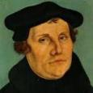
Lutheran Statement https://www.ccjr.us/dialogika-resources/documents-and-statements/interreligious/759-lwfijcic1983
  “We Lutherans take our name and much of our understanding of Christianity from Martin Luther. But we cannot accept or condone the violent verbal attacks that the Reformer made against the Jews…The sins of Luther’s anti-Jewish remarks, the violence of his attacks on the Jews, must be acknowledged with deep distress. And all occasions for similar sin in the present or the future must be removed from our churches…Lutherans of today refuse to be bound by all of Luther’s utterances on the Jews.”

Slide 42
  “But here he [the rabbi] not only betrays his ignorance, but his utter stupidity, since God so blinded the whole people that they were like restive dogs. I have had much conversation with many Jews: I have never seen either a drop of piety or a grain of truth or ingenuousness—nay, I have never found common sense in any Jew. But this fellow, who seems so sharp and ingenious, displays his own impudence to his great disgrace.”
John Calvin
Commentary on the Prophet Daniel (Vol 1, p. 185). Bellingham, WA: Logos Bible Software. Commentary on Daniel 2:44-45. (2010).

Slide 43
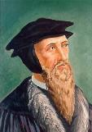
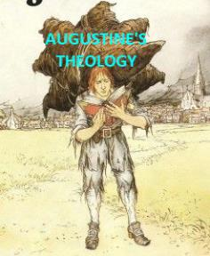
“But by this public call, the Gentiles were not only made equal to the Jews, but seemed to be substituted into their place, as if the Jews had been dead.”
John Calvin
Institutes of the Christian Religion, II, xi, 12.

Slide 44
In his sermon on 2 Samuel 24:24, Calvin declares: “Now the Jews are cut off like rotten limbs. We have taken their place.”
John Calvin
John Calvin, Supplementa Calviniana, I, 766, 12f; quoted in Selderhuis, Calvin Handbook, 145.

Slide 45
Calvin also declares them [Israel] to be “cut off from everything,” adding haughtily, “and we have succeeded them in their place.”
John Calvin
John Calvin, Supplementa Calviniana, II, 36, 28f; Sermon on Isa. 14:2; quoted in Selderhuis, Calvin Handbook, 145.

Slide 46
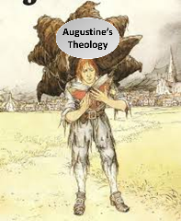
  Calvin repeatedly refers to the Jews as “profane unholy sacrilegious dogs,” describing them as “a barbarous nation” and “the people of Israel rejected by God.”
John Calvin
1. John Calvin, Ioannis Calvini opera quae supersunt Omnia, 50, 307; Sermon on Gal. 1:6–8; quoted in Selderhuis, Calvin Handbook, 145; 2. John Calvin, Supplementa Calviniana, V, 145, 10; Sermon on Mic. 40b–11; quoted in Selderhuis, Calvin Handbook, 145; 3. John Calvin, Ioannis Calvini opera quae supersunt Omnia, 27, 6; Sermon on Deut. 10:1–8; quoted in Selderhuis, Calvin Handbook, 145.

Slide 47
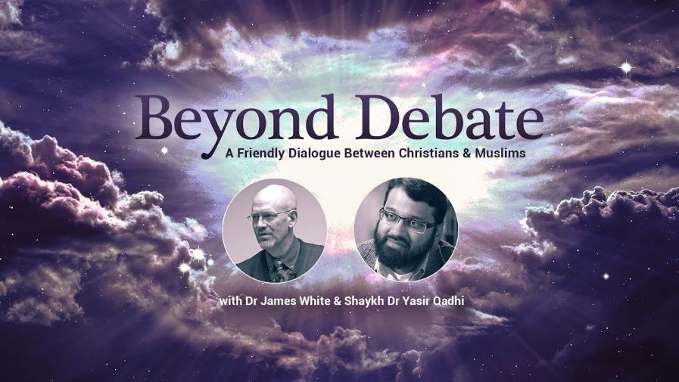

Slide 48
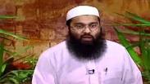
  “As for eighty to ninety percent of the Jews in our times, they are Ashkenazi…Russians…Look at them! White, crooked nose, blonde hairs. This is not the descendent of Yakub [Jacob]. These are not a Semitic people. Look at them! They don’t look like Semites and they are not Semites…Hitler never intended to mass-destroy the Jews. There are a number of books out written by Christians on this, you should read them. The Hoax of the Holocaust, I advise you to read this book, you may want to write this down, the Hoax of the Holocaust, a very good book. All of this is false propaganda and I know it sounds so far-fetched, and these theories, but read it. The evidences are very strong. And they’re talking about newspaper articles, clippings, everything and look up yourself what Hitler really wanted to do…but what the Jews, the way that they portray him, also is not correct.”
Yasir Qhadi
https://www.youtube.com/watch?v=OGOO5FcAE8E

Slide 49
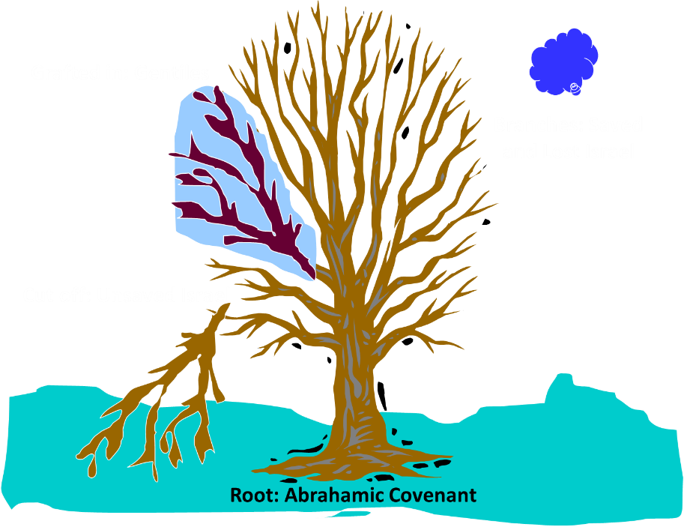
Notes:
49

Slide 50

Romans 11:13, 17-21
“But I am speaking to you who are Gentiles. Inasmuch then as I am an apostle of Gentiles, I magnify my ministry…But if some of the branches were broken off, and you, being a wild olive, were grafted in among them and became partaker with them of the rich root of the olive tree, ¹⁸ do not be arrogant toward the branches; but if you are arrogant, remember that it is not you who supports the root, but the root supports you. ¹⁹ You will say then, “Branches were broken off so that I might be grafted in.” ²⁰ Quite right, they were broken off for their unbelief, but you stand by your faith. Do not be conceited, but fear; ²¹ for if God did not spare the natural branches, He will not spare you, either.”

Slide 51
Romans 11:28-29
“From the standpoint of the gospel they are enemies for your sake, but from the standpoint of God’s choice they are beloved for the sake of the fathers; ²⁹ for the gifts and the calling of God are irrevocable.”

Slide 52
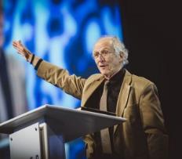
John Piper
John Piper, cited in Paul R. Wilkinson, Israel Betrayed: Volume 2: The Rise of Christian Palestinianism (San Antonio, TX: Ariel, 2018), 331-32.
“[God] has a saving purpose for Israel. All Israel will someday turn to the Lord Christ as a group. This is my deep understanding in belief of Romans 11. The broken off branches will be grafted in one day to the people of God, the bride of Christ, His church.”

Slide 53
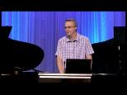
Paul Wilkinson
Paul R. Wilkinson, Israel Betrayed: Volume 2: The Rise of Christian Palestinianism (San Antonio, TX: Ariel, 2018), 332.
“On the basis of this kind of statement, many in the church are being misled into believing that Piper stands with Israel, but he does not. What Piper said is not what Paul taught. Israel’s destiny as a nation is not one of spiritual incorporation into the church, which is the classic Reformed, Calvinistic teaching. The church comprises individual Jews and Gentiles, not ‘Israel,’ which is a distinct national entity. The appointed destiny for Israel is for her to remain a nation in the sight of God and in the midst of all the nations, for as long as God’s ‘fixed order’ of creation endures (Jer. 31:36).”

Slide 54

Jeremiah 31:35-37
“Thus says the Lord, Who gives the sun for light by day And the fixed order of the moon and the stars for light by night, Who stirs up the sea so that its waves roar; The Lord of hosts is His name:³⁶ “If this fixed order departs From before Me,” declares the Lord, “Then the offspring of Israel also will cease From being a nation before Me forever.”³⁷ Thus says the Lord, “If the heavens above can be measured And the foundations of the earth searched out below, Then I will also cast off all the offspring of Israel For all that they have done,” declares the Lord.”

Slide 55
The Prophetic Implications of Calvinism
De-emphasis of Biblical Eschatology
Calvin’s mishandling of prophetic texts
Anti-Semitism
Implications of a lack of an Israel‒Church distinction
Neo-Calvinism as a fulfillment of Bible prophecy

Slide 56
Dispensational Theology is a
System of Theology
Traditional-normative dispensational theology is a system that embodies three essential, fundamental concepts called the sine qua non (lit. “without which is not”):
The consistent use of a plain, normal, literal, grammatical-historical method of interpretation;
Which reveals that the Church is distinct from Israel;
God’s overall purpose is to bring glory to Himself (Eph. 1:6, 12, 14).
Dr. Charles Ryrie, Dispensationalism, pp. 38-41

Slide 57
Augustine
The City of God, trans., Marcus Dods (NY: Random House, 1950), Book XX, chap. 9, p. 725-26.
Augustine wrote, “the saints reign with Christ during the same thousand years, understood in the same way, that is, of the time of His first coming” and “Therefore the Church even now is the kingdom of Christ, and the kingdom of heaven. Accordingly, even now His saints reign with Him.”

Slide 58
Augustine
The City of God, trans., Marcus Dods (NY: Random House, 1950), Book XX, chap. 7, p. 719.
“And this opinion would not be objectionable…for I myself, too, once held this opinion. But, as they assert that those who then rise again shall enjoy the leisure of immoderate carnal banquets, furnished with an amount of meat and drink such as not only to shock the feeling of the temperate, but even to surpass the measure of credulity itself, such assertions can be believed only by the carnal. They who do believe them are called by the spiritual Chiliasts, which we may literally reproduce by the name Millenarians.”

Slide 59

John Calvin
Institutes of the Christian Religion, III, xxv, 5.
“But Satan has not only befuddled men’s senses to make them bury with the corpses the memory of resurrection; he has also attempted to corrupt this part of the doctrine with various falsifications…Now their fiction is too childish either to need or to be worth a refutation. And the Apocalypse, from which they undoubtedly drew a pretext for their error, does not support them. For the number ‘one thousand’ [Rev. 20:4] does not apply to the eternal blessedness of the church but only to the various disturbances that awaited the church, while still toiling on earth…Those who assign the children of God a thousand years in which to enjoy the inheritance of the life to come do not realize how much reproach they are casting upon Christ and his Kingdom.”

Slide 60

THE NEW ISRAEL?
“We’re not dispensationalists here....We believe that the church is essentially Israel. We believe that the answer to, ‘What about the Jews?’ is, ‘Here we are.’ We deny that the church is God’s ‘plan B.’ We deny that we are living in God’s redemptive parenthesis. There, we are again one people. In His holy and heavenly temple there is neither Jew nor Greek, male nor female, pre-mil nor post-mil. There, we are all together, the Israel of God, princes with God, and the ekklesia, the set apart ones.”
From Table Talk magazine, Spring of 1999, p. 2 (inside cover), by R. C. Sproul Jr., editor, emphasis is mine

Slide 61
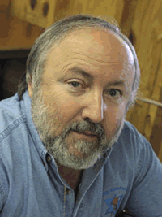
Arnold G. Fruchtenbaum
George Zeller, “Is R. C. Sproul Jr. Really A Jew?,” online: http://www.middletownbiblechurch.org/reformed/sprouljr.htm, accessed 17 February 2018.
“We believe that the answer to, ‘What about the Jews?’ is, ‘Here we are.’ I shared this comment with a friend of mine who is a converted Jew. He was born in Russia after his parents were released from a Communist prison. With the help of the Israeli underground, his family escaped from behind the Iron Curtain. He received Orthodox Jewish training while living in Germany from 1947 to 1951 and then his family immigrated to New York. He is a dedicated servant of Christ and a respected author. When told about Sproul Jr.’s comment ‘Here we are. [We are the Jews]’ he commented, ‘It’s a good thing he was not declaring this on the streets of Berlin, Germany around 1941!’”

Slide 62
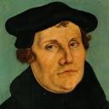
Martin Luther
Alister E. McGrath, Reformation Thought: An Introduction (Grand Rapids: Baker, 1995), 179.
He believed that “such sacraments could generate faith; and hence baptism could generate faith of an infant.”
Notes:
Outline

Slide 63
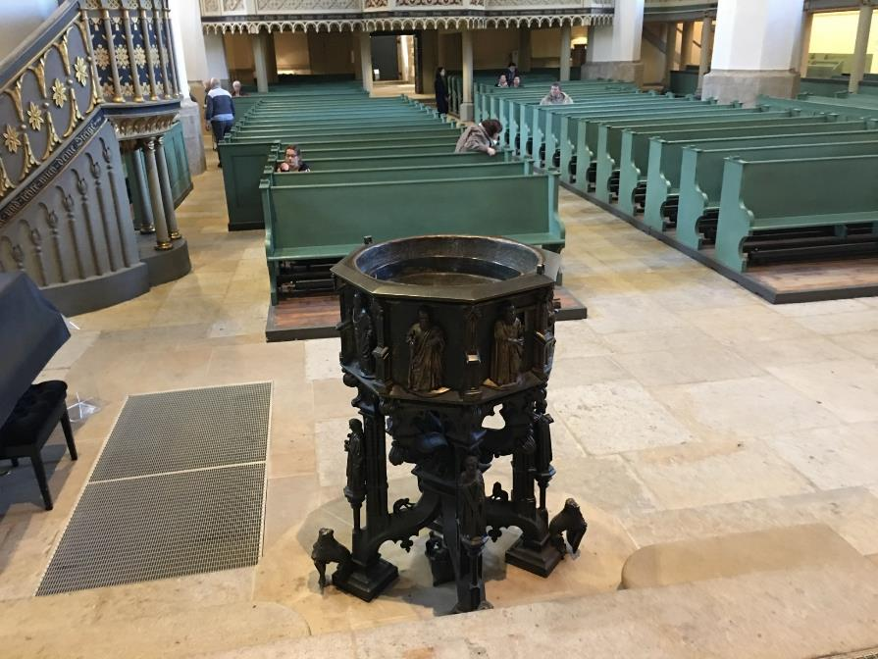

Slide 64

R.C. Sproul
https://www.ligonier.org/learn/devotionals/the-infant-baptism-question/
“The Eastern Orthodox, Roman Catholic, Lutheran, Anglican, and Reformed churches all practice infant baptism. Today we want to look at…lines of evidence that show the validity of this practice. …just as baptism is the sign of entrance into the community of the new covenant, so circumcision was the sign of entrance into the core community of the old covenant (the people of Israel; God-fearing Gentiles did not have to be circumcised).…The absence of controversy anywhere in the early church indicates that the church was comfortable with infant baptism, and was carrying on the apostolic tradition of the New Testament.”

Slide 65

Alva J. McClain
Alva J. McClain, The Greatness of the Kingdom: An Inductive Study of the Kingdom of God as Set Forth in the Scriptures (Grand Rapids: Zondervan, 1959), 438-39.
“Theological confusion, especially in matters which have to do with the church, will inevitably produce consequences which are of grave practical concern. The identification of the Kingdom with the church has led historically to ecclesiastical policies and programs which, even when not positively evil, have been far removed from the original simplicity of the New Testament ekklēssia. It is easy to claim that in the ‘present kingdom of grace’ that the rule of the saints is wholly ‘spiritual,’ exerted only through moral principles and influence. But practically, once the church becomes the Kingdom in any realistic theological sense, it is impossible to draw any clear line between principles and their implementation through political and social devices. For the logical implications of a present ecclesiastical kingdom are unmistakable, and historically have always led in one direction, i.e., political control of the state by the church.”

Slide 66
Alva J. McClain
Alva J. McClain, The Greatness of the Kingdom: An Inductive Study of the Kingdom of God as Set Forth in the Scriptures (Grand Rapids: Zondervan, 1959), 438-39.
“The distances traveled down this road by various religious movements, and the forms of control which were developed, have been widely different. The difference is very great between the Roman Catholic system and modern Protestant efforts to control the state; also between the ecclesiastical rule of Calvin in Geneva and the fanaticism of Münster and the English ‘fifth-monarchy.’ But the basic assumption is always the same: The church in some sense is the kingdom, and therefore has a divine right to rule; or it is the business of the church to ‘establish’ fully the Kingdom of God among men. Thus the church loses its pilgrim character and the sharp edge of its divinely commissioned ‘witness’ is blunted. It becomes an ekklēssia which is not only in the world, but also of the world. It forgets that just as in the regeneration of the soul only God can effect the miracle, even so the ‘regeneration’ of the world can only be wrought by the intrusion of regal power from on high (Matt. 19:28).”

Slide 67

Philip Schaff
History of the Christian Church, vol. 8 , p. 700.
“The Reformers inherited the doctrine of persecution from their mother Church, and practiced it as far as they had the power. They fought intolerance with intolerance. They differed favorably from their opponents in the degree and extent, but not in the principle, of intolerance. They broke down the tyranny of popery, and thus opened the way for the development of religious freedom; but they denied to others the liberty which they exercised themselves. The Protestant governments in Germany and Switzerland excluded, within the limits of their jurisdiction, the Roman Catholics from all religious and civil rights, and took exclusive possession of their churches, convents, and other property. They banished, imprisoned, drowned, beheaded, hanged, and burned Anabaptists, Antitrinitarians, Schwenkfeldians, and other dissenters.”

Slide 68
Edward Gibbon
Decline and Fall, ch. LIV.
“The Reformers came out of Roman Catholicism which was known for its intolerance and persecution of anyone who differed from Catholic dogma, as anyone who has studied the Spanish Inquisition fully knows. The tragedy is that John Calvin and some of the other Reformers, became shamefully intolerant of those who differed from their doctrinal position, even to the point of executing the offender!” “The Reformers were ambitious of succeeding the tyrants whom they had dethroned. They imposed with equal rigor their creeds and confessions; they asserted the right of the magistrate to punish heretics with death. The nature of the tiger was the same...”
Initial quote by George Zeller, “Should We Go Back to the Reformation?” online: www.middletownbiblechurch.org/reformed/backto.htm, accessed 22 November 2019

Slide 69
Dave Hunt
“Calvinism Denied,” in Debating Calvinism: Five Points, Two Views, ed. Dave Hunt and James White (Sisters, OR: Multnomah, 2004), pp. 23-24.
“In February of 1555, Calvin’s supporters gained the absolute majority on the council [in Geneva]. On May 16, there was an attempted uprising because Calvin had excluded certain libertarian civic officials from the Lord’s Supper. Leaders of the rebellion who fled to Bern were sentenced to death in abstentia. Four who failed to escape were beheaded, quartered, and their body parts hung in strategic locations as a warning. Evoking the phrase ‘henchmen of Satan,’ which he had used years earlier against the Anabaptists, Calvin justified this barbarity by saying, ‘Those who do not correct evil when they can do so and their office requires it are guilty of it.’ From 1554 until his death in 1564, ‘no one any longer dared oppose the Reformer [Calvin] openly.’”

Slide 71
Dispensational Theology is a
System of Theology
Traditional-normative dispensational theology is a system that embodies three essential, fundamental concepts called the sine qua non (lit. “without which is not”):
The consistent use of a plain, normal, literal, grammatical-historical method of interpretation;
Which reveals that the Church is distinct from Israel;
God’s overall purpose is to bring glory to Himself (Eph. 1:6, 12, 14).
Dr. Charles Ryrie, Dispensationalism, pp. 38-41

Slide 72

Premillennialism and Racism
“To understand this, we must account for the pre-millennial view that had come to dominate the American evangelical worldview and played a role in limiting evangelical social action on the race issues. According to this view, the present world is evil and will inevitably suffer moral decline until Christ comes again. Thus, to devote oneself to social reform is futile. The implications of this view were clearly expressed by Billy Graham. In response to King’s famous ‘I have a dream’ speech that his children might one day play together with white children, …
Michael O. Emerson and Christian Smith, Divided by Faith: Evangelical Religion and the Problem of Race in America (New York: Oxford University Press, 2000), 47.

Slide 73
Premillennialism and Racism (cont’d)
…Graham, who had been invited but did not attend the 1963 march on Washington, said: ‘only when Christ comes again will little white children of Alabama walk hand-in-hand with little black children.’ This was not meant to be harsh, but rather what he and most white evangelicals perceived to be realistic.”
Michael O. Emerson and Christian Smith, Divided by Faith: Evangelical Religion and the Problem of Race in America (New York: Oxford University Press, 2000), 47.

Slide 74

John MacArthur
John MacArthur Jr. writes:
“There is a tendency, however, for dispensationalists to get carried away with compartmentalizing truth to the point that they make unbiblical differentiations. An almost obsessive desire to categorize and contrast related truths has carried various dispensationalist interpreters (Chafer, Ryrie, Hodges, etc.) far beyond the legitimate distinctions between Israel and the Church. Many would also draw hard lines between salvation and discipleship (justification and sanctification), the church and the kingdom, Christ's preaching and the apostolic message, faith and repentance, and the age of law and the age of grace." (bold & emphasis mine) The Gospel According to Jesus, page 31

Slide 75
John MacArthur
“I was raised in a dispensational environment; there’s no question… But, as I got into seminary, I began to test some of those things. I have been perhaps aptly designated as a leaky dispensationalist…. Here’s my dispensationalism – I’ll give it to you in one sentence: there’s a difference between the church and Israel – period!...
At the same time in seminary, I began to be exposed to reading among more Reformed theologians… And over the years of exegeting the scripture, it has again yielded to me a Reformed theology….”

Slide 76
John MacArthur
“I was convinced of it (Reformed theology) when I started and I’m more convinced of it now as I’ve gone through the text. I was convinced of it when I started because I read so many noble men who have held that view (Reformed Theology). It was more at that point hero worship, and now it’s become my own.” (bold mine)
Transcribed from tape, #GC 70-15, entitled "Bible Questions and Answers." A copy of the tape can be obtained by writing, Word of Grace, P.O. Box 4000, Panorama City, CA 91412. Copyright 1994 by John MacArthur Jr., All Rights Reserved.
(My point here is only to demonstrate how John MacArthur, who claims to be a dispensationalist, has arrived at his position on Lordship salvation.)

Slide 77
John MacArthur
“When I wrote [GAJ] I didn’t know anybody outside of my circles really, and I didn’t know how this book would be received. But Jim Boice agreed to write the foreword, and John Piper wrote an endorsement that was absolutely stunning to me, because I was really not moving in Reformed circles at that time. I was a leaky dispensationalist. That was my world, and I realized that I was much more one of you than I was one of them.” Interview with John Piper and Justin Taylor, Stand, p. 129.

Slide 78
John MacArthur
“The lordship debate has had a devastating effect on dispensationalism. Because no-lordship theology [a pejorative term for Free Grace] is so closely associated with dispensationalism, many have imagined a cause-and-effect relationship between the two...Frankly, some mongrel species of dispensationalism [which he has defined as the Dispensationalism of Ryrie, Chafer, and others] ought to die, and I will be happy to join the cortege.” “The Gospel According to the Apostles,” page 221

Slide 79
John MacArthur
“Who are the defenders of no-lordship dispensationalism? Nearly all of them stand in a tradition that has its roots in the teaching of Lewis Sperry Chafer. I will show…that Dr. Chafer is the father of modern no-lordship teaching. Every prominent figure on the no-lordship side descends from Dr. Chafer’s spiritual lineage. Though Dr. Chafer did not invent or originate any of the key elements of no-lordship teaching, he codified the system of dispensationalism on which all contemporary no-lordship doctrine is founded. That system is the common link between those who attempt to defend no-lordship doctrine on theological grounds.” “The Gospel According to the Apostles,” page 35

Slide 80
The Prophetic Implications of Calvinism
De-emphasis of Biblical Eschatology
Calvin’s mishandling of prophetic texts
Anti-Semitism
Implications of a lack of an Israel‒Church distinction
Neo-Calvinism as a fulfillment of Bible prophecy

Slide 81
Calvinism as a Prophetic Fulfillment
      Apostasy (1 Tim. 4:1; 2 Tim. 3:1-13)
      Holds to a Form of Godliness (2 Tim. 3:5)
      Works based salvation (2 Tim. 4:3-4)
      Divides churches and families (Matt. 10:36)

Slide 82
Calvinism as a Prophetic Fulfillment
      Apostasy (1 Tim. 4:1; 2 Tim. 3:1-13)
      Holds to a Form of Godliness (2 Tim. 3:5)
      Works based salvation (2 Tim. 4:3-4)
      Divides churches and families (Matt. 10:36)

Slide 83
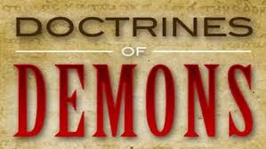
1 Timothy 4:1
“But the Spirit explicitly says that in later times some will fall away from the faith, paying attention to deceitful spirits and doctrines of demons.”

Slide 84
Calvinism as a Prophetic Fulfillment
      Apostasy (1 Tim. 4:1; 2 Tim. 3:1-13)
      Holds to a Form of Godliness (2 Tim. 3:5)
      Works based salvation (2 Tim. 4:3-4)
      Divides churches and families (Matt. 10:36)

Slide 85


2 Timothy 3:5
“holding to a form of godliness, although they have denied its power; Avoid such men as these.”

Slide 86
Calvinism as a Prophetic Fulfillment
      Apostasy (1 Tim. 4:1; 2 Tim. 3:1-13)
      Holds to a Form of Godliness (2 Tim. 3:5)
      Works based salvation (2 Tim. 4:3-4)
      Divides churches and families (Matt. 10:36)

Slide 87
2 Timothy 4:3-4
“³ For the time will come when they will not endure sound doctrine; but wanting to have their ears tickled, they will accumulate for themselves teachers in accordance to their own desires, ⁴ and will turn away their ears from the truth and will turn aside to myths.”

Slide 88
Calvinism as a Prophetic Fulfillment
      Apostasy (1 Tim. 4:1; 2 Tim. 3:1-13)
      Holds to a Form of Godliness (2 Tim. 3:5)
      Works based salvation (2 Tim. 4:3-4)
      Divides churches and families (Matt. 10:36)

Slide 89
Matthew 10:34-36
“³⁴ “Do not think that I came to bring peace on the earth; I did not come to bring peace, but a sword. ³⁵ For I came to set a man against his father, and a daughter against her mother, and a daughter-in-law against her mother-in-law; ³⁶ and a man’s enemies will be the members of his household.”

Slide 90
Conclusion

Slide 91
Neo-Calvinism vs. The Bible
Calvinism’s Mixed Blessing
Why Critique Calvinism?
The Source of Calvin’s Theology
Calvin’s Manner of Life
TULIP Through the Grid of Scripture
Conclusion

Slide 92
II. Why Critique Calvinism?
General calling to defend the faith (Jude 3)
The call to admonish fellow believers (2 Thess. 3:15)
Calvinism is a serious issue
The prophetic implications of Calvinism

Slide 93
II. Why Critique Calvinism?
General calling to defend the faith (Jude 3)
The call to admonish fellow believers (2 Thess. 3:15)
Calvinism is a serious issue
The prophetic implications of Calvinism

Slide 94
The Prophetic Implications of Calvinism
De-emphasis of Biblical Eschatology
Calvin’s mishandling of prophetic texts
Anti-Semitism
Implications of a lack of an Israel‒Church distinction
Neo-Calvinism as a fulfillment of Bible prophecy

