Slide 1
Genesis 12‒50
Israel’s Birth & Preservation

Slide 2
GENESIS STRUCTURE
Genesis 12-50 (four people)
Abraham (12:1–25:11)
Isaac (25:12–26:35)
Jacob (27–36)
Joseph (37–50)

Slide 3
Genesis 37‒50 Joseph
Joseph sold unto Egypt (37)
Canaan’s corruption (38)
Joseph falsely accused (39)
Joseph’s short-term predictions (40)
Joseph’s elevation (41)
Joseph’s first reunion with his brothers (42)
Joseph’s second reunion with his brothers (43‒45)

Slide 4
Genesis 43‒45 Second Reunion
Jacob sends sons to Egypt (43:1-14)
Second reunion with Joseph (43:15-34)
Benjamin’s arrest (44:1-17)
Judah’s intercession (44:18-34)
Joseph’s revelation (45:1-15)
Pharaoh’s invitation (45:16-20)
Brothers return to Jacob (45:21-28)

Slide 5
V. Genesis 45:1-15 Joseph’s Revelation
Circumstances (1-2)
Joseph’s self- identification (3-4)
Joseph comforts his brothers (5-8)
Joseph’s instructions to his brothers (9-13)
Joseph kisses his brothers (14-15)

Slide 6
Genesis 45:10-11a Residence in Goshen
Place (10a)
Family reunion (10b)
Provision (11a)

Slide 7
Genesis 37‒50 Joseph
Joseph sold unto Egypt (37)
Canaan’s corruption (38)
Joseph falsely accused (39)
Joseph’s short-term predictions (40)
Joseph’s elevation (41)
Joseph’s first reunion with his brothers (42)
Joseph’s second reunion with his brothers (43‒45)

Slide 8
Genesis 15:16
“Then in the fourth generation they will return here, for the wrongdoing of the Amorite is not yet complete.”

Slide 10
God’s Provision (Phil. 4:19)
Exodus 16
1 Kings 17:2-6
Psalm 37:25
Matthew 6:25-34

Slide 11
Genesis 45:9c-13 Content
Joseph’s elevation (9c)
Invitation (9d)
Residence in Goshen (10-11a)
Reason: timing (11b)
Witnesses (12)
What brothers are to do (13)

Slide 13
Jeremiah 31:35-37
“Thus says the Lord, Who gives the sun for light by day And the fixed order of the moon and the stars for light by night, Who stirs up the sea so that its waves roar; The Lord of hosts is His name:³⁶ “If this fixed order departs From before Me,” declares the Lord, “Then the offspring of Israel also will cease From being a nation before Me forever.”³⁷ Thus says the Lord, “If the heavens above can be measured And the foundations of the earth searched out below, Then I will also cast off all the offspring of Israel For all that they have done,” declares the Lord.”

Slide 14
Daniel 9:27
And he will make a firm covenant with the many for one week, but in the middle of the week he will put a stop to sacrifice and grain offering; and on the wing of abominations will come one who makes desolate, even until a complete destruction, one that is decreed, is poured out on the one who makes desolate.

Slide 16
Zechariah 12:10
“I will pour out on the house of David and on the inhabitants of Jerusalem, the Spirit of grace and of supplication, so that they will look on Me whom they have pierced; and they will mourn for Him, as one mourns for an only son, and they will weep bitterly over Him like the bitter weeping over a firstborn.”

Slide 17
Zechariah 13:8-9
⁸“It will come about in all the land,” Declares the Lord, “That two parts in it will be cut off and perish; But the third will be left in it. ⁹“And I will bring the third part through the fire, Refine them as silver is refined, And test them as gold is tested. They will call on My name, And I will answer them; I will say, ‘They are My people,’ And they will say, ‘The Lord is my God.’ ”

Slide 18
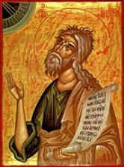
Jeremiah 30:7
“Alas! for that day is great, There is none like it; And it is the time of Jacob’s distress (Gen. 32:8; 35:10), But he will be saved from it.”

Slide 19
Genesis 45:9c-13 Content
Joseph’s elevation (9c)
Invitation (9d)
Residence in Goshen (10-11a)
Reason: timing (11b)
Witnesses (12)
What brothers are to do (13)

Slide 21
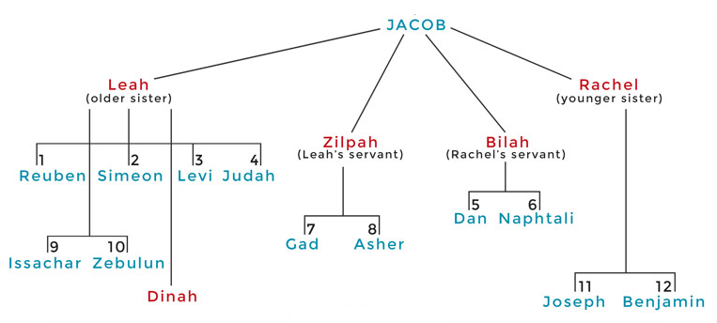

Slide 22
Genesis 45:9c-13 Content
Joseph’s elevation (9c)
Invitation (9d)
Residence in Goshen (10-11a)
Reason: timing (11b)
Witnesses (12)
What brothers are to do (13)

Slide 23
Genesis 45:13 What Brothers Are to Do
Tell of Egypt’s glory (13a)
Accomplish quickly (13b)

Slide 24
Genesis 45:13 What Brothers Are to Do
Tell of Egypt’s glory (13a)
Accomplish quickly (13b)

Slide 25
Genesis 45:13 What Brothers Are to Do
Tell of Egypt’s glory (13a)
Accomplish quickly (13b)

Slide 26
V. Genesis 45:1-15 Joseph’s Revelation
Circumstances (1-2)
Joseph’s self- identification (3-4)
Joseph comforts his brothers (5-8)
Joseph’s instructions to his brothers (9-13)
Joseph kisses his brothers (14-15)

Slide 27
Genesis 45:14-15 Joseph’s Kisses His Brothers
Joseph kisses Benjamin (14)
Joseph kisses rest of brothers (15)

Slide 28
Genesis 45:14-15 Joseph’s Kisses His Brothers
Joseph kisses Benjamin (14)
Joseph kisses rest of brothers (15)

Slide 29
Luke 19:41-44
^{41 “}When He approached Jerusalem, He saw the city and wept over it, ⁴² saying, “If you had known in this day, even you, the things which make for peace! But now they have been hidden from your eyes. ⁴³ For the days will come upon you when your enemies will throw up a barricade against you, and surround you and hem you in on every side, ⁴⁴ and they will level you to the ground and your children within you, and they will not leave in you one stone upon another, because you did not recognize the time of your visitation.”

Slide 30
Christ’s Human Experiences
Labor (Mark 6:3)
Distress (Luke 22:44)
Being troubled (John 12:27)
Thirst (John 19:28)
Hunger (Matt 4:2)
Fatigue (John 4:6)
Sadness (John 11:35)
Lack of understanding (Matt 24:36)
Temptation (Luke 4:1-13; Heb. 4:15)

Slide 31
Hebrews 2:18
“For since He Himself was tempted in that which He has suffered, He is able to come to the aid of those who are tempted.”

Slide 32
Hebrews 4:15-16
^{15 “}For we do not have a high priest who cannot sympathize with our weaknesses, but One who has been tempted in all things as we are, yet without sin. ¹⁶ Therefore let us draw near with confidence to the throne of grace, so that we may receive mercy and find grace to help in time of need.”

Slide 33
Daniel 9:27
And he will make a firm covenant with the many for one week, but in the middle of the week he will put a stop to sacrifice and grain offering; and on the wing of abominations will come one who makes desolate, even until a complete destruction, one that is decreed, is poured out on the one who makes desolate.

Slide 35
Zechariah 12:10
“I will pour out on the house of David and on the inhabitants of Jerusalem, the Spirit of grace and of supplication, so that they will look on Me whom they have pierced; and they will mourn for Him, as one mourns for an only son, and they will weep bitterly over Him like the bitter weeping over a firstborn.”

Slide 36
Zechariah 13:8-9
⁸“It will come about in all the land,” Declares the Lord, “That two parts in it will be cut off and perish; But the third will be left in it. ⁹“And I will bring the third part through the fire, Refine them as silver is refined, And test them as gold is tested. They will call on My name, And I will answer them; I will say, ‘They are My people,’ And they will say, ‘The Lord is my God.’ ”

Slide 37
Jeremiah 30:7
“Alas! for that day is great, There is none like it; And it is the time of Jacob’s distress (Gen. 32:8; 35:10), But he will be saved from it.”

Slide 38
Genesis 45:14-15 Joseph’s Kisses His Brothers
Joseph kisses Benjamin (14)
Joseph kisses rest of brothers (15)

Slide 41
Luke 19:41-44
^{41 “}When He approached Jerusalem, He saw the city and wept over it, ⁴² saying, “If you had known in this day, even you, the things which make for peace! But now they have been hidden from your eyes. ⁴³ For the days will come upon you when your enemies will throw up a barricade against you, and surround you and hem you in on every side, ⁴⁴ and they will level you to the ground and your children within you, and they will not leave in you one stone upon another, because you did not recognize the time of your visitation.”

Slide 42
Christ’s Human Experiences
Labor (Mark 6:3)
Distress (Luke 22:44)
Being troubled (John 12:27)
Thirst (John 19:28)
Hunger (Matt 4:2)
Fatigue (John 4:6)
Sadness (John 11:35)
Lack of understanding (Matt 24:36)
Temptation (Luke 4:1-13; Heb. 4:15)

Slide 43
Hebrews 2:18
“For since He Himself was tempted in that which He has suffered, He is able to come to the aid of those who are tempted.”

Slide 44
Hebrews 4:15-16
^{15 “}For we do not have a high priest who cannot sympathize with our weaknesses, but One who has been tempted in all things as we are, yet without sin. ¹⁶ Therefore let us draw near with confidence to the throne of grace, so that we may receive mercy and find grace to help in time of need.”

Slide 45
Genesis 43‒45 Second Reunion
Jacob sends sons to Egypt (43:1-14)
Second reunion with Joseph (43:15-34)
Benjamin’s arrest (44:1-17)
Judah’s intercession (44:18-34)
Joseph’s revelation (45:1-15)
Pharaoh’s invitation (45:16-20)
Brothers return to Jacob (45:21-28)

Slide 46
VI. Genesis 45:16-20 Pharaoh’s Invitation
Circumstances (16)
Invitation (17-20)

Slide 47
VI. Genesis 45:16-20 Pharaoh’s Invitation
Circumstances (16)
Invitation (17-20)

Slide 48
Genesis 45:16 Circumstances
Report (16a)
Result (16b)

Slide 49
Genesis 45:16 Circumstances
Report (16a)
Result (16b)

Slide 50
Genesis 45:16 Circumstances
Report (16a)
Result (16b)

Slide 51
VI. Genesis 45:16-20 Pharaoh’s Invitation
Circumstances (16)
Invitation (17-20)

Slide 52
Genesis 45:17-20 Invitation
Instructions (17)
Bring entire household (18)
Provision (19)
Lack of concern (20)

Slide 53
Genesis 45:17-20 Invitation
Instructions (17)
Bring entire household (18)
Provision (19)
Lack of concern (20)

Slide 55
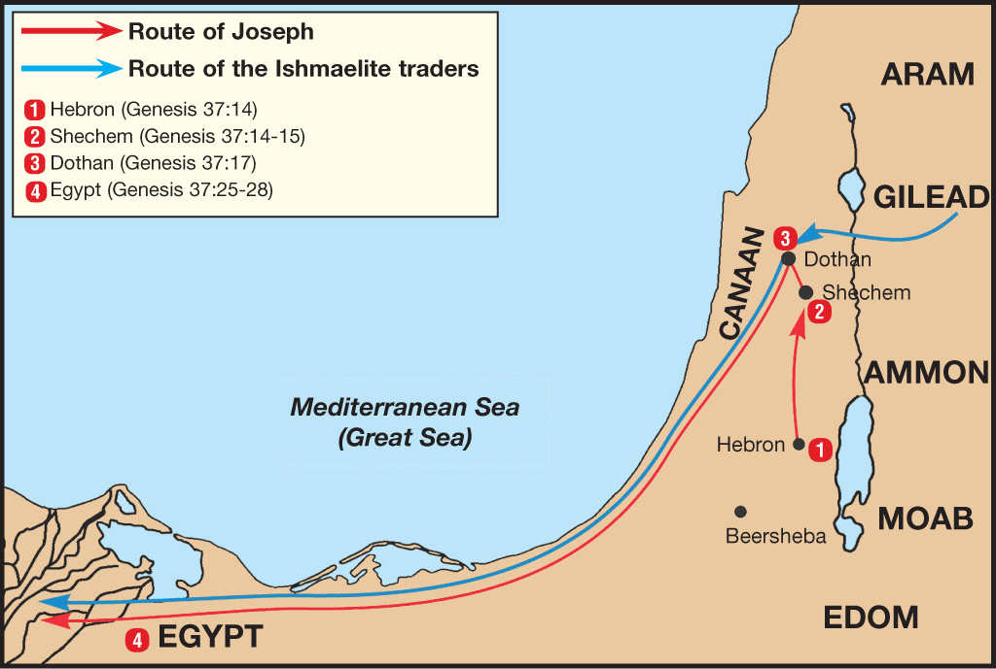

Slide 56
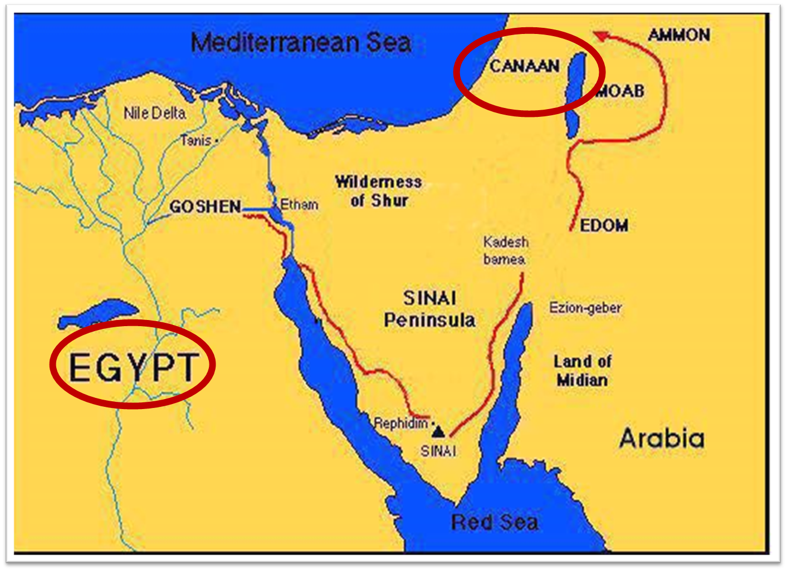

Slide 57
Genesis 45:17-20 Invitation
Instructions (17)
Bring entire household (18)
Provision (19)
Lack of concern (20)

Slide 60
Genesis 45:17-20 Invitation
Instructions (17)
Bring entire household (18)
Provision (19)
Lack of concern (20)

Slide 61
God’s Provision (Phil. 4:19)
Exodus 16
1 Kings 17:2-6
Psalm 37:25
Matthew 6:25-34

Slide 63
Genesis 45:17-20 Invitation
Instructions (17)
Bring entire household (18)
Provision (19)
Lack of concern (20)

Slide 64
Dr. Arnold G. Fruchtenbaum
The Book of Genesis, 570
“Therefore, a total separation of twenty years existed from the time he had last seen members of his family until they were reunited in Egypt. The Hyksos Period, during which Joseph’s story unfolds, was the two-hundred-year period from 1750 until 1550 B.C. The Hyksos were Semitic rulers that conquered Egypt and ruled during the sixteenth and seventeenth dynasties. Thus, the Pharaoh at the time of Joseph was Semitic. This explains how a Semite such as Joseph could rise to the second highest position in Egypt, which had a Hamitic population.”

Slide 65
Dr. Arnold G. Fruchtenbaum
The Book of Genesis, 601
“Now this is all coming out of the initiation of Pharaoh, and all Pharaoh knew at this point was that this was Joseph’s family. He knew nothing about them per se. This shows the high regard and respect Pharaoh had for Joseph, that he was willing to issue this invitation. Such an invitation coming from an Egyptian Pharaoh for Semites was only possible during the Hyksos’s rule. Later Egyptian Pharaohs would never have allowed this to take place. However, the Hyksos being the Semitic conquerors of Egypt and ruling at this point in time made it possible for another Semitic family to be invited down.”

Slide 66
Genesis 43‒45 Second Reunion
Jacob sends sons to Egypt (43:1-14)
Second reunion with Joseph (43:15-34)
Benjamin’s arrest (44:1-17)
Judah’s intercession (44:18-34)
Joseph’s revelation (45:1-15)
Pharaoh’s invitation (45:16-20)
Brothers return to Jacob (45:21-28)

Slide 67
VII. Genesis 45:21-28 Brothers’ Return to Jacob
Provisions (21-23)
Departure (24)
Journey home (25)
Report to Jacob (26-28)

Slide 68
VII. Genesis 45:21-28 Brothers’ Return to Jacob
Provisions (21-23)
Departure (24)
Journey home (25)
Report to Jacob (26-28)

Slide 69
Genesis 45:21-23 Provisions
Brothers’ obedience (21a)
Provisions (21b-23)

Slide 70
Genesis 45:21-23 Provisions
Brothers’ obedience (21a)
Provisions (21b-23)

Slide 71
Genesis 45:21-23 Provisions
Brothers’ obedience (21a)
Provisions (21b-23)

Slide 72
Genesis 45:21b-13 Content
Wagons (21b)
Food (21c)
Clothing (22a)
Provisions for Benjamin (22b)
Provisions for Jacob (23)

Slide 73
Genesis 45:21b-13 Content
Wagons (21b)
Food (21c)
Clothing (22a)
Provisions for Benjamin (22b)
Provisions for Jacob (23)

Slide 74
Genesis 45:21b-13 Content
Wagons (21b)
Food (21c)
Clothing (22a)
Provisions for Benjamin (22b)
Provisions for Jacob (23)

Slide 75
Genesis 45:21b-13 Content
Wagons (21b)
Food (21c)
Clothing (22a)
Provisions for Benjamin (22b)
Provisions for Jacob (23)

Slide 76
Genesis 45:21b-13 Content
Wagons (21b)
Food (21c)
Clothing (22a)
Provisions for Benjamin (22b)
Provisions for Jacob (23)

Slide 79
Genesis 45:21b-13 Content
Wagons (21b)
Food (21c)
Clothing (22a)
Provisions for Benjamin (22b)
Provisions for Jacob (23)

Slide 80
VII. Genesis 45:21-28 Brothers’ Return to Jacob
Provisions (21-23)
Departure (24)
Journey home (25)
Report to Jacob (26-28)

Slide 81
VII. Genesis 45:21-28 Brothers’ Return to Jacob
Provisions (21-23)
Departure (24)
Journey home (25)
Report to Jacob (26-28)

Slide 85
VII. Genesis 45:21-28 Brothers’ Return to Jacob
Provisions (21-23)
Departure (24)
Journey home (25)
Report to Jacob (26-28)

Slide 86
Genesis 45:26-28 Report to Jacob
News about Joseph (26a)
Jacob’s reaction (26b)
Report from Joseph (27a)
Jacob persuaded (27b)
Result (28)

Slide 87
Genesis 45:26-28 Report to Jacob
News about Joseph (26a)
Jacob’s reaction (26b)
Report from Joseph (27a)
Jacob persuaded (27b)
Result (28)

Slide 88
Genesis 45:26-28 Report to Jacob
News about Joseph (26a)
Jacob’s reaction (26b)
Report from Joseph (27a)
Jacob persuaded (27b)
Result (28)

Slide 89
Genesis 45:26-28 Report to Jacob
News about Joseph (26a)
Jacob’s reaction (26b)
Report from Joseph (27a)
Jacob persuaded (27b)
Result (28)

Slide 90
Genesis 45:26-28 Report to Jacob
News about Joseph (26a)
Jacob’s reaction (26b)
Report from Joseph (27a)
Jacob persuaded (27b)
Result (28)

Slide 91
Genesis 45:26-28 Report to Jacob
News about Joseph (26a)
Jacob’s reaction (26b)
Report from Joseph (27a)
Jacob persuaded (27b)
Result (28)

Slide 92
Conclusion

Slide 93
Genesis 43‒45 Second Reunion
Jacob sends sons to Egypt (43:1-14)
Second reunion with Joseph (43:15-34)
Benjamin’s arrest (44:1-17)
Judah’s intercession (44:18-34)
Joseph’s revelation (45:1-15)
Pharaoh’s invitation (45:16-20)
Brothers return to Jacob (45:21-28)

Slide 94
²⁴ The Lord bless you, and keep you; ²⁵ The Lord make His face shine on you, And be gracious to you; ²⁶ The Lord lift up His countenance on you, And give you peace.
Numbers 6:24–26 (NASB95)

