Slide 2
Acts 9:1-43 Saul’s Conversion
Saul (9:1-31)
Peter (Acts 9:32-43)

Slide 3
I. Saul Acts 9:1-31
Revelation (1-9)
Healing (10-19a)
Preaching (19b-22)
Conspiracy against Saul (23-25)
Return to Jerusalem (26-30)
Saul’s progress (31)

Slide 4
Acts 9:19b-22 Saul’s Preaching
Saul’s home with the disciples (19b)
Saul’s preaching (20)
Response of the Hebrews (21)
Saul’s power (22)

Slide 5
Acts 9:19b-22 Saul’s Preaching
Saul’s home with the disciples (19b)
Saul’s preaching (20)
Response of the Hebrews (21)
Saul’s power (22)

Slide 6
Acts 9:19b-22 Saul’s Preaching
Saul’s home with the disciples (19b)
Saul’s preaching (20)
Response of the Hebrews (21)
Saul’s power (22)

Slide 7
Acts 9:19b-22 Saul’s Preaching
Saul’s home with the disciples (19b)
Saul’s preaching (20)
Response of the Hebrews (21)
Saul’s power (22)

Slide 8
Acts 9:19b-22 Saul’s Preaching
Saul’s home with the disciples (19b)
Saul’s preaching (20)
Response of the Hebrews (21)
Saul’s power (22)

Slide 9
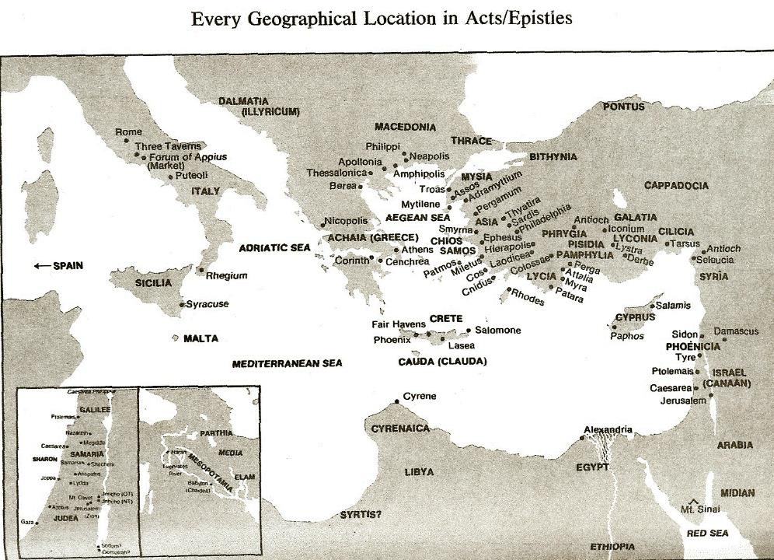

Slide 10
I. Saul Acts 9:1-31
Revelation (1-9)
Healing (10-19a)
Preaching (19b-22)
Conspiracy against Saul (23-25)
Return to Jerusalem (26-30)
Saul’s progress (31)

Slide 11
Acts 9:23-25 Conspiracy Against Saul
Plot against Saul (23)
Saul’s awareness (24a)
Plot’s execution (24b)
Saul’s escape (25)

Slide 12
Acts 9:23-25 Conspiracy Against Saul
Plot against Saul (23)
Saul’s awareness (24a)
Plot’s execution (24b)
Saul’s escape (25)

Slide 13
Acts 9:23-25 Conspiracy Against Saul
Plot against Saul (23)
Saul’s awareness (24a)
Plot’s execution (24b)
Saul’s escape (25)

Slide 14
Acts 9:23-25 Conspiracy Against Saul
Plot against Saul (23)
Saul’s awareness (24a)
Plot’s execution (24b)
Saul’s escape (25)

Slide 15
Acts 9:23-25 Conspiracy Against Saul
Plot against Saul (23)
Saul’s awareness (24a)
Plot’s execution (24b)
Saul’s escape (25)

Slide 16
I. Saul Acts 9:1-31
Revelation (1-9)
Healing (10-19a)
Preaching (19b-22)
Conspiracy against Saul (23-25)
Return to Jerusalem (26-30)
Saul’s progress (31)

Slide 17
Acts 9:26-30 Saul’s Return to Jerusalem
Jerusalem believers’ response (26)
Barnabas takes Saul to apostles (27)
Saul’s Jerusalem ministry (28-29)
Saul’s escape (30)

Slide 18
Acts 9:26-30 Saul’s Return to Jerusalem
Jerusalem believers’ response (26)
Barnabas takes Saul to apostles (27)
Saul’s Jerusalem ministry (28-29)
Saul’s escape (30)

Slide 20
Acts 9:26-30 Saul’s Return to Jerusalem
Jerusalem believers’ response (26)
Barnabas takes Saul to apostles (27)
Saul’s Jerusalem ministry (28-29)
Saul’s escape (30)

Slide 21
Acts 4:12
“And there is salvation in no one else; for there is no other name under heaven that has been given among men by which we must [dei] be saved.”

Slide 22
Acts 9:26-30 Saul’s Return to Jerusalem
Jerusalem believers’ response (26)
Barnabas takes Saul to apostles (27)
Saul’s Jerusalem ministry (28-29)
Saul’s escape (30)

Slide 23
Acts 9:28-29 Saul’s Jerusalem Ministry
Among the apostles (28)
Among the unsaved (29)

Slide 24
Acts 9:28-29 Saul’s Jerusalem Ministry
Among the apostles (28)
Among the unsaved (29)

Slide 25
Acts 9:28-29 Saul’s Jerusalem Ministry
Among the apostles (28)
Among the unsaved (29)

Slide 26
Acts 9:26-30 Saul’s Return to Jerusalem
Jerusalem believers’ response (26)
Barnabas takes Saul to apostles (27)
Saul’s Jerusalem ministry (28-29)
Saul’s escape (30)

Slide 27
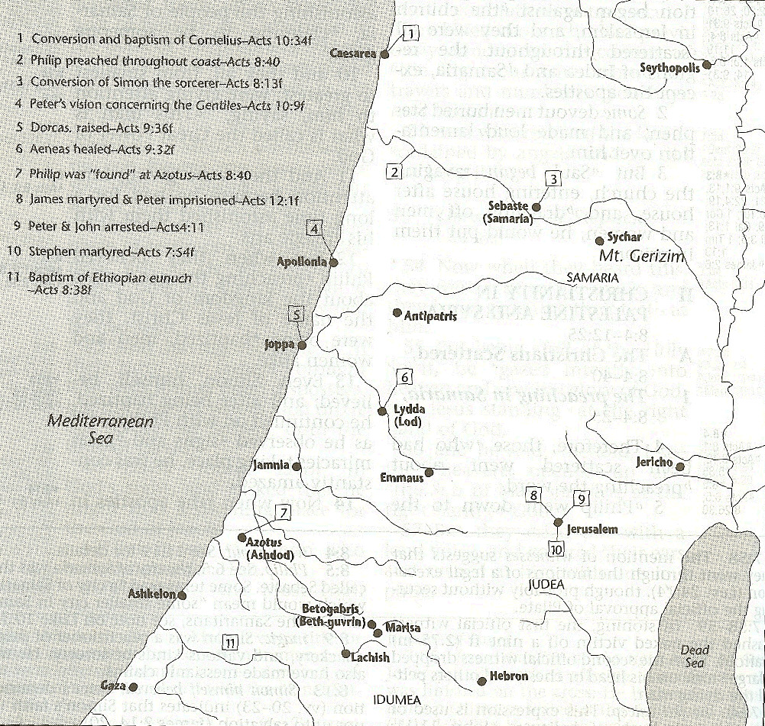

Slide 29
I. Saul Acts 9:1-31
Revelation (1-9)
Healing (10-19a)
Preaching (19b-22)
Conspiracy against Saul (23-25)
Return to Jerusalem (26-30)
Saul’s progress (31)

Slide 30
Acts 9:31 Saul’s Progress
Geography (31a)
Edification (31b)
Walk (31c)
Comfort (31d)
Numerical growth (31e)

Slide 31
Acts 9:31 Saul’s Progress
Geography (31a)
Edification (31b)
Walk (31c)
Comfort (31d)
Numerical growth (31e)

Slide 32
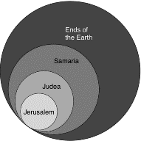
Acts 1:8
“but you will receive power when the Holy Spirit has come upon you; and you shall be My witnesses both in Jerusalem, and in all Judea and Samaria, and even to the remotest part of the earth.”

Slide 33
Acts 9:31 Saul’s Progress
Geography (31a)
Edification (31b)
Walk (31c)
Comfort (31d)
Numerical growth (31e)

Slide 34
Acts 9:31 Saul’s Progress
Geography (31a)
Edification (31b)
Walk (31c)
Comfort (31d)
Numerical growth (31e)

Slide 35
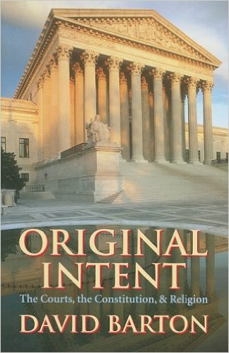
David Barton, Original Intent, p. 245

Slide 36
Acts 9:31 Saul’s Progress
Geography (31a)
Edification (31b)
Walk (31c)
Comfort (31d)
Numerical growth (31e)

Slide 37
Acts 9:31 Saul’s Progress
Geography (31a)
Edification (31b)
Walk (31c)
Comfort (31d)
Numerical growth (31e)

Slide 38
Message
Birth and growth of the church numerically, geographically, ethnically.
Components
Numerically (progress reports)
Geographically (From Jerusalem to Rome)
Ethnically (From Judaism to Gentile domination)

Slide 39
Progress Reports
Clearest: Acts 2:47; 6:7; 9:31; 12:24; 16:5; 19:20; 28:30-31
Less clear: Acts 1:15; 2:41; 4:4, 31; 5:14, 42; 8:25, 40; 11:21; 13:49; 17:6

Slide 40
Acts 9:1-43 Saul’s Conversion
Saul (9:1-31)
Peter (Acts 9:32-43)

Slide 41
II. Peter Acts 9:32-43
Lydda (32-35)
Joppa (36-43)

Slide 42
II. Peter Acts 9:32-43
Lydda (32-35)
Joppa (36-43)

Slide 43
Acts 9:32-35 Lydda
Place (32)
Aeneas’ healing (33-34)
Word spreads (35)

Slide 44
Acts 9:32-35 Lydda
Place (32)
Aeneas’ healing (33-34)
Word spreads (35)

Slide 46
Acts 1:8
“but you will receive power when the Holy Spirit has come upon you; and you shall be My witnesses both in Jerusalem, and in all Judea and Samaria, and even to the remotest part of the earth.”

Slide 47
Acts 8:3-4; 11:19
“³ But Saul began ravaging the church, entering house after house, and dragging off men and women, he would put them in prison. ⁴ Therefore, those who had been scattered went about preaching the word…¹⁹ So then those who were scattered because of the persecution that occurred in connection with Stephen made their way to Phoenicia and Cyprus and Antioch, speaking the word to no one except to Jews alone.”

Slide 48
Acts 9:32-35 Lydda
Place (32)
Aeneas’ healing (33-34)
Word spreads (35)

Slide 49
Acts 9:33-34 Aeneas’ Healing
Aeneas introduced (33)
Healing (34)

Slide 50
Acts 9:33-34 Aeneas’ Healing
Aeneas introduced (33)
Healing (34)

Slide 51
Acts 9:33-34 Aeneas’ Healing
Aeneas introduced (33)
Healing (34)

Slide 52
Acts 9:32-35 Lydda
Place (32)
Aeneas’ healing (33-34)
Word spreads (35)

Slide 53
II. Peter Acts 9:32-43
Lydda (32-35)
Joppa (36-43)

Slide 54
Acts 9:36-43 Joppa
Place (36)
Dorcas’ death (37)
Peter fetched (38)
Peter & mourners’ responses (39)
Miracle (40-41)
Word spreads (42)
Peter stays at Tanner’s home (43)

Slide 55
Acts 9:36-43 Joppa
Place (36)
Dorcas’ death (37)
Peter fetched (38)
Peter & mourners’ responses (39)
Miracle (40-41)
Word spreads (42)
Peter stays at Tanner’s home (43)

Slide 57
Acts 9:36-43 Joppa
Place (36)
Dorcas’ death (37)
Peter fetched (38)
Peter & mourners’ responses (39)
Miracle (40-41)
Word spreads (42)
Peter stays at Tanner’s home (43)

Slide 58
Acts 9:36-43 Joppa
Place (36)
Dorcas’ death (37)
Peter fetched (38)
Peter & mourners’ responses (39)
Miracle (40-41)
Word spreads (42)
Peter stays at Tanner’s home (43)

Slide 60
Acts 9:36-43 Joppa
Place (36)
Dorcas’ death (37)
Peter fetched (38)
Peter & mourners’ responses (39)
Miracle (40-41)
Word spreads (42)
Peter stays at Tanner’s home (43)

Slide 61
Acts 9:36-43 Joppa
Place (36)
Dorcas’ death (37)
Peter fetched (38)
Peter & mourners’ responses (39)
Miracle (40-41)
Word spreads (42)
Peter stays at Tanner’s home (43)

Slide 62
Acts 9:40-41 Miracle
Isolation (40a)
Resuscitation (40b-41)

Slide 63
Acts 9:40-41 Miracle
Isolation (40a)
Resuscitation (40b-41)

Slide 64
Acts 9:40-41 Miracle
Isolation (40a)
Resuscitation (40b-41)

Slide 65
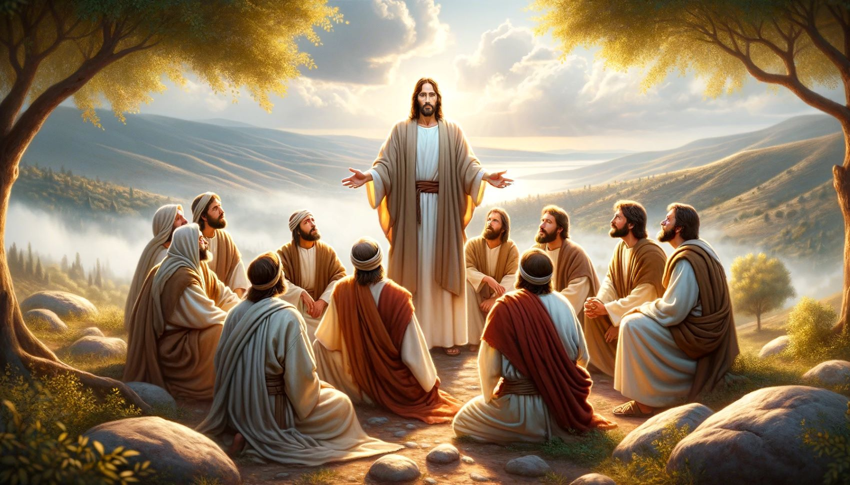
Dr. Arnold G. Fruchtenbaum
The Book of Acts, 224
“Again, it should be noted that while other believers were around, none of them performed the miracle. In Acts, only the apostles and their [de]legates (Acts 6:8; 8:6) perform signs and wonders.”

Slide 66
Acts 9:36-43 Joppa
Place (36)
Dorcas’ death (37)
Peter fetched (38)
Peter & mourners’ responses (39)
Miracle (40-41)
Word spreads (42)
Peter stays at Tanner’s home (43)

Slide 68
Acts 9:36-43 Joppa
Place (36)
Dorcas’ death (37)
Peter fetched (38)
Peter & mourners’ responses (39)
Miracle (40-41)
Word spreads (42)
Peter stays at Tanner’s home (43)

Slide 69
Conclusion

Slide 70
Acts 9:1-43 Saul’s Conversion
Saul (9:1-31)
Peter (Acts 9:32-43)

