Slide 1
Genesis 12‒50
Israel’s Birth & Preservation

Slide 2
GENESIS STRUCTURE
Genesis 12-50 (four people)
Abraham (12:1–25:11)
Isaac (25:12–26:35)
Jacob (27–36)
Joseph (37–50)

Slide 3
Genesis 37‒50 Joseph
Joseph sold unto Egypt (37)
Canaan’s corruption (38)
Joseph falsely accused (39)
Joseph’s short-term predictions (40)
Joseph’s elevation (41)
Joseph’s first reunion with his brothers (42)
Joseph’s second reunion with his brothers (43‒45)

Slide 4
Genesis 43‒45 Second Reunion
Jacob sends sons to Egypt (43:1-14)
Second reunion with Joseph (43:15-34)
Benjamin’s arrest (44:1-17)
Judah’s intercession (44:18-34)
Joseph’s revelation (45:1-15)
Pharaoh’s invitation (45:16-20)
Brothers return to Jacob (45:21-28)

Slide 5
V. Genesis 45:1-15 Joseph’s Revelation
Circumstances (1-2)
Joseph’s self- identification (3-4)
Joseph comforts his brothers (5-8)
Joseph’s instructions to his brothers (9-13)
Joseph kisses his brothers (14-15)

Slide 6
V. Genesis 45:1-15 Joseph’s Revelation
Circumstances (1-2)
Joseph’s self- identification (3-4)
Joseph comforts his brothers (5-8)
Joseph’s instructions to his brothers (9-13)
Joseph kisses his brothers (14-15)

Slide 7
Genesis 45:1-2 Circumstances
Solitude (1)
Weeping (2)

Slide 8
Genesis 45:1-2 Circumstances
Solitude (1)
Weeping (2)

Slide 9
Genesis 45:1-2 Circumstances
Solitude (1)
Weeping (2)

Slide 10
Luke 19:41-44
^{41 “}When He approached Jerusalem, He saw the city and wept over it, ⁴² saying, “If you had known in this day, even you, the things which make for peace! But now they have been hidden from your eyes. ⁴³ For the days will come upon you when your enemies will throw up a barricade against you, and surround you and hem you in on every side, ⁴⁴ and they will level you to the ground and your children within you, and they will not leave in you one stone upon another, because you did not recognize the time of your visitation.”

Slide 11
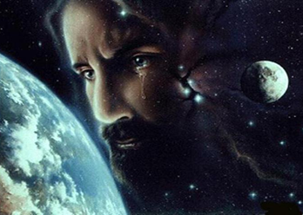
Christ’s Human Experiences
Labor (Mark 6:3)
Distress (Luke 22:44)
Being troubled (John 12:27)
Thirst (John 19:28)
Hunger (Matt 4:2)
Fatigue (John 4:6)
Sadness (John 11:35)
Lack of understanding (Matt 24:36)
Temptation (Luke 4:1-13; Heb. 4:15)

Slide 12
Hebrews 2:18
“For since He Himself was tempted in that which He has suffered, He is able to come to the aid of those who are tempted.”

Slide 13
Hebrews 4:15-16
^{15 “}For we do not have a high priest who cannot sympathize with our weaknesses, but One who has been tempted in all things as we are, yet without sin. ¹⁶ Therefore let us draw near with confidence to the throne of grace, so that we may receive mercy and find grace to help in time of need.”

Slide 14
V. Genesis 45:1-15 Joseph’s Revelation
Circumstances (1-2)
Joseph’s self- identification (3-4)
Joseph comforts his brothers (5-8)
Joseph’s instructions to his brothers (9-13)
Joseph kisses his brothers (14-15)

Slide 15
Genesis 45:3-4 Joseph’s Self Identification
Identification (3a)
Question (3b)
Brothers’ response (3c)
Instructions (4a)
Identification (4b)

Slide 16
Genesis 45:3-4 Joseph’s Self Identification
Identification (3a)
Question (3b)
Brothers’ response (3c)
Instructions (4a)
Identification (4b)

Slide 17
Genesis 45:3-4 Joseph’s Self Identification
Identification (3a)
Question (3b)
Brothers’ response (3c)
Instructions (4a)
Identification (4b)

Slide 18
Genesis 45:3-4 Joseph’s Self Identification
Identification (3a)
Question (3b)
Brothers’ response (3c)
Instructions (4a)
Identification (4b)

Slide 19
Charles Ryrie
The Ryrie Study Bible, p. 58
“45:3 they were dismayed. I.e., they were terrified, trembling. This uneasiness remained with the brothers for years (cf. 50:15).”

Slide 20
Genesis 45:3-4 Joseph’s Self Identification
Identification (3a)
Question (3b)
Brothers’ response (3c)
Instructions (4a)
Identification (4b)

Slide 21
Genesis 45:3-4 Joseph’s Self Identification
Identification (3a)
Question (3b)
Brothers’ response (3c)
Instructions (4a)
Identification (4b)

Slide 22
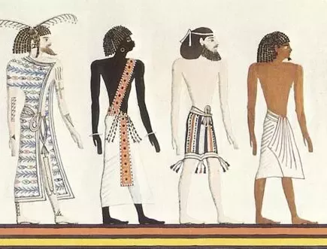
Dr. Arnold G. Fruchtenbaum
The Book of Genesis, 563-64
“Furthermore: and he shaved himself, since Egyptians did not approve of beards. In the Egyptian paintings, Semites are pictured as having beards while the Egyptians are clean shaven.”

Slide 23
V. Genesis 45:1-15 Joseph’s Revelation
Circumstances (1-2)
Joseph’s self- identification (3-4)
Joseph comforts his brothers (5-8)
Joseph’s instructions to his brothers (9-13)
Joseph kisses his brothers (14-15)

Slide 24
Genesis 45:5-8 Joseph Comforts His Brothers
Plan of God (5)
Timing (6)
Explanation of plan (7)
Providence (8)

Slide 25
Genesis 45:5-8 Joseph Comforts His Brothers
Plan of God (5)
Timing (6)
Explanation of plan (7)
Providence (8)

Slide 26
Genesis 45:5 Plan of God
Human side (5a)
Divine side (5b)

Slide 27
Genesis 45:5 Plan of God
Human side (5a)
Divine side (5b)

Slide 28
Genesis 45:5 Plan of God
Human side (5a)
Divine side (5b)

Slide 29
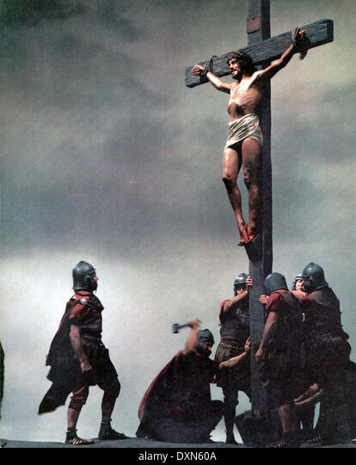
Acts 2:23
“this Man, delivered over by the predetermined plan and foreknowledge of God, you nailed to a cross by the hands of godless men and put Him to death.”

Slide 30
Acts 2:23
“this Man, delivered over by the predetermined plan and foreknowledge of God, you nailed to a cross by the hands of godless men and put Him to death.”

Slide 31
Acts 2:23
“this Man, delivered over by the predetermined plan and foreknowledge of God, you nailed to a cross by the hands of godless men and put Him to death.”

Slide 32
Genesis 45:5-8 Joseph Comforts His Brothers
Plan of God (5)
Timing (6)
Explanation of plan (7)
Providence (8)

Slide 33
Daniel 9:27
And he will make a firm covenant with the many for one week, but in the middle of the week he will put a stop to sacrifice and grain offering; and on the wing of abominations will come one who makes desolate, even until a complete destruction, one that is decreed, is poured out on the one who makes desolate.

Slide 35
Zechariah 12:10
“I will pour out on the house of David and on the inhabitants of Jerusalem, the Spirit of grace and of supplication, so that they will look on Me whom they have pierced; and they will mourn for Him, as one mourns for an only son, and they will weep bitterly over Him like the bitter weeping over a firstborn.”

Slide 36
Zechariah 13:8-9
⁸“It will come about in all the land,” Declares the Lord, “That two parts in it will be cut off and perish; But the third will be left in it. ⁹“And I will bring the third part through the fire, Refine them as silver is refined, And test them as gold is tested. They will call on My name, And I will answer them; I will say, ‘They are My people,’ And they will say, ‘The Lord is my God.’ ”

Slide 37
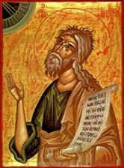
Jeremiah 30:7
“Alas! for that day is great, There is none like it; And it is the time of Jacob’s distress (Gen. 32:8; 35:10), But he will be saved from it.”

Slide 38
Genesis 45:5-8 Joseph Comforts His Brothers
Plan of God (5)
Timing (6)
Explanation of plan (7)
Providence (8)

Slide 40
Jeremiah 31:35-37
“Thus says the Lord, Who gives the sun for light by day And the fixed order of the moon and the stars for light by night, Who stirs up the sea so that its waves roar; The Lord of hosts is His name:³⁶ “If this fixed order departs From before Me,” declares the Lord, “Then the offspring of Israel also will cease From being a nation before Me forever.”³⁷ Thus says the Lord, “If the heavens above can be measured And the foundations of the earth searched out below, Then I will also cast off all the offspring of Israel For all that they have done,” declares the Lord.”

Slide 41
Genesis 45:5-8 Joseph Comforts His Brothers
Plan of God (5)
Timing (6)
Explanation of plan (7)
Providence (8)

Slide 42
Genesis 45:8 Providence of God
Limits of human side (8a)
Father to Pharaoh (8b)
Lord of Pharaoh’s house (8c)
Ruler over Egypt (8d)

Slide 43
Genesis 45:8 Providence of God
Limits of human side (8a)
Father to Pharaoh (8b)
Lord of Pharaoh’s house (8c)
Ruler over Egypt (8d)

Slide 44
Acts 2:23
“this Man, delivered over by the predetermined plan and foreknowledge of God, you nailed to a cross by the hands of godless men and put Him to death.”

Slide 45
Genesis 45:8 Providence of God
Limits of human side (8a)
Father to Pharaoh (8b)
Lord of Pharaoh’s house (8c)
Ruler over Egypt (8d)

Slide 46
Charles Ryrie
The Ryrie Study Bible, p. 58
“45:5–8 Joseph gave clear testimony to God’s providential overruling in his life. Note verse 8: not you … but God. Joseph was a father to Pharaoh in the sense of being his adviser.”

Slide 47
Genesis 45:8 Providence of God
Limits of human side (8a)
Father to Pharaoh (8b)
Lord of Pharaoh’s house (8c)
Ruler over Egypt (8d)

Slide 49
Genesis 45:8 Providence of God
Limits of human side (8a)
Father to Pharaoh (8b)
Lord of Pharaoh’s house (8c)
Ruler over Egypt (8d)

Slide 50
Zechariah 14:16-18
“¹⁶ Then it will come about that any who are left of all the nations that went against Jerusalem will go up from year to year to worship the King, the Lord of hosts, and to celebrate the Feast of Booths. ¹⁷ And it will be that whichever of the families of the earth does not go up to Jerusalem to worship the King, the Lord of hosts, there will be no rain on them. ¹⁸ If the family of Egypt does not go up or enter, then no rain will fall on them; it will be the plague with which the Lord smites the nations who do not go up to celebrate the Feast of Booths.”

Slide 51
V. Genesis 45:1-15 Joseph’s Revelation
Circumstances (1-2)
Joseph’s self- identification (3-4)
Joseph comforts his brothers (5-8)
Joseph’s instructions to his brothers (9-13)
Joseph kisses his brothers (14-15)

Slide 52
Genesis 45:9-13 Joseph’s Instructions to His Brothers
Speed (9a)
Recipient (9b)
Content (9c-13)

Slide 53
Genesis 45:9-13 Joseph’s Instructions to His Brothers
Speed (9a)
Recipient (9b)
Content (9c-13)

Slide 54
Genesis 45:9-13 Joseph’s Instructions to His Brothers
Speed (9a)
Recipient (9b)
Content (9c-13)

Slide 55
Genesis 45:9-13 Joseph’s Instructions to His Brothers
Speed (9a)
Recipient (9b)
Content (9c-13)

Slide 56
Genesis 45:9c-13 Content
Joseph’s elevation (9c)
Invitation (9d)
Residence in Goshen (10-11a)
Reason: timing (11b)
Witnesses (12)
What brothers are to do (13)

Slide 57
Genesis 45:9c-13 Content
Joseph’s elevation (9c)
Invitation (9d)
Residence in Goshen (10-11a)
Reason: timing (11b)
Witnesses (12)
What brothers are to do (13)

Slide 58
Genesis 45:9c-13 Content
Joseph’s elevation (9c)
Invitation (9d)
Residence in Goshen (10-11a)
Reason: timing (11b)
Witnesses (12)
What brothers are to do (13)

Slide 59
Genesis 45:9c-13 Content
Joseph’s elevation (9c)
Invitation (9d)
Residence in Goshen (10-11a)
Reason: timing (11b)
Witnesses (12)
What brothers are to do (13)

Slide 60
Genesis 45:10-11a Residence in Goshen
Place (10a)
Family reunion (10b)
Provision (11a)

Slide 61
Genesis 45:10-11a Residence in Goshen
Place (10a)
Family reunion (10b)
Provision (11a)

Slide 62
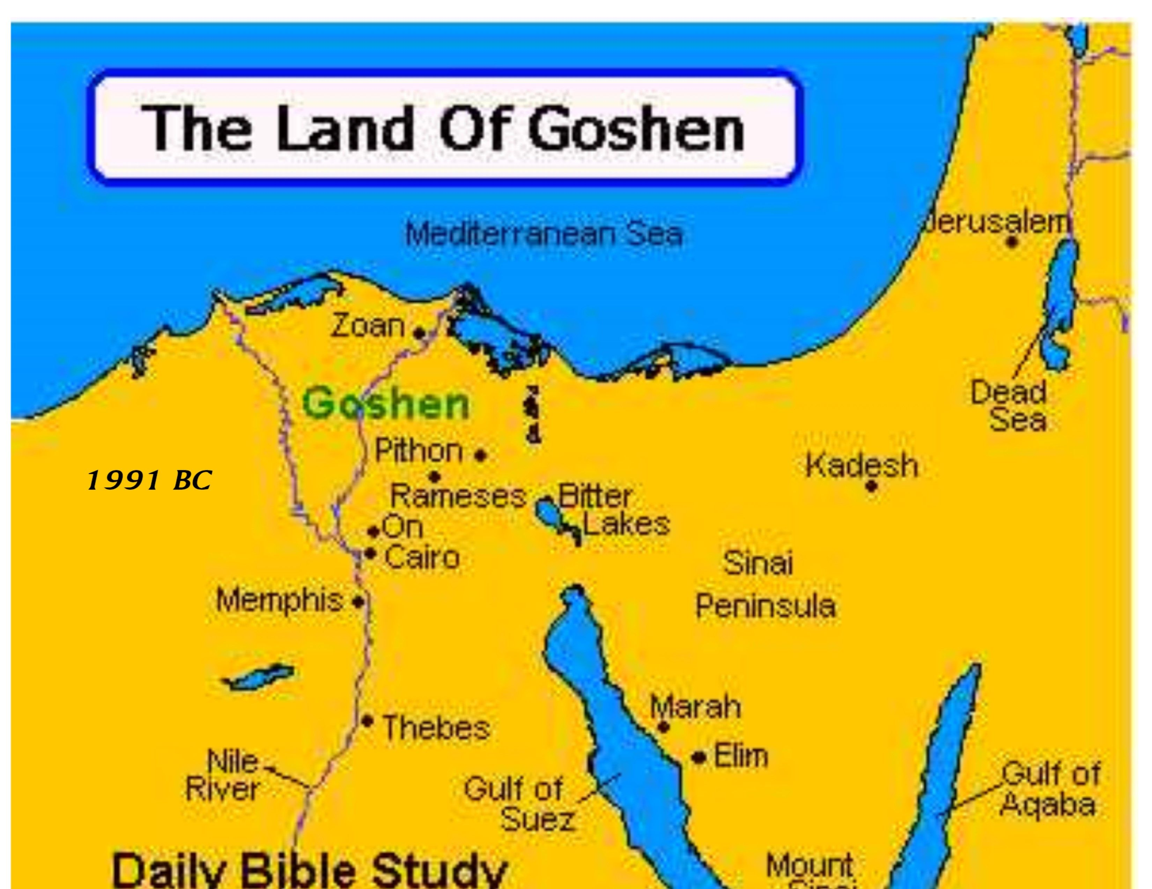

Slide 64
Charles Ryrie
The Ryrie Study Bible, p. 58
“45:10 The land of Goshen was the eastern section of the Nile delta. It was a fertile area, the main valley of it extending about 40 mi. (64 km).”

Slide 65
Dr. Arnold G. Fruchtenbaum
The Book of Genesis, 600
“Third, their place of residence was to be the land of Goshen. Goshen was located in the Eastern Nile Delta region, and that was the land bridge that connected Egypt of Africa with the Land of Canaan. This was near the city of Tanis, which was also the seat of the capital of Hyksos’s rule. Moreover, this will put them near Joseph and in a territory very suitable for grazing.”

Slide 66
Genesis 45:10-11a Residence in Goshen
Place (10a)
Family reunion (10b)
Provision (11a)

Slide 67
Genesis 45:10-11a Residence in Goshen
Place (10a)
Family reunion (10b)
Provision (11a)

Slide 68
Genesis 37‒50 Joseph
Joseph sold unto Egypt (37)
Canaan’s corruption (38)
Joseph falsely accused (39)
Joseph’s short-term predictions (40)
Joseph’s elevation (41)
Joseph’s first reunion with his brothers (42)
Joseph’s second reunion with his brothers (43‒45)

Slide 69
Genesis 15:16
“Then in the fourth generation they will return here, for the wrongdoing of the Amorite is not yet complete.”

Slide 71
God’s Provision (Phil. 4:19)
Exodus 16
1 Kings 17:2-6
Psalm 37:25
Matthew 6:25-34

Slide 72
Genesis 45:9c-13 Content
Joseph’s elevation (9c)
Invitation (9d)
Residence in Goshen (10-11a)
Reason: timing (11b)
Witnesses (12)
What brothers are to do (13)

Slide 74
Jeremiah 31:35-37
“Thus says the Lord, Who gives the sun for light by day And the fixed order of the moon and the stars for light by night, Who stirs up the sea so that its waves roar; The Lord of hosts is His name:³⁶ “If this fixed order departs From before Me,” declares the Lord, “Then the offspring of Israel also will cease From being a nation before Me forever.”³⁷ Thus says the Lord, “If the heavens above can be measured And the foundations of the earth searched out below, Then I will also cast off all the offspring of Israel For all that they have done,” declares the Lord.”

Slide 75
Daniel 9:27
And he will make a firm covenant with the many for one week, but in the middle of the week he will put a stop to sacrifice and grain offering; and on the wing of abominations will come one who makes desolate, even until a complete destruction, one that is decreed, is poured out on the one who makes desolate.

Slide 77
Zechariah 12:10
“I will pour out on the house of David and on the inhabitants of Jerusalem, the Spirit of grace and of supplication, so that they will look on Me whom they have pierced; and they will mourn for Him, as one mourns for an only son, and they will weep bitterly over Him like the bitter weeping over a firstborn.”

Slide 78
Zechariah 13:8-9
⁸“It will come about in all the land,” Declares the Lord, “That two parts in it will be cut off and perish; But the third will be left in it. ⁹“And I will bring the third part through the fire, Refine them as silver is refined, And test them as gold is tested. They will call on My name, And I will answer them; I will say, ‘They are My people,’ And they will say, ‘The Lord is my God.’ ”

Slide 79
Jeremiah 30:7
“Alas! for that day is great, There is none like it; And it is the time of Jacob’s distress (Gen. 32:8; 35:10), But he will be saved from it.”

Slide 80
Genesis 45:9c-13 Content
Joseph’s elevation (9c)
Invitation (9d)
Residence in Goshen (10-11a)
Reason: timing (11b)
Witnesses (12)
What brothers are to do (13)

Slide 82
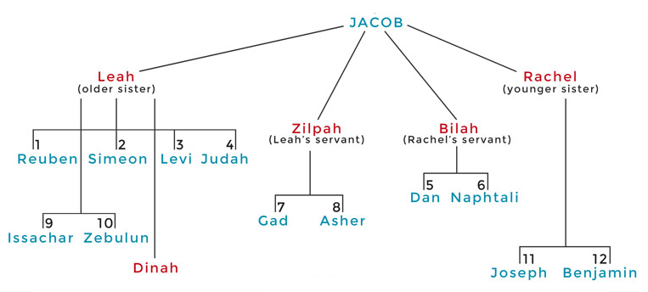

Slide 83
Genesis 45:9c-13 Content
Joseph’s elevation (9c)
Invitation (9d)
Residence in Goshen (10-11a)
Reason: timing (11b)
Witnesses (12)
What brothers are to do (13)

Slide 84
Genesis 45:13 What Brothers Are to Do
Tell of Egypt’s glory (13a)
Accomplish quickly (13b)

Slide 85
Genesis 45:13 What Brothers Are to Do
Tell of Egypt’s glory (13a)
Accomplish quickly (13b)

Slide 86
Genesis 45:13 What Brothers Are to Do
Tell of Egypt’s glory (13a)
Accomplish quickly (13b)

Slide 87
V. Genesis 45:1-15 Joseph’s Revelation
Circumstances (1-2)
Joseph’s self- identification (3-4)
Joseph comforts his brothers (5-8)
Joseph’s instructions to his brothers (9-13)
Joseph kisses his brothers (14-15)

Slide 88
Genesis 45:14-15 Joseph’s Kisses His Brothers
Joseph kisses Benjamin (14)
Joseph kisses rest of brothers (15)

Slide 89
Genesis 45:14-15 Joseph’s Kisses His Brothers
Joseph kisses Benjamin (14)
Joseph kisses rest of brothers (15)

Slide 90
Luke 19:41-44
^{41 “}When He approached Jerusalem, He saw the city and wept over it, ⁴² saying, “If you had known in this day, even you, the things which make for peace! But now they have been hidden from your eyes. ⁴³ For the days will come upon you when your enemies will throw up a barricade against you, and surround you and hem you in on every side, ⁴⁴ and they will level you to the ground and your children within you, and they will not leave in you one stone upon another, because you did not recognize the time of your visitation.”

Slide 91
Christ’s Human Experiences
Labor (Mark 6:3)
Distress (Luke 22:44)
Being troubled (John 12:27)
Thirst (John 19:28)
Hunger (Matt 4:2)
Fatigue (John 4:6)
Sadness (John 11:35)
Lack of understanding (Matt 24:36)
Temptation (Luke 4:1-13; Heb. 4:15)

Slide 92
Hebrews 2:18
“For since He Himself was tempted in that which He has suffered, He is able to come to the aid of those who are tempted.”

Slide 93
Hebrews 4:15-16
^{15 “}For we do not have a high priest who cannot sympathize with our weaknesses, but One who has been tempted in all things as we are, yet without sin. ¹⁶ Therefore let us draw near with confidence to the throne of grace, so that we may receive mercy and find grace to help in time of need.”

Slide 94
Daniel 9:27
And he will make a firm covenant with the many for one week, but in the middle of the week he will put a stop to sacrifice and grain offering; and on the wing of abominations will come one who makes desolate, even until a complete destruction, one that is decreed, is poured out on the one who makes desolate.

Slide 96
Zechariah 12:10
“I will pour out on the house of David and on the inhabitants of Jerusalem, the Spirit of grace and of supplication, so that they will look on Me whom they have pierced; and they will mourn for Him, as one mourns for an only son, and they will weep bitterly over Him like the bitter weeping over a firstborn.”

Slide 97
Zechariah 13:8-9
⁸“It will come about in all the land,” Declares the Lord, “That two parts in it will be cut off and perish; But the third will be left in it. ⁹“And I will bring the third part through the fire, Refine them as silver is refined, And test them as gold is tested. They will call on My name, And I will answer them; I will say, ‘They are My people,’ And they will say, ‘The Lord is my God.’ ”

Slide 98
Jeremiah 30:7
“Alas! for that day is great, There is none like it; And it is the time of Jacob’s distress (Gen. 32:8; 35:10), But he will be saved from it.”

Slide 99
Genesis 45:14-15 Joseph’s Kisses His Brothers
Joseph kisses Benjamin (14)
Joseph kisses rest of brothers (15)

Slide 102
Luke 19:41-44
^{41 “}When He approached Jerusalem, He saw the city and wept over it, ⁴² saying, “If you had known in this day, even you, the things which make for peace! But now they have been hidden from your eyes. ⁴³ For the days will come upon you when your enemies will throw up a barricade against you, and surround you and hem you in on every side, ⁴⁴ and they will level you to the ground and your children within you, and they will not leave in you one stone upon another, because you did not recognize the time of your visitation.”

Slide 103
Christ’s Human Experiences
Labor (Mark 6:3)
Distress (Luke 22:44)
Being troubled (John 12:27)
Thirst (John 19:28)
Hunger (Matt 4:2)
Fatigue (John 4:6)
Sadness (John 11:35)
Lack of understanding (Matt 24:36)
Temptation (Luke 4:1-13; Heb. 4:15)

Slide 104
Hebrews 2:18
“For since He Himself was tempted in that which He has suffered, He is able to come to the aid of those who are tempted.”

Slide 105
Hebrews 4:15-16
^{15 “}For we do not have a high priest who cannot sympathize with our weaknesses, but One who has been tempted in all things as we are, yet without sin. ¹⁶ Therefore let us draw near with confidence to the throne of grace, so that we may receive mercy and find grace to help in time of need.”

Slide 106
Genesis 43‒45 Second Reunion
Jacob sends sons to Egypt (43:1-14)
Second reunion with Joseph (43:15-34)
Benjamin’s arrest (44:1-17)
Judah’s intercession (44:18-34)
Joseph’s revelation (45:1-15)
Pharaoh’s invitation (45:16-20)
Brothers return to Jacob (45:21-28)

Slide 107
VI. Genesis 45:16-20 Pharaoh’s Invitation
Circumstances (16)
Invitation (17-20)

Slide 108
VI. Genesis 45:16-20 Pharaoh’s Invitation
Circumstances (16)
Invitation (17-20)

Slide 109
Genesis 45:16 Circumstances
Report (16a)
Result (16b)

Slide 110
Genesis 45:16 Circumstances
Report (16a)
Result (16b)

Slide 111
Genesis 45:16 Circumstances
Report (16a)
Result (16b)

Slide 112
VI. Genesis 45:16-20 Pharaoh’s Invitation
Circumstances (16)
Invitation (17-20)

Slide 113
Genesis 45:17-20 Invitation
Instructions (17)
Bring entire household (18)
Provision (19)
Lack of concern (20)

Slide 114
Genesis 45:17-20 Invitation
Instructions (17)
Bring entire household (18)
Provision (19)
Lack of concern (20)

Slide 115
Genesis 45:17-20 Invitation
Instructions (17)
Bring entire household (18)
Provision (19)
Lack of concern (20)

Slide 116
Genesis 45:17-20 Invitation
Instructions (17)
Bring entire household (18)
Provision (19)
Lack of concern (20)

Slide 117
God’s Provision (Phil. 4:19)
Exodus 16
1 Kings 17:2-6
Psalm 37:25
Matthew 6:25-34

Slide 119
Genesis 45:17-20 Invitation
Instructions (17)
Bring entire household (18)
Provision (19)
Lack of concern (20)

Slide 120
Dr. Arnold G. Fruchtenbaum
The Book of Genesis, 570
“Therefore, a total separation of twenty years existed from the time he had last seen members of his family until they were reunited in Egypt. The Hyksos Period, during which Joseph’s story unfolds, was the two-hundred-year period from 1750 until 1550 B.C. The Hyksos were Semitic rulers that conquered Egypt and ruled during the sixteenth and seventeenth dynasties. Thus, the Pharaoh at the time of Joseph was Semitic. This explains how a Semite such as Joseph could rise to the second highest position in Egypt, which had a Hamitic population.”

Slide 121
Dr. Arnold G. Fruchtenbaum
The Book of Genesis, 601
“Now this is all coming out of the initiation of Pharaoh, and all Pharaoh knew at this point was that this was Joseph’s family. He knew nothing about them per se. This shows the high regard and respect Pharaoh had for Joseph, that he was willing to issue this invitation. Such an invitation coming from an Egyptian Pharaoh for Semites was only possible during the Hyksos’s rule. Later Egyptian Pharaohs would never have allowed this to take place. However, the Hyksos being the Semitic conquerors of Egypt and ruling at this point in time made it possible for another Semitic family to be invited down.”

Slide 122
Genesis 43‒45 Second Reunion
Jacob sends sons to Egypt (43:1-14)
Second reunion with Joseph (43:15-34)
Benjamin’s arrest (44:1-17)
Judah’s intercession (44:18-34)
Joseph’s revelation (45:1-15)
Pharaoh’s invitation (45:16-20)
Brothers return to Jacob (45:21-28)

Slide 123
VII. Genesis 45:21-28 Brothers’ Return to Jacob
Provisions (21-23)
Departure (24)
Journey home (25)
Report to Jacob (26-28)

Slide 124
VII. Genesis 45:21-28 Brothers’ Return to Jacob
Provisions (21-23)
Departure (24)
Journey home (25)
Report to Jacob (26-28)

Slide 125
Genesis 45:21-23 Provisions
Brothers’ obedience (21a)
Provisions (21b-23)

Slide 126
Genesis 45:21-23 Provisions
Brothers’ obedience (21a)
Provisions (21b-23)

Slide 127
Genesis 45:21-23 Provisions
Brothers’ obedience (21a)
Provisions (21b-23)

Slide 128
Genesis 45:21b-13 Content
Wagons (21b)
Food (21c)
Clothing (22a)
Provisions for Benjamin (22b)
Provisions for Jacob (23)

Slide 129
Genesis 45:21b-13 Content
Wagons (21b)
Food (21c)
Clothing (22a)
Provisions for Benjamin (22b)
Provisions for Jacob (23)

Slide 130
Genesis 45:21b-13 Content
Wagons (21b)
Food (21c)
Clothing (22a)
Provisions for Benjamin (22b)
Provisions for Jacob (23)

Slide 131
Genesis 45:21b-13 Content
Wagons (21b)
Food (21c)
Clothing (22a)
Provisions for Benjamin (22b)
Provisions for Jacob (23)

Slide 132
Genesis 45:21b-13 Content
Wagons (21b)
Food (21c)
Clothing (22a)
Provisions for Benjamin (22b)
Provisions for Jacob (23)

Slide 135
Genesis 45:21b-13 Content
Wagons (21b)
Food (21c)
Clothing (22a)
Provisions for Benjamin (22b)
Provisions for Jacob (23)

Slide 136
VII. Genesis 45:21-28 Brothers’ Return to Jacob
Provisions (21-23)
Departure (24)
Journey home (25)
Report to Jacob (26-28)

Slide 137
VII. Genesis 45:21-28 Brothers’ Return to Jacob
Provisions (21-23)
Departure (24)
Journey home (25)
Report to Jacob (26-28)

Slide 139
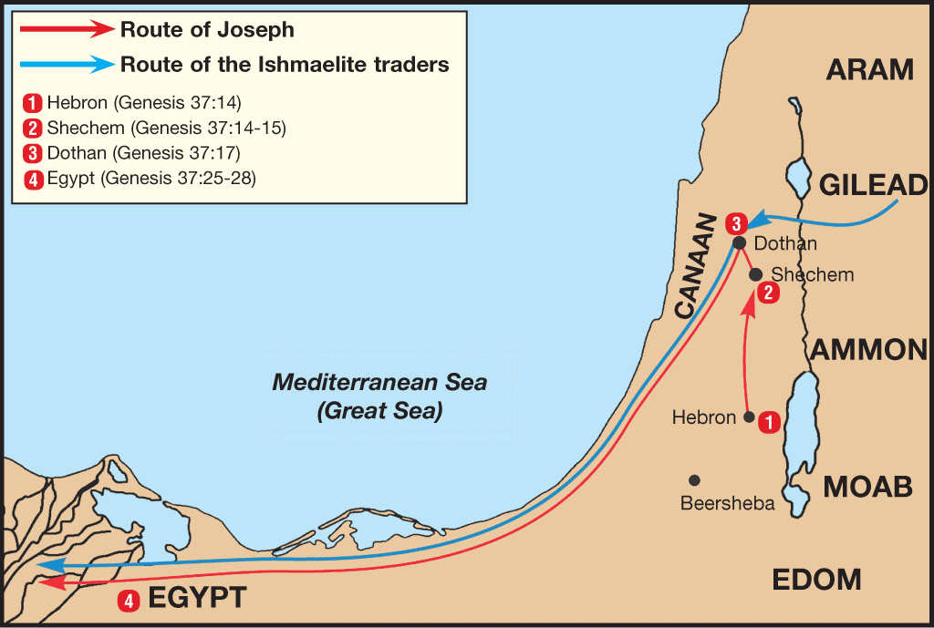

Slide 140
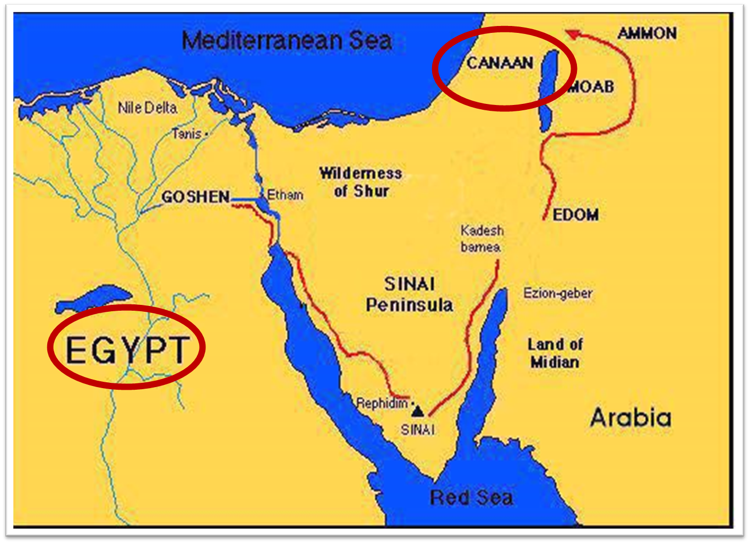

Slide 141
VII. Genesis 45:21-28 Brothers’ Return to Jacob
Provisions (21-23)
Departure (24)
Journey home (25)
Report to Jacob (26-28)

Slide 142
Genesis 45:26-28 Report to Jacob
News about Joseph (26a)
Jacob’s reaction (26b)
Report from Joseph (27a)
Jacob persuaded (27b)
Result (28)

Slide 143
Genesis 45:26-28 Report to Jacob
News about Joseph (26a)
Jacob’s reaction (26b)
Report from Joseph (27a)
Jacob persuaded (27b)
Result (28)

Slide 144
Genesis 45:26-28 Report to Jacob
News about Joseph (26a)
Jacob’s reaction (26b)
Report from Joseph (27a)
Jacob persuaded (27b)
Result (28)

Slide 145
Genesis 45:26-28 Report to Jacob
News about Joseph (26a)
Jacob’s reaction (26b)
Report from Joseph (27a)
Jacob persuaded (27b)
Result (28)

Slide 146
Genesis 45:26-28 Report to Jacob
News about Joseph (26a)
Jacob’s reaction (26b)
Report from Joseph (27a)
Jacob persuaded (27b)
Result (28)

Slide 147
Genesis 45:26-28 Report to Jacob
News about Joseph (26a)
Jacob’s reaction (26b)
Report from Joseph (27a)
Jacob persuaded (27b)
Result (28)

Slide 148
Conclusion

Slide 149
Genesis 43‒45 Second Reunion
Jacob sends sons to Egypt (43:1-14)
Second reunion with Joseph (43:15-34)
Benjamin’s arrest (44:1-17)
Judah’s intercession (44:18-34)
Joseph’s revelation (45:1-15)
Pharaoh’s invitation (45:16-20)
Brothers return to Jacob (45:21-28)

Slide 150
²⁴ The Lord bless you, and keep you; ²⁵ The Lord make His face shine on you, And be gracious to you; ²⁶ The Lord lift up His countenance on you, And give you peace.
Numbers 6:24–26 (NASB95)

