Slide 2
Message
Birth and growth of the church numerically, geographically, ethnically.
Components
Numerically (progress reports)
Geographically (From Jerusalem to Rome)
Ethnically (From Judaism to Gentile domination)

Slide 3
Acts 9:1-43 Saul’s Conversion
Saul (9:1-31)
Peter (Acts 9:32-43)

Slide 4
I. Saul Acts 9:1-31
Revelation (1-9)
Healing (10-19a)
Preaching (19b-22)
Conspiracy against Saul (23-25)
Return to Jerusalem (26-30)
Saul’s progress (31)

Slide 5
Acts 9:1-9 Revelation
Saul’s persecution (1-2)
Saul’s revelation (3-7)
Saul’s reaction (8-9)

Slide 6
Acts 9:8-9 Saul’s Reaction
Physical blindness (8)
Length of blindness (9)

Slide 7
Acts 9:8-9 Saul’s Reaction
Physical blindness (8)
Length of blindness (9)

Slide 8
Acts 9:8-9 Saul’s Reaction
Physical blindness (8)
Length of blindness (9)

Slide 9
Shaping and Populating (Gen 1:1)
Day 1: | Light | Day 4: | Luminaries
Day 2: | Water, sky | Day 5: | Sea animals, birds
Day 3: | Land, vegetation | Day 6: | Land animals, man

Slide 10
I. Saul Acts 9:1-31
Revelation (1-9)
Healing (10-19a)
Preaching (19b-22)
Conspiracy against Saul (23-25)
Return to Jerusalem (26-30)
Saul’s progress (31)

Slide 11
Acts 9:10-19a Healing
Call of Ananias (10)
God’s instructions to Ananias (11-12)
Ananias’ objection (13-14)
God’s response (15-16)
Ananias’ obedience (17)
Saul’s healing (18-19a)

Slide 12
Acts 9:10-19a Healing
Call of Ananias (10)
God’s instructions to Ananias (11-12)
Ananias’ objection (13-14)
God’s response (15-16)
Ananias’ obedience (17)
Saul’s healing (18-19a)

Slide 13
Acts 9:10-19a Healing
Call of Ananias (10)
God’s instructions to Ananias (11-12)
Ananias’ objection (13-14)
God’s response (15-16)
Ananias’ obedience (17)
Saul’s healing (18-19a)

Slide 14
Acts 9:11-12 God Instructs Ananias
Location of Saul (11)
Healing of Saul (12)

Slide 15
Acts 9:11-12 God Instructs Ananias
Location of Saul (11)
Healing of Saul (12)

Slide 16
Acts 9:11-12 God Instructs Ananias
Location of Saul (11)
Healing of Saul (12)

Slide 17
Acts 9:10-19a Healing
Call of Ananias (10)
God’s instructions to Ananias (11-12)
Ananias’ objection (13-14)
God’s response (15-16)
Ananias’ obedience (17)
Saul’s healing (18-19a)

Slide 18
Acts 9:13-14 Ananias’ Objections
Saul’s work in Jerusalem (13)
Saul’s work in Damascus (14)

Slide 19
Acts 9:13-14 Ananias’ Objections
Saul’s work in Jerusalem (13)
Saul’s work in Damascus (14)

Slide 20
Acts 8:3-4; 11:19
“³ But Saul began ravaging the church, entering house after house, and dragging off men and women, he would put them in prison. ⁴ Therefore, those who had been scattered went about preaching the word…¹⁹ So then those who were scattered because of the persecution that occurred in connection with Stephen made their way to Phoenicia and Cyprus and Antioch, speaking the word to no one except to Jews alone.”

Slide 21
Acts 9:13-14 Ananias’ Objections
Saul’s work in Jerusalem (13)
Saul’s work in Damascus (14)

Slide 22
Acts 9:10-19a Healing
Call of Ananias (10)
God’s instructions to Ananias (11-12)
Ananias’ objection (13-14)
God’s response (15-16)
Ananias’ obedience (17)
Saul’s healing (18-19a)

Slide 23
Acts 9:15-16 God’s response
Saul’s three-fold calling (15)
Prediction of Saul’s sufferings (16)

Slide 24
Acts 9:15-16 God’s response
Saul’s three-fold calling (15)
Prediction of Saul’s sufferings (16)

Slide 25
Galatians 2:7-8
“⁷ But on the contrary, seeing that I had been entrusted with the gospel to the uncircumcised, just as Peter had been to the circumcised ⁸ (for He who effectually worked for Peter in his apostleship to the circumcised effectually worked for me also to the Gentiles).”

Slide 26
Acts 9:15-16 God’s response
Saul’s three-fold calling (15)
Prediction of Saul’s sufferings (16)

Slide 27
John 13:19; 14:29
“^{13:19} From now on I am telling you before it comes to pass, so that when it does occur, you may believe that I am He… ^{14:29} Now I have told you before it happens, so that when it happens, you may believe.”

Slide 28
What Happened to Christ’s Disciples?
Disciple | Place | Martyrdom
James the Son of Alpheus | Jerusalem | Clubbed to death
Simon the Zealot | Jerusalem | Martyred
James the Son of Zebedee | Judea (Acts 12:2) | Executed
Thaddeus | Mesopotamia | Beaten to death
Peter | Babylon, Rome | Crucified upside down
Matthew | Parthia (Tehran) | Beheaded
Notes:
109 prophecies…
Peter Stoner – SCIENCE SPEAKS, An Evaluation of Certain Christian Evidences
To fulfill just 8 prophecies =1 X 10 to the twenty-eighth power!
Can we visualize this with an illustration? Suppose we took an atheistic professor, blindfolded him and covered the state of Texas two feet deep with silver dollars. Then we put a check on one of those silver dollars and mixed them up. The odds of one person fulfilling just these eight prophecies would be the same as this atheistic professor selecting the silver dollar upon which we have placed a check, in his first try.
https://www.bereanpublishers.com/the-odds-of-eight-messianic-prophecies-coming-true/

Slide 29
What Happened to Christ’s Disciples?
Disciple | Place | Martyrdom
John | Asia Minor, Patmos, Ephesus | Fried in boiling oil
Philip | E. Turkey | Tortured & crucified
Thomas | India | Speared
Bartholomew | India | Flayed & crucified
Andrew | Ukraine, Russia, Greece | Hanged
Notes:
109 prophecies…
Peter Stoner – SCIENCE SPEAKS, An Evaluation of Certain Christian Evidences
To fulfill just 8 prophecies =1 X 10 to the twenty-eighth power!
Can we visualize this with an illustration? Suppose we took an atheistic professor, blindfolded him and covered the state of Texas two feet deep with silver dollars. Then we put a check on one of those silver dollars and mixed them up. The odds of one person fulfilling just these eight prophecies would be the same as this atheistic professor selecting the silver dollar upon which we have placed a check, in his first try.
https://www.bereanpublishers.com/the-odds-of-eight-messianic-prophecies-coming-true/

Slide 30
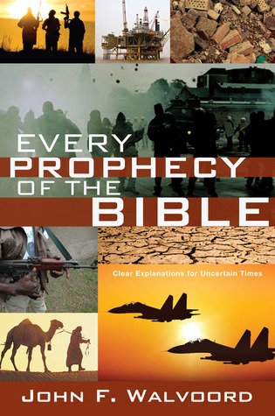

Slide 31
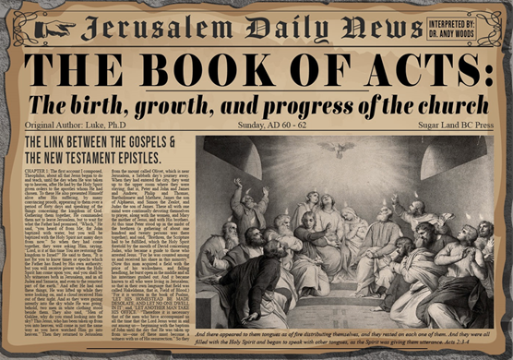
Acts 9:16
“for I will show him how much he must [dei] suffer for My name’s sake..”

Slide 32
Acts 4:12
“And there is salvation in no one else; for there is no other name under heaven that has been given among men by which we must [dei] be saved.”

Slide 33
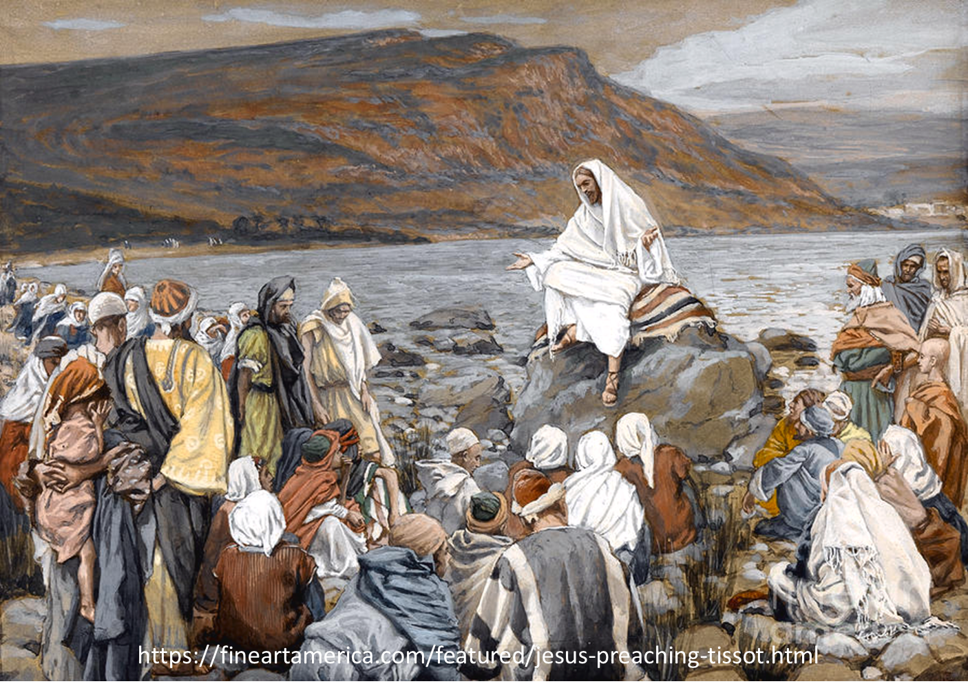
Luke 4:43
“But He said to them, “I must [dei] preach the kingdom of God to the other cities also, for I was sent for this purpose.”

Slide 34
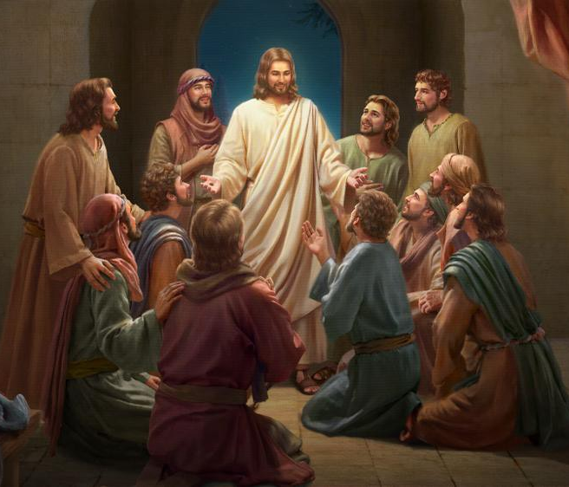
Luke 24:44
“Now He said to them, “These are My words which I spoke to you while I was still with you, that all things which are written about Me in the Law of Moses and the Prophets and the Psalms must [dei] be fulfilled.”

Slide 35
Acts 9:10-19a Healing
Call of Ananias (10)
God’s instructions to Ananias (11-12)
Ananias’ objection (13-14)
God’s response (15-16)
Ananias’ obedience (17)
Saul’s healing (18-19a)

Slide 36
Acts 9:10-19a Healing
Call of Ananias (10)
God’s instructions to Ananias (11-12)
Ananias’ objection (13-14)
God’s response (15-16)
Ananias’ obedience (17)
Saul’s healing (18-19a)

Slide 37
Acts 9:18-19a Saul’s Healing
Healing (18a)
Baptism (18b)
Break-fast (19a)

Slide 38
Acts 9:18-19a Saul’s Healing
Healing (18a)
Baptism (18b)
Break-fast (19a)

Slide 40
Acts 9:18-19a Saul’s Healing
Healing (18a)
Baptism (18b)
Break-fast (19a)

Slide 41
Acts 9:18-19a Saul’s Healing
Healing (18a)
Baptism (18b)
Break-fast (19a)

Slide 42
I. Saul Acts 9:1-31
Revelation (1-9)
Healing (10-19a)
Preaching (19b-22)
Conspiracy against Saul (23-25)
Return to Jerusalem (26-30)
Saul’s progress (31)

Slide 43
Acts 9:19b-22 Saul’s Preaching
Saul’s home with the disciples (19b)
Saul’s preaching (20)
Response of the Hebrews (21)
Saul’s power (22)

Slide 44
Acts 9:19b-22 Saul’s Preaching
Saul’s home with the disciples (19b)
Saul’s preaching (20)
Response of the Hebrews (21)
Saul’s power (22)

Slide 45
Acts 9:19b-22 Saul’s Preaching
Saul’s home with the disciples (19b)
Saul’s preaching (20)
Response of the Hebrews (21)
Saul’s power (22)

Slide 46
Acts 9:19b-22 Saul’s Preaching
Saul’s home with the disciples (19b)
Saul’s preaching (20)
Response of the Hebrews (21)
Saul’s power (22)

Slide 47
Acts 9:19b-22 Saul’s Preaching
Saul’s home with the disciples (19b)
Saul’s preaching (20)
Response of the Hebrews (21)
Saul’s power (22)

Slide 48
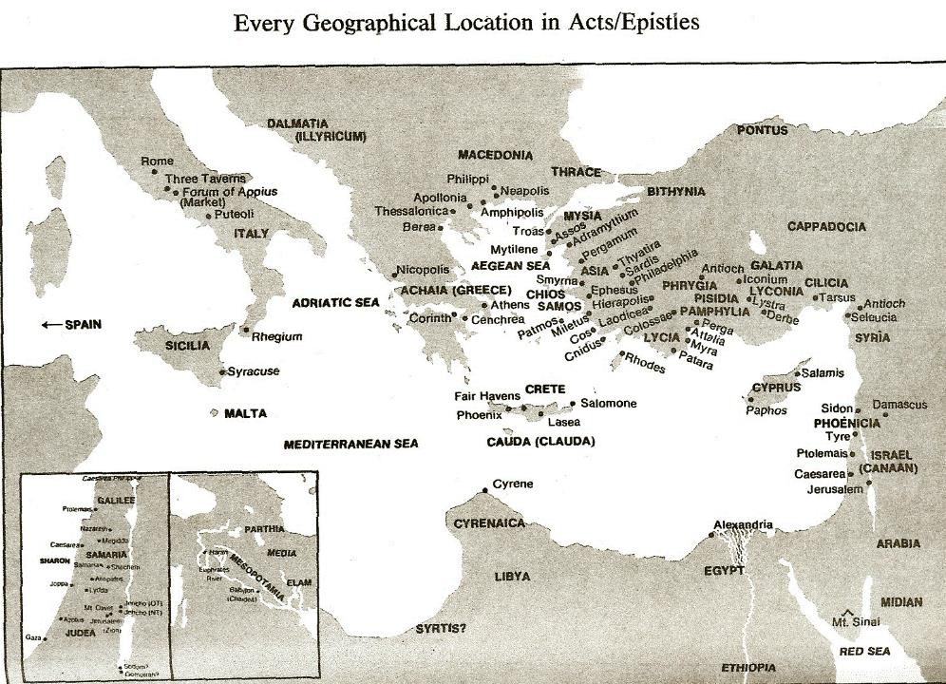

Slide 49
I. Saul Acts 9:1-31
Revelation (1-9)
Healing (10-19a)
Preaching (19b-22)
Conspiracy against Saul (23-25)
Return to Jerusalem (26-30)
Saul’s progress (31)

Slide 50
Acts 9:23-25 Conspiracy Against Saul
Plot against Saul (23)
Saul’s awareness (24a)
Plot’s execution (24b)
Saul’s escape (25)

Slide 51
Acts 9:23-25 Conspiracy Against Saul
Plot against Saul (23)
Saul’s awareness (24a)
Plot’s execution (24b)
Saul’s escape (25)

Slide 52
Acts 9:23-25 Conspiracy Against Saul
Plot against Saul (23)
Saul’s awareness (24a)
Plot’s execution (24b)
Saul’s escape (25)

Slide 53
Acts 9:23-25 Conspiracy Against Saul
Plot against Saul (23)
Saul’s awareness (24a)
Plot’s execution (24b)
Saul’s escape (25)

Slide 54
Acts 9:23-25 Conspiracy Against Saul
Plot against Saul (23)
Saul’s awareness (24a)
Plot’s execution (24b)
Saul’s escape (25)

Slide 56
I. Saul Acts 9:1-31
Revelation (1-9)
Healing (10-19a)
Preaching (19b-22)
Conspiracy against Saul (23-25)
Return to Jerusalem (26-30)
Saul’s progress (31)

Slide 57
Acts 9:26-30 Saul’s Return to Jerusalem
Jerusalem believers’ response (26)
Barnabas takes Saul to apostles (27)
Saul’s Jerusalem ministry (28-29)
Saul’s escape (30)

Slide 58
Acts 9:26-30 Saul’s Return to Jerusalem
Jerusalem believers’ response (26)
Barnabas takes Saul to apostles (27)
Saul’s Jerusalem ministry (28-29)
Saul’s escape (30)

Slide 59
Acts 9:26-30 Saul’s Return to Jerusalem
Jerusalem believers’ response (26)
Barnabas takes Saul to apostles (27)
Saul’s Jerusalem ministry (28-29)
Saul’s escape (30)

Slide 60
Acts 9:26-30 Saul’s Return to Jerusalem
Jerusalem believers’ response (26)
Barnabas takes Saul to apostles (27)
Saul’s Jerusalem ministry (28-29)
Saul’s escape (30)

Slide 61
Acts 9:28-29 Saul’s Jerusalem Ministry
Among the apostles (28)
Among the unsaved (29)

Slide 62
Acts 9:28-29 Saul’s Jerusalem Ministry
Among the apostles (28)
Among the unsaved (29)

Slide 63
Acts 9:28-29 Saul’s Jerusalem Ministry
Among the apostles (28)
Among the unsaved (29)

Slide 64
Acts 9:26-30 Saul’s Return to Jerusalem
Jerusalem believers’ response (26)
Barnabas takes Saul to apostles (27)
Saul’s Jerusalem ministry (28-29)
Saul’s escape (30)

Slide 65
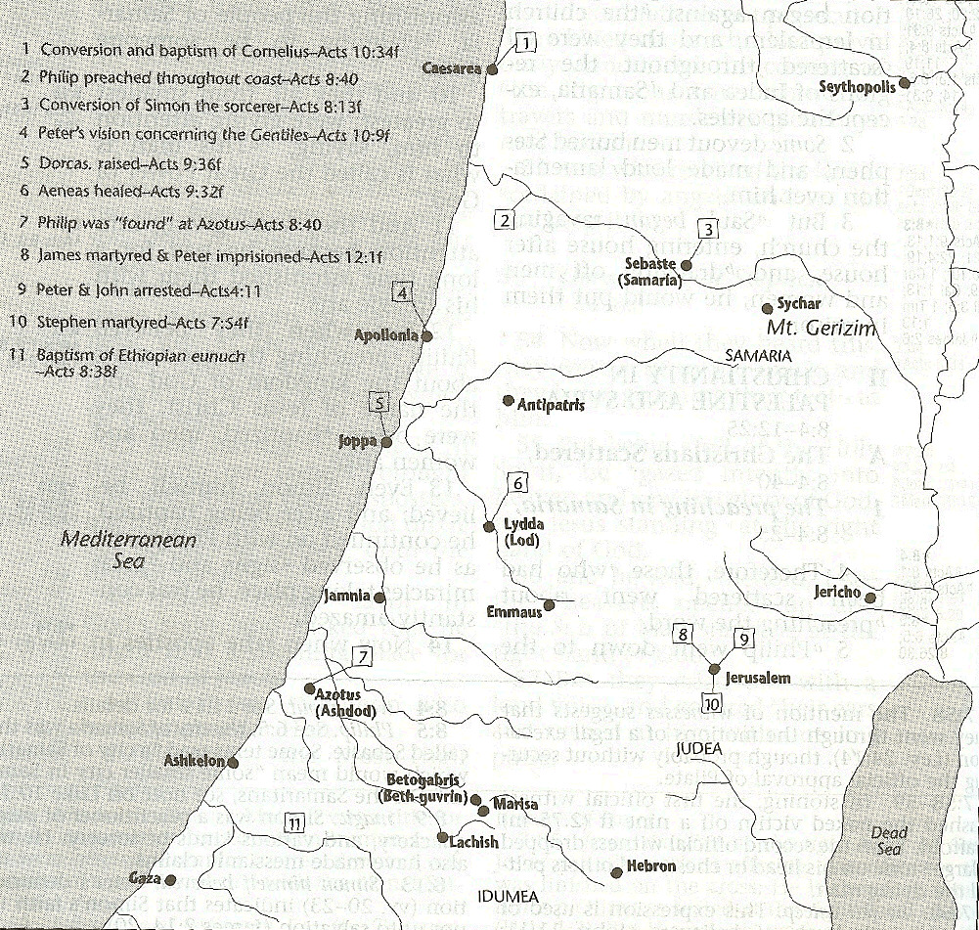

Slide 67
I. Saul Acts 9:1-31
Revelation (1-9)
Healing (10-19a)
Preaching (19b-22)
Conspiracy against Saul (23-25)
Return to Jerusalem (26-30)
Saul’s progress (31)

Slide 68
Acts 9:31 Saul’s Progress
Geography (31a)
Edification (31b)
Walk (31c)
Comfort (31d)
Numerical growth (31e)

Slide 69
Acts 9:31 Saul’s Progress
Geography (31a)
Edification (31b)
Walk (31c)
Comfort (31d)
Numerical growth (31e)

Slide 70
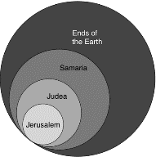
Acts 1:8
“but you will receive power when the Holy Spirit has come upon you; and you shall be My witnesses both in Jerusalem, and in all Judea and Samaria, and even to the remotest part of the earth.”

Slide 71
Acts 9:31 Saul’s Progress
Geography (31a)
Edification (31b)
Walk (31c)
Comfort (31d)
Numerical growth (31e)

Slide 72
Acts 9:31 Saul’s Progress
Geography (31a)
Edification (31b)
Walk (31c)
Comfort (31d)
Numerical growth (31e)

Slide 73
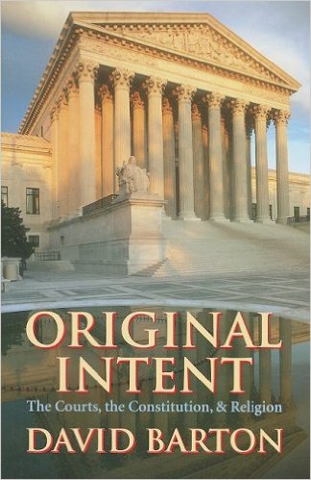
David Barton, Original Intent, p. 245

Slide 74
Acts 9:31 Saul’s Progress
Geography (31a)
Edification (31b)
Walk (31c)
Comfort (31d)
Numerical growth (31e)

Slide 75
Acts 9:31 Saul’s Progress
Geography (31a)
Edification (31b)
Walk (31c)
Comfort (31d)
Numerical growth (31e)

Slide 76
Message
Birth and growth of the church numerically, geographically, ethnically.
Components
Numerically (progress reports)
Geographically (From Jerusalem to Rome)
Ethnically (From Judaism to Gentile domination)

Slide 77
Progress Reports
Clearest: Acts 2:47; 6:7; 9:31; 12:24; 16:5; 19:20; 28:30-31
Less clear: Acts 1:15; 2:41; 4:4, 31; 5:14, 42; 8:25, 40; 11:21; 13:49; 17:6

Slide 78
Acts 9:1-43 Saul’s Conversion
Saul (9:1-31)
Peter (Acts 9:32-43)

Slide 79
II. Peter Acts 9:32-43
Lydda (32-35)
Joppa (36-43)

Slide 80
II. Peter Acts 9:32-43
Lydda (32-35)
Joppa (36-43)

Slide 81
Acts 9:32-35 Lydda
Place (32)
Aeneas’ healing (33-34)
Word spreads (35)

Slide 82
Acts 9:32-35 Lydda
Place (32)
Aeneas’ healing (33-34)
Word spreads (35)

Slide 84
Acts 1:8
“but you will receive power when the Holy Spirit has come upon you; and you shall be My witnesses both in Jerusalem, and in all Judea and Samaria, and even to the remotest part of the earth.”

Slide 85
Acts 8:3-4; 11:19
“³ But Saul began ravaging the church, entering house after house, and dragging off men and women, he would put them in prison. ⁴ Therefore, those who had been scattered went about preaching the word…¹⁹ So then those who were scattered because of the persecution that occurred in connection with Stephen made their way to Phoenicia and Cyprus and Antioch, speaking the word to no one except to Jews alone.”

Slide 86
Acts 9:32-35 Lydda
Place (32)
Aeneas’ healing (33-34)
Word spreads (35)

Slide 87
Acts 9:33-34 Aeneas’ Healing
Aeneas introduced (33)
Healing (34)

Slide 88
Acts 9:33-34 Aeneas’ Healing
Aeneas introduced (33)
Healing (34)

Slide 89
Acts 9:33-34 Aeneas’ Healing
Aeneas introduced (33)
Healing (34)

Slide 90
Acts 9:32-35 Lydda
Place (32)
Aeneas’ healing (33-34)
Word spreads (35)

Slide 91
II. Peter Acts 9:32-43
Lydda (32-35)
Joppa (36-43)

Slide 92
Acts 9:36-43 Joppa
Place (36)
Dorcas’ death (37)
Peter fetched (38)
Peter & mourners’ responses (39)
Miracle (40-41)
Word spreads (42)
Peter stays at Tanner’s home (43)

Slide 93
Acts 9:36-43 Joppa
Place (36)
Dorcas’ death (37)
Peter fetched (38)
Peter & mourners’ responses (39)
Miracle (40-41)
Word spreads (42)
Peter stays at Tanner’s home (43)

Slide 95
Acts 9:36-43 Joppa
Place (36)
Dorcas’ death (37)
Peter fetched (38)
Peter & mourners’ responses (39)
Miracle (40-41)
Word spreads (42)
Peter stays at Tanner’s home (43)

Slide 96
Acts 9:36-43 Joppa
Place (36)
Dorcas’ death (37)
Peter fetched (38)
Peter & mourners’ responses (39)
Miracle (40-41)
Word spreads (42)
Peter stays at Tanner’s home (43)

Slide 98
Acts 9:36-43 Joppa
Place (36)
Dorcas’ death (37)
Peter fetched (38)
Peter & mourners’ responses (39)
Miracle (40-41)
Word spreads (42)
Peter stays at Tanner’s home (43)

Slide 99
Acts 9:36-43 Joppa
Place (36)
Dorcas’ death (37)
Peter fetched (38)
Peter & mourners’ responses (39)
Miracle (40-41)
Word spreads (42)
Peter stays at Tanner’s home (43)

Slide 100
Acts 9:40-41 Miracle
Isolation (40a)
Resuscitation (40b-41)

Slide 101
Acts 9:40-41 Miracle
Isolation (40a)
Resuscitation (40b-41)

Slide 102
Acts 9:40-41 Miracle
Isolation (40a)
Resuscitation (40b-41)

Slide 103
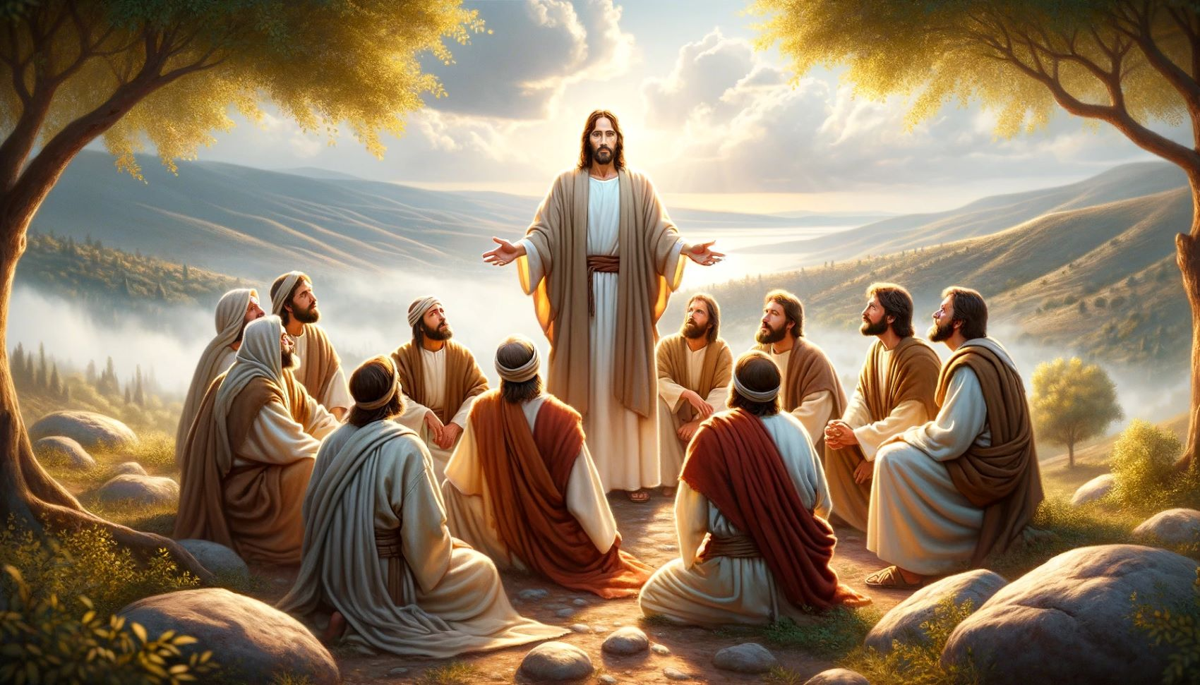
Dr. Arnold G. Fruchtenbaum
The Book of Acts, 224
“Again, it should be noted that while other believers were around, none of them performed the miracle. In Acts, only the apostles and their [de]legates (Acts 6:8; 8:6) perform signs and wonders.”

Slide 104
Acts 9:36-43 Joppa
Place (36)
Dorcas’ death (37)
Peter fetched (38)
Peter & mourners’ responses (39)
Miracle (40-41)
Word spreads (42)
Peter stays at Tanner’s home (43)

Slide 106
Acts 9:36-43 Joppa
Place (36)
Dorcas’ death (37)
Peter fetched (38)
Peter & mourners’ responses (39)
Miracle (40-41)
Word spreads (42)
Peter stays at Tanner’s home (43)

Slide 107
Conclusion

Slide 108
Acts 9:1-43 Saul’s Conversion
Saul (9:1-31)
Peter (Acts 9:32-43)

