Slide 1
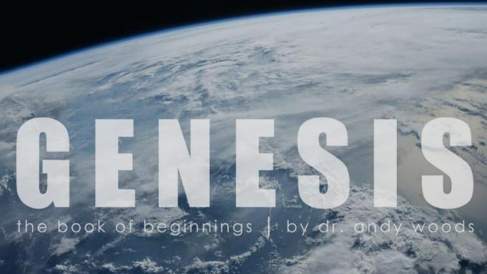

Genesis 12‒50
Israel’s Birth & Preservation

Slide 2
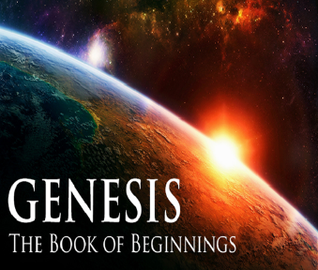
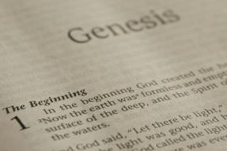
GENESIS STRUCTURE
  Genesis 12-50 (four people)
    Abraham (12:1–25:11)
    Isaac (25:12–26:35)
    Jacob (27–36)
    Joseph (37–50)

Slide 3
Genesis 37‒50
Joseph
  Joseph sold unto Egypt (37)
  Canaan’s corruption (38)
  Joseph falsely accused (39)
  Joseph’s short-term predictions (40)
  Joseph’s elevation (41)
  Joseph’s first reunion with his brothers (42)
  Joseph’s second reunion with his brothers (43‒45)

Slide 4
Genesis 43‒45
Second Reunion
  Jacob sends sons to Egypt (43:1-14)
  Second reunion with Joseph (43:15-34)
  Benjamin’s arrest (44:1-17)
  Judah’s intercession (44:18-34)
  Joseph’s revelation (45:1-15)
  Pharaoh’s invitation (45:16-20)
  Brothers return to Jacob (45:21-28)

Slide 5
IV. Genesis 44:18-34
Judah’s Intercession
    Judah’s request to speak (18)
    Judah re-tells story (19-29)
    Judah’s offer to Joseph (30-34)

Slide 6
IV. Genesis 44:18-34
Judah’s Intercession
    Judah’s request to speak (18)
    Judah re-tells story (19-29)
    Judah’s offer to Joseph (30-34)

Slide 7
Genesis 44:18
Judah’s Request to Speak
      Request (18a)
      Recognition of Joseph’s authority (18b)

Slide 8
Genesis 44:18
Judah’s Request to Speak
      Request (18a)
      Recognition of Joseph’s authority (18b)

Slide 9

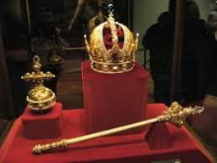
Genesis 49:10
“The scepter shall not depart from Judah, Nor the ruler’s staff from between his feet, Until Shiloh comes, And to him shall be the obedience of the peoples.”

Slide 10
Genesis 44:18
Judah’s Request to Speak
      Request (18a)
      Recognition of Joseph’s authority (18b)

Slide 11
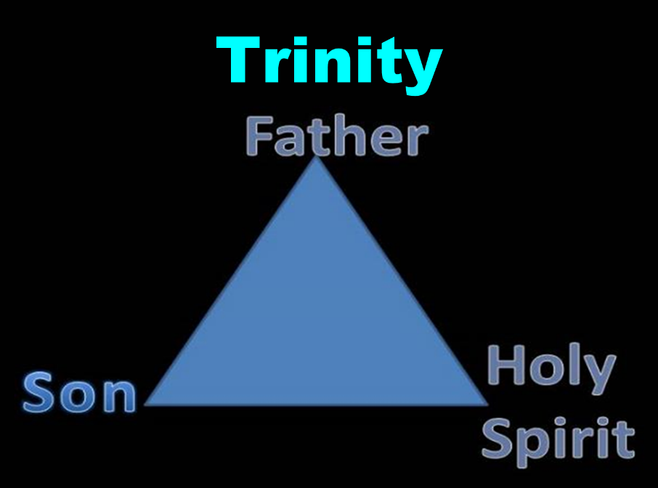

Slide 12
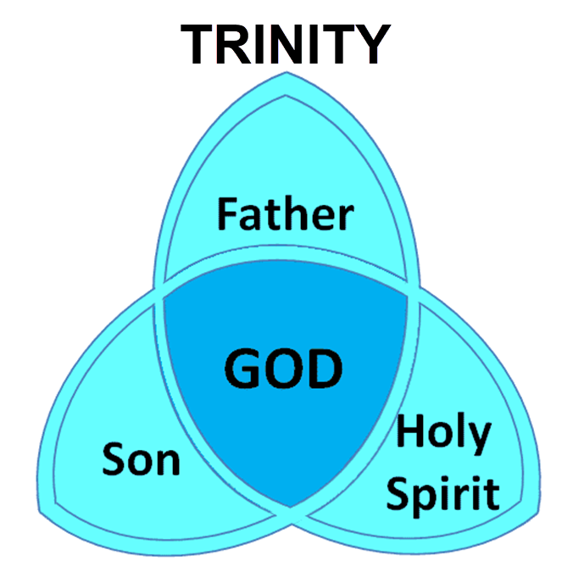

Slide 13
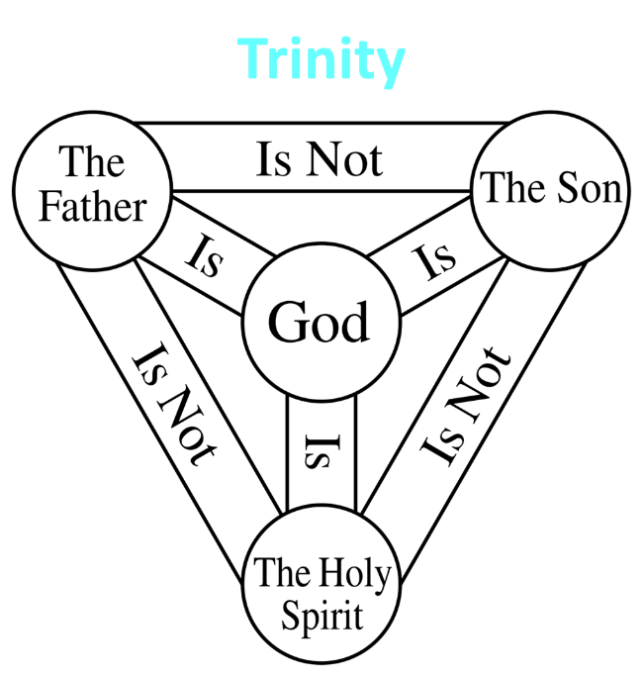

Slide 14
IV. Genesis 44:18-34
Judah’s Intercession
    Judah’s request to speak (18)
    Judah re-tells story (19-29)
    Judah’s offer to Joseph (30-34)

Slide 15
Genesis 44:19-29
Judah Re-tells Story
      Joseph’s question (19)
      Brothers’ answer (20)
      Joseph’s demand (21)
      Brothers’ protest (22)
      Joseph’s insistence (23)
      Brothers’ report to Jacob (24)
      Jacob’s request (25)
      Brothers’ protest (26)
      Jacob’s response (27-29)

Slide 16
Genesis 44:19-29
Judah Re-tells Story
      Joseph’s question (19)
      Brothers’ answer (20)
      Joseph’s demand (21)
      Brothers’ protest (22)
      Joseph’s insistence (23)
      Brothers’ report to Jacob (24)
      Jacob’s request (25)
      Brothers’ protest (26)
      Jacob’s response (27-29)

Slide 17
Genesis 44:19-29
Judah Re-tells Story
      Joseph’s question (19)
      Brothers’ answer (20)
      Joseph’s demand (21)
      Brothers’ protest (22)
      Joseph’s insistence (23)
      Brothers’ report to Jacob (24)
      Jacob’s request (25)
      Brothers’ protest (26)
      Jacob’s response (27-29)

Slide 18
Genesis 44:19-29
Judah Re-tells Story
      Joseph’s question (19)
      Brothers’ answer (20)
      Joseph’s demand (21)
      Brothers’ protest (22)
      Joseph’s insistence (23)
      Brothers’ report to Jacob (24)
      Jacob’s request (25)
      Brothers’ protest (26)
      Jacob’s response (27-29)

Slide 19
Genesis 44:19-29
Judah Re-tells Story
      Joseph’s question (19)
      Brothers’ answer (20)
      Joseph’s demand (21)
      Brothers’ protest (22)
      Joseph’s insistence (23)
      Brothers’ report to Jacob (24)
      Jacob’s request (25)
      Brothers’ protest (26)
      Jacob’s response (27-29)

Slide 20
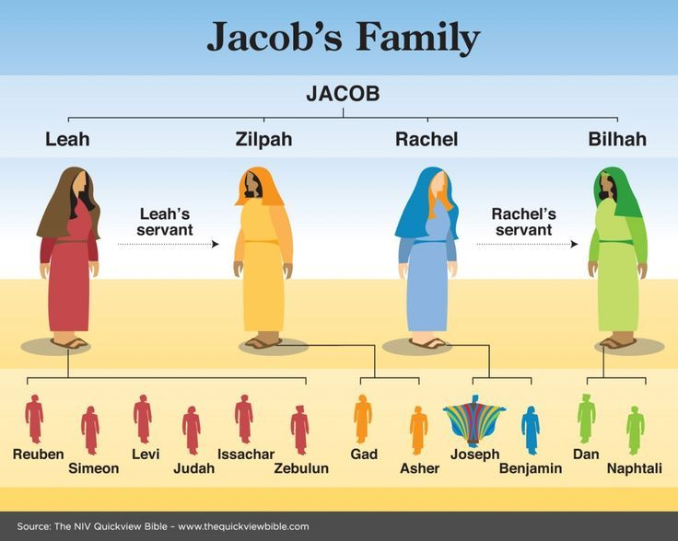

Slide 21
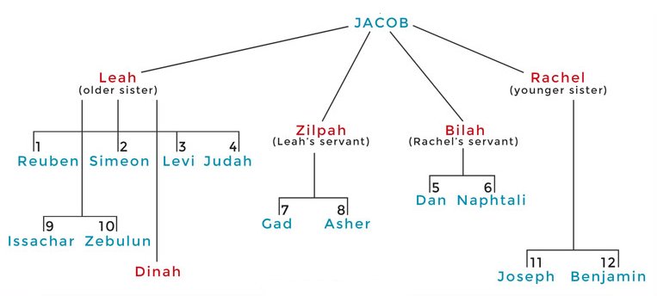

Slide 22
Genesis 44:19-29
Judah Re-tells Story
      Joseph’s question (19)
      Brothers’ answer (20)
      Joseph’s demand (21)
      Brothers’ protest (22)
      Joseph’s insistence (23)
      Brothers’ report to Jacob (24)
      Jacob’s request (25)
      Brothers’ protest (26)
      Jacob’s response (27-29)

Slide 23
Genesis 44:19-29
Judah Re-tells Story
      Joseph’s question (19)
      Brothers’ answer (20)
      Joseph’s demand (21)
      Brothers’ protest (22)
      Joseph’s insistence (23)
      Brothers’ report to Jacob (24)
      Jacob’s request (25)
      Brothers’ protest (26)
      Jacob’s response (27-29)

Slide 24
Genesis 44:19-29
Judah Re-tells Story
      Joseph’s question (19)
      Brothers’ answer (20)
      Joseph’s demand (21)
      Brothers’ protest (22)
      Joseph’s insistence (23)
      Brothers’ report to Jacob (24)
      Jacob’s request (25)
      Brothers’ protest (26)
      Jacob’s response (27-29)

Slide 25
Genesis 44:19-29
Judah Re-tells Story
      Joseph’s question (19)
      Brothers’ answer (20)
      Joseph’s demand (21)
      Brothers’ protest (22)
      Joseph’s insistence (23)
      Brothers’ report to Jacob (24)
      Jacob’s request (25)
      Brothers’ protest (26)
      Jacob’s response (27-29)

Slide 26
Genesis 44:19-29
Judah Re-tells Story
      Joseph’s question (19)
      Brothers’ answer (20)
      Joseph’s demand (21)
      Brothers’ protest (22)
      Joseph’s insistence (23)
      Brothers’ report to Jacob (24)
      Jacob’s request (25)
      Brothers’ protest (26)
      Jacob’s response (27-29)

Slide 27
Genesis 44:27-29
Jacob’s Response
      Two sons (27)
      Joseph (28)
      Benjamin (29)

Slide 28
Genesis 44:27-29
Jacob’s Response
      Two sons (27)
      Joseph (28)
      Benjamin (29)

Slide 31
Genesis 44:27-29
Jacob’s Response
      Two sons (27)
      Joseph (28)
      Benjamin (29)

Slide 32
Genesis 37‒50
Joseph
  Joseph sold unto Egypt (37)
  Canaan’s corruption (38)
  Joseph falsely accused (39)
  Joseph’s short-term predictions (40)
  Joseph’s elevation (41)
  Joseph’s first reunion with his brothers (42)
  Joseph’s second reunion with his brothers (43‒45)

Slide 33
Genesis 44:27-29
Jacob’s Response
      Two sons (27)
      Joseph (28)
      Benjamin (29)

Slide 34

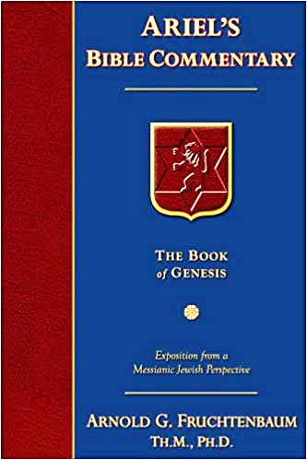
Dr. Arnold G. Fruchtenbaum
The Book of Genesis, 537
“Jacob’s refusal is stated: He refused to be comforted; and he said, For I will go down to Sheol to my son in mourning. And his father wept for him. Sheol is the center of the earth, and before the death of the Messiah, all souls descended there upon death; but the faithful and unfaithful entered into different compartments in Sheol.”

Slide 35
Dr. Arnold G. Fruchtenbaum
The Book of Genesis, 581
“The danger to Jacob was: If harm befall him by the way in which ye go, then will ye bring down my gray hairs with sorrow to Sheol. Jacob in this passage clearly anticipated going to Sheol at death, and the direction of Sheol was clearly downward not upward.”

Slide 36

Luke 16:24-26
“²⁴ And he cried out and said, ‘Father Abraham, have mercy on me, and send Lazarus so that he may dip the tip of his finger in water and cool off my tongue, for I am in agony in this flame.’ ²⁵ But Abraham said, ‘Child, remember that during your life you received your good things, and likewise Lazarus bad things; but now he is being comforted here, and you are in agony. ²⁶ And besides all this, between us and you there is a great chasm fixed, so that those who wish to come over from here to you will not be able, and that none may cross over from there to us.’”

Slide 37
IV. Genesis 44:18-34
Judah’s Intercession
    Judah’s request to speak (18)
    Judah re-tells story (19-29)
    Judah’s offer to Joseph (30-34)

Slide 38
Genesis 44:30-34
Judah’s Offer to Joseph
      Danger to Jacob (30-31)
      Judah’s commitment to Jacob (32)
      Judah’s offer to Joseph (33)
      Judah’s reason (34)

Slide 39
Genesis 44:30-34
Judah’s Offer to Joseph
      Danger to Jacob (30-31)
      Judah’s commitment to Jacob (32)
      Judah’s offer to Joseph (33)
      Judah’s reason (34)

Slide 40
Dr. Arnold G. Fruchtenbaum
The Book of Genesis, 595-96
“In verses 30–31 was the danger: Now therefore, moving to the conclusion: when I come to your servant my father, and the lad is not with us; seeing that his life is bound up in the lad’s life, he begins. The Hebrew here literally reads ‘his soul is knit with the lad’s soul,’ and is also used of the relationship of David and Jonathan (I Sam. 18:1).”

Slide 41
Genesis 44:30-34
Judah’s Offer to Joseph
      Danger to Jacob (30-31)
      Judah’s commitment to Jacob (32)
      Judah’s offer to Joseph (33)
      Judah’s reason (34)

Slide 42
Genesis 44:30-34
Judah’s Offer to Joseph
      Danger to Jacob (30-31)
      Judah’s commitment to Jacob (32)
      Judah’s offer to Joseph (33)
      Judah’s reason (34)

Slide 43
Dr. Arnold G. Fruchtenbaum
The Book of Genesis, 445
“Now the deceiver is deceived, although the motivations differ from good to bad. This is divine retribution in four ways. First, Isaac’s blindness equals the darkness of Jacob’s wedding night, and neither could see well as a result. Second, this Jacob is deceived by being presented the older for the younger, the reversal of Isaac’s presentation of Jacob for Esau. Third, Isaac thought Jacob was Esau and Jacob thought Leah was Rachel. Fourth, Jacob pretended to be his older brother, while Leah pretended to be her younger sister.”

Slide 44

Galatians 6:7-9
Sowing and Reaping
“Do not be deceived, God is not mocked; for whatever a man sows, this he will also reap. For the one who sows to his own flesh will from the flesh reap corruption, but the one who sows to the Spirit will from the Spirit reap eternal life. Let us not lose heart in doing good, for in due time we will reap if we do not grow weary.”

Slide 45
Messiah must be from the tribe of Judah
Genesis 49:10
Revelation 5:5

Slide 46
Genesis 49:10
“The scepter shall not depart from Judah, Nor the ruler’s staff from between his feet, Until Shiloh comes, And to him shall be the obedience of the peoples.”

Slide 47


Revelation 5:5
“and one of the elders said to me, “Stop weeping; behold, the Lion that is from the tribe of Judah, the Root of David, has overcome so as to open the book and its seven seals.”

Slide 50

Charles Ryrie
The Ryrie Study Bible, p. 57
“44:33 Judah’s eloquent plea is climaxed by his offer to take Benjamin’s punishment on himself—a beautiful illustration of what Judah’s illustrious descendant, Jesus, actually did at Calvary.”

Slide 51

1 Corinthians 6:9–11
⁹ Or do you not know that the unrighteous will not inherit the kingdom of God? Do not be deceived; neither fornicators, nor idolaters, nor adulterers, nor effeminate, nor homosexuals, ¹⁰ nor thieves, nor the covetous, nor drunkards, nor revilers, nor swindlers, will inherit the kingdom of God. ¹¹ Such were some of you; but you were washed, but you were sanctified, but you were justified in the name of the Lord Jesus Christ and in the Spirit of our God.

Slide 52
Genesis 44:30-34
Judah’s Offer to Joseph
      Danger to Jacob (30-31)
      Judah’s commitment to Jacob (32)
      Judah’s offer to Joseph (33)
      Judah’s reason (34)

Slide 53
Conclusion

Slide 54
Genesis 43‒45
Second Reunion
  Jacob sends sons to Egypt (43:1-14)
  Second reunion with Joseph (43:15-34)
  Benjamin’s arrest (44:1-17)
  Judah’s intercession (44:18-34)
  Joseph’s revelation (45:1-15)
  Pharaoh’s invitation (45:16-20)
  Brothers return to Jacob (45:21-28)

Slide 55
IV. Genesis 44:18-34
Judah’s Intercession
    Judah’s request to speak (18)
    Judah re-tells story (19-29)
    Judah’s offer to Joseph (30-34)

Slide 56
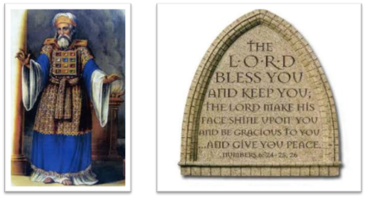
²⁴ The Lord bless you, and keep you; ²⁵ The Lord make His face shine on you, And be gracious to you; ²⁶ The Lord lift up His countenance on you, And give you peace.
Numbers 6:24–26 (NASB95)

