Slide 1
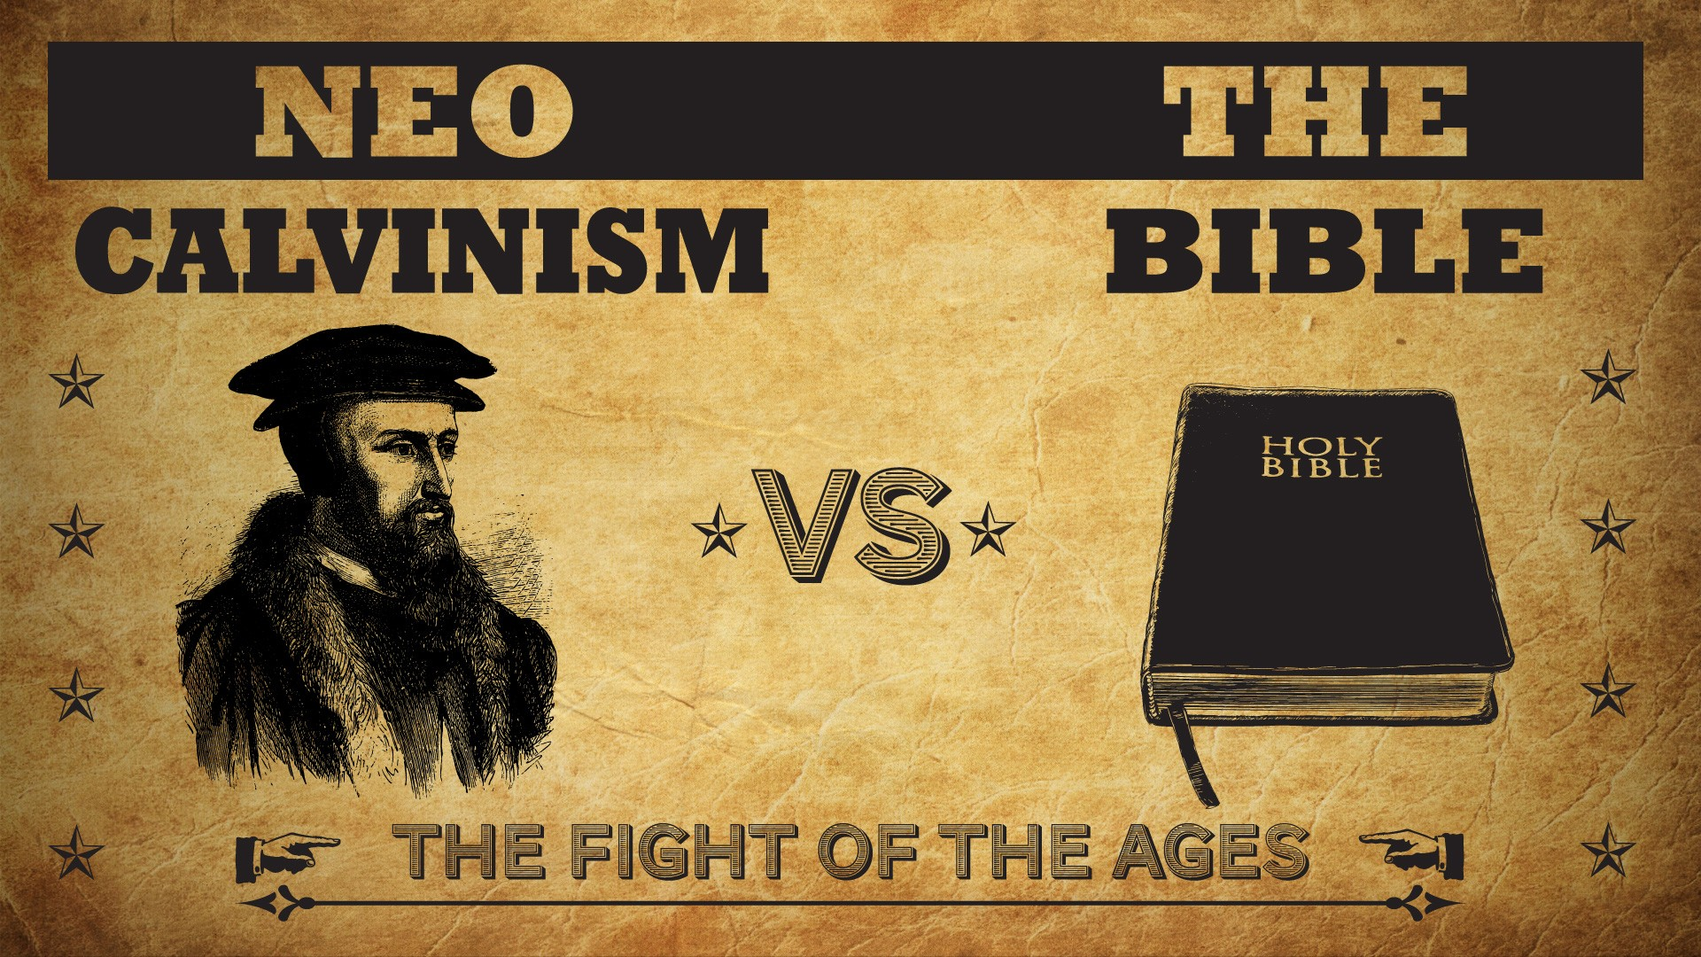

Slide 2
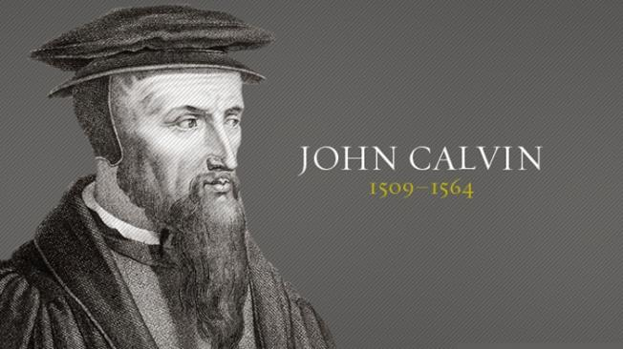

Neo-Calvinism vs. The Bible
Dr. Andy Woods
Senior Pastor – Sugar Land Bible Church
President – Chafer Theological Seminary

Slide 3
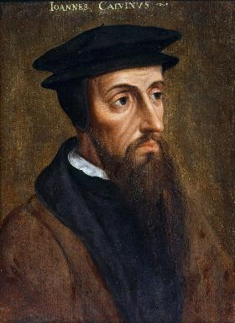
Neo-Calvinism vs. The Bible
Calvinism’s Mixed Blessing
Why Critique Calvinism?
The Source of Calvin’s Theology
Calvin’s Manner of Life
TULIP Through the Grid of Scripture
Conclusion

Slide 4
Neo-Calvinism vs. The Bible
Calvinism’s Mixed Blessing
Why Critique Calvinism?
The Source of Calvin’s Theology
Calvin’s Manner of Life
TULIP Through the Grid of Scripture
Conclusion

Slide 5
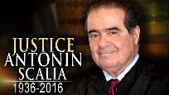
“Every tin horn dictator in the world today, every president for life, has a Bill of Rights,”...“That’s not what makes us free; if it did, you would rather live in Zimbabwe. But you wouldn’t want to live in most countries in the world that have a Bill of Rights. What has made us free is our Constitution. Think of the word ‘constitution;’ it means structure.” “That’s why America’s framers debated not the Bill of Rights during the Constitutional Convention of 1787 in Philadelphia,” he said, “but rather the structure of the federal government.” “The genius of the American constitutional system is the dispersal of power,” he said. “Once power is centralized in one person, or one part [of government], a Bill of Rights is just words on paper.”...“A constitution is about setting structure; it is not about writing the preferences of special interest groups,” he said.”
Kevin Mooney, “Supreme Court Justice Scalia: Constitution, Not Bill of Rights, Makes Us Free,” online: http://dailysignal.com/2015/05/11/supreme-court-justice-scalia-constitution-not-bill-of-rights-makes-us-free/, May 11 2015, accessed 20 January 2016.

Slide 6
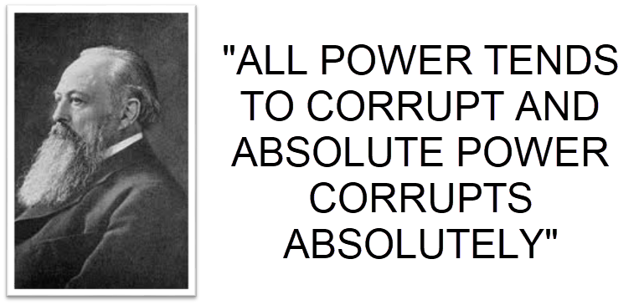
Lord Acton

Slide 7
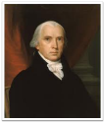
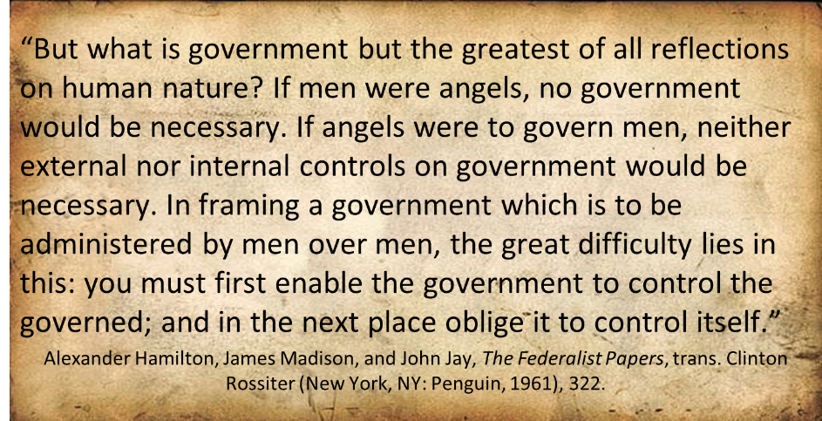
Federalist # 51

Slide 8
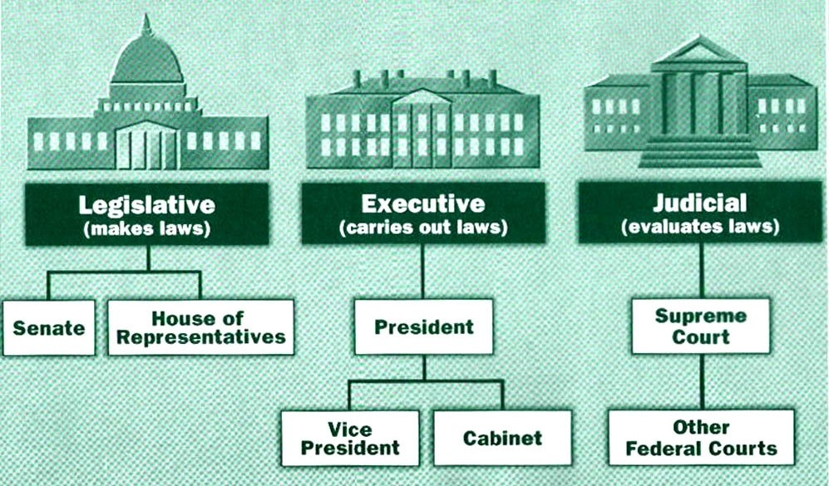

Slide 9


Isaiah 33:22
“For the LORD is our judge, The LORD is our lawgiver, The LORD is our king.”

Slide 10

Tenth Amendment
“The powers not delegated to the United States by the Constitution nor prohibited by it to the States are reserved to the States respectively or to the people.”

Slide 11
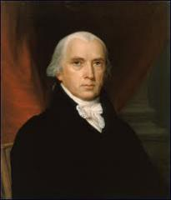
Federalist # 45
“The powers delegated by the proposed Constitution to the federal government, are few and defined. Those which are to remain in the State governments are numerous and indefinite.”
Alexander Hamilton, James Madison, and John Jay, The Federalist Papers, trans. Clinton Rossiter (New York, NY: Penguin, 1961), 292.

Slide 12
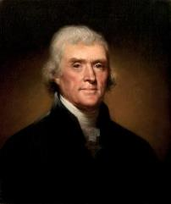
Thomas Jefferson
Kentucky Resolutions of 1798: "...in questions of power then, let no more be heard of confidence in man, but bind him down from mischief by the chains of the constitution..." (from draft)
Papers of Thomas Jefferson 30:529-556

Slide 13

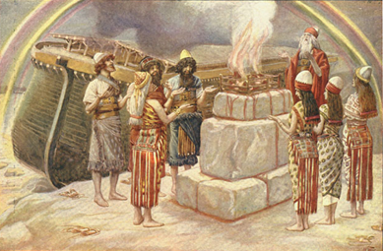
Genesis 8:21
The Lord smelled the soothing aroma; and the Lord said to Himself, “I will never again curse the ground on account of man, for the intent of man’s heart is evil from his youth; and I will never again destroy every living thing, as I have done.[emphasis mine].

Slide 14


Slide 15
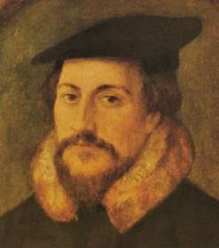
John Calvin
“Bancroft, who far though he was from being Calvinistic in his own personal convictions, simply calls Calvin ‘the father of America,“ and adds: “He who will not honor the memory and respect the influence of Calvin knows but little of the origins of American liberty.’”
Loraine Boettner, The Reformed Doctrine of Predestination (Philipsburg, NJ: Presbyterian and Reformed, 1932), 389-90.

Slide 16
Neo-Calvinism vs. The Bible
Calvinism’s Mixed Blessing
Why Critique Calvinism?
The Source of Calvin’s Theology
Calvin’s Manner of Life
TULIP Through the Grid of Scripture
Conclusion

Slide 17
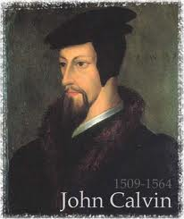
II. Why Critique Calvinism?
General calling to defend the faith (Jude 3)
The call to admonish fellow believers (2 Thess. 3:15)
Calvinism is a serious issue
The prophetic implications of Calvinism

Slide 18
II. Why Critique Calvinism?
General calling to defend the faith (Jude 3)
The call to admonish fellow believers (2 Thess. 3:15)
Calvinism is a serious issue
The prophetic implications of Calvinism

Slide 19

Romans 16:17
“Now I urge you, brethren, keep your eye on those who cause dissensions and hindrances contrary to the teaching which you learned, and turn away from them.”

Slide 20
Titus 1:9-13
^{“9} holding fast the faithful word which is in accordance with the teaching, so that he will be able both to exhort in sound doctrine and to refute those who contradict. ¹⁰ For there are many rebellious men, empty talkers and deceivers, especially those of the circumcision, ¹¹ who must be silenced because they are upsetting whole families, teaching things they should not teach for the sake of sordid gain. ¹² One of themselves, a prophet of their own, said, “Cretans are always liars, evil beasts, lazy gluttons.”

Slide 21
Jude 3-4
^{“3} Beloved, while I was making every effort to write you about our common salvation, I felt the necessity to write to you appealing that you contend earnestly for the faith which was once for all handed down to the saints. ⁴ For certain persons have crept in unnoticed, those who were long beforehand marked out for this condemnation, ungodly persons who turn the grace of our God into licentiousness and deny our only Master and Lord, Jesus Christ.”

Slide 22
II. Why Critique Calvinism?
General calling to defend the faith (Jude 3)
The call to admonish fellow believers (2 Thess. 3:15)
Calvinism is a serious issue
The prophetic implications of Calvinism

Slide 23
Titus 3:10
^{“9} But avoid foolish controversies and genealogies and strife and disputes about the Law, for they are unprofitable and worthless. ¹⁰ Reject [noutheteō] a factious [hairetikos] man after a first and second warning, ¹¹ knowing that such a man is perverted and is sinning, being self-condemned.”

Slide 24
2 Thessalonians 3:14-15
^{“14} If anyone does not obey our instruction in this letter, take special note of that person and do not associate with him, so that he will be put to shame. ¹⁵ Yet do not regard him as an enemy, but admonish [noutheteō] him as a brother.”

Slide 25

Romans 15:14
“And concerning you, my brethren, I myself also am convinced that you yourselves are full of goodness, filled with all knowledge and able also to admonish [noutheteō] one another.”

Slide 26
II. Why Critique Calvinism?
General calling to defend the faith (Jude 3)
The call to admonish fellow believers (2 Thess. 3:15)
Calvinism is a serious issue
The prophetic implications of Calvinism

Slide 27

C. Calvinism is a Serious Issue
Path to salvation becomes difficult (if not impossible)
The sacrifice of Christ becomes unavailable to whosoever
The character of God is questioned (double predestination)
Offers no assurance of Salvation
Calls into question basic Christian practices (such as the baptism of children)

Slide 28
C. Calvinism is a Serious Issue
Path to salvation becomes difficult (if not impossible)
The sacrifice of Christ becomes unavailable to whosoever
The character of God is questioned (double predestination)
Offers no assurance of Salvation
Calls into question basic Christian practices (such as the baptism of children)

Slide 29
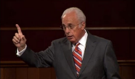

John MacArthur
Justin Peters, Do Not Hinder Them
FOREWORD by Dr. John MacArthur. “Jesus said, ‘Permit the children to come to Me and do not hinder them; for the Kingdom of God belongs to such as these’ (Mark 10:14). Is this a verse in support of baptizing children who make a profession of faith in Christ as most evangelicals have supposed? If it is, why is it that so many of the children we baptize grow up to show little if any fruit of having been genuinely converted? Why do so many walk away from Christianity once they gain independence from the home? In Do Not Hinder Them, author and evangelist Justin Peters presents a compelling biblical case that both the nature of children and the nature of salvation warrant extreme caution before we baptize children who have made intellectual assent to the basics of the Gospel. Do Not Hinder Them encourages parents to teach their children the Gospel but also provides strong biblical and theological reasons to wait until they are older before following through with baptism.”

Slide 30
II. Why Critique Calvinism?
General calling to defend the faith (Jude 3)
The call to admonish fellow believers (2 Thess. 3:15)
Calvinism is a serious issue
The prophetic implications of Calvinism

Slide 31
D. The Prophetic Implications of Calvinism
De-emphasis of Biblical Eschatology
Calvin’s mishandling of prophetic texts
Anti-Semitism
Implications of a lack of an Israel‒Church distinction
Neo-Calvinism as a fulfillment of Bible prophecy

Slide 32
D. The Prophetic Implications of Calvinism
De-emphasis of Biblical Eschatology
Calvin’s mishandling of prophetic texts
Anti-Semitism
Implications of a lack of an Israel‒Church distinction
Neo-Calvinism as a fulfillment of Bible prophecy

Slide 33
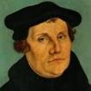
Martin Luther
Preface to the New Testament, 1522.
"I miss more than one thing in this book, and this makes me hold it to be neither apostolic nor prophetic…I think of it almost as I do of the Fourth Book of Esdras, and can in no way detect that the Holy Spirit produced it…It is just the same as if we did not have it, and there are many far better books for us to keep. Finally, let everyone think of it [Revelation] as his own spirit gives him to. My spirit cannot fit itself into this book. There is one sufficient reason for me not to think highly of it — Christ is not taught or known in it; but to teach Christ is the thing which an apostle is bound, above all else, to do, as He says in Acts 1, ‘Ye shall be my witnesses.’ Therefore I stick to the books which give me Christ, clearly and purely." In 1545, Luther printed the Book of Revelation with Hebrews, James and Jude as an appendix to the New Testament.
Notes:
Outline

Slide 34

“John Calvin (1509–1564) has been called ‘one of the greatest interpreters of the Bible.’...Though well known for his theology (spelled out in his two-volume Institutes of the Christian Religion), he wrote commentaries on every book of the Bible except 14 Old Testament books and 3 New Testament books. Those books are Judges, Ruth, 1 and 2 Samuel, 1 and 2 Kings, 1 and 2 Chronicles, Ezra, Nehemiah, Esther, Proverbs, Ecclesiastes, Song of Songs, 2 and 3 John, and Revelation.”
John Calvin
Roy B. Zuck, Basic Bible Interpretation: A Practical Guide to Discovering Biblical Truth (Colorado Springs, CO: Victor, 1991), 47.

Slide 35

Eschatology A Sin?
Justin Taylor, “Dever: ‘You Are in Sin If You Lead Your Congregation to Have a Statement of Faith that Requires a Particular Millennial View,’” online: https://www.thegospelcoalition.org/blogs/justin-taylor/dever-you-are-in-sin-if-you-lead-your/, July 14 2009, accessed May 28, 2019.
“I think that millennial views need not be among those doctrines that divide us. . . . I am suggesting that what you believe about the millennium—how you interpret these thousand years—is not something that it is necessary for us to agree upon in order to have a congregation together. The Lord Jesus Christ prayed in John 17:21 that we Christians might be one. Of course all true Christians are one in that we have his Spirit, we share his Spirit, we desire to live out that unity. But that unity is supposed to be evident as a testimony to the world around us. Therefore, I conclude that we should end our cooperations together with other Christians …only with the greatest of care, lest we rend the body of Christ for whose unity he’s prayed and given himself.”
Notes:
WRONG!!!

Slide 36
Eschatology A Sin?
Justin Taylor, “Dever: ‘You Are in Sin If You Lead Your Congregation to Have a Statement of Faith that Requires a Particular Millennial View,’” online: https://www.thegospelcoalition.org/blogs/justin-taylor/dever-you-are-in-sin-if-you-lead-your/, July 14 2009, accessed May 28, 2019.
“Therefore, I conclude that it is sin to divide the body of Christ—to divide the body that he prayed would be united. Therefore for us to conclude that we must agree upon a certain view of alcohol, or a certain view of schooling, or a certain view of meat sacrificed to idols, or a certain view of the millennium in order to have fellowship together is, I think, not only unnecessary for the body of Christ, but it is therefore both unwarranted and therefore condemned by scripture. So if you’re a pastor and you’re listening to me, you understand me correctly if you think I’m saying you are in sin if you lead your congregation to have a statement of faith that requires a particular millennial view. I do not understand why that has to be a matter of uniformity in order to have Christian unity in a local congregation.”
Notes:
WRONG!!!

Slide 37
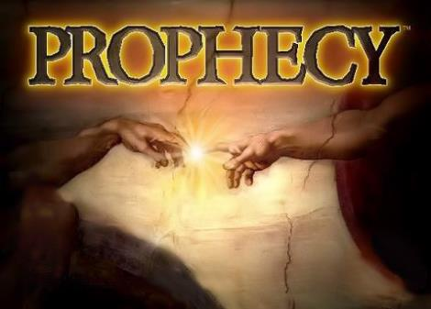
Biblical Prophecy: Importance
27% of Scripture was prophetic at the time it was written
2 Pet 1:19

Slide 38
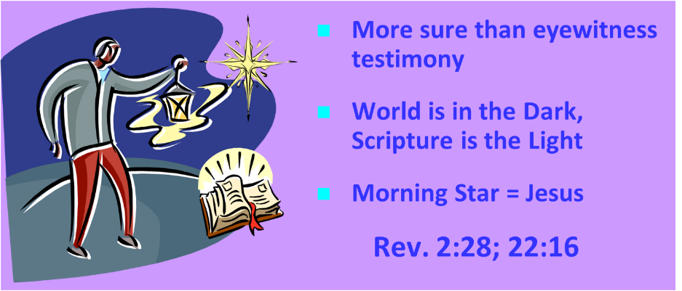
Authority of Scripture
V. 19

Slide 39
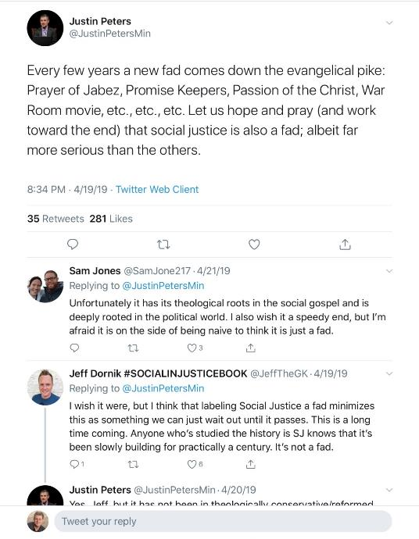

Slide 40
D. The Prophetic Implications of Calvinism
De-emphasis of Biblical Eschatology
Calvin’s mishandling of prophetic texts
Anti-Semitism
Implications of a lack of an Israel‒Church distinction
Neo-Calvinism as a fulfillment of Bible prophecy

Slide 41

Revelation 17:3
“And he carried me away in the Spirit into a wilderness; and I saw a woman sitting on a scarlet beast, full of blasphemous names, having seven heads and ten horns.”

Slide 42
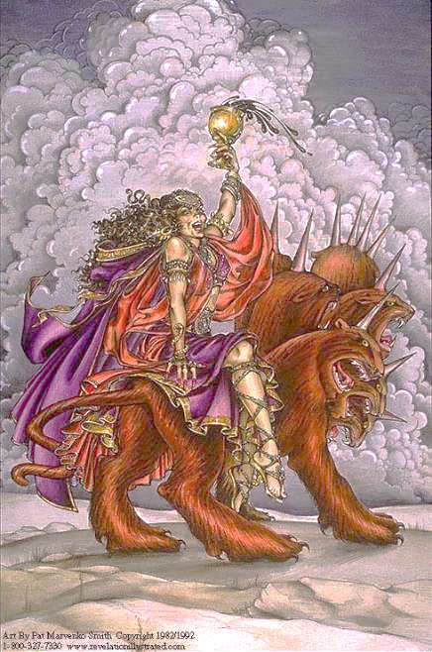

Slide 43
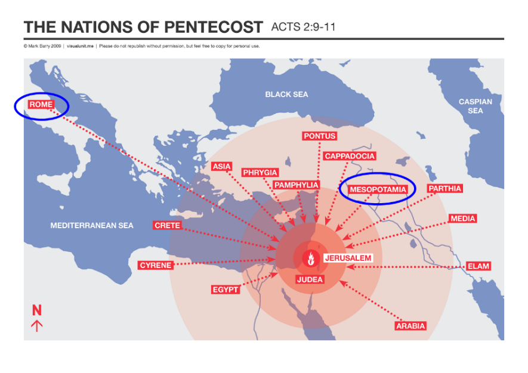

Slide 44
Revelation 17:9-10
“Here is the mind which has wisdom. The seven heads are seven mountains on which the woman sits, ¹⁰ and they are seven kings; five have fallen, one is, the other has not yet come; and when he comes, he must remain a little while.”

Slide 45
Daniel 2:37-38
You, O king, are the king of kings, to whom the God of heaven has given the kingdom, the power, the strength and the glory; ³⁸ and wherever the sons of men dwell, or the beasts of the field, or the birds of the sky, He has given them into your hand and has caused you to rule over them all. You are the head of gold.

Slide 46

7 Kings or Kingdoms (Dan. 2:37-38)
(Revelation 17:9-10)
Egypt
Assyria
Babylon
Persian
Greece
Rome I
Rome II

Slide 47

Martin Luther
"Against the Roman Papacy, an Institution of the Devil," in Luther's Works, ed. Eric. W. Gritsch (Philadelphia, PA: Fortress Press, 1966), 273-74.
“No man can believe what an abomination the papacy is. A Christian does not have to be of low intelligence, either, to recognize it. God himself must deride him in the hellish fire, and our Lord Jesus Christ, St. Paul says in II Thessalonians 2 [:8] will slay him with the breath of his mouth and destroy him by his glorious coming." I only deride, with my own weak derision, so that those who now live and those who will come after us should know what I have thought of the pope, the damned antichrist, and so that whoever wishes to be a Christian may be warned against such an abomination.”

Slide 48
John Calvin
Calvin, Institutes, IV, ii, 12.
“However, when we categorically deny to the papists the title of the church, we do not for this reason impugn the existence of churches among them. Rather, we are only contending about the true and lawful constitution of the church, required in the communion not only of the sacraments (which are the signs of profession) but also especially of doctrine. Daniel [Dan. 9:27] and Paul [2 Thess. 2:4] foretold that Antichrist would sit in the Temple of God. With us, it is the Roman pontiff we make the leader and standard bearer of that wicked and abominable kingdom. The fact that his seat is placed in the Temple of God signifies that his reign was not to be such as to wipe out either the name of Christ or of the church. From this it therefore is evident that we by no means deny that the churches under his tyranny remain churches. But these he has profaned by his sacrilegious impiety, afflicted by his inhuman domination, corrupted and well-nigh killed by his evil and deadly doctrines, which are like poisoned drinks. In them Christ lies hidden, half buried, the gospel overthrown, piety scattered, the worship of God nearly wiped out. In them, briefly, everything is so confused that there we see the face of Babylon rather than that of the Holy City of God.”

Slide 49
“This passage is explained in various ways. I pass by the dreams of the Jews, who apply all passages of this kind to the temporal reign of the Messiah, which they have contrived by their own imagination.... I willingly view this passage as referring to Judea, and afterwards to other parts of the world.... Let us now see when this prophecy was fulfilled, or shall be fulfilled. The Lord began some kind of restoration when he brought his people out of Babylon: but that was only a foretaste, and, therefore, I have no hesitation in saying that this passage, as well as others of a similar kind, must refer to the kingdom of Christ; and in no other light could it be viewed, if we compare it with other prophecies.”
John Calvin
Commentary on Isaiah 35:1
Isaiah 35:1— “The wilderness and the solitary place shall be glad.”

Slide 50
“Here the Prophet describes the felicity which shall be under the reign of Christ: and we know that whenever the Prophets set forth promises of a happy and prosperous state to God’s people, they adopt metaphorical expressions, and say, that abundance of all good things shall flow, that there shall be the most fruitful produce, that provisions shall be bountifully supplied; for they accommodated their mode of speaking to the notions of that ancient people; it is therefore no wonder if they sometimes speak to them as to children. At the same time, the Spirit under these figurative expressions declares, that the kingdom of Christ shall in every way be happy and blessed, or that the Church of God, which means the same thing, shall be blessed, when Christ shall begin to reign.”
John Calvin
Commentary on Amos 9:13
Amos 9:13—“Behold the days come, saith the LORD, that the plowman shall overtake the reaper, and the treader of grapes him that soweth seed: and the mountains shall drop sweet wine, and all the hills shall melt.”

Slide 51
“For as we are dull and entangled in earthly thoughts, our minds can hardly rise up to heaven, though the Lord with a clear voice invites us to himself. The Prophet then, in order to aid our weakness, adds a vivid representation, as though God stood before their eyes. Stand, he says, shall his feet on the mount of Olives. He does not here promise a miracle, such as even the ignorant might conceive to be literal; nor does he do this in what follows, when he says, The mount shall be rent…half…to the east and half to the west. This has never happened, that mount has never been rent: but as the Prophet could not, under those grievous trials, which might have overwhelmed the minds of the godly a hundred times, have extolled the power of God…without employing a highly figurative language, he therefore accommodates himself, as I have said, to the capacity of our flesh.”
John Calvin
Commentary on Zechariah 14:4
Zechariah 14:4—“And his feet shall stand in that day upon the mount of Olives…and the mount of Olives shall cleave in the midst thereof toward the east and toward the west….”

Slide 52
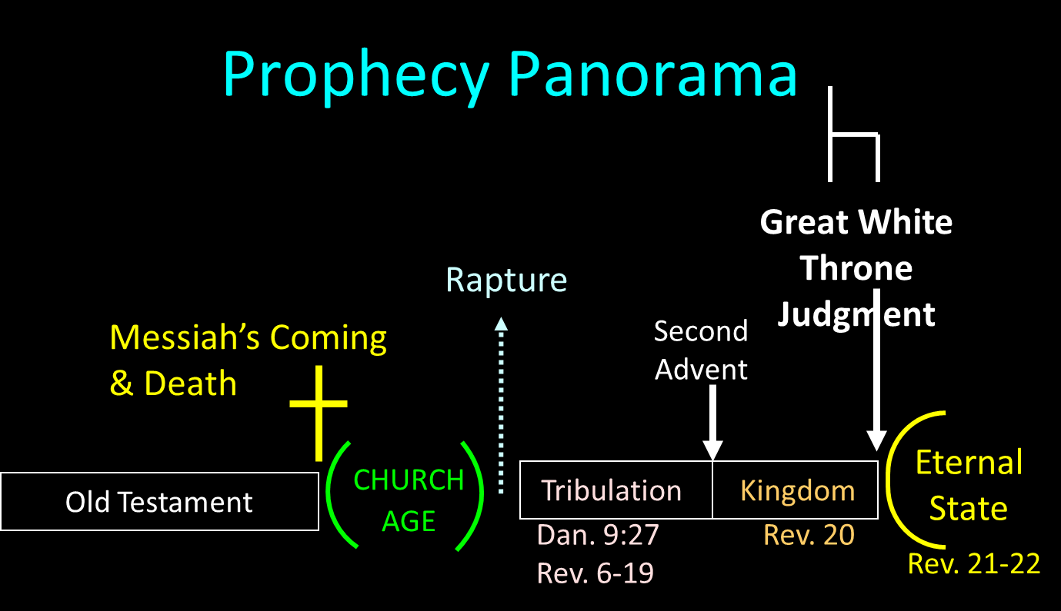

Slide 53
Reasons for Understanding 1000 Literally
John’s use of indefinite concepts elsewhere
  Revelation 20:8, 20:3
Exception to the “# of years” examples?
Other numbers are taken literally
  Two witnesses (11:3), 7000 people (11:13), 4 Angels (7:1) 7 Angels (8:6),144,000 Jews (7:4), 42 months (11:2), 1260 days (11:3)
Not always a symbolic interpretation
  (Rev. 17:18)

Slide 54

Robert Thomas
Revelation 8 to 22: An Exegetical Commentary (Chicago: Moody Press, 1992), 408.
Robert Thomas observes that, "no number in Revelation is verifiably a symbolic number.”

Slide 55
John Calvin
Institutes of the Christian Religion, III, xxv, 5.
“But Satan has not only befuddled men’s senses to make them bury with the corpses the memory of resurrection; he has also attempted to corrupt this part of the doctrine with various falsifications…Now their fiction is too childish either to need or to be worth a refutation. And the Apocalypse, from which they undoubtedly drew a pretext for their error, does not support them. For the number ‘one thousand’ [Rev. 20:4] does not apply to the eternal blessedness of the church but only to the various disturbances that awaited the church, while still toiling on earth…Those who assign the children of God a thousand years in which to enjoy the inheritance of the life to come do not realize how much reproach they are casting upon Christ and his Kingdom.”

Slide 56
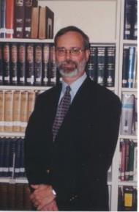
Kenneth L. Gentry
He Shall Have Dominion: A Post Millennial Eschatology (Tyler, Texas: Institute for Christian economics, 1992), page 335.
“The proper understanding of the thousand-year time frame in Revelation 20 is that it is representative of a long and glorious era and is not limited to a literal 365,000 days. The figure represents a perfect cube of 10, which is the number of quantitative perfection.”

Slide 57

Matthew 24:13
“But the one who endures to the end, he will be saved [sōzō].”

Slide 58
Matt 24 / Rev 6 Parallels
Prediction | Birth pangs (Matt 24) | Seal judgments (Rev 6)
False Christ | 24:5 | 6:2
War | 24:6 | 6:3-4
Famine | 24:7 | 6:5-6
Death | 24:6-7 | 6:7-8
Martyrs | 24:9-13 | 6:9-11
Earthquakes | 24:7 | 6:12-17
Evangelism | 24:14 | 7:1-9

Slide 59
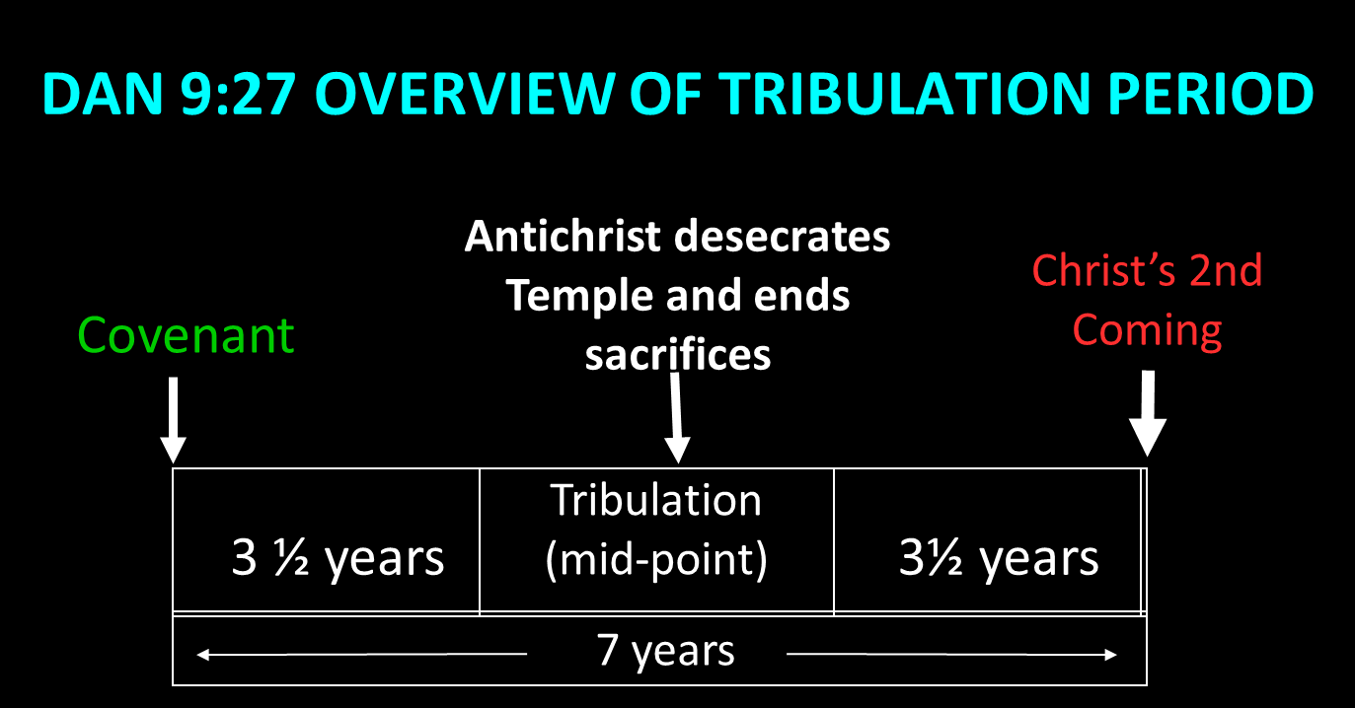

Slide 60

John MacArthur
Matthew 24‒25, The Macarthur New Testament Commentary (Chicago: Moody, 1989), 28.
"But the one who endures to the end, he shall be saved…his endurance will be a Spirit-empowered product and proof of the reality that he is saved. Neither the high cost of discipleship nor the deception of false prophets nor the enticement of sin will cause true believers to renounce Christ, because He Himself will protect them from defection. Endurance is always a mark of salvation…The perseverance of the saints in faith is a very basic element of salvation teaching in the New Testament. It states that people who are genuinely saved do not depart from the faith (see John 8: 31; 1 Cor. 15: 1-2; Col. 1: 21-23; Heb. 2: 1-3; 3: 14; 4: 14; 6: 11-12; 10: 39; 12: 14; James 1: 2-4)…Endurance…does give evidence of the spiritual life that resides in the believer...”

Slide 61

Dave Anderson
David R. Anderson, “The Soteriological Impact of Augustine’s Change from Premillennialism to Amillennialism: Part One,” Journal of the Grace Evangelical Society Volume 15, no. 28 (2002): 25.and Part Two is in no 29, Autumn, 2002.
“﻿...we chose Augustine as a case in point...Specifically, his reinterpretation of Matt 24:13 (“he who endures to the end will be saved”) as a spiritual salvation instead of a physical salvation (to enter and populate the Millennium) caused drastic changes in his soteriology. Perseverance of the saints (faithfulness until the end of one’s physical life) became the sine qua non of his soteriology. One could believe in Christ, have the fruit of the elect, but prove he was not elect if he should not persevere in faithfulness until the end of his physical life.”

Slide 62
Scripture’s Four Judgments
Name | Sheep and Goat | Judgment of the Jews | Bema Seat | Great White Throne
Scripture | Matt 25:31-46 | Ezek 20:33-44 | 1 Cor 3:10-15 | Rev 20:11-15
Place | Earth, Jerusalem | Earth, wilderness | Heaven | Earth
Audience | Gentile Tribulation survivors | Jewish Tribulation survivors | Church Age believers | All unsaved
When | After Tribulation | After Tribulation | After rapture | After Millennium
Purpose | Saved Gentiles enter kingdom | Saved Jews enter kingdom | Reward believers | Degree of punishment in hell
Evaluation | Treatment of Christ’s brethren | Passing under shepherd’s rod | Works taken through fire | Not in the book; judged by books

Slide 63

Dr. Robert R. Congdon
Robert R. Congdon, How Calvinism Serves Satan's Purposes (Greer, SC: Congdon Ministries International, 2014), 29.
“Most new Calvinist do not believe that Christ will return and reign on this earth for one thousand years, nor do they understand that those of the church age will return to rule with Him following a review time before His judgment seat or bema seat when our roles and responsibilities will be determined. Most Calvinists believe the Great White Throne judgment is for everyone of all ages and it will determine whether one is truly saved or not.”

Slide 64
D. The Prophetic Implications of Calvinism
De-emphasis of Biblical Eschatology
Calvin’s mishandling of prophetic texts
Anti-Semitism
Implications of a lack of an Israel‒Church distinction
Neo-Calvinism as a fulfillment of Bible prophecy

Slide 65

  “First, their synagogues should be set on fire…Secondly, their homes should likewise be broken down and destroyed…Thirdly, they should be deprived of their prayer books and Talmuds…”

Slide 66
  “…Fourthly, their rabbis must be forbidden under threat of death to teach any more…Fifthly, passport and traveling privileges should be absolutely forbidden to the Jews…Sixthly, they ought to be stopped from usury (charging interest on loans…”

Slide 67
  “Seventhly, let the young and strong Jews and Jewesses be given the flail, the ax, the hoe, the spade, the distaff, and spindle, and let the earn their bread by the sweat of their noses…We ought to drive the rascally lazy bones out of our system...”
Martin Luther, Concerning the Jews and Their Lies, cited in Michael Brown’s Our Hands Are Stained with Blood, pp. 14-15.

Slide 68
  “…Therefore away with them… To sum up, dear princes and nobles who have Jews in your domains, if this advice of mine does not suit you, then find a better one so that you and we may all be free of this insufferable devilish burden–the Jews.”
Martin Luther, Concerning the Jews and Their Lies, cited in Michael Brown’s Our Hands Are Stained with Blood, pp. 14-15.

Slide 69
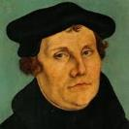
The Encyclopaedia Judaica says “Short of the Auschwitz oven and the extermination, the whole Nazi holocaust is pre-outlined here.”
Martin Luther
“Luther, Martin,” in Encyclopaedia Judaica, Vol. 8, 693.

Slide 70
Martin Luther
Rabbi Joseph Telushkin, "Martin Luther and the Protestant Reformation" in Jewish Literacy--The Most Important Things to Know About the Jewish Religion, Its People and Its History, [William Morrow and Company, NY, 1991], pages 204-206.
Telushkin likens Luther to Mohammed, because both men initially had a love for the Jews but later turned in hate against the Jews when the Jews would not convert. Here are some of Rabbi Telushkin's shocking quotes:
“[Luther] was to pen the most anti-Semitic writings produced in Germany until the time of Hitler.”
“On one occasion, this earlier exponent of Christian love said: ‘I would threaten to cut their tongues out from their throats, if they refuse to acknowledge the truth that God is a trinity and not a plain unity.’”

Slide 71
Martin Luther
Rabbi Joseph Telushkin, "Martin Luther and the Protestant Reformation" in Jewish Literacy--The Most Important Things to Know About the Jewish Religion, Its People and Its History, [William Morrow and Company, NY, 1991], pages 204-206.
“At the Nuremberg trials, Nazi propagandist Julius Streicher defended himself with the claim that he had not said anything worse about the Jews than had Martin Luther.”
“Hitler proudly claimed Luther as an ally: ‘He saw the Jew as we are only beginning to see him today.’”

Slide 72
  “But here he [the rabbi] not only betrays his ignorance, but his utter stupidity, since God so blinded the whole people that they were like restive dogs. I have had much conversation with many Jews: I have never seen either a drop of piety or a grain of truth or ingenuousness—nay, I have never found common sense in any Jew. But this fellow, who seems so sharp and ingenious, displays his own impudence to his great disgrace.”
John Calvin
Commentary on the Prophet Daniel (Vol 1, p. 185). Bellingham, WA: Logos Bible Software. Commentary on Daniel 2:44-45. (2010).

Slide 73
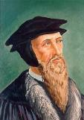

“But by this public call, the Gentiles were not only made equal to the Jews, but seemed to be substituted into their place, as if the Jews had been dead.”
John Calvin
Institutes of the Christian Religion, II, xi, 12.

Slide 74
In his sermon on 2 Samuel 24:24, Calvin declares: “Now the Jews are cut off like rotten limbs. We have taken their place.”
John Calvin
John Calvin, Supplementa Calviniana, I, 766, 12f; quoted in Selderhuis, Calvin Handbook, 145.

Slide 75
Calvin also declares them [Israel] to be “cut off from everything,” adding haughtily, “and we have succeeded them in their place.”
John Calvin
John Calvin, Supplementa Calviniana, II, 36, 28f; Sermon on Isa. 14:2; quoted in Selderhuis, Calvin Handbook, 145.

Slide 76


Slide 77

  “As for eighty to ninety percent of the Jews in our times, they are Ashkenazi…Russians…Look at them! White, crooked nose, blonde hairs. This is not the descendent of Yakub [Jacob]. These are not a Semitic people. Look at them! They don’t look like Semites and they are not Semites…Hitler never intended to mass-destroy the Jews. There are a number of books out written by Christians on this, you should read them. The Hoax of the Holocaust, I advise you to read this book, you may want to write this down, the Hoax of the Holocaust, a very good book. All of this is false propaganda and I know it sounds so far-fetched, and these theories, but read it. The evidences are very strong. And they’re talking about newspaper articles, clippings, everything and look up yourself what Hitler really wanted to do…but what the Jews, the way that they portray him, also is not correct.”
Yasir Qhadi
https://www.youtube.com/watch?v=OGOO5FcAE8E

Slide 78

Notes:
78

Slide 79
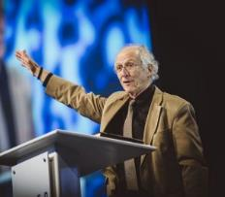
John Piper
John Piper, cited in Paul R. Wilkinson, Israel Betrayed: Volume 2: The Rise of Christian Palestinianism (San Antonio, TX: Ariel, 2018), 331-32.
“[God] has a saving purpose for Israel. All Israel will someday turn to the Lord Christ as a group. This is my deep understanding in belief of Romans 11. The broken off branches will be grafted in one day to the people of God, the bride of Christ, His church.”

Slide 80
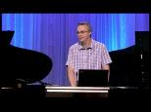
Paul Wilkinson
Paul R. Wilkinson, Israel Betrayed: Volume 2: The Rise of Christian Palestinianism (San Antonio, TX: Ariel, 2018), 332.
“On the basis of this kind of statement, many in the church are being misled into believing that Piper stands with Israel, but he does not. What Piper said is not what Paul taught. Israel’s destiny as a nation is not one of spiritual incorporation into the church, which is the classic Reformed, Calvinistic teaching. The church comprises individual Jews and Gentiles, not ‘Israel,’ which is a distinct national entity. The appointed destiny for Israel is for her to remain a nation in the sight of God and in the midst of all the nations, for as long as God’s ‘fixed order’ of creation endures (Jer. 31:36).”

Slide 81

Jeremiah 31:35-37
“Thus says the Lord, Who gives the sun for light by day And the fixed order of the moon and the stars for light by night, Who stirs up the sea so that its waves roar; The Lord of hosts is His name:³⁶ “If this fixed order departs From before Me,” declares the Lord, “Then the offspring of Israel also will cease From being a nation before Me forever.”³⁷ Thus says the Lord, “If the heavens above can be measured And the foundations of the earth searched out below, Then I will also cast off all the offspring of Israel For all that they have done,” declares the Lord.”

Slide 82
D. The Prophetic Implications of Calvinism
De-emphasis of Biblical Eschatology
Calvin’s mishandling of prophetic texts
Anti-Semitism
Implications of a lack of an Israel‒Church distinction
Neo-Calvinism as a fulfillment of Bible prophecy

Slide 83
Dispensational Theology is a
System of Theology
Traditional-normative dispensational theology is a system that embodies three essential, fundamental concepts called the sine qua non (lit. “without which is not”):
The consistent use of a plain, normal, literal, grammatical-historical method of interpretation;
Which reveals that the Church is distinct from Israel;
God’s overall purpose is to bring glory to Himself (Eph. 1:6, 12, 14).
Dr. Charles Ryrie, Dispensationalism, pp. 38-41

Slide 84
Augustine
The City of God, trans., Marcus Dods (NY: Random House, 1950), Book XX, chap. 9, p. 725-26.
Augustine wrote, “the saints reign with Christ during the same thousand years, understood in the same way, that is, of the time of His first coming” and “Therefore the Church even now is the kingdom of Christ, and the kingdom of heaven. Accordingly, even now His saints reign with Him.”

Slide 85
Augustine
The City of God, trans., Marcus Dods (NY: Random House, 1950), Book XX, chap. 7, p. 719.
“And this opinion would not be objectionable…for I myself, too, once held this opinion. But, as they assert that those who then rise again shall enjoy the leisure of immoderate carnal banquets, furnished with an amount of meat and drink such as not only to shock the feeling of the temperate, but even to surpass the measure of credulity itself, such assertions can be believed only by the carnal. They who do believe them are called by the spiritual Chiliasts, which we may literally reproduce by the name Millenarians.”

Slide 86

John Calvin
Institutes of the Christian Religion, III, xxv, 5.
“But Satan has not only befuddled men’s senses to make them bury with the corpses the memory of resurrection; he has also attempted to corrupt this part of the doctrine with various falsifications…Now their fiction is too childish either to need or to be worth a refutation. And the Apocalypse, from which they undoubtedly drew a pretext for their error, does not support them. For the number ‘one thousand’ [Rev. 20:4] does not apply to the eternal blessedness of the church but only to the various disturbances that awaited the church, while still toiling on earth…Those who assign the children of God a thousand years in which to enjoy the inheritance of the life to come do not realize how much reproach they are casting upon Christ and his Kingdom.”

Slide 87
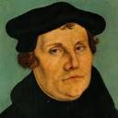
Martin Luther
Alister E. McGrath, Reformation Thought: An Introduction (Grand Rapids: Baker, 1995), 179.
He believed that “such sacraments could generate faith; and hence baptism could generate faith of an infant.”
Notes:
Outline

Slide 88
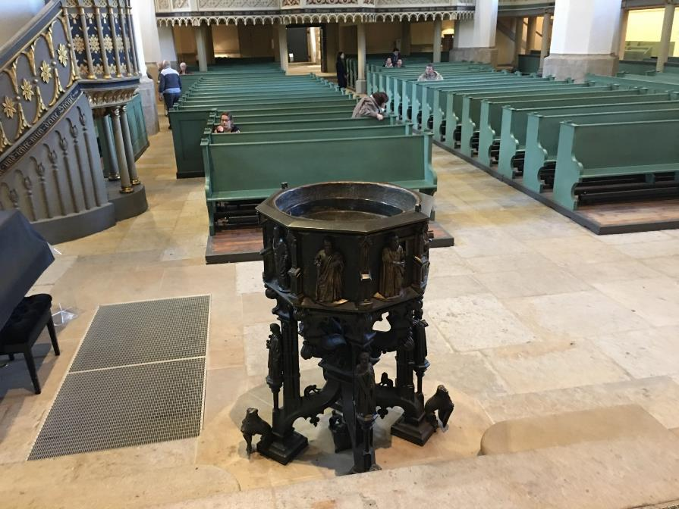

Slide 89

R.C. Sproul
https://www.ligonier.org/learn/devotionals/the-infant-baptism-question/
“The Eastern Orthodox, Roman Catholic, Lutheran, Anglican, and Reformed churches all practice infant baptism. Today we want to look at four lines of evidence that show the validity of this practice. First, just as baptism is the sign of entrance into the community of the new covenant, so circumcision was the sign of entrance into the core community of the old covenant (the people of Israel; God-fearing Gentiles did not have to be circumcised).…The absence of controversy anywhere in the early church indicates that the church was comfortable with infant baptism, and was carrying on the apostolic tradition of the New Testament.”

Slide 90

Alva J. McClain
Alva J. McClain, The Greatness of the Kingdom: An Inductive Study of the Kingdom of God as Set Forth in the Scriptures (Grand Rapids: Zondervan, 1959), 438-39.
“Theological confusion, especially in matters which have to do with the church, will inevitably produce consequences which are of grave practical concern. The identification of the Kingdom with the church has led historically to ecclesiastical policies and programs which, even when not positively evil, have been far removed from the original simplicity of the New Testament ekklēssia. It is easy to claim that in the ‘present kingdom of grace’ that the rule of the saints is wholly ‘spiritual,’ exerted only through moral principles and influence. But practically, once the church becomes the Kingdom in any realistic theological sense, it is impossible to draw any clear line between principles and their implementation through political and social devices. For the logical implications of a present ecclesiastical kingdom are unmistakable, and historically have always led in one direction, i.e., political control of the state by the church.”

Slide 91
Alva J. McClain
Alva J. McClain, The Greatness of the Kingdom: An Inductive Study of the Kingdom of God as Set Forth in the Scriptures (Grand Rapids: Zondervan, 1959), 438-39.
“The distances traveled down this road by various religious movements, and the forms of control which were developed, have been widely different. The difference is very great between the Roman Catholic system and modern Protestant efforts to control the state; also between the ecclesiastical rule of Calvin in Geneva and the fanaticism of Münster and the English ‘fifth-monarchy.’ But the basic assumption is always the same: The church in some sense is the kingdom, and therefore has a divine right to rule; or it is the business of the church to ‘establish’ fully the Kingdom of God among men. Thus the church loses its pilgrim character and the sharp edge of its divinely commissioned ‘witness’ is blunted. It becomes an ekklēssia which is not only in the world, but also of the world. It forgets that just as in the regeneration of the soul only God can effect the miracle, even so the ‘regeneration’ of the world can only be wrought by the intrusion of regal power from on high (Matt. 19:28).”

Slide 92

Philip Schaff
History of the Christian Church, vol. 8 , p. 700.
“The Reformers inherited the doctrine of persecution from their mother Church, and practiced it as far as they had the power. They fought intolerance with intolerance. They differed favorably from their opponents in the degree and extent, but not in the principle, of intolerance. They broke down the tyranny of popery, and thus opened the way for the development of religious freedom; but they denied to others the liberty which they exercised themselves. The Protestant governments in Germany and Switzerland excluded, within the limits of their jurisdiction, the Roman Catholics from all religious and civil rights, and took exclusive possession of their churches, convents, and other property. They banished, imprisoned, drowned, beheaded, hanged, and burned Anabaptists, Antitrinitarians, Schwenkfeldians, and other dissenters.”

Slide 93
Edward Gibbon
Decline and Fall, ch. LIV.
“The Reformers came out of Roman Catholicism which was known for its intolerance and persecution of anyone who differed from Catholic dogma, as anyone who has studied the Spanish Inquisition fully knows. The tragedy is that John Calvin and some of the other Reformers, became shamefully intolerant of those who differed from their doctrinal position, even to the point of executing the offender!” “The Reformers were ambitious of succeeding the tyrants whom they had dethroned. They imposed with equal rigor their creeds and confessions; they asserted the right of the magistrate to punish heretics with death. The nature of the tiger was the same...”
Initial quote by George Zeller, “Should We Go Back to the Reformation?” online: www.middletownbiblechurch.org/reformed/backto.htm, accessed 22 November 2019

Slide 94
Dave Hunt
“Calvinism Denied,” in Debating Calvinism: Five Points, Two Views, ed. Dave Hunt and James White (Sisters, OR: Multnomah, 2004), pp. 23-24.
“In February of 1555, Calvin’s supporters gained the absolute majority on the council [in Geneva]. On May 16, there was an attempted uprising because Calvin had excluded certain libertarian civic officials from the Lord’s Supper. Leaders of the rebellion who fled to Bern were sentenced to death in abstentia. Four who failed to escape were beheaded, quartered, and their body parts hung in strategic locations as a warning. Evoking the phrase ‘henchmen of Satan,’ which he had used years earlier against the Anabaptists, Calvin justified this barbarity by saying, ‘Those who do not correct evil when they can do so and their office requires it are guilty of it.’ From 1554 until his death in 1564, ‘no one any longer dared oppose the Reformer openly.’”

Slide 96
Dispensational Theology is a
System of Theology
Traditional-normative dispensational theology is a system that embodies three essential, fundamental concepts called the sine qua non (lit. “without which is not”):
The consistent use of a plain, normal, literal, grammatical-historical method of interpretation;
Which reveals that the Church is distinct from Israel;
God’s overall purpose is to bring glory to Himself (Eph. 1:6, 12, 14).
Dr. Charles Ryrie, Dispensationalism, pp. 38-41

Slide 97

Premillennialism and Racism
“To understand this, we must account for the pre-millennial view that had come to dominate the American evangelical worldview and played a role in limiting evangelical social action on the race issues. According to this view, the present world is evil and will inevitably suffer moral decline until Christ comes again. Thus, to devote oneself to social reform is futile. The implications of this view were clearly expressed by Billy Graham. In response to King’s famous ‘I have a dream’ speech that his children might one day play together with white children, Graham, who had…
Michael O. Emerson and Christian Smith, Divided by Faith: Evangelical Religion and the Problem of Race in America (New York: Oxford University Press, 2000), 47.

Slide 98
Premillennialism and Racism (cont’d)
…been invited but did not attend the 1963 march on Washington, said: ‘only when Christ comes again will little white children of Alabama walk hand-in-hand with little black children.’ This was not meant to be harsh, but rather what he and most white evangelicals perceived to be realistic.”
Michael O. Emerson and Christian Smith, Divided by Faith: Evangelical Religion and the Problem of Race in America (New York: Oxford University Press, 2000), 47.

Slide 99

John MacArthur
John MacArthur Jr. writes:
“There is a tendency, however, for dispensationalists to get carried away with compartmentalizing truth to the point that they make unbiblical differentiations. An almost obsessive desire to categorize and contrast related truths has carried various dispensationalist interpreters (Chafer, Ryrie, Hodges, etc.) far beyond the legitimate distinctions between Israel and the Church. Many would also draw hard lines between salvation and discipleship (justification and sanctification), the church and the kingdom, Christ's preaching and the apostolic message, faith and repentance, and the age of law and the age of grace." (bold & emphasis mine) The Gospel According to Jesus, page 31

Slide 100
John MacArthur
“I was raised in a dispensational environment; there’s no question… But, as I got into seminary, I began to test some of those things. I have been perhaps aptly designated as a leaky dispensationalist…. Here’s my dispensationalism – I’ll give it to you in one sentence: there’s a difference between the church and Israel – period!...
At the same time in seminary, I began to be exposed to reading among more Reformed theologians… And over the years of exegeting the scripture, it has again yielded to me a Reformed theology….”

Slide 101
John MacArthur
“I was convinced of it (Reformed theology) when I started and I’m more convinced of it now as I’ve gone through the text. I was convinced of it when I started because I read so many noble men who have held that view (Reformed Theology). It was more at that point hero worship, and now it’s become my own.” (bold mine)
Transcribed from tape, #GC 70-15, entitled "Bible Questions and Answers." A copy of the tape can be obtained by writing, Word of Grace, P.O. Box 4000, Panorama City, CA 91412. Copyright 1994 by John MacArthur Jr., All Rights Reserved.
(My point here is only to demonstrate how John MacArthur, who claims to be a dispensationalist, has arrived at his position on Lordship salvation.)

Slide 102
John MacArthur
“When I wrote [GAJ] I didn’t know anybody outside of my circles really, and I didn’t know how this book would be received. But Jim Boice agreed to write the foreword, and John Piper wrote an endorsement that was absolutely stunning to me, because I was really not moving in Reformed circles at that time. I was a leaky dispensationalist. That was my world, and I realized that I was much more one of you than I was one of them.” Interview with John Piper and Justin Taylor, Stand, p. 129.

Slide 103
John MacArthur
“The lordship debate has had a devastating effect on dispensationalism. Because no-lordship theology [a pejorative term for Free Grace] is so closely associated with dispensationalism, many have imagined a cause-and-effect relationship between the two...Frankly, some mongrel species of dispensationalism [which he has defined as the Dispensationalism of Ryrie, Chafer, and others] ought to die, and I will be happy to join the cortege.” “The Gospel According to the Apostles,” page 221

Slide 104
John MacArthur
“Who are the defenders of no-lordship dispensationalism? Nearly all of them stand in a tradition that has its roots in the teaching of Lewis Sperry Chafer. I will show…that Dr. Chafer is the father of modern no-lordship teaching. Every prominent figure on the no-lordship side descends from Dr. Chafer’s spiritual lineage. Though Dr. Chafer did not invent or originate any of the key elements of no-lordship teaching, he codified the system of dispensationalism on which all contemporary no-lordship doctrine is founded. That system is the common link between those who attempt to defend no-lordship doctrine on theological grounds.” “The Gospel According to the Apostles,” page 35

Slide 105
D. The Prophetic Implications of Calvinism
De-emphasis of Biblical Eschatology
Calvin’s mishandling of prophetic texts
Anti-Semitism
Implications of a lack of an Israel‒Church distinction
Neo-Calvinism as a fulfillment of Bible prophecy

Slide 106
5. Calvinism as a Prophetic Fulfillment
Apostasy (1 Tim. 4:1; 2 Tim. 3:1-13)
Holds to a Form of Godliness (2 Tim. 3:5)
Works based salvation (2 Tim. 4:3-4)
Divides churches and families (Matt. 10:36)

Slide 107
Neo-Calvinism vs. The Bible
Calvinism’s Mixed Blessing
Why Critique Calvinism?
The Source of Calvin’s Theology
Calvin’s Manner of Life
TULIP Through the Grid of Scripture
Conclusion

Slide 108
II. Why Critique Calvinism?
General calling to defend the faith (Jude 3)
The call to admonish fellow believers (2 Thess. 3:15)
Calvinism is a serious issue
The prophetic implications of Calvinism

Slide 109
D. The Prophetic Implications of Calvinism
De-emphasis of Biblical Eschatology
Calvin’s mishandling of prophetic texts
Anti-Semitism
Implications of a lack of an Israel‒Church distinction
Neo-Calvinism as a fulfillment of Bible prophecy

