Slide 2
Message
Birth and growth of the church numerically, geographically, ethnically.
Components
Numerically (progress reports)
Geographically (From Jerusalem to Rome)
Ethnically (From Judaism to Gentile domination)

Slide 3
Acts 9:1-43 Saul’s Conversion
Saul (9:1-31)
Peter (Acts 9:32-43)

Slide 4
Acts 9:1-43 Saul’s Conversion
Saul (9:1-31)
Peter (Acts 9:32-43)

Slide 5
I. Saul Acts 9:1-31
Revelation (1-9)
Healing (10-19a)
Preaching (19b-22)
Conspiracy against Saul (23-25)
Return to Jerusalem (26-30)
Saul’s progress (31)

Slide 6
I. Saul Acts 9:1-31
Revelation (1-9)
Healing (10-19a)
Preaching (19b-22)
Conspiracy against Saul (23-25)
Return to Jerusalem (26-30)
Saul’s progress (31)

Slide 7
Acts 9:1-9 Revelation
Saul’s persecution (1-2)
Saul’s revelation (3-7)
Saul’s reaction (8-9)

Slide 8
Acts 9:1-9 Revelation
Saul’s persecution (1-2)
Saul’s revelation (3-7)
Saul’s reaction (8-9)

Slide 9
Acts 9:1-2 Saul’s Persecution
Instigator (1a)
To the high priest (1b)
Request for letters (2a)
Saul’s plan (2b)

Slide 10
Acts 9:1-2 Saul’s Persecution
Instigator (1a)
To the high priest (1b)
Request for letters (2a)
Saul’s plan (2b)

Slide 11
Acts 9:1-2 Saul’s Persecution
Instigator (1a)
To the high priest (1b)
Request for letters (2a)
Saul’s plan (2b)

Slide 12
Acts 9:1-2 Saul’s Persecution
Instigator (1a)
To the high priest (1b)
Request for letters (2a)
Saul’s plan (2b)

Slide 13
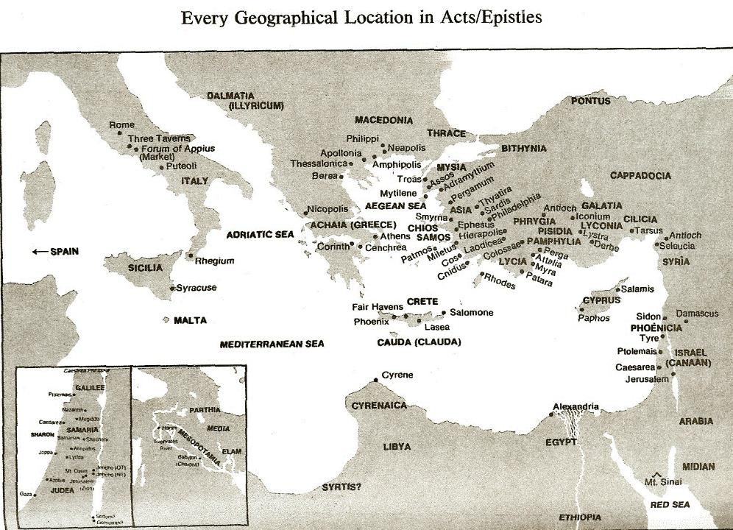

Slide 14
Acts 8:3-4; 11:19
“³ But Saul began ravaging the church, entering house after house, and dragging off men and women, he would put them in prison. ⁴ Therefore, those who had been scattered went about preaching the word…¹⁹ So then those who were scattered because of the persecution that occurred in connection with Stephen made their way to Phoenicia and Cyprus and Antioch, speaking the word to no one except to Jews alone.”

Slide 15
Acts 9:1-2 Saul’s Persecution
Instigator (1a)
To the high priest (1b)
Request for letters (2a)
Saul’s plan (2b)

Slide 17
Message
Birth and growth of the church numerically, geographically, ethnically.
Components
Numerically (progress reports)
Geographically (From Jerusalem to Rome)
Ethnically (From Judaism to Gentile domination)

Slide 19
Acts 9:1-9 Revelation
Saul’s persecution (1-2)
Saul’s revelation (3-7)
Saul’s reaction (8-9)

Slide 20
Acts 9:3-7 Saul’s Revelation
Place (3a)
Revelation (3b)
Sound (4)
Saul’s response (5a)
Christ’s self disclosure (5b)
Christ’s instructions to Saul (6)
Reaction of Saul’s companions (7)

Slide 21
Acts 9:3-7 Saul’s Revelation
Place (3a)
Revelation (3b)
Sound (4)
Saul’s response (5a)
Christ’s self disclosure (5b)
Christ’s instructions to Saul (6)
Reaction of Saul’s companions (7)

Slide 23
Acts 9:3-7 Saul’s Revelation
Place (3a)
Revelation (3b)
Sound (4)
Saul’s response (5a)
Christ’s self disclosure (5b)
Christ’s instructions to Saul (6)
Reaction of Saul’s companions (7)

Slide 24
Genesis 1:1-3
“¹ In the beginning God created the heavens and the earth. ² The earth was formless and void, and darkness was over the surface of the deep, and the Spirit of God was moving over the surface of the waters. ³ Then God said, ‘Let there be light’; and there was light.”

Slide 25
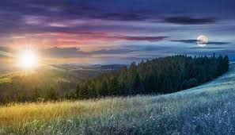
Genesis 1:14
Then God said, “Let there be lights in the expanse of the heavens to separate the day from the night, and let them be for signs and for seasons and for days and years.”

Slide 26
Acts 9:3-7 Saul’s Revelation
Place (3a)
Revelation (3b)
Sound (4)
Saul’s response (5a)
Christ’s self disclosure (5b)
Christ’s instructions to Saul (6)
Reaction of Saul’s companions (7)

Slide 27
Acts 9:3-7 Saul’s Revelation
Place (3a)
Revelation (3b)
Sound (4)
Saul’s response (5a)
Christ’s self disclosure (5b)
Christ’s instructions to Saul (6)
Reaction of Saul’s companions (7)

Slide 28
Acts 9:3-7 Saul’s Revelation
Place (3a)
Revelation (3b)
Sound (4)
Saul’s response (5a)
Christ’s self disclosure (5b)
Christ’s instructions to Saul (6)
Reaction of Saul’s companions (7)

Slide 29
Acts 9:3-7 Saul’s Revelation
Place (3a)
Revelation (3b)
Sound (4)
Saul’s response (5a)
Christ’s self disclosure (5b)
Christ’s instructions to Saul (6)
Reaction of Saul’s companions (7)

Slide 30
Acts 9:3-7 Saul’s Revelation
Place (3a)
Revelation (3b)
Sound (4)
Saul’s response (5a)
Christ’s self disclosure (5b)
Christ’s instructions to Saul (6)
Reaction of Saul’s companions (7)

Slide 31
Dr. Arnold G. Fruchtenbaum
The Book of Acts, 211
“According to verse 7, the men who journeyed with Saul stood speechless. They heard the voice, but saw no one. Some claim that there is a contradiction between Acts 9:7 and Acts 22:9, which states: they heard not the voice. However, if one understands Greek, there is no contradiction. In 9:7, the word ‘voice’ (phōnēs) is used with a genitive. In 22:9, it is used with an accusative. To hear a voice with a genitive simply means ‘to hear a sound,’ but to hear it with an accusative means ‘to hear with understanding.’ The point is that Saul’s travel companions heard something, but they could not understand the words. Only Saul actually understood the articulated words.”

Slide 32
Acts 9:1-9 Revelation
Saul’s persecution (1-2)
Saul’s revelation (3-7)
Saul’s reaction (8-9)

Slide 33
Acts 9:8-9 Saul’s Reaction
Physical blindness (8)
Length of blindness (9)

Slide 34
Acts 9:8-9 Saul’s Reaction
Physical blindness (8)
Length of blindness (9)

Slide 35
Acts 9:8-9 Saul’s Reaction
Physical blindness (8)
Length of blindness (9)

Slide 36
I. Saul Acts 9:1-31
Revelation (1-9)
Healing (10-19a)
Preaching (19b-22)
Conspiracy against Saul (23-25)
Return to Jerusalem (26-30)
Saul’s progress (31)

Slide 37
Acts 9:10-19a Healing
Call of Ananias (10)
God’s instructions to Ananias (11-12)
Ananias’ objection (13-14)
God’s response (15-16)
Ananias’ obedience (17)
Saul’s healing (18-19a)

Slide 38
Acts 9:10-19a Healing
Call of Ananias (10)
God’s instructions to Ananias (11-12)
Ananias’ objection (13-14)
God’s response (15-16)
Ananias’ obedience (17)
Saul’s healing (18-19a)

Slide 39
Acts 9:10-19a Healing
Call of Ananias (10)
God’s instructions to Ananias (11-12)
Ananias’ objection (13-14)
God’s response (15-16)
Ananias’ obedience (17)
Saul’s healing (18-19a)

Slide 40
Acts 9:11-12 God Instructs Ananias
Location of Saul (11)
Healing of Saul (12)

Slide 41
Acts 9:11-12 God Instructs Ananias
Location of Saul (11)
Healing of Saul (12)

Slide 42
Acts 9:11-12 God Instructs Ananias
Location of Saul (11)
Healing of Saul (12)

Slide 43
Acts 9:10-19a Healing
Call of Ananias (10)
God’s instructions to Ananias (11-12)
Ananias’ objection (13-14)
God’s response (15-16)
Ananias’ obedience (17)
Saul’s healing (18-19a)

Slide 44
Acts 9:13-14 Ananias’ Objections
Saul’s work in Jerusalem (13)
Saul’s work in Damascus (14)

Slide 45
Acts 9:13-14 Ananias’ Objections
Saul’s work in Jerusalem (13)
Saul’s work in Damascus (14)

Slide 46
Acts 9:13-14 Ananias’ Objections
Saul’s work in Jerusalem (13)
Saul’s work in Damascus (14)

Slide 47
Acts 9:10-19a Healing
Call of Ananias (10)
God’s instructions to Ananias (11-12)
Ananias’ objection (13-14)
God’s response (15-16)
Ananias’ obedience (17)
Saul’s healing (18-19a)

Slide 48
Acts 9:15-16 God’s response
Saul’s three-fold calling (15)
Prediction of Saul’s sufferings (16)

Slide 49
Acts 9:15-16 God’s response
Saul’s three-fold calling (15)
Prediction of Saul’s sufferings (16)

Slide 50
Galatians 2:7-8
“⁷ But on the contrary, seeing that I had been entrusted with the gospel to the uncircumcised, just as Peter had been to the circumcised ⁸ (for He who effectually worked for Peter in his apostleship to the circumcised effectually worked for me also to the Gentiles).”

Slide 51
Acts 9:15-16 God’s response
Saul’s three-fold calling (15)
Prediction of Saul’s sufferings (16)

Slide 52
John 13:19; 14:29
“^{13:19} From now on I am telling you before it comes to pass, so that when it does occur, you may believe that I am He… ^{14:29} Now I have told you before it happens, so that when it happens, you may believe.”

Slide 53
What Happened to Christ’s Disciples?
Disciple | Place | Martyrdom
James the Son of Alpheus | Jerusalem | Clubbed to death
Simon the Zealot | Jerusalem | Martyred
James the Son of Zebedee | Judea (Acts 12:2) | Executed
Thaddeus | Mesopotamia | Beaten to death
Peter | Babylon, Rome | Crucified upside down
Matthew | Parthia (Tehran) | Beheaded
Notes:
109 prophecies…
Peter Stoner – SCIENCE SPEAKS, An Evaluation of Certain Christian Evidences
To fulfill just 8 prophecies =1 X 10 to the twenty-eighth power!
Can we visualize this with an illustration? Suppose we took an atheistic professor, blindfolded him and covered the state of Texas two feet deep with silver dollars. Then we put a check on one of those silver dollars and mixed them up. The odds of one person fulfilling just these eight prophecies would be the same as this atheistic professor selecting the silver dollar upon which we have placed a check, in his first try.
https://www.bereanpublishers.com/the-odds-of-eight-messianic-prophecies-coming-true/

Slide 54
What Happened to Christ’s Disciples?
Disciple | Place | Martyrdom
John | Asia Minor, Patmos, Ephesus | Fried in boiling oil
Philip | E. Turkey | Tortured & crucified
Thomas | India | Speared
Bartholomew | India | Flayed & crucified
Andrew | Ukraine, Russia, Greece | Hanged
Notes:
109 prophecies…
Peter Stoner – SCIENCE SPEAKS, An Evaluation of Certain Christian Evidences
To fulfill just 8 prophecies =1 X 10 to the twenty-eighth power!
Can we visualize this with an illustration? Suppose we took an atheistic professor, blindfolded him and covered the state of Texas two feet deep with silver dollars. Then we put a check on one of those silver dollars and mixed them up. The odds of one person fulfilling just these eight prophecies would be the same as this atheistic professor selecting the silver dollar upon which we have placed a check, in his first try.
https://www.bereanpublishers.com/the-odds-of-eight-messianic-prophecies-coming-true/

Slide 56
Acts 9:10-19a Healing
Call of Ananias (10)
God’s instructions to Ananias (11-12)
Ananias’ objection (13-14)
God’s response (15-16)
Ananias’ obedience (17)
Saul’s healing (18-19a)

Slide 57
Acts 9:10-19a Healing
Call of Ananias (10)
God’s instructions to Ananias (11-12)
Ananias’ objection (13-14)
God’s response (15-16)
Ananias’ obedience (17)
Saul’s healing (18-19a)

Slide 58
Acts 9:18-19a Saul’s Healing
Healing (18a)
Baptism (18b)
Break-fast (19a)

Slide 59
Acts 9:18-19a Saul’s Healing
Healing (18a)
Baptism (18b)
Break-fast (19a)

Slide 61
Acts 9:18-19a Saul’s Healing
Healing (18a)
Baptism (18b)
Break-fast (19a)

Slide 62
Acts 9:18-19a Saul’s Healing
Healing (18a)
Baptism (18b)
Break-fast (19a)

Slide 63
I. Saul Acts 9:1-31
Revelation (1-9)
Healing (10-19a)
Preaching (19b-22)
Conspiracy against Saul (23-25)
Return to Jerusalem (26-30)
Saul’s progress (31)

Slide 64
Acts 9:19b-22 Saul’s Preaching
Saul’s home with the disciples (19b)
Saul’s preaching (20)
Response of the Hebrews (21)
Saul’s power (22)

Slide 65
Acts 9:19b-22 Saul’s Preaching
Saul’s home with the disciples (19b)
Saul’s preaching (20)
Response of the Hebrews (21)
Saul’s power (22)

Slide 66
Acts 9:19b-22 Saul’s Preaching
Saul’s home with the disciples (19b)
Saul’s preaching (20)
Response of the Hebrews (21)
Saul’s power (22)

Slide 67
Acts 9:19b-22 Saul’s Preaching
Saul’s home with the disciples (19b)
Saul’s preaching (20)
Response of the Hebrews (21)
Saul’s power (22)

Slide 68
Acts 9:19b-22 Saul’s Preaching
Saul’s home with the disciples (19b)
Saul’s preaching (20)
Response of the Hebrews (21)
Saul’s power (22)

Slide 70
I. Saul Acts 9:1-31
Revelation (1-9)
Healing (10-19a)
Preaching (19b-22)
Conspiracy against Saul (23-25)
Return to Jerusalem (26-30)
Saul’s progress (31)

Slide 71
Acts 9:23-25 Conspiracy Against Saul
Plot against Saul (23)
Saul’s awareness (24a)
Plot’s execution (24b)
Saul’s escape (25)

Slide 72
Acts 9:23-25 Conspiracy Against Saul
Plot against Saul (23)
Saul’s awareness (24a)
Plot’s execution (24b)
Saul’s escape (25)

Slide 73
Acts 9:23-25 Conspiracy Against Saul
Plot against Saul (23)
Saul’s awareness (24a)
Plot’s execution (24b)
Saul’s escape (25)

Slide 74
Acts 9:23-25 Conspiracy Against Saul
Plot against Saul (23)
Saul’s awareness (24a)
Plot’s execution (24b)
Saul’s escape (25)

Slide 75
Acts 9:23-25 Conspiracy Against Saul
Plot against Saul (23)
Saul’s awareness (24a)
Plot’s execution (24b)
Saul’s escape (25)

Slide 77
I. Saul Acts 9:1-31
Revelation (1-9)
Healing (10-19a)
Preaching (19b-22)
Conspiracy against Saul (23-25)
Return to Jerusalem (26-30)
Saul’s progress (31)

Slide 78
Acts 9:26-30 Saul’s Return to Jerusalem
Jerusalem believers’ response (26)
Barnabas takes Saul to apostles (27)
Saul’s Jerusalem ministry (28-29)
Saul’s escape (30)

Slide 79
Acts 9:26-30 Saul’s Return to Jerusalem
Jerusalem believers’ response (26)
Barnabas takes Saul to apostles (27)
Saul’s Jerusalem ministry (28-29)
Saul’s escape (30)

Slide 80
Acts 9:26-30 Saul’s Return to Jerusalem
Jerusalem believers’ response (26)
Barnabas takes Saul to apostles (27)
Saul’s Jerusalem ministry (28-29)
Saul’s escape (30)

Slide 81
Acts 9:26-30 Saul’s Return to Jerusalem
Jerusalem believers’ response (26)
Barnabas takes Saul to apostles (27)
Saul’s Jerusalem ministry (28-29)
Saul’s escape (30)

Slide 82
Acts 9:28-29 Saul’s Jerusalem Ministry
Among the apostles (28)
Among the unsaved (29)

Slide 83
Acts 9:28-29 Saul’s Jerusalem Ministry
Among the apostles (28)
Among the unsaved (29)

Slide 84
Acts 9:28-29 Saul’s Jerusalem Ministry
Among the apostles (28)
Among the unsaved (29)

Slide 85
Acts 9:26-30 Saul’s Return to Jerusalem
Jerusalem believers’ response (26)
Barnabas takes Saul to apostles (27)
Saul’s Jerusalem ministry (28-29)
Saul’s escape (30)

Slide 86
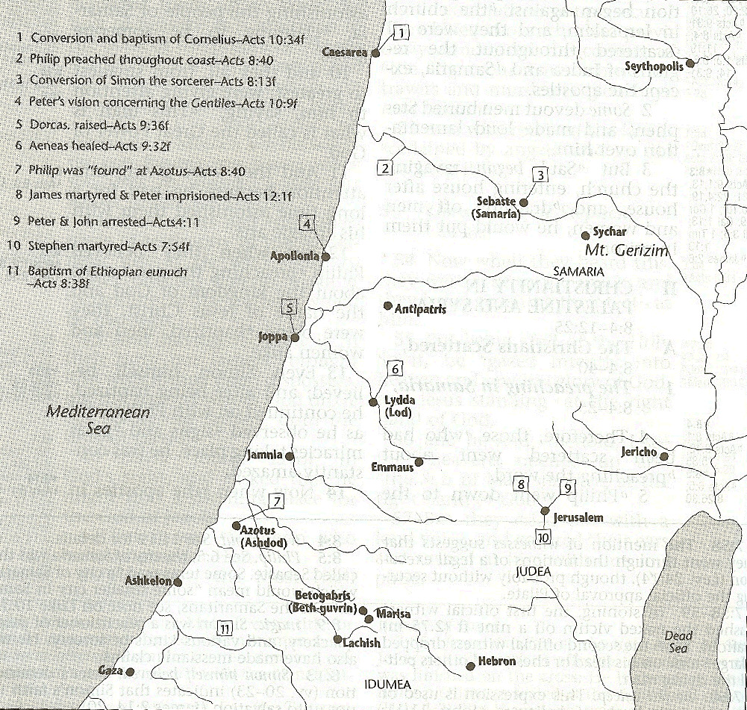

Slide 88
I. Saul Acts 9:1-31
Revelation (1-9)
Healing (10-19a)
Preaching (19b-22)
Conspiracy against Saul (23-25)
Return to Jerusalem (26-30)
Saul’s progress (31)

Slide 89
Acts 9:31 Saul’s Progress
Geography (31a)
Edification (31b)
Walk (31c)
Comfort (31d)
Numerical growth (31e)

Slide 90
Acts 9:31 Saul’s Progress
Geography (31a)
Edification (31b)
Walk (31c)
Comfort (31d)
Numerical growth (31e)

Slide 91
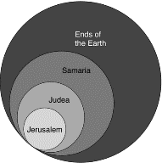
Acts 1:8
“but you will receive power when the Holy Spirit has come upon you; and you shall be My witnesses both in Jerusalem, and in all Judea and Samaria, and even to the remotest part of the earth.”

Slide 92
Acts 9:31 Saul’s Progress
Geography (31a)
Edification (31b)
Walk (31c)
Comfort (31d)
Numerical growth (31e)

Slide 93
Acts 9:31 Saul’s Progress
Geography (31a)
Edification (31b)
Walk (31c)
Comfort (31d)
Numerical growth (31e)

Slide 94
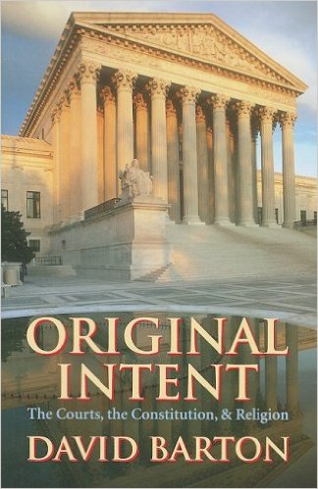
David Barton, Original Intent, p. 245

Slide 95
Acts 9:31 Saul’s Progress
Geography (31a)
Edification (31b)
Walk (31c)
Comfort (31d)
Numerical growth (31e)

Slide 96
Acts 9:31 Saul’s Progress
Geography (31a)
Edification (31b)
Walk (31c)
Comfort (31d)
Numerical growth (31e)

Slide 97
Message
Birth and growth of the church numerically, geographically, ethnically.
Components
Numerically (progress reports)
Geographically (From Jerusalem to Rome)
Ethnically (From Judaism to Gentile domination)

Slide 98
Progress Reports
Clearest: Acts 2:47; 6:7; 9:31; 12:24; 16:5; 19:20; 28:30-31
Less clear: Acts 1:15; 2:41; 4:4, 31; 5:14, 42; 8:25, 40; 11:21; 13:49; 17:6

Slide 99
Acts 9:1-43 Saul’s Conversion
Saul (9:1-31)
Peter (Acts 9:32-43)

Slide 100
II. Peter Acts 9:32-43
Lydda (32-35)
Joppa (36-43)

Slide 101
II. Peter Acts 9:32-43
Lydda (32-35)
Joppa (36-43)

Slide 102
Acts 9:32-35 Lydda
Place (32)
Aeneas’ healing (33-34)
Word spreads (35)

Slide 103
Acts 9:32-35 Lydda
Place (32)
Aeneas’ healing (33-34)
Word spreads (35)

Slide 105
Acts 1:8
“but you will receive power when the Holy Spirit has come upon you; and you shall be My witnesses both in Jerusalem, and in all Judea and Samaria, and even to the remotest part of the earth.”

Slide 106
Acts 8:3-4; 11:19
“³ But Saul began ravaging the church, entering house after house, and dragging off men and women, he would put them in prison. ⁴ Therefore, those who had been scattered went about preaching the word…¹⁹ So then those who were scattered because of the persecution that occurred in connection with Stephen made their way to Phoenicia and Cyprus and Antioch, speaking the word to no one except to Jews alone.”

Slide 107
Acts 9:32-35 Lydda
Place (32)
Aeneas’ healing (33-34)
Word spreads (35)

Slide 108
Acts 9:33-34 Aeneas’ Healing
Aeneas introduced (33)
Healing (34)

Slide 109
Acts 9:33-34 Aeneas’ Healing
Aeneas introduced (33)
Healing (34)

Slide 110
Acts 9:33-34 Aeneas’ Healing
Aeneas introduced (33)
Healing (34)

Slide 111
Acts 9:32-35 Lydda
Place (32)
Aeneas’ healing (33-34)
Word spreads (35)

Slide 112
II. Peter Acts 9:32-43
Lydda (32-35)
Joppa (36-43)

Slide 113
Acts 9:36-43 Joppa
Place (36)
Dorcas’ death (37)
Peter fetched (38)
Peter & mourners’ responses (39)
Miracle (40-41)
Word spreads (42)
Peter stays at Tanner’s home (43)

Slide 114
Acts 9:36-43 Joppa
Place (36)
Dorcas’ death (37)
Peter fetched (38)
Peter & mourners’ responses (39)
Miracle (40-41)
Word spreads (42)
Peter stays at Tanner’s home (43)

Slide 116
Acts 9:36-43 Joppa
Place (36)
Dorcas’ death (37)
Peter fetched (38)
Peter & mourners’ responses (39)
Miracle (40-41)
Word spreads (42)
Peter stays at Tanner’s home (43)

Slide 117
Acts 9:36-43 Joppa
Place (36)
Dorcas’ death (37)
Peter fetched (38)
Peter & mourners’ responses (39)
Miracle (40-41)
Word spreads (42)
Peter stays at Tanner’s home (43)

Slide 119
Acts 9:36-43 Joppa
Place (36)
Dorcas’ death (37)
Peter fetched (38)
Peter & mourners’ responses (39)
Miracle (40-41)
Word spreads (42)
Peter stays at Tanner’s home (43)

Slide 120
Acts 9:36-43 Joppa
Place (36)
Dorcas’ death (37)
Peter fetched (38)
Peter & mourners’ responses (39)
Miracle (40-41)
Word spreads (42)
Peter stays at Tanner’s home (43)

Slide 121
Acts 9:40-41 Miracle
Isolation (40a)
Resuscitation (40b-41)

Slide 122
Acts 9:40-41 Miracle
Isolation (40a)
Resuscitation (40b-41)

Slide 123
Acts 9:40-41 Miracle
Isolation (40a)
Resuscitation (40b-41)

Slide 124
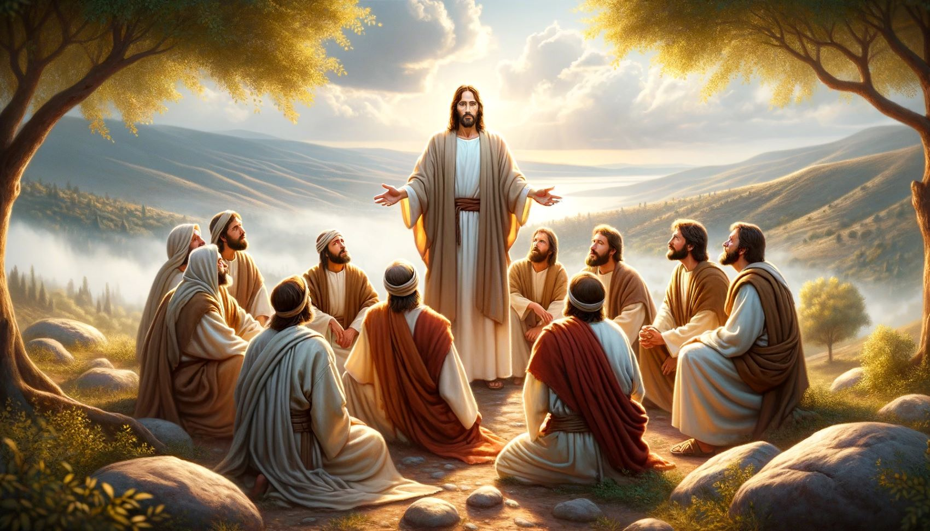
Dr. Arnold G. Fruchtenbaum
The Book of Acts, 224
“Again, it should be noted that while other believers were around, none of them performed the miracle. In Acts, only the apostles and their [de]legates (Acts 6:8; 8:6) perform signs and wonders.”

Slide 125
Acts 9:36-43 Joppa
Place (36)
Dorcas’ death (37)
Peter fetched (38)
Peter & mourners’ responses (39)
Miracle (40-41)
Word spreads (42)
Peter stays at Tanner’s home (43)

Slide 127
Acts 9:36-43 Joppa
Place (36)
Dorcas’ death (37)
Peter fetched (38)
Peter & mourners’ responses (39)
Miracle (40-41)
Word spreads (42)
Peter stays at Tanner’s home (43)

Slide 128
Conclusion

Slide 129
Acts 9:1-43 Saul’s Conversion
Saul (9:1-31)
Peter (Acts 9:32-43)

