Slide 1
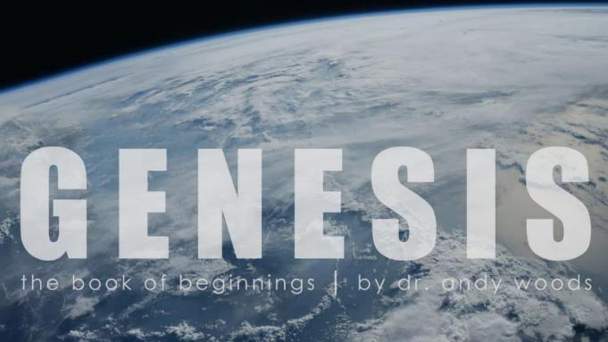

Genesis 12‒50
Israel’s Birth & Preservation

Slide 2
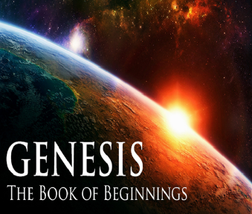
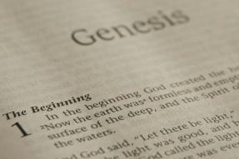
GENESIS STRUCTURE
  Genesis 12-50 (four people)
    Abraham (12:1–25:11)
    Isaac (25:12–26:35)
    Jacob (27–36)
    Joseph (37–50)

Slide 3
Genesis 37‒50
Joseph
  Joseph sold unto Egypt (37)
  Canaan’s corruption (38)
  Joseph falsely accused (39)
  Joseph’s short-term predictions (40)
  Joseph’s elevation (41)
  Joseph’s first reunion with his brothers (42)
  Joseph’s second reunion with his brothers (43‒45)

Slide 4
Genesis 43‒45
Second Reunion
  Jacob sends sons to Egypt (43:1-14)
  Second reunion with Joseph (43:15-34)
  Benjamin’s arrest (44:1-17)
  Judah’s intercession (44:18-34)
  Joseph’s revelation (45:1-15)
  Pharaoh’s invitation (45:16-20)
  Brothers return to Jacob (45:21-28)

Slide 5
III. Genesis 44:1-17
Benjamin’s Arrest
    Joseph’s instructions (1-2b)
    Steward’s obedience (2c)
    Departure (3)
    Joseph’s further instructions (4-5)
    Steward’s obedience (6)
    Brothers’ response (7-9)
    Steward’s response (10)
    Search (11-13)
    Arrival at Joseph’s house (14)
    Joseph’s response (15)
    Judah’s response (16)
    Joseph’s answer (17)

Slide 6
III. Genesis 44:1-17
Benjamin’s Arrest
    Joseph’s instructions (1-2b)
    Steward’s obedience (2c)
    Departure (3)
    Joseph’s further instructions (4-5)
    Steward’s obedience (6)
    Brothers’ response (7-9)
    Steward’s response (10)
    Search (11-13)
    Arrival at Joseph’s house (14)
    Joseph’s response (15)
    Judah’s response (16)
    Joseph’s answer (17)

Slide 7
Genesis 44:1-2b
Joseph’s Instructions
      Food (1a)
      Money (1b)
      Cup (2a)
      Placing of cup (2b)

Slide 8
Genesis 44:1-2b
Joseph’s Instructions
      Food (1a)
      Money (1b)
      Cup (2a)
      Placing of cup (2b)

Slide 9
Genesis 44:1-2b
Joseph’s Instructions
      Food (1a)
      Money (1b)
      Cup (2a)
      Placing of cup (2b)

Slide 10
Genesis 44:1-2b
Joseph’s Instructions
      Food (1a)
      Money (1b)
      Cup (2a)
      Placing of cup (2b)

Slide 11
Genesis 44:1-2b
Joseph’s Instructions
      Food (1a)
      Money (1b)
      Cup (2a)
      Placing of cup (2b)

Slide 12
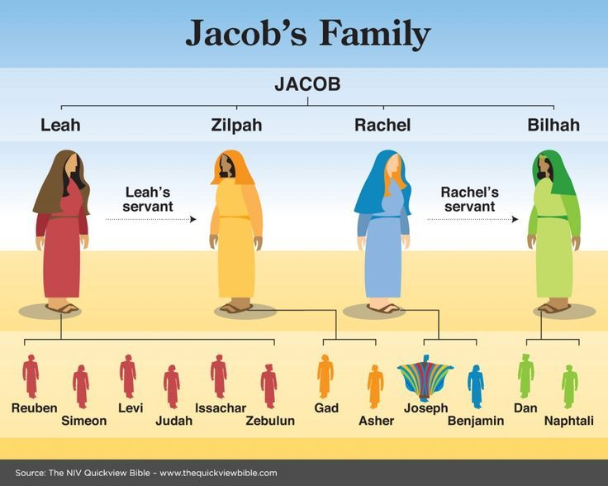

Slide 13
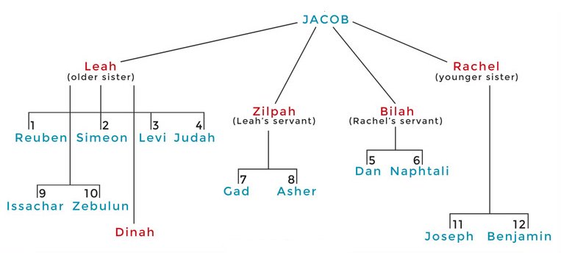

Slide 14
III. Genesis 44:1-17
Benjamin’s Arrest
    Joseph’s instructions (1-2b)
    Steward’s obedience (2c)
    Departure (3)
    Joseph’s further instructions (4-5)
    Steward’s obedience (6)
    Brothers’ response (7-9)
    Steward’s response (10)
    Search (11-13)
    Arrival at Joseph’s house (14)
    Joseph’s response (15)
    Judah’s response (16)
    Joseph’s answer (17)

Slide 15
III. Genesis 44:1-17
Benjamin’s Arrest
    Joseph’s instructions (1-2b)
    Steward’s obedience (2c)
    Departure (3)
    Joseph’s further instructions (4-5)
    Steward’s obedience (6)
    Brothers’ response (7-9)
    Steward’s response (10)
    Search (11-13)
    Arrival at Joseph’s house (14)
    Joseph’s response (15)
    Judah’s response (16)
    Joseph’s answer (17)

Slide 16
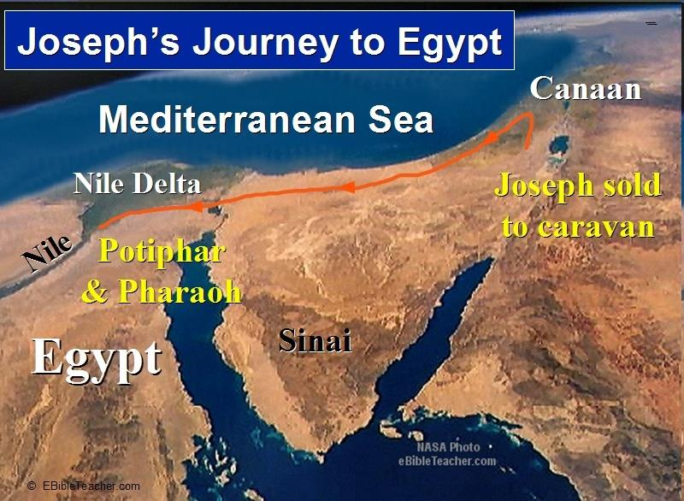

Slide 17
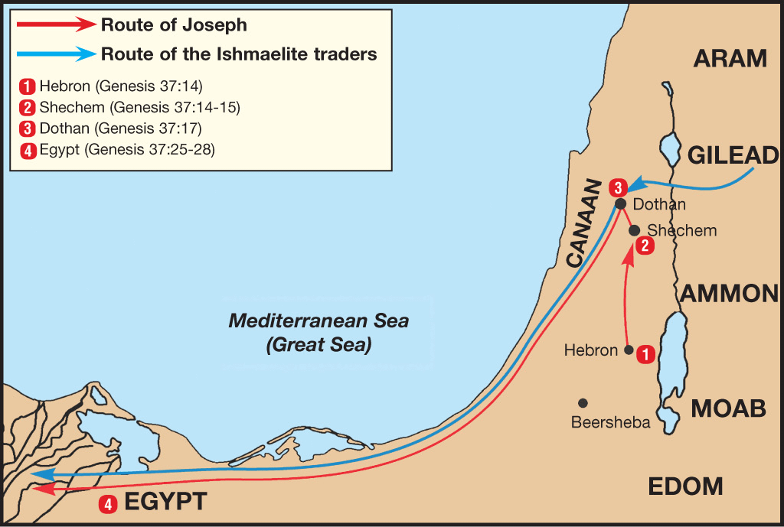

Slide 18
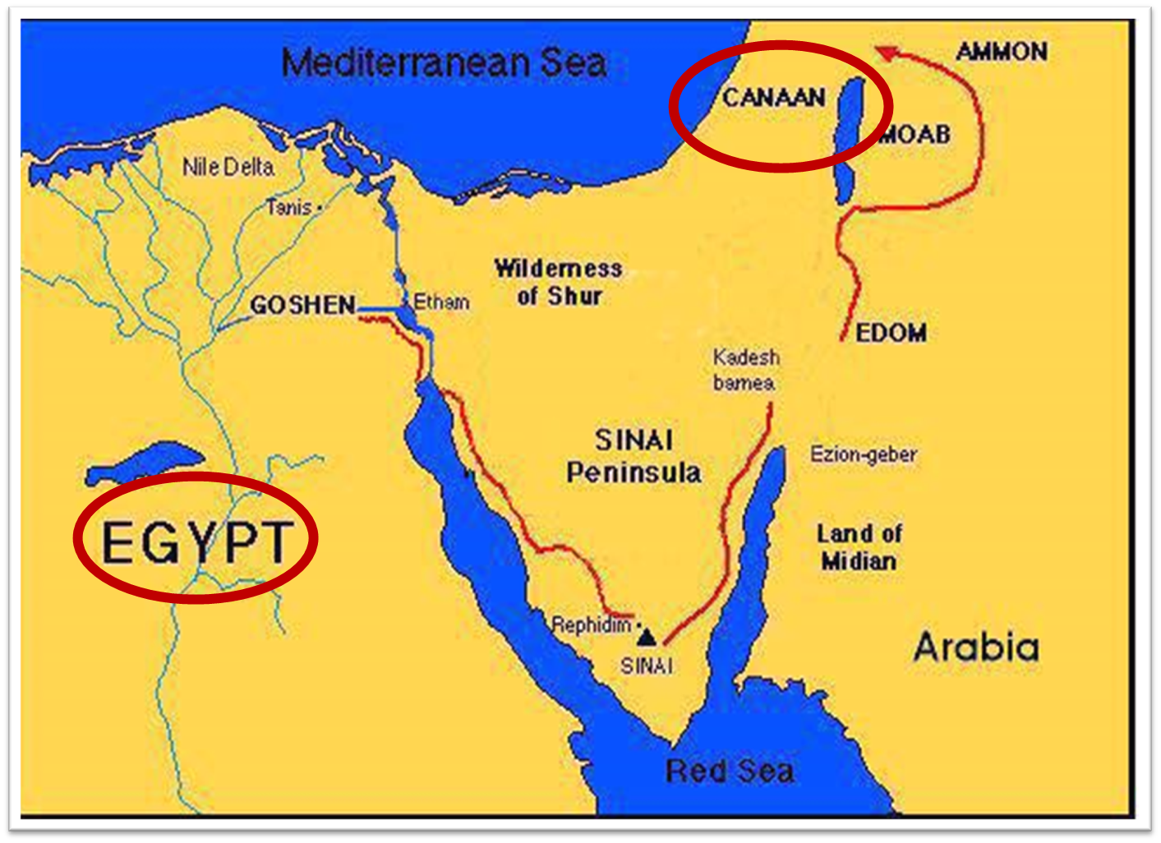

Slide 19
III. Genesis 44:1-17
Benjamin’s Arrest
    Joseph’s instructions (1-2b)
    Steward’s obedience (2c)
    Departure (3)
    Joseph’s further instructions (4-5)
    Steward’s obedience (6)
    Brothers’ response (7-9)
    Steward’s response (10)
    Search (11-13)
    Arrival at Joseph’s house (14)
    Joseph’s response (15)
    Judah’s response (16)
    Joseph’s answer (17)

Slide 20
Genesis 44:4-5
Joseph’s Further Instructions
      Timing (4a)
      Instructions (4b-5)

Slide 21
Genesis 44:4-5
Joseph’s Further Instructions
      Timing (4a)
      Instructions (4b-5)

Slide 22
Genesis 44:4-5
Joseph’s Further Instructions
      Timing (4a)
      Instructions (4b-5)

Slide 23

Charles Ryrie
The Ryrie Study Bible, p. 57
“44:5 It is unlikely that Joseph used divination; rather, this statement (made in order to attach special significance to the cup) was part of the situation Joseph contrived in order to test his brothers. Would they seize on this opportunity to get rid of Benjamin, or had their hearts indeed been changed so that they would stand with him?”

Slide 24

Bible Verses Against Necromancy
Lev. 19:31
Deut. 18:9-14
1 Sam. 28:7-8
2 Kgs. 21:6
1 Chron. 10:13
Isa. 8:19-20

Slide 25

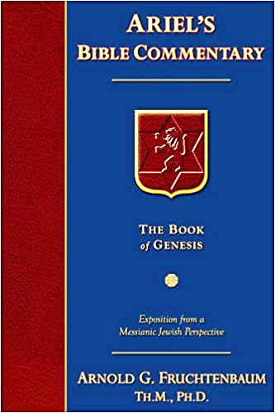
Dr. Arnold G. Fruchtenbaum
The Book of Genesis, 591
“Then the steward was to focus on the cup: Is not this that in which my lord drinks, and whereby he indeed divines? The Hebrew has a play on words, literally meaning ‘Divining he divines.’ The root of the word ‘to divine’ is the same root as the word for ‘serpent’ because occultism is connected with Satan. Earlier, this object was simply referred to as ‘the silver cup,’ and that was really all that it was and not truly a divining cup. Egyptian magicians did use divining cups, and the procedure for divining went something like this.”

Slide 26
Dr. Arnold G. Fruchtenbaum
The Book of Genesis, 591
“Clean water was poured into such a cup or a bowl, particles of gold or silver or precious stones were dropped into the clean water, and then some oil was added. Then, depending on exactly how light broke out between the oil and the particles, a prediction would be made. This practice is known by a variety of names: oleomancy, meaning pouring oil into water; hydromancy, or pouring water into oil; or lecanumancy, observing the actions of liquids inside a cup. Nevertheless, Joseph did not practice such divines nor was it the source of his ability to interpret dreams.”

Slide 27

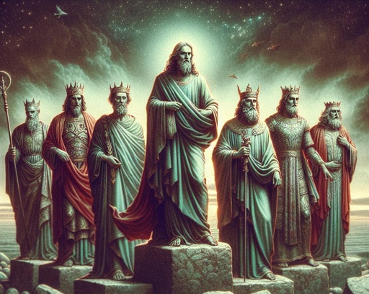
Revelation 17:9-10
“⁹ Here is the mind which has wisdom. The seven heads are seven mountains [oros] on which the woman sits, ¹⁰ and they are seven kings; five have fallen, one is, the other has not yet come; and when he comes, he must remain a little while.”

Slide 28

7 Kings or Kingdoms (Dan. 2:37-38)
(Revelation 17:9-10)
Egypt
Assyria
Babylon
Persian
Greece
Rome I
Rome II

Slide 29
III. Genesis 44:1-17
Benjamin’s Arrest
    Joseph’s instructions (1-2b)
    Steward’s obedience (2c)
    Departure (3)
    Joseph’s further instructions (4-5)
    Steward’s obedience (6)
    Brothers’ response (7-9)
    Steward’s response (10)
    Search (11-13)
    Arrival at Joseph’s house (14)
    Joseph’s response (15)
    Judah’s response (16)
    Joseph’s answer (17)

Slide 30
III. Genesis 44:1-17
Benjamin’s Arrest
    Joseph’s instructions (1-2b)
    Steward’s obedience (2c)
    Departure (3)
    Joseph’s further instructions (4-5)
    Steward’s obedience (6)
    Brothers’ response (7-9)
    Steward’s response (10)
    Search (11-13)
    Arrival at Joseph’s house (14)
    Joseph’s response (15)
    Judah’s response (16)
    Joseph’s answer (17)

Slide 31
Genesis 44:7-9
Brothers’ Response
      Denial (7)
      Evidence (8)
      Offer (9)

Slide 32
Genesis 44:7-9
Brothers’ Response
      Denial (7)
      Evidence (8)
      Offer (9)

Slide 33
Genesis 44:7-9
Brothers’ Response
      Denial (7)
      Evidence (8)
      Offer (9)

Slide 34
Genesis 44:7-9
Brothers’ Response
      Denial (7)
      Evidence (8)
      Offer (9)

Slide 35
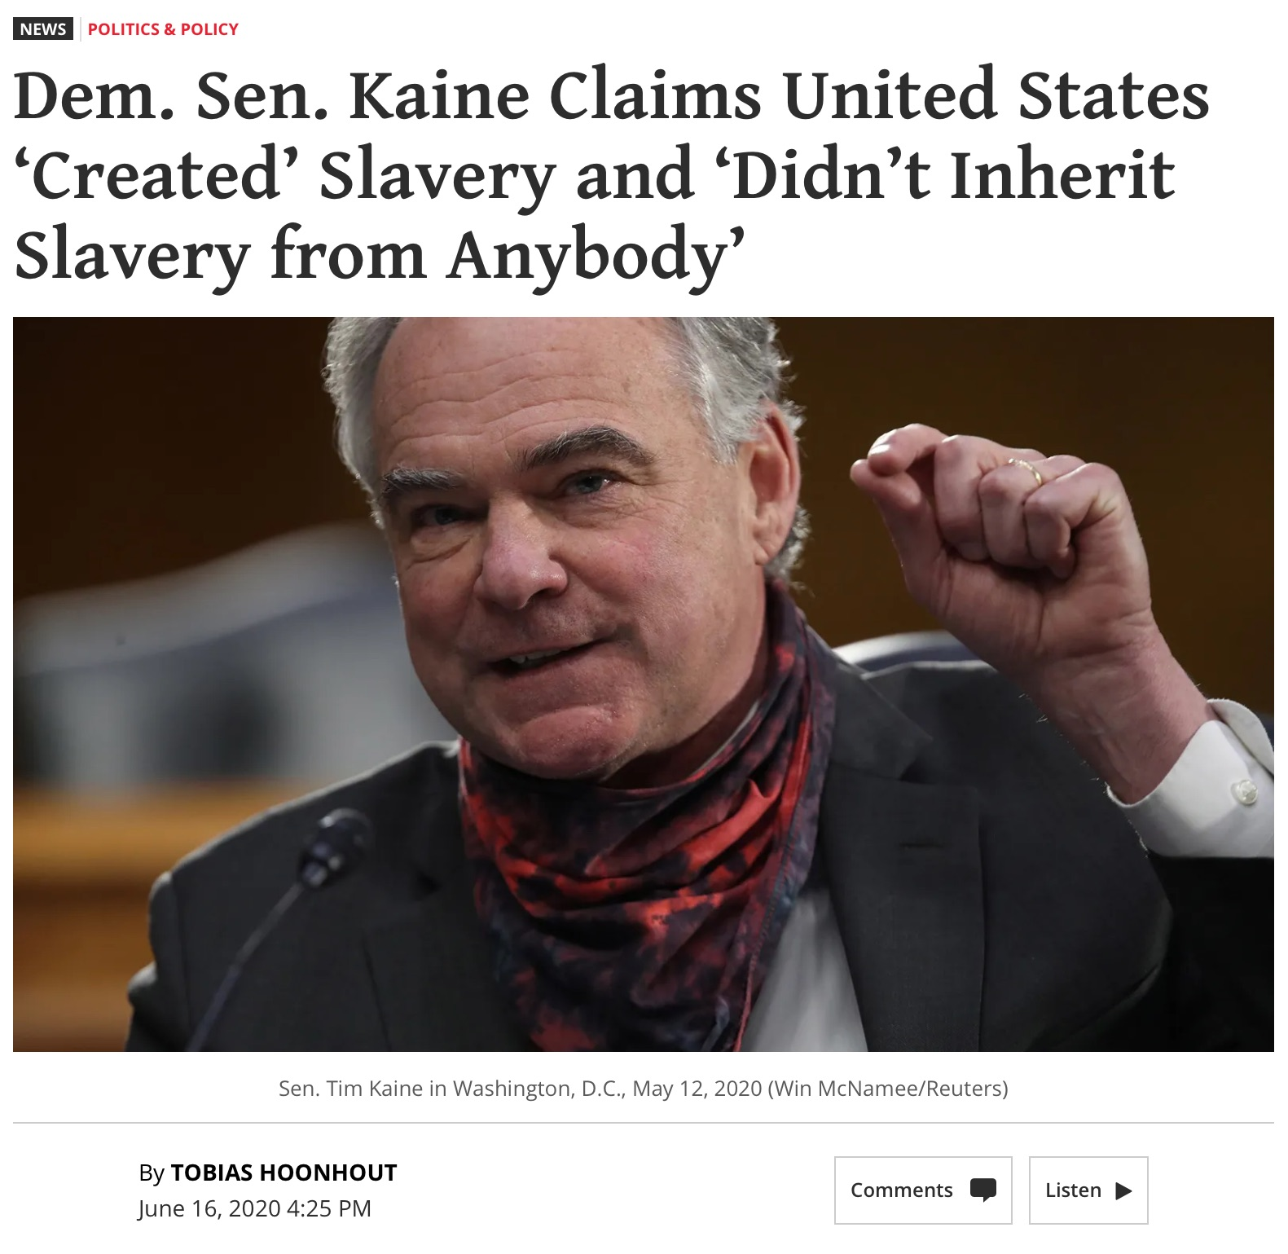

Slide 36
III. Genesis 44:1-17
Benjamin’s Arrest
    Joseph’s instructions (1-2b)
    Steward’s obedience (2c)
    Departure (3)
    Joseph’s further instructions (4-5)
    Steward’s obedience (6)
    Brothers’ response (7-9)
    Steward’s response (10)
    Search (11-13)
    Arrival at Joseph’s house (14)
    Joseph’s response (15)
    Judah’s response (16)
    Joseph’s answer (17)

Slide 37
Genesis 44:10
Steward’s Response
      Enslavement (10a)
      Freedom (10b)

Slide 38
Genesis 44:10
Steward’s Response
      Enslavement (10a)
      Freedom (10b)

Slide 39
Genesis 44:10
Steward’s Response
      Enslavement (10a)
      Freedom (10b)

Slide 40
III. Genesis 44:1-17
Benjamin’s Arrest
    Joseph’s instructions (1-2b)
    Steward’s obedience (2c)
    Departure (3)
    Joseph’s further instructions (4-5)
    Steward’s obedience (6)
    Brothers’ response (7-9)
    Steward’s response (10)
    Search (11-13)
    Arrival at Joseph’s house (14)
    Joseph’s response (15)
    Judah’s response (16)
    Joseph’s answer (17)

Slide 41
Genesis 44:11-13
Search
      Opening of sacks (11)
      Search (12a)
      Discovery (12b)
      Reaction (13)

Slide 42
Genesis 44:11-13
Search
      Opening of sacks (11)
      Search (12a)
      Discovery (12b)
      Reaction (13)

Slide 43
Genesis 44:11-13
Search
      Opening of sacks (11)
      Search (12a)
      Discovery (12b)
      Reaction (13)

Slide 44
Genesis 44:11-13
Search
      Opening of sacks (11)
      Search (12a)
      Discovery (12b)
      Reaction (13)

Slide 45
Genesis 44:11-13
Search
      Opening of sacks (11)
      Search (12a)
      Discovery (12b)
      Reaction (13)

Slide 46
Genesis 44:13
Reaction
      Emotion (13a)
      Repacking (13b)
      Return (13c)

Slide 47
Genesis 44:13
Reaction
      Emotion (13a)
      Repacking (13b)
      Return (13c)

Slide 48
Genesis 44:13
Reaction
      Emotion (13a)
      Repacking (13b)
      Return (13c)

Slide 49
Genesis 44:13
Reaction
      Emotion (13a)
      Repacking (13b)
      Return (13c)

Slide 50
III. Genesis 44:1-17
Benjamin’s Arrest
    Joseph’s instructions (1-2b)
    Steward’s obedience (2c)
    Departure (3)
    Joseph’s further instructions (4-5)
    Steward’s obedience (6)
    Brothers’ response (7-9)
    Steward’s response (10)
    Search (11-13)
    Arrival at Joseph’s house (14)
    Joseph’s response (15)
    Judah’s response (16)
    Joseph’s answer (17)

Slide 51
Genesis 44:14
Arrival at Joseph’s House
      Judah’s prominence (14a)
      Prophecy fulfilled (14b)

Slide 52
Genesis 44:14
Arrival at Joseph’s House
      Judah’s prominence (14a)
      Prophecy fulfilled (14b)

Slide 53
Messiah must be from the tribe of Judah
Genesis 49:10
Revelation 5:5

Slide 54

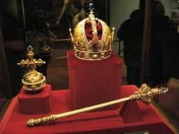
Genesis 49:10
“The scepter shall not depart from Judah, Nor the ruler’s staff from between his feet, Until Shiloh comes, And to him shall be the obedience of the peoples.”

Slide 55


Revelation 5:5
“and one of the elders said to me, “Stop weeping; behold, the Lion that is from the tribe of Judah, the Root of David, has overcome so as to open the book and its seven seals.”

Slide 58
Genesis 44:14
Arrival at Joseph’s House
      Judah’s prominence (14a)
      Prophecy fulfilled (14b)

Slide 59

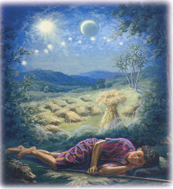
Genesis 37:9
Now he had still another dream, and related it to his brothers, and said, “Lo, I have had still another dream; and behold, the sun and the moon and eleven stars were bowing down to me.”

Slide 60

Genesis 37:10
He related it to his father and to his brothers; and his father rebuked him and said to him, “What is this dream that you have had? Shall I and your mother and your brothers actually come to bow ourselves down before you to the ground?”

Slide 61

Sun = Jacob
Moon = Leah
11 Stars = Joseph’s brothers
12th Star = Joseph
12 Stars = Israel’s twelve tribes

Slide 62


John 13:19; 14:29
“^{13:19} From now on I am telling you before it comes to pass, so that when it does occur, you may believe that I am He… ^{14:29} Now I have told you before it happens, so that when it happens, you may believe.”

Slide 63
What Happened to Christ’s Disciples?
Disciple | Place | Martyrdom
James the Son of Alpheus | Jerusalem | Clubbed to death
Simon the Zealot | Jerusalem | Martyred
James the Son of Zebedee | Judea (Acts 12:2) | Executed
Thaddeus | Mesopotamia | Beaten to death
Peter | Babylon, Rome | Crucified upside down
Matthew | Parthia (Tehran) | Beheaded
Notes:
109 prophecies…
Peter Stoner – SCIENCE SPEAKS, An Evaluation of Certain Christian Evidences
To fulfill just 8 prophecies =1 X 10 to the twenty-eighth power!
Can we visualize this with an illustration? Suppose we took an atheistic professor, blindfolded him and covered the state of Texas two feet deep with silver dollars. Then we put a check on one of those silver dollars and mixed them up. The odds of one person fulfilling just these eight prophecies would be the same as this atheistic professor selecting the silver dollar upon which we have placed a check, in his first try.
https://www.bereanpublishers.com/the-odds-of-eight-messianic-prophecies-coming-true/

Slide 64
What Happened to Christ’s Disciples?
Disciple | Place | Martyrdom
John | Asia Minor, Patmos, Ephesus | Fried in boiling oil
Philip | E. Turkey | Tortured & crucified
Thomas | India | Speared
Bartholomew | India | Flayed & crucified
Andrew | Ukraine, Russia, Greece | Hanged
Notes:
109 prophecies…
Peter Stoner – SCIENCE SPEAKS, An Evaluation of Certain Christian Evidences
To fulfill just 8 prophecies =1 X 10 to the twenty-eighth power!
Can we visualize this with an illustration? Suppose we took an atheistic professor, blindfolded him and covered the state of Texas two feet deep with silver dollars. Then we put a check on one of those silver dollars and mixed them up. The odds of one person fulfilling just these eight prophecies would be the same as this atheistic professor selecting the silver dollar upon which we have placed a check, in his first try.
https://www.bereanpublishers.com/the-odds-of-eight-messianic-prophecies-coming-true/

Slide 65


Slide 66

Luke 16:24-26
“²⁴ And he cried out and said, ‘Father Abraham, have mercy on me, and send Lazarus so that he may dip the tip of his finger in water and cool off my tongue, for I am in agony in this flame.’ ²⁵ But Abraham said, ‘Child, remember that during your life you received your good things, and likewise Lazarus bad things; but now he is being comforted here, and you are in agony. ²⁶ And besides all this, between us and you there is a great chasm fixed, so that those who wish to come over from here to you will not be able, and that none may cross over from there to us.’”

Slide 67
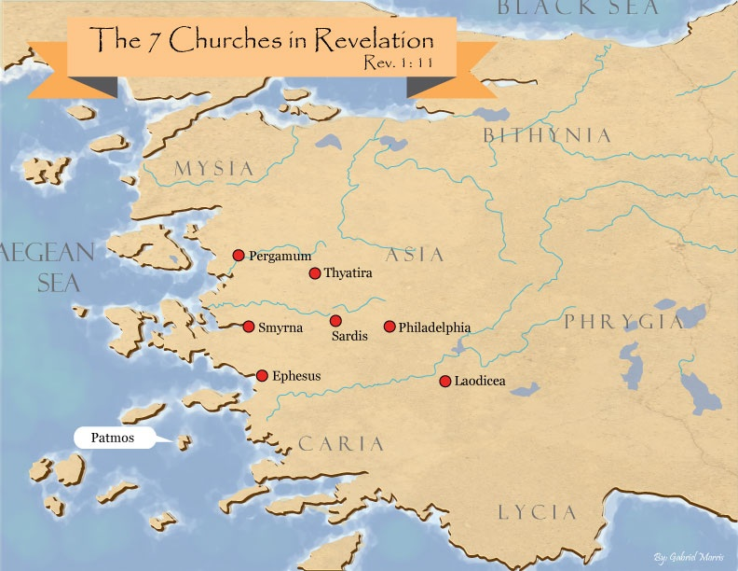
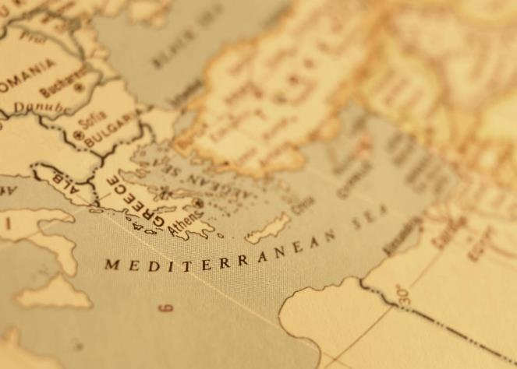

Slide 68

Revelation 3:9
“Behold, I will cause those of the synagogue of Satan, who say that they are Jews and are not, but lie—I will make them come and bow down at your feet, and make them know that I have loved you.”

Slide 69
III. Genesis 44:1-17
Benjamin’s Arrest
    Joseph’s instructions (1-2b)
    Steward’s obedience (2c)
    Departure (3)
    Joseph’s further instructions (4-5)
    Steward’s obedience (6)
    Brothers’ response (7-9)
    Steward’s response (10)
    Search (11-13)
    Arrival at Joseph’s house (14)
    Joseph’s response (15)
    Judah’s response (16)
    Joseph’s answer (17)

Slide 70
Genesis 44:15
Joseph’s Response
      Accusation (15a)
      Question (15b)

Slide 71
Genesis 44:15
Joseph’s Response
      Accusation (15a)
      Question (15b)

Slide 72
Genesis 44:15
Joseph’s Response
      Accusation (15a)
      Question (15b)

Slide 73
Bible Verses Against Necromancy
Lev. 19:31
Deut. 18:9-14
1 Sam. 28:7-8
2 Kgs. 21:6
1 Chron. 10:13
Isa. 8:19-20

Slide 74
III. Genesis 44:1-17
Benjamin’s Arrest
    Joseph’s instructions (1-2b)
    Steward’s obedience (2c)
    Departure (3)
    Joseph’s further instructions (4-5)
    Steward’s obedience (6)
    Brothers’ response (7-9)
    Steward’s response (10)
    Search (11-13)
    Arrival at Joseph’s house (14)
    Joseph’s response (15)
    Judah’s response (16)
    Joseph’s answer (17)

Slide 75
Genesis 44:16
Judah’s Response
      No defense (16a)
      Guilt (16b)
      Surrender (16c)

Slide 76
Genesis 44:16
Judah’s Response
      No defense (16a)
      Guilt (16b)
      Surrender (16c)

Slide 77
Genesis 44:16
Judah’s Response
      No defense (16a)
      Guilt (16b)
      Surrender (16c)

Slide 79
Genesis 44:16
Judah’s Response
      No defense (16a)
      Guilt (16b)
      Surrender (16c)

Slide 81
III. Genesis 44:1-17
Benjamin’s Arrest
    Joseph’s instructions (1-2b)
    Steward’s obedience (2c)
    Departure (3)
    Joseph’s further instructions (4-5)
    Steward’s obedience (6)
    Brothers’ response (7-9)
    Steward’s response (10)
    Search (11-13)
    Arrival at Joseph’s house (14)
    Joseph’s response (15)
    Judah’s response (16)
    Joseph’s answer (17)

Slide 82
Genesis 44:17
Joseph’s Answer
      Rejection of offer (17a)
      No collective punishment (17b)
      Return to Canaan (17c)

Slide 83
Genesis 44:17
Joseph’s Answer
      Rejection of offer (17a)
      No collective punishment (17b)
      Return to Canaan (17c)

Slide 84
Genesis 44:17
Joseph’s Answer
      Rejection of offer (17a)
      No collective punishment (17b)
      Return to Canaan (17c)

Slide 85
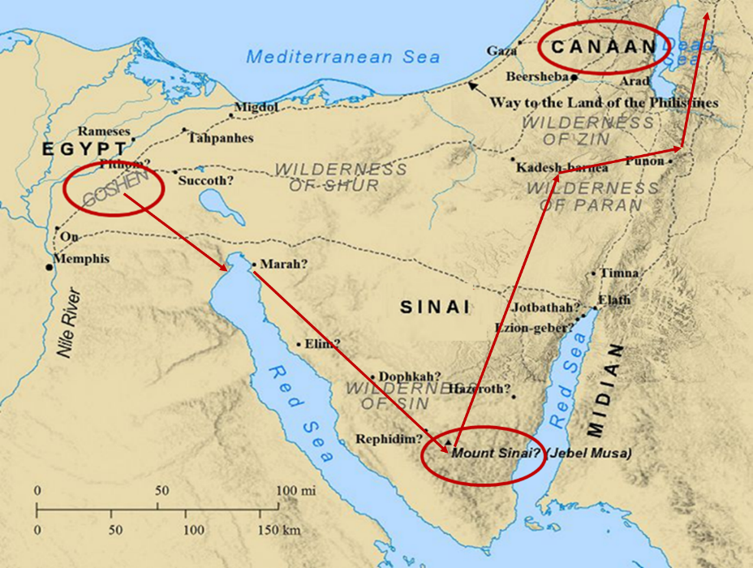

Slide 86
Genesis 44:17
Joseph’s Answer
      Rejection of offer (17a)
      No collective punishment (17b)
      Return to Canaan (17c)

Slide 90
Genesis 43‒45
Second Reunion
  Jacob sends sons to Egypt (43:1-14)
  Second reunion with Joseph (43:15-34)
  Benjamin’s arrest (44:1-17)
  Judah’s intercession (44:18-34)
  Joseph’s revelation (45:1-15)
  Pharaoh’s invitation (45:16-20)
  Brothers return to Jacob (45:21-28)

Slide 91
IV. Genesis 44:18-34
Judah’s Intercession
    Judah’s request to speak (18)
    Judah re-tells story (19-29)
    Judah’s offer to Joseph (30-34)

Slide 92
IV. Genesis 44:18-34
Judah’s Intercession
    Judah’s request to speak (18)
    Judah re-tells story (19-29)
    Judah’s offer to Joseph (30-34)

Slide 93
Genesis 44:18
Judah’s Request to Speak
      Request (18a)
      Recognition of Joseph’s authority (18b)

Slide 94
Genesis 44:18
Judah’s Request to Speak
      Request (18a)
      Recognition of Joseph’s authority (18b)

Slide 95
Genesis 44:18
Judah’s Request to Speak
      Request (18a)
      Recognition of Joseph’s authority (18b)

Slide 96
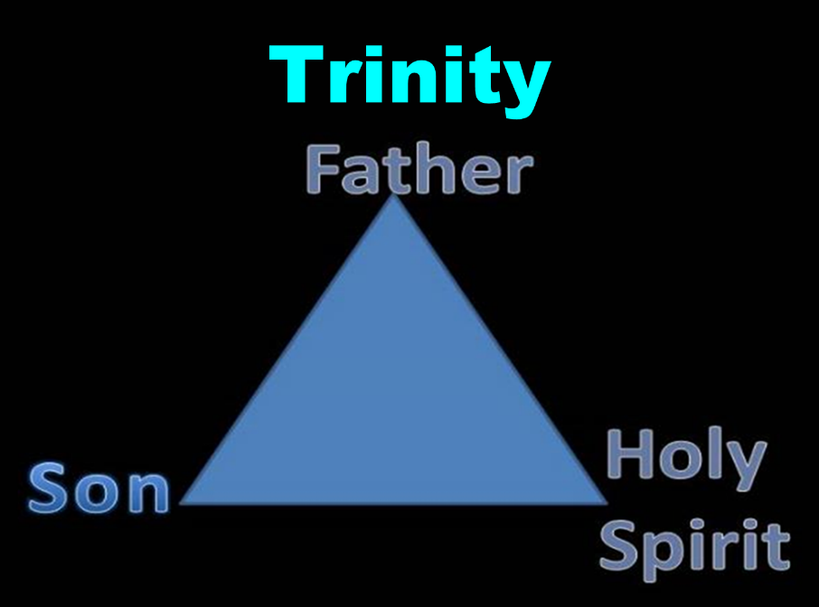

Slide 97
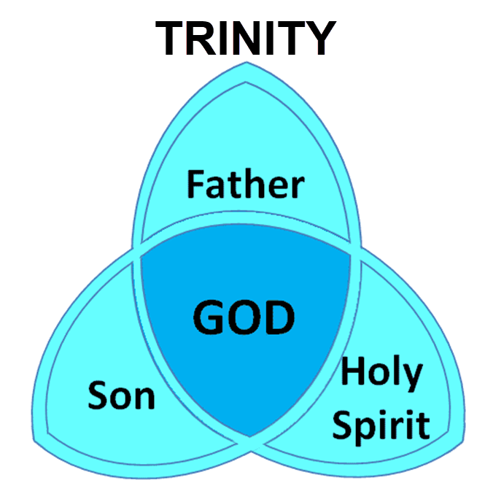

Slide 98
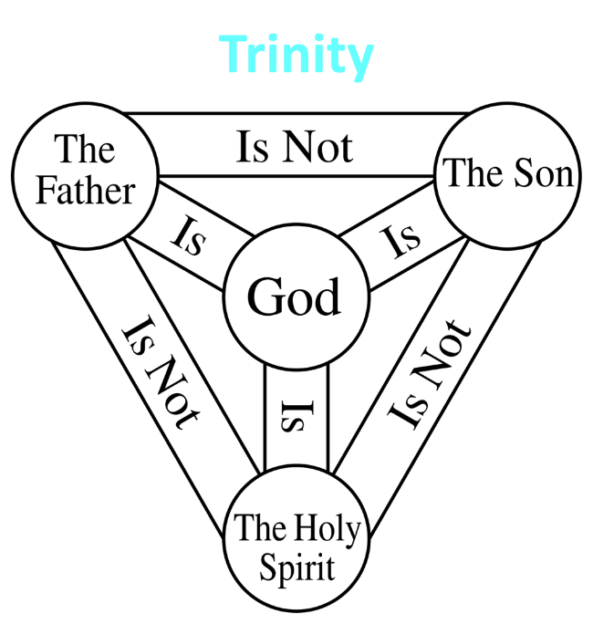

Slide 99
IV. Genesis 44:18-34
Judah’s Intercession
    Judah’s request to speak (18)
    Judah re-tells story (19-29)
    Judah’s offer to Joseph (30-34)

Slide 100
Genesis 44:19-29
Judah Re-tells Story
      Joseph’s question (19)
      Brothers’ answer (20)
      Joseph’s demand (21)
      Brothers’ protest (22)
      Joseph’s insistence (23)
      Brothers’ report to Jacob (24)
      Jacob’s request (25)
      Brothers’ protest (26)
      Jacob’s response (27-29)

Slide 101
Genesis 44:19-29
Judah Re-tells Story
      Joseph’s question (19)
      Brothers’ answer (20)
      Joseph’s demand (21)
      Brothers’ protest (22)
      Joseph’s insistence (23)
      Brothers’ report to Jacob (24)
      Jacob’s request (25)
      Brothers’ protest (26)
      Jacob’s response (27-29)

Slide 102
Genesis 44:19-29
Judah Re-tells Story
      Joseph’s question (19)
      Brothers’ answer (20)
      Joseph’s demand (21)
      Brothers’ protest (22)
      Joseph’s insistence (23)
      Brothers’ report to Jacob (24)
      Jacob’s request (25)
      Brothers’ protest (26)
      Jacob’s response (27-29)

Slide 103
Genesis 44:19-29
Judah Re-tells Story
      Joseph’s question (19)
      Brothers’ answer (20)
      Joseph’s demand (21)
      Brothers’ protest (22)
      Joseph’s insistence (23)
      Brothers’ report to Jacob (24)
      Jacob’s request (25)
      Brothers’ protest (26)
      Jacob’s response (27-29)

Slide 104
Genesis 44:19-29
Judah Re-tells Story
      Joseph’s question (19)
      Brothers’ answer (20)
      Joseph’s demand (21)
      Brothers’ protest (22)
      Joseph’s insistence (23)
      Brothers’ report to Jacob (24)
      Jacob’s request (25)
      Brothers’ protest (26)
      Jacob’s response (27-29)

Slide 105
Genesis 44:19-29
Judah Re-tells Story
      Joseph’s question (19)
      Brothers’ answer (20)
      Joseph’s demand (21)
      Brothers’ protest (22)
      Joseph’s insistence (23)
      Brothers’ report to Jacob (24)
      Jacob’s request (25)
      Brothers’ protest (26)
      Jacob’s response (27-29)

Slide 106
Genesis 44:19-29
Judah Re-tells Story
      Joseph’s question (19)
      Brothers’ answer (20)
      Joseph’s demand (21)
      Brothers’ protest (22)
      Joseph’s insistence (23)
      Brothers’ report to Jacob (24)
      Jacob’s request (25)
      Brothers’ protest (26)
      Jacob’s response (27-29)

Slide 107
Genesis 44:19-29
Judah Re-tells Story
      Joseph’s question (19)
      Brothers’ answer (20)
      Joseph’s demand (21)
      Brothers’ protest (22)
      Joseph’s insistence (23)
      Brothers’ report to Jacob (24)
      Jacob’s request (25)
      Brothers’ protest (26)
      Jacob’s response (27-29)

Slide 108
Genesis 44:19-29
Judah Re-tells Story
      Joseph’s question (19)
      Brothers’ answer (20)
      Joseph’s demand (21)
      Brothers’ protest (22)
      Joseph’s insistence (23)
      Brothers’ report to Jacob (24)
      Jacob’s request (25)
      Brothers’ protest (26)
      Jacob’s response (27-29)

Slide 109
Genesis 44:19-29
Judah Re-tells Story
      Joseph’s question (19)
      Brothers’ answer (20)
      Joseph’s demand (21)
      Brothers’ protest (22)
      Joseph’s insistence (23)
      Brothers’ report to Jacob (24)
      Jacob’s request (25)
      Brothers’ protest (26)
      Jacob’s response (27-29)

Slide 110
Genesis 44:27-29
Jacob’s Response
      Two sons (27)
      Joseph (28)
      Benjamin (29)

Slide 111
Genesis 44:27-29
Jacob’s Response
      Two sons (27)
      Joseph (28)
      Benjamin (29)

Slide 114
Genesis 44:27-29
Jacob’s Response
      Two sons (27)
      Joseph (28)
      Benjamin (29)

Slide 115
Genesis 44:27-29
Jacob’s Response
      Two sons (27)
      Joseph (28)
      Benjamin (29)

Slide 116
Dr. Arnold G. Fruchtenbaum
The Book of Genesis, 537
“Jacob’s refusal is stated: He refused to be comforted; and he said, For I will go down to Sheol to my son in mourning. And his father wept for him. Sheol is the center of the earth, and before the death of the Messiah, all souls descended there upon death; but the faithful and unfaithful entered into different compartments in Sheol.”

Slide 117
Dr. Arnold G. Fruchtenbaum
The Book of Genesis, 581
“The danger to Jacob was: If harm befall him by the way in which ye go, then will ye bring down my gray hairs with sorrow to Sheol. Jacob in this passage clearly anticipated going to Sheol at death, and the direction of Sheol was clearly downward not upward.”

Slide 118
Luke 16:24-26
“²⁴ And he cried out and said, ‘Father Abraham, have mercy on me, and send Lazarus so that he may dip the tip of his finger in water and cool off my tongue, for I am in agony in this flame.’ ²⁵ But Abraham said, ‘Child, remember that during your life you received your good things, and likewise Lazarus bad things; but now he is being comforted here, and you are in agony. ²⁶ And besides all this, between us and you there is a great chasm fixed, so that those who wish to come over from here to you will not be able, and that none may cross over from there to us.’”

Slide 119
IV. Genesis 44:18-34
Judah’s Intercession
    Judah’s request to speak (18)
    Judah re-tells story (19-29)
    Judah’s offer to Joseph (30-34)

Slide 120
Genesis 44:30-34
Judah’s Offer to Joseph
      Danger to Jacob (30-31)
      Judah’s commitment to Jacob (32)
      Judah’s offer to Joseph (33)
      Judah’s reason (34)

Slide 121
Genesis 44:30-34
Judah’s Offer to Joseph
      Danger to Jacob (30-31)
      Judah’s commitment to Jacob (32)
      Judah’s offer to Joseph (33)
      Judah’s reason (34)

Slide 122
Dr. Arnold G. Fruchtenbaum
The Book of Genesis, 595-96
“In verses 30–31 was the danger: Now therefore, moving to the conclusion: when I come to your servant my father, and the lad is not with us; seeing that his life is bound up in the lad’s life, he begins. The Hebrew here literally reads ‘his soul is knit with the lad’s soul,’ and is also used of the relationship of David and Jonathan (I Sam. 18:1).”

Slide 123
Dr. Arnold G. Fruchtenbaum
The Book of Genesis, 537
“Jacob’s refusal is stated: He refused to be comforted; and he said, For I will go down to Sheol to my son in mourning. And his father wept for him. Sheol is the center of the earth, and before the death of the Messiah, all souls descended there upon death; but the faithful and unfaithful entered into different compartments in Sheol.”

Slide 124
Dr. Arnold G. Fruchtenbaum
The Book of Genesis, 581
“The danger to Jacob was: If harm befall him by the way in which ye go, then will ye bring down my gray hairs with sorrow to Sheol. Jacob in this passage clearly anticipated going to Sheol at death, and the direction of Sheol was clearly downward not upward.”

Slide 125
Luke 16:24-26
“²⁴ And he cried out and said, ‘Father Abraham, have mercy on me, and send Lazarus so that he may dip the tip of his finger in water and cool off my tongue, for I am in agony in this flame.’ ²⁵ But Abraham said, ‘Child, remember that during your life you received your good things, and likewise Lazarus bad things; but now he is being comforted here, and you are in agony. ²⁶ And besides all this, between us and you there is a great chasm fixed, so that those who wish to come over from here to you will not be able, and that none may cross over from there to us.’”

Slide 126
Genesis 44:30-34
Judah’s Offer to Joseph
      Danger to Jacob (30-31)
      Judah’s commitment to Jacob (32)
      Judah’s offer to Joseph (33)
      Judah’s reason (34)

Slide 127
Genesis 44:30-34
Judah’s Offer to Joseph
      Danger to Jacob (30-31)
      Judah’s commitment to Jacob (32)
      Judah’s offer to Joseph (33)
      Judah’s reason (34)

Slide 128
Dr. Arnold G. Fruchtenbaum
The Book of Genesis, 445
“Now the deceiver is deceived, although the motivations differ from good to bad. This is divine retribution in four ways. First, Isaac’s blindness equals the darkness of Jacob’s wedding night, and neither could see well as a result. Second, this Jacob is deceived by being presented the older for the younger, the reversal of Isaac’s presentation of Jacob for Esau. Third, Isaac thought Jacob was Esau and Jacob thought Leah was Rachel. Fourth, Jacob pretended to be his older brother, while Leah pretended to be her younger sister.”

Slide 129

Galatians 6:7-9
Sowing and Reaping
“Do not be deceived, God is not mocked; for whatever a man sows, this he will also reap. For the one who sows to his own flesh will from the flesh reap corruption, but the one who sows to the Spirit will from the Spirit reap eternal life. Let us not lose heart in doing good, for in due time we will reap if we do not grow weary.”

Slide 130
Messiah must be from the tribe of Judah
Genesis 49:10
Revelation 5:5

Slide 131
Genesis 49:10
“The scepter shall not depart from Judah, Nor the ruler’s staff from between his feet, Until Shiloh comes, And to him shall be the obedience of the peoples.”

Slide 132
Revelation 5:5
“and one of the elders said to me, “Stop weeping; behold, the Lion that is from the tribe of Judah, the Root of David, has overcome so as to open the book and its seven seals.”

Slide 135
Charles Ryrie
The Ryrie Study Bible, p. 57
“44:33 Judah’s eloquent plea is climaxed by his offer to take Benjamin’s punishment on himself—a beautiful illustration of what Judah’s illustrious descendant, Jesus, actually did at Calvary.”

Slide 136

1 Corinthians 6:9–11
⁹ Or do you not know that the unrighteous will not inherit the kingdom of God? Do not be deceived; neither fornicators, nor idolaters, nor adulterers, nor effeminate, nor homosexuals, ¹⁰ nor thieves, nor the covetous, nor drunkards, nor revilers, nor swindlers, will inherit the kingdom of God. ¹¹ Such were some of you; but you were washed, but you were sanctified, but you were justified in the name of the Lord Jesus Christ and in the Spirit of our God.

Slide 137
Genesis 44:30-34
Judah’s Offer to Joseph
      Danger to Jacob (30-31)
      Judah’s commitment to Jacob (32)
      Judah’s offer to Joseph (33)
      Judah’s reason (34)

Slide 138
Conclusion

Slide 139
Genesis 43‒45
Second Reunion
  Jacob sends sons to Egypt (43:1-14)
  Second reunion with Joseph (43:15-34)
  Benjamin’s arrest (44:1-17)
  Judah’s intercession (44:18-34)
  Joseph’s revelation (45:1-15)
  Pharaoh’s invitation (45:16-20)
  Brothers return to Jacob (45:21-28)

Slide 140
III. Genesis 44:1-17
Benjamin’s Arrest
    Joseph’s instructions (1-2b)
    Steward’s obedience (2c)
    Departure (3)
    Joseph’s further instructions (4-5)
    Steward’s obedience (6)
    Brothers’ response (7-9)
    Steward’s response (10)
    Search (11-13)
    Arrival at Joseph’s house (14)
    Joseph’s response (15)
    Judah’s response (16)
    Joseph’s answer (17)

Slide 141
Genesis 43‒45
Second Reunion
  Jacob sends sons to Egypt (43:1-14)
  Second reunion with Joseph (43:15-34)
  Benjamin’s arrest (44:1-17)
  Judah’s intercession (44:18-34)
  Joseph’s revelation (45:1-15)
  Pharaoh’s invitation (45:16-20)
  Brothers return to Jacob (45:21-28)

Slide 142
IV. Genesis 44:18-34
Judah’s Intercession
    Judah’s request to speak (18)
    Judah re-tells story (19-29)
    Judah’s offer to Joseph (30-34)

Slide 143
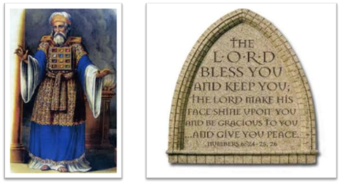
²⁴ The Lord bless you, and keep you; ²⁵ The Lord make His face shine on you, And be gracious to you; ²⁶ The Lord lift up His countenance on you, And give you peace.
Numbers 6:24–26 (NASB95)

