Slide 1


Dr. Andy Woods
Senior Pastor – Sugar Land Bible Church
President – Chafer Theological Seminary

Slide 2

Structure
1 – Commendation
2 – Correction
3 – Consequences

Slide 3
Structure
1 – Commendation
2 – Correction
3 – Consequences

Slide 4
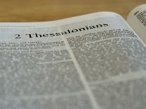
2 Thessalonians 2:1-12
Problem (2:1-2)
Prerequisites for the Day of the Lord (2:3-12)
  The departure (2:3a)
  Advent of the lawless one (2:3b-4)
  Removal of the restrainer (2:5-7)
  Destruction of the lawless one (2:8-9)
  Destruction of lawless one’s followers (2:10-12)

Slide 5
Structure
1 – Commendation
2 – Correction
3 – Consequences

Slide 6
Consequences of Poor Doctrine (3)
Reciprocal prayer (3:1-5)
Exhortation to discipline the idle (3:6-15)
Conclusion (3:16-18)

Slide 7

2 Thessalonians 3:16-18
Conclusion
  Peace (16)
  Discernment (17)
  Grace (18)

Slide 8
2 Thessalonians 3:16-18
Conclusion
  Peace (16)
  Discernment (17)
  Grace (18)

Slide 9
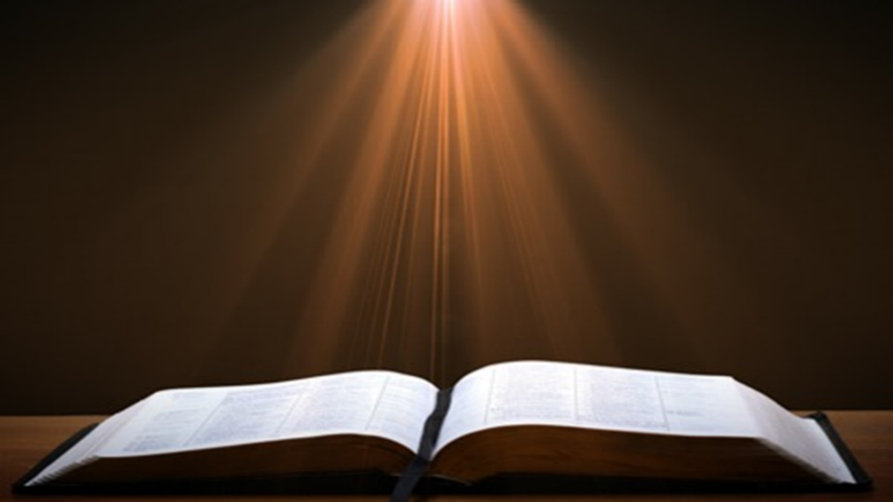
Isaiah 9:6-7
⁶ For a child will be born to us, a son will be given to us; And the government will rest on His shoulders; And His name will be called Wonderful Counselor, Mighty God, Eternal Father, Prince of Peace.⁷ There will be no end to the increase of His government or of peace, On the throne of David and over his kingdom, To establish it and to uphold it with justice and righteousness From then on and forevermore. The zeal of the Lord of hosts will accomplish this.

Slide 10
2 Thessalonians 3:16-18
Conclusion
  Peace (16)
  Discernment (17)
  Grace (18)

Slide 11
2 Thessalonians 2:1-12
Problem (2:1-2)
Prerequisites for the Day of the Lord (2:3-12)
  The departure (2:3a)
  Advent of the lawless one (2:3b-4)
  Removal of the restrainer (2:5-7)
  Destruction of the lawless one (2:8-9)
  Destruction of lawless one’s followers (2:10-12)

Slide 12

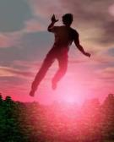
2 Thessalonians 2:2
“that you not be quickly shaken [saleuō] from your composure or be disturbed either by a spirit or a message or a letter as if from us, to the effect that the day of the Lord [the Tribulation] has come.”

Slide 13
Acts 16:26
“and suddenly there came a great earthquake, so that the foundations of the prison house were shaken [saleuō]; and immediately all the doors were opened and everyone’s chains were unfastened.”

Slide 14
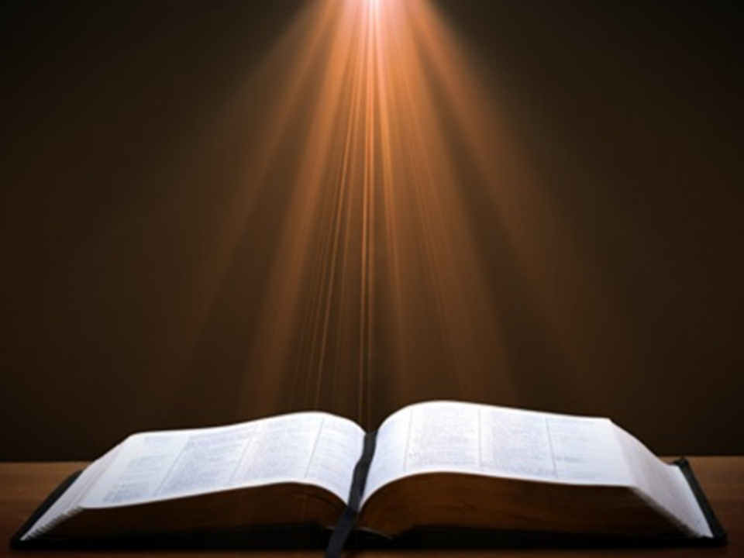
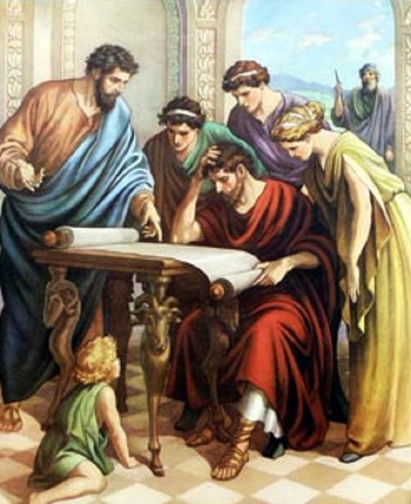
Acts 17:11
“Now these were more noble-minded than those in Thessalonica, for they received the word with great eagerness, examining the Scriptures daily to see whether these things were so.”

Slide 15
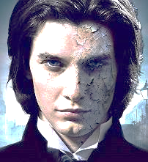
1 John 4:1
“Beloved, do not believe every spirit, but test the spirits to see whether they are from God, because many false prophets have gone out into the world.”

Slide 16
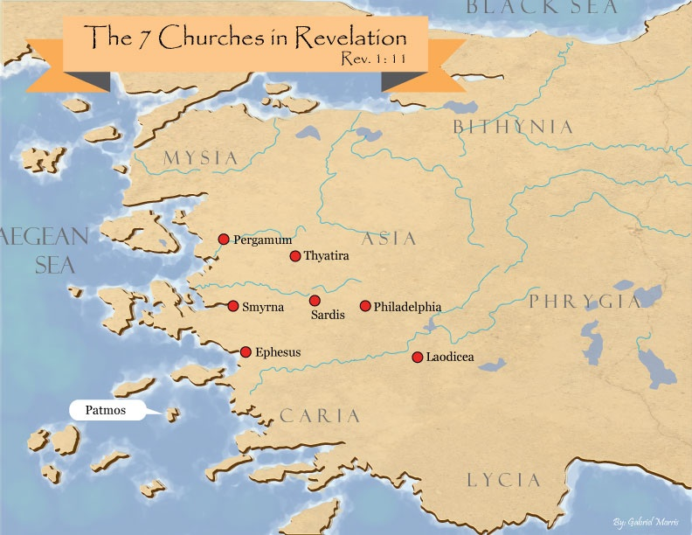
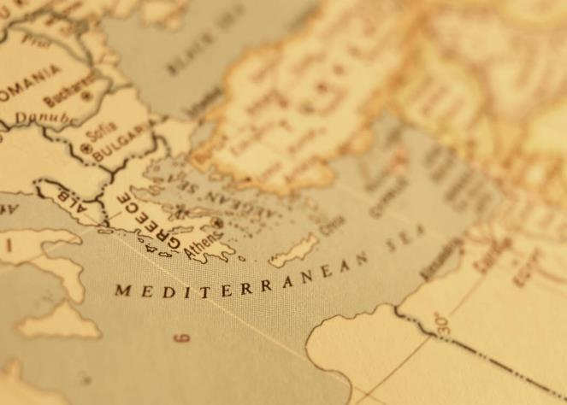

Slide 17


Revelation 2:2
“I know your deeds and your toil and perseverance, and that you cannot tolerate evil men, and you put to the test [peirázō] those who call themselves apostles, and they are not, and you found them to be false.”

Slide 18

Ephesians 4:11-16
“¹¹ And He gave some as apostles, and some as prophets, and some as evangelists, and some as pastors and teachers, ¹² for the equipping of the saints for the work of service, to the building up of the body of Christ; ¹³ until we all attain to the unity of the faith, and of the knowledge of the Son of God, to a mature man, to the measure of the stature which belongs to the fullness of Christ. ¹⁴ As a result, we are no longer to be children, tossed here and there by. . .

Slide 19
Ephesians 4:11-16
“. . . waves and carried about by every wind of doctrine, by the trickery of men, by craftiness in deceitful scheming; ¹⁵ but speaking the truth in love, we are to grow up in all aspects into Him who is the head, even Christ, ¹⁶ from whom the whole body, being fitted and held together by what every joint supplies, according to the proper working of each individual part, causes the growth of the body for the building up of itself in love.”

Slide 20
2 Thessalonians 3:16-18
Conclusion
  Peace (16)
  Discernment (17)
  Grace (18)

Slide 21

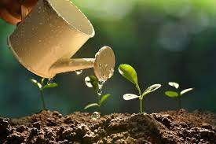
2 Peter 3:18
“but grow in the grace and knowledge of our Lord and Savior Jesus Christ. To Him be the glory, both now and to the day of eternity. Amen.”

Slide 22
Conclusion

Slide 23
2 Thessalonians 3:16-18
Conclusion
  Peace (16)
  Discernment (17)
  Grace (18)

