Slide 1
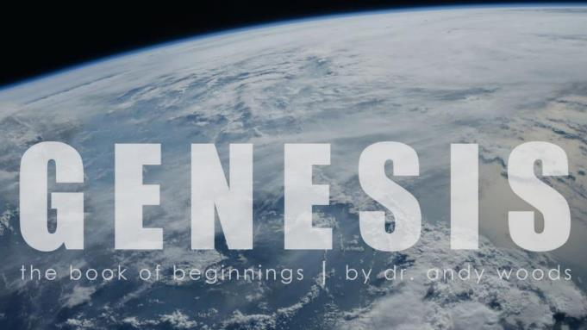
Genesis 12‒50
Israel’s Birth & Preservation

Slide 2
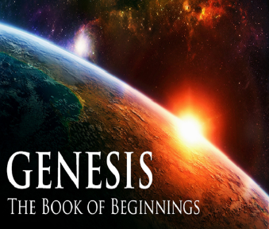
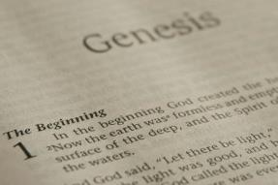
GENESIS STRUCTURE
Genesis 12-50 (four people)
Abraham (12:1–25:11)
Isaac (25:12–26:35)
Jacob (27–36)
Joseph (37–50)

Slide 3
Genesis 37‒50 Joseph
Joseph sold unto Egypt (37)
Canaan’s corruption (38)
Joseph falsely accused (39)
Joseph’s short-term predictions (40)
Joseph’s elevation (41)
Joseph’s first reunion with his brothers (42)
Joseph’s second reunion with his brothers (43‒45)

Slide 4
Genesis 43‒45 Second Reunion
Jacob sends sons to Egypt (43:1-14)
Second reunion with Joseph (43:15-34)
Benjamin’s arrest (44:1-17)
Judah’s intercession (44:18-34)
Joseph’s revelation (45:1-15)
Pharaoh’s invitation (45:16-20)
Brothers return to Jacob (45:21-28)

Slide 5
II. Genesis 43:15-34 Second Encounter with Joseph
Departure for Egypt (15)
Brothers & steward (16-25)
Brothers & Joseph (26-34)

Slide 6
Genesis 43:26-34 Joseph Encounters His Brothers
Joseph’s arrival (26)
Joseph’s questions (27)
Brothers’ response (28)
Joseph & Benjamin (29-30)
Feast (31-34)

Slide 7
Genesis 43:26-34 Joseph Encounters His Brothers
Joseph’s arrival (26)
Joseph’s questions (27)
Brothers’ response (28)
Joseph & Benjamin (29-30)
Feast (31-34)

Slide 8
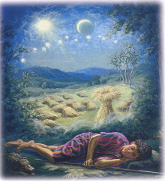
Genesis 37:9
Now he had still another dream, and related it to his brothers, and said, “Lo, I have had still another dream; and behold, the sun and the moon and eleven stars were bowing down to me.”

Slide 9
Genesis 37:10
He related it to his father and to his brothers; and his father rebuked him and said to him, “What is this dream that you have had? Shall I and your mother and your brothers actually come to bow ourselves down before you to the ground?”

Slide 10
Sun = Jacob
Moon = Leah
11 Stars = Joseph’s brothers
12th Star = Joseph
12 Stars = Israel’s twelve tribes

Slide 11
John 13:19; 14:29
“^{13:19} From now on I am telling you before it comes to pass, so that when it does occur, you may believe that I am He… ^{14:29} Now I have told you before it happens, so that when it happens, you may believe.”

Slide 12
What Happened to Christ’s Disciples?
Disciple | Place | Martyrdom
James the Son of Alpheus | Jerusalem | Clubbed to death
Simon the Zealot | Jerusalem | Martyred
James the Son of Zebedee | Judea (Acts 12:2) | Executed
Thaddeus | Mesopotamia | Beaten to death
Peter | Babylon, Rome | Crucified upside down
Matthew | Parthia (Tehran) | Beheaded
Notes:
109 prophecies…
Peter Stoner – SCIENCE SPEAKS, An Evaluation of Certain Christian Evidences
To fulfill just 8 prophecies =1 X 10 to the twenty-eighth power!
Can we visualize this with an illustration? Suppose we took an atheistic professor, blindfolded him and covered the state of Texas two feet deep with silver dollars. Then we put a check on one of those silver dollars and mixed them up. The odds of one person fulfilling just these eight prophecies would be the same as this atheistic professor selecting the silver dollar upon which we have placed a check, in his first try.
https://www.bereanpublishers.com/the-odds-of-eight-messianic-prophecies-coming-true/

Slide 13
What Happened to Christ’s Disciples?
Disciple | Place | Martyrdom
John | Asia Minor, Patmos, Ephesus | Fried in boiling oil
Philip | E. Turkey | Tortured & crucified
Thomas | India | Speared
Bartholomew | India | Flayed & crucified
Andrew | Ukraine, Russia, Greece | Hanged
Notes:
109 prophecies…
Peter Stoner – SCIENCE SPEAKS, An Evaluation of Certain Christian Evidences
To fulfill just 8 prophecies =1 X 10 to the twenty-eighth power!
Can we visualize this with an illustration? Suppose we took an atheistic professor, blindfolded him and covered the state of Texas two feet deep with silver dollars. Then we put a check on one of those silver dollars and mixed them up. The odds of one person fulfilling just these eight prophecies would be the same as this atheistic professor selecting the silver dollar upon which we have placed a check, in his first try.
https://www.bereanpublishers.com/the-odds-of-eight-messianic-prophecies-coming-true/

Slide 14
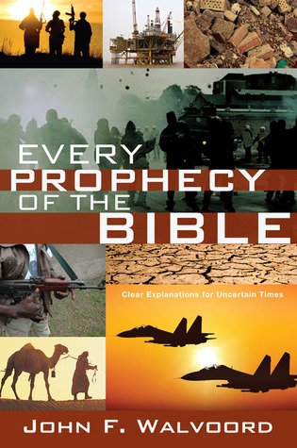

Slide 15
Genesis 43:26-34 Joseph Encounters His Brothers
Joseph’s arrival (26)
Joseph’s questions (27)
Brothers’ response (28)
Joseph & Benjamin (29-30)
Feast (31-34)

Slide 16
Genesis 43:26-34 Joseph Encounters His Brothers
Joseph’s arrival (26)
Joseph’s questions (27)
Brothers’ response (28)
Joseph & Benjamin (29-30)
Feast (31-34)

Slide 17
Genesis 43:26-34 Joseph Encounters His Brothers
Joseph’s arrival (26)
Joseph’s questions (27)
Brothers’ response (28)
Joseph & Benjamin (29-30)
Feast (31-34)

Slide 18
Genesis 43:29-30 Joseph & Benjamin
Benjamin identified (29)
Joseph’s reaction (30)

Slide 19
Genesis 43:29-30 Joseph & Benjamin
Benjamin identified (29)
Joseph’s reaction (30)

Slide 21
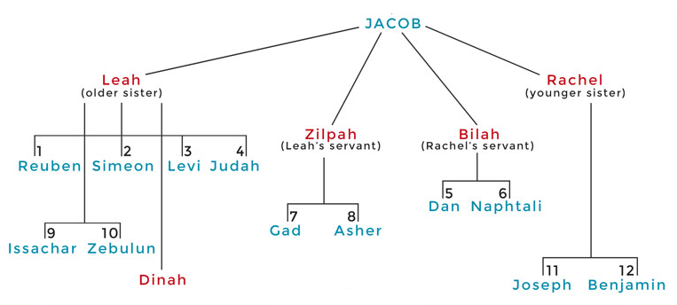

Slide 22
Genesis 43:29-30 Joseph & Benjamin
Benjamin identified (29)
Joseph’s reaction (30)

Slide 23
Luke 19:41-44
^{41 “}When He approached Jerusalem, He saw the city and wept over it, ⁴² saying, “If you had known in this day, even you, the things which make for peace! But now they have been hidden from your eyes. ⁴³ For the days will come upon you when your enemies will throw up a barricade against you, and surround you and hem you in on every side, ⁴⁴ and they will level you to the ground and your children within you, and they will not leave in you one stone upon another, because you did not recognize the time of your visitation.”

Slide 24
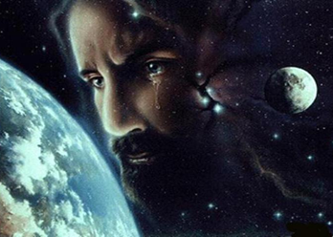
Christ’s Human Experiences
Labor (Mark 6:3)
Distress (Luke 22:44)
Being troubled (John 12:27)
Thirst (John 19:28)
Hunger (Matt 4:2)
Fatigue (John 4:6)
Sadness (John 11:35)
Lack of understanding (Matt 24:36)
Temptation (Luke 4:1-13; Heb. 4:15)

Slide 25
Hebrews 2:18
“For since He Himself was tempted in that which He has suffered, He is able to come to the aid of those who are tempted.”

Slide 26
Hebrews 4:15-16
^{15 “}For we do not have a high priest who cannot sympathize with our weaknesses, but One who has been tempted in all things as we are, yet without sin. ¹⁶ Therefore let us draw near with confidence to the throne of grace, so that we may receive mercy and find grace to help in time of need.”

Slide 27
Zechariah 12:10
“I will pour out on the house of David and on the inhabitants of Jerusalem, the Spirit of grace and of supplication, so that they will look on Me whom they have pierced; and they will mourn for Him, as one mourns for an only son, and they will weep bitterly over Him like the bitter weeping over a firstborn.”

Slide 28
Genesis 43:26-34 Joseph Encounters His Brothers
Joseph’s arrival (26)
Joseph’s questions (27)
Brothers’ response (28)
Joseph & Benjamin (29-30)
Feast (31-34)

Slide 29
Genesis 43:31-34 Feast
Joseph’s preparations (31)
Three separations (32)
Seating arrangement (33)
Food serving (34)

Slide 30
Genesis 43:31-34 Feast
Joseph’s preparations (31)
Three separations (32)
Seating arrangement (33)
Food serving (34)

Slide 31
Genesis 43:31 Joseph’s Preparations
Washing (31a)
Command (31b)

Slide 32
Genesis 43:31 Joseph’s Preparations
Washing (31a)
Command (31b)

Slide 33
Genesis 43:31 Joseph’s Preparations
Washing (31a)
Command (31b)

Slide 34
Genesis 43:31-34 Feast
Joseph’s preparations (31)
Three separations (32)
Seating arrangement (33)
Food serving (34)

Slide 35
Genesis 43:32 Three Separations
Joseph (32a)
Brothers (32b)
Egyptians (32c)
Reason (32d)

Slide 36
Genesis 43:32 Three Separations
Joseph (32a)
Brothers (32b)
Egyptians (32c)
Reason (32d)

Slide 37
Genesis 43:32 Three Separations
Joseph (32a)
Brothers (32b)
Egyptians (32c)
Reason (32d)

Slide 38
Genesis 43:32 Three Separations
Joseph (32a)
Brothers (32b)
Egyptians (32c)
Reason (32d)

Slide 39
Genesis 43:32 Three Separations
Joseph (32a)
Brothers (32b)
Egyptians (32c)
Reason (32d)

Slide 40
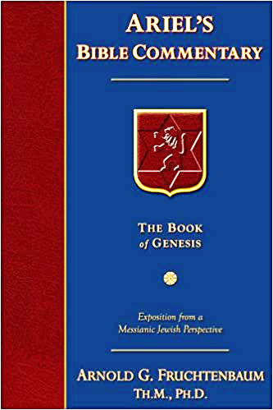
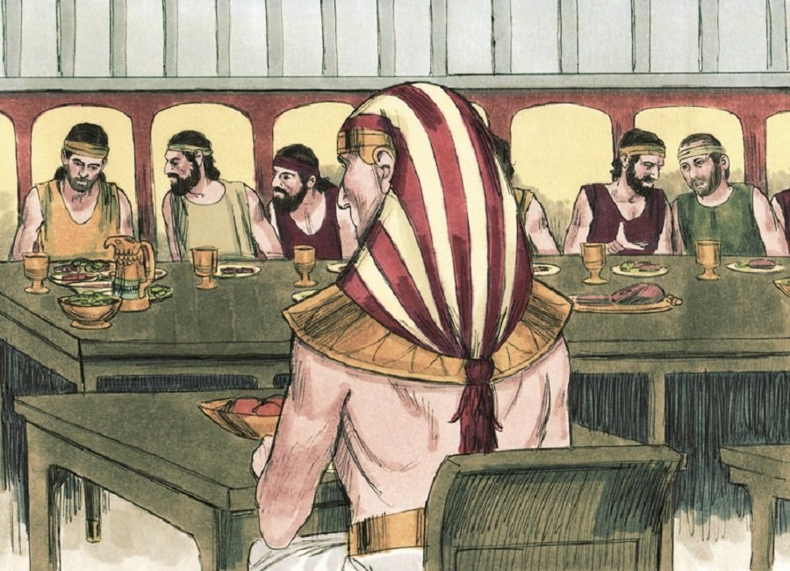
Dr. Arnold G. Fruchtenbaum
The Book of Genesis, 588
“The reason for these separations was: because the Egyptians might not eat bread with the Hebrews. These are native Egyptians, not Hyksos, for that is an abomination unto the Egyptians to eat with Semites; and that was true with all Semites. The Hebrews were Semites.”

Slide 41
Genesis 43:31-34 Feast
Joseph’s preparations (31)
Three separations (32)
Seating arrangement (33)
Food serving (34)

Slide 42
Genesis 43:33 Seating Arrangement
According to birth order (33a)
Reaction (33b)

Slide 43
Genesis 43:33 Seating Arrangement
According to birth order (33a)
Reaction (33b)

Slide 46
Genesis 43:33 Seating Arrangement
According to birth order (33a)
Reaction (33b)

Slide 47
Genesis 43:31-34 Feast
Joseph’s preparations (31)
Three separations (32)
Seating arrangement (33)
Food serving (34)

Slide 48
Genesis 43:34 Food Serving
Test (34a)
Test passed (34b)

Slide 49
Genesis 43:34 Food Serving
Test (34a)
Test passed (34b)

Slide 50
Genesis 43:34 Food Serving
Test (34a)
Test passed (34b)

Slide 51
1 Corinthians 6:9–11
⁹ Or do you not know that the unrighteous will not inherit the kingdom of God? Do not be deceived; neither fornicators, nor idolaters, nor adulterers, nor effeminate, nor homosexuals, ¹⁰ nor thieves, nor the covetous, nor drunkards, nor revilers, nor swindlers, will inherit the kingdom of God. ¹¹ Such were some of you; but you were washed, but you were sanctified, but you were justified in the name of the Lord Jesus Christ and in the Spirit of our God.

Slide 52
Conclusion

Slide 53
Genesis 43‒45 Second Reunion
Jacob sends sons to Egypt (43:1-14)
Second reunion with Joseph (43:15-34)
Benjamin’s arrest (44:1-17)
Judah’s intercession (44:18-34)
Joseph’s revelation (45:1-15)
Pharaoh’s invitation (45:16-20)
Brothers return to Jacob (45:21-28)

Slide 54
II. Genesis 43:15-34 Second Encounter with Joseph
Departure for Egypt (15)
Brothers & steward (16-25)
Brothers & Joseph (26-34)

Slide 55
Genesis 43:26-34 Joseph Encounters His Brothers
Joseph’s arrival (26)
Joseph’s questions (27)
Brothers’ response (28)
Joseph & Benjamin (29-30)
Feast (31-34)

Slide 56
²⁴ The Lord bless you, and keep you; ²⁵ The Lord make His face shine on you, And be gracious to you; ²⁶ The Lord lift up His countenance on you, And give you peace.
Numbers 6:24–26 (NASB95)

