Slide 1
Genesis 12‒50
Israel’s Birth & Preservation

Slide 2
GENESIS STRUCTURE
Genesis 12-50 (four people)
Abraham (12:1–25:11)
Isaac (25:12–26:35)
Jacob (27–36)
Joseph (37–50)

Slide 3
Genesis 37‒50 Joseph
Joseph sold unto Egypt (37)
Canaan’s corruption (38)
Joseph falsely accused (39)
Joseph’s short-term predictions (40)
Joseph’s elevation (41)
Joseph’s first reunion with his brothers (42)
Joseph’s second reunion with his brothers (43‒45)

Slide 4
Genesis 43‒45 Second Reunion
Jacob sends sons to Egypt (43:1-14)
Second reunion with Joseph (43:15-34)
Benjamin’s arrest (44:1-17)
Judah’s intercession (44:18-34)
Joseph’s revelation (45:1-15)
Pharaoh’s invitation (45:16-20)
Brothers return to Jacob (45:21-28)

Slide 5
II. Genesis 43:15-34 Second Encounter with Joseph
Departure for Egypt (15)
Brothers & steward (16-25)
Brothers & Joseph (26-34)

Slide 6
II. Genesis 43:15-34 Second Encounter with Joseph
Departure for Egypt (15)
Brothers & steward (16-25)
Brothers & Joseph (26-34)

Slide 7
Genesis 43:15 Departure for Egypt
Departure (15a)
Arrival (15b)

Slide 8
Genesis 43:15 Departure for Egypt
Departure (15a)
Arrival (15b)

Slide 9
Genesis 43:15 Departure for Egypt
Departure (15a)
Arrival (15b)

Slide 11
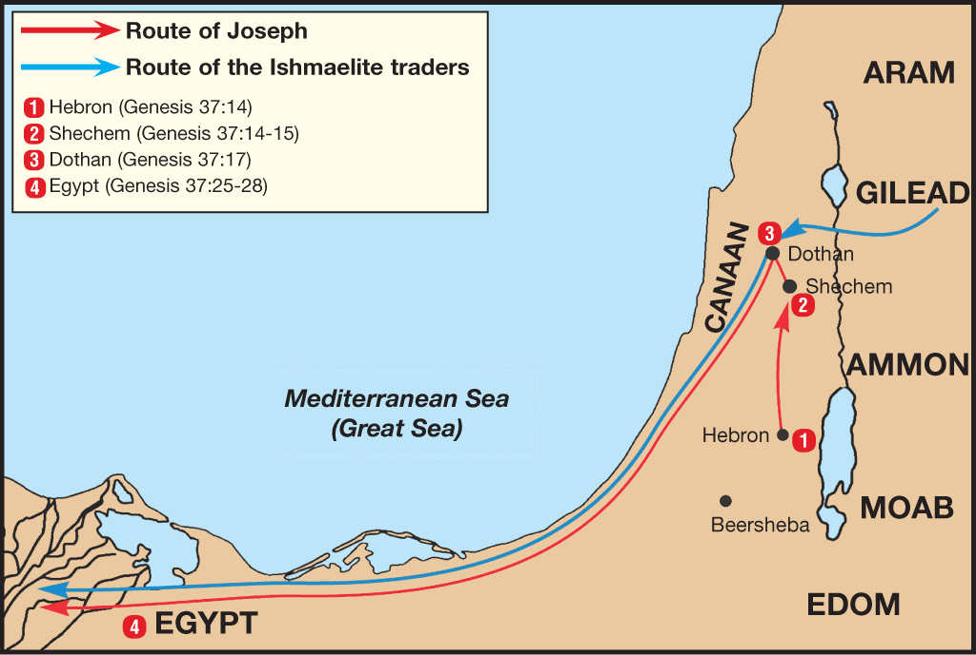

Slide 12
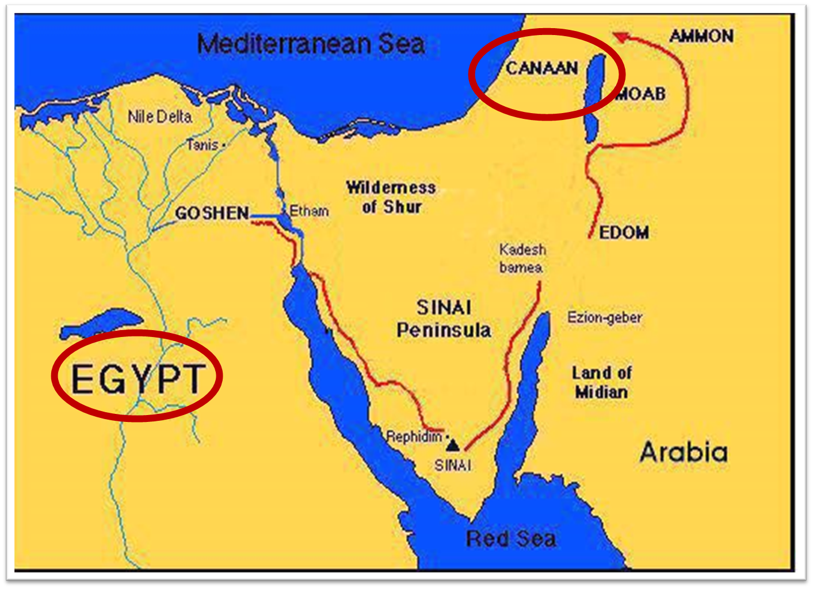

Slide 13
II. Genesis 43:15-34 Second Encounter with Joseph
Departure for Egypt (15)
Brothers & steward (16-25)
Brothers & Joseph (26-34)

Slide 14
Genesis 43:16-25 Brothers & Steward
Joseph’s instructions (16)
Steward’s obedience (17)
Brothers’ response (18-22)
Steward’s response (23a)
Steward’s preparation (23b-24)
Brothers’ preparation (25)

Slide 15
Genesis 43:16-25 Brothers & Steward
Joseph’s instructions (16)
Steward’s obedience (17)
Brothers’ response (18-22)
Steward’s response (23a)
Steward’s preparation (23b-24)
Brothers’ preparation (25)

Slide 16
Genesis 43:16 Joseph’s Instructions
Occasion (16a)
Instructions (16b)

Slide 17
Genesis 43:16 Joseph’s Instructions
Occasion (16a)
Instructions (16b)

Slide 18
Genesis 43:16 Joseph’s Instructions
Occasion (16a)
Instructions (16b)

Slide 19
Genesis 43:16-25 Brothers & Steward
Joseph’s instructions (16)
Steward’s obedience (17)
Brothers’ response (18-22)
Steward’s response (23a)
Steward’s preparation (23b-24)
Brothers’ preparation (25)

Slide 20
Genesis 43:16-25 Brothers & Steward
Joseph’s instructions (16)
Steward’s obedience (17)
Brothers’ response (18-22)
Steward’s response (23a)
Steward’s preparation (23b-24)
Brothers’ preparation (25)

Slide 21
Genesis 43:18-22 Brother’s Response
Fear (18)
Approach (19)
Explanation (20-22)

Slide 22
Genesis 43:18-22 Brother’s Response
Fear (18)
Approach (19)
Explanation (20-22)

Slide 23
Genesis 43:18-22 Brother’s Response
Fear (18)
Approach (19)
Explanation (20-22)

Slide 24
Genesis 43:18-22 Brother’s Response
Fear (18)
Approach (19)
Explanation (20-22)

Slide 25
Genesis 43:20-22 Explanation
1st trip’s purpose (20)
Discovery (21a)
Double money (21b-22a)
Ignorance (22b)

Slide 26
Genesis 43:20-22 Explanation
1st trip’s purpose (20)
Discovery (21a)
Double money (21b-22a)
Ignorance (22b)

Slide 27
Genesis 43:20-22 Explanation
1st trip’s purpose (20)
Discovery (21a)
Double money (21b-22a)
Ignorance (22b)

Slide 28
Genesis 43:20-22 Explanation
1st trip’s purpose (20)
Discovery (21a)
Double money (21b-22a)
Ignorance (22b)

Slide 29
Genesis 43:21b-22a Double Money
Old money (21a)
New money (22b)

Slide 30
Genesis 43:21b-22a Double Money
Old money (21a)
New money (22b)

Slide 31
Genesis 43:21b-22a Double Money
Old money (21a)
New money (22b)

Slide 32
Genesis 43:20-22 Explanation
1st trip’s purpose (20)
Discovery (21a)
Double money (21b-22a)
Ignorance (22b)

Slide 33
Genesis 43:16-25 Brothers & Steward
Joseph’s instructions (16)
Steward’s obedience (17)
Brothers’ response (18-22)
Steward’s response (23a)
Steward’s preparation (23b-24)
Brothers’ preparation (25)

Slide 34
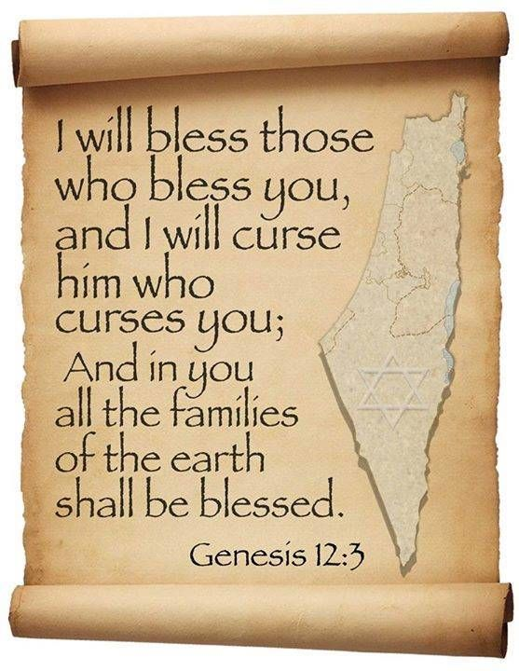
Genesis 12:3
“And I will bless those who bless you, And the one who curses you I will curse. And in you all the families of the earth will be blessed.”

Slide 35
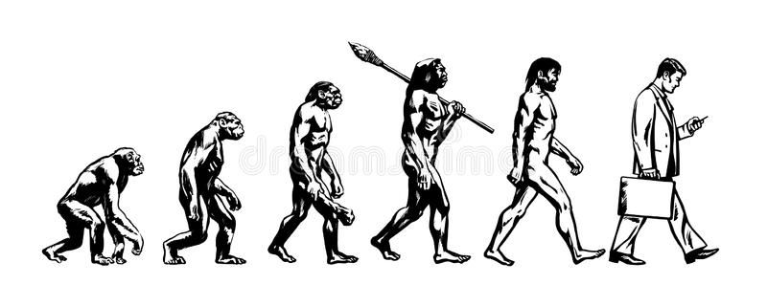

Slide 36
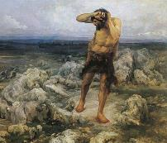
Ungodly Line of Cain (Gen 4:16-24)
Evil line that will not bring forth the Messiah (Gen 3:15)
Continuation of Cain’s line (4:16-18)
Immorality (4:19)
Technological but not spiritual advancement (4:20-22)
Violence (4:23-24)

Slide 37
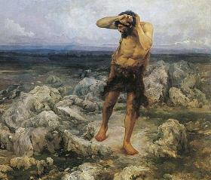
Technological Advancement Genesis 4:17-22
City – Gen. 4:17
Livestock – Gen. 4:20
Music – Gen. 4:21
Metallurgy – Gen. 4:22

Slide 38
Genesis 5:1-2
“¹ This is the book of the generations of Adam. In the day when God created man, He made him in the likeness of God. ² He created them male and female, and He blessed them and named them Man in the day when they were created.”

Slide 39
Dr. Henry M. Morris
The Genesis Record, 147-48
“Musical instruments, another important aspect of modern culture, were also an early development. All of these things, in addition, confirm the necessary coexistence of a written language for formal communications. This is further intimated by use of the word ‘book’ in Genesis 5:1. More and more modern archaeological discoveries today are verifying the high degree of technology possessed by the earliest men, thus indirectly validating this Biblical testimony.”

Slide 40
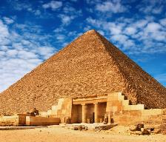
The Genius of Ancient Man (Gen 4:19)
The Palace at Knossos on Crete
La Bastida in Spain
The Great Pyramids of Egypt
The Stonehenge of England
The Great Wall of China
The architecture of the Incas
Landis, Don. "Ancient Man ‒ Genius or Primitive?" In Searching for Adam: Genesis & the Truth About Man's Origin, edited by Terry Mortenson, 415-44. Green Forest, AR: Master Books, 2016.

Slide 41
Genesis 43:16-25 Brothers & Steward
Joseph’s instructions (16)
Steward’s obedience (17)
Brothers’ response (18-22)
Steward’s response (23a)
Steward’s preparation (23b-24)
Brothers’ preparation (25)

Slide 42
Genesis 43:23b-24 Steward’s Preparations
Return of Simeon (23b)
Brothers’ welfare (24)

Slide 43
Genesis 43:23b-24 Steward’s Preparations
Return of Simeon (23b)
Brothers’ welfare (24)

Slide 45
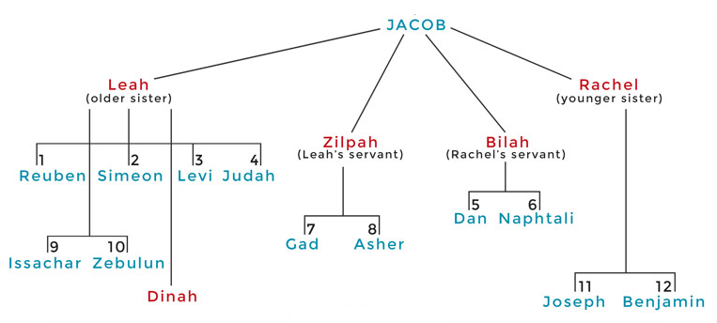

Slide 46
Genesis 43:23b-24 Steward’s Preparations
Return of Simeon (23b)
Brothers’ welfare (24)

Slide 47
Genesis 43:16-25 Brothers & Steward
Joseph’s instructions (16)
Steward’s obedience (17)
Brothers’ response (18-22)
Steward’s response (23a)
Steward’s preparation (23b-24)
Brothers’ preparation (25)

Slide 50
II. Genesis 43:15-34 Second Encounter with Joseph
Departure for Egypt (15)
Brothers & steward (16-25)
Brothers & Joseph (26-34)

Slide 51
Genesis 43:26-34 Joseph Encounters His Brothers
Joseph’s arrival (26)
Joseph’s questions (27)
Brothers’ response (28)
Joseph & Benjamin (29-30)
Feast (31-34)

Slide 52
Genesis 43:26-34 Joseph Encounters His Brothers
Joseph’s arrival (26)
Joseph’s questions (27)
Brothers’ response (28)
Joseph & Benjamin (29-30)
Feast (31-34)

Slide 53
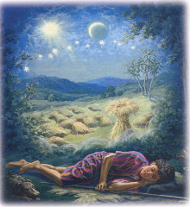
Genesis 37:9
Now he had still another dream, and related it to his brothers, and said, “Lo, I have had still another dream; and behold, the sun and the moon and eleven stars were bowing down to me.”

Slide 54
Genesis 37:10
He related it to his father and to his brothers; and his father rebuked him and said to him, “What is this dream that you have had? Shall I and your mother and your brothers actually come to bow ourselves down before you to the ground?”

Slide 55
Sun = Jacob
Moon = Leah
11 Stars = Joseph’s brothers
12th Star = Joseph
12 Stars = Israel’s twelve tribes

Slide 56
John 13:19; 14:29
“^{13:19} From now on I am telling you before it comes to pass, so that when it does occur, you may believe that I am He… ^{14:29} Now I have told you before it happens, so that when it happens, you may believe.”

Slide 57
What Happened to Christ’s Disciples?
Disciple | Place | Martyrdom
James the Son of Alpheus | Jerusalem | Clubbed to death
Simon the Zealot | Jerusalem | Martyred
James the Son of Zebedee | Judea (Acts 12:2) | Executed
Thaddeus | Mesopotamia | Beaten to death
Peter | Babylon, Rome | Crucified upside down
Matthew | Parthia (Tehran) | Beheaded
Notes:
109 prophecies…
Peter Stoner – SCIENCE SPEAKS, An Evaluation of Certain Christian Evidences
To fulfill just 8 prophecies =1 X 10 to the twenty-eighth power!
Can we visualize this with an illustration? Suppose we took an atheistic professor, blindfolded him and covered the state of Texas two feet deep with silver dollars. Then we put a check on one of those silver dollars and mixed them up. The odds of one person fulfilling just these eight prophecies would be the same as this atheistic professor selecting the silver dollar upon which we have placed a check, in his first try.
https://www.bereanpublishers.com/the-odds-of-eight-messianic-prophecies-coming-true/

Slide 58
What Happened to Christ’s Disciples?
Disciple | Place | Martyrdom
John | Asia Minor, Patmos, Ephesus | Fried in boiling oil
Philip | E. Turkey | Tortured & crucified
Thomas | India | Speared
Bartholomew | India | Flayed & crucified
Andrew | Ukraine, Russia, Greece | Hanged
Notes:
109 prophecies…
Peter Stoner – SCIENCE SPEAKS, An Evaluation of Certain Christian Evidences
To fulfill just 8 prophecies =1 X 10 to the twenty-eighth power!
Can we visualize this with an illustration? Suppose we took an atheistic professor, blindfolded him and covered the state of Texas two feet deep with silver dollars. Then we put a check on one of those silver dollars and mixed them up. The odds of one person fulfilling just these eight prophecies would be the same as this atheistic professor selecting the silver dollar upon which we have placed a check, in his first try.
https://www.bereanpublishers.com/the-odds-of-eight-messianic-prophecies-coming-true/

Slide 60
Genesis 43:26-34 Joseph Encounters His Brothers
Joseph’s arrival (26)
Joseph’s questions (27)
Brothers’ response (28)
Joseph & Benjamin (29-30)
Feast (31-34)

Slide 61
Genesis 43:26-34 Joseph Encounters His Brothers
Joseph’s arrival (26)
Joseph’s questions (27)
Brothers’ response (28)
Joseph & Benjamin (29-30)
Feast (31-34)

Slide 62
Genesis 43:26-34 Joseph Encounters His Brothers
Joseph’s arrival (26)
Joseph’s questions (27)
Brothers’ response (28)
Joseph & Benjamin (29-30)
Feast (31-34)

Slide 63
Genesis 43:29-30 Joseph & Benjamin
Benjamin identified (29)
Joseph’s reaction (30)

Slide 64
Genesis 43:29-30 Joseph & Benjamin
Benjamin identified (29)
Joseph’s reaction (30)

Slide 67
Genesis 43:29-30 Joseph & Benjamin
Benjamin identified (29)
Joseph’s reaction (30)

Slide 68
Luke 19:41-44
^{41 “}When He approached Jerusalem, He saw the city and wept over it, ⁴² saying, “If you had known in this day, even you, the things which make for peace! But now they have been hidden from your eyes. ⁴³ For the days will come upon you when your enemies will throw up a barricade against you, and surround you and hem you in on every side, ⁴⁴ and they will level you to the ground and your children within you, and they will not leave in you one stone upon another, because you did not recognize the time of your visitation.”

Slide 69
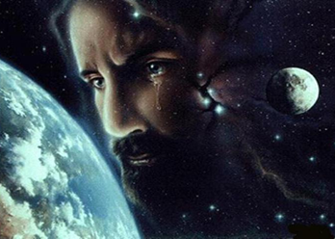
Christ’s Human Experiences
Labor (Mark 6:3)
Distress (Luke 22:44)
Being troubled (John 12:27)
Thirst (John 19:28)
Hunger (Matt 4:2)
Fatigue (John 4:6)
Sadness (John 11:35)
Lack of understanding (Matt 24:36)
Temptation (Luke 4:1-13; Heb. 4:15)

Slide 70
Hebrews 2:18
“For since He Himself was tempted in that which He has suffered, He is able to come to the aid of those who are tempted.”

Slide 71
Hebrews 4:15-16
^{15 “}For we do not have a high priest who cannot sympathize with our weaknesses, but One who has been tempted in all things as we are, yet without sin. ¹⁶ Therefore let us draw near with confidence to the throne of grace, so that we may receive mercy and find grace to help in time of need.”

Slide 72
Zechariah 12:10
“I will pour out on the house of David and on the inhabitants of Jerusalem, the Spirit of grace and of supplication, so that they will look on Me whom they have pierced; and they will mourn for Him, as one mourns for an only son, and they will weep bitterly over Him like the bitter weeping over a firstborn.”

Slide 73
Genesis 43:26-34 Joseph Encounters His Brothers
Joseph’s arrival (26)
Joseph’s questions (27)
Brothers’ response (28)
Joseph & Benjamin (29-30)
Feast (31-34)

Slide 74
Genesis 43:31-34 Feast
Joseph’s preparations (31)
Three separations (32)
Seating arrangement (33)
Food serving (34)

Slide 75
Genesis 43:31-34 Feast
Joseph’s preparations (31)
Three separations (32)
Seating arrangement (33)
Food serving (34)

Slide 76
Genesis 43:31 Joseph’s Preparations
Washing (31a)
Command (31b)

Slide 77
Genesis 43:31 Joseph’s Preparations
Washing (31a)
Command (31b)

Slide 78
Genesis 43:31 Joseph’s Preparations
Washing (31a)
Command (31b)

Slide 79
Genesis 43:31-34 Feast
Joseph’s preparations (31)
Three separations (32)
Seating arrangement (33)
Food serving (34)

Slide 80
Genesis 43:32 Three Separations
Joseph (32a)
Brothers (32b)
Egyptians (32c)
Reason (32d)

Slide 81
Genesis 43:32 Three Separations
Joseph (32a)
Brothers (32b)
Egyptians (32c)
Reason (32d)

Slide 82
Genesis 43:32 Three Separations
Joseph (32a)
Brothers (32b)
Egyptians (32c)
Reason (32d)

Slide 83
Genesis 43:32 Three Separations
Joseph (32a)
Brothers (32b)
Egyptians (32c)
Reason (32d)

Slide 84
Dr. Arnold G. Fruchtenbaum
The Book of Genesis, 588
“The reason for these separations was: because the Egyptians might not eat bread with the Hebrews. These are native Egyptians, not Hyksos, for that is an abomination unto the Egyptians to eat with Semites; and that was true with all Semites. The Hebrews were Semites.”

Slide 85
Genesis 43:32 Three Separations
Joseph (32a)
Brothers (32b)
Egyptians (32c)
Reason (32d)

Slide 86
Genesis 43:31-34 Feast
Joseph’s preparations (31)
Three separations (32)
Seating arrangement (33)
Food serving (34)

Slide 87
Genesis 43:33 Seating Arrangement
According to birth order (33a)
Reaction (33b)

Slide 88
Genesis 43:33 Seating Arrangement
According to birth order (33a)
Reaction (33b)

Slide 91
Genesis 43:33 Seating Arrangement
According to birth order (33a)
Reaction (33b)

Slide 92
Genesis 43:31-34 Feast
Joseph’s preparations (31)
Three separations (32)
Seating arrangement (33)
Food serving (34)

Slide 93
Genesis 43:34 Food Serving
Test (34a)
Test passed (34b)

Slide 94
Genesis 43:34 Food Serving
Test (34a)
Test passed (34b)

Slide 95
Genesis 43:34 Food Serving
Test (34a)
Test passed (34b)

Slide 96
1 Corinthians 6:9–11
⁹ Or do you not know that the unrighteous will not inherit the kingdom of God? Do not be deceived; neither fornicators, nor idolaters, nor adulterers, nor effeminate, nor homosexuals, ¹⁰ nor thieves, nor the covetous, nor drunkards, nor revilers, nor swindlers, will inherit the kingdom of God. ¹¹ Such were some of you; but you were washed, but you were sanctified, but you were justified in the name of the Lord Jesus Christ and in the Spirit of our God.

Slide 97
Conclusion

Slide 98
Genesis 37‒50 Joseph
Joseph sold unto Egypt (37)
Canaan’s corruption (38)
Joseph falsely accused (39)
Joseph’s short-term predictions (40)
Joseph’s elevation (41)
Joseph’s first reunion with his brothers (42)
Joseph’s second reunion with his brothers (43‒45)

Slide 99
Genesis 43‒45 Second Reunion
Jacob sends sons to Egypt (43:1-14)
Second reunion with Joseph (43:15-34)
Benjamin’s arrest (44:1-17)
Judah’s intercession (44:18-34)
Joseph’s revelation (45:1-15)
Pharaoh’s invitation (45:16-20)
Brothers return to Jacob (45:21-28)

Slide 100
I. Genesis 43:1-14 Jacob Sends his Sons to Egypt
Circumstances (1-2)
Judah’s condition (3-5)
Jacob’s protest (6)
Brothers’ answer (7)
Judah’s offer (8-10)
Jacob’s agreement (11-14)

Slide 101
Genesis 43‒45 Second Reunion
Jacob sends sons to Egypt (43:1-14)
Second reunion with Joseph (43:15-34)
Benjamin’s arrest (44:1-17)
Judah’s intercession (44:18-34)
Joseph’s revelation (45:1-15)
Pharaoh’s invitation (45:16-20)
Brothers return to Jacob (45:21-28)

Slide 102
II. Genesis 43:15-34 Second Encounter with Joseph
Departure for Egypt (15)
Brothers & steward (16-25)
Brothers & Joseph (26-34)

Slide 103
²⁴ The Lord bless you, and keep you; ²⁵ The Lord make His face shine on you, And be gracious to you; ²⁶ The Lord lift up His countenance on you, And give you peace.
Numbers 6:24–26 (NASB95)

