Slide 1
Genesis 12‒50
Israel’s Birth & Preservation

Slide 2
GENESIS STRUCTURE
Genesis 12-50 (four people)
Abraham (12:1–25:11)
Isaac (25:12–26:35)
Jacob (27–36)
Joseph (37–50)

Slide 3
Genesis 37‒50 Joseph
Joseph sold unto Egypt (37)
Canaan’s corruption (38)
Joseph falsely accused (39)
Joseph’s short-term predictions (40)
Joseph’s elevation (41)
Joseph’s first reunion with his brothers (42)
Joseph’s second reunion with his brothers (43‒45)

Slide 4
Genesis 37‒50 Joseph
Joseph sold unto Egypt (37)
Canaan’s corruption (38)
Joseph falsely accused (39)
Joseph’s short-term predictions (40)
Joseph’s elevation (41)
Joseph’s first reunion with his brothers (42)
Joseph’s second reunion with his brothers (43‒45)

Slide 5
Genesis 43‒45 Second Reunion
Jacob sends sons to Egypt (43:1-14)
Second reunion with Joseph (43:15-34)
Benjamin’s arrest (44:1-17)
Judah’s intercession (44:18-34)
Joseph’s revelation (45:1-15)
Pharaoh’s invitation (45:16-20)
Brothers return to Jacob (45:21-28)

Slide 6
Genesis 43‒45 Second Reunion
Jacob sends sons to Egypt (43:1-14)
Second reunion with Joseph (43:15-34)
Benjamin’s arrest (44:1-17)
Judah’s intercession (44:18-34)
Joseph’s revelation (45:1-15)
Pharaoh’s invitation (45:16-20)
Brothers return to Jacob (45:21-28)

Slide 7
I. Genesis 43:1-14 Jacob Sends his Sons to Egypt
Circumstances (1-2)
Judah’s condition (3-5)
Jacob’s protest (6)
Brothers’ answer (7)
Judah’s offer (8-10)
Jacob’s agreement (11-14)

Slide 8
I. Genesis 43:1-14 Jacob Sends his Sons to Egypt
Circumstances (1-2)
Judah’s condition (3-5)
Jacob’s protest (6)
Brothers’ answer (7)
Judah’s offer (8-10)
Jacob’s agreement (11-14)

Slide 9
Genesis 43:1-2 Circumstances
Famine (1)
Timing (2a)
Request (2b)

Slide 10
Genesis 43:1-2 Circumstances
Famine (1)
Timing (2a)
Request (2b)

Slide 11
Genesis 43:1-2 Circumstances
Famine (1)
Timing (2a)
Request (2b)

Slide 12
Genesis 43:1-2 Circumstances
Famine (1)
Timing (2a)
Request (2b)

Slide 13
I. Genesis 43:1-14 Jacob Sends his Sons to Egypt
Circumstances (1-2)
Judah’s condition (3-5)
Jacob’s protest (6)
Brothers’ answer (7)
Judah’s offer (8-10)
Jacob’s agreement (11-14)

Slide 15
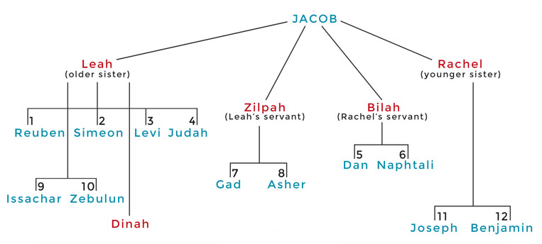

Slide 16
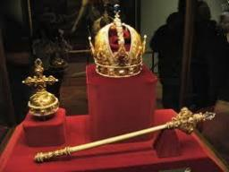
Genesis 49:10
“The scepter shall not depart from Judah, Nor the ruler’s staff from between his feet, Until Shiloh comes, And to him shall be the obedience of the peoples.”

Slide 17
Genesis 43:3-5 Judah’s Condition
Reminder (3)
Positive (4)
Negative (5)

Slide 18
Genesis 43:3-5 Judah’s Condition
Reminder (3)
Positive (4)
Negative (5)

Slide 19
Genesis 43:3-5 Judah’s Condition
Reminder (3)
Positive (4)
Negative (5)

Slide 20
Genesis 43:3-5 Judah’s Condition
Reminder (3)
Positive (4)
Negative (5)

Slide 21
I. Genesis 43:1-14 Jacob Sends his Sons to Egypt
Circumstances (1-2)
Judah’s condition (3-5)
Jacob’s protest (6)
Brothers’ answer (7)
Judah’s offer (8-10)
Jacob’s agreement (11-14)

Slide 22
Genesis 43:6 Jacob’s Protest
Jacob’s feelings (6a)
Means (6b)

Slide 23
Genesis 43:6 Jacob’s Protest
Jacob’s feelings (6a)
Means (6b)

Slide 24
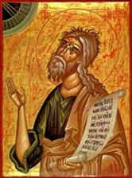
Jeremiah 30:6-7
“⁶ Ask now, and see If a male can give birth. Why do I see every man With his hands on his loins, as a woman in childbirth? And why have all faces turned pale? ⁷ Alas! for that day is great, There is none like it; And it is the time of Jacob’s distress (Gen. 32:8; 35:10), But he will be saved from it.”

Slide 25
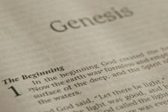
Beginning Themes
Universe Life Man Marriage Evil Clothing | Religion Salvation Language Government Nations Israel
Morris, Genesis Record, 18-20

Slide 26
Genesis 43:6 Jacob’s Protest
Jacob’s feelings (6a)
Means (6b)

Slide 27
I. Genesis 43:1-14 Jacob Sends his Sons to Egypt
Circumstances (1-2)
Judah’s condition (3-5)
Jacob’s protest (6)
Brothers’ answer (7)
Judah’s offer (8-10)
Jacob’s agreement (11-14)

Slide 28
Genesis 43:7 Brothers’ Answer
Simple question (7a)
Means (7b)

Slide 29
Genesis 43:7 Brothers’ Answer
Simple question (7a)
Means (7b)

Slide 30
Genesis 43:7 Brothers’ Answer
Simple question (7a)
Means (7b)

Slide 31
I. Genesis 43:1-14 Jacob Sends his Sons to Egypt
Circumstances (1-2)
Judah’s condition (3-5)
Jacob’s protest (6)
Brothers’ answer (7)
Judah’s offer (8-10)
Jacob’s agreement (11-14)

Slide 32
Genesis 43:8-10 Judah’s Offer
Request (8)
Surety (9)
Cost of delay (10)

Slide 33
Genesis 43:8-10 Judah’s Offer
Request (8)
Surety (9)
Cost of delay (10)

Slide 34
Genesis 43:8-10 Judah’s Offer
Request (8)
Surety (9)
Cost of delay (10)

Slide 35
Genesis 49:10
“The scepter shall not depart from Judah, Nor the ruler’s staff from between his feet, Until Shiloh comes, And to him shall be the obedience of the peoples.”

Slide 36
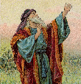
Isaiah 53:3–6
³ “He was despised and forsaken of men, A man of sorrows and acquainted with grief; And like one from whom men hide their face He was despised, and we did not esteem Him. ⁴ Surely our griefs He Himself bore, And our sorrows He carried; Yet we ourselves esteemed Him stricken, Smitten of God, and afflicted. ⁵ But He was pierced through for our . . .

Slide 37
Isaiah 53:3–6
. . .of God, and afflicted. ⁵ But He was pierced through for our transgressions, He was crushed for our iniquities; The chastening for our well-being fell upon Him, And by His scourging we are healed. ⁶ All of us like sheep have gone astray, Each of us has turned to his own way; But the Lord has caused the iniquity of us all To fall on Him.”

Slide 38
Genesis 43:8-10 Judah’s Offer
Request (8)
Surety (9)
Cost of delay (10)

Slide 40
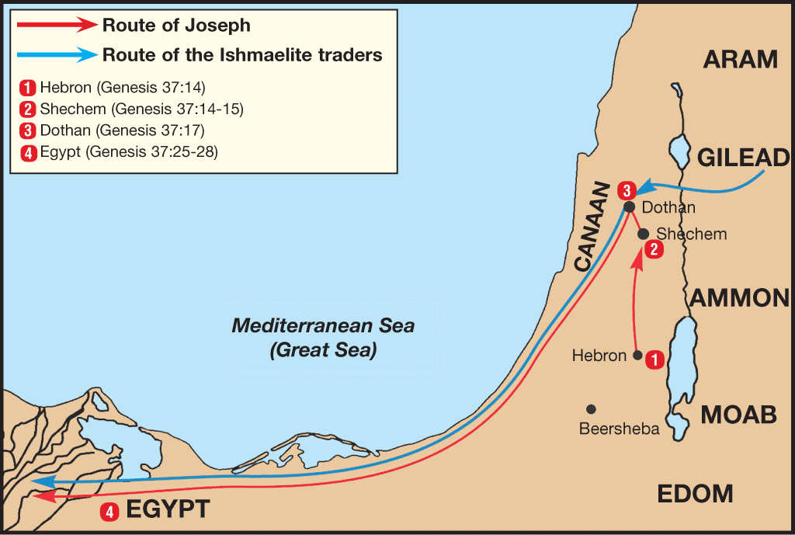

Slide 41
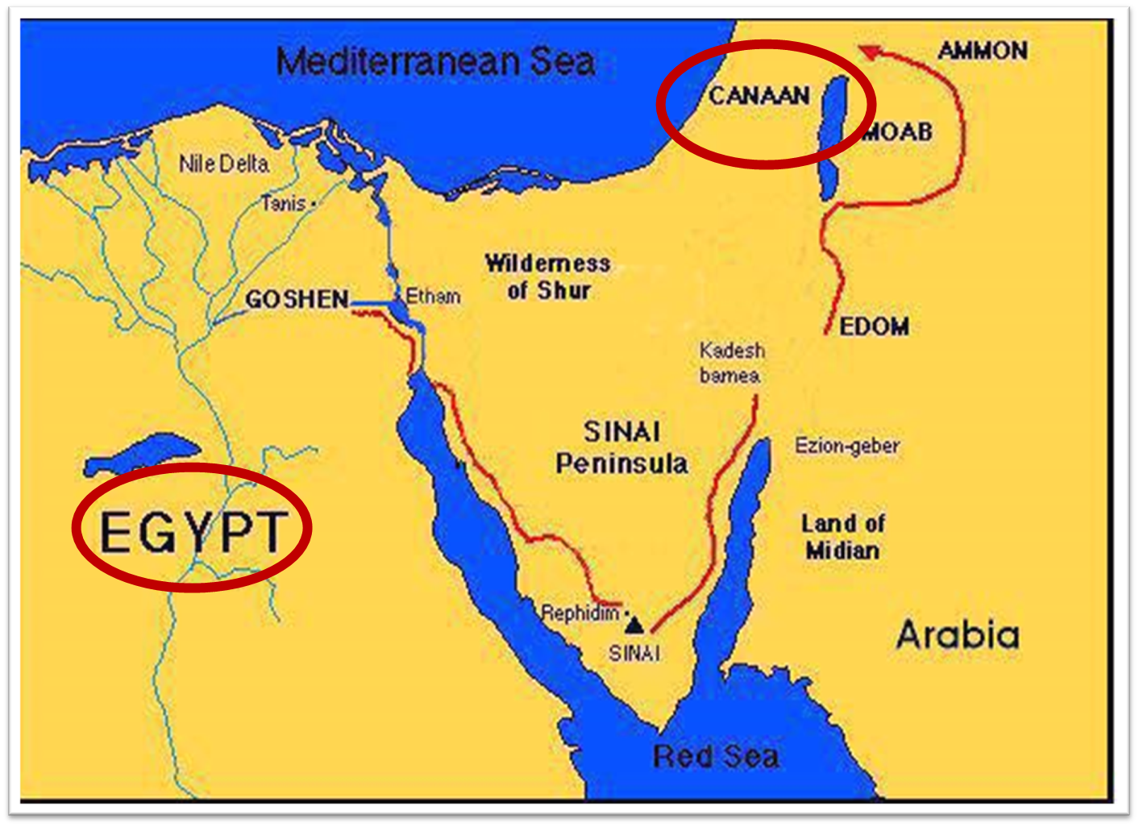

Slide 42
I. Genesis 43:1-14 Jacob Sends his Sons to Egypt
Circumstances (1-2)
Judah’s condition (3-5)
Jacob’s protest (6)
Brothers’ answer (7)
Judah’s offer (8-10)
Jacob’s agreement (11-14)

Slide 43
Genesis 43:11-14 Jacob’s Instructions & Agreement
Instructions (11)
Double money (12)
Relents concerning Benjamin (13)
Prayer & resignation (14)

Slide 44
Genesis 43:11-14 Jacob’s Instructions & Agreement
Instructions (11)
Double money (12)
Relents concerning Benjamin (13)
Prayer & resignation (14)

Slide 45
Genesis 43:11 Instructions
Purpose (11a)
Gifts (11b)

Slide 46
Genesis 43:11 Instructions
Purpose (11a)
Gifts (11b)

Slide 47
Genesis 43:11 Instructions
Purpose (11a)
Gifts (11b)

Slide 48
Dr. Arnold G. Fruchtenbaum
The Book of Genesis, 445
“Now the deceiver is deceived, although the motivations differ from good to bad. This is divine retribution in four ways. First, Isaac’s blindness equals the darkness of Jacob’s wedding night, and neither could see well as a result. Second, this Jacob is deceived by being presented the older for the younger, the reversal of Isaac’s presentation of Jacob for Esau. Third, Isaac thought Jacob was Esau and Jacob thought Leah was Rachel. Fourth, Jacob pretended to be his older brother, while Leah pretended to be her younger sister.”

Slide 49
Galatians 6:7-9
Sowing and Reaping
“Do not be deceived, God is not mocked; for whatever a man sows, this he will also reap. For the one who sows to his own flesh will from the flesh reap corruption, but the one who sows to the Spirit will from the Spirit reap eternal life. Let us not lose heart in doing good, for in due time we will reap if we do not grow weary.”

Slide 50
Genesis 43:11-14 Jacob’s Instructions & Agreement
Instructions (11)
Double money (12)
Relents concerning Benjamin (13)
Prayer & resignation (14)

Slide 51
Genesis 43:11-14 Jacob’s Instructions & Agreement
Instructions (11)
Double money (12)
Relents concerning Benjamin (13)
Prayer & resignation (14)

Slide 54
Genesis 43:11-14 Jacob’s Instructions & Agreement
Instructions (11)
Double money (12)
Relents concerning Benjamin (13)
Prayer & resignation (14)

Slide 55
Genesis 43:14 Prayer & Resignation
Prayer (14a)
Resignation (14b)

Slide 56
Genesis 43:14 Prayer & Resignation
Prayer (14a)
Resignation (14b)

Slide 57
Charles Ryrie
The Ryrie Study Bible, p. 28
“Genesis 17:1 (RSB:NASB1995U): 17:1. God Almighty. Heb., El Shaddai. Shaddai is derived from a related word that means ‘mountain,’ thus picturing God as the overpowering, almighty One, standing on a mountain.”

Slide 60
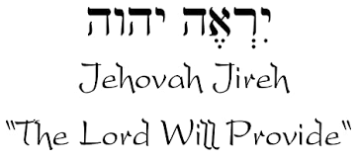

Slide 61
Names for God in Genesis
Elohim (1:1) - Power
Yahweh (2:4) - Relational
El Roi (Gen. 16:13) – Aware
El Shaddai (Gen. 17:1) – Mountainous
El Olam (21:33) – Eternal
Jehovah Jireh (22:14) - Provision
God Isaac Feared (31:42, 53) - Reverenced

Slide 62
Genesis 43:14 Prayer & Resignation
Prayer (14a)
Resignation (14b)

Slide 63
Genesis 43‒45 Second Reunion
Jacob sends sons to Egypt (43:1-14)
Second reunion with Joseph (43:15-34)
Benjamin’s arrest (44:1-17)
Judah’s intercession (44:18-34)
Joseph’s revelation (45:1-15)
Pharaoh’s invitation (45:16-20)
Brothers return to Jacob (45:21-28)

Slide 64
II. Genesis 43:15-34 Second Encounter with Joseph
Departure for Egypt (15)
Brothers & steward (16-25)
Brothers & Joseph (26-34)

Slide 65
II. Genesis 43:15-34 Second Encounter with Joseph
Departure for Egypt (15)
Brothers & steward (16-25)
Brothers & Joseph (26-34)

Slide 66
Genesis 43:15 Departure for Egypt
Departure (15a)
Arrival (15b)

Slide 67
Genesis 43:15 Departure for Egypt
Departure (15a)
Arrival (15b)

Slide 68
Genesis 43:15 Departure for Egypt
Departure (15a)
Arrival (15b)

Slide 72
II. Genesis 43:15-34 Second Encounter with Joseph
Departure for Egypt (15)
Brothers & steward (16-25)
Brothers & Joseph (26-34)

Slide 73
Genesis 43:16-25 Brothers & Steward
Joseph’s instructions (16)
Steward’s obedience (17)
Brothers’ response (18-22)
Steward’s response (23a)
Steward’s preparation (23b-24)
Brothers’ preparation (25)

Slide 74
Genesis 43:16-25 Brothers & Steward
Joseph’s instructions (16)
Steward’s obedience (17)
Brothers’ response (18-22)
Steward’s response (23a)
Steward’s preparation (23b-24)
Brothers’ preparation (25)

Slide 75
Genesis 43:16 Joseph’s Instructions
Occasion (16a)
Instructions (16b)

Slide 76
Genesis 43:16 Joseph’s Instructions
Occasion (16a)
Instructions (16b)

Slide 77
Genesis 43:16 Joseph’s Instructions
Occasion (16a)
Instructions (16b)

Slide 78
Genesis 43:16-25 Brothers & Steward
Joseph’s instructions (16)
Steward’s obedience (17)
Brothers’ response (18-22)
Steward’s response (23a)
Steward’s preparation (23b-24)
Brothers’ preparation (25)

Slide 79
Genesis 43:16-25 Brothers & Steward
Joseph’s instructions (16)
Steward’s obedience (17)
Brothers’ response (18-22)
Steward’s response (23a)
Steward’s preparation (23b-24)
Brothers’ preparation (25)

Slide 80
Genesis 43:18-22 Brother’s Response
Fear (18)
Approach (19)
Explanation (20-22)

Slide 81
Genesis 43:18-22 Brother’s Response
Fear (18)
Approach (19)
Explanation (20-22)

Slide 82
Genesis 43:18-22 Brother’s Response
Fear (18)
Approach (19)
Explanation (20-22)

Slide 83
Genesis 43:18-22 Brother’s Response
Fear (18)
Approach (19)
Explanation (20-22)

Slide 84
Genesis 43:20-22 Explanation
1st trip’s purpose (20)
Discovery (21a)
Double money (21b-22a)
Ignorance (22b)

Slide 85
Genesis 43:20-22 Explanation
1st trip’s purpose (20)
Discovery (21a)
Double money (21b-22a)
Ignorance (22b)

Slide 86
Genesis 43:20-22 Explanation
1st trip’s purpose (20)
Discovery (21a)
Double money (21b-22a)
Ignorance (22b)

Slide 87
Genesis 43:20-22 Explanation
1st trip’s purpose (20)
Discovery (21a)
Double money (21b-22a)
Ignorance (22b)

Slide 88
Genesis 43:21b-22a Double Money
Old money (21a)
New money (22b)

Slide 89
Genesis 43:21b-22a Double Money
Old money (21a)
New money (22b)

Slide 90
Genesis 43:21b-22a Double Money
Old money (21a)
New money (22b)

Slide 91
Genesis 43:20-22 Explanation
1st trip’s purpose (20)
Discovery (21a)
Double money (21b-22a)
Ignorance (22b)

Slide 92
Genesis 43:16-25 Brothers & Steward
Joseph’s instructions (16)
Steward’s obedience (17)
Brothers’ response (18-22)
Steward’s response (23a)
Steward’s preparation (23b-24)
Brothers’ preparation (25)

Slide 93
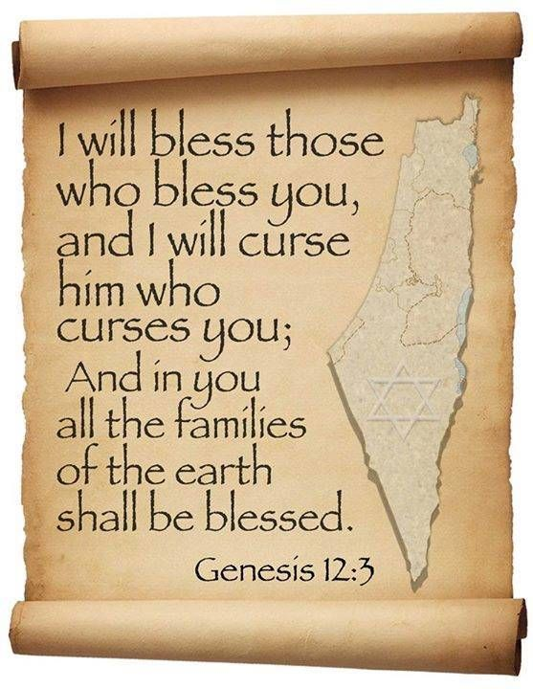
Genesis 12:3
“And I will bless those who bless you, And the one who curses you I will curse. And in you all the families of the earth will be blessed.”

Slide 94
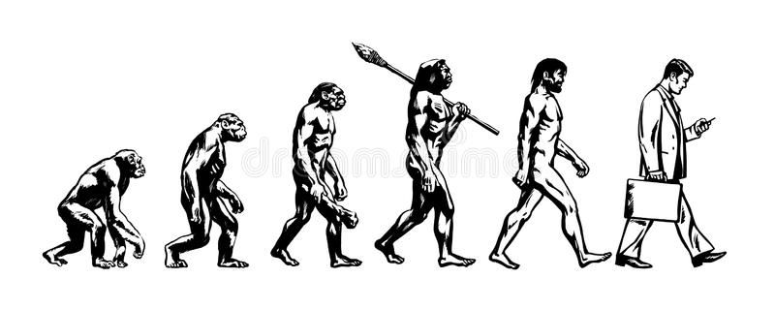

Slide 95
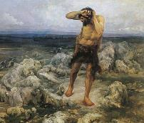
Ungodly Line of Cain (Gen 4:16-24)
Evil line that will not bring forth the Messiah (Gen 3:15)
Continuation of Cain’s line (4:16-18)
Immorality (4:19)
Technological but not spiritual advancement (4:20-22)
Violence (4:23-24)

Slide 96
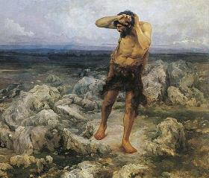
Technological Advancement Genesis 4:17-22
City – Gen. 4:17
Livestock – Gen. 4:20
Music – Gen. 4:21
Metallurgy – Gen. 4:22

Slide 97
Genesis 5:1-2
“¹ This is the book of the generations of Adam. In the day when God created man, He made him in the likeness of God. ² He created them male and female, and He blessed them and named them Man in the day when they were created.”

Slide 98
Dr. Henry M. Morris
The Genesis Record, 147-48
“Musical instruments, another important aspect of modern culture, were also an early development. All of these things, in addition, confirm the necessary coexistence of a written language for formal communications. This is further intimated by use of the word ‘book’ in Genesis 5:1. More and more modern archaeological discoveries today are verifying the high degree of technology possessed by the earliest men, thus indirectly validating this Biblical testimony.”

Slide 99
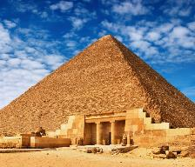
The Genius of Ancient Man (Gen 4:19)
The Palace at Knossos on Crete
La Bastida in Spain
The Great Pyramids of Egypt
The Stonehenge of England
The Great Wall of China
The architecture of the Incas
Landis, Don. "Ancient Man ‒ Genius or Primitive?" In Searching for Adam: Genesis & the Truth About Man's Origin, edited by Terry Mortenson, 415-44. Green Forest, AR: Master Books, 2016.

Slide 100
Genesis 43:16-25 Brothers & Steward
Joseph’s instructions (16)
Steward’s obedience (17)
Brothers’ response (18-22)
Steward’s response (23a)
Steward’s preparation (23b-24)
Brothers’ preparation (25)

Slide 101
Genesis 43:23b-24 Steward’s Preparations
Return of Simeon (23b)
Brothers’ welfare (24)

Slide 102
Genesis 43:23b-24 Steward’s Preparations
Return of Simeon (23b)
Brothers’ welfare (24)

Slide 105
Genesis 43:23b-24 Steward’s Preparations
Return of Simeon (23b)
Brothers’ welfare (24)

Slide 106
Genesis 43:16-25 Brothers & Steward
Joseph’s instructions (16)
Steward’s obedience (17)
Brothers’ response (18-22)
Steward’s response (23a)
Steward’s preparation (23b-24)
Brothers’ preparation (25)

Slide 107
II. Genesis 43:15-34 Second Encounter with Joseph
Departure for Egypt (15)
Brothers & steward (16-25)
Brothers & Joseph (26-34)

Slide 108
Genesis 43:26-34 Joseph Encounters His Brothers
Joseph’s arrival (26)
Joseph’s questions (27)
Brothers’ response (28)
Joseph & Benjamin (29-30)
Feast (31-34)

Slide 109
Genesis 43:26-34 Joseph Encounters His Brothers
Joseph’s arrival (26)
Joseph’s questions (27)
Brothers’ response (28)
Joseph & Benjamin (29-30)
Feast (31-34)

Slide 110
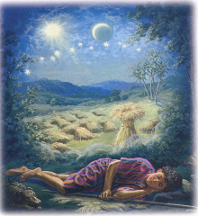
Genesis 37:9
Now he had still another dream, and related it to his brothers, and said, “Lo, I have had still another dream; and behold, the sun and the moon and eleven stars were bowing down to me.”

Slide 111
Genesis 37:10
He related it to his father and to his brothers; and his father rebuked him and said to him, “What is this dream that you have had? Shall I and your mother and your brothers actually come to bow ourselves down before you to the ground?”

Slide 112
Sun = Jacob
Moon = Leah
11 Stars = Joseph’s brothers
12th Star = Joseph
12 Stars = Israel’s twelve tribes

Slide 113
John 13:19; 14:29
“^{13:19} From now on I am telling you before it comes to pass, so that when it does occur, you may believe that I am He… ^{14:29} Now I have told you before it happens, so that when it happens, you may believe.”

Slide 114
What Happened to Christ’s Disciples?
Disciple | Place | Martyrdom
James the Son of Alpheus | Jerusalem | Clubbed to death
Simon the Zealot | Jerusalem | Martyred
James the Son of Zebedee | Judea (Acts 12:2) | Executed
Thaddeus | Mesopotamia | Beaten to death
Peter | Babylon, Rome | Crucified upside down
Matthew | Parthia (Tehran) | Beheaded
Notes:
109 prophecies…
Peter Stoner – SCIENCE SPEAKS, An Evaluation of Certain Christian Evidences
To fulfill just 8 prophecies =1 X 10 to the twenty-eighth power!
Can we visualize this with an illustration? Suppose we took an atheistic professor, blindfolded him and covered the state of Texas two feet deep with silver dollars. Then we put a check on one of those silver dollars and mixed them up. The odds of one person fulfilling just these eight prophecies would be the same as this atheistic professor selecting the silver dollar upon which we have placed a check, in his first try.
https://www.bereanpublishers.com/the-odds-of-eight-messianic-prophecies-coming-true/

Slide 115
What Happened to Christ’s Disciples?
Disciple | Place | Martyrdom
John | Asia Minor, Patmos, Ephesus | Fried in boiling oil
Philip | E. Turkey | Tortured & crucified
Thomas | India | Speared
Bartholomew | India | Flayed & crucified
Andrew | Ukraine, Russia, Greece | Hanged
Notes:
109 prophecies…
Peter Stoner – SCIENCE SPEAKS, An Evaluation of Certain Christian Evidences
To fulfill just 8 prophecies =1 X 10 to the twenty-eighth power!
Can we visualize this with an illustration? Suppose we took an atheistic professor, blindfolded him and covered the state of Texas two feet deep with silver dollars. Then we put a check on one of those silver dollars and mixed them up. The odds of one person fulfilling just these eight prophecies would be the same as this atheistic professor selecting the silver dollar upon which we have placed a check, in his first try.
https://www.bereanpublishers.com/the-odds-of-eight-messianic-prophecies-coming-true/

Slide 117
Genesis 43:26-34 Joseph Encounters His Brothers
Joseph’s arrival (26)
Joseph’s questions (27)
Brothers’ response (28)
Joseph & Benjamin (29-30)
Feast (31-34)

Slide 118
Genesis 43:26-34 Joseph Encounters His Brothers
Joseph’s arrival (26)
Joseph’s questions (27)
Brothers’ response (28)
Joseph & Benjamin (29-30)
Feast (31-34)

Slide 119
Genesis 43:26-34 Joseph Encounters His Brothers
Joseph’s arrival (26)
Joseph’s questions (27)
Brothers’ response (28)
Joseph & Benjamin (29-30)
Feast (31-34)

Slide 120
Genesis 43:29-30 Joseph & Benjamin
Benjamin identified (29)
Joseph’s reaction (30)

Slide 121
Genesis 43:29-30 Joseph & Benjamin
Benjamin identified (29)
Joseph’s reaction (30)

Slide 124
Genesis 43:29-30 Joseph & Benjamin
Benjamin identified (29)
Joseph’s reaction (30)

Slide 125
Luke 19:41-44
^{41 “}When He approached Jerusalem, He saw the city and wept over it, ⁴² saying, “If you had known in this day, even you, the things which make for peace! But now they have been hidden from your eyes. ⁴³ For the days will come upon you when your enemies will throw up a barricade against you, and surround you and hem you in on every side, ⁴⁴ and they will level you to the ground and your children within you, and they will not leave in you one stone upon another, because you did not recognize the time of your visitation.”

Slide 126
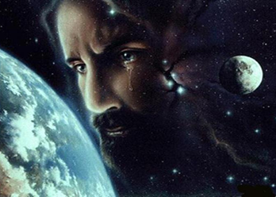
Christ’s Human Experiences
Labor (Mark 6:3)
Distress (Luke 22:44)
Being troubled (John 12:27)
Thirst (John 19:28)
Hunger (Matt 4:2)
Fatigue (John 4:6)
Sadness (John 11:35)
Lack of understanding (Matt 24:36)
Temptation (Luke 4:1-13; Heb. 4:15)

Slide 127
Hebrews 2:18
“For since He Himself was tempted in that which He has suffered, He is able to come to the aid of those who are tempted.”

Slide 128
Hebrews 4:15-16
^{15 “}For we do not have a high priest who cannot sympathize with our weaknesses, but One who has been tempted in all things as we are, yet without sin. ¹⁶ Therefore let us draw near with confidence to the throne of grace, so that we may receive mercy and find grace to help in time of need.”

Slide 129
Zechariah 12:10
“I will pour out on the house of David and on the inhabitants of Jerusalem, the Spirit of grace and of supplication, so that they will look on Me whom they have pierced; and they will mourn for Him, as one mourns for an only son, and they will weep bitterly over Him like the bitter weeping over a firstborn.”

Slide 130
Genesis 43:26-34 Joseph Encounters His Brothers
Joseph’s arrival (26)
Joseph’s questions (27)
Brothers’ response (28)
Joseph & Benjamin (29-30)
Feast (31-34)

Slide 131
Genesis 43:31-34 Feast
Joseph’s preparations (31)
Three separations (32)
Seating arrangement (33)
Food serving (34)

Slide 132
Genesis 43:31-34 Feast
Joseph’s preparations (31)
Three separations (32)
Seating arrangement (33)
Food serving (34)

Slide 133
Genesis 43:31 Joseph’s Preparations
Washing (31a)
Command (31b)

Slide 134
Genesis 43:31 Joseph’s Preparations
Washing (31a)
Command (31b)

Slide 135
Genesis 43:31 Joseph’s Preparations
Washing (31a)
Command (31b)

Slide 136
Genesis 43:31-34 Feast
Joseph’s preparations (31)
Three separations (32)
Seating arrangement (33)
Food serving (34)

Slide 137
Genesis 43:32 Three Separations
Joseph (32a)
Brothers (32b)
Egyptians (32c)
Reason (32d)

Slide 138
Genesis 43:32 Three Separations
Joseph (32a)
Brothers (32b)
Egyptians (32c)
Reason (32d)

Slide 139
Genesis 43:32 Three Separations
Joseph (32a)
Brothers (32b)
Egyptians (32c)
Reason (32d)

Slide 140
Genesis 43:32 Three Separations
Joseph (32a)
Brothers (32b)
Egyptians (32c)
Reason (32d)

Slide 141
Dr. Arnold G. Fruchtenbaum
The Book of Genesis, 588
“The reason for these separations was: because the Egyptians might not eat bread with the Hebrews. These are native Egyptians, not Hyksos, for that is an abomination unto the Egyptians to eat with Semites; and that was true with all Semites. The Hebrews were Semites.”

Slide 142
Genesis 43:32 Three Separations
Joseph (32a)
Brothers (32b)
Egyptians (32c)
Reason (32d)

Slide 143
Genesis 43:31-34 Feast
Joseph’s preparations (31)
Three separations (32)
Seating arrangement (33)
Food serving (34)

Slide 144
Genesis 43:33 Seating Arrangement
According to birth order (33a)
Reaction (33b)

Slide 145
Genesis 43:33 Seating Arrangement
According to birth order (33a)
Reaction (33b)

Slide 148
Genesis 43:33 Seating Arrangement
According to birth order (33a)
Reaction (33b)

Slide 149
Genesis 43:31-34 Feast
Joseph’s preparations (31)
Three separations (32)
Seating arrangement (33)
Food serving (34)

Slide 150
Genesis 43:34 Food Serving
Test (34a)
Test passed (34b)

Slide 151
Genesis 43:34 Food Serving
Test (34a)
Test passed (34b)

Slide 152
Genesis 43:34 Food Serving
Test (34a)
Test passed (34b)

Slide 153
1 Corinthians 6:9–11
⁹ Or do you not know that the unrighteous will not inherit the kingdom of God? Do not be deceived; neither fornicators, nor idolaters, nor adulterers, nor effeminate, nor homosexuals, ¹⁰ nor thieves, nor the covetous, nor drunkards, nor revilers, nor swindlers, will inherit the kingdom of God. ¹¹ Such were some of you; but you were washed, but you were sanctified, but you were justified in the name of the Lord Jesus Christ and in the Spirit of our God.

Slide 154
Conclusion

Slide 155
Genesis 37‒50 Joseph
Joseph sold unto Egypt (37)
Canaan’s corruption (38)
Joseph falsely accused (39)
Joseph’s short-term predictions (40)
Joseph’s elevation (41)
Joseph’s first reunion with his brothers (42)
Joseph’s second reunion with his brothers (43‒45)

Slide 156
Genesis 43‒45 Second Reunion
Jacob sends sons to Egypt (43:1-14)
Second reunion with Joseph (43:15-34)
Benjamin’s arrest (44:1-17)
Judah’s intercession (44:18-34)
Joseph’s revelation (45:1-15)
Pharaoh’s invitation (45:16-20)
Brothers return to Jacob (45:21-28)

Slide 157
I. Genesis 43:1-14 Jacob Sends his Sons to Egypt
Circumstances (1-2)
Judah’s condition (3-5)
Jacob’s protest (6)
Brothers’ answer (7)
Judah’s offer (8-10)
Jacob’s agreement (11-14)

Slide 158
Genesis 43‒45 Second Reunion
Jacob sends sons to Egypt (43:1-14)
Second reunion with Joseph (43:15-34)
Benjamin’s arrest (44:1-17)
Judah’s intercession (44:18-34)
Joseph’s revelation (45:1-15)
Pharaoh’s invitation (45:16-20)
Brothers return to Jacob (45:21-28)

Slide 159
II. Genesis 43:15-34 Second Encounter with Joseph
Departure for Egypt (15)
Brothers & steward (16-25)
Brothers & Joseph (26-34)

Slide 160
²⁴ The Lord bless you, and keep you; ²⁵ The Lord make His face shine on you, And be gracious to you; ²⁶ The Lord lift up His countenance on you, And give you peace.
Numbers 6:24–26 (NASB95)

