Slide 1


Dr. Andy Woods
Senior Pastor – Sugar Land Bible Church
President – Chafer Theological Seminary

Slide 2

Structure
1 – Commendation
2 – Correction
3 – Consequences

Slide 3
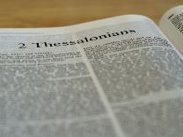
2 Thessalonians 2:1-12
Problem (2:1-2)
Prerequisites for the Day of the Lord (2:3-12)
  The departure (2:3a)
  Advent of the lawless one (2:3b-4)
  Removal of the restrainer (2:5-7)
  Destruction of the lawless one (2:8-9)
  Destruction of lawless one’s followers (2:10-12)

Slide 4
Structure
1 – Commendation
2 – Correction
3 – Consequences

Slide 5
Consequences of Poor Doctrine (3)
Reciprocal prayer (3:1-5)
Exhortation to discipline the idle (3:6-15)
Conclusion (3:16-18)

Slide 6

2 Thessalonians 3:6-15
Discipline the Idle
  Exhortation (6)
  Better example (7-9)
  Reason (10-11)
  Lazy must work (12)
  Patience needed (13)
  Discipline procedure (14-15)

Slide 7

Divine Judgments
(3:14-19)
  Serpent (3:14-15)
  Woman (3:16)
  Man (3:17-19)

Slide 8
Man
(3:17-19)
  Painful labor (3:17-19a)
  Death (3:19b)

Slide 9

Genesis 3:17-19a
¹⁷ Then to Adam He said, “Because you have listened to the voice of your wife, and have eaten from the tree about which I commanded you, saying, ‘You shall not eat from it’; Cursed is the ground because of you; In toil you will eat of it All the days of your life. ¹⁸ “Both thorns and thistles it shall grow for you; And you will eat the plants of the field; ¹⁹ By the sweat of your face You will eat bread...”

Slide 10
Romans 8:19-22
¹⁹ For the anxious longing of the creation waits eagerly for the revealing of the sons of God. ²⁰ For the creation was subjected to futility, not willingly, but because of Him who subjected it, in hope ²¹ that the creation itself also will be set free from its slavery to corruption into the freedom of the glory of the children of God. ²² For we know that the whole creation groans and suffers the pains of childbirth together until now.

Slide 11
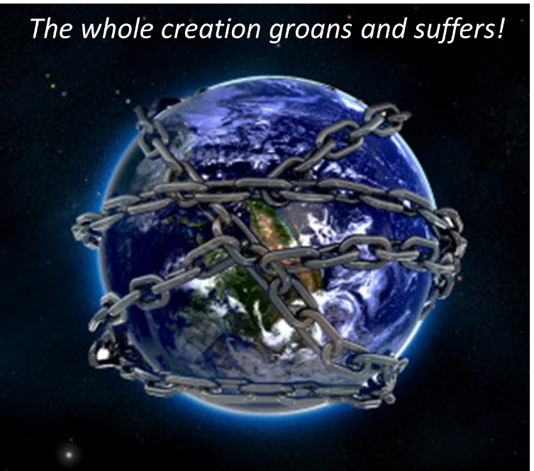

Slide 12
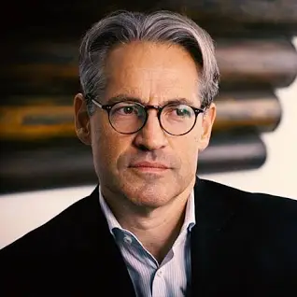
Eric Metaxas
The Eric Metaxas Show on TBN which aired on January 9, 20024. Eric Metaxas interviewed author Benjamin Thomas about his book “Revelation Riddle: Kingdom Age of the Saints, End Times for the New World Order.” The video is titled "Dangerous END TIMES Doctrines & The Spiritual Battle Against The Deep State.”
“[rescue Rapture Doctrine]…they think Jesus is going to rescue them. On the other hand there are a lot of people l've met that they're almost psyched to see the world go to hell. They're almost psyched to see everything get worse, like haha judgment is coming, instead of being moved by compassion to help those who might be helped. They're kind of glad to see it go downhill…and a lot of people who have this rescue Rapture rescue mentality…they're kind of like we we're happy to see America go down the tubes…and they're not even slightly patriotic thinking what can I do to help my nation stand for God's principles…I'm just about Jesus.”

Slide 13


Slide 14
Eric Metaxas
The Eric Metaxas Show on TBN which aired on January 9, 20024. Eric Metaxas interviewed author Benjamin Thomas about his book “Revelation Riddle: Kingdom Age of the Saints, End Times for the New World Order.” The video is titled "Dangerous END TIMES Doctrines & The Spiritual Battle Against The Deep State.”
“Let's call it what it is folks. It’s bad Theology. And by the way I want to be very clear. I say this in all my speeches. Bad theology to be clear is from the pit of Hell. It's Satan's theology. It's not like all B minus theology. It's from the pit of Hell.”

Slide 15

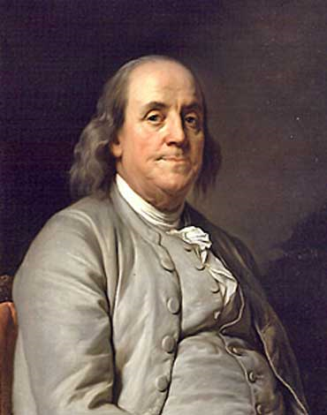
Benjamin Franklin
At the close of the Constitutional Convention of 1787, when queried as he left Independence Hall on the final day of deliberation (in the notes of Dr. James McHenry, one of Maryland’s delegates to the Convention) a lady asked Dr. Benjamin Franklin, “Well Doctor what have we got a republic or a monarchy?” Franklin responded, “A republic replied the Doctor if you can keep it.”
The Records of the Federal Convention of 1787, ed. Max Farrand,
vol. 3, appendix A, p. 85 (1911, reprinted 1934).

Slide 16
2 Thessalonians 3:6-15
Discipline the Idle
  Exhortation (6)
  Better example (7-9)
  Reason (10-11)
  Lazy must work (12)
  Patience needed (13)
  Discipline procedure (14-15)

Slide 17
Genesis 3:17-19a
¹⁷ Then to Adam He said, “Because you have listened to the voice of your wife, and have eaten from the tree about which I commanded you, saying, ‘You shall not eat from it’; Cursed is the ground because of you; In toil you will eat of it All the days of your life. ¹⁸ “Both thorns and thistles it shall grow for you; And you will eat the plants of the field; ¹⁹ By the sweat of your face You will eat bread...”

Slide 18
2 Thessalonians 3:6-15
Discipline the Idle
  Exhortation (6)
  Better example (7-9)
  Reason (10-11)
  Lazy must work (12)
  Patience needed (13)
  Discipline procedure (14-15)

Slide 19

1 Corinthians 3:1-3 (NKJV)
¹ And I, brethren, could not speak to you as to spiritual people but as to carnal, as to babes in Christ. ² I fed you with milk and not with solid food; for until now you were not able to receive it, and even now you are still not able; ³ for you are still carnal. For where there are envy, strife, and divisions among you, are you not carnal and behaving like mere men?

Slide 20
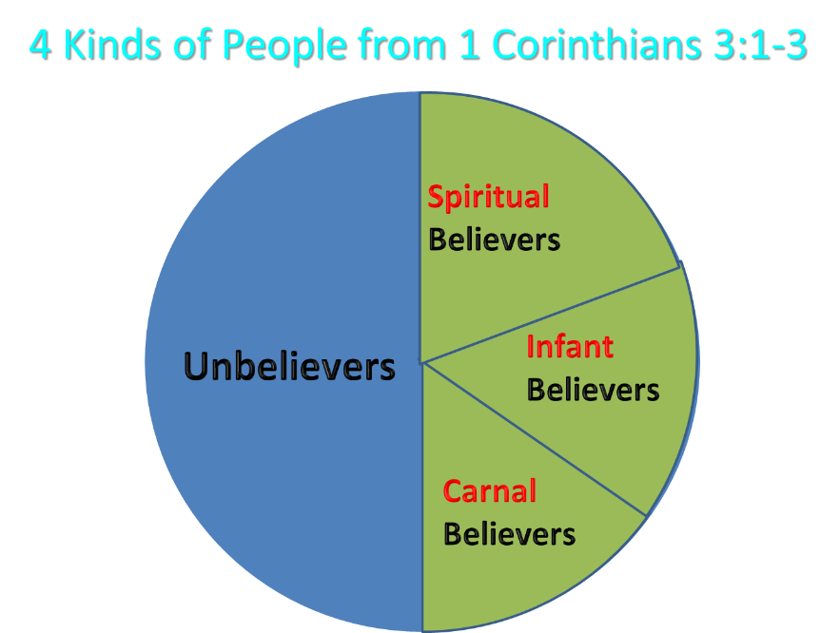
Notes:
Ray Steadman – “1st Californians”
Unbelievers vs Categories of Believers
Unbelievers – ψυχικός psuchikós; Natural, pertaining to the natural as distinguished from the spiritual
Spiritual Believers – πνευματικός pneumatikós; of persons who are spiritual, enlightened by the Holy Spirit
Infant Believers – σάρκινος sárkinos; with propensities of the flesh unto sin; νήπιος nḗpios; an infant, child, baby without any definite limitation of age. (This relates to immaturity and lack of instruction)
Carnal Believers – σαρκικός sarkikós; tendency to satisfy the flesh, implying sinfulness, sinful propensity, carnal (This relates to disobedience and open rebellion)

Slide 21

Galatians 6:7-9
God Blesses His Truth
“Do not be deceived, God is not mocked; for whatever a man sows, this he will also reap. For the one who sows to his own flesh will from the flesh reap corruption, but the one who sows to the Spirit will from the Spirit reap eternal life. Let us not lose heart in doing good, for in due time we will reap if we do not grow weary.”

Slide 22
2 Thessalonians 3:6-15
Discipline the Idle
  Exhortation (6)
  Better example (7-9)
  Reason (10-11)
  Lazy must work (12)
  Patience needed (13)
  Discipline procedure (14-15)

Slide 23
2 Thessalonians 3:14-15
Discipline Procedure
  Negative: disassociation & shame (14)
  Positive: disciplinee = a brother (15)

Slide 24
2 Thessalonians 3:14-15
Discipline Procedure
  Negative: disassociation & shame (14)
  Positive: disciplinee = a brother (15)

Slide 25

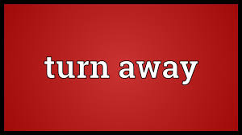
Romans 16:17
“Now I urge you, brethren, keep your eye on those who cause dissensions and hindrances contrary to the teaching which you learned, and turn away from them.”

Slide 26
Romans 16:17 (KJV)
“Now I beseech you, brethren, mark them which cause divisions and offences contrary to the doctrine which ye have learned; and avoid them.”

Slide 27

  Biblical Basis for Separation?
2 Thess. 3:6, 14
1 Cor. 5:11
2 Cor. 6:14-18
Rom. 16:17
Eph. 5:11
Titus 3:9-11
2 John 9-11

Slide 28
Romans 16:17
“Now I urge you, brethren, keep your eye on those who cause dissensions and hindrances contrary to the teaching which you learned, and turn away from them.”

Slide 29
Romans 16:17 (KJV)
“Now I beseech you, brethren, mark them which cause divisions and offences contrary to the doctrine which ye have learned; and avoid them.”

Slide 30
Ephesians 5:11
“Do not participate (synkoinōneō) in the unfruitful deeds of darkness, but instead even expose them.”

Slide 31

2 John 7-11
“⁷ For many deceivers have gone out into the world, those who do not acknowledge Jesus Christ as coming in the flesh. This is the deceiver and the antichrist. ⁸ Watch yourselves, that you do not lose what we have accomplished, but that you may receive a full reward. ⁹ Anyone who goes too far and does not abide in the teaching of Christ, does not have God; the one who abides in the teaching, he has both the Father and the Son. ¹⁰ If anyone comes to you and does not bring this teaching, do not receive him into your house, and do not give him a greeting; ¹¹ for the one who gives him a greeting participates in his evil deeds.”

Slide 32
Purity of the Church
Ecclesiastical separation
Church discipline

Slide 33

Church Discipline
Command (1 Cor 5:13)
Reason (Gal 5:9)
Offenses meriting discipline
Procedure (Matt 18:15-17)
Goal (2 Thess 3:14-15)

Slide 34
Church Discipline
Command (1 Cor 5:13)
Reason (Gal 5:9)
Offenses meriting discipline
Procedure (Matt 18:15-17)
Goal (2 Thess 3:14-15)

Slide 35
Church Discipline
Command (1 Cor 5:13)
Reason (Gal 5:9)
Offenses meriting discipline
Procedure (Matt 18:15-17)
Goal (2 Thess 3:14-15)

Slide 36
Church Discipline
Command (1 Cor 5:13)
Reason (Gal 5:9)
Offenses meriting discipline
Procedure (Matt 18:15-17)
Goal (2 Thess 3:14-15)

Slide 37
Offenses Meriting Discipline
Disobedience – 2 Thess. 3:6, 14-15
Immorality – 1 Cor. 5:9-11, 13
Divisiveness – Rom. 16:17-18

Slide 38
Romans 16:17
“Now I urge you, brethren, keep your eye on those who cause dissensions and hindrances contrary to the teaching which you learned, and turn away from them.”

Slide 39
Romans 16:17 (KJV)
“Now I beseech you, brethren, mark them which cause divisions and offences contrary to the doctrine which ye have learned; and avoid them.”

Slide 40
Church Discipline
Command (1 Cor 5:13)
Reason (Gal 5:9)
Offenses meriting discipline
Procedure (Matt 18:15-17)
Goal (2 Thess 3:14-15)

Slide 41
Church Discipline
Command (1 Cor 5:13)
Reason (Gal 5:9)
Offenses meriting discipline
Procedure (Matt 18:15-17)
Goal (2 Thess 3:14-15)

Slide 42
2 Thessalonians 3:14-15
Discipline Procedure
  Negative: disassociation & shame (14)
  Positive: disciplinee = a brother (15)

Slide 43
Conclusion

Slide 44
Consequences of Poor Doctrine (3)
Reciprocal prayer (3:1-5)
Exhortation to discipline the idle (3:6-15)
Conclusion (3:16-18)

Slide 45
2 Thessalonians 3:6-15
Discipline the Idle
  Exhortation (6)
  Better example (7-9)
  Reason (10-11)
  Lazy must work (12)
  Patience needed (13)
  Discipline procedure (14-15)

Slide 46
Consequences of Poor Doctrine (3)
Reciprocal prayer (3:1-5)
Exhortation to discipline the idle (3:6-15)
Conclusion (3:16-18)

