Slide 1
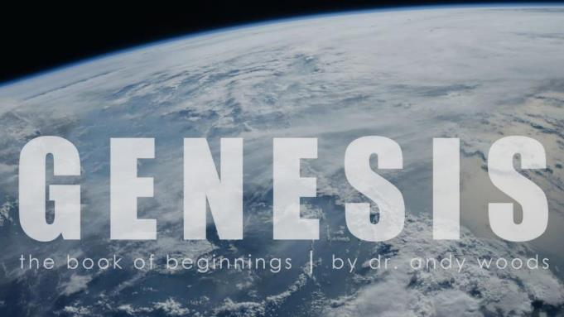
Genesis 12‒50
Israel’s Birth & Preservation

Slide 2
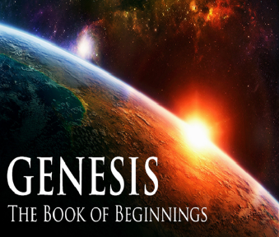
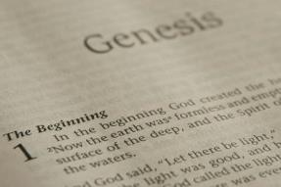
GENESIS STRUCTURE
Genesis 12-50 (four people)
Abraham (12:1–25:11)
Isaac (25:12–26:35)
Jacob (27–36)
Joseph (37–50)

Slide 3
Genesis 37‒50 Joseph
Joseph sold unto Egypt (37)
Canaan’s corruption (38)
Joseph falsely accused (39)
Joseph’s short-term predictions (40)
Joseph’s elevation (41)
Joseph’s first reunion with his brothers (42)

Slide 4
Genesis 42:1-38 First Reunion
Jacob’s sons sent to Egypt (42:1-5)
First reunion (42:6-17)
Change of plans (42:18-25)
Brothers return to Canaan (42:26-38)

Slide 5
IV. Genesis 42:26-38 Brothers Return to Canaan
Return (26)
Brother’s first discovery (27-28)
Report to Jacob (29-34)
Brother’s second discovery (35)
Jacob’s reaction (36)
Reuben’s offer (37)
Jacob’s refusal (38)

Slide 6
Genesis 42:27-28 Brothers’ First Discovery
Discovery (27)
Report (28a)
Reaction (28b)

Slide 7
Genesis 42:27-28 Brothers’ First Discovery
Discovery (27)
Report (28a)
Reaction (28b)

Slide 8
Genesis 42:27-28 Brothers’ First Discovery
Discovery (27)
Report (28a)
Reaction (28b)

Slide 9
Genesis 42:27-28 Brothers’ First Discovery
Discovery (27)
Report (28a)
Reaction (28b)

Slide 10
IV. Genesis 42:26-38 Brothers Return to Canaan
Return (26)
Brother’s first discovery (27-28)
Report to Jacob (29-34)
Brother’s second discovery (35)
Jacob’s reaction (36)
Reuben’s offer (37)
Jacob’s refusal (38)

Slide 11
Genesis 42:29-34 Report to Jacob
Return (29)
Accusation (30)
Denial (31-32)
Test (33-34)

Slide 12
Genesis 42:29-34 Report to Jacob
Return (29)
Accusation (30)
Denial (31-32)
Test (33-34)

Slide 14
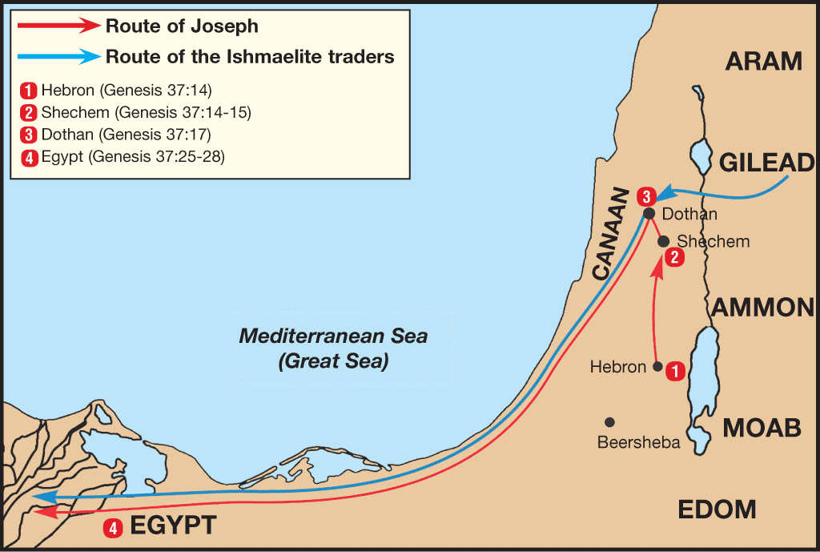

Slide 15
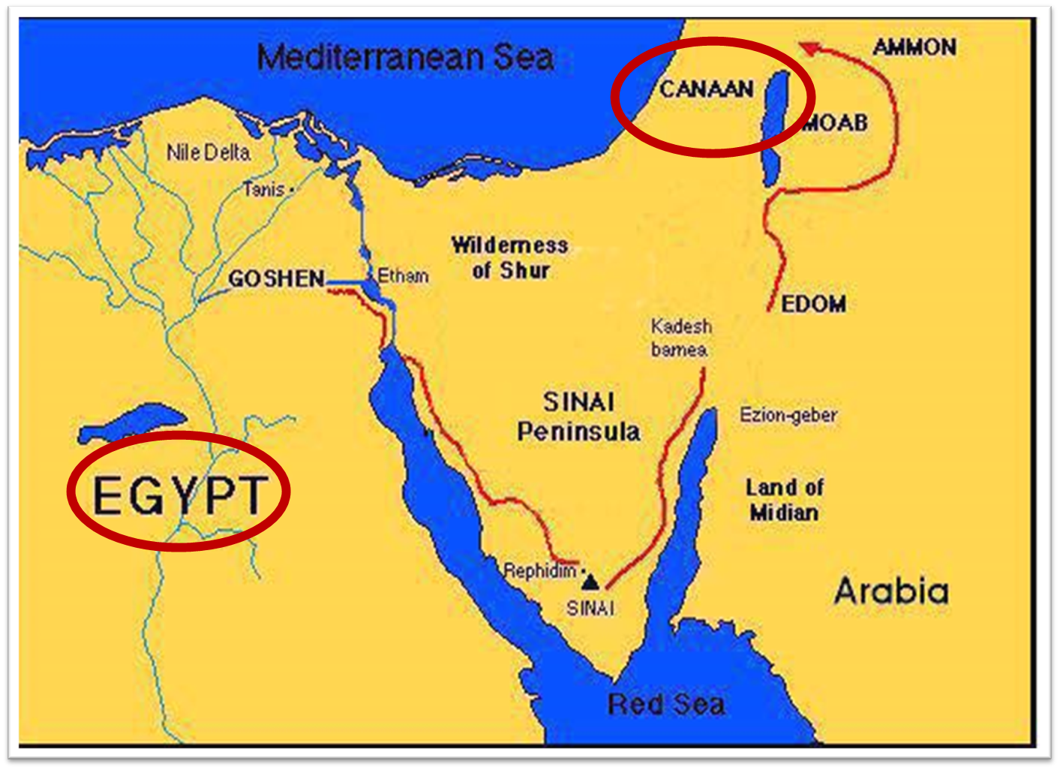

Slide 16
Genesis 42:29-34 Report to Jacob
Return (29)
Accusation (30)
Denial (31-32)
Test (33-34)

Slide 17
Genesis 42:29-34 Report to Jacob
Return (29)
Accusation (30)
Denial (31-32)
Test (33-34)

Slide 19
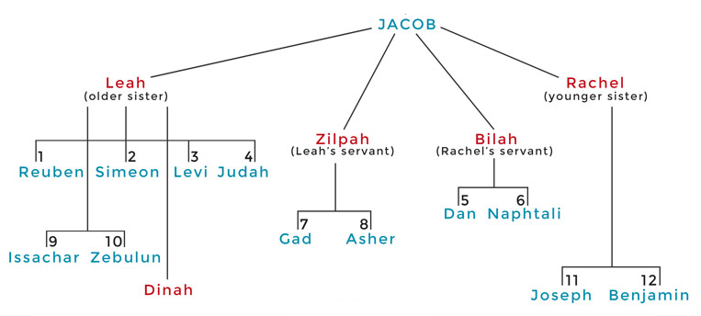

Slide 20
Genesis 42:29-34 Report to Jacob
Return (29)
Accusation (30)
Denial (31-32)
Test (33-34)

Slide 21
IV. Genesis 42:26-38 Brothers Return to Canaan
Return (26)
Brother’s first discovery (27-28)
Report to Jacob (29-34)
Brother’s second discovery (35)
Jacob’s reaction (36)
Reuben’s offer (37)
Jacob’s refusal (38)

Slide 22
Genesis 42:35 Brothers’ Second Discovery
Timing (35a)
Reaction (35b)

Slide 23
Genesis 42:35 Brothers’ Second Discovery
Timing (35a)
Reaction (35b)

Slide 24
Genesis 42:35 Brothers’ Second Discovery
Timing (35a)
Reaction (35b)

Slide 25
IV. Genesis 42:26-38 Brothers Return to Canaan
Return (26)
Brother’s first discovery (27-28)
Report to Jacob (29-34)
Brother’s second discovery (35)
Jacob’s reaction (36)
Reuben’s offer (37)
Jacob’s refusal (38)

Slide 28
IV. Genesis 42:26-38 Brothers Return to Canaan
Return (26)
Brother’s first discovery (27-28)
Report to Jacob (29-34)
Brother’s second discovery (35)
Jacob’s reaction (36)
Reuben’s offer (37)
Jacob’s refusal (38)

Slide 31
Ephesians 4:11-16
“¹¹ And He gave some as apostles, and some as prophets, and some as evangelists, and some as pastors and teachers, ¹² for the equipping of the saints for the work of service, to the building up of the body of Christ; “¹³ until we all attain to the unity of the faith, and of the knowledge of the Son of God, to a mature man, to the measure of the stature which belongs to the . . .

Slide 32
Ephesians 4:11-16
…fullness of Christ. ¹⁴ As a result, we are no longer to be children, tossed here and there by waves and carried about by every wind of doctrine, by the trickery of men, by craftiness in deceitful scheming;” ¹⁵ but speaking the truth in love, we are to grow up in all aspects into Him who is the head, even Christ, ¹⁶ from whom the whole body, being fitted and held together by what every . . .

Slide 33
Ephesians 4:11-16
...joint supplies, according to the proper working of each individual part, causes the growth of the body for the building up of itself in love.”

Slide 34
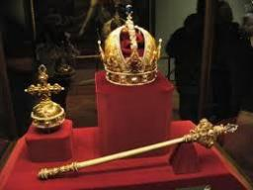
Genesis 49:10
“The scepter shall not depart from Judah, Nor the ruler’s staff from between his feet, Until Shiloh comes, And to him shall be the obedience of the peoples.”

Slide 35
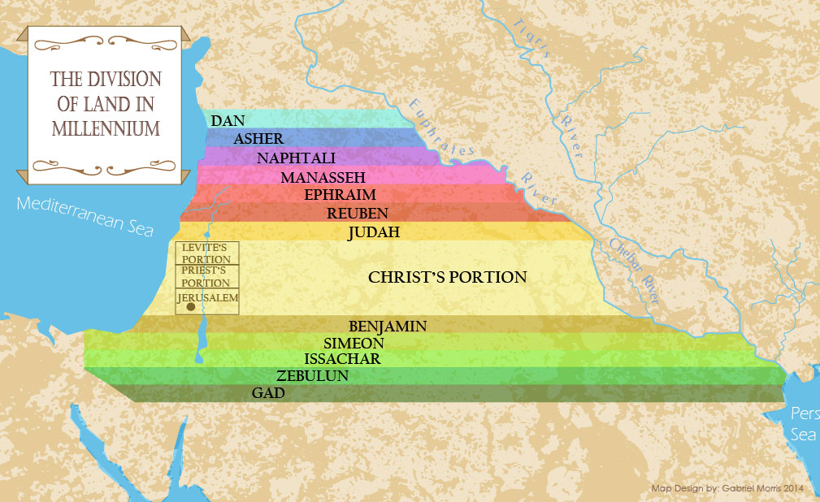

Slide 36
IV. Genesis 42:26-38 Brothers Return to Canaan
Return (26)
Brother’s first discovery (27-28)
Report to Jacob (29-34)
Brother’s second discovery (35)
Jacob’s reaction (36)
Reuben’s offer (37)
Jacob’s refusal (38)

Slide 39
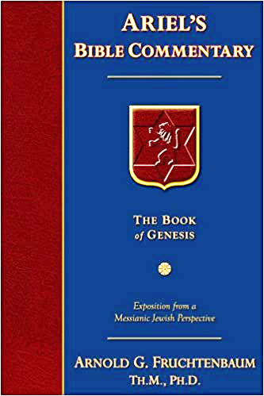
Dr. Arnold G. Fruchtenbaum
The Book of Genesis, 581
“The danger to Jacob was: If harm befall him by the way in which ye go, then will ye bring down my gray hairs with sorrow to Sheol. Jacob in this passage clearly anticipated going to Sheol at death, and the direction of Sheol was clearly downward not upward.”

Slide 40
Dr. Arnold G. Fruchtenbaum
The Book of Genesis, 537
“Jacob’s refusal is stated: He refused to be comforted; and he said, For I will go down to Sheol to my son in mourning. And his father wept for him. Sheol is the center of the earth, and before the death of the Messiah, all souls descended there upon death; but the faithful and unfaithful entered into different compartments in Sheol.”

Slide 41
Luke 16:24-26
“²⁴ And he cried out and said, ‘Father Abraham, have mercy on me, and send Lazarus so that he may dip the tip of his finger in water and cool off my tongue, for I am in agony in this flame.’ ²⁵ But Abraham said, ‘Child, remember that during your life you received your good things, and likewise Lazarus bad things; but now he is being comforted here, and you are in agony. ²⁶ And besides all this, between us and you there is a great chasm fixed, so that those who wish to come over from here to you will not be able, and that none may cross over from there to us.’”

Slide 42
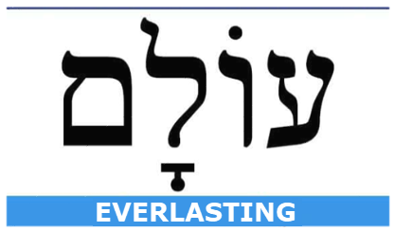
Daniel 12:2
“Many of those who sleep in the dust of the ground will awake, these to everlasting (olam) life, but the others to disgrace and everlasting (olam) contempt.”

Slide 43
Conclusion

Slide 44
Genesis 42:1-38 First Reunion
Jacob’s sons sent to Egypt (42:1-5)
First reunion (42:6-17)
Change of plans (42:18-25)
Brothers return to Canaan (42:26-38)

Slide 45
²⁴ The Lord bless you, and keep you; ²⁵ The Lord make His face shine on you, And be gracious to you; ²⁶ The Lord lift up His countenance on you, And give you peace.
Numbers 6:24–26 (NASB95)

