Slide 1
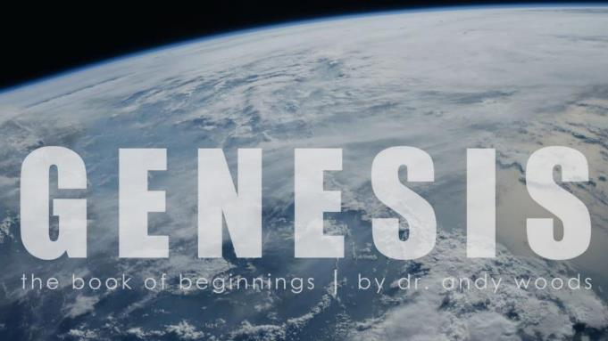
Genesis 12‒50
Israel’s Birth & Preservation

Slide 2
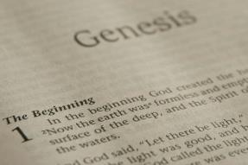
GENESIS STRUCTURE
Genesis 12-50 (four people)
Abraham (12:1–25:11)
Isaac (25:12–26:35)
Jacob (27–36)
Joseph (37–50)

Slide 3
Genesis 37‒50 Joseph
Joseph sold unto Egypt (37)
Canaan’s corruption (38)
Joseph falsely accused (39)
Joseph’s short-term predictions (40)
Joseph’s elevation (41)
Joseph’s first reunion with his brothers (42)

Slide 4
Genesis 42:1-38 First Reunion
Jacob’s sons sent to Egypt (42:1-5)
First reunion (42:6-17)
Change of plans (42:18-25)
Brothers return to Canaan (42:26-38)

Slide 5
III. Genesis 42:18-25 Joseph’s Change of Plans
Basis (18)
Content (19-20a)
Results (20b-c)
Brothers’ agreement (20d)
Deliberations (21-22)
Joseph’s reaction (23-25)

Slide 6
Genesis 42:23-25 Joseph’s Reaction
Joseph overhears (23)
Joseph weeps (24a)
Simeon bound (24b)
Joseph’s provision (25)

Slide 7
Genesis 42:23-25 Joseph’s Reaction
Joseph overhears (23)
Joseph weeps (24a)
Simeon bound (24b)
Joseph’s provision (25)

Slide 8
Genesis 42:23-25 Joseph’s Reaction
Joseph overhears (23)
Joseph weeps (24a)
Simeon bound (24b)
Joseph’s provision (25)

Slide 9
Luke 19:41-44
^{41 “}When He approached Jerusalem, He saw the city and wept over it, ⁴² saying, “If you had known in this day, even you, the things which make for peace! But now they have been hidden from your eyes. ⁴³ For the days will come upon you when your enemies will throw up a barricade against you, and surround you and hem you in on every side, ⁴⁴ and they will level you to the ground and your children within you, and they will not leave in you one stone upon another, because you did not recognize the time of your visitation.”

Slide 10
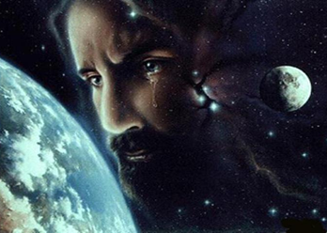
Christ’s Human Experiences
Labor (Mark 6:3)
Distress (Luke 22:44)
Being troubled (John 12:27)
Thirst (John 19:28)
Hunger (Matt 4:2)
Fatigue (John 4:6)
Sadness (John 11:35)
Lack of understanding (Matt 24:36)
Temptation (Luke 4:1-13; Heb. 4:15)

Slide 11
Hebrews 2:18
“For since He Himself was tempted in that which He has suffered, He is able to come to the aid of those who are tempted.”

Slide 12
Hebrews 4:15-16
^{15 “}For we do not have a high priest who cannot sympathize with our weaknesses, but One who has been tempted in all things as we are, yet without sin. ¹⁶ Therefore let us draw near with confidence to the throne of grace, so that we may receive mercy and find grace to help in time of need.”

Slide 13
Zechariah 12:10
“I will pour out on the house of David and on the inhabitants of Jerusalem, the Spirit of grace and of supplication, so that they will look on Me whom they have pierced; and they will mourn for Him, as one mourns for an only son, and they will weep bitterly over Him like the bitter weeping over a firstborn.”

Slide 14
Genesis 42:23-25 Joseph’s Reaction
Joseph overhears (23)
Joseph weeps (24a)
Simeon bound (24b)
Joseph’s provision (25)

Slide 16
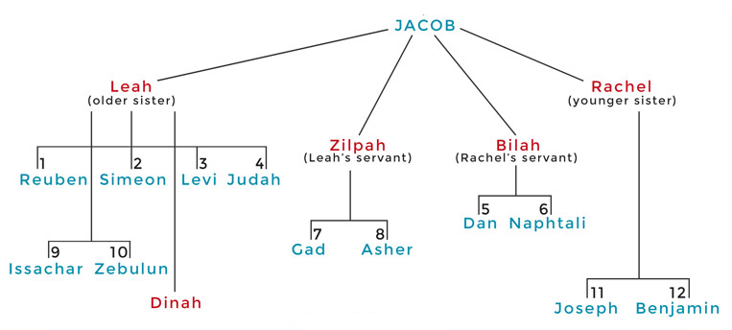

Slide 17
Genesis 42:23-25 Joseph’s Reaction
Joseph overhears (23)
Joseph weeps (24a)
Simeon bound (24b)
Joseph’s provision (25)

Slide 18
Genesis 42:25 Joseph’s Provision
Grain (25a)
Money (25b)
Provisions (25c)
Conclusion (25d)

Slide 19
Genesis 42:25 Joseph’s Provision
Grain (25a)
Money (25b)
Provisions (25c)
Conclusion (25d)

Slide 20
Genesis 42:25 Joseph’s Provision
Grain (25a)
Money (25b)
Provisions (25c)
Conclusion (25d)

Slide 21
Genesis 42:25 Joseph’s Provision
Grain (25a)
Money (25b)
Provisions (25c)
Conclusion (25d)

Slide 22
Genesis 42:25 Joseph’s Provision
Grain (25a)
Money (25b)
Provisions (25c)
Conclusion (25d)

Slide 23
Genesis 42:1-38 First Reunion
Jacob’s sons sent to Egypt (42:1-5)
First reunion (42:6-17)
Change of plans (42:18-25)
Brothers return to Canaan (42:26-38)

Slide 24
IV. Genesis 42:26-38 Brothers Return to Canaan
Return (26)
Brother’s first discovery (27-28)
Report to Jacob (29-34)
Brother’s second discovery (35)
Jacob’s reaction (36)
Reuben’s offer (37)
Jacob’s refusal (38)

Slide 25
IV. Genesis 42:26-38 Brothers Return to Canaan
Return (26)
Brother’s first discovery (27-28)
Report to Jacob (29-34)
Brother’s second discovery (35)
Jacob’s reaction (36)
Reuben’s offer (37)
Jacob’s refusal (38)

Slide 27
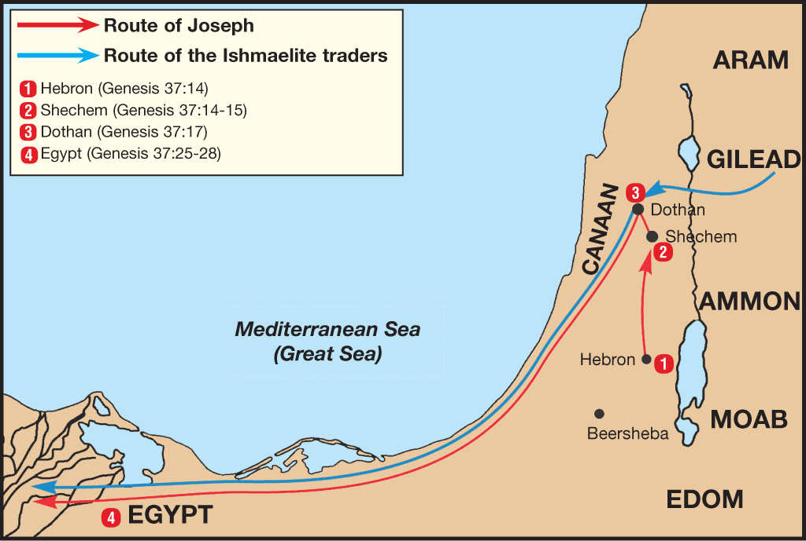

Slide 28
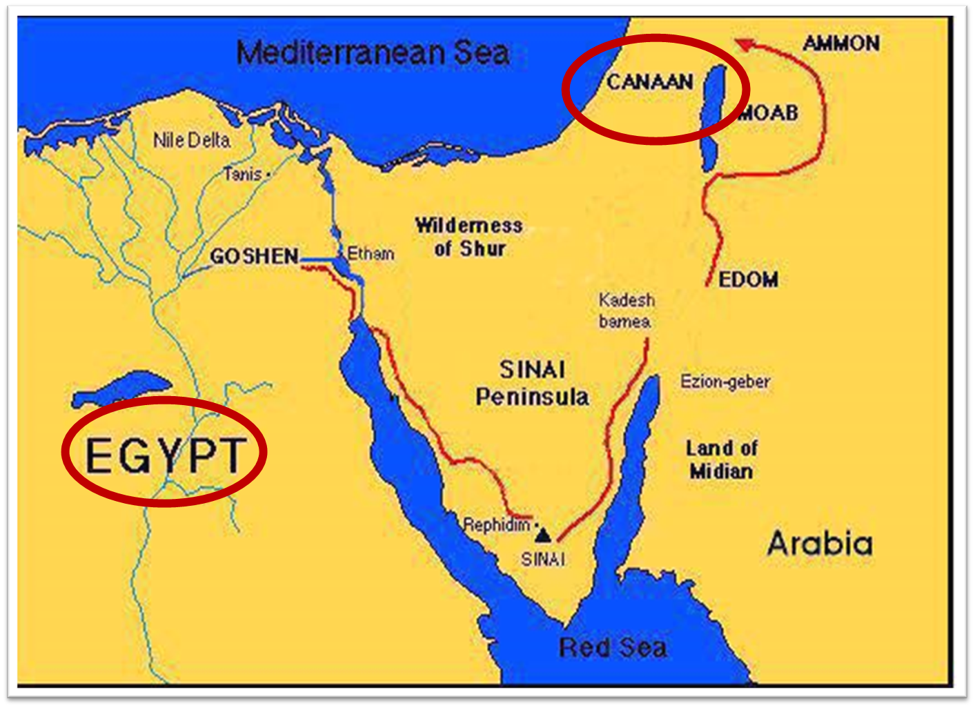

Slide 29
IV. Genesis 42:26-38 Brothers Return to Canaan
Return (26)
Brother’s first discovery (27-28)
Report to Jacob (29-34)
Brother’s second discovery (35)
Jacob’s reaction (36)
Reuben’s offer (37)
Jacob’s refusal (38)

Slide 30
Genesis 42:27-28 Brothers’ First Discovery
Discovery (27)
Report (28a)
Reaction (28b)

Slide 31
Genesis 42:27-28 Brothers’ First Discovery
Discovery (27)
Report (28a)
Reaction (28b)

Slide 32
Genesis 42:27-28 Brothers’ First Discovery
Discovery (27)
Report (28a)
Reaction (28b)

Slide 33
Genesis 42:27-28 Brothers’ First Discovery
Discovery (27)
Report (28a)
Reaction (28b)

Slide 34
IV. Genesis 42:26-38 Brothers Return to Canaan
Return (26)
Brother’s first discovery (27-28)
Report to Jacob (29-34)
Brother’s second discovery (35)
Jacob’s reaction (36)
Reuben’s offer (37)
Jacob’s refusal (38)

Slide 35
Genesis 42:29-34 Report to Jacob
Return (29)
Accusation (30)
Denial (31-32)
Test (33-34)

Slide 36
Genesis 42:29-34 Report to Jacob
Return (29)
Accusation (30)
Denial (31-32)
Test (33-34)

Slide 40
Genesis 42:29-34 Report to Jacob
Return (29)
Accusation (30)
Denial (31-32)
Test (33-34)

Slide 41
Genesis 42:29-34 Report to Jacob
Return (29)
Accusation (30)
Denial (31-32)
Test (33-34)

Slide 44
Genesis 42:29-34 Report to Jacob
Return (29)
Accusation (30)
Denial (31-32)
Test (33-34)

Slide 45
IV. Genesis 42:26-38 Brothers Return to Canaan
Return (26)
Brother’s first discovery (27-28)
Report to Jacob (29-34)
Brother’s second discovery (35)
Jacob’s reaction (36)
Reuben’s offer (37)
Jacob’s refusal (38)

Slide 46
Genesis 42:35 Brothers’ Second Discovery
Timing (35a)
Reaction (35b)

Slide 47
Genesis 42:35 Brothers’ Second Discovery
Timing (35a)
Reaction (35b)

Slide 48
Genesis 42:35 Brothers’ Second Discovery
Timing (35a)
Reaction (35b)

Slide 49
IV. Genesis 42:26-38 Brothers Return to Canaan
Return (26)
Brother’s first discovery (27-28)
Report to Jacob (29-34)
Brother’s second discovery (35)
Jacob’s reaction (36)
Reuben’s offer (37)
Jacob’s refusal (38)

Slide 52
IV. Genesis 42:26-38 Brothers Return to Canaan
Return (26)
Brother’s first discovery (27-28)
Report to Jacob (29-34)
Brother’s second discovery (35)
Jacob’s reaction (36)
Reuben’s offer (37)
Jacob’s refusal (38)

Slide 55
IV. Genesis 42:26-38 Brothers Return to Canaan
Return (26)
Brother’s first discovery (27-28)
Report to Jacob (29-34)
Brother’s second discovery (35)
Jacob’s reaction (36)
Reuben’s offer (37)
Jacob’s refusal (38)

Slide 58
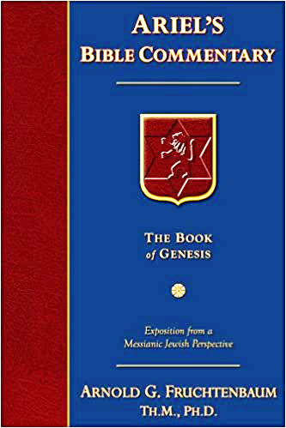
Dr. Arnold G. Fruchtenbaum
The Book of Genesis, 581
“The danger to Jacob was: If harm befall him by the way in which ye go, then will ye bring down my gray hairs with sorrow to Sheol. Jacob in this passage clearly anticipated going to Sheol at death, and the direction of Sheol was clearly downward not upward.”

Slide 59
Dr. Arnold G. Fruchtenbaum
The Book of Genesis, 537
“Jacob’s refusal is stated: He refused to be comforted; and he said, For I will go down to Sheol to my son in mourning. And his father wept for him. Sheol is the center of the earth, and before the death of the Messiah, all souls descended there upon death; but the faithful and unfaithful entered into different compartments in Sheol.”

Slide 60
Luke 16:24-26
“²⁴ And he cried out and said, ‘Father Abraham, have mercy on me, and send Lazarus so that he may dip the tip of his finger in water and cool off my tongue, for I am in agony in this flame.’ ²⁵ But Abraham said, ‘Child, remember that during your life you received your good things, and likewise Lazarus bad things; but now he is being comforted here, and you are in agony. ²⁶ And besides all this, between us and you there is a great chasm fixed, so that those who wish to come over from here to you will not be able, and that none may cross over from there to us.’”

Slide 61
Conclusion

Slide 62
Genesis 42:1-38 First Reunion
Jacob’s sons sent to Egypt (42:1-5)
First reunion (42:6-17)
Change of plans (42:18-25)
Brothers return to Canaan (42:26-38)

Slide 63
²⁴ The Lord bless you, and keep you; ²⁵ The Lord make His face shine on you, And be gracious to you; ²⁶ The Lord lift up His countenance on you, And give you peace.
Numbers 6:24–26 (NASB95)

