Slide 1


Dr. Andy Woods
Senior Pastor – Sugar Land Bible Church
President – Chafer Theological Seminary

Slide 2

Structure
1 – Commendation
2 – Correction
3 – Consequences

Slide 3
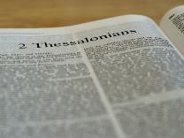
2 Thessalonians 2:1-12
Problem (2:1-2)
Prerequisites for the Day of the Lord (2:3-12)
  The departure (2:3a)
  Advent of the lawless one (2:3b-4)
  Removal of the restrainer (2:5-7)
  Destruction of the lawless one (2:8-9)
  Destruction of lawless one’s followers (2:10-12)

Slide 4
Structure
1 – Commendation
2 – Correction
3 – Consequences

Slide 5
Consequences of Poor Doctrine (3)
Reciprocal prayer (3:1-5)
Exhortation to discipline the idle (3:6-15)
Conclusion (3:16-18)

Slide 6
Consequences of Poor Doctrine (3)
Reciprocal prayer (3:1-5)
Exhortation to discipline the idle (3:6-15)
Conclusion (3:16-18)

Slide 7

2 Thessalonians 3:1-5
Reciprocal Prayer
  Thessalonians’ Prayer for Paul (1-2)
  Paul’s Prayer for the Thessalonians (3-5)

Slide 8
2 Thessalonians 3:1-5
Reciprocal Prayer
  Thessalonians’ Prayer for Paul (1-2)
  Paul’s Prayer for the Thessalonians (3-5)

Slide 9
2 Thessalonians 3:1-2
Thessalonians’ Prayer for Paul
  Effectiveness (1)
  Deliverance (2)

Slide 10
2 Thessalonians 3:1-5
Reciprocal Prayer
  Thessalonians’ Prayer for Paul (1-2)
  Paul’s Prayer for the Thessalonians (3-5)

Slide 11
2 Thessalonians 3:3-5
Paul’s Prayer for the Thessalonians
  Protection from Satan (3)
  Continued obedience (4)
  Greater intimacy with God (5)

Slide 12
Consequences of Poor Doctrine (3)
Reciprocal prayer (3:1-5)
Exhortation to discipline the idle (3:6-15)
Conclusion (3:16-18)

Slide 13
2 Thessalonians 3:6-15
Discipline the Idle
  Exhortation (6)
  Better example (7-9)
  Reason (10-11)
  Lazy must work (12)
  Patience needed (13)
  Discipline procedure (14-15)

Slide 14
2 Thessalonians 3:6-15
Discipline the Idle
  Exhortation (6)
  Better example (7-9)
  Reason (10-11)
  Lazy must work (12)
  Patience needed (13)
  Discipline procedure (14-15)

Slide 15

1 Corinthians 3:1-3 (NKJV)
¹ And I, brethren, could not speak to you as to spiritual people but as to carnal, as to babes in Christ. ² I fed you with milk and not with solid food; for until now you were not able to receive it, and even now you are still not able; ³ for you are still carnal. For where there are envy, strife, and divisions among you, are you not carnal and behaving like mere men?

Slide 16
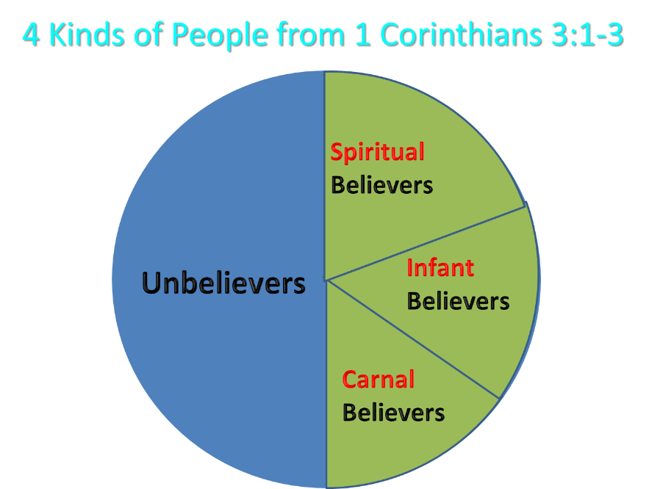
Notes:
Ray Steadman – “1st Californians”
Unbelievers vs Categories of Believers
Unbelievers – ψυχικός psuchikós; Natural, pertaining to the natural as distinguished from the spiritual
Spiritual Believers – πνευματικός pneumatikós; of persons who are spiritual, enlightened by the Holy Spirit
Infant Believers – σάρκινος sárkinos; with propensities of the flesh unto sin; νήπιος nḗpios; an infant, child, baby without any definite limitation of age. (This relates to immaturity and lack of instruction)
Carnal Believers – σαρκικός sarkikós; tendency to satisfy the flesh, implying sinfulness, sinful propensity, carnal (This relates to disobedience and open rebellion)

Slide 17

Purity of the Church
Ecclesiastical separation
Church discipline

Slide 18
Purity of the Church
Ecclesiastical separation
Church discipline

Slide 19
Ecclesiastical Separation
  Why separate?
  Biblical basis for separation
  What to separate from?

Slide 20
Ecclesiastical Separation
  Why separate?
  Biblical basis for separation
  What to separate from?

Slide 21
  Why Separate?
Not hatred
Gives world a false sense of security
Loss of distinctiveness and power

Slide 22
Ecclesiastical Separation
  Why separate?
  Biblical basis for separation
  What to separate from?

Slide 23
  Biblical Basis for Separation?
2 Thess. 3:6, 14
1 Cor. 5:11
2 Cor. 6:14-18
Rom. 16:17
Eph. 5:11
Titus 3:9-11
2 John 9-11

Slide 24


Romans 16:17
“Now I urge you, brethren, keep your eye on those who cause dissensions and hindrances contrary to the teaching which you learned, and turn away from them.”

Slide 25
Romans 16:17 (KJV)
“Now I beseech you, brethren, mark them which cause divisions and offences contrary to the doctrine which ye have learned; and avoid them.”

Slide 26
Ephesians 5:11
“Do not participate (synkoinōneō) in the unfruitful deeds of darkness, but instead even expose them.”

Slide 27

Titus 3:9-11
“⁹ But avoid foolish controversies and genealogies and strife and disputes about the Law, for they are unprofitable and worthless. ¹⁰ Reject a factious (hairetikós) man after a first and second warning, ¹¹ knowing that such a man is perverted and is sinning, being self-condemned.”

Slide 28

2 John 7-11
“⁷ For many deceivers have gone out into the world, those who do not acknowledge Jesus Christ as coming in the flesh. This is the deceiver and the antichrist. ⁸ Watch yourselves, that you do not lose what we have accomplished, but that you may receive a full reward. ⁹ Anyone who goes too far and does not abide in the teaching of Christ, does not have God; the one who abides in the teaching, he has both the Father and the Son. ¹⁰ If anyone comes to you and does not bring this teaching, do not receive him into your house, and do not give him a greeting; ¹¹ for the one who gives him a greeting participates in his evil deeds.”

Slide 29
Ecclesiastical Separation
  Why separate?
  Biblical basis for separation
  What to separate from?

Slide 30
  What to Separate From?
False doctrine – 1 Tim. 4:16; Titus 1:9
Divisive persons – Rom. 16:17; Titus 3:9-11
Immorality – 1 Cor. 5:9-11; Eph. 5:11
General disobedience to Scripture –2 Thess. 3:6, 14

Slide 31
  What to Separate From?
False doctrine – 1 Tim. 4:16; Titus 1:9
Divisive persons – Rom. 16:17; Titus 3:9-11
Immorality – 1 Cor. 5:9-11; Eph. 5:11
General disobedience to Scripture –2 Thess. 3:6, 14

Slide 32

Fundamentals of the Faith
Creation/Fall – Rom. 5:14
Inspiration/inerrancy of the Scripture – Matt. 5:18; John 17:17; 2 Tim. 3:16; 2 Pet. 1:20-21
Salvation by faith alone
Eternal existence of heaven/hell – Dan. 12:2; Matt. 25:46
Trinity
Virgin birth of Christ
Deity of Christ
Atoning death of Christ – Isa. 53:3-6; 1 Pet. 2:24
Bodily Resurrection of Christ – John 20:27-28; 1 Cor. 15:14
Bodily Second Advent of Christ – Job 19:25; Zech. 14:4; Acts 1:9-11

Slide 33
  What to Separate From?
False doctrine – 1 Tim. 4:16; Titus 1:9
Divisive persons – Rom. 16:17; Titus 3:9-11
Immorality – 1 Cor. 5:9-11; Eph. 5:11
General disobedience to Scripture –2 Thess. 3:6, 14

Slide 34
Romans 16:17
“Now I urge you, brethren, keep your eye on those who cause dissensions and hindrances contrary to the teaching which you learned, and turn away from them.”

Slide 35
Titus 3:9-11
“⁹ But avoid foolish controversies and genealogies and strife and disputes about the Law, for they are unprofitable and worthless. ¹⁰ Reject a factious (hairetikós) man after a first and second warning, ¹¹ knowing that such a man is perverted and is sinning, being self-condemned.”

Slide 36
  What to Separate From?
False doctrine – 1 Tim. 4:16; Titus 1:9
Divisive persons – Rom. 16:17; Titus 3:9-11
Immorality – 1 Cor. 5:9-11; Eph. 5:11
General disobedience to Scripture –2 Thess. 3:6, 14

Slide 37
Ephesians 5:11
“Do not participate (synkoinōneō) in the unfruitful deeds of darkness, but instead even expose them.”

Slide 38
  What to Separate From?
False doctrine – 1 Tim. 4:16; Titus 1:9
Divisive persons – Rom. 16:17; Titus 3:9-11
Immorality – 1 Cor. 5:9-11; Eph. 5:11
General disobedience to Scripture –2 Thess. 3:6, 14

Slide 39


Mark 7:13
“thus invalidating the word of God by your tradition which you have handed down; and you do many things such as that.”

Slide 40
2 Thessalonians 3:6-15
Discipline the Idle
  Exhortation (6)
  Better example (7-9)
  Reason (10-11)
  Lazy must work (12)
  Patience needed (13)
  Discipline procedure (14-15)

Slide 41
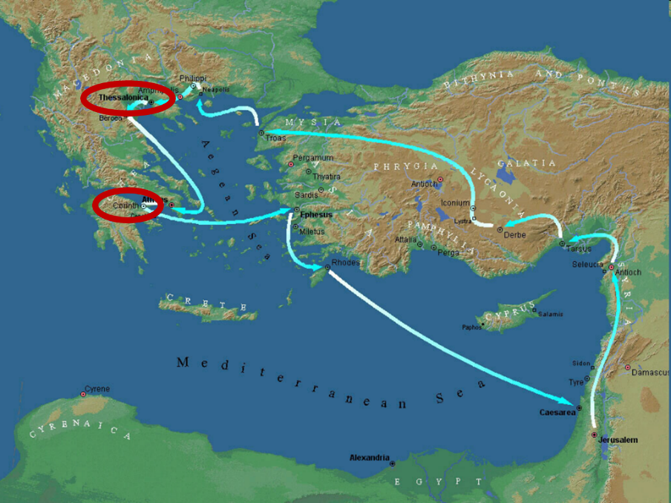

Slide 42
2 Thessalonians 3:6-15
Discipline the Idle
  Exhortation (6)
  Better example (7-9)
  Reason (10-11)
  Lazy must work (12)
  Patience needed (13)
  Discipline procedure (14-15)

Slide 43

Divine Judgments
(3:14-19)
  Serpent (3:14-15)
  Woman (3:16)
  Man (3:17-19)

Slide 44
Man
(3:17-19)
  Painful labor (3:17-19a)
  Death (3:19b)

Slide 45

Genesis 3:17-19a
¹⁷ Then to Adam He said, “Because you have listened to the voice of your wife, and have eaten from the tree about which I commanded you, saying, ‘You shall not eat from it’; Cursed is the ground because of you; In toil you will eat of it All the days of your life. ¹⁸ “Both thorns and thistles it shall grow for you; And you will eat the plants of the field; ¹⁹ By the sweat of your face You will eat bread...”

Slide 46
Romans 8:19-22
¹⁹ For the anxious longing of the creation waits eagerly for the revealing of the sons of God. ²⁰ For the creation was subjected to futility, not willingly, but because of Him who subjected it, in hope ²¹ that the creation itself also will be set free from its slavery to corruption into the freedom of the glory of the children of God. ²² For we know that the whole creation groans and suffers the pains of childbirth together until now.

Slide 47
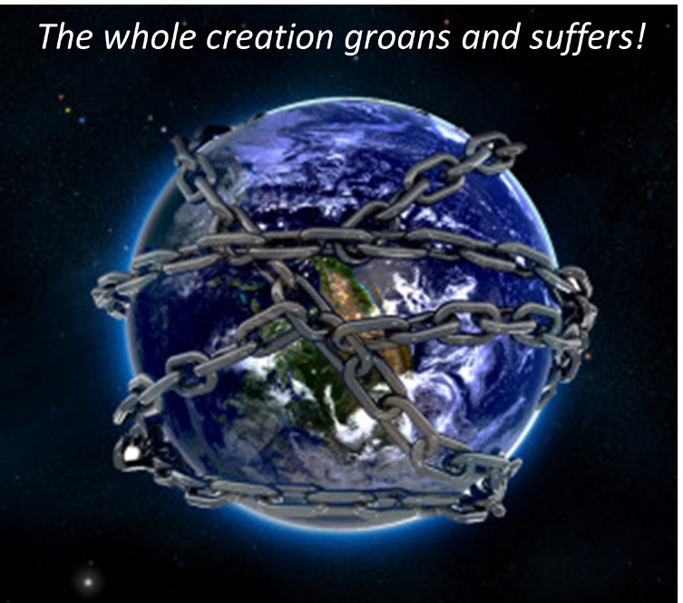

Slide 48
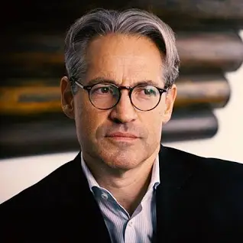
Eric Metaxas
The Eric Metaxas Show on TBN which aired on January 9, 20024. Eric Metaxas interviewed author Benjamin Thomas about his book “Revelation Riddle: Kingdom Age of the Saints, End Times for the New World Order.” The video is titled "Dangerous END TIMES Doctrines & The Spiritual Battle Against The Deep State.”
“[rescue Rapture Doctrine]…they think Jesus is going to rescue them. On the other hand there are a lot of people l've met that they're almost psyched to see the world go to hell. They're almost psyched to see everything get worse, like haha judgment is coming, instead of being moved by compassion to help those who might be helped. They're kind of glad to see it go downhill…and a lot of people who have this rescue Rapture rescue mentality…they're kind of like we we're happy to see America go down the tubes…and they're not even slightly patriotic thinking what can I do to help my nation stand for God's principles…I'm just about Jesus.”

Slide 49


Slide 50
Eric Metaxas
The Eric Metaxas Show on TBN which aired on January 9, 20024. Eric Metaxas interviewed author Benjamin Thomas about his book “Revelation Riddle: Kingdom Age of the Saints, End Times for the New World Order.” The video is titled "Dangerous END TIMES Doctrines & The Spiritual Battle Against The Deep State.”
“Let's call it what it is folks. It’s bad Theology. And by the way I want to be very clear. I say this in all my speeches. Bad theology to be clear is from the pit of Hell. It's Satan's theology. It's not like all B minus theology. It's from the pit of Hell.”

Slide 51

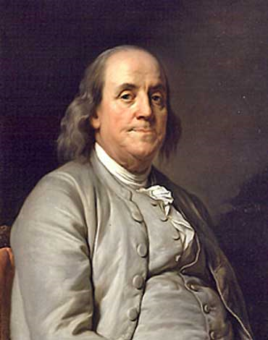
Benjamin Franklin
At the close of the Constitutional Convention of 1787, when queried as he left Independence Hall on the final day of deliberation (in the notes of Dr. James McHenry, one of Maryland’s delegates to the Convention) a lady asked Dr. Benjamin Franklin, “Well Doctor what have we got a republic or a monarchy?” Franklin responded, “A republic replied the Doctor if you can keep it.”
The Records of the Federal Convention of 1787, ed. Max Farrand,
vol. 3, appendix A, p. 85 (1911, reprinted 1934).

Slide 52
2 Thessalonians 3:6-15
Discipline the Idle
  Exhortation (6)
  Better example (7-9)
  Reason (10-11)
  Lazy must work (12)
  Patience needed (13)
  Discipline procedure (14-15)

Slide 53
Genesis 3:17-19a
¹⁷ Then to Adam He said, “Because you have listened to the voice of your wife, and have eaten from the tree about which I commanded you, saying, ‘You shall not eat from it’; Cursed is the ground because of you; In toil you will eat of it All the days of your life. ¹⁸ “Both thorns and thistles it shall grow for you; And you will eat the plants of the field; ¹⁹ By the sweat of your face You will eat bread...”

Slide 54
2 Thessalonians 3:6-15
Discipline the Idle
  Exhortation (6)
  Better example (7-9)
  Reason (10-11)
  Lazy must work (12)
  Patience needed (13)
  Discipline procedure (14-15)

Slide 55
1 Corinthians 3:1-3 (NKJV)
¹ And I, brethren, could not speak to you as to spiritual people but as to carnal, as to babes in Christ. ² I fed you with milk and not with solid food; for until now you were not able to receive it, and even now you are still not able; ³ for you are still carnal. For where there are envy, strife, and divisions among you, are you not carnal and behaving like mere men?

Slide 56
Notes:
Ray Steadman – “1st Californians”
Unbelievers vs Categories of Believers
Unbelievers – ψυχικός psuchikós; Natural, pertaining to the natural as distinguished from the spiritual
Spiritual Believers – πνευματικός pneumatikós; of persons who are spiritual, enlightened by the Holy Spirit
Infant Believers – σάρκινος sárkinos; with propensities of the flesh unto sin; νήπιος nḗpios; an infant, child, baby without any definite limitation of age. (This relates to immaturity and lack of instruction)
Carnal Believers – σαρκικός sarkikós; tendency to satisfy the flesh, implying sinfulness, sinful propensity, carnal (This relates to disobedience and open rebellion)

Slide 57

Galatians 6:7-9
God Blesses His Truth
“Do not be deceived, God is not mocked; for whatever a man sows, this he will also reap. For the one who sows to his own flesh will from the flesh reap corruption, but the one who sows to the Spirit will from the Spirit reap eternal life. Let us not lose heart in doing good, for in due time we will reap if we do not grow weary.”

Slide 58
2 Thessalonians 3:6-15
Discipline the Idle
  Exhortation (6)
  Better example (7-9)
  Reason (10-11)
  Lazy must work (12)
  Patience needed (13)
  Discipline procedure (14-15)

Slide 59
2 Thessalonians 3:14-15
Discipline Procedure
  Negative: disassociation & shame (14)
  Positive: disciplinee = a brother (15)

Slide 60
2 Thessalonians 3:14-15
Discipline Procedure
  Negative: disassociation & shame (14)
  Positive: disciplinee = a brother (15)

Slide 61
Romans 16:17
“Now I urge you, brethren, keep your eye on those who cause dissensions and hindrances contrary to the teaching which you learned, and turn away from them.”

Slide 62
Romans 16:17 (KJV)
“Now I beseech you, brethren, mark them which cause divisions and offences contrary to the doctrine which ye have learned; and avoid them.”

Slide 63
  Biblical Basis for Separation?
2 Thess. 3:6, 14
1 Cor. 5:11
2 Cor. 6:14-18
Rom. 16:17
Eph. 5:11
Titus 3:9-11
2 John 9-11

Slide 64
Romans 16:17
“Now I urge you, brethren, keep your eye on those who cause dissensions and hindrances contrary to the teaching which you learned, and turn away from them.”

Slide 65
Ephesians 5:11
“Do not participate (synkoinōneō) in the unfruitful deeds of darkness, but instead even expose them.”

Slide 66
2 John 7-11
“⁷ For many deceivers have gone out into the world, those who do not acknowledge Jesus Christ as coming in the flesh. This is the deceiver and the antichrist. ⁸ Watch yourselves, that you do not lose what we have accomplished, but that you may receive a full reward. ⁹ Anyone who goes too far and does not abide in the teaching of Christ, does not have God; the one who abides in the teaching, he has both the Father and the Son. ¹⁰ If anyone comes to you and does not bring this teaching, do not receive him into your house, and do not give him a greeting; ¹¹ for the one who gives him a greeting participates in his evil deeds.”

Slide 67
Purity of the Church
Ecclesiastical separation
Church discipline

Slide 68

Church Discipline
Command (1 Cor 5:13)
Reason (Gal 5:9)
Offenses meriting discipline
Procedure (Matt 18:15-17)
Goal (2 Thess 3:14-15)

Slide 69
Church Discipline
Command (1 Cor 5:13)
Reason (Gal 5:9)
Offenses meriting discipline
Procedure (Matt 18:15-17)
Goal (2 Thess 3:14-15)

Slide 70
Church Discipline
Command (1 Cor 5:13)
Reason (Gal 5:9)
Offenses meriting discipline
Procedure (Matt 18:15-17)
Goal (2 Thess 3:14-15)

Slide 71
Church Discipline
Command (1 Cor 5:13)
Reason (Gal 5:9)
Offenses meriting discipline
Procedure (Matt 18:15-17)
Goal (2 Thess 3:14-15)

Slide 72
Offenses Meriting Discipline
Disobedience – 2 Thess. 3:6, 14-15
Immorality – 1 Cor. 5:9-11, 13
Divisiveness – Rom. 16:17-18

Slide 73
Romans 16:17
“Now I urge you, brethren, keep your eye on those who cause dissensions and hindrances contrary to the teaching which you learned, and turn away from them.”

Slide 74
Church Discipline
Command (1 Cor 5:13)
Reason (Gal 5:9)
Offenses meriting discipline
Procedure (Matt 18:15-17)
Goal (2 Thess 3:14-15)

Slide 75
Church Discipline
Command (1 Cor 5:13)
Reason (Gal 5:9)
Offenses meriting discipline
Procedure (Matt 18:15-17)
Goal (2 Thess 3:14-15)

Slide 76
2 Thessalonians 3:14-15
Discipline Procedure
  Negative: disassociation & shame (14)
  Positive: disciplinee = a brother (15)

Slide 77
Conclusion

Slide 78
Consequences of Poor Doctrine (3)
Reciprocal prayer (3:1-5)
Exhortation to discipline the idle (3:6-15)
Conclusion (3:16-18)

Slide 79
2 Thessalonians 3:6-15
Discipline the Idle
  Exhortation (6)
  Better example (7-9)
  Reason (10-11)
  Lazy must work (12)
  Patience needed (13)
  Discipline procedure (14-15)

Slide 80
Consequences of Poor Doctrine (3)
Reciprocal prayer (3:1-5)
Exhortation to discipline the idle (3:6-15)
Conclusion (3:16-18)

