Slide 1
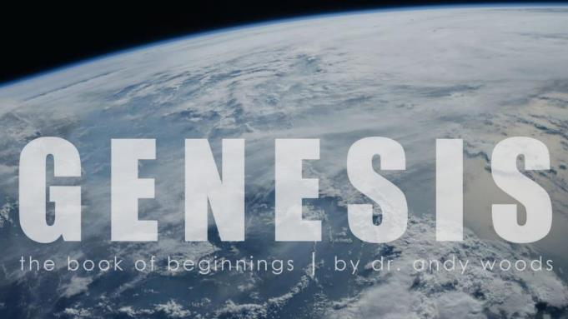
Genesis 12‒50
Israel’s Birth & Preservation

Slide 2
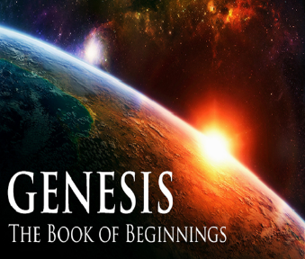
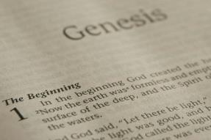
GENESIS STRUCTURE
Genesis 12-50 (four people)
Abraham (12:1–25:11)
Isaac (25:12–26:35)
Jacob (27–36)
Joseph (37–50)

Slide 3
Genesis 37‒50 Joseph
Joseph sold unto Egypt (37)
Canaan’s corruption (38)
Joseph falsely accused (39)
Joseph’s short-term predictions (40)
Joseph’s elevation (41)
Joseph’s first reunion with his brothers (42)

Slide 4
Genesis 42:1-38 First Reunion
Jacob’s sons sent to Egypt (42:1-5)
First reunion (42:6-17)
Change of plans (42:18-25)
Brothers return to Canaan (42:26-38)

Slide 5
II. Genesis 42:6-17 First Reunion
Meeting (6)
Joseph’s recognition (7-9a)
Joseph’s first accusation (9b)
Brothers’ first denial (10-11)
Joseph’s second accusation (12)
Brothers’ second denial (13)
Challenge for vindication (14-17)

Slide 6
Genesis 42:14-17 Challenge for Vindication
Joseph’s third accusation (14)
Evidence for vindication (15)
Means (16)
Imprisonment (17)

Slide 7
Genesis 42:14-17 Challenge for Vindication
Joseph’s third accusation (14)
Evidence for vindication (15)
Means (16)
Imprisonment (17)

Slide 8
Genesis 42:14-17 Challenge for Vindication
Joseph’s third accusation (14)
Evidence for vindication (15)
Means (16)
Imprisonment (17)

Slide 10
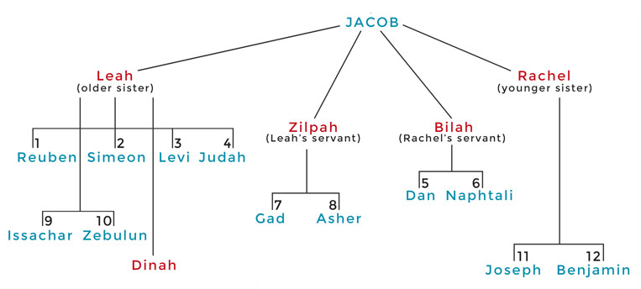

Slide 11
Genesis 42:14-17 Challenge for Vindication
Joseph’s third accusation (14)
Evidence for vindication (15)
Means (16)
Imprisonment (17)

Slide 12
Genesis 42:14-17 Challenge for Vindication
Joseph’s third accusation (14)
Evidence for vindication (15)
Means (16)
Imprisonment (17)

Slide 13
Shaping and Populating (Gen 1:1)
Day 1: | Light | Day 4: | Luminaries
Day 2: | Water, sky | Day 5: | Sea animals, birds
Day 3: | Land, vegetation | Day 6: | Land animals, man

Slide 14
Exodus 20:8-11
“⁸ Remember the sabbath day, to keep it holy. ⁹ Six days you shall labor and do all your work, ¹⁰ but the seventh day is a sabbath of the LORD your God; in it you shall not do any work, you or your son or your daughter, your male or your female servant or your cattle or your sojourner who stays with you. ¹¹ For in six days the LORD made the heavens and the earth, the sea and all that is in them, and rested on the seventh day; therefore, the LORD blessed the sabbath day and made it holy.”

Slide 15
Exodus 31:15-17
¹⁵ “For six days work may be done, but on the seventh day there is a sabbath of complete rest, holy to the Lord; whoever does any work on the sabbath day shall surely be put to death. ¹⁶ So the sons of Israel shall observe the sabbath, to celebrate the sabbath throughout their generations as a perpetual covenant. ¹⁷ It is a sign between Me and the sons of Israel forever; for in six days the Lord made heaven and earth, but on the seventh day He ceased from labor, and was refreshed.”

Slide 16
Genesis 42:1-38 First Reunion
Jacob’s sons sent to Egypt (42:1-5)
First reunion (42:6-17)
Change of plans (42:18-25)
Brothers return to Canaan (42:26-38)

Slide 17
III. Genesis 42:18-25 Joseph’s Change of Plans
Basis (18)
Content (19-20a)
Results (20b-c)
Brothers’ agreement (20d)
Deliberations (21-22)
Joseph’s reaction (23-25)

Slide 18
III. Genesis 42:18-25 Joseph’s Change of Plans
Basis (18)
Content (19-20a)
Results (20b-c)
Brothers’ agreement (20d)
Deliberations (21-22)
Joseph’s reaction (23-25)

Slide 19
Josh McDowell & Don Stewart
Answers to Tough Questions
“How could Jesus have remained in the tomb three days and three nights if He was crucified on Friday and rose on Sunday? Jesus prophesied in Matthew 12:40 (NASB) that ‘just as Jonah was three days and three nights in the belly of the sea monster, so shall the Son of Man be three days and three nights in the heart of the earth.’…Since this is clearly not three full, twenty-four-hour days, do we have a problem of conflict with the prophecy of Jesus in Matthew 12:40? In Mark 8:31 and Matthew 16:21, Jesus is recorded as saying, ‘The Son of man will rise again after three days,’ and ‘He will be raised again on the third day—expressions that are used interchangeably.”

Slide 20
Josh McDowell & Don Stewart
Answers to Tough Questions
“This can be seen from the fact that the most references to the resurrection state that it occurred on the third day. Also, Jesus, in addition to the Matthew 12:40 passage, spoke of His resurrection in John 2:19–22, stating that He would be raised up in three days (not the fourth day). Matthew 27:63 (KJV) gives weight to this idiomatic usage. After the Pharisees tell Pilate of the prediction of Jesus, ‘After three days I will rise again,’ they ask for a guard to secure the tomb until the third day. If the phrase, ‘after three days,’ was not interchangeable with the ‘third day,’ the Pharisees would have asked for a guard for the fourth day.”

Slide 21
Josh McDowell & Don Stewart
Answers to Tough Questions
“That the expression ‘one day and one night’ was an idiom employed by the Jews for indicating a day, even when only a part of a day was indicated, can be seen also in the Old Testament. For example, I Samuel 30:12, 13 (KJV), ‘For he had not eaten bread or drunk water for three days and three nights,’ and in the next verse, ‘My master left me behind…three days ago.’ Just as clearly, Genesis 42:17 shows this idiomatic usage. Joseph imprisoned his brothers for three days; in verse 18, he speaks to them and releases them, all on the third day. The phrases, ‘after three days’ and ‘on the third day,’ are not contradictory, either to each other or with Matthew 12:40, but simply idiomatic, interchangeable terms, clearly a common mode of Jewish expression.”

Slide 22
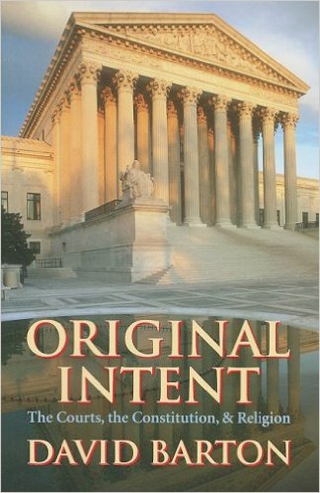
David Barton, Original Intent, p. 245

Slide 23
III. Genesis 42:18-25 Joseph’s Change of Plans
Basis (18)
Content (19-20a)
Results (20b-c)
Brothers’ agreement (20d)
Deliberations (21-22)
Joseph’s reaction (23-25)

Slide 25
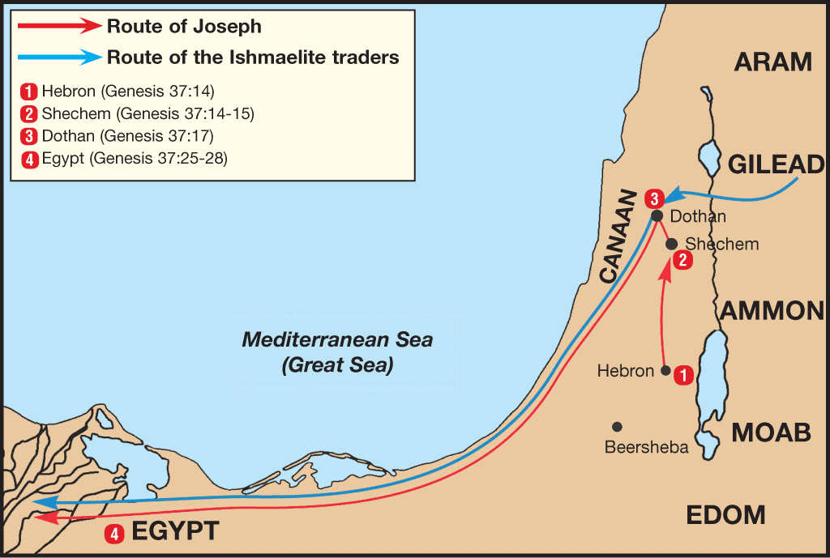

Slide 26
III. Genesis 42:18-25 Joseph’s Change of Plans
Basis (18)
Content (19-20a)
Results (20b-c)
Brothers’ agreement (20d)
Deliberations (21-22)
Joseph’s reaction (23-25)

Slide 27
Genesis 42:20b-c Results
Words vindicated (20b)
Will not die (20c)

Slide 28
Genesis 42:20b-c Results
Words vindicated (20b)
Will not die (20c)

Slide 29
Genesis 42:20b-c Results
Words vindicated (20b)
Will not die (20c)

Slide 30
III. Genesis 42:18-25 Joseph’s Change of Plans
Basis (18)
Content (19-20a)
Results (20b-c)
Brothers’ agreement (20d)
Deliberations (21-22)
Joseph’s reaction (23-25)

Slide 31
III. Genesis 42:18-25 Joseph’s Change of Plans
Basis (18)
Content (19-20a)
Results (20b-c)
Brothers’ agreement (20d)
Deliberations (21-22)
Joseph’s reaction (23-25)

Slide 32
Genesis 42:21-22 Deliberations
Added information (21)
Reuben’s words (22)

Slide 33
Genesis 42:21-22 Deliberations
Added information (21)
Reuben’s words (22)

Slide 34
Genesis 42:21-22 Deliberations
Added information (21)
Reuben’s words (22)

Slide 37
III. Genesis 42:18-25 Joseph’s Change of Plans
Basis (18)
Content (19-20a)
Results (20b-c)
Brothers’ agreement (20d)
Deliberations (21-22)
Joseph’s reaction (23-25)

Slide 38
Genesis 42:23-25 Joseph’s Reaction
Joseph overhears (23)
Joseph weeps (24a)
Simeon bound (24b)
Joseph’s provision (25)

Slide 39
Genesis 42:23-25 Joseph’s Reaction
Joseph overhears (23)
Joseph weeps (24a)
Simeon bound (24b)
Joseph’s provision (25)

Slide 40
Genesis 42:23-25 Joseph’s Reaction
Joseph overhears (23)
Joseph weeps (24a)
Simeon bound (24b)
Joseph’s provision (25)

Slide 41
Luke 19:41-44
^{41 “}When He approached Jerusalem, He saw the city and wept over it, ⁴² saying, “If you had known in this day, even you, the things which make for peace! But now they have been hidden from your eyes. ⁴³ For the days will come upon you when your enemies will throw up a barricade against you, and surround you and hem you in on every side, ⁴⁴ and they will level you to the ground and your children within you, and they will not leave in you one stone upon another, because you did not recognize the time of your visitation.”

Slide 42
Zechariah 12:10
“I will pour out on the house of David and on the inhabitants of Jerusalem, the Spirit of grace and of supplication, so that they will look on Me whom they have pierced; and they will mourn for Him, as one mourns for an only son, and they will weep bitterly over Him like the bitter weeping over a firstborn.”

Slide 43
Genesis 42:23-25 Joseph’s Reaction
Joseph overhears (23)
Joseph weeps (24a)
Simeon bound (24b)
Joseph’s provision (25)

Slide 46
Genesis 42:23-25 Joseph’s Reaction
Joseph overhears (23)
Joseph weeps (24a)
Simeon bound (24b)
Joseph’s provision (25)

Slide 47
Genesis 42:25 Joseph’s Provision
Grain (25a)
Money (25b)
Provisions (25c)
Conclusion (25d)

Slide 48
Genesis 42:25 Joseph’s Provision
Grain (25a)
Money (25b)
Provisions (25c)
Conclusion (25d)

Slide 49
Genesis 42:25 Joseph’s Provision
Grain (25a)
Money (25b)
Provisions (25c)
Conclusion (25d)

Slide 50
Genesis 42:25 Joseph’s Provision
Grain (25a)
Money (25b)
Provisions (25c)
Conclusion (25d)

Slide 51
Genesis 42:25 Joseph’s Provision
Grain (25a)
Money (25b)
Provisions (25c)
Conclusion (25d)

Slide 52
Genesis 42:1-38 First Reunion
Jacob’s sons sent to Egypt (42:1-5)
First reunion (42:6-17)
Change of plans (42:18-25)
Brothers return to Canaan (42:26-38)

Slide 53
IV. Genesis 42:26-38 Brothers Return to Canaan
Return (26)
Brother’s first discovery (27-28)
Report to Jacob (29-34)
Brother’s second discovery (35)
Jacob’s reaction (36)
Reuben’s offer (37)
Jacob’s refusal (38)

Slide 54
IV. Genesis 42:26-38 Brothers Return to Canaan
Return (26)
Brother’s first discovery (27-28)
Report to Jacob (29-34)
Brother’s second discovery (35)
Jacob’s reaction (36)
Reuben’s offer (37)
Jacob’s refusal (38)

Slide 57
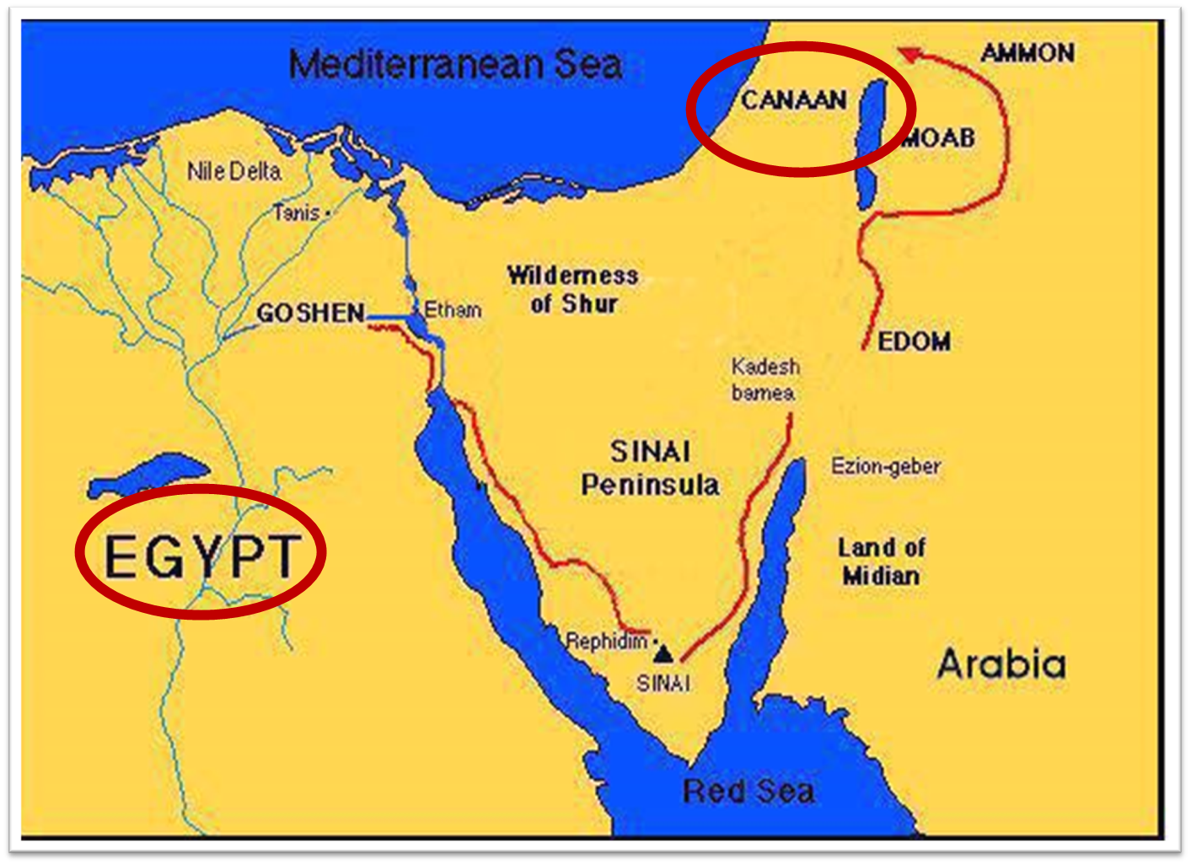

Slide 58
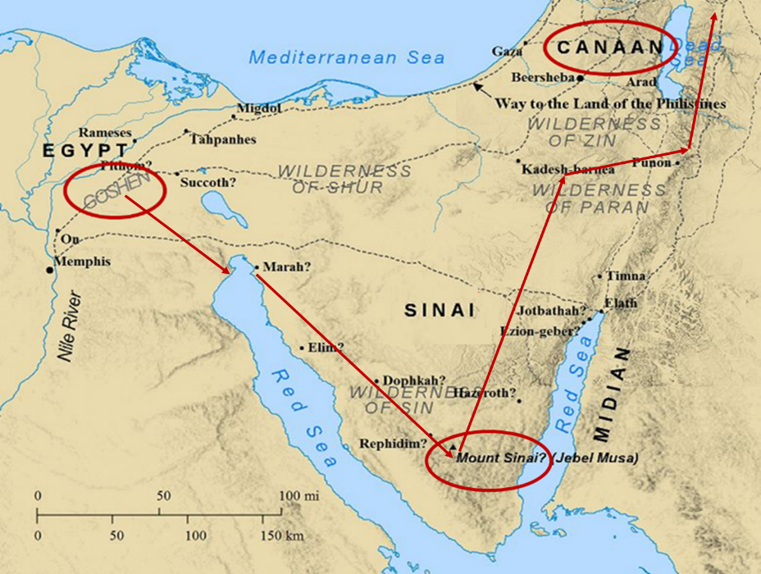

Slide 59
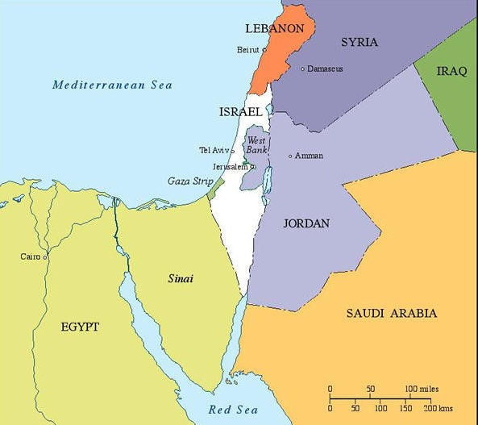

Slide 60
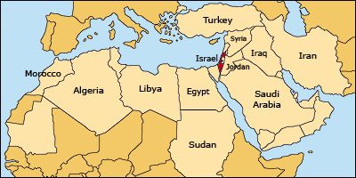

Slide 61
IV. Genesis 42:26-38 Brothers Return to Canaan
Return (26)
Brother’s first discovery (27-28)
Report to Jacob (29-34)
Brother’s second discovery (35)
Jacob’s reaction (36)
Reuben’s offer (37)
Jacob’s refusal (38)

Slide 62
Genesis 42:27-28 Brothers’ First Discovery
Discovery (27)
Report (28a)
Reaction (28b)

Slide 63
Genesis 42:27-28 Brothers’ First Discovery
Discovery (27)
Report (28a)
Reaction (28b)

Slide 64
Genesis 42:27-28 Brothers’ First Discovery
Discovery (27)
Report (28a)
Reaction (28b)

Slide 65
Genesis 42:27-28 Brothers’ First Discovery
Discovery (27)
Report (28a)
Reaction (28b)

Slide 66
IV. Genesis 42:26-38 Brothers Return to Canaan
Return (26)
Brother’s first discovery (27-28)
Report to Jacob (29-34)
Brother’s second discovery (35)
Jacob’s reaction (36)
Reuben’s offer (37)
Jacob’s refusal (38)

Slide 67
Genesis 42:29-34 Report to Jacob
Return (29)
Accusation (30)
Denial (31-32)
Test (33-34)

Slide 68
Genesis 42:29-34 Report to Jacob
Return (29)
Accusation (30)
Denial (31-32)
Test (33-34)

Slide 75
Genesis 42:29-34 Report to Jacob
Return (29)
Accusation (30)
Denial (31-32)
Test (33-34)

Slide 76
Genesis 42:29-34 Report to Jacob
Return (29)
Accusation (30)
Denial (31-32)
Test (33-34)

Slide 79
Genesis 42:29-34 Report to Jacob
Return (29)
Accusation (30)
Denial (31-32)
Test (33-34)

Slide 80
IV. Genesis 42:26-38 Brothers Return to Canaan
Return (26)
Brother’s first discovery (27-28)
Report to Jacob (29-34)
Brother’s second discovery (35)
Jacob’s reaction (36)
Reuben’s offer (37)
Jacob’s refusal (38)

Slide 81
Genesis 42:35 Brothers’ Second Discovery
Timing (35a)
Reaction (35b)

Slide 82
Genesis 42:35 Brothers’ Second Discovery
Timing (35a)
Reaction (35b)

Slide 83
Genesis 42:35 Brothers’ Second Discovery
Timing (35a)
Reaction (35b)

Slide 84
IV. Genesis 42:26-38 Brothers Return to Canaan
Return (26)
Brother’s first discovery (27-28)
Report to Jacob (29-34)
Brother’s second discovery (35)
Jacob’s reaction (36)
Reuben’s offer (37)
Jacob’s refusal (38)

Slide 87
IV. Genesis 42:26-38 Brothers Return to Canaan
Return (26)
Brother’s first discovery (27-28)
Report to Jacob (29-34)
Brother’s second discovery (35)
Jacob’s reaction (36)
Reuben’s offer (37)
Jacob’s refusal (38)

Slide 90
IV. Genesis 42:26-38 Brothers Return to Canaan
Return (26)
Brother’s first discovery (27-28)
Report to Jacob (29-34)
Brother’s second discovery (35)
Jacob’s reaction (36)
Reuben’s offer (37)
Jacob’s refusal (38)

Slide 93
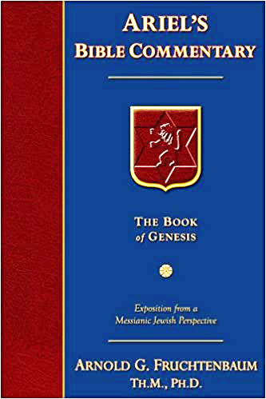
Dr. Arnold G. Fruchtenbaum
The Book of Genesis, 581
“The danger to Jacob was: If harm befall him by the way in which ye go, then will ye bring down my gray hairs with sorrow to Sheol. Jacob in this passage clearly anticipated going to Sheol at death, and the direction of Sheol was clearly downward not upward.”

Slide 94
Dr. Arnold G. Fruchtenbaum
The Book of Genesis, 537
“Jacob’s refusal is stated: He refused to be comforted; and he said, For I will go down to Sheol to my son in mourning. And his father wept for him. Sheol is the center of the earth, and before the death of the Messiah, all souls descended there upon death; but the faithful and unfaithful entered into different compartments in Sheol.”

Slide 95
Luke 16:24-26
“²⁴ And he cried out and said, ‘Father Abraham, have mercy on me, and send Lazarus so that he may dip the tip of his finger in water and cool off my tongue, for I am in agony in this flame.’ ²⁵ But Abraham said, ‘Child, remember that during your life you received your good things, and likewise Lazarus bad things; but now he is being comforted here, and you are in agony. ²⁶ And besides all this, between us and you there is a great chasm fixed, so that those who wish to come over from here to you will not be able, and that none may cross over from there to us.’”

Slide 96
Conclusion

Slide 97
Genesis 42:1-38 First Reunion
Jacob’s sons sent to Egypt (42:1-5)
First reunion (42:6-17)
Change of plans (42:18-25)
Brothers return to Canaan (42:26-38)

Slide 98
²⁴ The Lord bless you, and keep you; ²⁵ The Lord make His face shine on you, And be gracious to you; ²⁶ The Lord lift up His countenance on you, And give you peace.
Numbers 6:24–26 (NASB95)

