Slide 1
Law and Grace: An Overview Jim McGowan, Th.D. Sugar Land Bible Church 07-21-2024
…but grace and truth were realized through Jesus Christ - John 1:17
For the Law was given through Moses…
Special thanks to Dr. Vern Peterman for access to his insights and resources.

Slide 2
Session 44 Outline
Review
Purpose, Aim, and Objective
Session 43
Flood, Rock, & Sand - Matt. 7:24-29
General Observations
Matt. 7:24-29
Concluding Observations

Slide 3
OUR PURPOSE, AIM AND OBJECTIVE
Law and Grace
…is to Compare and Contrast Law and Grace so as to properly understand these two important themes and how they are related to the life of the New Testament Believer.

Slide 4
C. I. Scofield, D. D.
The Grace of God, The Fundamentals Vol. 3, Chapter VII, p. 98
We have, most of us, been reared and now live under the influence of Galatianism. Protestant theology, alas, is for the most part, thoroughly Galatianized, in that neither law nor grace are given their distinct and separated places, as in the counsels of God, but are mingled together in one incoherent system.
The law is no longer, as in the Divine intent, a ministration of death (2 Cor. 3:7), of cursing (Gal. 3:10), of conviction (Rom. 3:19), because we are taught that we must try to keep it, and that by Divine help we may.
Nor, on the other hand, does grace bring us blessed deliverance from the dominion of sin, for we are kept under the law as a rule of life despite the plain declaration, “Sin shall not have dominion over you: for ye are not under the law, but under grace” (Rom. 6:14). (emphasis mine)

Slide 5
William R. Newell
Romans Verse-by-Verse (p. 274).
Grand Rapids, MI: Christian Classics Ethereal Library.
It is because Reformed theology has kept us Gentiles under the Law,—if not as a means of righteousness, then as “a rule of life,” that all the trouble has arisen. The Law is no more a rule of life than it is a means of righteousness. Walking in the Spirit has now taken the place of walking by ordinances. God has another principle under which He has put his saints: “Ye are not under law, but, under grace! (Rom. 6:14)” (italics mine)
PDF Download Here: https://archive.org/details/Romans_Verse_By_Verse-NewellWR

Slide 6
Henry Ironside
The Continual Burnt Offering: Daily Meditations on the Word of God (p. 265). Neptune, NJ: Loizeaux Brothers.
In Romans 7 we have a man renewed by the Spirit of God, but struggling under law, hoping thereby to subdue or find deliverance from the power of the old Adamic nature. In chapter 8 we have God’s way of deliverance through the death and resurrection of Christ with which the believer is identified before God. The chapter begins with “no condemnation” and ends with “no separation.” All who are in Christ Jesus are accepted in the Beloved and as free from every charge of guilt as He is Himself. He paid our penalty on the cross. Now we are linked up with Him in resurrection, not under law but under grace.

Slide 7
Matthew’s 3-Fold Purpose
Law and Grace: Review – Matthew
To explain:
that Jesus in whom they had believed was the long-awaited Jewish Messiah
why the kingdom had been postponed despite the fact that the king had arrived
the interim program of God during the kingdom’s absence

Slide 8
Matthew and the Kingdom
Law and Grace: Review – Matthew
 | offered
 | rejected
 | postponed Interim program
 | ultimately accepted

Slide 9
Matthew’s Message
Law and Grace: Review – Matthew
Jesus is the predicted Jewish king who ushered in an interim program by building the sons of the kingdom into the Church in between Israel’s past rejection and future acceptance of her king.

Slide 10
Session 44 Outline
Review
Purpose, Aim, and Objective
Session 43
Flood, Rock, & Sand - Matt. 7:24-29
General Observations
Matt. 7:24-29
Concluding Observations

Slide 11
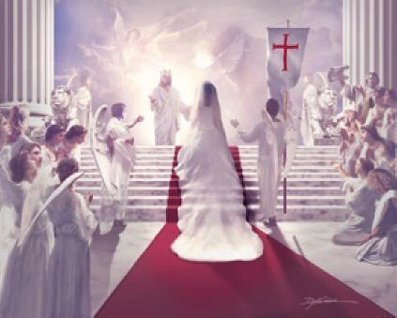
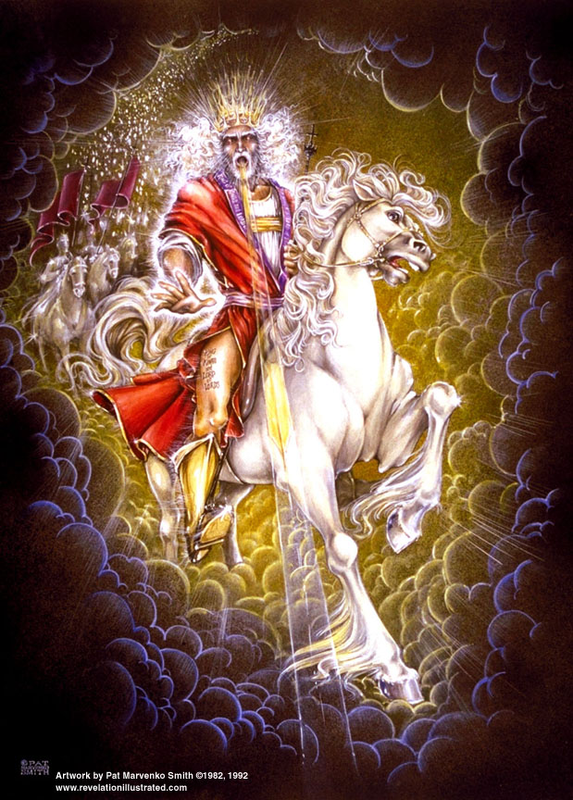
Law and Grace: Review – Relationship, Position, and Blessing – Does It Matter?
RELATIONSHIP, POSITION, AND BLESSING – DOES IT MATTER?
Christ will be the King of Israel and King of kings over the Gentiles, but He will be our groom.

Slide 12
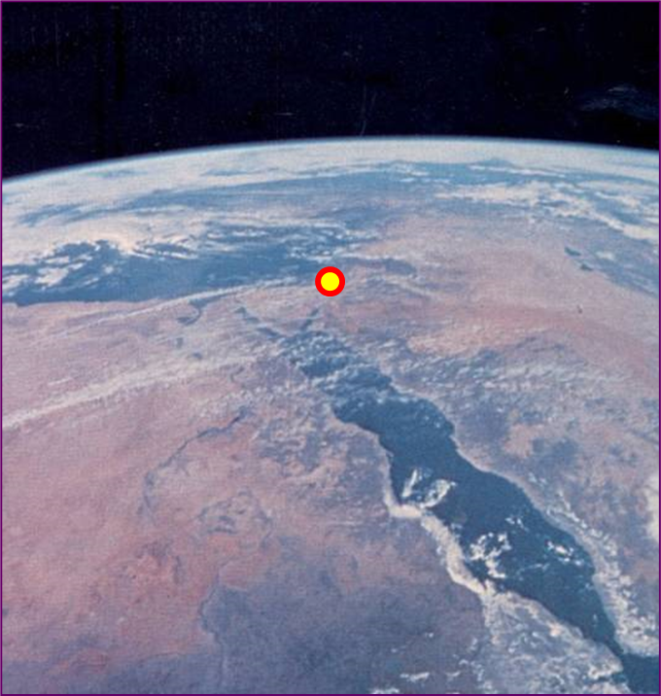
Law and Grace: Review – Relationship, Position, and Blessing – Does It Matter?
GENTILES, ISRAEL AND THE CHURCH
During the Millennial Kingdom the Gentiles will come to Jesus Christ the Messiah through the people of Israel. (cf. Zech. 8:23)
Christ reigning over the people of Israel in the land of Israel will be the fulfillment of the promised kingdom of God.
Zechariah 8:23

Slide 13
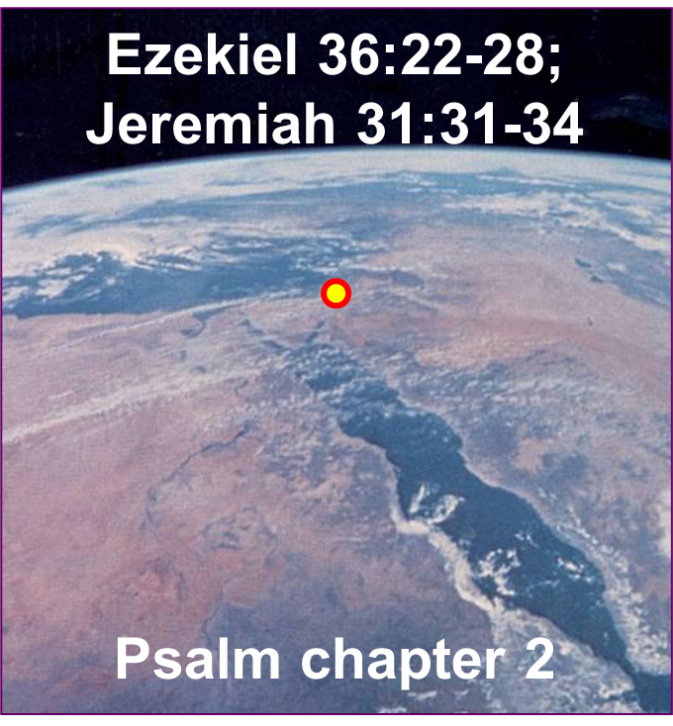
Law and Grace: Review – Relationship, Position, and Blessing – Does It Matter?
GENTILES, ISRAEL AND THE CHURCH
The people of Israel will be indwelt by the Holy Spirit to know and live out Kingdom Law. (cf. Ezekiel 36:22-28; Jeremiah 31:31-34)
The Gentiles will also be ruled under Kingdom Law as is indicated by the Scriptures use of the term, “rod of iron”. (cf. Psalm 2; Rev. 12:5).
But we in the Church will forever be the people of Grace.

Slide 14
Law and Grace: Review – Relationship, Position, and Blessing – Does It Matter?
THE CROSS WAS A CROSSROAD
The Cross does not mean the very same thing for all people of all time. For everyone, Christ’s death on the cross is His death for our sins (cf. 1 John 2:2).

Slide 15
Law and Grace: Review – Relationship, Position, and Blessing – Does It Matter?
THE CROSS WAS A CROSSROAD
But only we in the Church have been crucified with Him.

Slide 16
Law and Grace: Review – Relationship, Position, and Blessing – Does It Matter?
THE CROSS WAS A CROSSROAD
And for Israelites the Cross meant the blood ratification of the New Covenant (Jeremiah 31:31-34; Luke 22:20).

Slide 17
Law and Grace: Review – Relationship, Position, and Blessing – Does It Matter?
It’s Grace not Law for the Church!
Grace is and will be the reigning principle! (cf. Rom. 5:17; 21)
Grace is to be our motivation in life! (Eph. 4:32; Col. 3:12-13)
Grace is to be a strengthener (Heb. 13:9)
God’s grace to us is from ABBA’s wealth of grace! (Eph. 2:6-7)
God’s demonstration of grace will occupy us forever! (Eph. 2:6-7; 1 Cor. 2:9)

Slide 18
Session 44 Outline
Review
Purpose, Aim, and Objective
Session 43
Flood, Rock, & Sand - Matt. 7:24-29
General Observations
Matt. 7:24-29
Concluding Observations

Slide 19
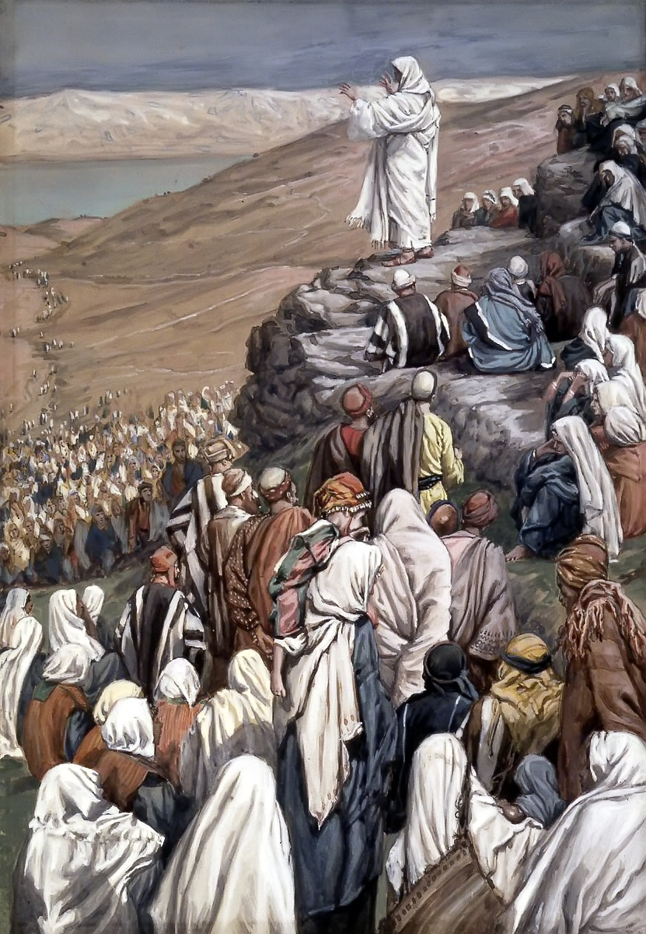
Law and Grace: The SOM – Matthew 5:1–8:1 (Luke 6:17–49)
WE’RE BACK IN THE BOOK OF MATTHEW
Matthew 7:24-29
Except for the introduction and the last few verses of the Sermon on the Mount, all the words are the words of Jesus!
Nowhere in the Sermon on the Mount is the message of the Cross taught, preached, or declared!

Slide 20
THE SERMON ON THE MOUNT - WHAT IT IS
Law and Grace: Session 24 The SOM – Matthew 5:1–8:1 (Luke 6:17–49)
In its context—in the Jewish frame of reference in which it was spoken—the Sermon on the Mount is the Messiah’s interpretation of the standard of righteousness, which the Law demanded, put in contrast with the Pharisaic interpretation of the kind of righteousness, which the Law demanded. A better title for this “sermon” would be “The Messiah’s Interpretation of the Righteousness of the Law.” So, as a unit, it is the Messiah’s interpretation of the kind of righteousness, which the Law demanded, stated in contradistinction to the Pharisaic interpretation of the kind of righteousness that the Law demanded. The difference is between mere external conformity in contrast to internal conformity that naturally lends itself to external conformity.
Fruchtenbaum, A. G. (1983). The Messianic Bible Study Collection
(Vol. 94, pp. 6–7). Tustin, CA: Ariel Ministries.

Slide 21
HOW DID CHRIST INTEND FOR US TO VIEW THE SERMON ON THE MOUNT?
Law and Grace: Session 25 The SOM – Matthew 5:1–8:1 (Luke 6:17–49)
The sermon was designed to lead [the Jewish] multitude away from a false concept of righteousness to a true concept of righteousness; from a false hope of entrance into the kingdom to a sure foundation for entrance into Messiah’s kingdom…the Sermon on the Mount in its historical setting was Christ’s instruction to that generation to which He was offering Himself as Saviour and Sovereign…
Pentecost, J. D. (1995). Thy Kingdom Come: Tracing God’s Kingdom Program and Covenant Promises throughout History (pp. 205–206). Grand Rapids, MI: Kregel Publications.

Slide 22
Law and Grace: Session 27 The SOM – Matthew 5:1–8:1 (Luke 6:17–49)
TO WHOM IS JESUS SPEAKING IN THE SOM?
Roses are red
And violets are bluish
All of those listening to Jesus are Jewish!

Slide 23
Law and Grace: The SOM – Matthew 5:1–8:1 (Luke 6:17–49)
CONTEXT, CONTEXT, CONTEXT!
Matthew 7:24-29

Slide 24
Session 44 Outline
Review
Purpose, Aim, and Objective
Session 43
Flood, Rock, & Sand - Matt. 7:24-29
General Observations
Matt. 7:24-29
Concluding Observations

Slide 25
Matthew 7:24–29
²⁴ “Therefore everyone who hears these words of Mine and acts on them, may be compared to a wise man who built his house on the rock. ²⁵ “And the rain fell, and the floods came, and the winds blew and slammed against that house; and yet it did not fall, for it had been founded on the rock. ²⁶ “Everyone who hears these words of Mine and does not act on them, will be like a foolish man who built his house on the sand. ²⁷ “The rain fell, and the floods came, and the winds blew and slammed against that house; and it fell—and great was its fall.” ²⁸ When Jesus had finished these words, the crowds were amazed at His teaching; ²⁹ for He was teaching them as one having authority, and not as their scribes.

Slide 26
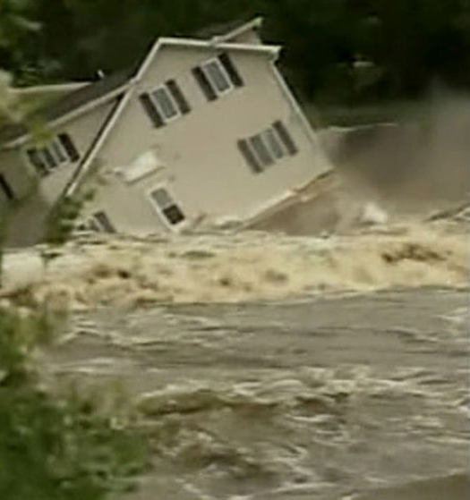
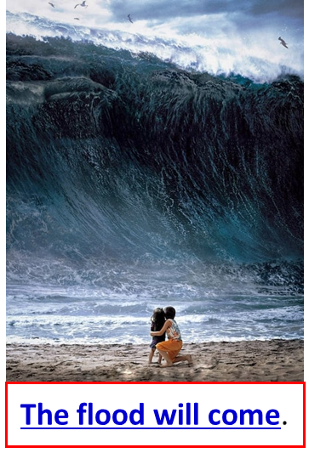
Law and Grace: The SOM – Matthew 5:1–8:1 (Luke 6:17–49)
WE’RE BACK IN THE BOOK OF MATTHEW
Matthew 7:24-29
This is the well-known passage about building your life upon the rock rather than the sand, in order to remain standing after the flood.

Slide 27
Law and Grace: The SOM – Matthew 5:1–8:1 (Luke 6:17–49)
TWO MEN, TWO HOUSES, AND TWO FOUNDATIONS
Matthew 7:24, 26
To get His point across Jesus uses a powerful illustration.
Two men,
Two houses
Two foundations
Two outcomes

Slide 28
Law and Grace: The SOM – Matthew 5:1–8:1 (Luke 6:17–49)
JESUS HAD THEIR ATTENTION
Matthew 7:24, 26
Keep in mind here that these Israelites had just heard Jesus speak about the speck and the beam and the narrow gate and the wide gate!

Slide 29
Matthew 7:24–29
²⁴ “Therefore everyone who hears these words of Mine and acts on them, may be compared to a wise man who built his house on the rock. ²⁵ “And the rain fell, and the floods came, and the winds blew and slammed against that house; and yet it did not fall, for it had been founded on the rock. ²⁶ “Everyone who hears these words of Mine and does not act on them, will be like a foolish man who built his house on the sand. ²⁷ “The rain fell, and the floods came, and the winds blew and slammed against that house; and it fell—and great was its fall.” ²⁸ When Jesus had finished these words, the crowds were amazed at His teaching; ²⁹ for He was teaching them as one having authority, and not as their scribes.

Slide 30
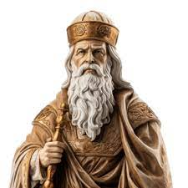
Law and Grace: The SOM – Matthew 5:1–8:1 (Luke 6:17–49)
BOTH HEAR, BUT THE WISE MAN ACTS ON IT!
Matthew 7:24, 26
In the illustration that Jesus makes, both men hear what Jesus says, but the one who is wise is the one who acts on what he has heard Christ say.

Slide 31
Matthew 7:24–29
²⁴ “Therefore everyone who hears these words of Mine and acts on them, may be compared to a wise man who built his house on the rock. ²⁵ “And the rain fell, and the floods came, and the winds blew and slammed against that house; and yet it did not fall, for it had been founded on the rock. ²⁶ “Everyone who hears these words of Mine and does not act on them, will be like a foolish man who built his house on the sand. ²⁷ “The rain fell, and the floods came, and the winds blew and slammed against that house; and it fell—and great was its fall.” ²⁸ When Jesus had finished these words, the crowds were amazed at His teaching; ²⁹ for He was teaching them as one having authority, and not as their scribes.

Slide 32
Law and Grace: The SOM – Matthew 5:1–8:1 (Luke 6:17–49)
BOTH HEAR, BUT THE FOOLISH MAN REFUSES TO ACT
Matthew 7:24, 26
In contrast, the foolish person is the one who hears what Jesus says and does nothing with it.

Slide 33
Law and Grace: The SOM – Matthew 5:1–8:1 (Luke 6:17–49)
TAKE IT TO HEART AND APPLY IT!
Matthew 7:24-27
Jesus’ point in this passage is that those who had been hearing His teaching in the SOM now need to make sure that they are taking it to heart and applying it to their life!

Slide 34
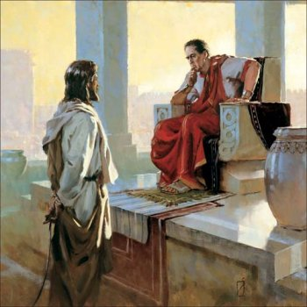
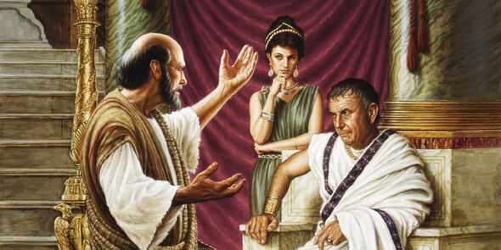
Law and Grace: The SOM – Matthew 5:1–8:1 (Luke 6:17–49)
OTHER FOOLISH MEN
John 18:38; Acts 24:24-25
When confronted with Jesus’ statement about bearing witness to the truth, Pilate’s response was, “What is Truth!” (cf. John 18:38)
When confronted with Paul’s preaching, Felix became frightened and sent Paul away. (cf. Acts 24:24-25)

Slide 35
James 1:22–24
²² But prove yourselves doers of the word, and not merely hearers who delude themselves. ²³ For if anyone is a hearer of the word and not a doer, he is like a man who looks at his natural face in a mirror; ²⁴ for once he has looked at himself and gone away, he has immediately forgotten what kind of person he was.

Slide 36
Law and Grace: The SOM – Matthew 5:1–8:1 (Luke 6:17–49)
THE WISE MAN BUILDS HIS HOUSE UPON THE ROCK
Matthew 7:24-27
The pivotal issue is where the house is built – the house built upon the rock is built on a solid foundation.

Slide 37
Law and Grace: The SOM – Matthew 5:1–8:1 (Luke 6:17–49)
THE WISE MAN BUILDS HIS HOUSE UPON THE ROCK
Matthew 7:24-27
God is called the Rock in several books of the Old Testament (cf. Proverbs 10:1, 4, 14; 14:1, 3; 15:20; 21:20; 29:9 Ecclesiastes 4:13; 10:2), and…
Christ is called the Rock in several books in the New Testament (cf. Romans 1:14; 1 Corinthians 1:20, 27; 3:18; 2 Corinthians 11:19).
And contrasting the wise and the foolish is a common Old Testament and New Testament theme.

Slide 38
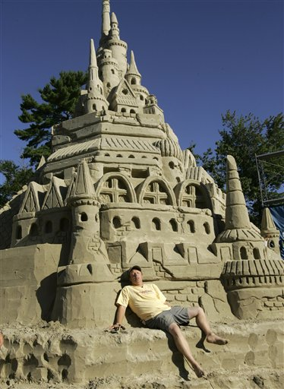
Law and Grace: The SOM – Matthew 5:1–8:1 (Luke 6:17–49)
THE FOOLISH MAN BUILDS HIS HOUSE UPON THE SAND
Matthew 7:24-27
Building houses on sand, or of sand, is actually pretty easy to do – and kind of fun!

Slide 39
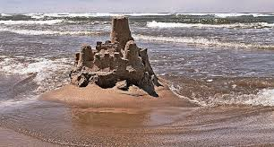
Law and Grace: The SOM – Matthew 5:1–8:1 (Luke 6:17–49)
THE FOOLISH MAN BUILDS HIS HOUSE UPON THE SAND
Matthew 7:24-27
For a time, it may even look rather impressive!

Slide 40
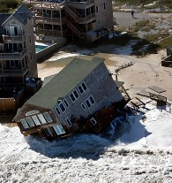
Law and Grace: The SOM – Matthew 5:1–8:1 (Luke 6:17–49)
THE FOOLISH MAN BUILDS HIS HOUSE UPON THE SAND
Matthew 7:24-27
Jesus is not making a glib or flippant point – the reality is that houses built on sand, will fail, and fail catastrophically! It is only a question of when.

Slide 41
Law and Grace: The SOM – Matthew 5:1–8:1 (Luke 6:17–49)
THE FOOLISH MAN BUILDS HIS HOUSE UPON THE SAND
Matthew 7:24-27
Remember that Jesus is using an illustration addressing the issue of Jewish entrance into the kingdom, and His illustration is emphasizing the need for proper decision making by the Israelites
A secondary but critical point addressed in this illustration is God’s testing!

Slide 42
Law and Grace: The SOM – Matthew 5:1–8:1 (Luke 6:17–49)
THERE ARE GREATER PRINCIPLES TO BE DRAWN HERE
Matthew 7:24-27
Even though Jesus was speaking to the Israelites living in the land of Israel, who were all under the Law of Moses, we can draw some critical principles from the words He spoke to them.

Slide 43
Law and Grace: The SOM – Matthew 5:1–8:1 (Luke 6:17–49)
THERE ARE GREATER PRINCIPLES TO BE DRAWN HERE
Matthew 7:24-27
Remember that the word ‘principle’ means:
a fundamental truth or perspective or,
the way things work – sometimes both of these definitions, as is the case with this passage.

Slide 44
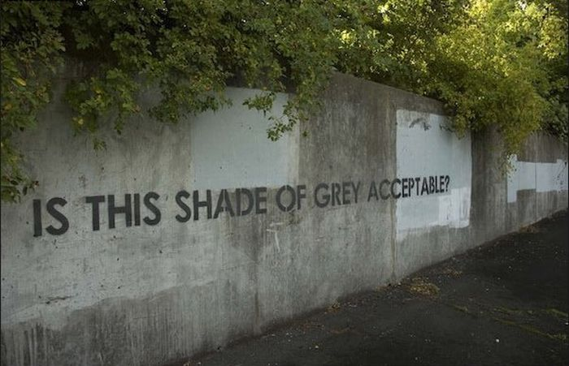
Law and Grace: The SOM – Matthew 5:1–8:1 (Luke 6:17–49)
NOT EVERYTHING IN LIFE & ETERNITY IS INCONSEQUENTIAL
Matthew 7:24-27
The 1st principle is that not everything in life and eternity is gray-scale or inconsequential and issues can take a long time to become evident and apparent.

Slide 45
Law and Grace: The SOM – Matthew 5:1–8:1 (Luke 6:17–49)
NOT EVERYTHING IN LIFE & ETERNITY IS INCONSEQUENTIAL
Matthew 7:24-27
God’s word reveals to us what is of great eternal consequence and what is not!
The Bible tells us what is important and what is not because God loves us, and He wants us to know that true wisdom is from Him.

Slide 46
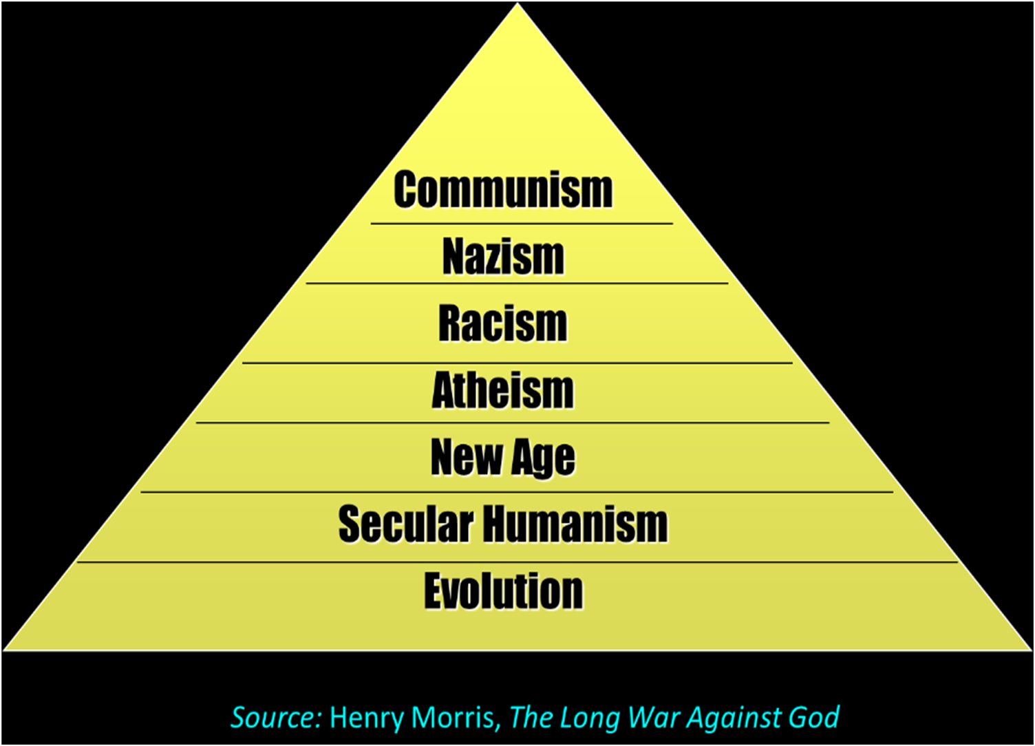
Law and Grace: The SOM – Matthew 5:1–8:1 (Luke 6:17–49)
THERE IS ONLY ONE VALID APPROACH TO LIFE – SPIRITUAL
Matthew 7:24-27
The world system is increasingly pushing to enforce a non-spiritual approach to life, i.e., both secular, and non-theistic.
Atheism:
Let’s all pretend that life has no meaning…
Let’s be morally outraged at the Christians, even though we have no rational basis for morality.

Slide 47
Law and Grace: The SOM – Matthew 5:1–8:1 (Luke 6:17–49)
THERE IS ONLY ONE VALID APPROACH TO LIFE – SPIRITUAL
Matthew 7:24-27
What is presented to the world as the only proper spiritual approach to life is in fact, increasingly devoid of truth as singularly and specifically based in the One True God of the Bible.

Slide 48
Law and Grace: The SOM – Matthew 5:1–8:1 (Luke 6:17–49)
THERE IS ONLY ONE VALID APPROACH TO LIFE – SPIRITUAL
Matthew 7:24-27
But the Word of God and the words of Jesus are a singular, specific and absolute truth deliberately revealed for us.

Slide 49
Law and Grace: The SOM – Matthew 5:1–8:1 (Luke 6:17–49)
GOD’S SPECIFIC, DELIBERATELY REVEALED, ABSOLUTE TRUTH
Matthew 7:24-27
God’s specific, deliberately revealed, absolute truth was never intended to just sit on our mental bookshelves.

Slide 50
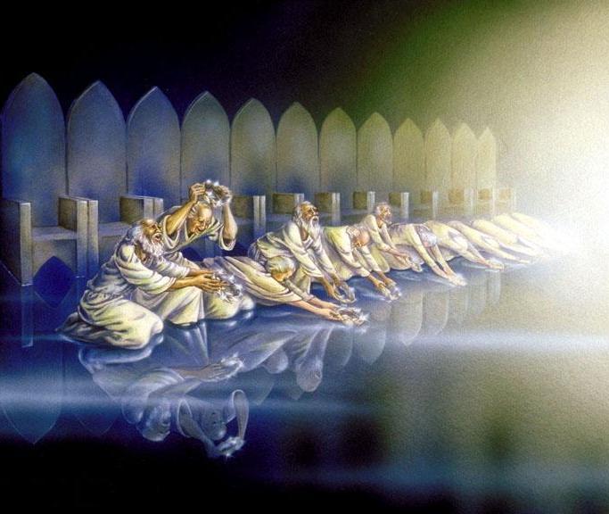
Law and Grace: The SOM – Matthew 5:1–8:1 (Luke 6:17–49)
GOD’S SPECIFIC, DELIBERATELY REVEALED, ABSOLUTE TRUTH
Matthew 7:24-27
God’s specific, deliberately revealed, absolute truth was and is intended to be lived out in this life, so that we would share in His life in all of the ages to come.

Slide 51
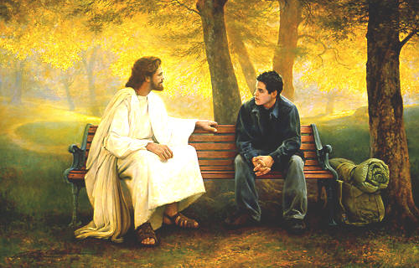
Law and Grace: The SOM – Matthew 5:1–8:1 (Luke 6:17–49)
GOD’S SPECIFIC, DELIBERATELY REVEALED, ABSOLUTE TRUTH
Matthew 7:24-27
God’s specific, deliberately revealed, absolute truth was and is intended for fellowship with Him!

Slide 52
Law and Grace: The SOM – Matthew 5:1–8:1 (Luke 6:17–49)
TESTING AND JUDGMENT ARE INEVITABLE
Matthew 7:24-27
Jesus spends zero time on debating and discussing whether or not the flood will come – it will.
As a broad and true generalization for all of humanity, times of testing and assessment and judgment will be coming for everyone.

Slide 53
Law and Grace: The SOM – Matthew 5:1–8:1 (Luke 6:17–49)
FOR US IN THE CHURCH, THE BODY OF CHRIST…

Slide 54
Law and Grace: The SOM – Matthew 5:1–8:1 (Luke 6:17–49)
FOR US IN THE CHURCH, THE BODY OF CHRIST…

Slide 55
Law and Grace: The SOM – Matthew 5:1–8:1 (Luke 6:17–49)
FOR US IN THE CHURCH, THE BODY OF CHRIST…

Slide 56
Law and Grace: The SOM – Matthew 5:1–8:1 (Luke 6:17–49)
FOR US IN THE CHURCH, THE BODY OF CHRIST…
…the issue is how we build:
The foundation for us has already been founded upon Christ as the cornerstone, and the apostles and prophets.

Slide 57
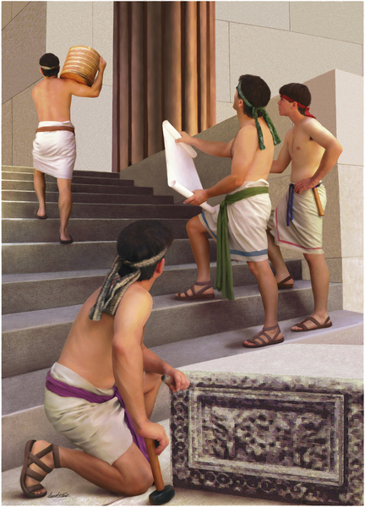
Law and Grace: The SOM – Matthew 5:1–8:1 (Luke 6:17–49)
HOW WE IN THE CHURCH, BUILD…
God Himself will accomplish His building of the Body of Christ, but each believer has a specific purpose and part in God’s process of building.
How we build upon the foundation that is now laid, will be assessed and rewarded! (cf. 1 Corinthians 3:10-15, Ephesians 2:21-22)

Slide 58
1 Corinthians 3:10-15
¹⁰ According to the grace of God which was given to me, like a wise master builder I laid a foundation, and another is building on it. But each man must be careful how he builds on it. ¹¹ For no man can lay a foundation other than the one which is laid, which is Jesus Christ. ¹² Now if any man builds on the foundation with gold, silver, precious stones, wood, hay, straw, ¹³ each man's work will become evident; for the day will show it because it is to be revealed with fire, and the fire itself will test the quality of each man's work. ¹⁴ If any man's work which he has built on it remains, he will receive a reward. ¹⁵ If any man's work is burned up, he will suffer loss; but he himself will be saved, yet so as through fire.

Slide 59
Scripture’s Five Crowns (Rev 4:10: 3:11; 2 John 8)
Scripture | Crown | Purpose
1 Cor. 9:24-27 | Victor’s, Incorruptible | Gaining mastery over the flesh
1 Thess. 2:19-20 | Church Founder’s, Rejoicing | Soul winning
Jas. 1:12; Rev. 2:10 | Trial, Life | Enduring trials
1 Pet. 5:2-4 | Elder’s Service, Glory | Shepherding God’s people
2 Tim. 4:8 | Rapture Lover’s, Righteousness | Longing for His appearing

Slide 60
Three Rewards
Scripture | Reward
1 Corinthians 3:14 | Solid Foundation Reward
1 Corinthians 9:17 | Voluntary Service Reward
Colossians 3:23-24 | Inheritance Reward

Slide 61
Session 44 Outline
Review
Purpose, Aim, and Objective
Session 43
Flood, Rock, & Sand - Matt. 7:24-29
General Observations
Matt. 7:24-29
Concluding Observations

Slide 62
Matthew 7:24–29
²⁴ “Therefore everyone who hears these words of Mine and acts on them, may be compared to a wise man who built his house on the rock. ²⁵ “And the rain fell, and the floods came, and the winds blew and slammed against that house; and yet it did not fall, for it had been founded on the rock. ²⁶ “Everyone who hears these words of Mine and does not act on them, will be like a foolish man who built his house on the sand. ²⁷ “The rain fell, and the floods came, and the winds blew and slammed against that house; and it fell—and great was its fall.” ²⁸ When Jesus had finished these words, the crowds were amazed at His teaching; ²⁹ for He was teaching them as one having authority, and not as their scribes.

Slide 63
Law and Grace: The SOM – Matthew 5:1–8:1 (Luke 6:17–49)
WHEN JESUS HAD FINISHED…
Matthew 7:28-29
Matt. 7:28 – When Jesus had finished these words…
Matt. 11:1 – When Jesus had finished giving instructions…He departed…
Matt. 13:53 – When Jesus had finished these parables…He departed…
Matt. 19:1 – When Jesus had finished these words…He departed…
Matt. 26:1 – When Jesus had finished all these words…He said to His disciples…

Slide 64
Matthew 7:24–29
²⁴ “Therefore everyone who hears these words of Mine and acts on them, may be compared to a wise man who built his house on the rock. ²⁵ “And the rain fell, and the floods came, and the winds blew and slammed against that house; and yet it did not fall, for it had been founded on the rock. ²⁶ “Everyone who hears these words of Mine and does not act on them, will be like a foolish man who built his house on the sand. ²⁷ “The rain fell, and the floods came, and the winds blew and slammed against that house; and it fell—and great was its fall.” ²⁸ When Jesus had finished these words, the crowds were amazed at His teaching; ²⁹ for He was teaching them as one having authority, and not as their scribes.

Slide 65
Law and Grace: The SOM – Matthew 5:1–8:1 (Luke 6:17–49)
JESUS TAUGHT WITH AUTHORITY – NOT JUST QUOTING OTHERS
Matthew 7:28-29
It was common for the Jewish rabbis and scribes to:
present their listeners with Dichotomies
present their listeners with Quandaries,
and leave their listeners with ongoing unresolved tension,
generally just quote others rabbis.

Slide 66
Law and Grace: The SOM – Matthew 5:1–8:1 (Luke 6:17–49)
JESUS TAUGHT WITH AUTHORITY – NOT JUST QUOTING OTHERS
Matthew 7:28-29
But Jesus would speak with authority and finality, setting out His words as the only wise foundation because when Jesus spoke, he did so as the voice of God, which makes sense, since He is eternal deity.

Slide 67
Law and Grace: The SOM – Matthew 5:1–8:1 (Luke 6:17–49)
OVERFLOWING GRATITUDE!

Slide 68
Law and Grace: An Overview Jim McGowan, Th.D. Sugar Land Bible Church 07-21-2024
…but grace and truth were realized through Jesus Christ - John 1:17
For the Law was given through Moses…
Special thanks to Dr. Vern Peterman for access to his insights and resources.

