Slide 1
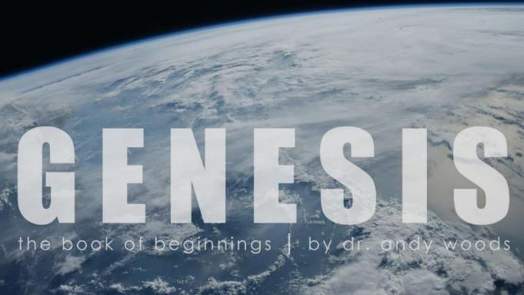

Genesis 12‒50
Israel’s Birth & Preservation

Slide 2
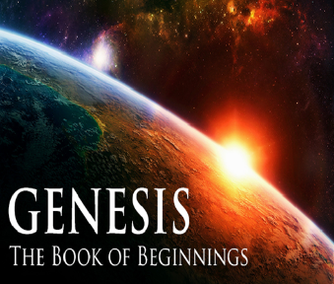
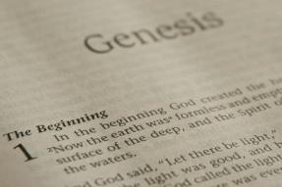
GENESIS STRUCTURE
  Genesis 12-50 (four people)
    Abraham (12:1–25:11)
    Isaac (25:12–26:35)
    Jacob (27–36)
    Joseph (37–50)

Slide 3
Genesis 37‒50
Joseph
  Joseph sold unto Egypt (37)
  Canaan’s corruption (38)
  Joseph falsely accused (39)
  Joseph’s short-term predictions (40)
  Joseph’s elevation (41)
  Joseph’s first reunion with his brothers (42)

Slide 4
Genesis 42:1-38
First Reunion
  Jacob’s sons sent to Egypt (42:1-5)
  First reunion (42:6-17)
  Change of plans (42:18-25)
  Brothers return to Canaan (42:26-38)

Slide 5
Genesis 42:1-38
First Reunion
  Jacob’s sons sent to Egypt (42:1-5)
  First reunion (42:6-17)
  Change of plans (42:18-25)
  Brothers return to Canaan (42:26-38)

Slide 6
I. Genesis 42:1-5
Jacob’s Sons Sent to Egypt
    Jacob’s instructions (1-2)
    Departure from Canaan to Egypt (3)
    Exception (4)
    Arrival in Egypt (5)

Slide 7
I. Genesis 42:1-5
Jacob’s Sons Sent to Egypt
    Jacob’s instructions (1-2)
    Departure from Canaan to Egypt (3)
    Exception (4)
    Arrival in Egypt (5)

Slide 8
Genesis 42:1-2
Jacob’s Instructions
      Occasion (1a)
      Rhetorical question (1b)
      Instructions (2)

Slide 9
Genesis 42:1-2
Jacob’s Instructions
      Occasion (1a)
      Rhetorical question (1b)
      Instructions (2)

Slide 10
Genesis 42:1-2
Jacob’s Instructions
      Occasion (1a)
      Rhetorical question (1b)
      Instructions (2)

Slide 11


Charles Ryrie
The Ryrie Study Bible, page 54
Genesis 42:1 (RSBEE:NASB1995U): 42:1 “Jacob’s sons sat around looking at each other helplessly instead of trying to find grain to eat.”

Slide 12
Genesis 42:1-2
Jacob’s Instructions
      Occasion (1a)
      Rhetorical question (1b)
      Instructions (2)

Slide 13
I. Genesis 42:1-5
Jacob’s Sons Sent to Egypt
    Jacob’s instructions (1-2)
    Departure from Canaan to Egypt (3)
    Exception (4)
    Arrival in Egypt (5)

Slide 14
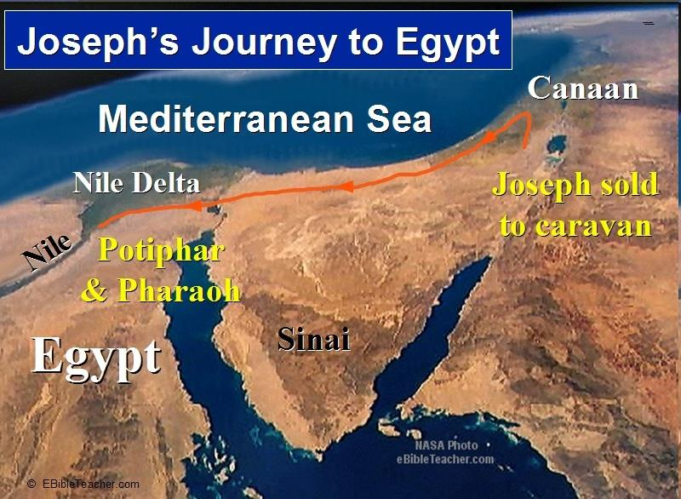

Slide 15
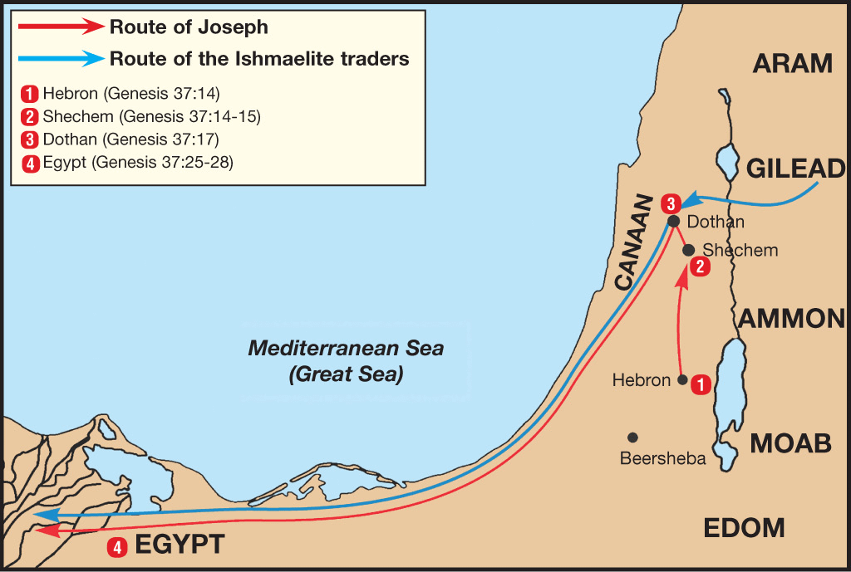

Slide 16
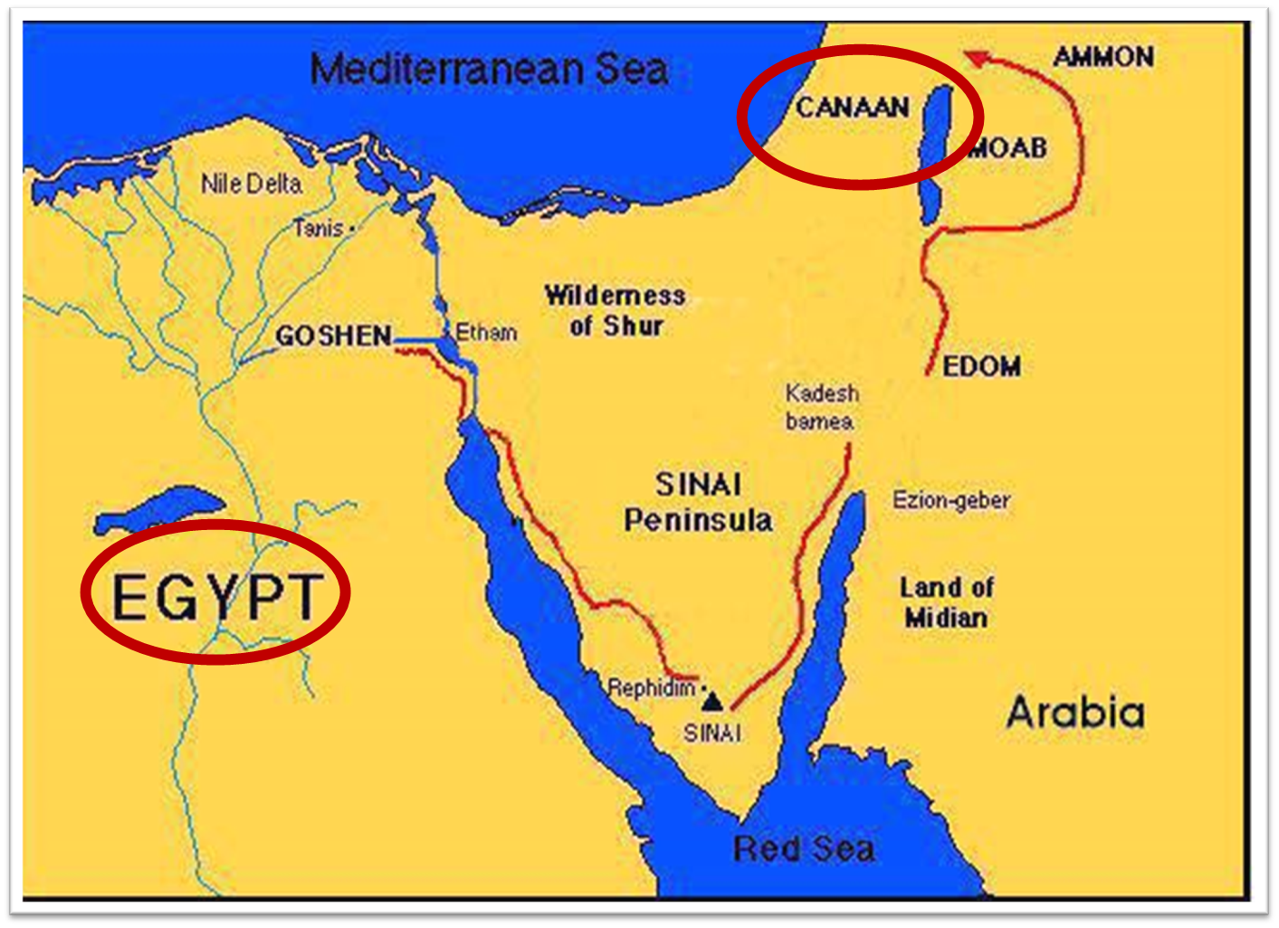

Slide 17
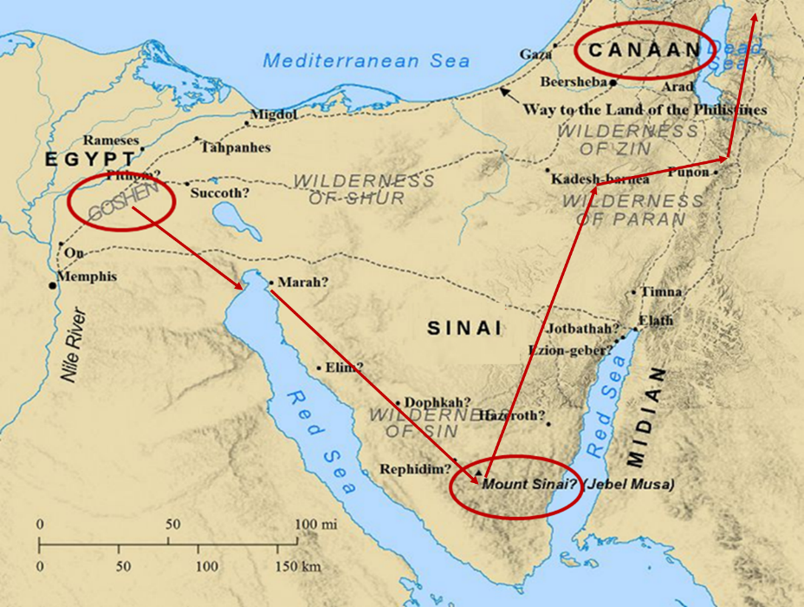

Slide 18
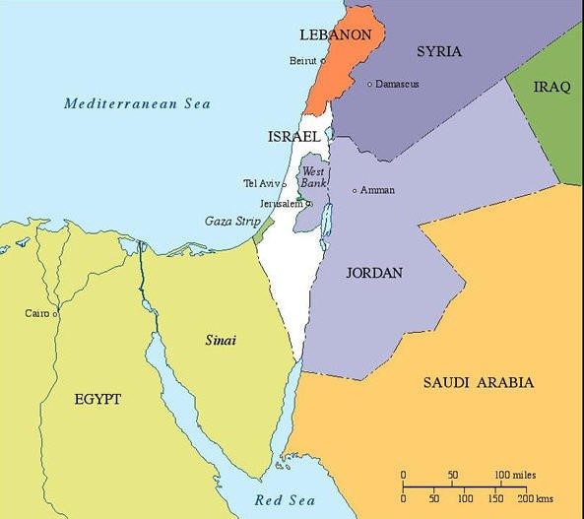

Slide 19
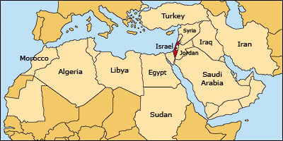

Slide 20
I. Genesis 42:1-5
Jacob’s Sons Sent to Egypt
    Jacob’s instructions (1-2)
    Departure from Canaan to Egypt (3)
    Exception (4)
    Arrival in Egypt (5)

Slide 21
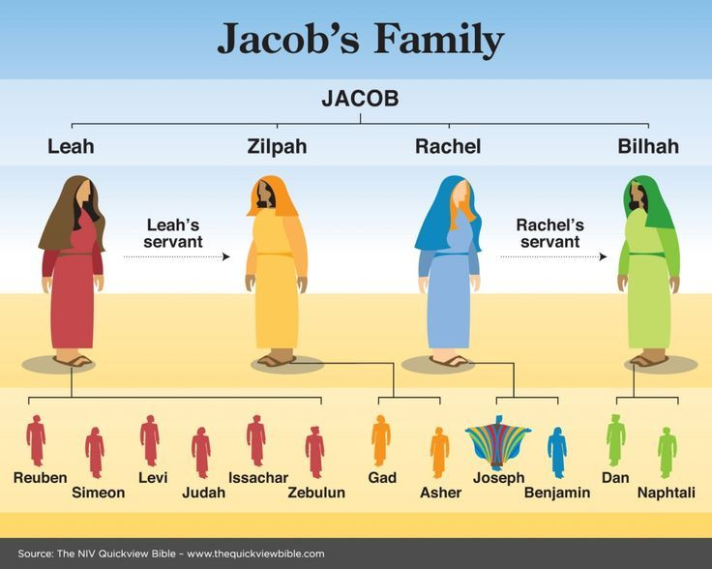

Slide 22
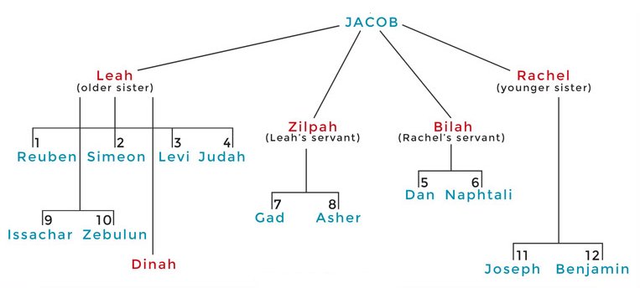

Slide 23
I. Genesis 42:1-5
Jacob’s Sons Sent to Egypt
    Jacob’s instructions (1-2)
    Departure from Canaan to Egypt (3)
    Exception (4)
    Arrival in Egypt (5)

Slide 30
Genesis 42:1-38
First Reunion
  Jacob’s sons sent to Egypt (42:1-5)
  First reunion (42:6-17)
  Change of plans (42:18-25)
  Brothers return to Canaan (42:26-38)

Slide 31
II. Genesis 42:6-17
First Reunion
    Meeting (6)
    Joseph’s recognition (7-9a)
    Joseph’s first accusation (9b)
    Brothers’ first denial (10-11)
    Joseph’s second accusation (12)
    Brothers’ second denial (13)
    Challenge for vindication (14-17)

Slide 32
II. Genesis 42:6-17
First Reunion
    Meeting (6)
    Joseph’s recognition (7-9a)
    Joseph’s first accusation (9b)
    Brothers’ first denial (10-11)
    Joseph’s second accusation (12)
    Brothers’ second denial (13)
    Challenge for vindication (14-17)

Slide 33
II. Genesis 42:6-17
First Reunion
    Meeting (6)
    Joseph’s recognition (7-9a)
    Joseph’s first accusation (9b)
    Brothers’ first denial (10-11)
    Joseph’s second accusation (12)
    Brothers’ second denial (13)
    Challenge for vindication (14-17)

Slide 34
Genesis 42:7-9a
Recognition
      Recognition (7)
      Brothers’ lack of recognition (8)
      Prophetic fulfillment (9a)

Slide 35
Genesis 42:7-9a
Recognition
      Recognition (7)
      Brothers’ lack of recognition (8)
      Prophetic fulfillment (9a)

Slide 36
Genesis 42:7-9a
Recognition
      Recognition (7)
      Brothers’ lack of recognition (8)
      Prophetic fulfillment (9a)

Slide 37

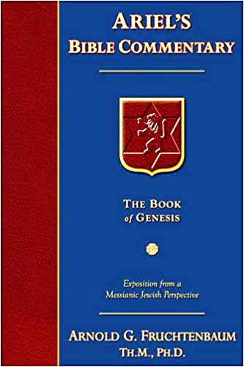
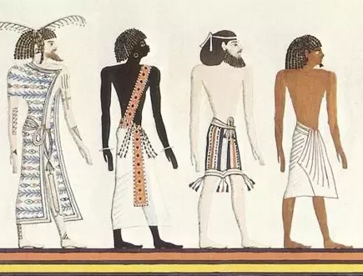
Dr. Arnold G. Fruchtenbaum
The Book of Genesis, 563-64
“Furthermore: and he shaved himself, since Egyptians did not approve of beards. In the Egyptian paintings, Semites are pictured as having beards while the Egyptians are clean shaven.”

Slide 38
Charles Ryrie
The Ryrie Study Bible, page 55
Genesis 42:8 (RSBEE:NASB1995U): 42:8 “they did not recognize him since he was a teenager when enslaved, but now was grown, clean-shaved, in Egyptian clothes, and using an interpreter.”

Slide 39
Genesis 42:7-9a
Recognition
      Recognition (7)
      Brothers’ lack of recognition (8)
      Prophetic fulfillment (9a)

Slide 40
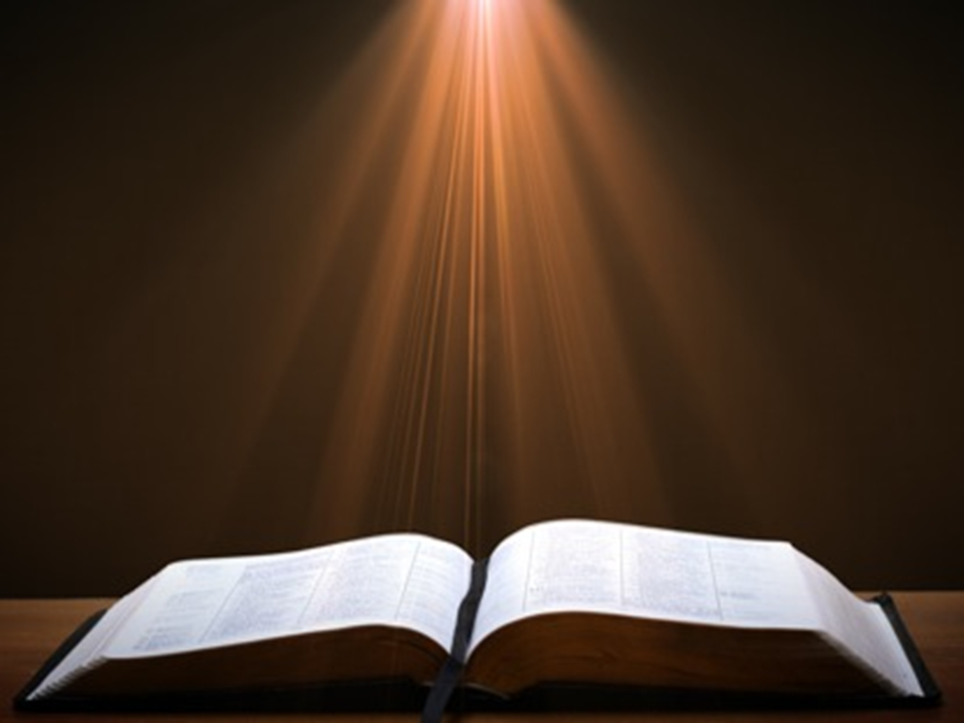
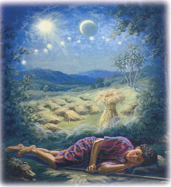
Genesis 37:9
Now he had still another dream, and related it to his brothers, and said, “Lo, I have had still another dream; and behold, the sun and the moon and eleven stars were bowing down to me.”

Slide 41

Genesis 37:10
He related it to his father and to his brothers; and his father rebuked him and said to him, “What is this dream that you have had? Shall I and your mother and your brothers actually come to bow ourselves down before you to the ground?”

Slide 42

Sun = Jacob
Moon = Leah
11 Stars = Joseph’s brothers
12th Star = Joseph
12 Stars = Israel’s twelve tribes

Slide 43
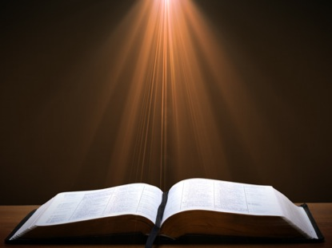

John 13:19; 14:29
“^{13:19} From now on I am telling you before it comes to pass, so that when it does occur, you may believe that I am He… ^{14:29} Now I have told you before it happens, so that when it happens, you may believe.”

Slide 44
What Happened to Christ’s Disciples?
Disciple | Place | Martyrdom
James the Son of Alpheus | Jerusalem | Clubbed to death
Simon the Zealot | Jerusalem | Martyred
James the Son of Zebedee | Judea (Acts 12:2) | Executed
Thaddeus | Mesopotamia | Beaten to death
Peter | Babylon, Rome | Crucified upside down
Matthew | Parthia (Tehran) | Beheaded
Notes:
109 prophecies…
Peter Stoner – SCIENCE SPEAKS, An Evaluation of Certain Christian Evidences
To fulfill just 8 prophecies =1 X 10 to the twenty-eighth power!
Can we visualize this with an illustration? Suppose we took an atheistic professor, blindfolded him and covered the state of Texas two feet deep with silver dollars. Then we put a check on one of those silver dollars and mixed them up. The odds of one person fulfilling just these eight prophecies would be the same as this atheistic professor selecting the silver dollar upon which we have placed a check, in his first try.
https://www.bereanpublishers.com/the-odds-of-eight-messianic-prophecies-coming-true/

Slide 45
What Happened to Christ’s Disciples?
Disciple | Place | Martyrdom
John | Asia Minor, Patmos, Ephesus | Fried in boiling oil
Philip | E. Turkey | Tortured & crucified
Thomas | India | Speared
Bartholomew | India | Flayed & crucified
Andrew | Ukraine, Russia, Greece | Hanged
Notes:
109 prophecies…
Peter Stoner – SCIENCE SPEAKS, An Evaluation of Certain Christian Evidences
To fulfill just 8 prophecies =1 X 10 to the twenty-eighth power!
Can we visualize this with an illustration? Suppose we took an atheistic professor, blindfolded him and covered the state of Texas two feet deep with silver dollars. Then we put a check on one of those silver dollars and mixed them up. The odds of one person fulfilling just these eight prophecies would be the same as this atheistic professor selecting the silver dollar upon which we have placed a check, in his first try.
https://www.bereanpublishers.com/the-odds-of-eight-messianic-prophecies-coming-true/

Slide 46


Slide 47
II. Genesis 42:6-17
First Reunion
    Meeting (6)
    Joseph’s recognition (7-9a)
    Joseph’s first accusation (9b)
    Brothers’ first denial (10-11)
    Joseph’s second accusation (12)
    Brothers’ second denial (13)
    Challenge for vindication (14-17)

Slide 48
II. Genesis 42:6-17
First Reunion
    Meeting (6)
    Joseph’s recognition (7-9a)
    Joseph’s first accusation (9b)
    Brothers’ first denial (10-11)
    Joseph’s second accusation (12)
    Brothers’ second denial (13)
    Challenge for vindication (14-17)

Slide 51

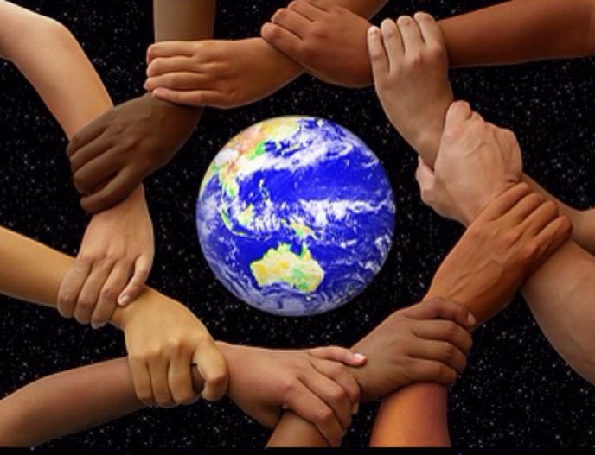
Acts 17:26
“and He made from one man every nation of mankind to live on all the face of the earth, having determined their appointed times and the boundaries of their habitation.” (Italics added)

Slide 52
II. Genesis 42:6-17
First Reunion
    Meeting (6)
    Joseph’s recognition (7-9a)
    Joseph’s first accusation (9b)
    Brothers’ first denial (10-11)
    Joseph’s second accusation (12)
    Brothers’ second denial (13)
    Challenge for vindication (14-17)

Slide 53
II. Genesis 42:6-17
First Reunion
    Meeting (6)
    Joseph’s recognition (7-9a)
    Joseph’s first accusation (9b)
    Brothers’ first denial (10-11)
    Joseph’s second accusation (12)
    Brothers’ second denial (13)
    Challenge for vindication (14-17)

Slide 57
II. Genesis 42:6-17
First Reunion
    Meeting (6)
    Joseph’s recognition (7-9a)
    Joseph’s first accusation (9b)
    Brothers’ first denial (10-11)
    Joseph’s second accusation (12)
    Brothers’ second denial (13)
    Challenge for vindication (14-17)

Slide 58
Genesis 42:14-17
Challenge for Vindication
      Joseph’s third accusation (14)
      Evidence for vindication (15)
      Means (16)
      Imprisonment (17)

Slide 59
Genesis 42:14-17
Challenge for Vindication
      Joseph’s third accusation (14)
      Evidence for vindication (15)
      Means (16)
      Imprisonment (17)

Slide 60
Genesis 42:14-17
Challenge for Vindication
      Joseph’s third accusation (14)
      Evidence for vindication (15)
      Means (16)
      Imprisonment (17)

Slide 63
Genesis 42:14-17
Challenge for Vindication
      Joseph’s third accusation (14)
      Evidence for vindication (15)
      Means (16)
      Imprisonment (17)

Slide 64
Genesis 42:14-17
Challenge for Vindication
      Joseph’s third accusation (14)
      Evidence for vindication (15)
      Means (16)
      Imprisonment (17)

Slide 65
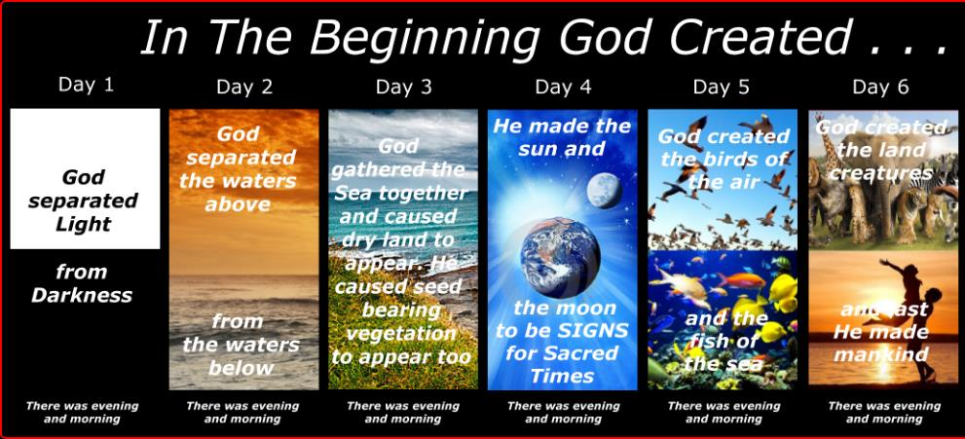
Shaping and Populating (Gen 1:1)
Day 1: | Light | Day 4: | Luminaries
Day 2: | Water, sky | Day 5: | Sea animals, birds
Day 3: | Land, vegetation | Day 6: | Land animals, man

Slide 66

Exodus 20:8-11
“⁸ Remember the sabbath day, to keep it holy. ⁹ Six days you shall labor and do all your work, ¹⁰ but the seventh day is a sabbath of the LORD your God; in it you shall not do any work, you or your son or your daughter, your male or your female servant or your cattle or your sojourner who stays with you. ¹¹ For in six days the LORD made the heavens and the earth, the sea and all that is in them, and rested on the seventh day; therefore, the LORD blessed the sabbath day and made it holy.”

Slide 67

Exodus 31:15-17
¹⁵ “For six days work may be done, but on the seventh day there is a sabbath of complete rest, holy to the Lord; whoever does any work on the sabbath day shall surely be put to death. ¹⁶ So the sons of Israel shall observe the sabbath, to celebrate the sabbath throughout their generations as a perpetual covenant. ¹⁷ It is a sign between Me and the sons of Israel forever; for in six days the Lord made heaven and earth, but on the seventh day He ceased from labor, and was refreshed.”

Slide 68
Genesis 42:1-38
First Reunion
  Jacob’s sons sent to Egypt (42:1-5)
  First reunion (42:6-17)
  Change of plans (42:18-25)
  Brothers return to Canaan (42:26-38)

Slide 69
III. Genesis 42:18-25
Joseph’s Change of Plans
    Basis (18)
    Content (19-20a)
    Results (20b-c)
    Brothers’ agreement (20d)
    Deliberations (21-22)
    Joseph’s reaction (23-25)

Slide 70
III. Genesis 42:18-25
Joseph’s Change of Plans
    Basis (18)
    Content (19-20a)
    Results (20b-c)
    Brothers’ agreement (20d)
    Deliberations (21-22)
    Joseph’s reaction (23-25)

Slide 71
Josh McDowell & Don Stewart
Answers to Tough Questions
“How could Jesus have remained in the tomb three days and three nights if He was crucified on Friday and rose on Sunday? Jesus prophesied in Matthew 12:40 (NASB) that ‘just as Jonah was three days and three nights in the belly of the sea monster, so shall the Son of Man be three days and three nights in the heart of the earth.’…Since this is clearly not three full, twenty-four-hour days, do we have a problem of conflict with the prophecy of Jesus in Matthew 12:40? In Mark 8:31 and Matthew 16:21, Jesus is recorded as saying, ‘The Son of man will rise again after three days,’ and ‘He will be raised again on the third day—expressions that are used interchangeably.”

Slide 72
Josh McDowell & Don Stewart
Answers to Tough Questions
“This can be seen from the fact that the most references to the resurrection state that it occurred on the third day. Also, Jesus, in addition to the Matthew 12:40 passage, spoke of His resurrection in John 2:19–22, stating that He would be raised up in three days (not the fourth day). Matthew 27:63 (KJV) gives weight to this idiomatic usage. After the Pharisees tell Pilate of the prediction of Jesus, ‘After three days I will rise again,’ they ask for a guard to secure the tomb until the third day. If the phrase, ‘after three days,’ was not interchangeable with the ‘third day,’ the Pharisees would have asked for a guard for the fourth day.”

Slide 73
Josh McDowell & Don Stewart
Answers to Tough Questions
“That the expression ‘one day and one night’ was an idiom employed by the Jews for indicating a day, even when only a part of a day was indicated, can be seen also in the Old Testament. For example, I Samuel 30:12, 13 (KJV), ‘For he had not eaten bread or drunk water for three days and three nights,’ and in the next verse, ‘My master left me behind… three days ago.’ Just as clearly, Genesis 42:17 shows this idiomatic usage. Joseph imprisoned his brothers for three days; in verse 18, he speaks to them and releases them, all on the third day. The phrases, ‘after three days’ and ‘on the third day,’ are not contradictory, either to each other or with Matthew 12:40, but simply idiomatic, interchangeable terms, clearly a common mode of Jewish expression.”

Slide 74
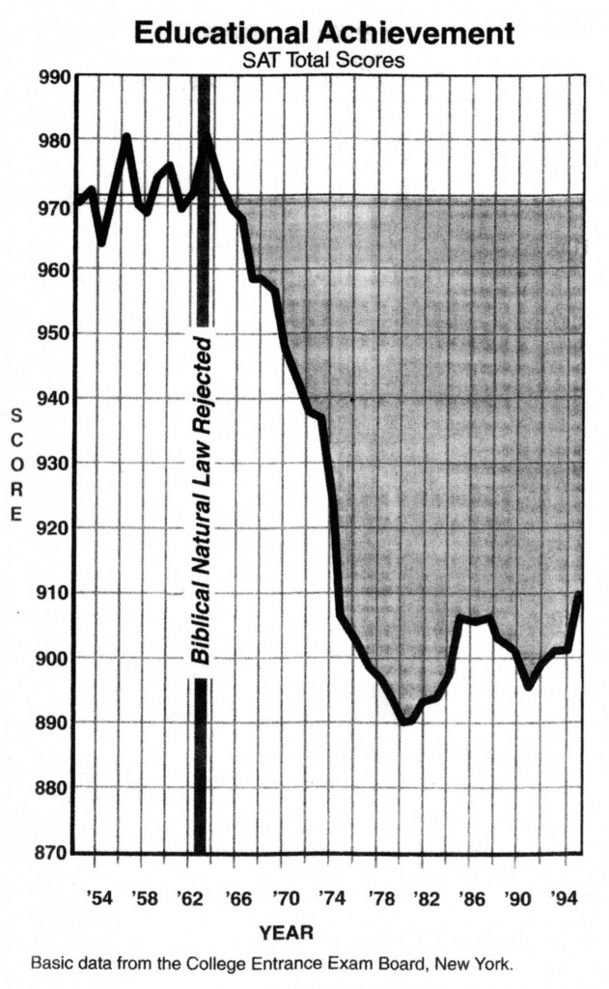
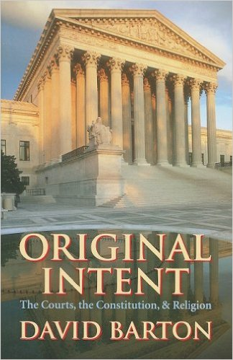
David Barton, Original Intent, p. 245

Slide 75
III. Genesis 42:18-25
Joseph’s Change of Plans
    Basis (18)
    Content (19-20a)
    Results (20b-c)
    Brothers’ agreement (20d)
    Deliberations (21-22)
    Joseph’s reaction (23-25)

Slide 82
III. Genesis 42:18-25
Joseph’s Change of Plans
    Basis (18)
    Content (19-20a)
    Results (20b-c)
    Brothers’ agreement (20d)
    Deliberations (21-22)
    Joseph’s reaction (23-25)

Slide 83
Genesis 42:20b-c
Results
      Words vindicated (20b)
      Will not die (20c)

Slide 84
Genesis 42:20b-c
Results
      Words vindicated (20b)
      Will not die (20c)

Slide 85
Genesis 42:20b-c
Results
      Words vindicated (20b)
      Will not die (20c)

Slide 86
III. Genesis 42:18-25
Joseph’s Change of Plans
    Basis (18)
    Content (19-20a)
    Results (20b-c)
    Brothers’ agreement (20d)
    Deliberations (21-22)
    Joseph’s reaction (23-25)

Slide 87
III. Genesis 42:18-25
Joseph’s Change of Plans
    Basis (18)
    Content (19-20a)
    Results (20b-c)
    Brothers’ agreement (20d)
    Deliberations (21-22)
    Joseph’s reaction (23-25)

Slide 88
Genesis 42:21-22
Deliberations
      Added information (21)
      Reuben’s words (22)

Slide 89
Genesis 42:21-22
Deliberations
      Added information (21)
      Reuben’s words (22)

Slide 90
Genesis 42:21-22
Deliberations
      Added information (21)
      Reuben’s words (22)

Slide 93
III. Genesis 42:18-25
Joseph’s Change of Plans
    Basis (18)
    Content (19-20a)
    Results (20b-c)
    Brothers’ agreement (20d)
    Deliberations (21-22)
    Joseph’s reaction (23-25)

Slide 94
Genesis 42:23-25
Joseph’s Reaction
      Joseph overhears (23)
      Joseph weeps (24a)
      Simeon bound (24b)
      Joseph’s provision (25)

Slide 95
Genesis 42:23-25
Joseph’s Reaction
      Joseph overhears (23)
      Joseph weeps (24a)
      Simeon bound (24b)
      Joseph’s provision (25)

Slide 96
Genesis 42:23-25
Joseph’s Reaction
      Joseph overhears (23)
      Joseph weeps (24a)
      Simeon bound (24b)
      Joseph’s provision (25)

Slide 97

Luke 19:41-44
^{41 “}When He approached Jerusalem, He saw the city and wept over it, ⁴² saying, “If you had known in this day, even you, the things which make for peace! But now they have been hidden from your eyes. ⁴³ For the days will come upon you when your enemies will throw up a barricade against you, and surround you and hem you in on every side, ⁴⁴ and they will level you to the ground and your children within you, and they will not leave in you one stone upon another, because you did not recognize the time of your visitation.”

Slide 98
Zechariah 12:10
“I will pour out on the house of David and on the inhabitants of Jerusalem, the Spirit of grace and of supplication, so that they will look on Me whom they have pierced; and they will mourn for Him, as one mourns for an only son, and they will weep bitterly over Him like the bitter weeping over a firstborn.”

Slide 99
Genesis 42:23-25
Joseph’s Reaction
      Joseph overhears (23)
      Joseph weeps (24a)
      Simeon bound (24b)
      Joseph’s provision (25)

Slide 102
Genesis 42:23-25
Joseph’s Reaction
      Joseph overhears (23)
      Joseph weeps (24a)
      Simeon bound (24b)
      Joseph’s provision (25)

Slide 103
Genesis 42:25
Joseph’s Provision
      Grain (25a)
      Money (25b)
      Provisions (25c)
      Conclusion (25d)

Slide 104
Genesis 42:25
Joseph’s Provision
      Grain (25a)
      Money (25b)
      Provisions (25c)
      Conclusion (25d)

Slide 105
Genesis 42:25
Joseph’s Provision
      Grain (25a)
      Money (25b)
      Provisions (25c)
      Conclusion (25d)

Slide 106
Genesis 42:25
Joseph’s Provision
      Grain (25a)
      Money (25b)
      Provisions (25c)
      Conclusion (25d)

Slide 107
Genesis 42:25
Joseph’s Provision
      Grain (25a)
      Money (25b)
      Provisions (25c)
      Conclusion (25d)

Slide 108
Genesis 42:1-38
First Reunion
  Jacob’s sons sent to Egypt (42:1-5)
  First reunion (42:6-17)
  Change of plans (42:18-25)
  Brothers return to Canaan (42:26-38)

Slide 109
IV. Genesis 42:26-38
Brothers Return to Canaan
    Return (26)
    Brother’s first discovery (27-28)
    Report to Jacob (29-34)
    Brother’s second discovery (35)
    Jacob’s reaction (36)
    Reuben’s offer (37)
    Jacob’s refusal (38)

Slide 110
IV. Genesis 42:26-38
Brothers Return to Canaan
    Return (26)
    Brother’s first discovery (27-28)
    Report to Jacob (29-34)
    Brother’s second discovery (35)
    Jacob’s reaction (36)
    Reuben’s offer (37)
    Jacob’s refusal (38)

Slide 117
IV. Genesis 42:26-38
Brothers Return to Canaan
    Return (26)
    Brother’s first discovery (27-28)
    Report to Jacob (29-34)
    Brother’s second discovery (35)
    Jacob’s reaction (36)
    Reuben’s offer (37)
    Jacob’s refusal (38)

Slide 118
Genesis 42:27-28
Brothers’ First Discovery
      Discovery (27)
      Report (28a)
      Reaction (28b)

Slide 119
Genesis 42:27-28
Brothers’ First Discovery
      Discovery (27)
      Report (28a)
      Reaction (28b)

Slide 120
Genesis 42:27-28
Brothers’ First Discovery
      Discovery (27)
      Report (28a)
      Reaction (28b)

Slide 121
Genesis 42:27-28
Brothers’ First Discovery
      Discovery (27)
      Report (28a)
      Reaction (28b)

Slide 122
IV. Genesis 42:26-38
Brothers Return to Canaan
    Return (26)
    Brother’s first discovery (27-28)
    Report to Jacob (29-34)
    Brother’s second discovery (35)
    Jacob’s reaction (36)
    Reuben’s offer (37)
    Jacob’s refusal (38)

Slide 123
Genesis 42:29-34
Report to Jacob
      Return (29)
      Accusation (30)
      Denial (31-32)
      Test (33-34)

Slide 124
Genesis 42:29-34
Report to Jacob
      Return (29)
      Accusation (30)
      Denial (31-32)
      Test (33-34)

Slide 131
Genesis 42:29-34
Report to Jacob
      Return (29)
      Accusation (30)
      Denial (31-32)
      Test (33-34)

Slide 132
Genesis 42:29-34
Report to Jacob
      Return (29)
      Accusation (30)
      Denial (31-32)
      Test (33-34)

Slide 135
Genesis 42:29-34
Report to Jacob
      Return (29)
      Accusation (30)
      Denial (31-32)
      Test (33-34)

Slide 136
IV. Genesis 42:26-38
Brothers Return to Canaan
    Return (26)
    Brother’s first discovery (27-28)
    Report to Jacob (29-34)
    Brother’s second discovery (35)
    Jacob’s reaction (36)
    Reuben’s offer (37)
    Jacob’s refusal (38)

Slide 137
Genesis 42:35
Brothers’ Second Discovery
      Timing (35a)
      Reaction (35b)

Slide 138
Genesis 42:35
Brothers’ Second Discovery
      Timing (35a)
      Reaction (35b)

Slide 139
Genesis 42:35
Brothers’ Second Discovery
      Timing (35a)
      Reaction (35b)

Slide 140
IV. Genesis 42:26-38
Brothers Return to Canaan
    Return (26)
    Brother’s first discovery (27-28)
    Report to Jacob (29-34)
    Brother’s second discovery (35)
    Jacob’s reaction (36)
    Reuben’s offer (37)
    Jacob’s refusal (38)

Slide 143
IV. Genesis 42:26-38
Brothers Return to Canaan
    Return (26)
    Brother’s first discovery (27-28)
    Report to Jacob (29-34)
    Brother’s second discovery (35)
    Jacob’s reaction (36)
    Reuben’s offer (37)
    Jacob’s refusal (38)

Slide 146
IV. Genesis 42:26-38
Brothers Return to Canaan
    Return (26)
    Brother’s first discovery (27-28)
    Report to Jacob (29-34)
    Brother’s second discovery (35)
    Jacob’s reaction (36)
    Reuben’s offer (37)
    Jacob’s refusal (38)

Slide 149
Dr. Arnold G. Fruchtenbaum
The Book of Genesis, 581
“The danger to Jacob was: If harm befall him by the way in which ye go, then will ye bring down my gray hairs with sorrow to Sheol. Jacob in this passage clearly anticipated going to Sheol at death, and the direction of Sheol was clearly downward not upward.”

Slide 150
Dr. Arnold G. Fruchtenbaum
The Book of Genesis, 537
“Jacob’s refusal is stated: He refused to be comforted; and he said, For I will go down to Sheol to my son in mourning. And his father wept for him. Sheol is the center of the earth, and before the death of the Messiah, all souls descended there upon death; but the faithful and unfaithful entered into different compartments in Sheol.”

Slide 151

Luke 16:24-26
“²⁴ And he cried out and said, ‘Father Abraham, have mercy on me, and send Lazarus so that he may dip the tip of his finger in water and cool off my tongue, for I am in agony in this flame.’ ²⁵ But Abraham said, ‘Child, remember that during your life you received your good things, and likewise Lazarus bad things; but now he is being comforted here, and you are in agony. ²⁶ And besides all this, between us and you there is a great chasm fixed, so that those who wish to come over from here to you will not be able, and that none may cross over from there to us.’”

Slide 152
Conclusion

Slide 153
Genesis 42:1-38
First Reunion
  Jacob’s sons sent to Egypt (42:1-5)
  First reunion (42:6-17)
  Change of plans (42:18-25)
  Brothers return to Canaan (42:26-38)

Slide 154
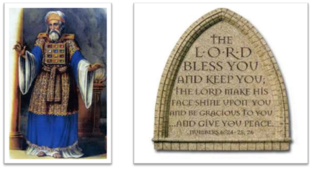
²⁴ The Lord bless you, and keep you; ²⁵ The Lord make His face shine on you, And be gracious to you; ²⁶ The Lord lift up His countenance on you, And give you peace.
Numbers 6:24–26 (NASB95)

