Slide 1
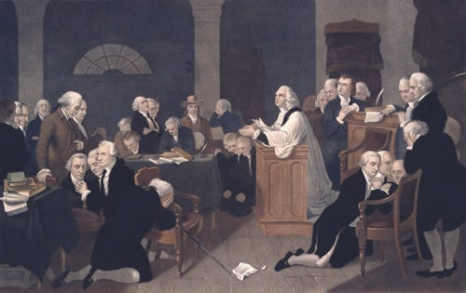
America:
A Christian Nation?
By Justice David Josiah Brewer

Slide 2

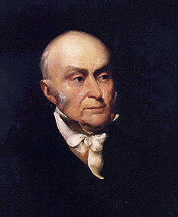
John Quincy Adams
“The birth-day of the nation is indissolubly linked with the birth-day of the Saviour [and] forms a leading event in the progress of the gospel dispensation…the Declaration of Independence first organized the social compact on the foundation of the Redeemer’s mission upon the earth [and] laid the corner stone of human government upon the first precepts of Christianity.”
John Quincy Adams, An Oration Delivered before the Inhabitants of the Town of Newburyport at Their Request on the Sixty-First Anniversary of the Declaration of Independence (Newburyport: Whipple, 1837), 5-6.

Slide 3
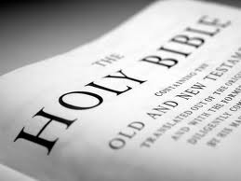
God Blesses His Truth
Ps 33:12, “Blessed is the nation whose is the Lord.”
Proverbs 14:34, “Righteousness exalts a nation, but sin is a reproach to any people.”

Slide 4

Matt 7:16-18
God Blesses His Truth
“You will know them by their fruits. Grapes are not gathered from thorn bushes nor figs from thistles, are they? So every good tree bears good fruit, but the bad tree bears bad fruit. A good tree cannot produce bad fruit, nor can a bad tree produce good fruit.”

Slide 5
Galatians 6:7-9
God Blesses His Truth
“Do not be deceived, God is not mocked; for whatever a man sows, this he will also reap. For the one who sows to his own flesh will from the flesh reap corruption, but the one who sows to the Spirit will from the Spirit reap eternal life. Let us not lose heart in doing good, for in due time we will reap if we do not grow weary.”

Slide 6

Daniel Webster
“If an angel should be winged from Heaven, on an errand of mercy to our country, the first accents that would glow on his lips would be, 'Beware! Be cautious! You have everything to lose; nothing to gain.’ We live under the only government that ever existed which was framed by the unrestrained and deliberate consultations of the people. Miracles do not cluster. That which has happened but once in six thousand years cannot be expected to happen often. Such a government, once gone, might leave a void, to be filled, for ages, with revolution and tumult, riot and despotism. The history of the world is before us.”
DANIEL WEBSTER, NEWLY DISCOVERED FOURTH OF JULY ORATION (BOSTON: A. WILLIAMS & CO., 1882), 13-14.

Slide 7


Amos 7:7-8
God Blesses His Truth
⁷ “Thus, He showed me, and behold, the Lord was standing by a vertical wall with a plumb line in His hand. ⁸ The LORD said to me, ‘What do you see, Amos?’ And I said, ‘A plumb line.’ Then the Lord said, ‘Behold I am about to put a plumb line In the midst of My people Israel. I will spare them no longer.’”

Slide 8
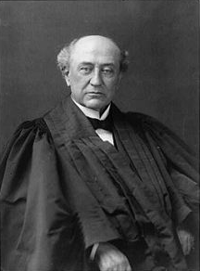
America is a “Christian Nation”
“This is historically true. From the discovery of this continent to the present hour, there is a single voice making this affirmation…These are not the sayings, declarations of private persons: they are organic utterances; they speak the voice of the entire people…These and many other matters which might be noticed, add a volume of unofficial declarations to the mass of organic utterances that this is a Christian nation.”
Church of the Holy Trinity v. U.S., 143 U.S. 457, 465, 470-71 (1892)

Slide 9
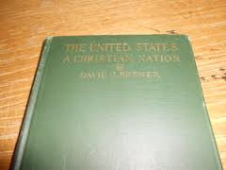

Slide 10
America is a “Christian Nation”
“This republic is classified among the Christian nations of the world. It was so formally declared by the Supreme Court of the United States. In the case of Holy Trinity Church vs. United States, 143 U.S. 471, that court, after mentioning various circumstances, added, ‘these and many other matters which might be noticed, add a volume of unofficial declarations to the mass of organic utterances that this is a Christian nation.’”
Brewer, United States A Christian Nation, 11-12

Slide 11
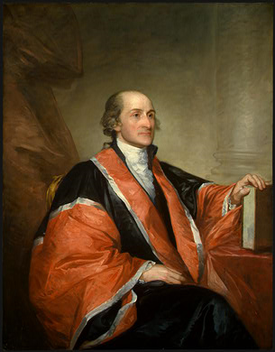
John Jay
“Providence has given to our people the choice of their rulers, and it is the duty, as well as the privilege and interest of our Christian nation to select and prefer Christians for their rulers.”
William Jay, The Life of John Jay (New York: J. & J. Harper, 1833), Vol. II, p. 376, to John Murray Jr. on October 12, 1816.

Slide 12
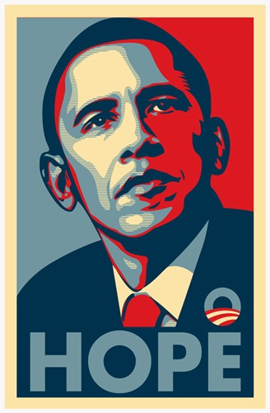
A Christian Nation?
“Although…we have a very large Christian population, we do not consider ourselves a Christian nation or a Jewish nation or a Muslim nation; we consider ourselves a nation of citizens who are bound by ideals and a set of values” (italics added).
Cited in Lynn Sweet, “Obama and President Gul of Turkey Press Conference. Obama’s Islamic Outreach,” Chicago Sun Times (April 6, 2009).

Slide 13
America is a “Christian Nation”
“But in what sense can it be called a Christian nation? Not in the sense that Christianity is the established religion or that the people are in any manner compelled to support it.”
Brewer, United States A Christian Nation, 11-12

Slide 14

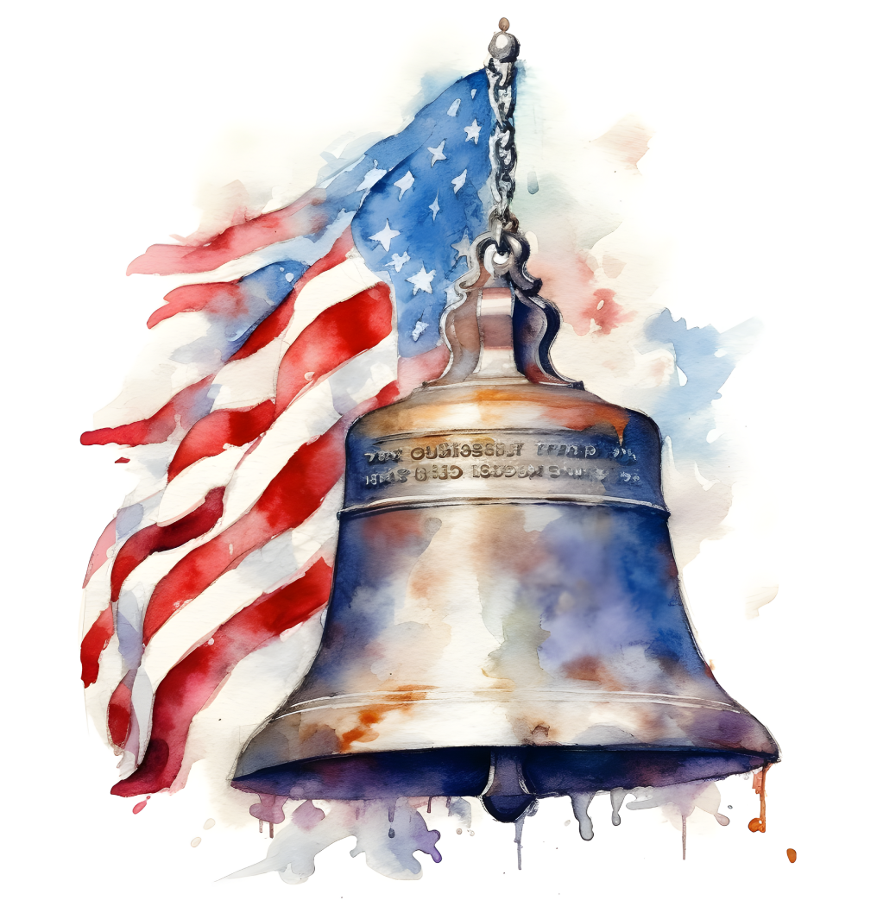
2 Corinthians 3:17
God Blesses His Truth
“Now the Lord is the Spirit, and where the Spirit of the Lord is, there is liberty.”

Slide 15
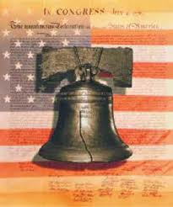
Preview
Early America’s:
  Settlements
  Colonial motivations
  Educational institutions
  Support for the church
  Requirement of Christian officeholders
  Recognition of the Sabbath
  Use of “God”

Slide 16
Preview
Early America’s:
  Absence of contrary declarations
  Chaplains
  Judicial opinions
  Christian population
  Acceptance of the Bible
  Unofficial Christian declarations
  Conclusion

Slide 17
Preview
Early America’s:
  Settlements
  Colonial motivations
  Educational institutions
  Support for the church
  Requirement of Christian officeholders
  Recognition of the Sabbath
  Use of “God”

Slide 18
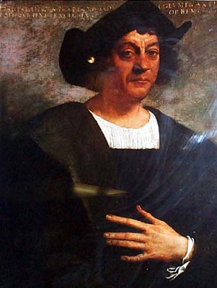
Christopher Columbus
“Our Lord opened to my understanding (I could sense his hand upon me) so it became clear to me that the voyage was feasible…All those who heard of my enterprise rejected it with laughter, scoffing at me…Who doubts this illumination was from the Holy Spirit? I attest that He, with marvelous rays of light, consoled me with the holy and sacred Scriptures, they inflame me with a sense of…

Slide 19
Christopher Columbus
…great urgency…No one should be afraid to take on any enterprise in the name of the savior if it is right and if the purpose is purely for His holy service…And I say that the sign that convinces me that our Lord is hastening the end of the world is the preaching of the Gospel in so many distant lands.”
Columbus, Book of Prophecies, trans. Kay Brigham, 178-79, 182-83.

Slide 20
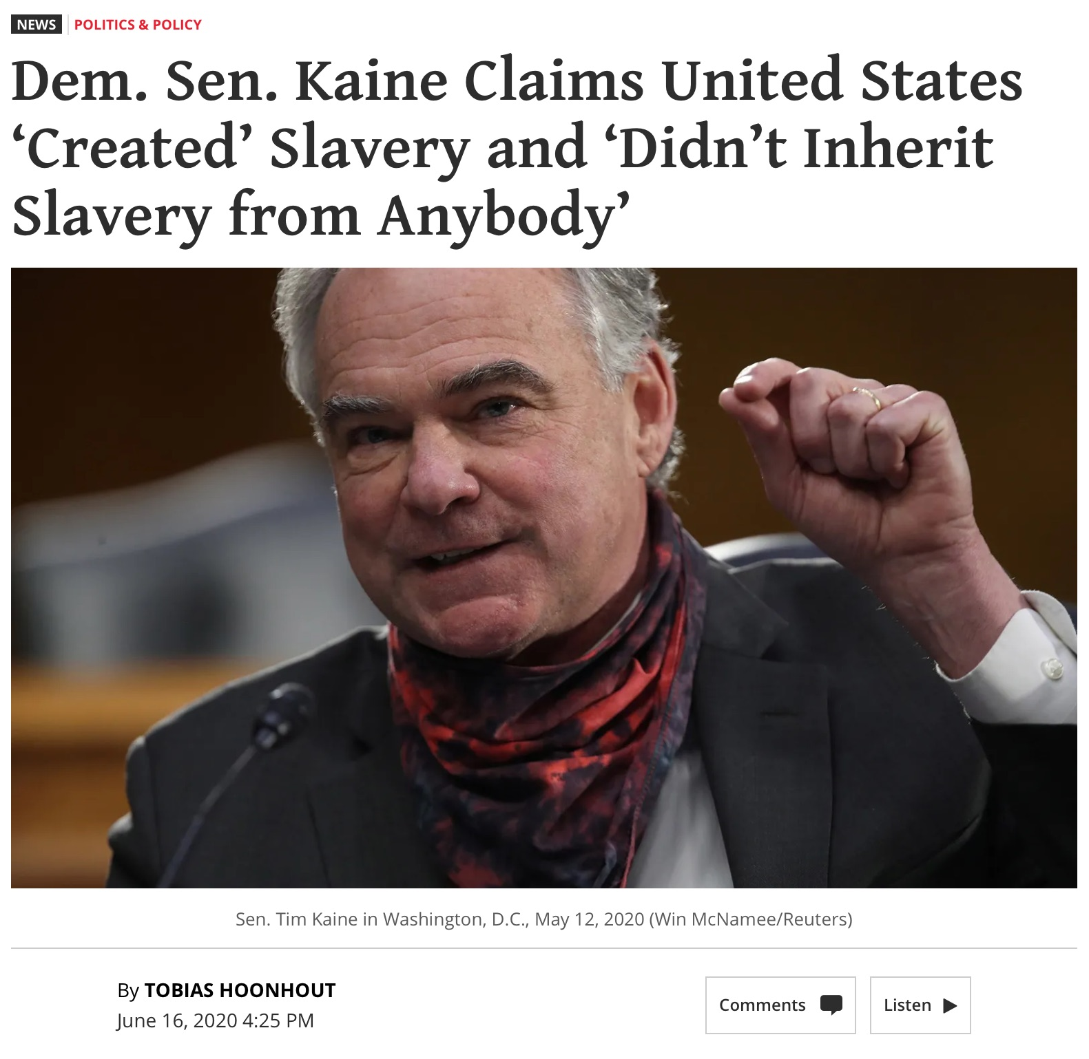

Slide 21
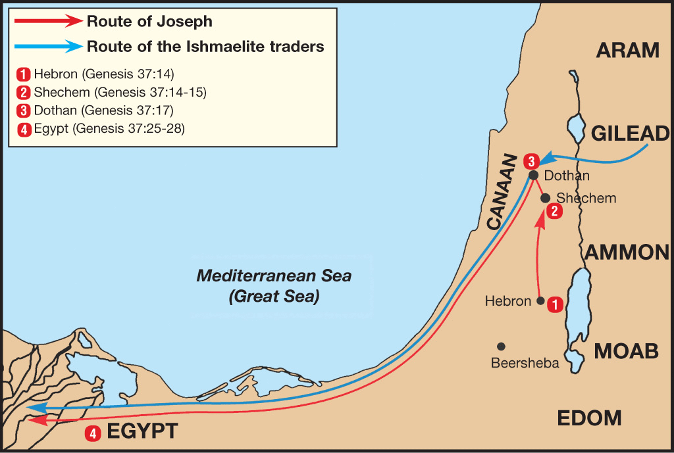

Slide 22
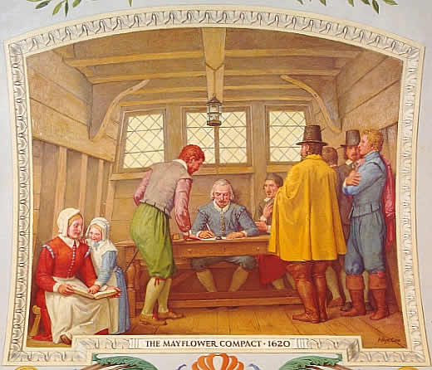
Mayflower Compact (1620)
“Mayflower, in 1620, recites: ‘Having undertaken for the glory of God and advancement of the Christian faith and the honor of our king and country a voyage to plant the first colony in the northern parts of Virginia.’”
Brewer, United States A Christian Nation, 14

Slide 23
South Carolina Constitution (1778)
“In the Constitution of South Carolina, of 1778, it was declared that ‘the Christian Protestant religion shall be deemed and is hereby constituted and declared to be the established religion of this State.’ And further of which were ‘that the Christian religion is the true religion; that the holy scriptures of the Old and New Testament are of divine inspiration, and are the rule of faith and practice.’”
Brewer, United States A Christian Nation, 18-19

Slide 24
Preview
Early America’s:
  Settlements
  Colonial motivations
  Educational institutions
  Support for the church
  Requirement of Christian officeholders
  Recognition of the Sabbath
  Use of “God”

Slide 25
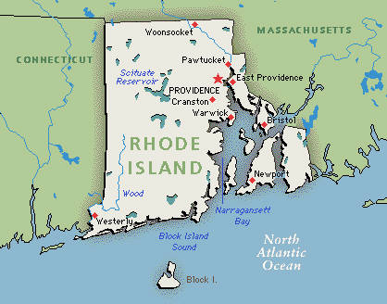
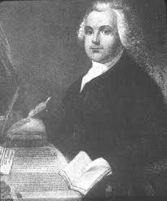
Roger Williams
“Roger Williams, exiled from Massachusetts because of his religious views, established an independent colony in Rhode Island.”
Brewer, United States A Christian Nation, 19

Slide 26
Declarations of America’s Early Settlements
“It is not exaggeration to say that Christianity in some of its creeds was the principal cause of the settlement of many of the colonies, and cooperated with business hopes and purposes in the settlement of the others. Beginning in this way and under these influences it is not strange that the colonial life had an emphatic Christian tone.”
Brewer, United States A Christian Nation, 19-20

Slide 27
Preview
Early America’s:
  Settlements
  Colonial motivations
  Educational institutions
  Support for the church
  Requirement of Christian officeholders
  Recognition of the Sabbath
  Use of “God”

Slide 28
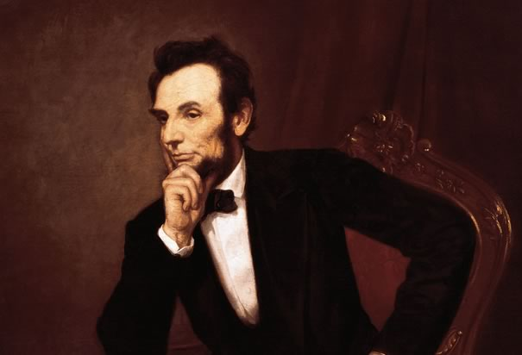
Cited in Mark A. Beliles and Stephen K. McDowell, America's Providential History (Charlottesville, VA: Providence, 1989), 95.
“The philosophy of the school room in one generation will be the philosophy of government in the next.”

Slide 29
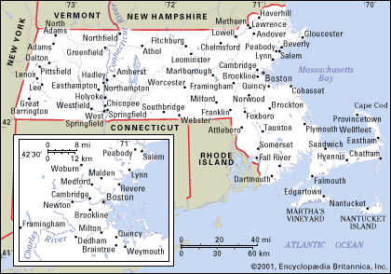
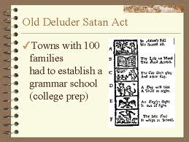
Old Satan Deluder Law
“It being one chief project of that old deluder, Satan, to keep men from the knowledge of the Scriptures, as in former time…It is therefore ordered…that after the Lord hath increased the settlement…they shall…appoint one within their town, to teach all such children to read…they shall set up a grammar school to instruct youths…”
Church of the Holy Trinity v. U.S., 143 U.S. 457, 467 (1892)

Slide 30
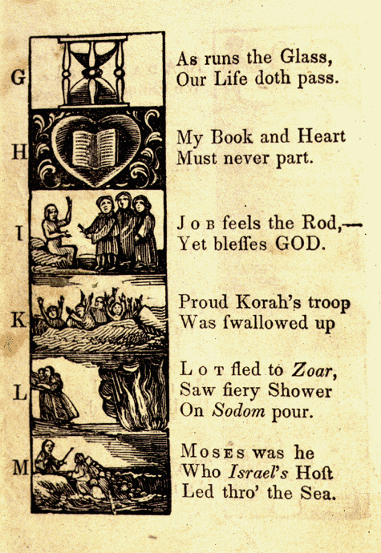
New England Primer
A: “In Adam’s fall we sinned all.”
C: Christ crucify’d for sinners dy’d.”
D: “The deluge drown’d the earth around.”
J: Job feels the rod, yet blesses God
N: “Noah did view the old world & new.”
Z: “Zaccheus he did climb the tree our Lord to see.”
New England Primer, 1737

Slide 31

Harvard University
“The first seal used by Harvard College had as a motto, ‘In Christi Gloriam,’”…
Brewer, United States A Christian Nation, 20

Slide 32
Harvard University
“Let every student be plainly instructed and earnestly pressed to consider well the main end of his life and studies is to know God and Jesus Christ which is eternal life (John 17:3) and therefore to lay Christ in the bottom as the only foundation of all sound knowledge and learning. And seeing the Lord only giveth wisdom, let everyone seriously set himself by prayer in secret to seek it of Him (Prov. 2, 3). Everyone shall exercise himself in reading the Scriptures twice a day that he shall be ready to give such an account of his proficiency therein.”
Rules of Harvard in 1636; quoted in David Barton, Original Intent, 81

Slide 33
America’s Early Schools
“Think of the vast number of academies, colleges and universities scattered through the land. Some of them, it is true, are under secular control, but there is yet to be established in this country one of those institutions founded on the religions of Confucius, Buddha or Mohammed, while an overwhelming majority are under the special direction and control of Christian teachers.”
Brewer, United States A Christian Nation, 37

Slide 34
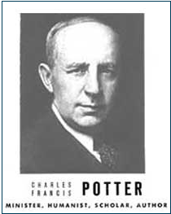
Humanist Proselytizing
“Education is thus a most powerful ally of Humanism, and every public school is a school of Humanism. What can the theistic Sunday-schools, meeting for an hour once a week, and teaching only a fraction of the children, do to stem the tide of a five-day program of humanistic teaching?”
Charles Francis Potter, Humanism: A New Religion (New York: Simon and Schuster, 1930), 128

Slide 35
Karl Marx’s Communist Manifesto 1848
Abolish private property.
Heavy progressive income tax.
Abolish rights of inheritance.
Confiscation of property rights.
Central Bank.
Government ownership of communication and transportation.
Government ownership of factories and agriculture.
Government control of labor.
Corporate farms, regional planning.
Free Education for All Children in Public Schools. Combination of Education with Industrial Production.
Karl Marx, Manifesto of the Communist Party, trans., Samuel Moore (RMB, 2020), 16.

Slide 36
Preview
Early America’s:
  Settlements
  Colonial motivations
  Educational institutions
  Support for the church
  Requirement of Christian officeholders
  Recognition of the Sabbath
  Use of “God”

Slide 37
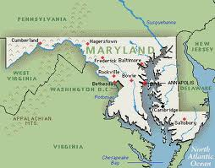
Maryland Constitution (1776)
“In Maryland, by the Constitution of 1776, it was provided that ‘the legislature may, in their discretion, lay a general and equal tax, for the support of the Christian religion.’”
Brewer, United States A Christian Nation, 22

Slide 38
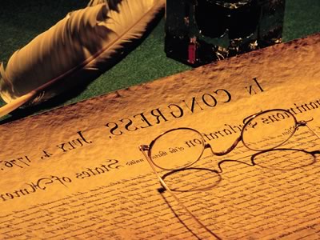
Article III of the Northwest Ordinance (1789)
“Religion, morality, and knowledge being necessary to good government and the happiness of mankind, schools and the means of education shall forever be encouraged.”
Documents of American History, Henry S. Commager, ed., 5th ed. (NY: Appleton-Century-Crofts, Inc., 1949), 131.

Slide 39
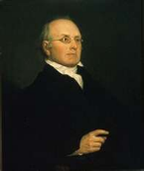
Joseph Story
“Probably at the time of the adoption of the Constitution, and of the amendment to it now under consideration [the First Amendment], the general if not the universal sentiment in America was, that Christianity ought to receive encouragement from the state so far as it was not incompatible with the private rights of conscience and the freedom of religious worship. An attempt to level all religions, and to make it a matter of state policy to hold all in utter indifference, would have created universal disapprobation, if not universal indignation” (underlining mine).
Joseph Story, Commentaries on the Constitution of the United States: With a Preliminary Review of the Constitutional History of the Colonies and the States before the Adoption of the Constitution, 5th ed., 2 vols., ed. Melville M. Bigelow (Boston, MA: Little and Brown, 1891; reprint, Buffalo, NY: Hein, 1994), 2:630-31.

Slide 40
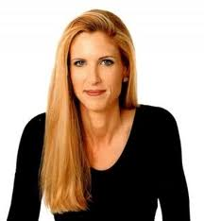
Ann Coulter
“First they claim there is no place for religion in the public square, and then they expand the public square to include everything.”
Ann Coulter, “Foreword,” in Speechless: Silencing the Christians, ed. Donald E. Wildmon (Minneapolis, MN: Vigilante, 2009), xiii.

Slide 41
Preview
Early America’s:
  Settlements
  Colonial motivations
  Educational institutions
  Support for the church
  Requirement of Christian officeholders
  Recognition of the Sabbath
  Use of “God”

Slide 42
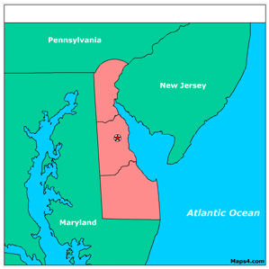
Delaware Constitution (1776)
“In Delaware, by the Constitution of 1776, every officeholder was required to make and subscribe the following declaration: ‘I, A. B., do profess faith in God the Father, and in Jesus Christ His Only Son, and in the Holy Ghost, one God, blessed forevermore; and I do acknowledge the Holy Scriptures of the Old and New Testament to be given by divine inspiration.’”
Brewer, United States A Christian Nation, 23

Slide 43
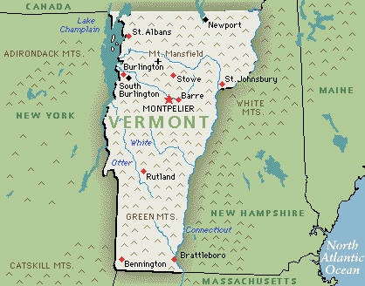
Vermont Constitution (1777)
“The Vermont Constitution of 1777 required of every member of the House of Representatives that he take this oath: ‘I do believe in one God, the creator and governor of the universe, the rewarder of the good and punisher of the wicked, and I do acknowledge the scriptures of the Old and New Testaments to be given by divine inspiration, and own and profess that Protestant religion.’ A similar requirement was provided by the Constitution of 1786.”
Brewer, United States A Christian Nation, 25

Slide 44
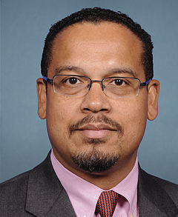
Keith Ellison
Keith Maurice Ellison (born August 4, 1963) is the U.S. Representative for Minnesota's 5th congressional district, serving since 2007. He is a member of the Democratic-Farmer-Labor Party, the Minnesota state Democratic Party affiliate. The district centers on Minneapolis and surrounding suburbs. Ellison is a co-chair of the Congressional Progressive Caucus and Chief Deputy Whip for the 113th Congress. Ellison is the first Muslim to be elected to the Congress.
http://en.wikipedia.org/wiki/Keith_Ellison

Slide 45
Preview
Early America’s:
  Settlements
  Colonial motivations
  Educational institutions
  Support for the church
  Requirement of Christian officeholders
  Recognition of the Sabbath
  Use of “God”

Slide 46
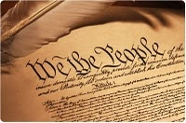
SABBATH
Article I, Section 7, Paragraph 2 of the Constitution says, “If any bill should not be returned by the President within ten days (Sundays excepted) after it shall have been presented to him, the same shall be a law in like manner as if he had signed it.”
Brewer, United States A Christian Nation, 27

Slide 47

Exod 20:8-11
“Remember the sabbath day, to keep it holy. Six days you shall labor and do all your work, but the seventh day is a sabbath of the LORD your God; in it you shall not do any work, you or your son or your daughter, your male or your female servant or your cattle or your sojourner who stays with you. For in six days the LORD made the heavens and the earth, the sea and all that is in them, and rested on the seventh day; therefore, the LORD blessed the sabbath day and made it holy.”

Slide 48
Preview
Early America’s:
  Settlements
  Colonial motivations
  Educational institutions
  Support for the church
  Requirement of Christian officeholders
  Recognition of the Sabbath
  Use of “God”

Slide 49
Use of “God”
“While the word ‘God’ is not infrequently used both in the singular and plural to denote any supreme being or beings, yet when used alone and in the singular number it generally refers to that Supreme Being spoken of in the Old and New Testaments and worshiped by Jew and Christian. In that sense the word is used in constitution, statute and instrument. In many State Constitutions we find in the preamble a declaration like this: ‘Grateful to Almighty God.’ In some he who denied the being of God was disqualified from holding office. It is again and again declared in constitution and statute that official oaths shall close with an appeal, ‘So help me, God.’ When, upon inauguration, the President-elect each . . .

Slide 50
Use of “God”
“...four years consecrates himself to the great responsibilities of Chief Executive of the republic, his vow of consecration in the presence of the vast throng filling the Capitol grounds will end with the solemn words, ‘So help me, God.’ In all our courts witnesses in like manner vouch for the truthfulness of their testimony. The common commencement of wills is ‘In the name of God, Amen.’ Every foreigner attests his renunciation of allegiance to his former sovereign and his acceptance of citizenship in this republic by an appeal to God.”
Brewer, United States A Christian Nation, 30-31

Slide 51
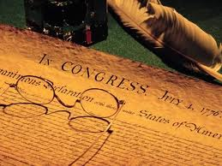
Declaration of Independence
“the Laws of Nature and of Nature’s God,”
“we hold these truths to be self evident, that all men are created equal,”
“they are endowed by their Creator with certain unalienable Rights,”
“appealing to the Supreme Judge of the world for the rectitude of our intentions,”
“with firm reliance on the protection of Divine Providence.”
Church of the Holy Trinity v. U.S., 143 U.S. 457, 467-68 (1892)

Slide 52
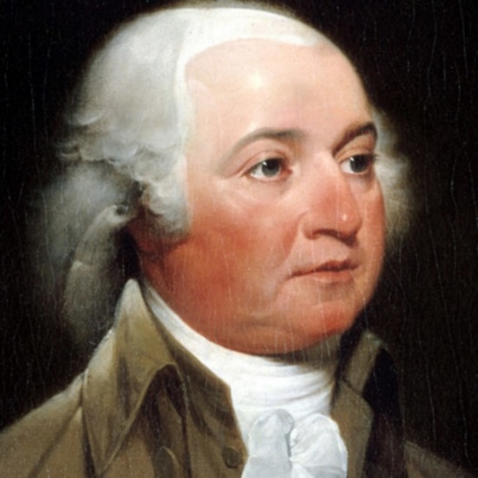
John Adams
John Adams - America's second President "Rights [are] antecedent to all earthly government; Rights...cannot be repealed or restrained by human laws; Rights [are] derived from the great Legislature of the universe."
John Adams, The Works of John Adams, Second President of the United States, ed. Charles Francis Adams, 10 vols. (Boston: Little, Brown, 1856), 3:449.

Slide 53
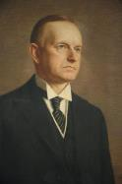
Calvin Coolidge
Calvin Coolidge stated July 5, 1926: "The principles...which went into the Declaration of Independence...are found in...the sermons...of the early colonial clergy...They justified freedom by the text that we are all created in the Divine image."
Calvin Coolidge, May 15, 1926, College of William and Mary, Williamsburg, Virginia, http.americanminute.com/index.php?date=05-15

Slide 54
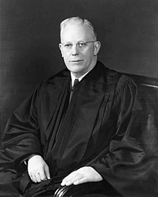
Earl Warren
“I believe the entire Bill of Rights came into being because of the knowledge our forefathers had of the Bible and their belief in it; freedom of belief, of expression, of assembly, of petition, the dignity of the individual, the sanctity of the home, equal justice under law, and the reservation of powers to the people…we are living today in the spirit of the Christian religion…as long as we do so, no great harm can come to our country."
Time, February 15, 1954, p. 49; cited in Jim Nelson Black, When Nations Die: America on the Brink: Ten Warning Signs of a Culture in Crisis (Wheaton, IL: Tyndale, 1994), 253.

Slide 55
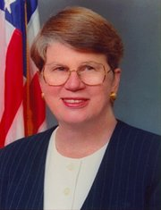
Speech by Attorney General Janet Reno, Newark, New Jersey, May 5, 1995. Quoted in James Bovard, “Waco Must Get a Hearing,” Wall Street Journal, May 15, 1995.
“You are part of a government that has given its people more freedom . . . than any other government in the history of the world.”

Slide 56
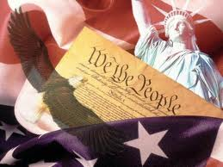
“Year of Our Lord”
Article VII, Paragraph 2 says, “Done in Convention by the Unanimous Consent of the States present the Seventeenth Day of September in the Year of our Lord one thousand seven hundred and eighty seven, and of the Independence of the United States of America the Twelfth” (italics added).

Slide 57
Preview
Early America’s:
  Absence of contrary declarations
  Chaplains
  Judicial opinions
  Christian population
  Acceptance of the Bible
  Unofficial Christian declarations
  Conclusion

Slide 58
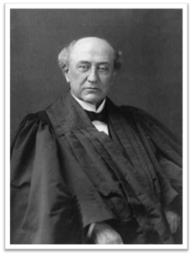
Absence of Contrary Declarations
“…it is of still more significance that there are no contrary declarations. In no charter or constitution is there anything to even suggest that any other than the Christian is the religion of his country. In none of them is Mohammed or Confucius or Buddha in any manner noticed. In none of them is Judaism recognized other than by way of toleration of its special creed. While the separation of church and state is often affirmed, there is nowhere a repudiation of Christianity as one of the institutions as well as benedictions of society. In short, there is no charter or constitution that is either infidel, agnostic or anti-Christian. Wherever there is a declaration in favor of any religion it is of the Christian.”
Brewer, United States A Christian Nation, 31-32

Slide 59
Preview
Early America’s:
  Absence of contrary declarations
  Chaplains
  Judicial opinions
  Christian population
  Acceptance of the Bible
  Unofficial Christian declarations
  Conclusion

Slide 60
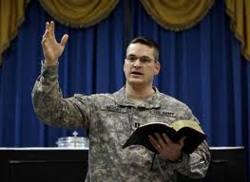
Christian Chaplains
“Notice also the matter of chaplains. These are appointed for the army and navy, named as officials of legislative assemblies, and universally they belong to one or other of the Christian denominations. Their whole range of service, whether in prayer or preaching, is an official recognition of Christianity. If it be not so, why do we have chaplains?”
Brewer, United States A Christian Nation, 32

Slide 61
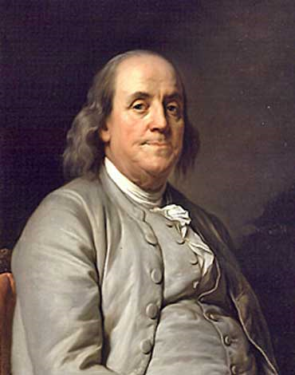
Benjamin Franklin
“In the beginning of the contest with Great Britain, when we were sensible of danger we had daily prayer in this room for the Divine Protection. Our prayers, Sir, were heard, and they were graciously answered. All of us who were engaged in the struggle must have observed frequent instances of a Superintending providence in our favor…And have we now forgotten that powerful friend?”
James Madison, The Papers of James Madison, 3 vols.,
ed. Henry D. Gilpin (Mobile, AL: Mygatt, 1842), 2:984-85.

Slide 62
Benjamin Franklin
“I therefore beg leave to move that henceforth prayers imploring the assistance of Heaven, and its blessings on our deliberations, be held in this Assembly every morning before we proceed to business, and that one or more of the Clergy of this City be requested to officiate in that service.”
Madison, The Papers of James Madison, 2:984-85.

Slide 63
Preview
Early America’s:
  Absence of contrary declarations
  Chaplains
  Judicial opinions
  Christian population
  Acceptance of the Bible
  Unofficial Christian declarations
  Conclusion

Slide 64
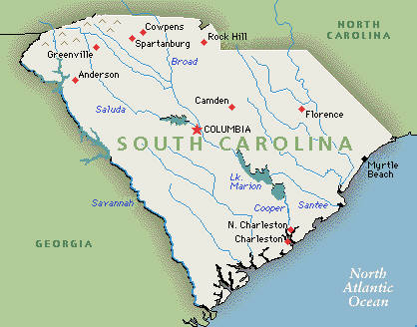
South Carolina Supreme Court
(1787)
“It appears to have been long perfectly settled by the common law, that blasphemy against the Deity in general, or a malicious and wanton attack against the Christian religion individually, for the purpose of exposing its doctrines to contempt and ridicule, is indictable and punishable as a temporal offence.”
Brewer, United States A Christian Nation, 34

Slide 65
Preview
Early America’s:
  Absence of contrary declarations
  Chaplains
  Judicial opinions
  Christian population
  Acceptance of the Bible
  Unofficial Christian declarations
  Conclusion

Slide 66
American Population (1890)
“In other words, about one-third of the entire population were directly connected with Christian organizations…and yet it is clear that there is an identification of the great mass of American citizens with the Christian church.”
Brewer, United States A Christian Nation, 37-38

Slide 67
Benjamin Franklin
“Hence bad examples to youth are more rare in America…Atheism is unknown there, Infidelity rare and secret; so that great persons may live to a great age in that country without having their piety shocked by meeting with either Atheist or Infidel.”
Benjamin Franklin, “Advice on Coming to America,”
America in Person, ed. George D. Youstra, 109.

Slide 68
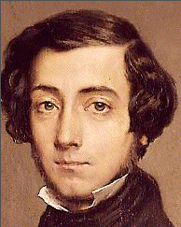
Alexis de Tocqueville
“There is no country in the whole world in which the Christian religion retains a greater influence over the souls of men than in America and there can be no greater proof of its utility, and of its conformity to human nature, than that its influence is most powerfully felt over the most enlightened and free nation on earth.”
Alexis de Tocqueville, Democracy in America and Two Essays,
Trans. Gerald E. Bevan (1830 reprint, N.Y., Penguin, 2003), 340

Slide 69
Alexis de Tocqueville
“Upon my arrival in the United States, the religious aspect of the country was the first thing that struck my attention; and the longer I stayed there, the more I did perceive the great political consequences resulting from the state of things, to which I was unaccustomed. In France I had almost always seen the spirit of religion and the spirit of freedom pursuing courses diametrically opposed to each other, but in America I found that they were intimately united, and that they reigned in common over the same country.”
Alexis de Tocqueville, Democracy in America and Two Essays,
Trans. Gerald E. Bevan (1830 reprint, N.Y., Penguin, 2003), 345

Slide 70
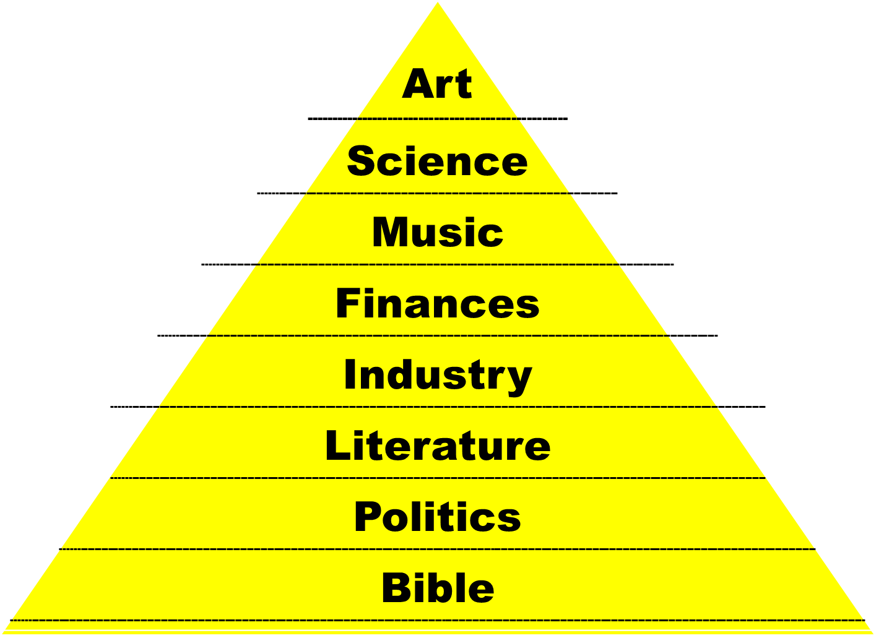

Slide 71
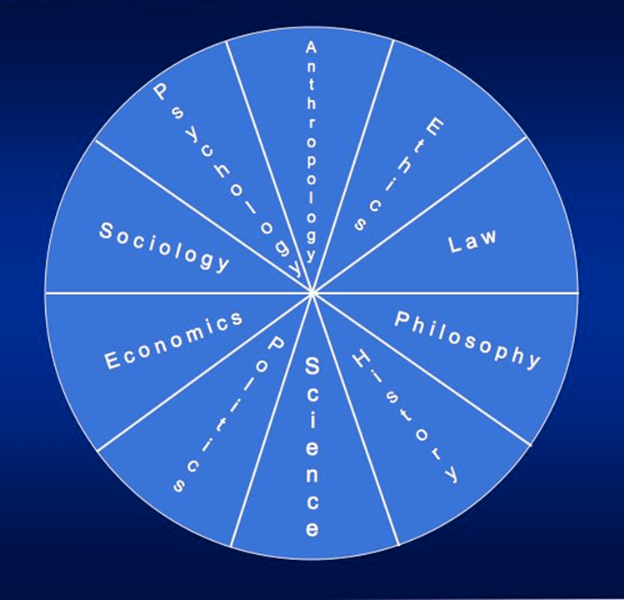

Slide 72
John Adams
John Adams - America's second President "Because we have no government armed with power capable of contending with human passions unbridled by morality and religion, avarice, ambition, revenge or galantry, would break the strongest cords of our Constitution as a whale goes through a net. Our Constitution was made only for a moral and religious People. It is wholly inadequate to the government of any other."
From John Adams to Massachusetts Militia, 11 October 1798
https://founders.archives.gov/documents/Adams/99-02-02-3102

Slide 73
Preview
Early America’s:
  Absence of contrary declarations
  Chaplains
  Judicial opinions
  Christian population
  Acceptance of the Bible
  Unofficial Christian declarations
  Conclusion

Slide 74
Acceptance of the Bible
“No other book has so wide a circulation or is so universally found in the households of the land. During their century of existence the English and American Bible Societies have published and circulated two hundred and fifty million copies, and this represents but a fraction of its circulation. And then think of the multitude of volumes published in exposition, explanation and illustration of that book or some portion of it.”
Brewer, United States A Christian Nation, 39

Slide 75
Preview
Early America’s:
  Absence of contrary declarations
  Chaplains
  Judicial opinions
  Christian population
  Acceptance of the Bible
  Unofficial Christian declarations
  Conclusion

Slide 76
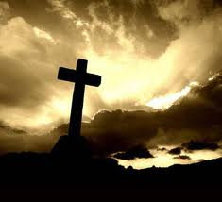
Unofficial Declarations
“trend of pubic opinion”
“our laws and customs are based upon the laws of Moses and the teachings of Christ”
“Bible is appealed to as a guide of life and the authority in questions of morals”
“Christian doctrines are accepted as the great comfort in times of sorrow and affliction”
“on every hilltop towers the steeple of some Christian church”

Slide 77
Unofficial Declarations
“Annual Thanksgiving proclamations”
“Days of fasting and prayer”
“the universal celebration of Christmas”
“the gathering of millions of our children in Sunday Schools”
“Countless volumes of Christian literature”
Brewer, United States A Christian Nation, 39-40

Slide 78
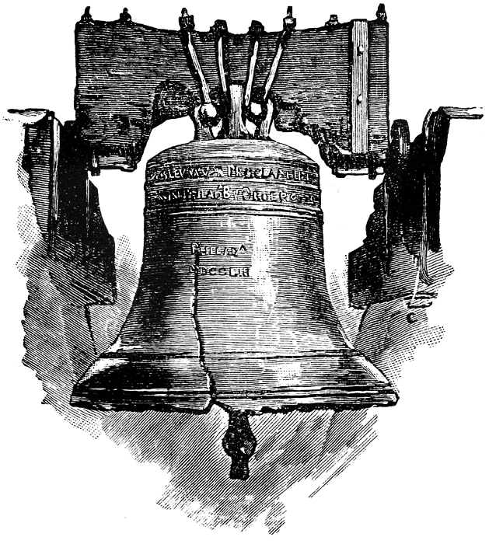

Slide 79

Leviticus 25:10
“And you shall consecrate the fiftieth year, and proclaim liberty throughout [all] the land to all its inhabitants. It shall be a Jubilee for you; and each of you shall return to his possession, and each of you shall return to his family.”

Slide 80
Preview
Early America’s:
  Absence of contrary declarations
  Chaplains
  Judicial opinions
  Christian population
  Acceptance of the Bible
  Unofficial Christian declarations
  Conclusion

Slide 81

Beyond Dispute
“You will have noticed that I have presented no doubtful facts. The quotations from charters are in the archives of the several States; the laws are on the statute books; judicial opinions are taken from the official reports; statistics from the census publications. In short, no evidence has been presented which is open to question.”
Brewer, United States A Christian Nation, 39

Slide 82

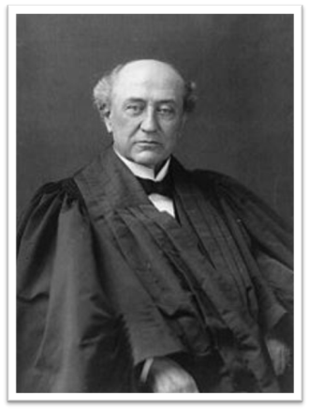
Conclusion
“But I must not weary you. I could go on indefinitely, pointing out further illustrations both official and non-official, public and private…This is a Christian nation, and we can all rejoice…”
Brewer, United States A Christian Nation, 40

Slide 83
Review
Early America’s:
  Settlements
  Colonial motivations
  Educational institutions
  Support for the church
  Requirement of Christian officeholders
  Recognition of the Sabbath
  Use of “God”

Slide 84
Review
Early America’s:
  Absence of contrary declarations
  Chaplains
  Judicial opinions
  Christian population
  Acceptance of the Bible
  Unofficial Christian declarations
  Conclusion

Slide 85
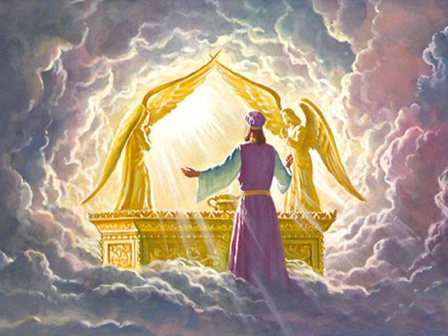
So What? – Points of Application!
God deserves glory for what He has done – doxological purpose

Slide 86
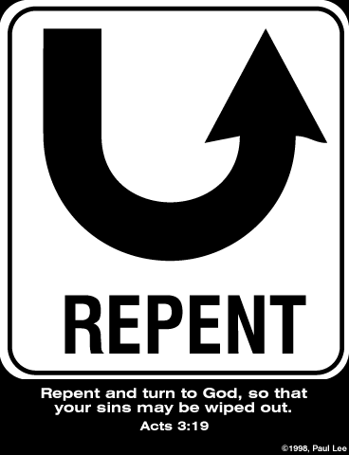
So What? – Points of Application!
Repent (Rev 2:5)
Therefore remember from where you have fallen, and repent and do the deeds you did at first; or else I am coming to you and will remove your lampstand out of its place—unless you repent.

Slide 87
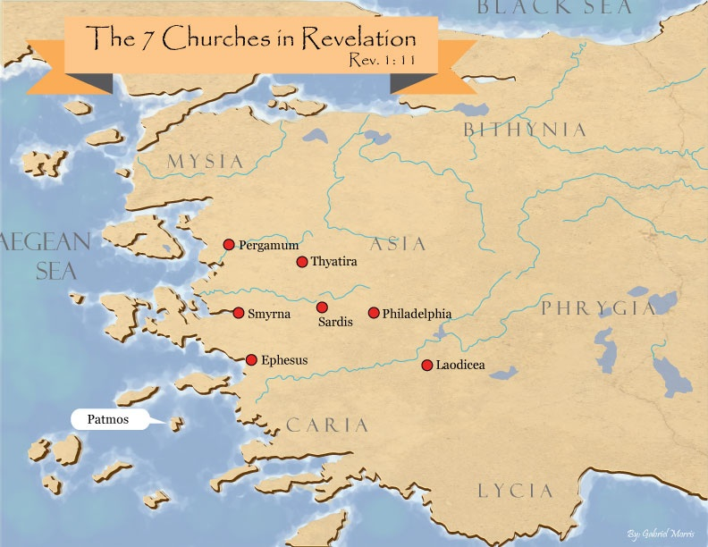
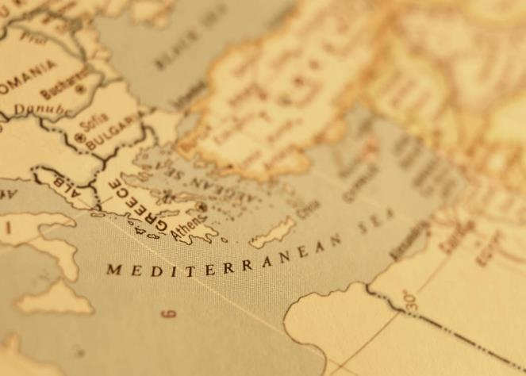

Slide 88
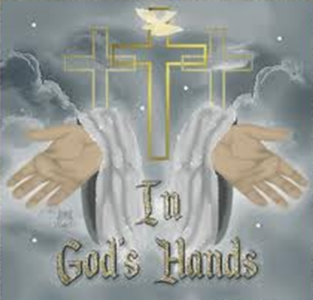
So What? – Points of Application!
The Truth Sets Free

Slide 89
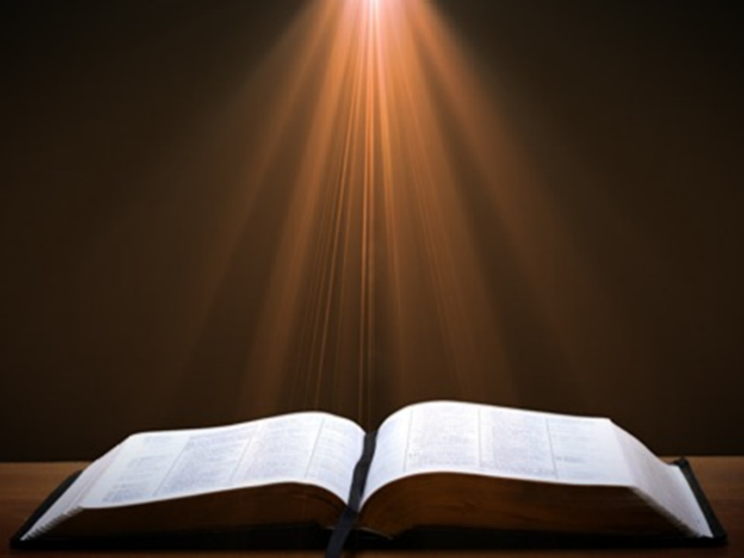

John 8:32
“and you will know the truth, and the truth will make you free.”

Slide 90

²⁴ The Lord bless you, and keep you; ²⁵ The Lord make His face shine on you, And be gracious to you; ²⁶ The Lord lift up His countenance on you, And give you peace.
Numbers 6:24–26 (NASB95)

