Slide 1
Dr. Andy Woods
Senior Pastor – Sugar Land Bible Church
President – Chafer Theological Seminary

Slide 2
Structure
1 – Commendation
2 – Correction
3 – Consequences

Slide 3
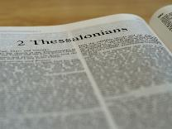
2 Thessalonians 2:1-12
Problem (2:1-2)
Prerequisites for the Day of the Lord (2:3-12)
The departure (2:3a)
Advent of the lawless one (2:3b-4)
Removal of the restrainer (2:5-7)
Destruction of the lawless one (2:8-9)
Destruction of lawless one’s followers (2:10-12)

Slide 4
Structure
1 – Commendation
2 – Correction
3 – Consequences

Slide 5
Consequences of Poor Doctrine (3)
Reciprocal prayer (3:1-5)
Exhortation to discipline the idle (3:6-15)
Conclusion (3:16-18)

Slide 6
Consequences of Poor Doctrine (3)
Reciprocal prayer (3:1-5)
Exhortation to discipline the idle (3:6-15)
Conclusion (3:16-18)

Slide 7
2 Thessalonians 3:1-5 Reciprocal Prayer
Thessalonians’ Prayer for Paul (1-2)
Paul’s Prayer for the Thessalonians (3-5)

Slide 8
2 Thessalonians 3:1-5 Reciprocal Prayer
Thessalonians’ Prayer for Paul (1-2)
Paul’s Prayer for the Thessalonians (3-5)

Slide 9
2 Thessalonians 3:1-2 Thessalonians’ Prayer for Paul
Effectiveness (1)
Deliverance (2)

Slide 10
2 Thessalonians 3:1-5 Reciprocal Prayer
Thessalonians’ Prayer for Paul (1-2)
Paul’s Prayer for the Thessalonians (3-5)

Slide 11
2 Thessalonians 3:3-5 Paul’s Prayer for the Thessalonians
Protection from Satan (3)
Continued obedience (4)
Greater intimacy with God (5)

Slide 12
2 Thessalonians 3:3-5 Paul’s Prayer for the Thessalonians
Protection from Satan (3)
Continued obedience (4)
Greater intimacy with God (5)

Slide 13
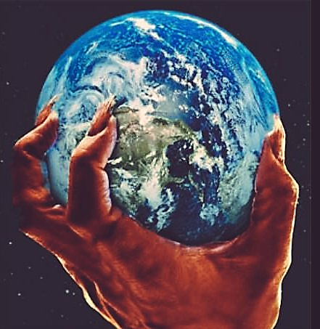
Names & Titles Demonstrating
Satan’s Post-Fall, Earthly Authority
(Job 1:7; 2:2; Luke 4:5-8; Rom. 8:19-22)
Prince of this world (John 12:31; 14:30; 16:11)
God of this age (2 Cor. 4:4)
Prince and power of the air (Eph. 2:2)
Who the believer wrestles with (Eph. 6:12)
Roaring lion (1 Pet. 5:8)
Whole world lies in his power (1 John 5:19)

Slide 14
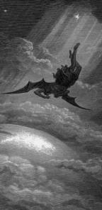
Satan’s Progressive Defeat
Initial eviction from heaven (Isa 14:12-15; Ezek 28:12-17)
Eden (Gen 3:15)
Pre-diluvian world (1 Pet 3:19-20)
Cross (John 12:31; 16:11; Col 2:15; Heb 2:14; 1 John 3:8)
Mid point of the Tribulation (Rev 12:9)
Beginning of millennium (Rev 20:2-3)
End of millennium (Rev 20:10)

Slide 16
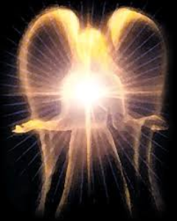
Satan’s Works - Past
Lied to Adam and Eve (Gen 3:1ff)
Corrupted the pre-flood gene pool (Gen 6:1-4)
Accused and afflicted Job (Job 1–2)
Disputed Michael regarding Moses’ body (Jude 9)
Tempted David to take a census (1 Chr 21:1)
Accused Joshua (Zech 3:1-3)

Slide 17
Satan’s Works – Past (cont’d)
Tempted Christ (Matt 4:1-11)
Tested Peter (Luke 22:31-33)
Possessed Judas (John 13:27)
Hindered Paul (1 Thess 2:18)
Afflicted Paul (2 Cor 12:7-10)
Influenced Ananias & Sapphira to lie (Acts 5:3-4, 8)

Slide 18
Satan’s Works – Present
Snatches God’s Word (Luke 8:12)
Rules world (1 John 5:19)
Blinds the mind (2 Cor 4:4)
Sends false ministers (2 Cor 11:14-15)
Sends false gospels (2 Cor 11:3-4)
Sows unbelievers among believers (Matt 13:38-39)
Performs miracles (2 Thess 2:9)

Slide 19
Satan’s Works – Present (cont’d )
Promotes immorality (Eph 2:1-3)
Opposes God’s people (Eph 6:11-12)
Tempts God’s people (1 Cor 7:5)
Uses the carnality of Christians (Eph 4:26-27)
Causes physical problems (Luke 13:11, 16)
Influences civil government (Dan 10:10ff)
Lies (John 8:44)
Deceives (Rev 12:9; 20:3)

Slide 20
2 Thessalonians 3:3-5 Paul’s Prayer for the Thessalonians
Protection from Satan (3)
Continued obedience (4)
Greater intimacy with God (5)

Slide 21
Three Tenses of Salvation
Phase | Justification | SANCTIFICATION | Glorification
Tense | Past | PRESENT | Future
Saved from sin’s: | Penalty | POWER | Presence
Scripture | Eph 2:8-9; Titus 3:5 | PHILIP 2:12 | Rom 5:10
Nature | Single | DUAL | Single

Slide 22
2 Thessalonians 3:3-5 Paul’s Prayer for the Thessalonians
Protection from Satan (3)
Continued obedience (4)
Greater intimacy with God (5)

Slide 23
Matthew 5:21-22
“²¹ “You have heard that the ancients were told, ‘You shall not commit murder’ and ‘Whoever commits murder shall be liable to the court.’ ²² But I say to you that everyone who is angry with his brother shall be guilty before the court; and whoever says to his brother, ‘You good-for-nothing,’ shall be guilty before the supreme court; and whoever says, ‘You fool,’ shall be guilty enough to go into the fiery hell.”

Slide 24
Matthew 5:27-28
“²⁷ You have heard that it was said, ‘You shall not commit adultery’; ²⁸ but I say to you that everyone who looks at a woman with lust for her has already committed adultery with her in his heart.”

Slide 25
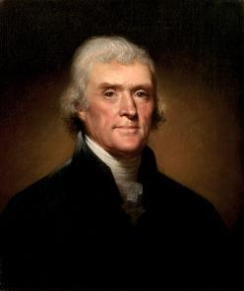
Thomas Jefferson
"My views ... are the result of a life of inquiry and reflection, and very different from the anti-Christian system imputed to me by those who know nothing of my opinions. To the corruptions of Christianity, I am, indeed, opposed; but not to the genuine precepts of Jesus Himself. I am a Christian in the only sense in which He wished any one to be; sincerely attached to his doctrines in preference to all others...His system of morals...if filled up in the style and spirit of the rich fragments He left us, would be the most perfect and sublime that has ever been taught by man...His moral doctrines...were more pure and . . .
On April 21, 1803, Jefferson wrote to Dr. Benjamin Rush, also a signer of the Declaration

Slide 26
Thomas Jefferson
...perfect than those of the most correct of the philosophers...gathering all into one family under the bonds of love, charity, peace, common wants and common aids. A development of this head will evince the peculiar superiority of the system of Jesus over all others. The precepts of philosophy, and of the Hebrew code, laid hold of actions only. He pushed his scrutinies into the heart of man; erected his tribunal in the region of his thoughts, and purified the waters at the fountain head.”
On April 21, 1803, Jefferson wrote to Dr. Benjamin Rush, also a signer of the Declaration

Slide 27
2 Peter 1:5-7
⁵ Now for this very reason also, applying all diligence, in your faith supply moral excellence, and in your moral excellence, knowledge, ⁶ and in your knowledge, self-control, and in your self-control, perseverance [hypomonē], and in your perseverance, godliness, ⁷ and in your godliness, brotherly kindness, and in your brotherly kindness, love.

Slide 28
Thomas L. Constable “Notes on 2 Peter,” online: www.soniclight.com, accessed 21 January 2020, 12.
“Unlike other New Testament ethical lists (except Rom. 5:3-5), Peter used a literary device called ‘sorites’ (also called ‘climax’ or gradatio). Sorites (from the Gr. soros, ‘a heap’) is a set of statements that proceed, step by step, to a climactic conclusion through the force of logic or reliance upon a series of indisputable facts. Each new statement picks up the last key word or phrase of the preceding one.”

Slide 29
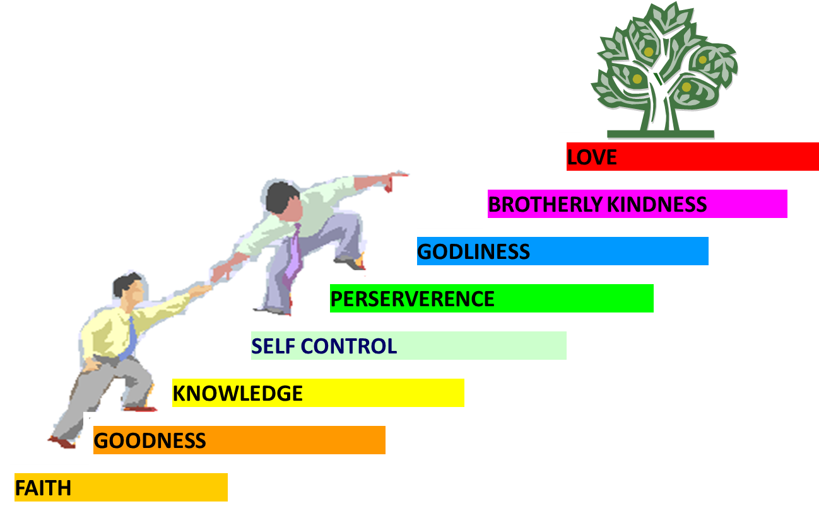
PORTRAIT OF GROWTH 1:5-7

Slide 30
2 Thessalonians 2:2
“that you not be quickly shaken from your composure or be disturbed either by a spirit or a message or a letter as if from us, to the effect that the day of the Lord [the Tribulation] has come.”

Slide 31
2 Thessalonians 3:3-5 Paul’s Prayer for the Thessalonians
Protection from Satan (3)
Continued obedience (4)
Greater intimacy with God (5)

Slide 32
Conclusion

Slide 33
2 Thessalonians 3:1-5 Reciprocal Prayer
Thessalonians’ Prayer for Paul (1-2)
Paul’s Prayer for the Thessalonians (3-5)

Slide 34
2 Thessalonians 3:3-5 Paul’s Prayer for the Thessalonians
Protection from Satan (3)
Continued obedience (4)
Greater intimacy with God (5)

Slide 35
Consequences of Poor Doctrine (3)
Reciprocal prayer (3:1-5)
Exhortation to discipline the idle (3:6-15)
Conclusion (3:16-18)

Slide 36
Consequences of Poor Doctrine (3)
Reciprocal prayer (3:1-5)
Exhortation to discipline the idle (3:6-15)
Conclusion (3:16-18)

