Slide 1
Genesis 12‒50
Israel’s Birth & Preservation

Slide 2
GENESIS STRUCTURE
Genesis 12-50 (four people)
Abraham (12:1–25:11)
Isaac (25:12–26:35)
Jacob (27–36)
Joseph (37–50)

Slide 3
Genesis 37:2-36 Joseph Sold unto Egypt
Joseph’s coat (37:2-4)
Joseph’s dreams (37:5-11)
Joseph’s pit (37:12-24)
Joseph’s enslavement (37:25-36)

Slide 4
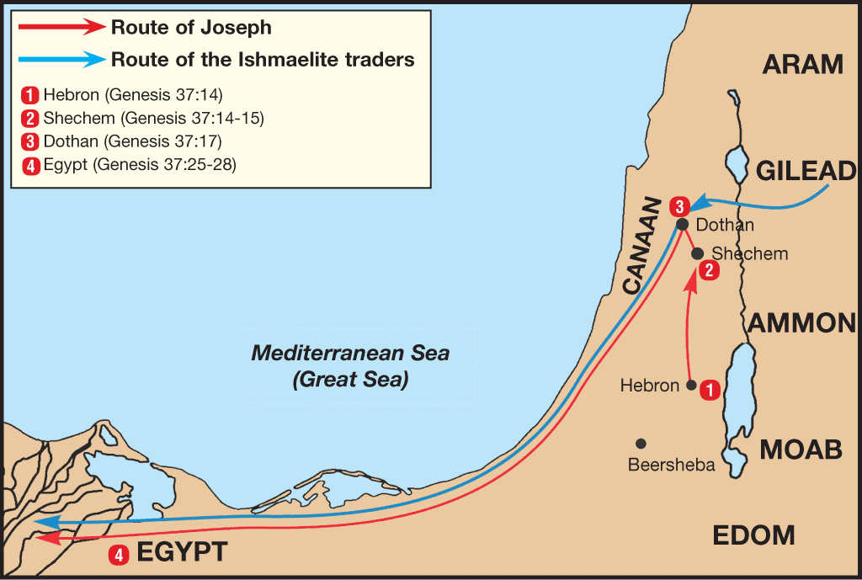

Slide 5
Genesis 38:1-30 Judah & Tamar
Tamar & Judah’s sons (38:1-11)
Tamar & Judah (38:12-26)
Tamar & Judah’s twins (38:27-30)

Slide 6
Genesis 39:1-23 Joseph in Potiphar's House
Blessing (39:1-6)
Temptation & Accusation (39:7-18)
Prison (39:19-23)

Slide 7
Genesis 40:1-23 Joseph in Prison
Imprisonment (40:1-8)
Butler’s dream (40:9-15)
Baker’s dream (40:16-19)
Fulfillment of the dreams (40:20-23)

Slide 8
Genesis 41:1-57 Joseph Before Pharoah
Pharoah’s 2 dreams (41:1-8)
Butler’s report (41:9-13)
Joseph before Pharoah (41:14-24)
Joseph’s interpretation & advice (41:25-36)
Joseph’s elevation (41:37-46a)
Joseph’s activities (41:46b-57)

Slide 9
VI. Genesis 41:46b-57 Joseph’s Activities
Joseph exercises his authority (46b)
7 years of plenty (47-49)
Joseph’s family (50-52)
7 years of famine (53-54)
Egyptians’ response (55-56)
Foreigners’ response (57)

Slide 10
VI. Genesis 41:46b-57 Joseph’s Activities
Joseph exercises his authority (46b)
7 years of plenty (47-49)
Joseph’s family (50-52)
7 years of famine (53-54)
Egyptians’ response (55-56)
Foreigners’ response (57)

Slide 11
VI. Genesis 41:46b-57 Joseph’s Activities
Joseph exercises his authority (46b)
7 years of plenty (47-49)
Joseph’s family (50-52)
7 years of famine (53-54)
Egyptians’ response (55-56)
Foreigners’ response (57)

Slide 12
Genesis 41:47-49 7 Years of Plenty
Abundance of food (47)
Gathering & storing (48)
Record keeping (49)

Slide 13
Genesis 41:47-49 7 Years of Plenty
Abundance of food (47)
Gathering & storing (48)
Record keeping (49)

Slide 14
Genesis 41:47-49 7 Years of Plenty
Abundance of food (47)
Gathering & storing (48)
Record keeping (49)

Slide 15
Genesis 41:47-49 7 Years of Plenty
Abundance of food (47)
Gathering & storing (48)
Record keeping (49)

Slide 17
Revelation 20:7-10
“⁷ When the thousand years are completed, Satan will be released from his prison, ⁸ and will come out to deceive the nations which are in the four corners of the earth, Gog and Magog, to gather them together for the war; the number of them is like the sand of the seashore. ⁹ And they came up on the broad plain of the earth and surrounded the camp of the saints and the beloved city, and fire came down from. . .

Slide 18
VI. Genesis 41:46b-57 Joseph’s Activities
Joseph exercises his authority (46b)
7 years of plenty (47-49)
Joseph’s family (50-52)
7 years of famine (53-54)
Egyptians’ response (55-56)
Foreigners’ response (57)

Slide 19
Genesis 41:50-52 Joseph’s Family
Wife-Mother (50)
First son (51)
Second son (52)

Slide 20
Genesis 41:50-52 Joseph’s Family
Wife-Mother (50)
First son (51)
Second son (52)

Slide 21
Genesis 41:50-52 Joseph’s Family
Wife-Mother (50)
First son (51)
Second son (52)

Slide 22
2 Cor. 4:16
“Therefore we do not lose heart, but though our outer man is decaying, yet our inner man is being renewed day by day.”

Slide 23
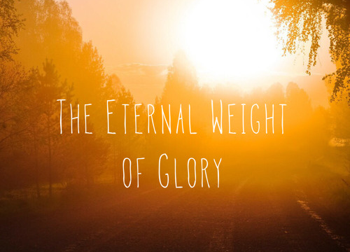
2 Cor. 4:17
“For momentary, light affliction is producing for us an eternal weight of glory far beyond all comparison.”

Slide 24
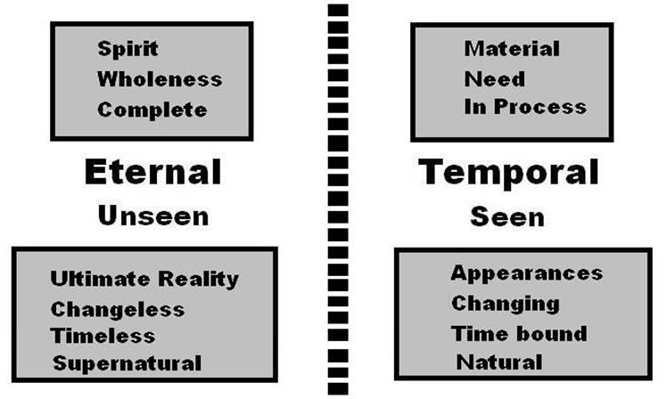
2 Cor. 4:18
“while we look not at the things which are seen, but at the things which are not seen; for the things which are seen are temporal, but the things which are not seen are eternal.”

Slide 25
Genesis 41:50-52 Joseph’s Family
Wife-Mother (50)
First son (51)
Second son (52)

Slide 26
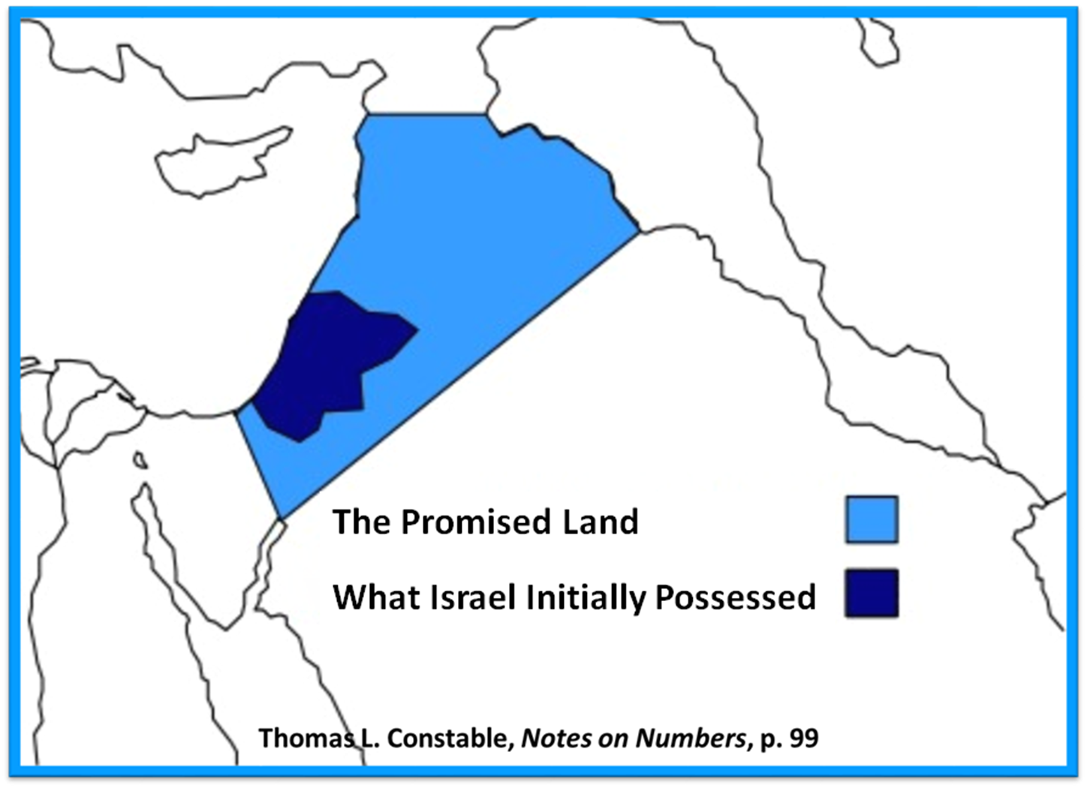

Slide 27
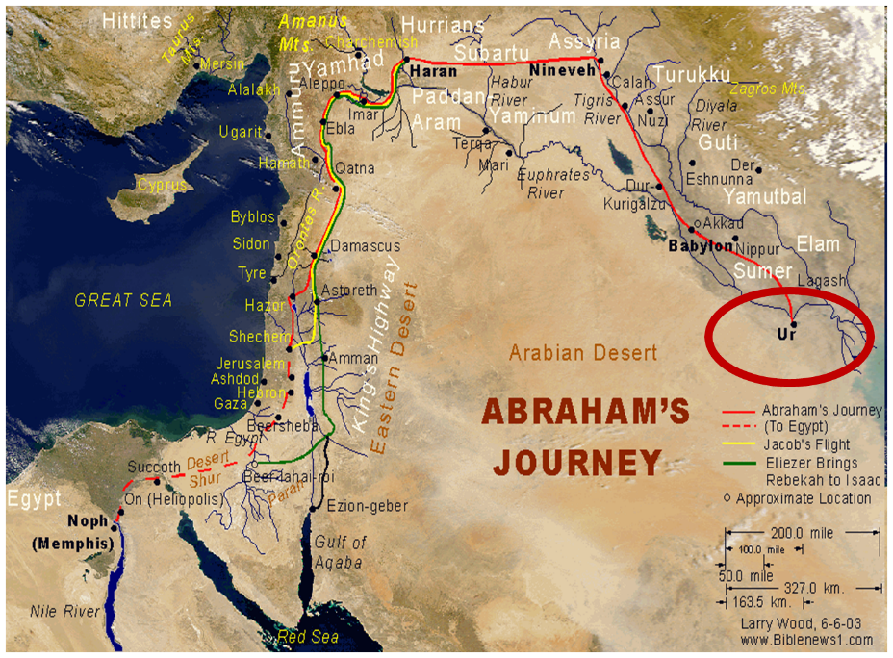

Slide 28
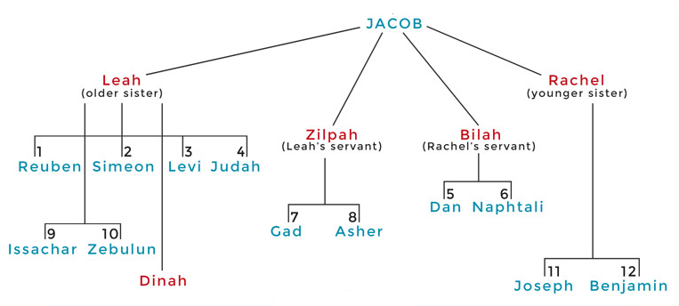

Slide 31
Distinctions Between 144,000 & Multitude
144,000 | MULTITUDE
Revelation 7:1-8 | Revelation 7:9-17
Numbered | Innumerable
Jews | All nations
Sealed | Slain
Sealed before the Tribulation | Converted out of the Tribulation
Hitchcock and Ice, The Truth Behind Left Behind, 77

Slide 32
VI. Genesis 41:46b-57 Joseph’s Activities
Joseph exercises his authority (46b)
7 years of plenty (47-49)
Joseph’s family (50-52)
7 years of famine (53-54)
Egyptians’ response (55-56)
Foreigners’ response (57)

Slide 33
Genesis 41:53-54 7 Years of Famine
End of fat years (53)
Beginning of lean years (54)

Slide 34
Genesis 41:53-54 7 Years of Famine
End of fat years (53)
Beginning of lean years (54)

Slide 35
Genesis 41:53-54 7 Years of Famine
End of fat years (53)
Beginning of lean years (54)

Slide 36
John 13:19; 14:29
“^{13:19} From now on I am telling you before it comes to pass, so that when it does occur, you may believe that I am He… ^{14:29} Now I have told you before it happens, so that when it happens, you may believe.”

Slide 37
What Happened to Christ’s Disciples?
Disciple | Place | Martyrdom
James the Son of Alpheus | Jerusalem | Clubbed to death
Simon the Zealot | Jerusalem | Martyred
James the Son of Zebedee | Judea (Acts 12:2) | Executed
Thaddeus | Mesopotamia | Beaten to death
Peter | Babylon, Rome | Crucified upside down
Matthew | Parthia (Tehran) | Beheaded
Notes:
109 prophecies…
Peter Stoner – SCIENCE SPEAKS, An Evaluation of Certain Christian Evidences
To fulfill just 8 prophecies =1 X 10 to the twenty-eighth power!
Can we visualize this with an illustration? Suppose we took an atheistic professor, blindfolded him and covered the state of Texas two feet deep with silver dollars. Then we put a check on one of those silver dollars and mixed them up. The odds of one person fulfilling just these eight prophecies would be the same as this atheistic professor selecting the silver dollar upon which we have placed a check, in his first try.
https://www.bereanpublishers.com/the-odds-of-eight-messianic-prophecies-coming-true/

Slide 38
What Happened to Christ’s Disciples?
Disciple | Place | Martyrdom
John | Asia Minor, Patmos, Ephesus | Fried in boiling oil
Philip | E. Turkey | Tortured & crucified
Thomas | India | Speared
Bartholomew | India | Flayed & crucified
Andrew | Ukraine, Russia, Greece | Hanged
Notes:
109 prophecies…
Peter Stoner – SCIENCE SPEAKS, An Evaluation of Certain Christian Evidences
To fulfill just 8 prophecies =1 X 10 to the twenty-eighth power!
Can we visualize this with an illustration? Suppose we took an atheistic professor, blindfolded him and covered the state of Texas two feet deep with silver dollars. Then we put a check on one of those silver dollars and mixed them up. The odds of one person fulfilling just these eight prophecies would be the same as this atheistic professor selecting the silver dollar upon which we have placed a check, in his first try.
https://www.bereanpublishers.com/the-odds-of-eight-messianic-prophecies-coming-true/

Slide 39
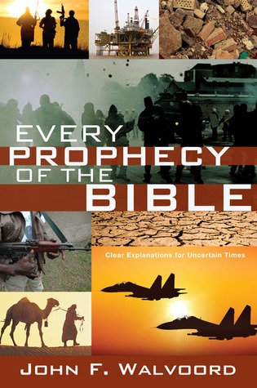

Slide 40
VI. Genesis 41:46b-57 Joseph’s Activities
Joseph exercises his authority (46b)
7 years of plenty (47-49)
Joseph’s family (50-52)
7 years of famine (53-54)
Egyptians’ response (55-56)
Foreigners’ response (57)

Slide 41
Genesis 41:55-56 Egyptians’ Response
Pharoah’s command (55)
Selling of the grain (56)

Slide 42
Genesis 41:55-56 Egyptians’ Response
Pharoah’s command (55)
Selling of the grain (56)

Slide 43
Genesis 41:55 Pharoah’s Command
Timing (55a)
Circumstances (55b)
Command (55c)

Slide 44
Genesis 41:55 Pharoah’s Command
Timing (55a)
Circumstances (55b)
Command (55c)

Slide 45
Genesis 41:55 Pharoah’s Command
Timing (55a)
Circumstances (55b)
Command (55c)

Slide 46
Genesis 41:55 Pharoah’s Command
Timing (55a)
Circumstances (55b)
Command (55c)

Slide 47
Genesis 41:55-56 Egyptians’ Response
Pharoah’s command (55)
Selling of the grain (56)

Slide 48
Genesis 41:56 Selling of the Grain
Statement of fact (56a)
Joseph responds (56b)
Statement of fact (56c)

Slide 49
Genesis 41:56 Selling of the Grain
Statement of fact (56a)
Joseph responds (56b)
Statement of fact (56c)

Slide 50
Genesis 7:19-23
They rose greatly on the earth, and all the high mountains under the entire heaven were covered…Every living thing that moved on the earth perished—birds, livestock, wild animals, all the creatures that swarm over the earth, and all mankind. Everything on dry land that had the breath of life in its nostrils died. Every living thing on the face of the earth was wiped out; men and animals and the creatures that move along the ground and the birds of the air were wiped from the earth. Only Noah was left, and those with him in the ark.”

Slide 51
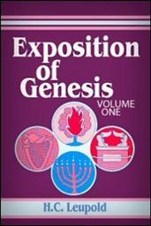
H.C. Leupold
Exposition of Genesis (Grand Rapids: Baker, 1942), vol. 1, p. 301-302.
“… ‘all the high mountains under all the heavens.’ One of these expressions alone would almost necessitate the impression that the author intends to convey the idea of the absolute universality of the Flood…Yet since ‘all’ is known to be used in a relative sense, the writer removes all ambiguity by adding the phrase ‘under all the heavens.’ A double ‘all’ (kol) cannot allow for so relative a sense. It almost constitutes a Hebrew superlative. So we believe that the text disposes of the question of the universality of the flood. By way of objection to this interpretation, those who believe in a limited flood…urge the . . .

Slide 52
H.C. Leupold
Exposition of Genesis (Grand Rapids: Baker, 1942), vol. 1, p. 301-302.
. . . fact that kol is used in a relative sense, as is clearly the case in passages such as Genesis 41:57; Exodus 9:25, 10:15; Deuteronomy 2:25; and 1 Kings 10:24. However, we still insist that this fact could overthrow a single kol, never a double kol, as our verse has it.”

Slide 53
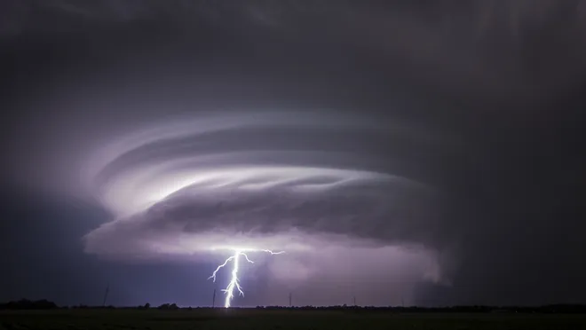
Exodus 9:24 (NIV)
“…It was the worst storm in all the land of Egypt since it had become a nation.”

Slide 54
Genesis 41:56 Selling of the Grain
Statement of fact (56a)
Joseph responds (56b)
Statement of fact(56c)

Slide 55
Genesis 41:56 Selling of the Grain
Statement of fact (56a)
Joseph responds (56b)
Statement of fact (56c)

Slide 56
VI. Genesis 41:46b-57 Joseph’s Activities
Joseph exercises his authority (46b)
7 years of plenty (47-49)
Joseph’s family (50-52)
7 years of famine (53-54)
Egyptians’ response (55-56)
Foreigners’ response (57)

Slide 59
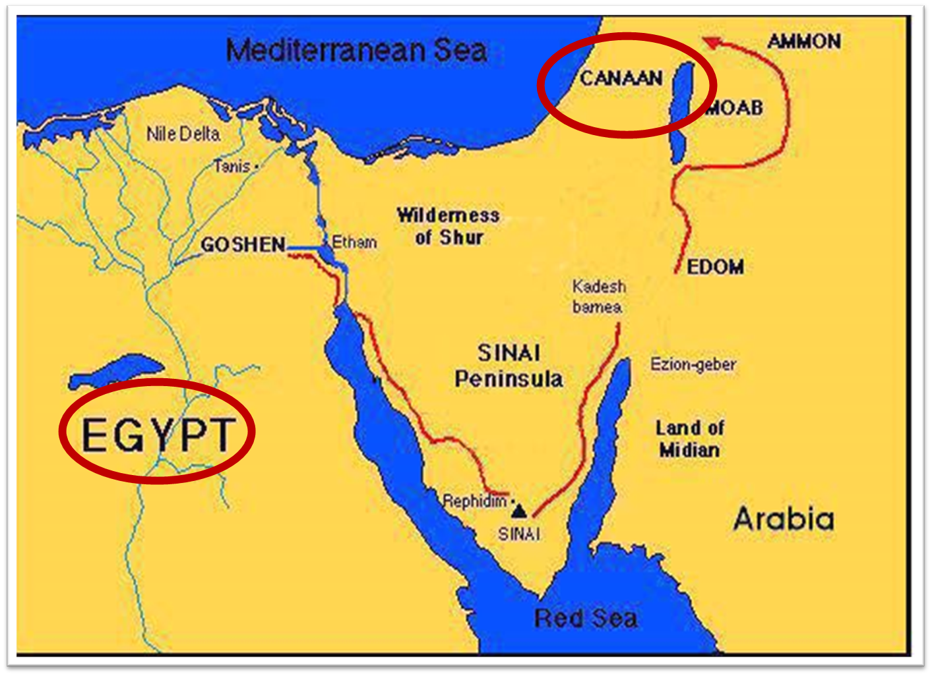

Slide 61
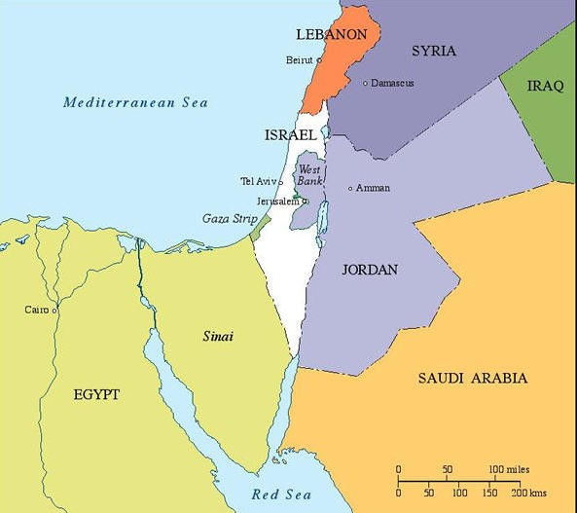

Slide 62
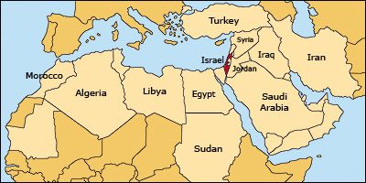

Slide 63
Conclusion

Slide 64
Genesis 41:1-57 Joseph Before Pharoah
Pharoah’s 2 dreams (41:1-8)
Butler’s report (41:9-13)
Joseph before Pharoah (41:14-24)
Joseph’s interpretation & advice (41:25-36)
Joseph’s elevation (41:37-46a)
Joseph’s activities (41:46b-57)

Slide 65
²⁴ The Lord bless you, and keep you; ²⁵ The Lord make His face shine on you, And be gracious to you; ²⁶ The Lord lift up His countenance on you, And give you peace.
Numbers 6:24–26 (NASB95)

