Slide 1
Dr. Andy Woods
Senior Pastor – Sugar Land Bible Church
President – Chafer Theological Seminary

Slide 2
Structure
1 – Commendation
2 – Correction
3 – Consequences

Slide 3
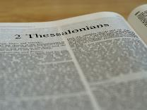
2 Thessalonians 2:1-12
Problem (2:1-2)
Prerequisites for the Day of the Lord (2:3-12)
The departure (2:3a)
Advent of the lawless one (2:3b-4)
Removal of the restrainer (2:5-7)
Destruction of the lawless one (2:8-9)
Destruction of lawless one’s followers (2:10-12)

Slide 4
Structure
1 – Commendation
2 – Correction
3 – Consequences

Slide 5
Consequences of Poor Doctrine (3)
Reciprocal prayer (3:1-5)
Exhortation to discipline the idle (3:6-15)
Conclusion (3:16-18)

Slide 6
Consequences of Poor Doctrine (3)
Reciprocal prayer (3:1-5)
Exhortation to discipline the idle (3:6-15)
Conclusion (3:16-18)

Slide 7
2 Thessalonians 3:1-5 Reciprocal Prayer
Thessalonians’ Prayer for Paul (1-2)
Paul’s Prayer for the Thessalonians (3-5)

Slide 8
2 Thessalonians 3:1-5 Reciprocal Prayer
Thessalonians’ Prayer for Paul (1-2)
Paul’s Prayer for the Thessalonians (3-5)

Slide 9
2 Thessalonians 3:1-2 Thessalonians’ Prayer for Paul
Effectiveness (1)
Deliverance (2)

Slide 10
2 Thessalonians 3:1-5 Reciprocal Prayer
Thessalonians’ Prayer for Paul (1-2)
Paul’s Prayer for the Thessalonians (3-5)

Slide 11
2 Thessalonians 3:3-5 Paul’s Prayer for the Thessalonians
Protection from Satan (3)
Continued obedience (4)
Greater intimacy with God (5)

Slide 12
2 Thessalonians 3:3-5 Paul’s Prayer for the Thessalonians
Protection from Satan (3)
Continued obedience (4)
Greater intimacy with God (5)

Slide 13
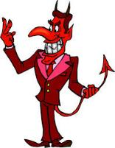
Names & Titles Demonstrating Satan’s Post-Fall, Earthly Authority
(Job 1:7; 2:2; Luke 4:5-8; Rom. 8:19-22)
Prince of this world (John 12:31; 14:30; 16:11)
God of this age (2 Cor. 4:4)
Prince and power of the air (Eph. 2:2)
Who the believer wrestles with (Eph. 6:12)
Roaring lion (1 Pet. 5:8)
Whole world lies in his power (1 John 5:19)

Slide 14
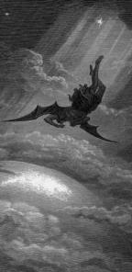
Satan’s Progressive Defeat
Initial eviction from heaven (Isa 14:12-15; Ezek 28:12-17)
Eden (Gen 3:15)
Pre-diluvian world (1 Pet 3:19-20)
Cross (John 12:31; 16:11; Col 2:15; Heb 2:14; 1 John 3:8)
Mid point of the Tribulation (Rev 12:9)
Beginning of millennium (Rev 20:2-3)
End of millennium (Rev 20:10)

Slide 16
Revelation 20:1-3
“¹ Then I saw an angel coming down from heaven, holding the key of the abyss and a great chain in his hand. ² And he laid hold of the dragon, the serpent of old, who is the devil and Satan, and bound him for a thousand years; ³ and he threw him into the abyss, and shut it and so that he would not deceive the nations any longer sealed it over him,, until the thousand years were completed; after these things he must be released for a short time.”

Slide 17
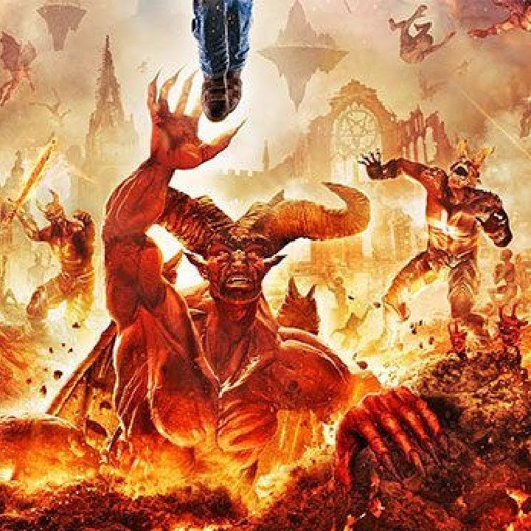
Revelation 20:10
¹⁰ And the devil who deceived them was thrown into the lake of fire and brimstone, where the beast and the false prophet are also; and they will be tormented day and night forever and ever.”

Slide 18
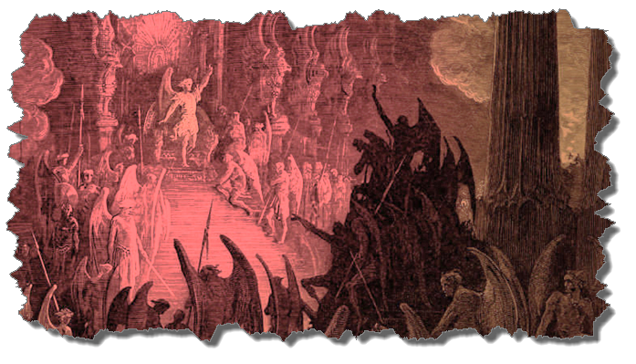
Christian’s Defense Against Satan/Demons
God’s responsibility
Believer’s responsibility

Slide 19
Christian’s Defense Against Satan/Demons
God’s responsibility
Believer’s responsibility

Slide 20
Christian’s Defense Against Satan/Demons
God’s responsibility
Divine restraint (Job 1:12; 2:6; Luke 22:31-32; Thess. 2:6-7; 1 John 5:18)
Divine intercession (John 17:15; Rom 8:34; Heb 7:25)

Slide 21
Christian’s Defense Against Satan/Demons
God’s responsibility
Believer’s responsibility

Slide 22
Christian’s Defense Against Satan/Demons
Believer’s responsibility
Our defensive posture (Rev 20:2-3, 10; 2 Pet 2:10-11)
Avoid catering to the flesh (Eph 4:26-27)
Resist (Jas 4:7; 1 Pet 5:8-9; Eph 6:13)
Rely on the Spirit (1 John 4:4)
Put on the full armor of God (Eph 6:10-20)

Slide 23
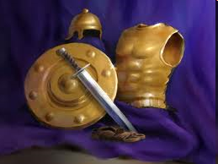
Ephesians 6:10-20
Dressed for Success!

Slide 25
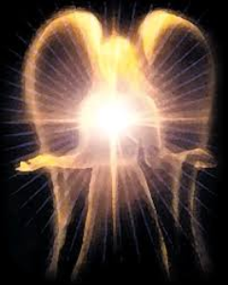
Satan’s Works - Past
Lied to Adam and Eve (Gen 3:1ff)
Corrupted the pre-flood gene pool (Gen 6:1-4)
Accused and afflicted Job (Job 1–2)
Disputed Michael regarding Moses’ body (Jude 9)
Tempted David to take a census (1 Chr 21:1)
Accused Joshua (Zech 3:1-3)

Slide 26
Satan’s Works – Past (cont’d)
Tempted Christ (Matt 4:1-11)
Tested Peter (Luke 22:31-33)
Possessed Judas (John 13:27)
Hindered Paul (1 Thess 2:18)
Afflicted Paul (2 Cor 12:7-10)
Influenced Ananias & Sapphira to lie (Acts 5:3-4, 8)

Slide 27
Satan’s Works – Present
Snatches God’s Word (Luke 8:12)
Rules world (1 John 5:19)
Blinds the mind (2 Cor 4:4)
Sends false ministers (2 Cor 11:14-15)
Sends false gospels (2 Cor 11:3-4)
Sows unbelievers among believers (Matt 13:38-39)
Performs miracles (2 Thess 2:9)

Slide 28
Satan’s Works – Present (cont’d )
Promotes immorality (Eph 2:1-3)
Opposes God’s people (Eph 6:11-12)
Tempts God’s people (1 Cor 7:5)
Uses the carnality of Christians (Eph 4:26-27)
Causes physical problems (Luke 13:11, 16)
Influences civil government (Dan 10:10ff)
Lies (John 8:44)
Deceives (Rev 12:9; 20:3)

Slide 29
2 Thessalonians 3:3-5 Paul’s Prayer for the Thessalonians
Protection from Satan (3)
Continued obedience (4)
Greater intimacy with God (5)

Slide 30
Three Tenses of Salvation
Phase | Justification | SANCTIFICATION | Glorification
Tense | Past | PRESENT | Future
Saved from sin’s: | Penalty | POWER | Presence
Scripture | Eph 2:8-9; Titus 3:5 | PHILIP 2:12 | Rom 5:10
Nature | Single | DUAL | Single

Slide 31
2 Thessalonians 3:3-5 Paul’s Prayer for the Thessalonians
Protection from Satan (3)
Continued obedience (4)
Greater intimacy with God (5)

Slide 32
2 Peter 1:5-7
⁵ Now for this very reason also, applying all diligence, in your faith supply moral excellence, and in your moral excellence, knowledge, ⁶ and in your knowledge, self-control, and in your self-control, perseverance [hypomonē], and in your perseverance, godliness, ⁷ and in your godliness, brotherly kindness, and in your brotherly kindness, love.

Slide 33
Thomas L. Constable “Notes on 2 Peter,” online: www.soniclight.com, accessed 21 January 2020, 12.
“Unlike other New Testament ethical lists (except Rom. 5:3-5), Peter used a literary device called ‘sorites’ (also called ‘climax’ or gradatio). Sorites (from the Gr. soros, ‘a heap’) is a set of statements that proceed, step by step, to a climactic conclusion through the force of logic or reliance upon a series of indisputable facts. Each new statement picks up the last key word or phrase of the preceding one.”

Slide 34
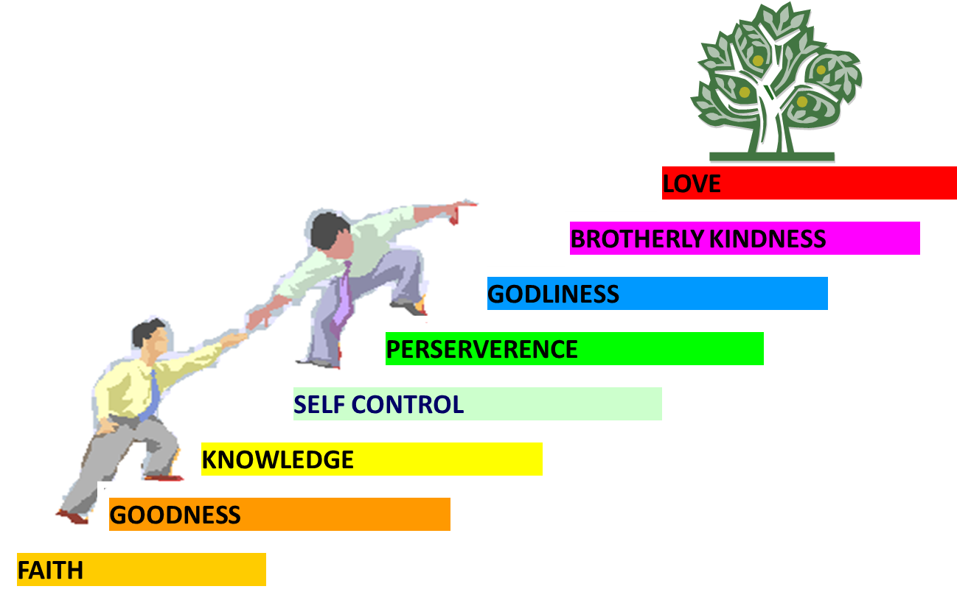
PORTRAIT OF GROWTH 1:5-7

Slide 35
2 Thessalonians 2:2
“that you not be quickly shaken from your composure or be disturbed either by a spirit or a message or a letter as if from us, to the effect that the day of the Lord [the Tribulation] has come.”

Slide 36
2 Thessalonians 3:3-5 Paul’s Prayer for the Thessalonians
Protection from Satan (3)
Continued obedience (4)
Greater intimacy with God (5)

Slide 37
Conclusion

Slide 38
2 Thessalonians 3:1-5 Reciprocal Prayer
Thessalonians’ Prayer for Paul (1-2)
Paul’s Prayer for the Thessalonians (3-5)

Slide 39
2 Thessalonians 3:3-5 Paul’s Prayer for the Thessalonians
Protection from Satan (3)
Continued obedience (4)
Greater intimacy with God (5)

Slide 40
Consequences of Poor Doctrine (3)
Reciprocal prayer (3:1-5)
Exhortation to discipline the idle (3:6-15)
Conclusion (3:16-18)

Slide 41
Consequences of Poor Doctrine (3)
Reciprocal prayer (3:1-5)
Exhortation to discipline the idle (3:6-15)
Conclusion (3:16-18)

