Slide 1
Genesis 12‒50
Israel’s Birth & Preservation

Slide 2
GENESIS STRUCTURE
Genesis 12-50 (four people)
Abraham (12:1–25:11)
Isaac (25:12–26:35)
Jacob (27–36)
Joseph (37–50)

Slide 3
Genesis 37:2-36 Joseph Sold unto Egypt
Joseph’s coat (37:2-4)
Joseph’s dreams (37:5-11)
Joseph’s pit (37:12-24)
Joseph’s enslavement (37:25-36)

Slide 4
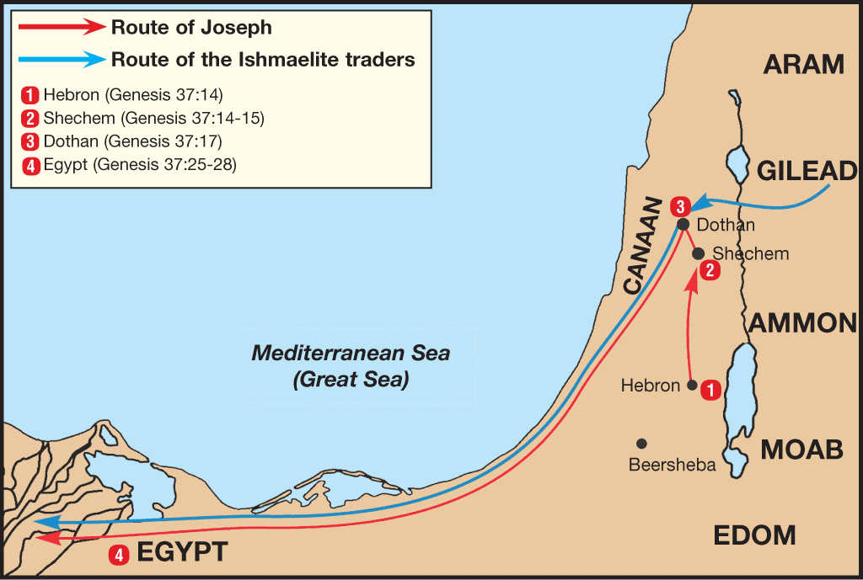

Slide 5
Genesis 38:1-30 Judah & Tamar
Tamar & Judah’s sons (38:1-11)
Tamar & Judah (38:12-26)
Tamar & Judah’s twins (38:27-30)

Slide 6
Genesis 39:1-23 Joseph in Potiphar's House
Blessing (39:1-6)
Temptation & Accusation (39:7-18)
Prison (39:19-23)

Slide 7
Genesis 40:1-23 Joseph in Prison
Imprisonment (40:1-8)
Butler’s dream (40:9-15)
Baker’s dream (40:16-19)
Fulfillment of the dreams (40:20-23)

Slide 8
Genesis 41:1-57 Joseph Before Pharoah
Pharoah’s 2 dreams (41:1-8)
Butler’s report (41:9-13)
Joseph before Pharoah (41:14-24)
Joseph’s interpretation & advice (41:25-36)
Joseph’s elevation (41:37-46a)
Joseph’s activities (41:46b-57)

Slide 9
Genesis 41:39-44 Joseph’s Appointment
Appointment (39-40)
Extent of authority (41)
Royal garb (42)
Royal chariot (43a)
Royal honor (43b)
Decree of authority (44)

Slide 10
Genesis 41:42 Royal Garb
Ring (42a)
Clothing (42b)
Chain (42c)

Slide 11
Genesis 41:42 Royal Garb
Ring (42a)
Clothing (42b)
Chain (42c)

Slide 12
Genesis 41:42 Royal Garb
Ring (42a)
Clothing (42b)
Chain (42c)

Slide 13
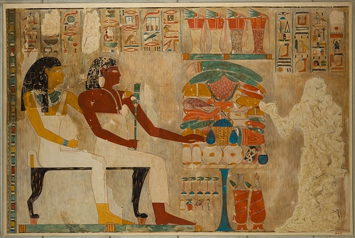
Dr. Arnold G. Fruchtenbaum
The Book of Genesis, 569
“Second was the clothing: and arrayed him in vestures of fine linen. This, too, is paralleled in the Egyptian accounts. When Rekhmire was appointed vizier, he wrote: ‘I was a noble, the second of the king … It was the first occasion of my being summoned … I went forth … clad in fine linen.’ This was the type of clothing worn by a vizier, a prime minister, someone who was second to the king.”

Slide 14
Genesis 41:42 Royal Garb
Ring (42a)
Clothing (42b)
Chain (42c)

Slide 15
Genesis 41:39-44 Joseph’s Appointment
Appointment (39-40)
Extent of authority (41)
Royal garb (42)
Royal chariot (43a)
Royal honor (43b)
Decree of authority (44)

Slide 16
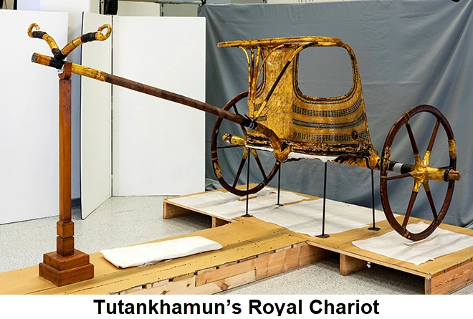
Dr. Arnold G. Fruchtenbaum
The Book of Genesis, 569
“In verse 43a Joseph was given a royal chariot: and he made him to ride in the second chariot which he had; the Hyksos introduced chariots into Egypt.”

Slide 17
Genesis 41:39-44 Joseph’s Appointment
Appointment (39-40)
Extent of authority (41)
Royal garb (42)
Royal chariot (43a)
Royal honor (43b)
Decree of authority (44)

Slide 18
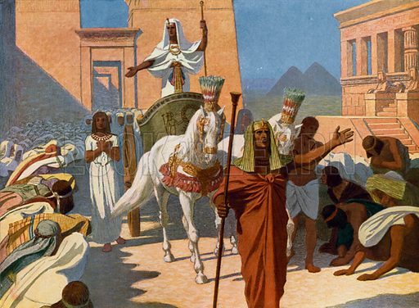
Dr. Arnold G. Fruchtenbaum
The Book of Genesis, 569
“Then, in verse 43b, came the royal honor: and they cried before him, Bow the knee. As Joseph rode in the chariot, heralds were sent out in advance with the command: Bow the knee. This was a practice that is well attested to in Egyptian pictures.”

Slide 19
Genesis 41:39-44 Joseph’s Appointment
Appointment (39-40)
Extent of authority (41)
Royal garb (42)
Royal chariot (43a)
Royal honor (43b)
Decree of authority (44)

Slide 20
V. Genesis 41:37-46a Joseph’s Elevation
Pharaoh’s response (37-38)
Joseph’s appointment (39-44)
Joseph’s settlement (45-46a)

Slide 21
Genesis 41:45-46a Joseph’s Settlement
Name (45a)
Marriage (45b)
Authority (45c)
Age (46a)

Slide 22
Genesis 41:45-46a Joseph’s Settlement
Name (45a)
Marriage (45b)
Authority (45c)
Age (46a)

Slide 23
Charles Ryrie The Ryrie Study Bible, page 54
Genesis 41:45 (RSBEE:NASB1995U): 41:45 “In order to ‘Egyptianize’ Joseph, Pharaoh gave him an Egyptian name and an Egyptian wife. The meaning of his Egyptian name is uncertain. Asenath means ‘she belongs to Neith’ (a goddess of the Egyptians). On is the city of Heliopolis, a center for the worship of the sun god, Ra.”

Slide 24
Genesis 41:45-46a Joseph’s Settlement
Name (45a)
Marriage (45b)
Authority (45c)
Age (46a)

Slide 25
Charles Ryrie The Ryrie Study Bible, page 54
Genesis 41:45 (RSBEE:NASB1995U): 41:45 “In order to ‘Egyptianize’ Joseph, Pharaoh gave him an Egyptian name and an Egyptian wife. The meaning of his Egyptian name is uncertain. Asenath means ‘she belongs to Neith’ (a goddess of the Egyptians). On is the city of Heliopolis, a center for the worship of the sun god, Ra.”

Slide 26
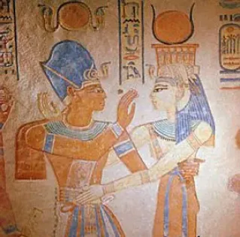
Dr. Arnold G. Fruchtenbaum
The Book of Genesis, 570
“His marriage to a pagan was the result of an order from the king and something he did not have much choice about.”

Slide 27
Genesis 41:45-46a Joseph’s Settlement
Name (45a)
Marriage (45b)
Authority (45c)
Age (46a)

Slide 28
Dr. Arnold G. Fruchtenbaum
The Book of Genesis, 570
“Therefore, a total separation of twenty years existed from the time he had last seen members of his family until they were reunited in Egypt. The Hyksos Period, during which Joseph’s story unfolds, was the two-hundred-year period from 1750 until 1550 B.C. The Hyksos were Semitic rulers that conquered Egypt and ruled during the sixteenth and seventeenth dynasties. Thus, the Pharaoh at the time of Joseph was Semitic. This explains how a Semite such as Joseph could rise to the second highest position in Egypt, which had a Hamitic population.”

Slide 29
GENESIS 10 Outline
Introduction (1)
Japheth's line (2-5)
Ham’s Line (6-20)
Shem’s line (21-31)
Conclusion (32)

Slide 30
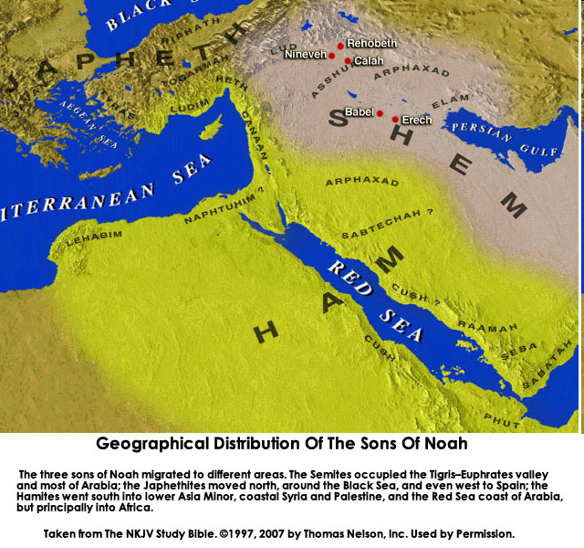

Slide 31
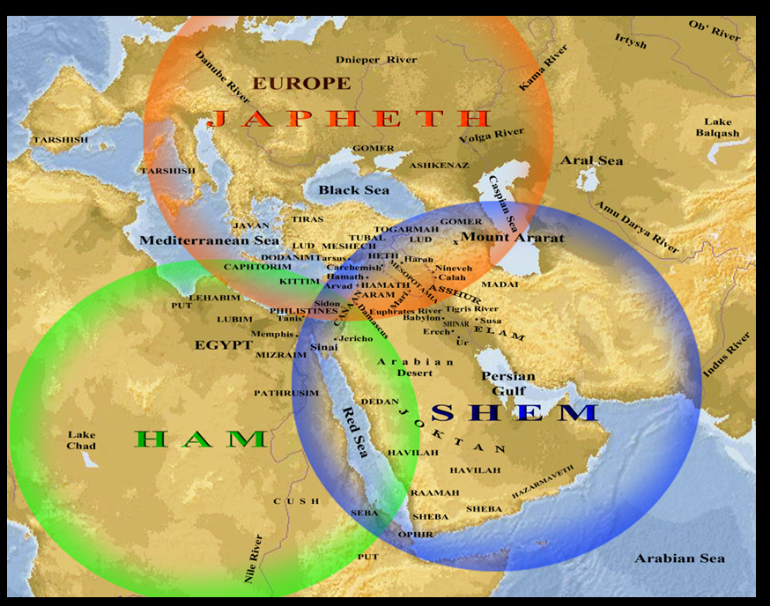

Slide 32
Ham’s Sons (vs. 6)
Cush
Mizraim
Put
Canaan

Slide 33
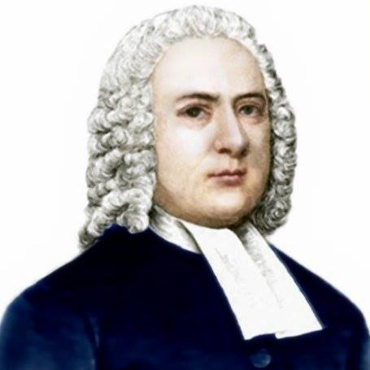
John Gill
Exposition of the Old and New Testaments, 1810
“Mitzraim is a name by which Egypt is frequently called in Scripture, and this man was the father of the Egyptians; and because Egypt was inhabited by a son of Ham, it is sometimes called the land of Ham (Psalm 105:23). The word is of the dual number, and serves to express Egypt, which was divided into two parts, lower and upper Egypt.”

Slide 34
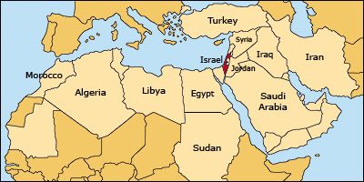

Slide 35
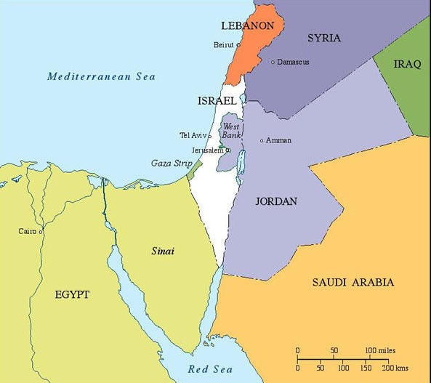

Slide 37
Galatians 4:4
“But when the fullness of the time came, God sent forth His Son, born of a woman, born under the Law.”

Slide 38
Genesis 41:45-46a Joseph’s Settlement
Name (45a)
Marriage (45b)
Authority (45c)
Age (46a)

Slide 39
Genesis 41:1-57 Joseph Before Pharoah
Pharoah’s 2 dreams (41:1-8)
Butler’s report (41:9-13)
Joseph before Pharoah (41:14-24)
Joseph’s interpretation & advice (41:25-36)
Joseph’s elevation (41:37-46a)
Joseph’s activities (41:46b-57)

Slide 40
VI. Genesis 41:46b-57 Joseph’s Activities
Joseph exercises his authority (46b)
7 years of plenty (47-49)
Joseph’s family (50-52)
7 years of famine (53-54)
Egyptians’ response (55-56)
Foreigners’ response (57)

Slide 41
VI. Genesis 41:46b-57 Joseph’s Activities
Joseph exercises his authority (46b)
7 years of plenty (47-49)
Joseph’s family (50-52)
7 years of famine (53-54)
Egyptians’ response (55-56)
Foreigners’ response (57)

Slide 42
VI. Genesis 41:46b-57 Joseph’s Activities
Joseph exercises his authority (46b)
7 years of plenty (47-49)
Joseph’s family (50-52)
7 years of famine (53-54)
Egyptians’ response (55-56)
Foreigners’ response (57)

Slide 43
Genesis 41:47-49 7 Years of Plenty
Abundance of food (47)
Gathering & storing (48)
Record keeping (49)

Slide 44
Genesis 41:47-49 7 Years of Plenty
Abundance of food (47)
Gathering & storing (48)
Record keeping (49)

Slide 45
Genesis 41:47-49 7 Years of Plenty
Abundance of food (47)
Gathering & storing (48)
Record keeping (49)

Slide 46
Genesis 41:47-49 7 Years of Plenty
Abundance of food (47)
Gathering & storing (48)
Record keeping (49)

Slide 47
VI. Genesis 41:46b-57 Joseph’s Activities
Joseph exercises his authority (46b)
7 years of plenty (47-49)
Joseph’s family (50-52)
7 years of famine (53-54)
Egyptians’ response (55-56)
Foreigners’ response (57)

Slide 48
Genesis 41:50-52 Joseph’s Family
Wife-Mother (50)
First son (51)
Second son (52)

Slide 49
Genesis 41:50-52 Joseph’s Family
Wife-Mother (50)
First son (51)
Second son (52)

Slide 50
Genesis 41:50-52 Joseph’s Family
Wife-Mother (50)
First son (51)
Second son (52)

Slide 51
2 Cor. 4:16
¹⁶ Therefore we do not lose heart, but though our outer man is decaying, yet our inner man is being renewed day by day.

Slide 52
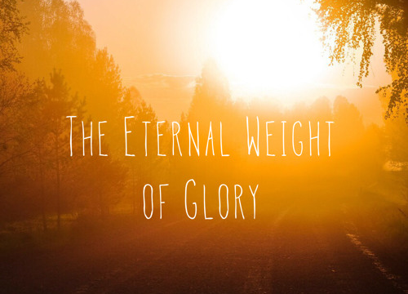
2 Cor. 4:17
¹⁷ For momentary, light affliction is producing for us an eternal weight of glory far beyond all comparison

Slide 53
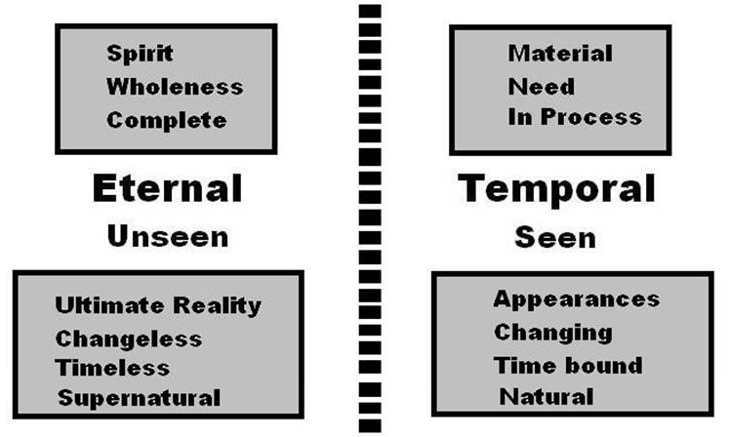
2 Cor. 4:18
¹⁸ while we look not at the things which are seen, but at the things which are not seen; for the things which are seen are temporal, but the things which are not seen are eternal.

Slide 54
Genesis 41:50-52 Joseph’s Family
Wife-Mother (50)
First son (51)
Second son (52)

Slide 55
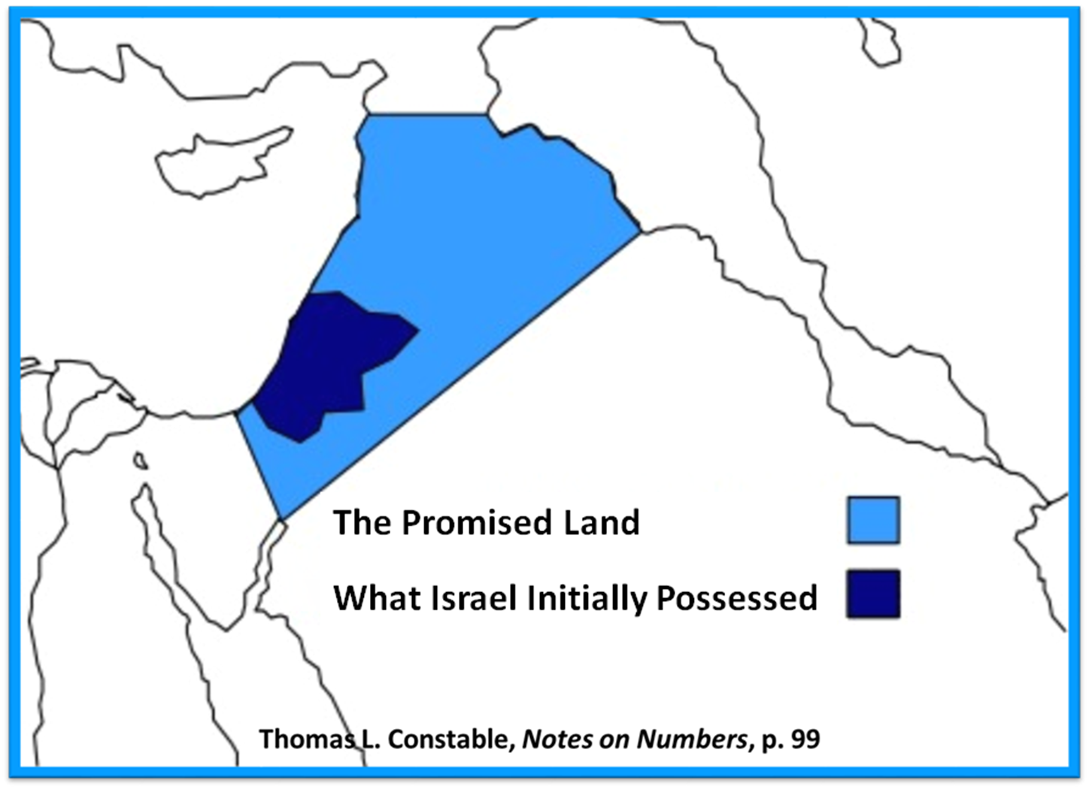

Slide 56
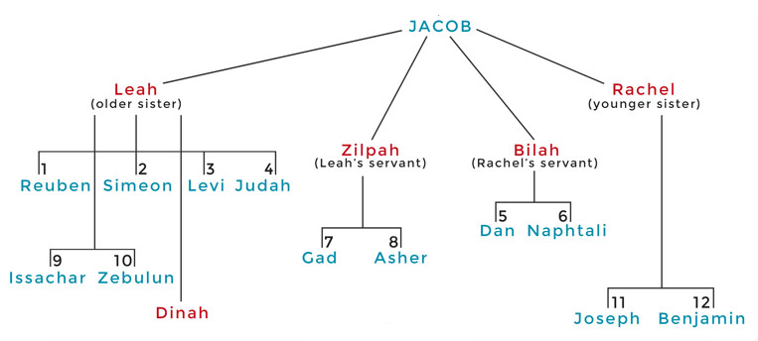

Slide 59
Distinctions Between 144,000 & Multitude
144,000 | MULTITUDE
Revelation 7:1-8 | Revelation 7:9-17
Numbered | Innumerable
Jews | All nations
Sealed | Slain
Sealed before the Tribulation | Converted out of the Tribulation
Hitchcock and Ice, The Truth Behind Left Behind, 77

Slide 60
VI. Genesis 41:46b-57 Joseph’s Activities
Joseph exercises his authority (46b)
7 years of plenty (47-49)
Joseph’s family (50-52)
7 years of famine (53-54)
Egyptians’ response (55-56)
Foreigners’ response (57)

Slide 61
Genesis 41:53-54 7 Years of Famine
End of fat years (53)
Beginning of lean years (54)

Slide 62
Genesis 41:53-54 7 Years of Famine
End of fat years (53)
Beginning of lean years (54)

Slide 63
Genesis 41:53-54 7 Years of Famine
End of fat years (53)
Beginning of lean years (54)

Slide 64
John 13:19; 14:29
“^{13:19} From now on I am telling you before it comes to pass, so that when it does occur, you may believe that I am He… ^{14:29} Now I have told you before it happens, so that when it happens, you may believe.”

Slide 66
VI. Genesis 41:46b-57 Joseph’s Activities
Joseph exercises his authority (46b)
7 years of plenty (47-49)
Joseph’s family (50-52)
7 years of famine (53-54)
Egyptians’ response (55-56)
Foreigners’ response (57)

Slide 67
Genesis 41:55-56 Egyptians’ Response
Pharoah’s command (55)
Selling of the grain (56)

Slide 68
Genesis 41:55-56 Egyptians’ Response
Pharoah’s command (55)
Selling of the grain (56)

Slide 69
Genesis 41:55 Pharoah’s Command
Timing (55a)
Circumstances (55b)
Command (55c)

Slide 70
Genesis 41:55 Pharoah’s Command
Timing (55a)
Circumstances (55b)
Command (55c)

Slide 71
Genesis 41:55 Pharoah’s Command
Timing (55a)
Circumstances (55b)
Command (55c)

Slide 72
Genesis 41:55 Pharoah’s Command
Timing (55a)
Circumstances (55b)
Command (55c)

Slide 73
Genesis 41:55-56 Egyptians’ Response
Pharoah’s command (55)
Selling of the grain (56)

Slide 74
Genesis 41:56 Selling of the Grain
Statement of fact (56a)
Joseph responds (56b)
Joseph responds (56c)

Slide 75
Genesis 41:56 Selling of the Grain
Statement of fact (56a)
Joseph responds (56b)
Joseph responds (56c)

Slide 76
Genesis 7:19-23
They rose greatly on the earth, and all the high mountains under the entire heaven were covered…Every living thing that moved on the earth perished—birds, livestock, wild animals, all the creatures that swarm over the earth, and all mankind. Everything on dry land that had the breath of life in its nostrils died. Every living thing on the face of the earth was wiped out; men and animals and the creatures that move along the ground and the birds of the air were wiped from the earth. Only Noah was left, and those with him in the ark.”

Slide 77
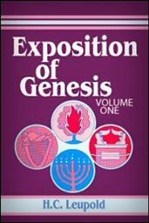
H.C. Leupold
Exposition of Genesis (Grand Rapids: Baker, 1942), vol. 1, p. 301-302.
“… ‘all the high mountains under all the heavens.’ One of these expressions alone would almost necessitate the impression that the author intends to convey the idea of the absolute universality of the Flood…Yet since ‘all’ is known to be used in a relative sense, the writer removes all ambiguity by adding the phrase ‘under all the heavens.’ A double ‘all’ (kol) cannot allow for so relative a sense. It almost constitutes a Hebrew superlative. So we believe that the text disposes of the question of the universality of the flood. By way of objection to this interpretation, those who believe in a limited flood…urge the . . .

Slide 78
H.C. Leupold
Exposition of Genesis (Grand Rapids: Baker, 1942), vol. 1, p. 301-302.
. . . fact that kol is used in a relative sense, as is clearly the case in passages such as Genesis 41:57; Exodus 9:25, 10:15; Deuteronomy 2:25; and 1 Kings 10:24. However, we still insist that this fact could overthrow a single kol, never a double kol, as our verse has it.”

Slide 79
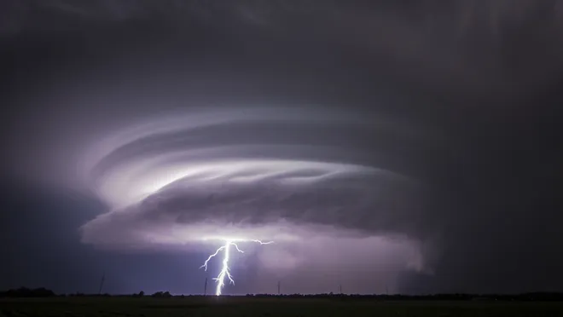
Exodus 9:24 (NIV)
“…It was the worst storm in all the land of Egypt since it had become a nation.”

Slide 80
Genesis 41:56 Selling of the Grain
Statement of fact (56a)
Joseph responds (56b)
Joseph responds (56c)

Slide 81
Genesis 41:56 Selling of the Grain
Statement of fact (56a)
Joseph responds (56b)
Joseph responds (56c)

Slide 82
VI. Genesis 41:46b-57 Joseph’s Activities
Joseph exercises his authority (46b)
7 years of plenty (47-49)
Joseph’s family (50-52)
7 years of famine (53-54)
Egyptians’ response (55-56)
Foreigners’ response (57)

Slide 83
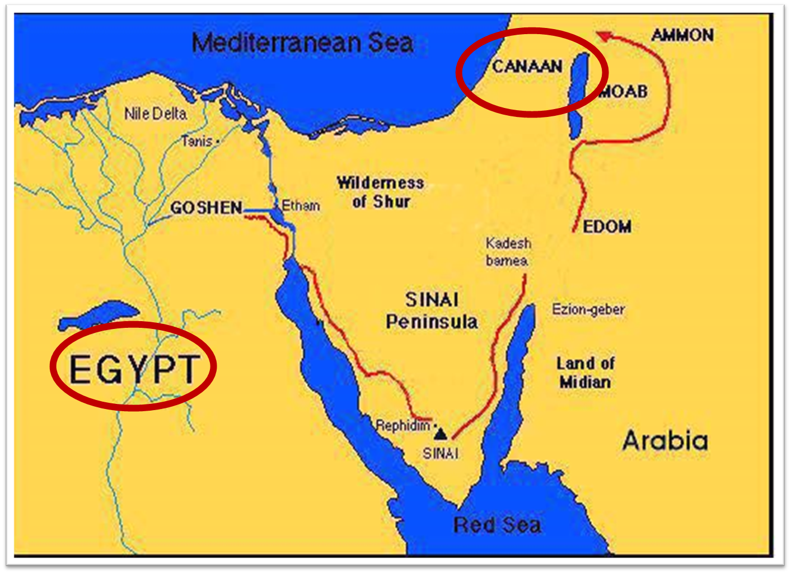

Slide 86
Conclusion

Slide 87
Genesis 41:1-57 Joseph Before Pharoah
Pharoah’s 2 dreams (41:1-8)
Butler’s report (41:9-13)
Joseph before Pharoah (41:14-24)
Joseph’s interpretation & advice (41:25-36)
Joseph’s elevation (41:37-46a)
Joseph’s activities (41:46b-57)

Slide 88
²⁴ The Lord bless you, and keep you; ²⁵ The Lord make His face shine on you, And be gracious to you; ²⁶ The Lord lift up His countenance on you, And give you peace.
Numbers 6:24–26 (NASB95)

