Slide 1


Genesis 12‒50
Israel’s Birth & Preservation

Slide 2
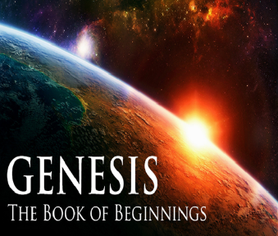
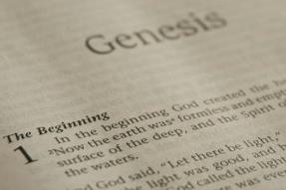
GENESIS STRUCTURE
  Genesis 12-50 (four people)
    Abraham (12:1–25:11)
    Isaac (25:12–26:35)
    Jacob (27–36)
    Joseph (37–50)

Slide 3
Genesis 37:2-36
Joseph Sold unto Egypt
  Joseph’s coat (37:2-4)
  Joseph’s dreams (37:5-11)
  Joseph’s pit (37:12-24)
  Joseph’s enslavement (37:25-36)

Slide 4
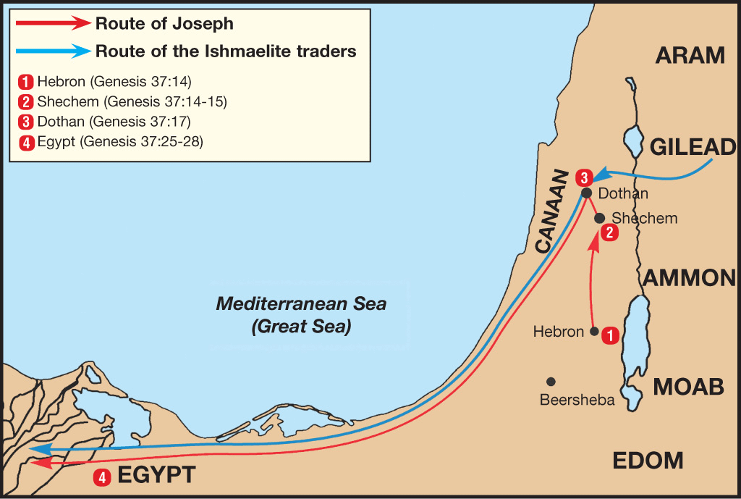

Slide 5
Genesis 38:1-30
Judah & Tamar
  Tamar & Judah’s sons (38:1-11)
  Tamar & Judah (38:12-26)
  Tamar & Judah’s twins (38:27-30)

Slide 6
Genesis 39:1-23
Joseph in Potiphar's House
  Blessing (39:1-6)
  Temptation & Accusation (39:7-18)
  Prison (39:19-23)

Slide 7
Genesis 40:1-23
Joseph in Prison
  Imprisonment (40:1-8)
  Butler’s dream (40:9-15)
  Baker’s dream (40:16-19)
  Fulfillment of the dreams (40:20-23)

Slide 8
Genesis 41:1-57
Joseph Before Pharoah
  Pharoah’s 2 dreams (41:1-8)
  Butler’s report (41:9-13)
  Joseph before Pharoah (41:14-24)
  Joseph’s interpretation & advice (41:25-36)
  Joseph’s elevation (41:37-46a)
  Joseph’s activities (41:46b-57)

Slide 9
IV. Genesis 41:25-36
Joseph’s Interpretation & Advice
    Joseph’s interpretation (25-32)
    Joseph’s advice (33-36)

Slide 10
Genesis 41:33-36
Joseph’s Advice
      Appoint an economic leader (33)
      Appoint stewards (34)
      Storing (35)
      Purpose (36)

Slide 11
Genesis 41:33-36
Joseph’s Advice
      Appoint an economic leader (33)
      Appoint stewards (34)
      Storing (35)
      Purpose (36)

Slide 12
Genesis 41:33-36
Joseph’s Advice
      Appoint an economic leader (33)
      Appoint stewards (34)
      Storing (35)
      Purpose (36)

Slide 13
Genesis 41:33-36
Joseph’s Advice
      Appoint an economic leader (33)
      Appoint stewards (34)
      Storing (35)
      Purpose (36)

Slide 14
Genesis 41:33-36
Joseph’s Advice
      Appoint an economic leader (33)
      Appoint stewards (34)
      Storing (35)
      Purpose (36)

Slide 15
Genesis 41:1-57
Joseph Before Pharoah
  Pharoah’s 2 dreams (41:1-8)
  Butler’s report (41:9-13)
  Joseph before Pharoah (41:14-24)
  Joseph’s interpretation & advice (41:25-36)
  Joseph’s elevation (41:37-46a)
  Joseph’s activities (41:46b-57)

Slide 16
V. Genesis 41:37-46a
Joseph’s Elevation
    Pharaoh’s response (37-38)
    Joseph’s appointment (39-44)
    Joseph’s settlement (45-46a)

Slide 17
V. Genesis 41:37-46a
Joseph’s Elevation
    Pharaoh’sresponse (37-38)
    Joseph’s appointment (39-44)
    Joseph’s settlement (45-46a)

Slide 18
Genesis 41:37-38
Pharaoh’s Response
      Reaction (37)
      Rhetorical question (38)

Slide 19
Genesis 41:37-38
Pharaoh’s Response
      Reaction (37)
      Rhetorical question (38)

Slide 20
Genesis 41:37-38
Pharaoh’s Response
      Reaction (37)
      Rhetorical question (38)

Slide 21
V. Genesis 41:37-46a
Joseph’s Elevation
    Pharaoh’s response (37-38)
    Joseph’s appointment (39-44)
    Joseph’s settlement (45-46a)

Slide 22
Genesis 41:39-44
Joseph’s Appointment
      Appointment (39-40)
      Extent of authority (41)
      Royal garb (42)
      Royal chariot (43a)
      Royal honor (43b)
      Decree of authority (44)

Slide 23
Genesis 41:39-44
Joseph’s Appointment
      Appointment (39-40)
      Extent of authority (41)
      Royal garb (42)
      Royal chariot (43a)
      Royal honor (43b)
      Decree of authority (44)

Slide 24
Genesis 41:39-40
Appointment
      Joseph’s abilities (39)
      Appointment details (40)

Slide 25
Genesis 41:39-40
Appointment
      Joseph’s abilities (39)
      Appointment details (40)

Slide 26


1 John 4:1
“Beloved, do not believe every spirit, but test the spirits to see whether they are from God, because many false prophets have gone out into the world.”

Slide 27
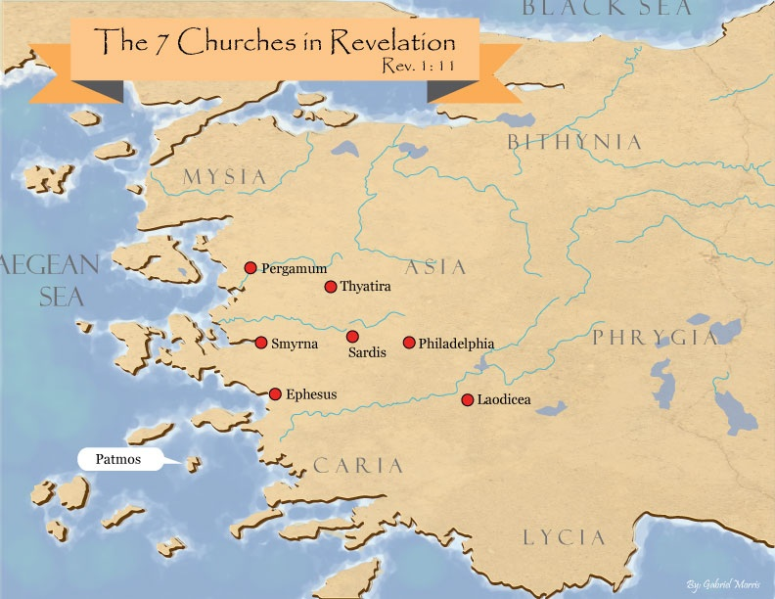
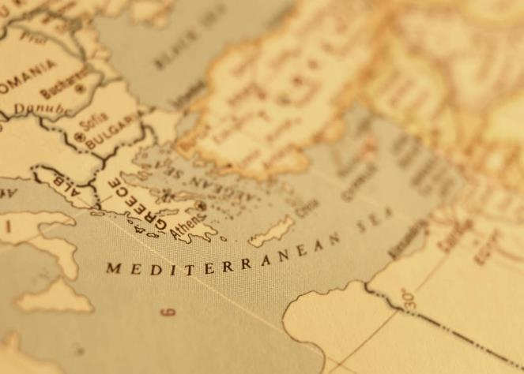

Slide 28

Revelation 2:2
‘I know your deeds and your toil and perseverance, and that you cannot tolerate evil men, and you put to the test [peirázō] those who call themselves apostles, and they are not, and you found them to be false;

Slide 29
EPHESIANS: WHAT IS INSIDE?
1–3 | 4–6
Relationship | Responsibility
Doctrine | Deed
Orthodoxy | Orthopraxy
Knowledge | Wisdom
Belief | Behavior
Position | Practice
Privileges | Responsibility

Slide 30
Genesis 41:39-40
Appointment
      Joseph’s abilities (39)
      Appointment details (40)

Slide 31
Genesis 40:40
Appointment Details
      Positive (40a)
      Negative (40b)

Slide 32
Genesis 40:40
Appointment Details
      Positive (40a)
      Negative (40b)

Slide 33
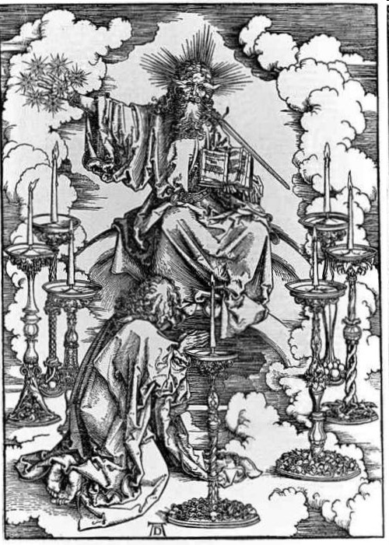
His Body
(Rev. 1:14-16)
His hair (14a)
His eyes (14b)
His feet (15a)
His voice (15b)
His right hand (16a)
His mouth (16b)
His face (16c)

Slide 34
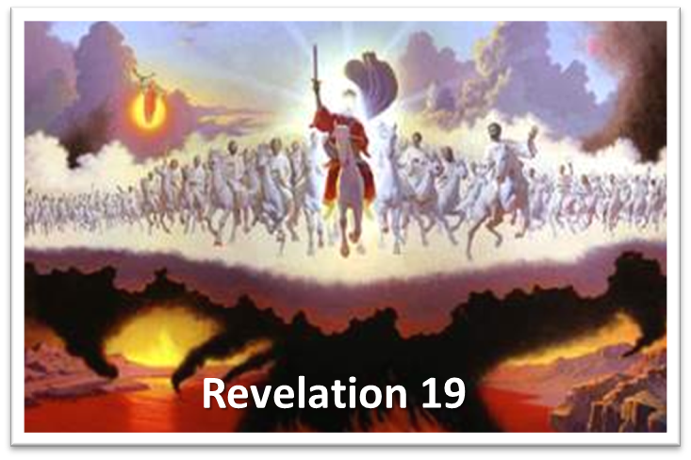
His Activities
Revelation 19:15-16
His spoken word (15a)
His smiting of the nations (15b)
His ruling of the nations (15c)
His treading of the winepress (15d)
His rulership as King (16)

Slide 35
Genesis 40:40
Appointment Details
      Positive (40a)
      Negative (40b)

Slide 36
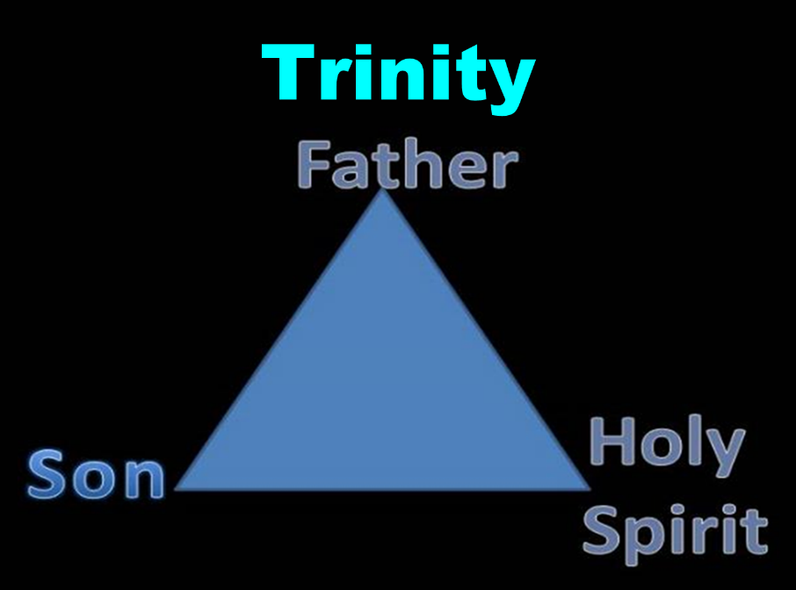

Slide 37
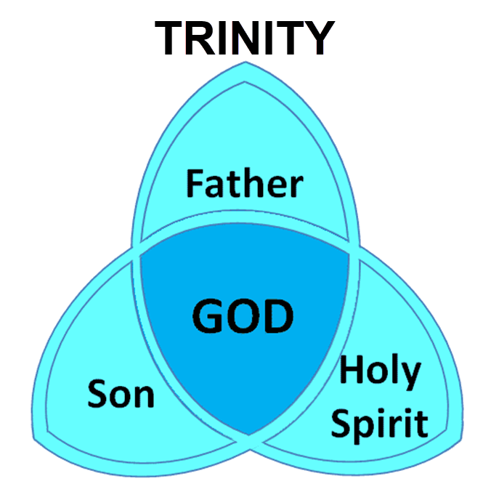

Slide 38
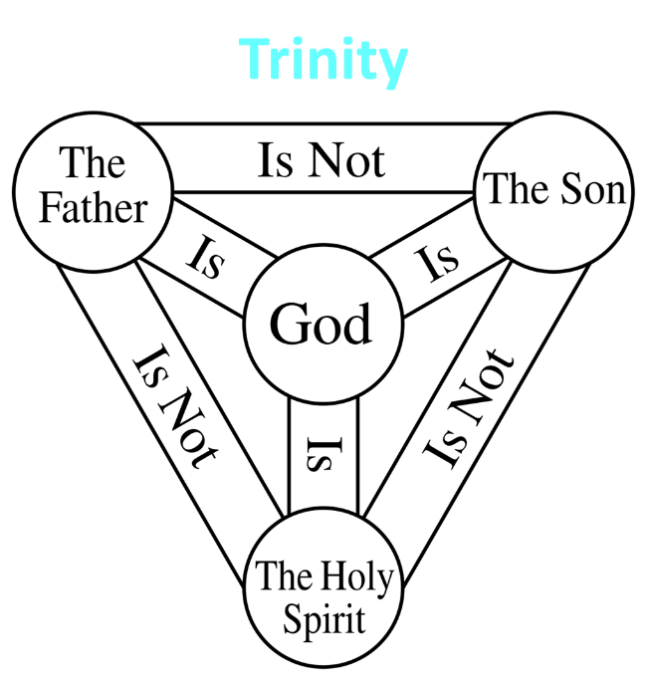

Slide 39
Genesis 41:39-44
Joseph’s Appointment
      Appointment (39-40)
      Extent of authority (41)
      Royal garb (42)
      Royal chariot (43a)
      Royal honor (43b)
      Decree of authority (44)

Slide 40

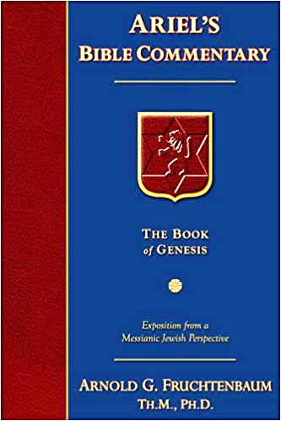
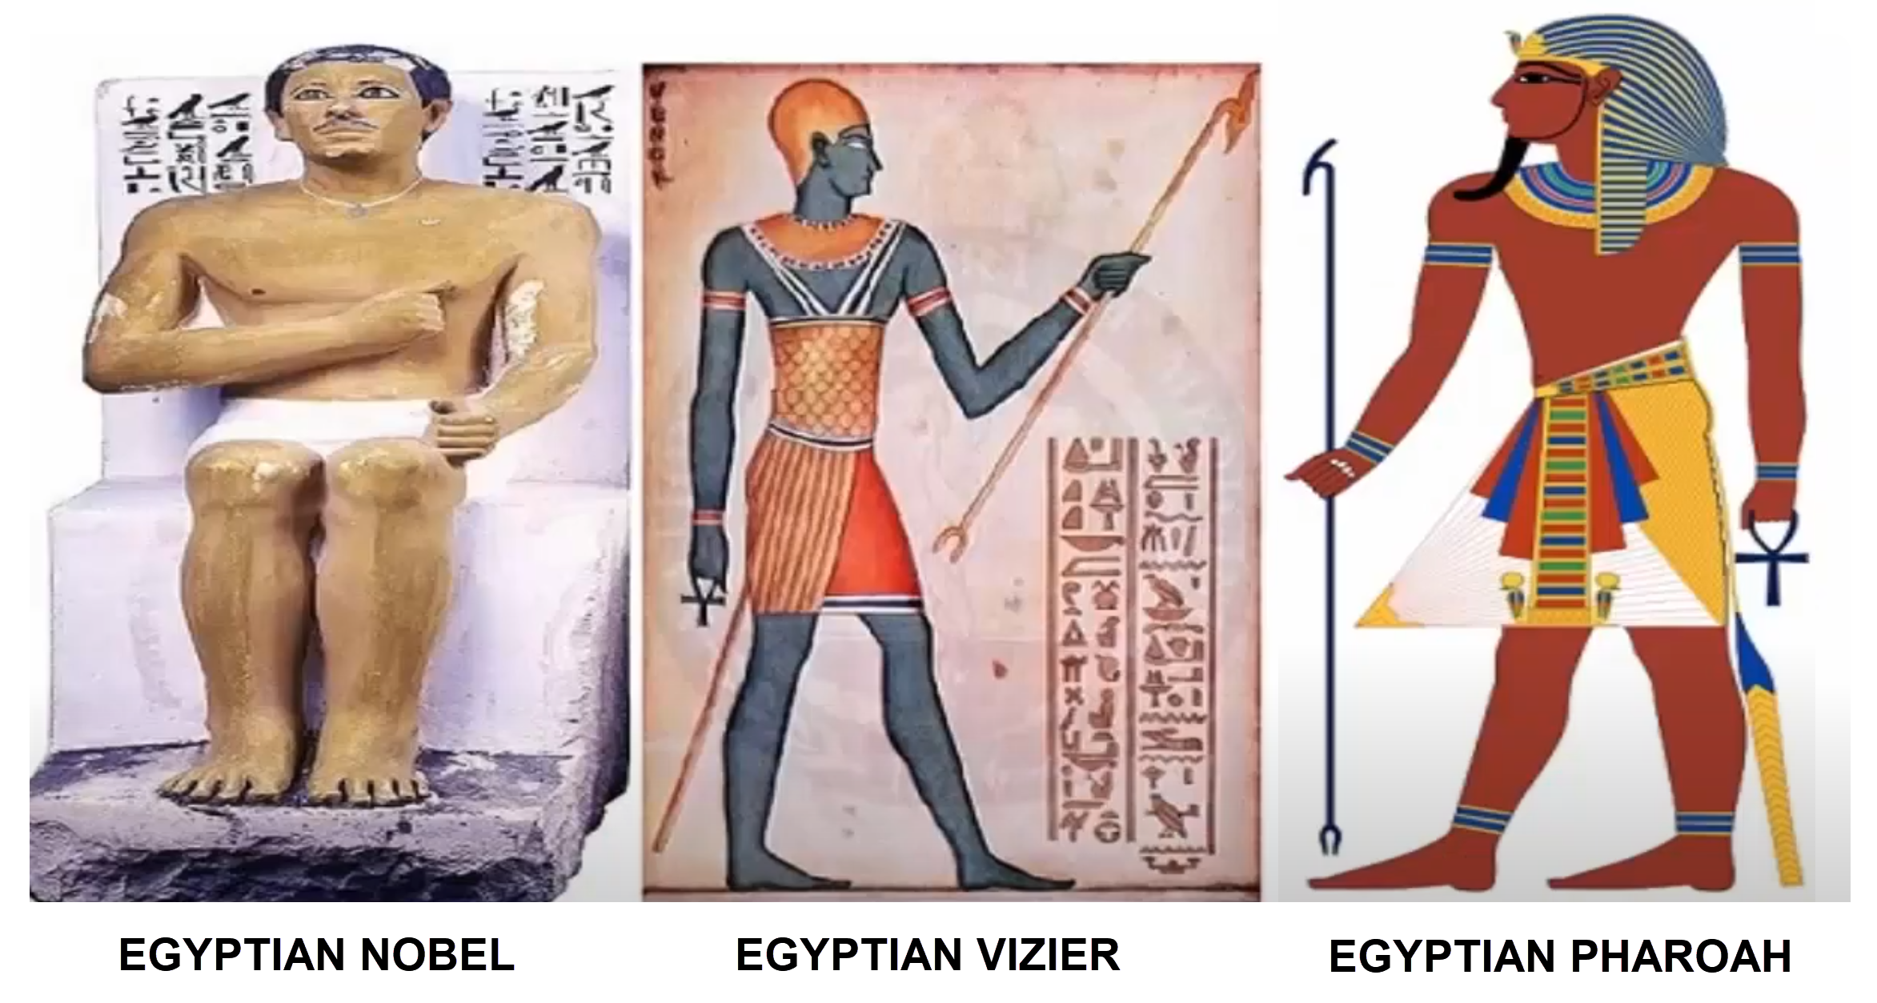
Dr. Arnold G. Fruchtenbaum
The Book of Genesis, 569
“This was a position of a vizier or a prime minister, and there is a parallel in the records of Thutmose III: ‘Look you to this office of vizier. Be vigilant over everything that is done in it. Behold, it is the support of the entire land.’”

Slide 41
Genesis 41:39-44
Joseph’s Appointment
      Appointment (39-40)
      Extent of authority (41)
      Royal garb (42)
      Royal chariot (43a)
      Royal honor (43b)
      Decree of authority (44)

Slide 42
Genesis 41:42
Royal Garb
      Ring (42a)
      Clothing (42b)
      Chain (42c)

Slide 43
Genesis 41:42
Royal Garb
      Ring (42a)
      Clothing (42b)
      Chain (42c)

Slide 44
Genesis 41:42
Royal Garb
      Ring (42a)
      Clothing (42b)
      Chain (42c)

Slide 45
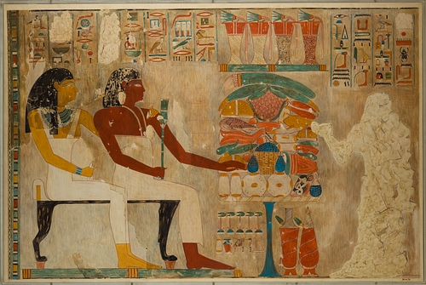
Dr. Arnold G. Fruchtenbaum
The Book of Genesis, 569
“Second was the clothing: and arrayed him in vestures of fine linen. This, too, is paralleled in the Egyptian accounts. When Rekhmire was appointed vizier, he wrote: ‘I was a noble, the second of the king … It was the first occasion of my being summoned … I went forth … clad in fine linen.’ This was the type of clothing worn by a vizier, a prime minister, someone who was second to the king.”

Slide 46
Genesis 41:42
Royal Garb
      Ring (42a)
      Clothing (42b)
      Chain (42c)

Slide 47
Genesis 41:39-44
Joseph’s Appointment
      Appointment (39-40)
      Extent of authority (41)
      Royal garb (42)
      Royal chariot (43a)
      Royal honor (43b)
      Decree of authority (44)

Slide 48
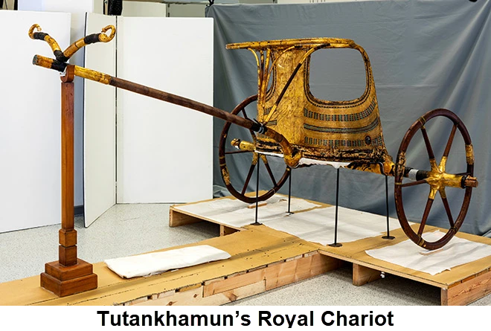
Dr. Arnold G. Fruchtenbaum
The Book of Genesis, 569
“In verse 43a Joseph was given a royal chariot: and he made him to ride in the second chariot which he had; the Hyksos introduced chariots into Egypt.”

Slide 49
Genesis 41:39-44
Joseph’s Appointment
      Appointment (39-40)
      Extent of authority (41)
      Royal garb (42)
      Royal chariot (43a)
      Royal honor (43b)
      Decree of authority (44)

Slide 50
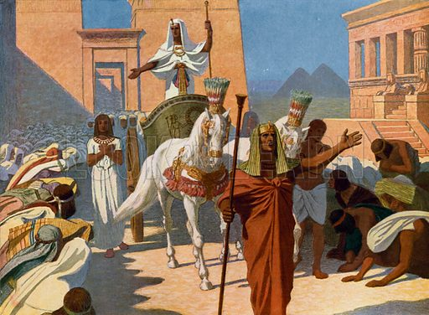
Dr. Arnold G. Fruchtenbaum
The Book of Genesis, 569
“Then, in verse 43b, came the royal honor: and they cried before him, Bow the knee. As Joseph rode in the chariot, heralds were sent out in advance with the command: Bow the knee. This was a practice that is well attested to in Egyptian pictures.”

Slide 51
Genesis 41:39-44
Joseph’s Appointment
      Appointment (39-40)
      Extent of authority (41)
      Royal garb (42)
      Royal chariot (43a)
      Royal honor (43b)
      Decree of authority (44)

Slide 52
V. Genesis 41:37-46a
Joseph’s Elevation
    Pharaoh’s response (37-38)
    Joseph’s appointment (39-44)
    Joseph’s settlement (45-46a)

Slide 53
Genesis 41:45-46a
Joseph’s Settlement
      Name (45a)
      Marriage (45b)
      Authority (45c)
      Age (46a)

Slide 54
Genesis 41:45-46a
Joseph’s Settlement
      Name (45a)
      Marriage (45b)
      Authority (45c)
      Age (46a)

Slide 55
Genesis 41:45-46a
Joseph’s Settlement
      Name (45a)
      Marriage (45b)
      Authority (45c)
      Age (46a)

Slide 56
Genesis 41:45-46a
Joseph’s Settlement
      Name (45a)
      Marriage (45b)
      Authority (45c)
      Age (46a)

Slide 57
Dr. Arnold G. Fruchtenbaum
The Book of Genesis, 570
“Therefore, a total separation of twenty years existed from the time he had last seen members of his family until they were reunited in Egypt. The Hyksos Period, during which Joseph’s story unfolds, was the two-hundred-year period from 1750 until 1550 B.C. The Hyksos were Semitic rulers that conquered Egypt and ruled during the sixteenth and seventeenth dynasties. Thus, the Pharaoh at the time of Joseph was Semitic. This explains how a Semite such as Joseph could rise to the second highest position in Egypt, which had a Hamitic population.”

Slide 58


GENESIS 10
Outline
  Introduction (1)
  Japheth's line (2-5)
  Ham’s Line (6-20)
  Shem’s line (21-31)
  Conclusion (32)

Slide 59
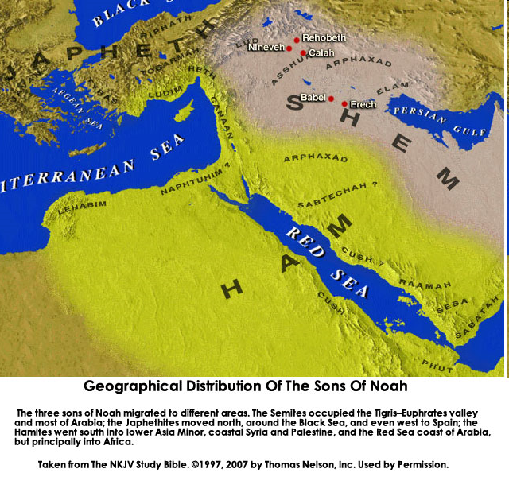

Slide 60
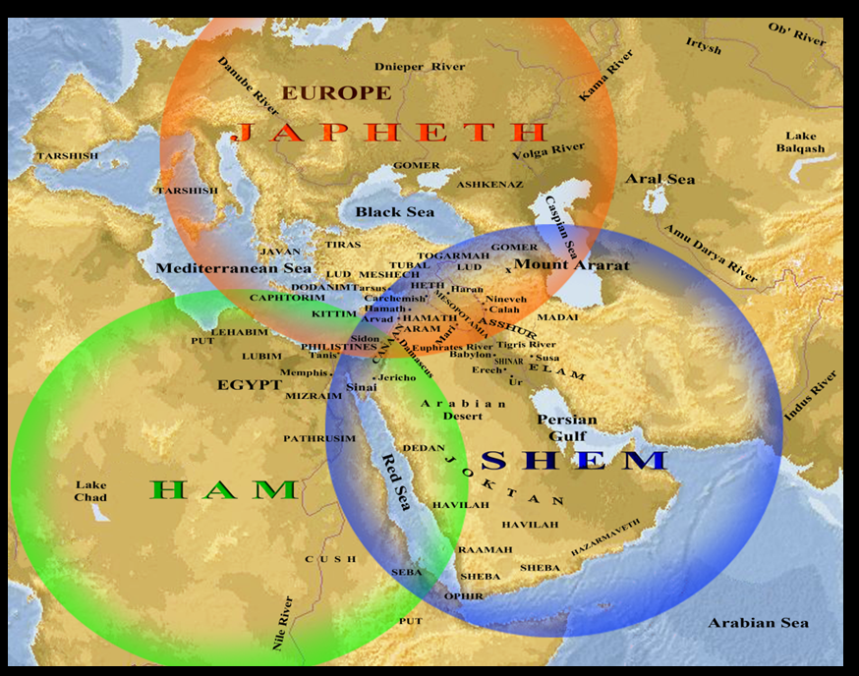

Slide 61
Ham’s Sons (vs. 6)
  Cush
  Mizraim
  Put
  Canaan

Slide 62
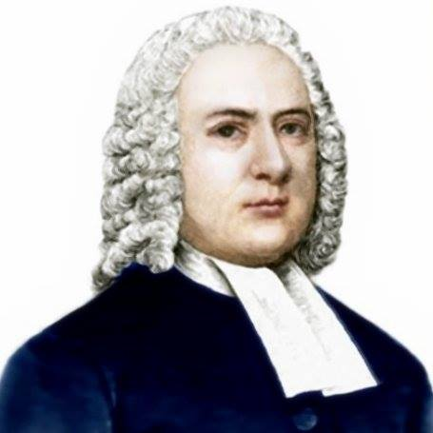

John Gill
Exposition of the Old and New Testaments, 1810
“Mitzraim is a name by which Egypt is frequently called in Scripture, and this man was the father of the Egyptians; and because Egypt was inhabited by a son of Ham, it is sometimes called the land of Ham (Psalm 105:23). The word is of the dual number, and serves to express Egypt, which was divided into two parts, lower and upper Egypt.”

Slide 63
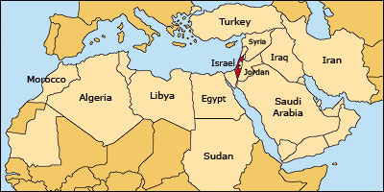

Slide 64
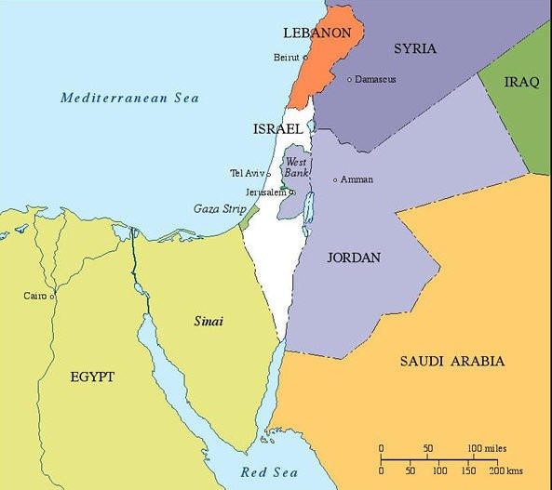

Slide 65
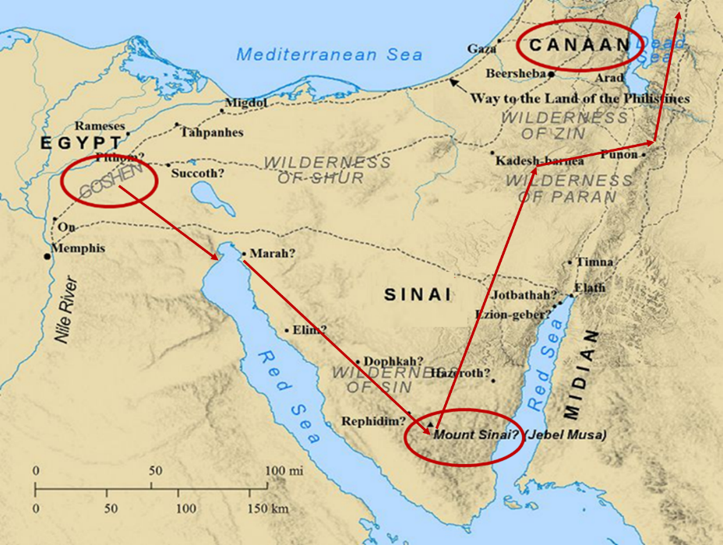

Slide 66

Galatians 4:4
“But when the fullness of the time came, God sent forth His Son, born of a woman, born under the Law.”

Slide 67
Genesis 41:45-46a
Joseph’s Settlement
      Name (45a)
      Marriage (45b)
      Authority (45c)
      Age (46a)

Slide 68
Genesis 41:1-57
Joseph Before Pharoah
  Pharoah’s 2 dreams (41:1-8)
  Butler’s report (41:9-13)
  Joseph before Pharoah (41:14-24)
  Joseph’s interpretation & advice (41:25-36)
  Joseph’s elevation (41:37-46a)
  Joseph’s activities (41:46b-57)

Slide 69
VI. Genesis 41:46b-57
Joseph’s Activities
    Joseph exercises his authority (46b)
    7 years of plenty (47-49)
    Joseph’s family (50-52)
    7 years of famine (53-54)
    Egyptians’ response (55-56)
    Foreigners’ response (57)

Slide 70
VI. Genesis 41:46b-57
Joseph’s Activities
    Joseph exercises his authority (46b)
    7 years of plenty (47-49)
    Joseph’s family (50-52)
    7 years of famine (53-54)
    Egyptians’ response (55-56)
    Foreigners’ response (57)

Slide 71
VI. Genesis 41:46b-57
Joseph’s Activities
    Joseph exercises his authority (46b)
    7 years of plenty (47-49)
    Joseph’s family (50-52)
    7 years of famine (53-54)
    Egyptians’ response (55-56)
    Foreigners’ response (57)

Slide 72
Genesis 41:47-49
7 Years of Plenty
      Abundance of food (47)
      Gathering & storing (48)
      Record keeping (49)

Slide 73
Genesis 41:47-49
7 Years of Plenty
      Abundance of food (47)
      Gathering & storing (48)
      Record keeping (49)

Slide 74
Genesis 41:47-49
7 Years of Plenty
      Abundance of food (47)
      Gathering & storing (48)
      Record keeping (49)

Slide 75
Genesis 41:47-49
7 Years of Plenty
      Abundance of food (47)
      Gathering & storing (48)
      Record keeping (49)

Slide 76
VI. Genesis 41:46b-57
Joseph’s Activities
    Joseph exercises his authority (46b)
    7 years of plenty (47-49)
    Joseph’s family (50-52)
    7 years of famine (53-54)
    Egyptians’ response (55-56)
    Foreigners’ response (57)

Slide 77
Genesis 41:50-52
Joseph’s Family
      Wife-Mother (50)
      First son (51)
      Second son (52)

Slide 78
Genesis 41:50-52
Joseph’s Family
      Wife-Mother (50)
      First son (51)
      Second son (52)

Slide 79
Genesis 41:50-52
Joseph’s Family
      Wife-Mother (50)
      First son (51)
      Second son (52)

Slide 80
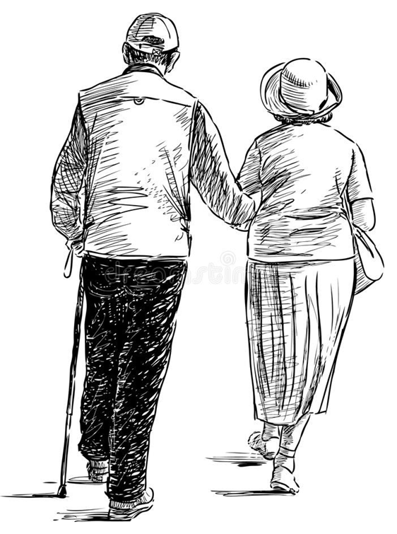
2 Cor. 4:16
¹⁶ Therefore we do not lose heart, but though our outer man is decaying, yet our inner man is being renewed day by day.

Slide 81
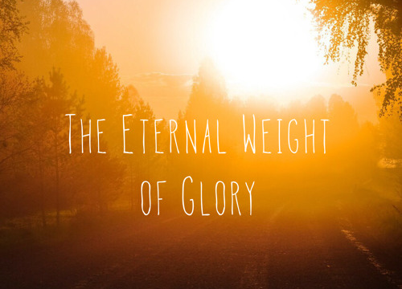
2 Cor. 4:17
¹⁷ For momentary, light affliction is producing for us an eternal weight of glory far beyond all comparison

Slide 82
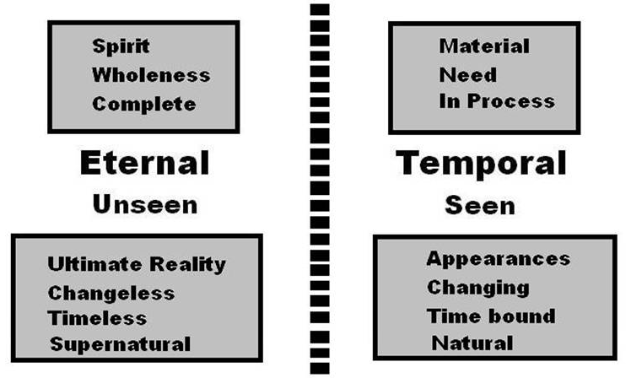
2 Cor. 4:18
¹⁸ while we look not at the things which are seen, but at the things which are not seen; for the things which are seen are temporal, but the things which are not seen are eternal.

Slide 83
Genesis 41:50-52
Joseph’s Family
      Wife-Mother (50)
      First son (51)
      Second son (52)

Slide 84
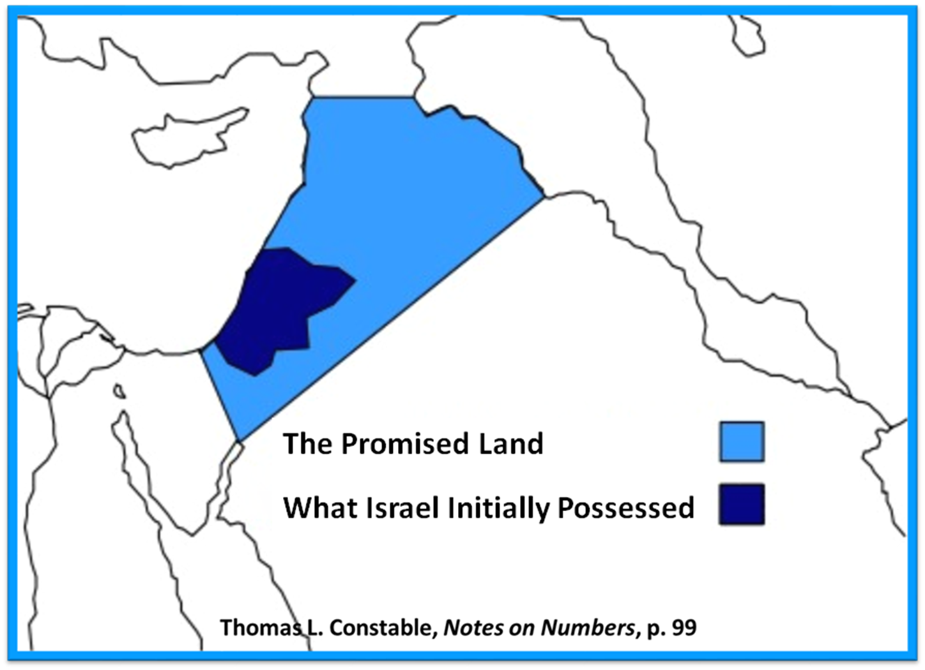

Slide 85
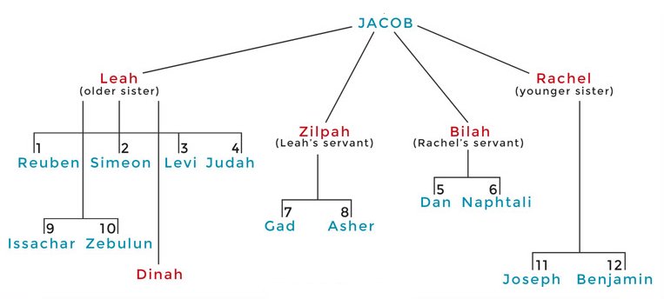

Slide 86
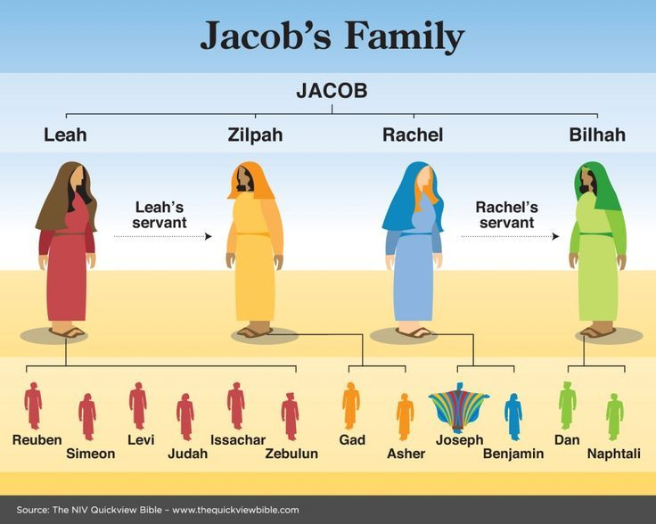

Slide 87
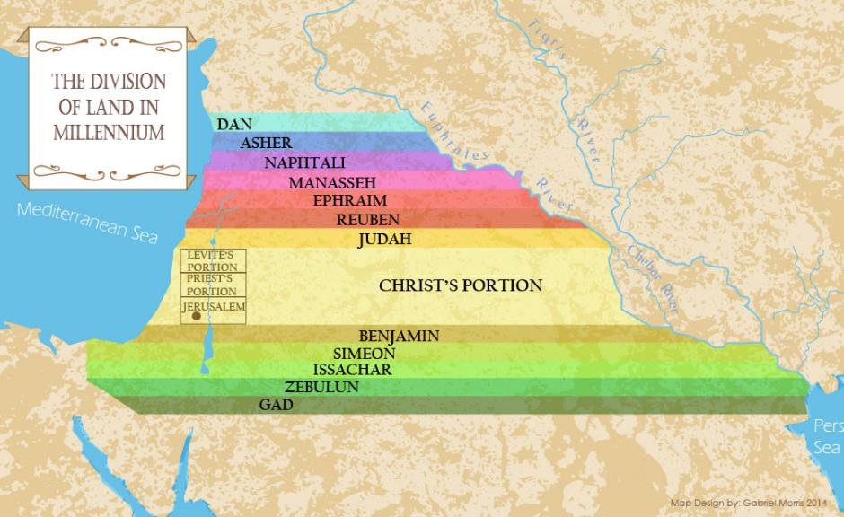

Slide 88
Distinctions Between 144,000 & Multitude
144,000 | MULTITUDE
Revelation 7:1-8 | Revelation 7:9-17
Numbered | Innumerable
Jews | All nations
Sealed | Slain
Sealed before the Tribulation | Converted out of the Tribulation
Hitchcock and Ice, The Truth Behind Left Behind, 77

Slide 89
VI. Genesis 41:46b-57
Joseph’s Activities
    Joseph exercises his authority (46b)
    7 years of plenty (47-49)
    Joseph’s family (50-52)
    7 years of famine (53-54)
    Egyptians’ response (55-56)
    Foreigners’ response (57)

Slide 90
Genesis 41:53-54
7 Years of Famine
      End of fat years (53)
      Beginning of lean years (54)

Slide 91
Genesis 41:53-54
7 Years of Famine
      End of fat years (53)
      Beginning of lean years (54)

Slide 92
Genesis 41:53-54
7 Years of Famine
      End of fat years (53)
      Beginning of lean years (54)

Slide 93


John 13:19; 14:29
“^{13:19} From now on I am telling you before it comes to pass, so that when it does occur, you may believe that I am He… ^{14:29} Now I have told you before it happens, so that when it happens, you may believe.”

Slide 94


Slide 95
VI. Genesis 41:46b-57
Joseph’s Activities
    Joseph exercises his authority (46b)
    7 years of plenty (47-49)
    Joseph’s family (50-52)
    7 years of famine (53-54)
    Egyptians’ response (55-56)
    Foreigners’ response (57)

Slide 96
Genesis 41:55-56
Egyptians’ Response
      Pharoah’s command (55)
      Selling of the grain (56)

Slide 97
Genesis 41:55-56
Egyptians’ Response
      Pharoah’s command (55)
      Selling of the grain (56)

Slide 98
Genesis 41:55
Pharoah’s Command
      Timing (55a)
      Circumstances (55b)
      Command (55c)

Slide 99
Genesis 41:55
Pharoah’s Command
      Timing (55a)
      Circumstances (55b)
      Command (55c)

Slide 100
Genesis 41:55
Pharoah’s Command
      Timing (55a)
      Circumstances (55b)
      Command (55c)

Slide 101
Genesis 41:55
Pharoah’s Command
      Timing (55a)
      Circumstances (55b)
      Command (55c)

Slide 102
Genesis 41:55-56
Egyptians’ Response
      Pharoah’s command (55)
      Selling of the grain (56)

Slide 103
Genesis 41:56
Selling of the Grain
      Statement of fact (56a)
      Joseph responds (56b)
      Joseph responds (56c)

Slide 104
Genesis 41:56
Selling of the Grain
      Statement of fact (56a)
      Joseph responds (56b)
      Joseph responds (56c)

Slide 105

Genesis 7:19-23
They rose greatly on the earth, and all the high mountains under the entire heaven were covered…Every living thing that moved on the earth perished—birds, livestock, wild animals, all the creatures that swarm over the earth, and all mankind. Everything on dry land that had the breath of life in its nostrils died. Every living thing on the face of the earth was wiped out; men and animals and the creatures that move along the ground and the birds of the air were wiped from the earth. Only Noah was left, and those with him in the ark.”

Slide 106
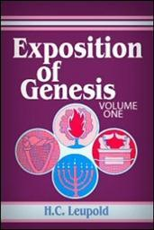
H.C. Leupold
Exposition of Genesis (Grand Rapids: Baker, 1942), vol. 1, p. 301-302.
“… ‘all the high mountains under all the heavens.’ One of these expressions alone would almost necessitate the impression that the author intends to convey the idea of the absolute universality of the Flood…Yet since ‘all’ is known to be used in a relative sense, the writer removes all ambiguity by adding the phrase ‘under all the heavens.’ A double ‘all’ (kol) cannot allow for so relative a sense. It almost constitutes a Hebrew superlative. So we believe that the text disposes of the question of the universality of the flood. By way of objection to this interpretation, those who believe in a limited flood…urge the . . .

Slide 107
H.C. Leupold
Exposition of Genesis (Grand Rapids: Baker, 1942), vol. 1, p. 301-302.
. . . fact that kol is used in a relative sense, as is clearly the case in passages such as Genesis 41:57; Exodus 9:25, 10:15; Deuteronomy 2:25; and 1 Kings 10:24. However, we still insist that this fact could overthrow a single kol, never a double kol, as our verse has it.”

Slide 108

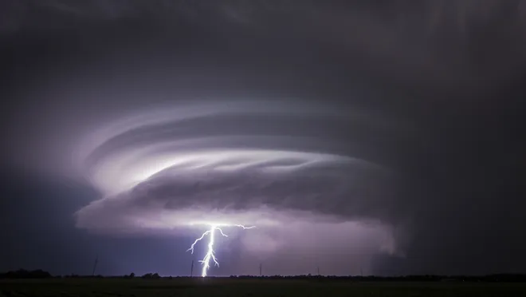
Exodus 9:24 (NIV)
“…It was the worst storm in all the land of Egypt since it had become a nation.”

Slide 109
Genesis 41:56
Selling of the Grain
      Statement of fact (56a)
      Joseph responds (56b)
      Joseph responds (56c)

Slide 110
Genesis 41:56
Selling of the Grain
      Statement of fact (56a)
      Joseph responds (56b)
      Joseph responds (56c)

Slide 111
VI. Genesis 41:46b-57
Joseph’s Activities
    Joseph exercises his authority (46b)
    7 years of plenty (47-49)
    Joseph’s family (50-52)
    7 years of famine (53-54)
    Egyptians’ response (55-56)
    Foreigners’ response (57)

Slide 112
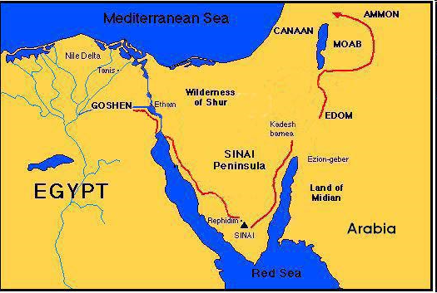

Slide 113
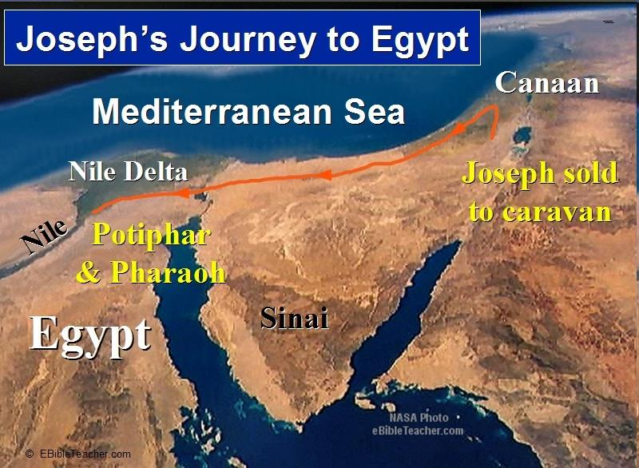

Slide 115
Conclusion

Slide 116
Genesis 41:1-57
Joseph Before Pharoah
  Pharoah’s 2 dreams (41:1-8)
  Butler’s report (41:9-13)
  Joseph before Pharoah (41:14-24)
  Joseph’s interpretation & advice (41:25-36)
  Joseph’s elevation (41:37-46a)
  Joseph’s activities (41:46b-57)

Slide 117
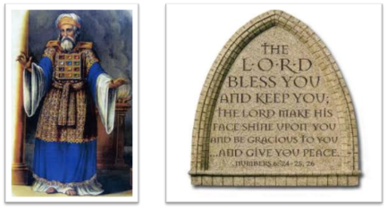
²⁴ The Lord bless you, and keep you; ²⁵ The Lord make His face shine on you, And be gracious to you; ²⁶ The Lord lift up His countenance on you, And give you peace.
Numbers 6:24–26 (NASB95)

