Slide 1


Dr. Andy Woods
Senior Pastor – Sugar Land Bible Church
President – Chafer Theological Seminary

Slide 2
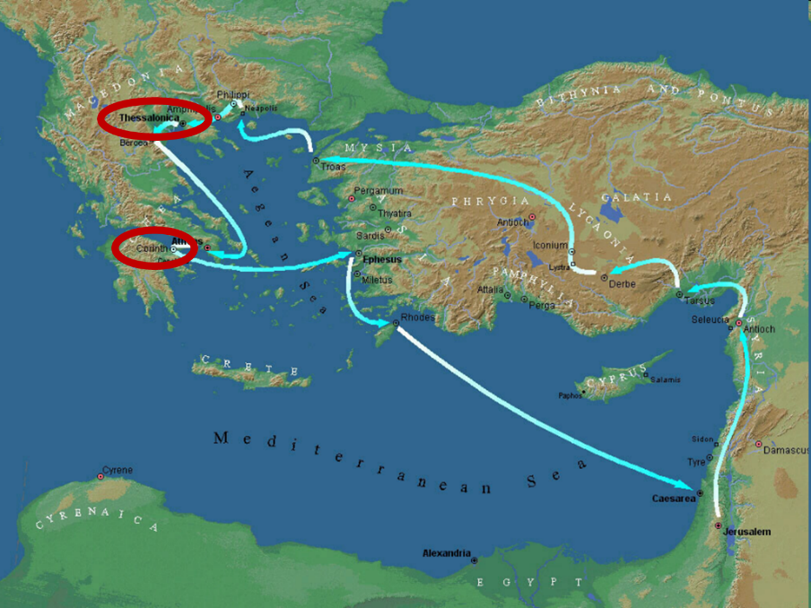

Slide 3
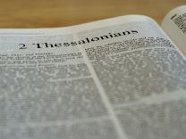
2 Thessalonians 2:1-12
Problem (2:1-2)
Prerequisites for the Day of the Lord (2:3-12)
  The departure (2:3a)
  Advent of the lawless one (2:3b-4)
  Removal of the restrainer (2:5-7)
  Destruction of the lawless one (2:8-9)
  Destruction of lawless one’s followers (2:10-12)

Slide 4
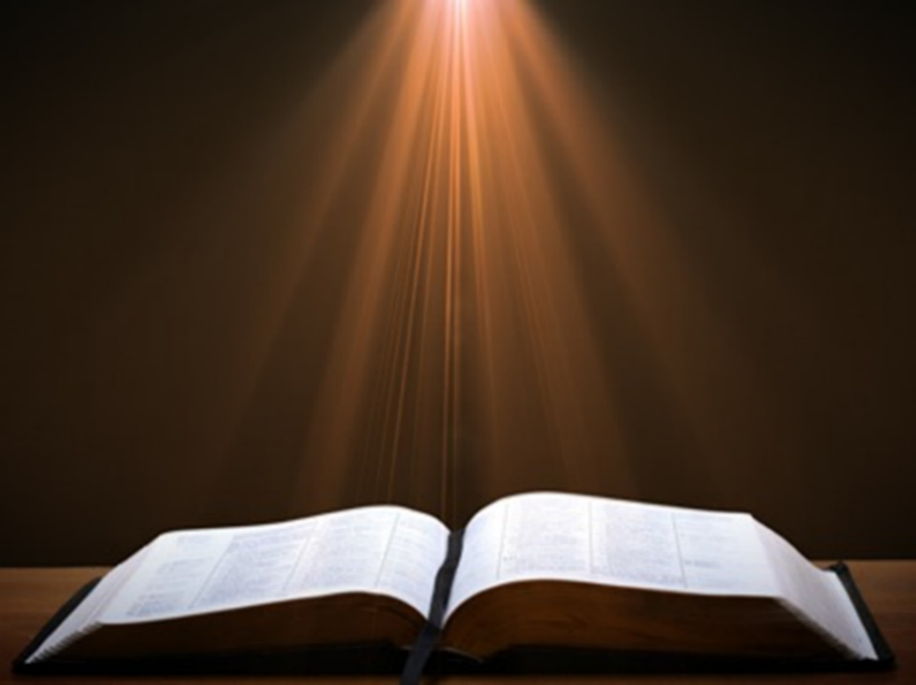
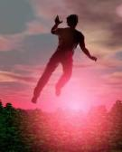
2 Thessalonians 2:2
“that you not be quickly shaken from your composure or be disturbed either by a spirit or a message or a letter as if from us, to the effect that the day of the Lord [the Tribulation] has come.”

Slide 5
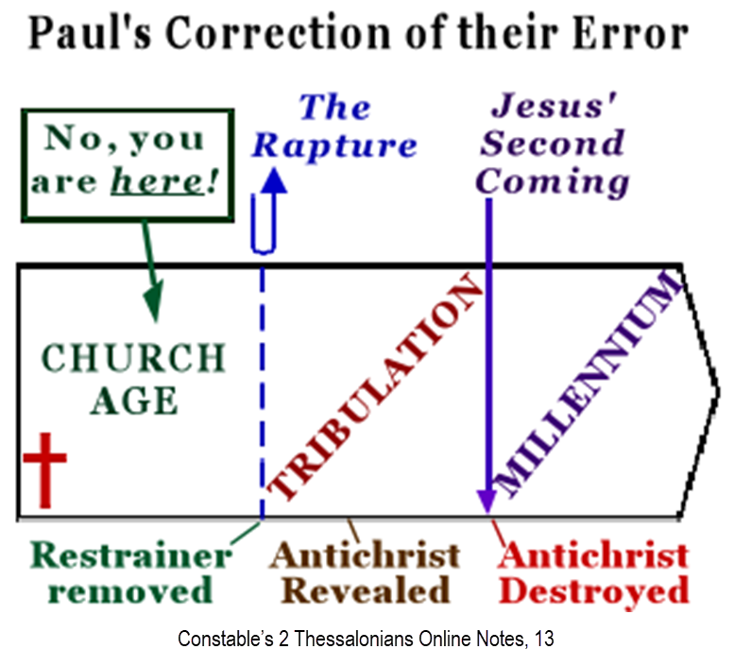

Slide 6
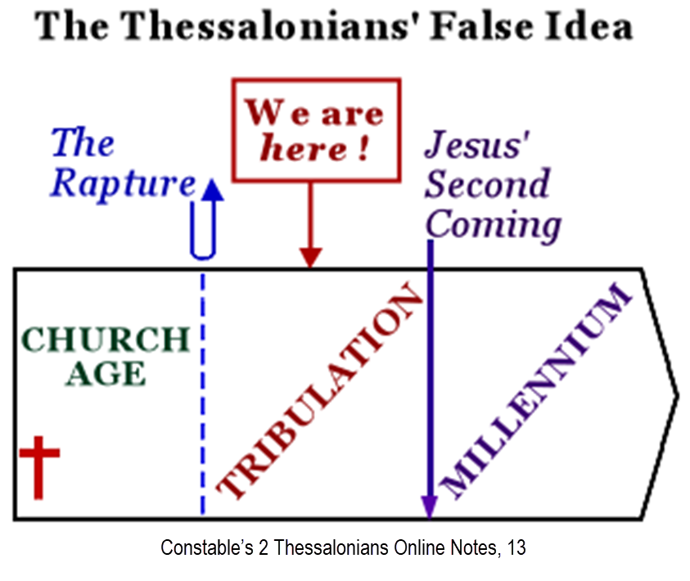

Slide 7
2 Thessalonians 2:1-12
Problem (2:1-2)
Prerequisites for the Day of the Lord (2:3-12)
  The departure (2:3a)
  Advent of the lawless one (2:3b-4)
  Removal of the restrainer (2:5-7)
  Destruction of the lawless one (2:8-9)
  Destruction of lawless one’s followers (2:10-12)

Slide 8

Contrasting Destiny of the Righteous
(2:13-17)
Thanksgiving for their calling (2:13-14)
Exhortation to stand firm (2:15)
Prayer for strength (2:16-17)

Slide 9
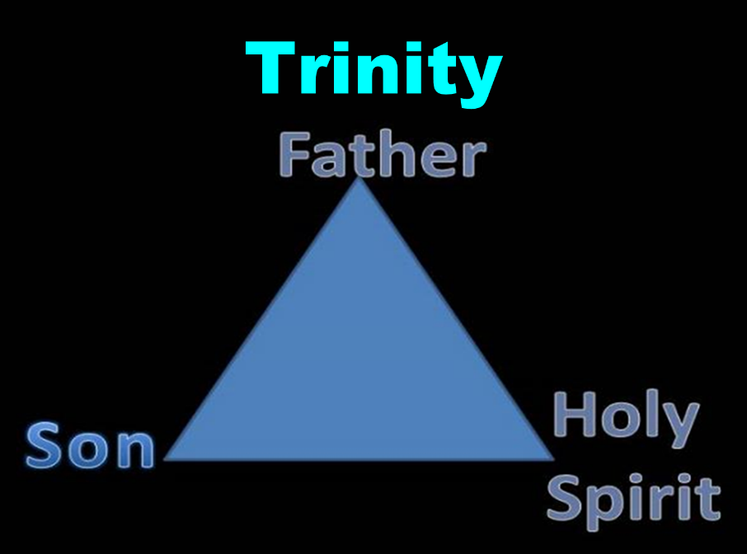

Slide 10
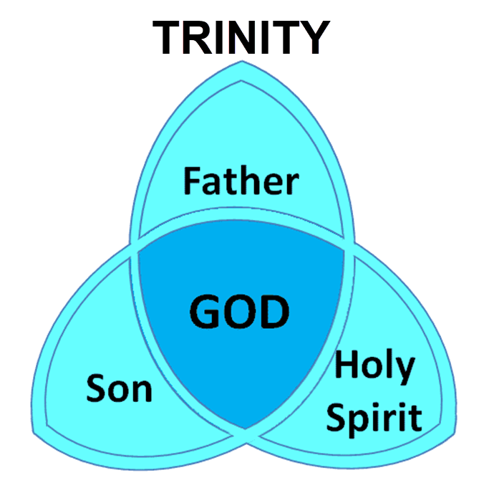

Slide 11
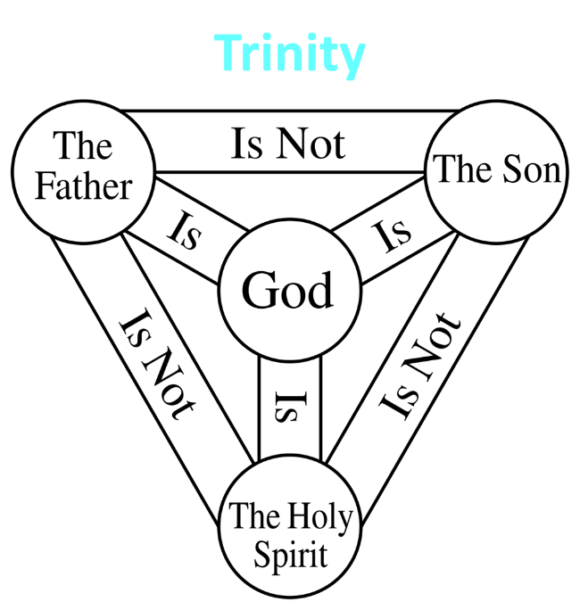

Slide 12

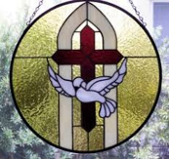
John 14:16-17
¹⁶ “I will ask the Father, and He will give you another Helper, that He may be with you forever [aiōn]; ¹⁷ that is the Spirit of truth, whom the world cannot receive, because it does not see Him or know Him, but you know Him because He abides with you and will be in you.”

Slide 13
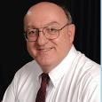
Definition of Eternal Security
“The new birth has given every believer the confident assurance of God’s certain and future blessings. The word ‘hope’ in the Bible does not involve anxious wishing or uncertainty; rather it means a confident assurance of something yet future. Unlike the empty and false hopes of this world-system, God has given believers a ‘living hope’ of guaranteed future blessings ‘by the resurrection of Jesus Christ from the dead’…”
Dennis Rokser, Shall Never Perish Forever, p. 53

Slide 14
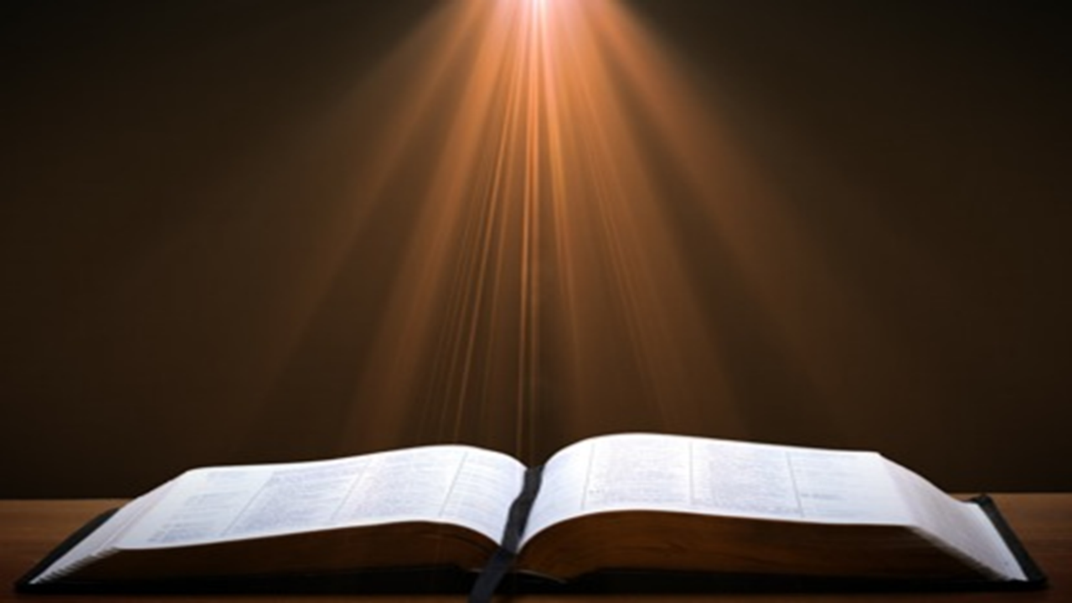
Ephesians 2:8-10
“⁸ For by grace you have been saved through faith; and that not of yourselves, it is the gift of God; ⁹ not as a result of works, so that no one may boast. ¹⁰ For we are His workmanship, created in Christ Jesus for good works, which God prepared beforehand so that we would walk [peripateō, subjunctive mood] in them.”

Slide 15
Ephesians 2:8-10
“⁸ For by grace you have been saved through faith; and that not of yourselves, it is the gift of God; ⁹ not as a result of works, so that no one may boast. ¹⁰ For we are His workmanship, created in Christ Jesus for good works, which God prepared beforehand so that we would walk [peripateō, subjunctive mood] in them.”

Slide 16
2 Thessalonians 2:2
“that you not be quickly shaken from your composure or be disturbed either by a spirit or a message or a letter as if from us, to the effect that the day of the Lord [the Tribulation] has come.”

Slide 17
Structure
1 – Commendation
2 – Correction
3 – Consequences

Slide 18
Consequences of Poor Doctrine (3)
Reciprocal prayer (3:1-5)
Exhortation to discipline the idle (3:6-15)
Conclusion (3:16-18)

Slide 19
Consequences of Poor Doctrine (3)
Reciprocal prayer (3:1-5)
Exhortation to discipline the idle (3:6-15)
Conclusion (3:16-18)

Slide 20
Consequences of Poor Doctrine (3)
Reciprocal prayer (3:1-5)
Exhortation to discipline the idle (3:6-15)
Conclusion (3:16-18)

Slide 21
Consequences of Poor Doctrine (3)
Reciprocal prayer (3:1-5)
Exhortation to discipline the idle (3:6-15)
Conclusion (3:16-18)

Slide 22
Conclusion

Slide 23
Contrasting Destiny of the Righteous
(2:13-17)
Thanksgiving for their calling (2:13-14)
Exhortation to stand firm (2:15)
Prayer for strength (2:16-17)

