Slide 1


Genesis 12‒50
Israel’s Birth & Preservation

Slide 2
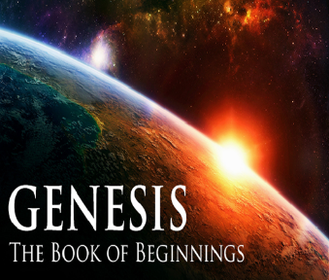
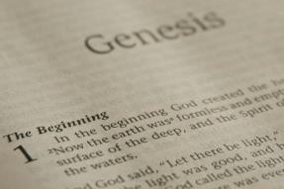
GENESIS STRUCTURE
  Genesis 12-50 (four people)
    Abraham (12:1–25:11)
    Isaac (25:12–26:35)
    Jacob (27–36)
    Joseph (37–50)

Slide 3
Genesis 37:2-36
Joseph Sold unto Egypt
  Joseph’s coat (37:2-4)
  Joseph’s dreams (37:5-11)
  Joseph’s pit (37:12-24)
  Joseph’s enslavement (37:25-36)

Slide 4
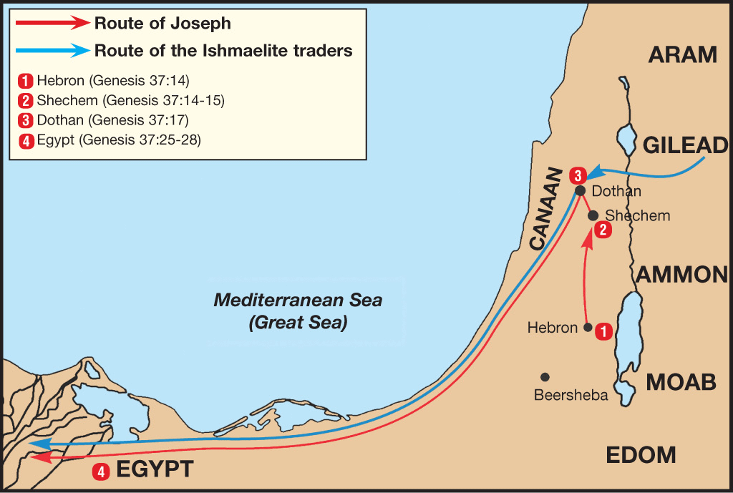

Slide 5
Genesis 38:1-30
Judah & Tamar
  Tamar & Judah’s sons (38:1-11)
  Tamar & Judah (38:12-26)
  Tamar & Judah’s twins (38:27-30)

Slide 6
Genesis 39:1-23
Joseph in Potiphar's House
  Blessing (39:1-6)
  Temptation & Accusation (39:7-18)
  Prison (39:19-23)

Slide 7
Genesis 40:1-23
Joseph in Prison
  Imprisonment (40:1-8)
  Butler’s dream (40:9-15)
  Baker’s dream (40:16-19)
  Fulfillment of the dreams (40:20-23)

Slide 8
Genesis 41:1-57
Joseph Before Pharoah
  Pharoah’s 2 dreams (41:1-8)
  Butler’s report (41:9-13)
  Joseph before Pharoah (41:14-24)
  Joseph’s interpretation & advice (41:25-36)
  Joseph’s elevation (41:37-46a)
  Joseph’s activities (41:46b-57)

Slide 9
III. Genesis 41:14-24
Joseph Before Pharoah
    Joseph before Pharoah (14-16)
    First dream (17-21)
    Second dream (22-24a)
    Pharoah’s conclusion (24b)

Slide 10
Genesis 41:17-21
First Dream
      Pharoah’s position (17)
      Fat cows (18)
      Thin cows (19)
      Eating (20)
      Result (21)

Slide 11
Genesis 41:17-21
First Dream
      Pharoah’s position (17)
      Fat cows (18)
      Thin cows (19)
      Eating (20)
      Result (21)

Slide 12
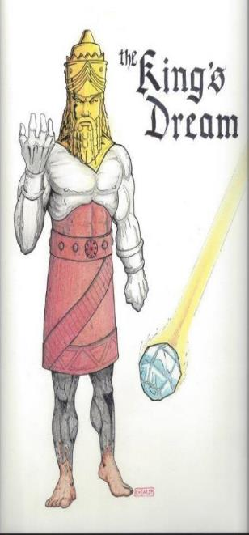
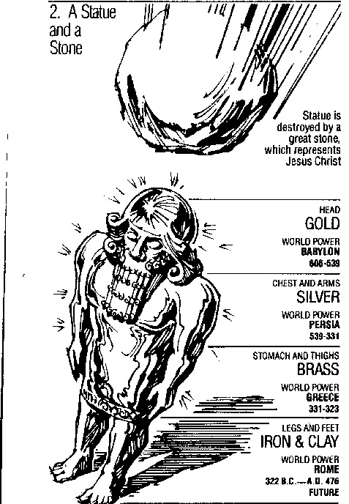
Statue
&
Stone

Slide 13

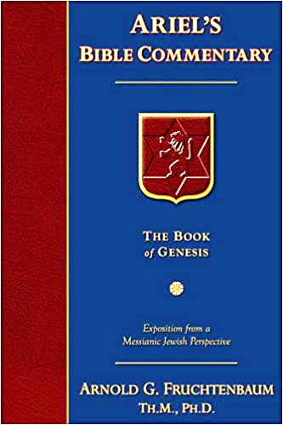
Dr. Arnold G. Fruchtenbaum
The Book of Genesis, 566
“The reason was: for it shall be very grievous. This explains why in the dream, the position of the Pharaoh was by the Nile. The Nile was the lifeline of Egypt since Egypt virtually has no rainfall throughout the entire year. Egypt is dependent upon the periodic flooding of the Nile to moisten the land and the plantings. The Nile will flow in abundance for the first seven years but will recede into inadequacy for the second seven years. That would be the nature of a famine in the land of Egypt: not the withholding of rain, but failure of the Nile to flood.”

Slide 14
The Plagues of Egypt
NO. | DESCRIPTION | SCRIPTURE | Egyptian Deity
1. | Water to Blood | Exod. 7:14-25 | Hapi, Khnum
2. | Frogs | Exod. 8:1-15 | Heqt
3. | Gnats | Exod. 8:16-19 | Set
4. | Flies | Exod. 8:20-32 | Uatchit
5. | Disease on Cattle | Exod. 9:1-7 | Hathor, Apis
6. | Boils | Exod. 9:8-12 | Sekhmet, Serapis
7. | Hail | Exod. 9:13-35 | Seth, Nut
8. | Locusts | Exod. 10:1-20 | Seth, Nut, Osiris
9. | Darkness | Exod. 10:21-29 | Re, Horus, Atum
10. | Death of the First Born | Exod. 12:29-36 | Min, Osiris, Heqt, Isis

Slide 15
Genesis 41:17-21
First Dream
      Pharoah’s position (17)
      Fat cows (18)
      Thin cows (19)
      Eating (20)
      Result (21)

Slide 16
Genesis 41:17-21
First Dream
      Pharoah’s position (17)
      Fat cows (18)
      Thin cows (19)
      Eating (20)
      Result (21)

Slide 17
Genesis 41:17-21
First Dream
      Pharoah’s position (17)
      Fat cows (18)
      Thin cows (19)
      Eating (20)
      Result (21)

Slide 18
Genesis 41:17-21
First Dream
      Pharoah’s position (17)
      Fat cows (18)
      Thin cows (19)
      Eating (20)
      Result (21)

Slide 19
Statue
&
Stone

Slide 20
III. Genesis 41:14-24
Joseph Before Pharoah
    Joseph before Pharoah (14-16)
    First dream (17-21)
    Second dream (22-24a)
    Pharoah’s conclusion (24b)

Slide 21
Genesis 41:22-24a
Second Dream
      Fat stalks (22)
      Thin stalks (23)
      Eating (24a)

Slide 22
Genesis 41:22-24a
Second Dream
      Fat stalks (22)
      Thin stalks (23)
      Eating (24a)

Slide 23
Genesis 41:22-24a
Second Dream
      Fat stalks (22)
      Thin stalks (23)
      Eating (24a)

Slide 24
Genesis 41:22-24a
Second Dream
      Fat stalks (22)
      Thin stalks (23)
      Eating (24a)

Slide 25
III. Genesis 41:14-24
Joseph Before Pharoah
    Joseph before Pharoah (14-16)
    First dream (17-21)
    Second dream (22-24a)
    Pharoah’s conclusion (24b)

Slide 26
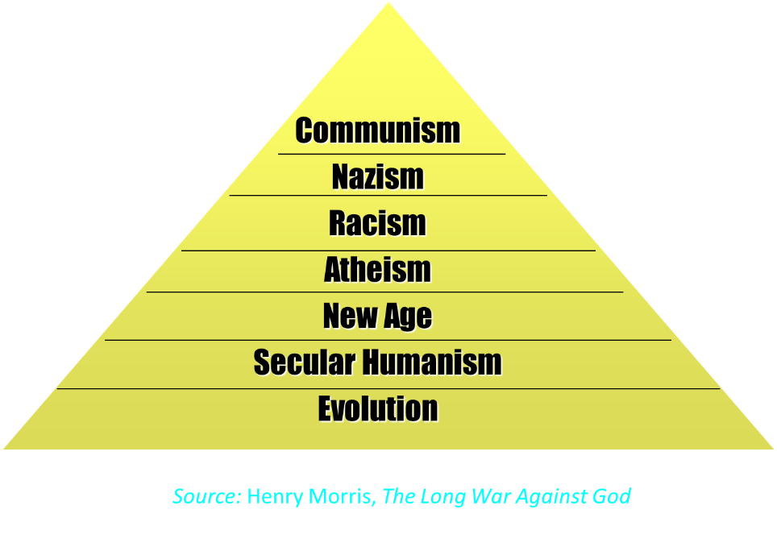

Slide 27
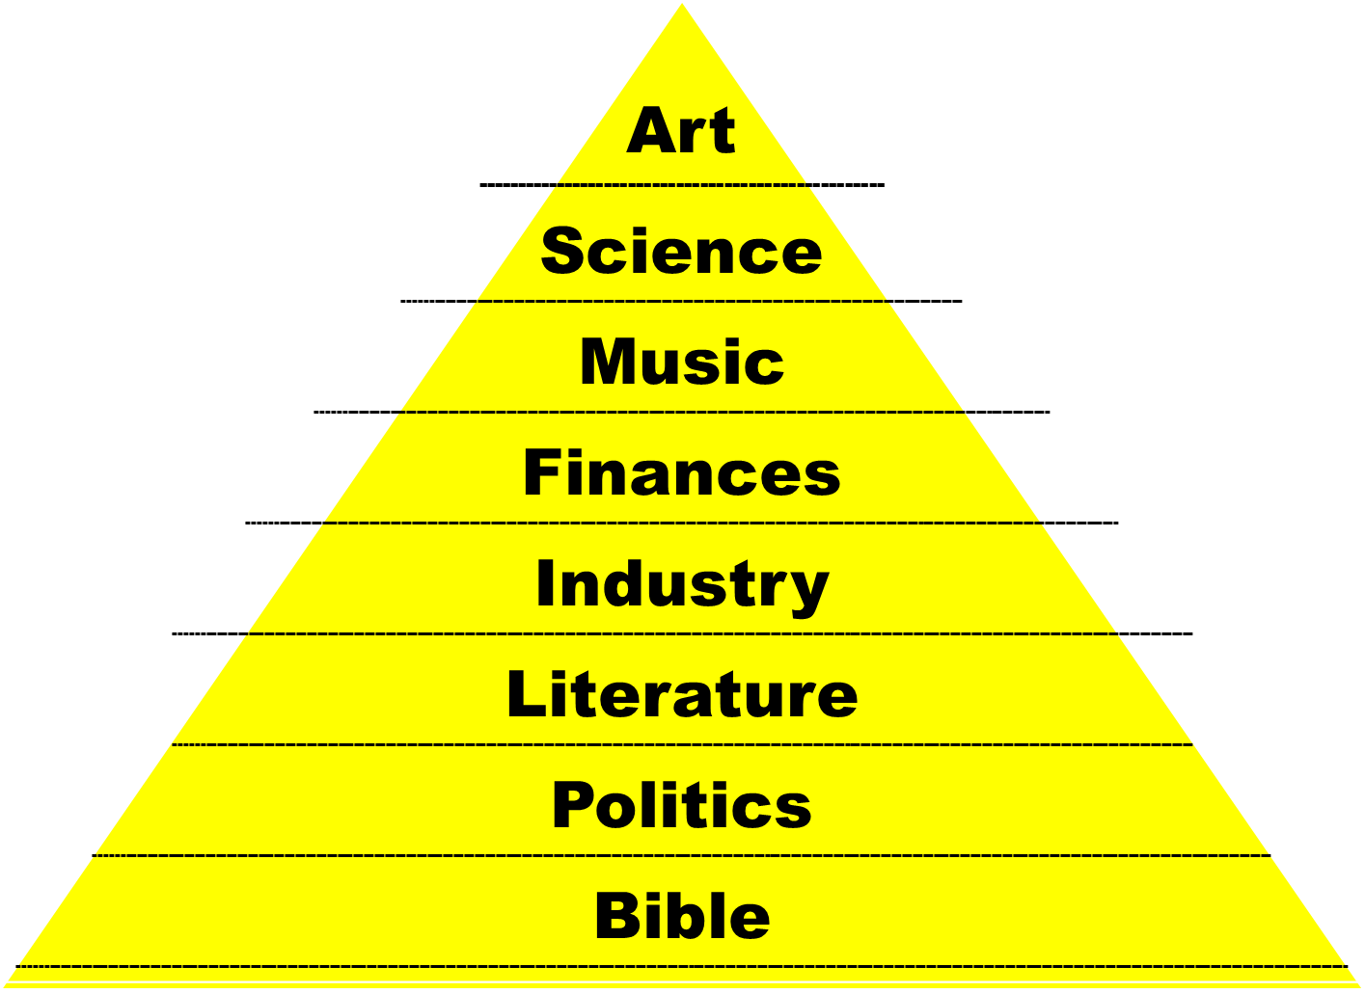

Slide 28
Statue
&
Stone

Slide 29
Genesis 41:1-57
Joseph Before Pharoah
  Pharoah’s 2 dreams (41:1-8)
  Butler’s report (41:9-13)
  Joseph before Pharoah (41:14-24)
  Joseph’s interpretation & advice (41:25-36)
  Joseph’s elevation (41:37-46a)
  Joseph’s activities (41:46b-57)

Slide 30
IV. Genesis 41:25-36
Joseph’s Interpretation & Advice
    Joseph’s interpretation (25-32)
    Joseph’s advice (33-36)

Slide 31
IV. Genesis 41:25-36
Joseph’s Interpretation & Advice
    Joseph’s interpretation (25-32)
    Joseph’s advice (33-36)

Slide 32
Genesis 41:25-32
Joseph’s Interpretation
      Introduction (25)
      Interpretation (26-27)
      More detailed information (28-32)

Slide 33
Genesis 41:25-32
Joseph’s Interpretation
      Introduction (25)
      Interpretation (26-27)
      More detailed information (28-32)

Slide 34
Genesis 41:25-32
Joseph’s Interpretation
      Introduction (25)
      Interpretation (26-27)
      More detailed information (28-32)

Slide 35
Genesis 41:26-27
Interpretation
      Fat objects (26)
      Thin objects (27)

Slide 36
Genesis 41:26-27
Interpretation
      Fat objects (26)
      Thin objects (27)

Slide 37
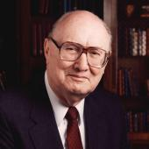
Two Rules of Interpretation
Search the immediate context
  Walvoord: 26X
Search the remote context
  Old Testament
  Thomas: 278 / 404 verses

Slide 38
Genesis 41:26-27
Interpretation
      Fat objects (26)
      Thin objects (27)

Slide 39
Genesis 41:25-32
Joseph’s Interpretation
      Introduction (25)
      Interpretation (26-27)
      More detailed information (28-32)

Slide 40
Genesis 41:28-32
Interpretation
      God’s revelation to Pharoah (28)
      7 years of plenty (29)
      7 years of famine (30-31)
      God’s decree (32)

Slide 41
Genesis 41:28-32
Interpretation
      God’s revelation to Pharoah (28)
      7 years of plenty (29)
      7 years of famine (30-31)
      God’s decree (32)

Slide 42
Statue
&
Stone

Slide 43
Genesis 41:28-32
Interpretation
      God’s revelation to Pharoah (28)
      7 years of plenty (29)
      7 years of famine (30-31)
      God’s decree (32)

Slide 44
Genesis 41:28-32
Interpretation
      God’s revelation to Pharoah (28)
      7 years of plenty (29)
      7 years of famine (30-31)
      God’s decree (32)

Slide 45
Dr. Arnold G. Fruchtenbaum
The Book of Genesis, 566-67
“Seven-year famines are recorded in Egyptian documents. For example, there is the text from the reign and rule of King Djoser of the Third Dynasty (2700 B.C.): ‘I was in distress on the Great Throne, and those who are in the palace where in the heart’s affliction from a very great evil, since the Nile had not come in my time for a space of seven years. Grain was scant, fruits were dried up, and everything which they ate was short. Every man robbed his companion. They moved without going (ahead). The infant was wailing; the youth was waiting; the heart of the old men was in sorrow; their legs were bent, crouching on the . . .

Slide 46
Dr. Arnold G. Fruchtenbaum
The Book of Genesis, 566-67
…ground, their arms were folded.’ So, seven-year famines are not something merely recorded in Scripture but also in Egyptian documents. This famine would affect indeed the gods of Egypt. For example, it would affect Osiris, a god who had the form of a bull was the god of the Nile. It would also affect Isis, also known as Hathor, who was a goddess in the form of a cow; and she was the goddess of fertility.”

Slide 47
The Plagues of Egypt
NO. | DESCRIPTION | SCRIPTURE | Egyptian Deity
1. | Water to Blood | Exod. 7:14-25 | Hapi, Khnum
2. | Frogs | Exod. 8:1-15 | Heqt
3. | Gnats | Exod. 8:16-19 | Set
4. | Flies | Exod. 8:20-32 | Uatchit
5. | Disease on Cattle | Exod. 9:1-7 | Hathor, Apis
6. | Boils | Exod. 9:8-12 | Sekhmet, Serapis
7. | Hail | Exod. 9:13-35 | Seth, Nut
8. | Locusts | Exod. 10:1-20 | Seth, Nut, Osiris
9. | Darkness | Exod. 10:21-29 | Re, Horus, Atum
10. | Death of the First Born | Exod. 12:29-36 | Min, Osiris, Heqt, Isis

Slide 48
Genesis 41:28-32
Interpretation
      God’s revelation to Pharoah (28)
      7 years of plenty (29)
      7 years of famine (30-31)
      God’s decree (32)

Slide 49
IV. Genesis 41:25-36
Joseph’s Interpretation & Advice
    Joseph’s interpretation (25-32)
    Joseph’s advice (33-36)

Slide 50
Genesis 41:33-36
Joseph’s Advice
      Appoint an economic leader (33)
      Appoint stewards (34)
      Storing (35)
      Purpose (36)

Slide 51
Genesis 41:33-36
Joseph’s Advice
      Appoint an economic leader (33)
      Appoint stewards (34)
      Storing (35)
      Purpose (36)

Slide 52
Genesis 41:33-36
Joseph’s Advice
      Appoint an economic leader (33)
      Appoint stewards (34)
      Storing (35)
      Purpose (36)

Slide 53
Genesis 41:33-36
Joseph’s Advice
      Appoint an economic leader (33)
      Appoint stewards (34)
      Storing (35)
      Purpose (36)

Slide 54
Genesis 41:33-36
Joseph’s Advice
      Appoint an economic leader (33)
      Appoint stewards (34)
      Storing (35)
      Purpose (36)

Slide 55
Genesis 41:1-57
Joseph Before Pharoah
  Pharoah’s 2 dreams (41:1-8)
  Butler’s report (41:9-13)
  Joseph before Pharoah (41:14-24)
  Joseph’s interpretation & advice (41:25-36)
  Joseph’s elevation (41:37-46a)
  Joseph’s activities (41:46b-57)

Slide 56
V. Genesis 41:37-46a
Joseph’s Elevation
    Joseph’s response (37-38)
    Joseph’s appointment (39-44)
    Joseph’s settlement (45-46a)

Slide 57
V. Genesis 41:37-46a
Joseph’s Elevation
    Joseph’s response (37-38)
    Joseph’s appointment (39-44)
    Joseph’s settlement (45-46a)

Slide 58
Genesis 41:37-38
Joseph’s Response
      Reaction (37)
      Rhetorical question (38)

Slide 59
Genesis 41:37-38
Joseph’s Response
      Reaction (37)
      Rhetorical question (38)

Slide 60
Genesis 41:37-38
Joseph’s Response
      Reaction (37)
      Rhetorical question (38)

Slide 61
V. Genesis 41:37-46a
Joseph’s Elevation
    Joseph’s response (37-38)
    Joseph’s appointment (39-44)
    Joseph’s settlement (45-46a)

Slide 62
Genesis 41:39-44
Joseph’s Appointment
      Appointment (39-40)
      Extent of authority (41)
      Royal garb (42)
      Royal chariot (43a)
      Royal honor (43b)
      Decree of authority (44)

Slide 63
Genesis 41:39-44
Joseph’s Appointment
      Appointment (39-40)
      Extent of authority (41)
      Royal garb (42)
      Royal chariot (43a)
      Royal honor (43b)
      Decree of authority (44)

Slide 64
Genesis 41:39-40
Appointment
      Joseph’s abilities (39)
      Appointment details (40)

Slide 65
Genesis 41:39-40
Appointment
      Joseph’s abilities (39)
      Appointment details (40)

Slide 66
Genesis 41:39-40
Appointment
      Joseph’s abilities (39)
      Appointment details (40)

Slide 67
Genesis 40:40
Appointment Details
      Positive (40a)
      Negative (40b)

Slide 68
Genesis 40:40
Appointment Details
      Positive (40a)
      Negative (40b)

Slide 69
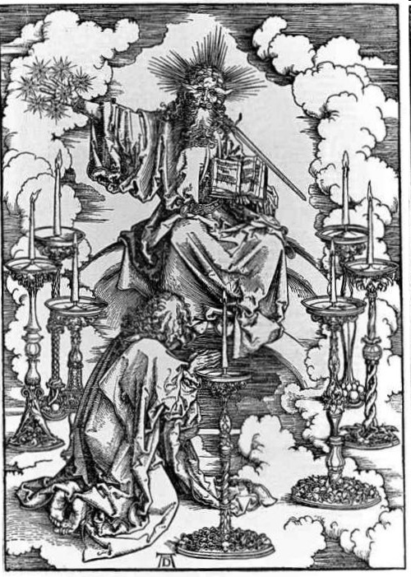
His Body
(Rev. 1:14-16)
His hair (14a)
His eyes (14b)
His feet (15a)
His voice (15b)
His right hand (16a)
His mouth (16b)
His face (16c)

Slide 70
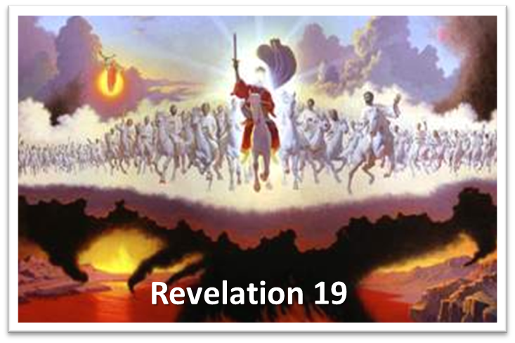
His Activities
Revelation 19:15-16
His spoken word (15a)
His smiting of the nations (15b)
His ruling of the nations (15c)
His treading of the winepress (15d)
His rulership as King (16)

Slide 71
Genesis 40:40
Appointment Details
      Positive (40a)
      Negative (40b)

Slide 72
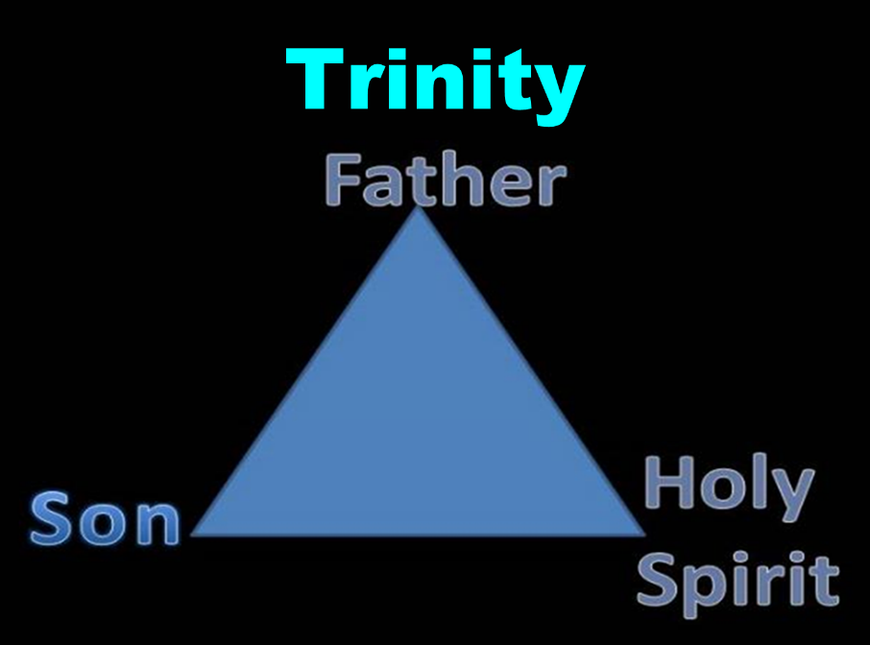

Slide 73
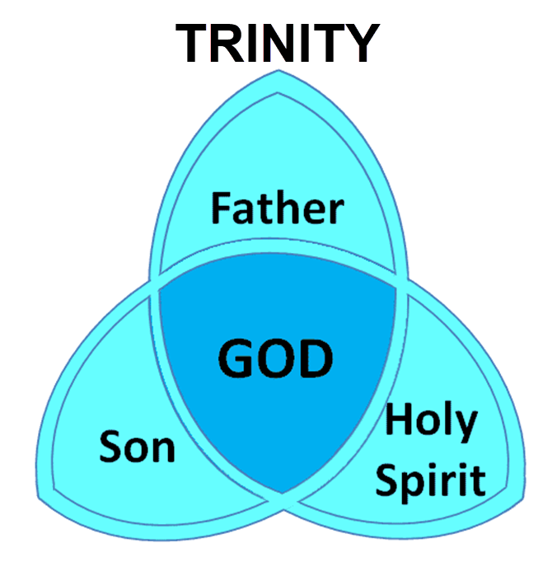

Slide 74
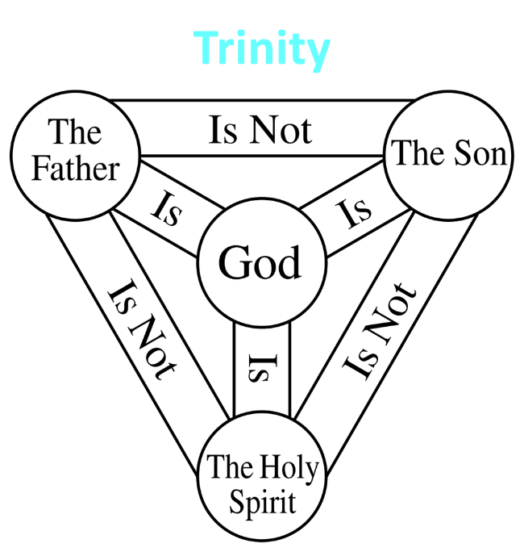

Slide 75
Genesis 41:39-44
Joseph’s Appointment
      Appointment (39-40)
      Extent of authority (41)
      Royal garb (42)
      Royal chariot (43a)
      Royal honor (43b)
      Decree of authority (44)

Slide 76
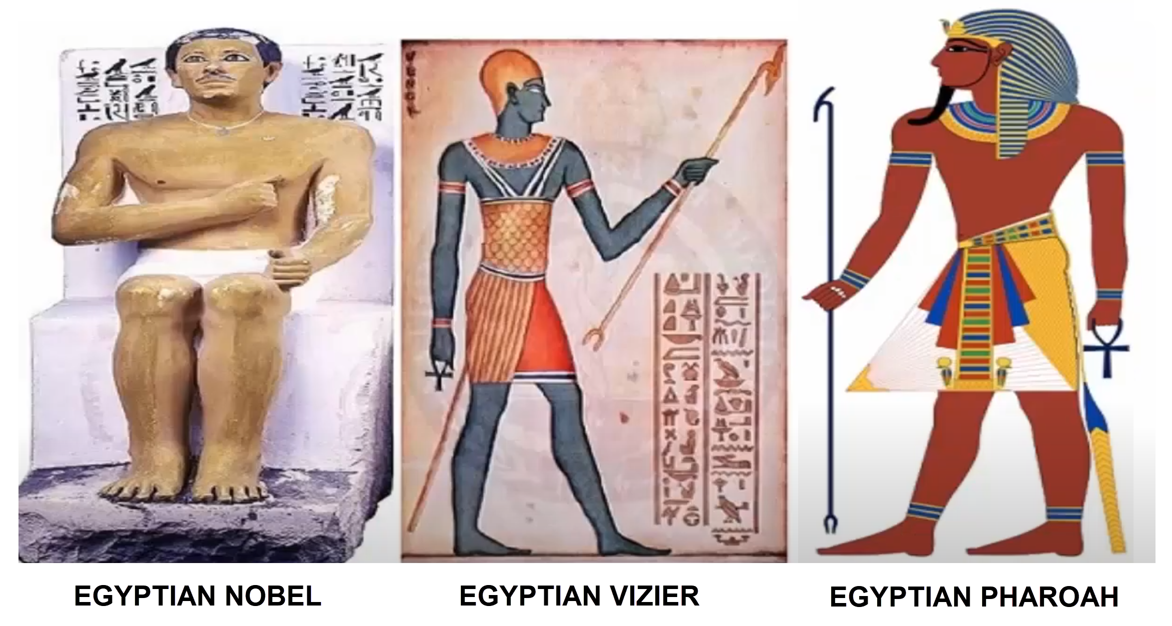
Dr. Arnold G. Fruchtenbaum
The Book of Genesis, 569
“This was a position of a vizier or a prime minister, and there is a parallel in the records of Thutmose III: ‘Look you to this office of vizier. Be vigilant over everything that is done in it. Behold, it is the support of the entire land.’”

Slide 77
Genesis 41:39-44
Joseph’s Appointment
      Appointment (39-40)
      Extent of authority (41)
      Royal garb (42)
      Royal chariot (43a)
      Royal honor (43b)
      Decree of authority (44)

Slide 78
Genesis 41:42
Royal Garb
      Ring (42a)
      Clothing (42b)
      Chain (42c)

Slide 79
Genesis 41:42
Royal Garb
      Ring (42a)
      Clothing (42b)
      Chain (42c)

Slide 80
Genesis 41:42
Royal Garb
      Ring (42a)
      Clothing (42b)
      Chain (42c)

Slide 81
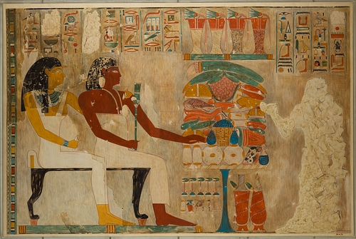
Dr. Arnold G. Fruchtenbaum
The Book of Genesis, 569
“Second was the clothing: and arrayed him in vestures of fine linen. This, too, is paralleled in the Egyptian accounts. When Rekhmire was appointed vizier, he wrote: ‘I was a noble, the second of the king … It was the first occasion of my being summoned … I went forth … clad in fine linen.’ This was the type of clothing worn by a vizier, a prime minister, someone who was second to the king.”

Slide 82
Genesis 41:42
Royal Garb
      Ring (42a)
      Clothing (42b)
      Chain (42c)

Slide 83
Genesis 41:39-44
Joseph’s Appointment
      Appointment (39-40)
      Extent of authority (41)
      Royal garb (42)
      Royal chariot (43a)
      Royal honor (43b)
      Decree of authority (44)

Slide 84
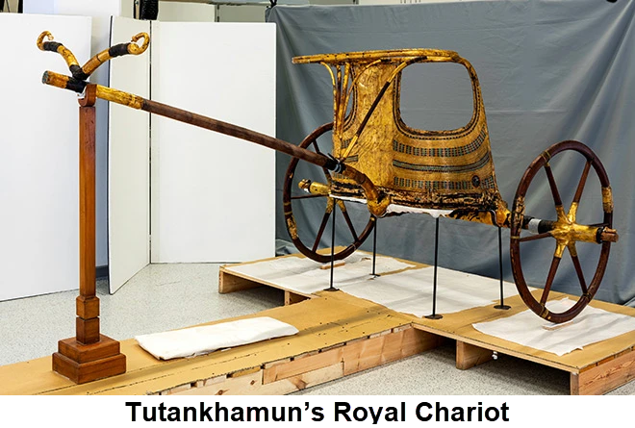
Dr. Arnold G. Fruchtenbaum
The Book of Genesis, 569
“In verse 43a Joseph was given a royal chariot: and he made him to ride in the second chariot which he had; the Hyksos introduced chariots into Egypt.”

Slide 85
Genesis 41:39-44
Joseph’s Appointment
      Appointment (39-40)
      Extent of authority (41)
      Royal garb (42)
      Royal chariot (43a)
      Royal honor (43b)
      Decree of authority (44)

Slide 86
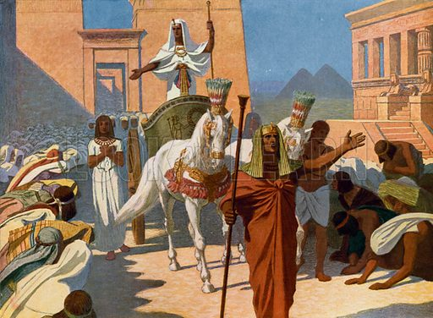
Dr. Arnold G. Fruchtenbaum
The Book of Genesis, 569
“Then, in verse 43b, came the royal honor: and they cried before him, Bow the knee. As Joseph rode in the chariot, heralds were sent out in advance with the command: Bow the knee. This was a practice that is well attested to in Egyptian pictures.”

Slide 87
Genesis 41:39-44
Joseph’s Appointment
      Appointment (39-40)
      Extent of authority (41)
      Royal garb (42)
      Royal chariot (43a)
      Royal honor (43b)
      Decree of authority (44)

Slide 88
V. Genesis 41:37-46a
Joseph’s Elevation
    Joseph’s response (37-38)
    Joseph’s appointment (39-44)
    Joseph’s settlement (45-46a)

Slide 89
Genesis 41:45-46a
Joseph’s Settlement
      Name (45a)
      Marriage (45b)
      Authority (45c)
      Age (46a)

Slide 90
Genesis 41:45-46a
Joseph’s Settlement
      Name (45a)
      Marriage (45b)
      Authority (45c)
      Age (46a)

Slide 91
Genesis 41:45-46a
Joseph’s Settlement
      Name (45a)
      Marriage (45b)
      Authority (45c)
      Age (46a)

Slide 92
Genesis 41:45-46a
Joseph’s Settlement
      Name (45a)
      Marriage (45b)
      Authority (45c)
      Age (46a)

Slide 93
Dr. Arnold G. Fruchtenbaum
The Book of Genesis, 570
“Therefore, a total separation of twenty years existed from the time he had last seen members of his family until they were reunited in Egypt. The Hyksos Period, during which Joseph’s story unfolds, was the two-hundred-year period from 1750 until 1550 B.C. The Hyksos were Semitic rulers that conquered Egypt and ruled during the sixteenth and seventeenth dynasties. Thus, the Pharaoh at the time of Joseph was Semitic. This explains how a Semite such as Joseph could rise to the second highest position in Egypt, which had a Hamitic population.”

Slide 94


GENESIS 10
Outline
  Introduction (1)
  Japheth's line (2-5)
  Ham’s Line (6-20)
  Shem’s line (21-31)
  Conclusion (32)

Slide 95
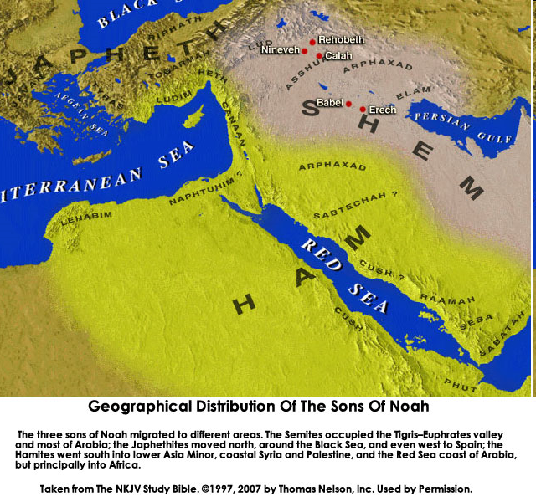

Slide 96
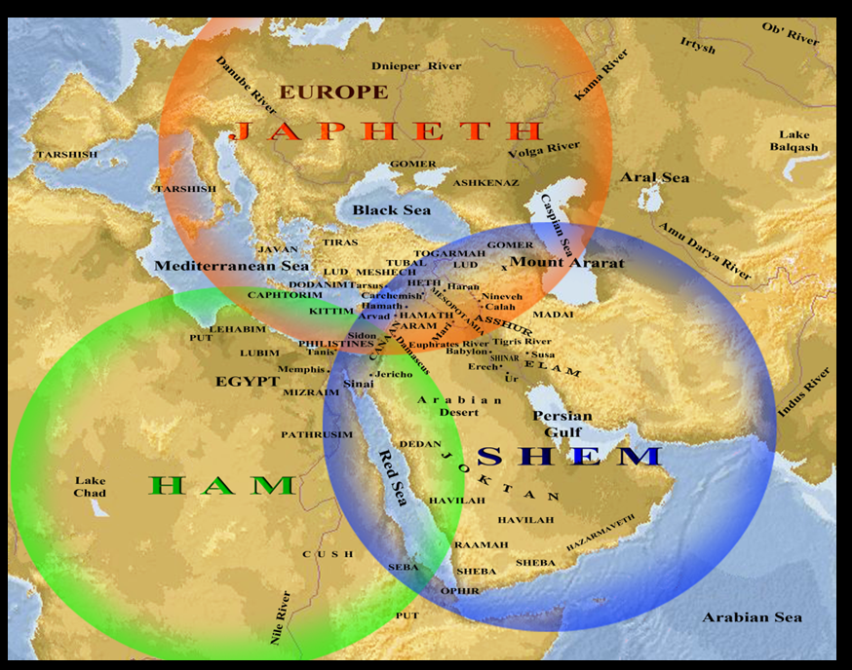

Slide 97
Ham’s Sons (vs. 6)
  Cush
  Mizraim
  Put
  Canaan

Slide 98
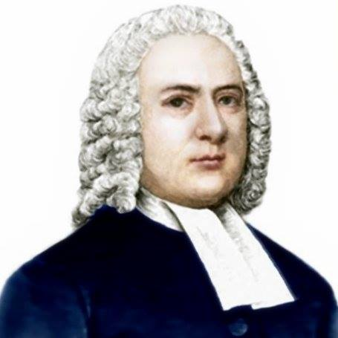

John Gill
Exposition of the Old and New Testaments, 1810
“Mitzraim is a name by which Egypt is frequently called in Scripture, and this man was the father of the Egyptians; and because Egypt was inhabited by a son of Ham, it is sometimes called the land of Ham (Psalm 105:23). The word is of the dual number, and serves to express Egypt, which was divided into two parts, lower and upper Egypt.”

Slide 99
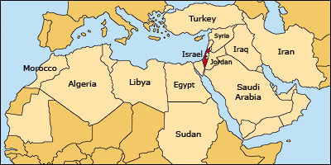

Slide 100
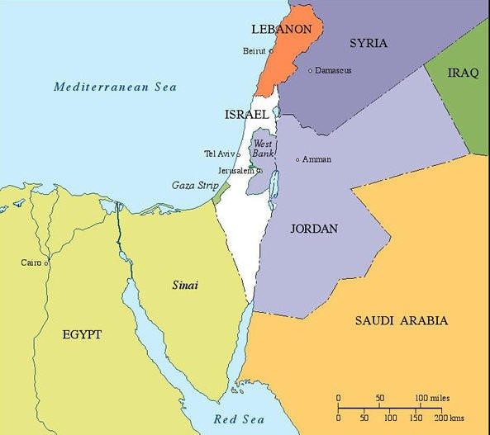

Slide 101
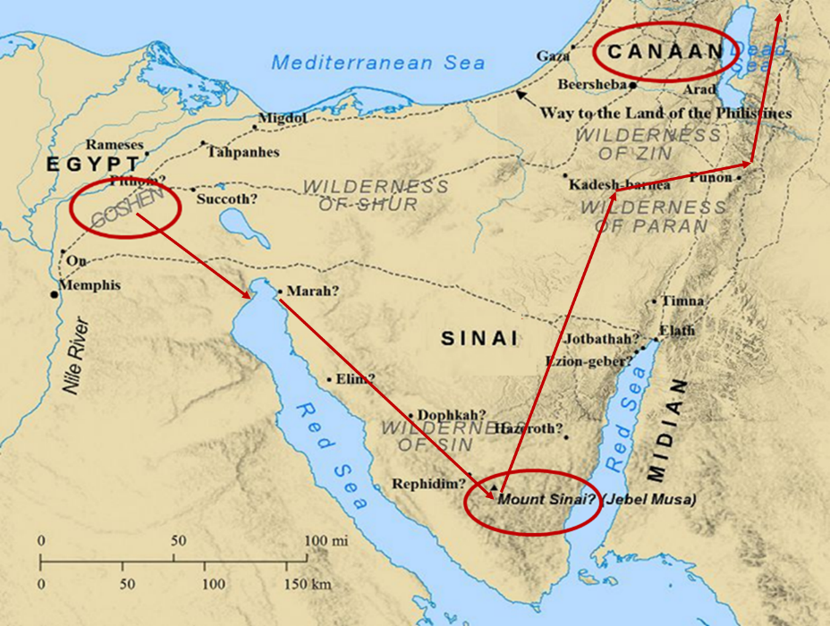

Slide 102


Galatians 4:4
“But when the fullness of the time came, God sent forth His Son, born of a woman, born under the Law.”

Slide 103
Genesis 41:45-46a
Joseph’s Settlement
      Name (45a)
      Marriage (45b)
      Authority (45c)
      Age (46a)

Slide 104
Genesis 41:1-57
Joseph Before Pharoah
  Pharoah’s 2 dreams (41:1-8)
  Butler’s report (41:9-13)
  Joseph before Pharoah (41:14-24)
  Joseph’s interpretation & advice (41:25-36)
  Joseph’s elevation (41:37-46a)
  Joseph’s activities (41:46b-57)

Slide 105
VI. Genesis 41:46b-57
Joseph’s Activities
    Joseph exercises his authority (46b)
    7 years of plenty (47-49)
    Joseph’s family (50-52)
    7 years of famine (53-54)
    Egyptians’ response (55-56)
    Foreigners’ response (57)

Slide 106
VI. Genesis 41:46b-57
Joseph’s Activities
    Joseph exercises his authority (46b)
    7 years of plenty (47-49)
    Joseph’s family (50-52)
    7 years of famine (53-54)
    Egyptians’ response (55-56)
    Foreigners’ response (57)

Slide 107
VI. Genesis 41:46b-57
Joseph’s Activities
    Joseph exercises his authority (46b)
    7 years of plenty (47-49)
    Joseph’s family (50-52)
    7 years of famine (53-54)
    Egyptians’ response (55-56)
    Foreigners’ response (57)

Slide 108
Genesis 41:47-49
7 Years of Plenty
      Abundance of food (47)
      Gathering & storing (48)
      Record keeping (49)

Slide 109
Genesis 41:47-49
7 Years of Plenty
      Abundance of food (47)
      Gathering & storing (48)
      Record keeping (49)

Slide 110
Genesis 41:47-49
7 Years of Plenty
      Abundance of food (47)
      Gathering & storing (48)
      Record keeping (49)

Slide 111
Genesis 41:47-49
7 Years of Plenty
      Abundance of food (47)
      Gathering & storing (48)
      Record keeping (49)

Slide 112
VI. Genesis 41:46b-57
Joseph’s Activities
    Joseph exercises his authority (46b)
    7 years of plenty (47-49)
    Joseph’s family (50-52)
    7 years of famine (53-54)
    Egyptians’ response (55-56)
    Foreigners’ response (57)

Slide 113
Genesis 41:50-52
Joseph’s Family
      Wife-Mother (50)
      First son (51)
      Second son (52)

Slide 114
Genesis 41:50-52
Joseph’s Family
      Wife-Mother (50)
      First son (51)
      Second son (52)

Slide 115
Genesis 41:50-52
Joseph’s Family
      Wife-Mother (50)
      First son (51)
      Second son (52)

Slide 116

2 Cor. 4:16
¹⁶ Therefore we do not lose heart, but though our outer man is decaying, yet our inner man is being renewed day by day.

Slide 117
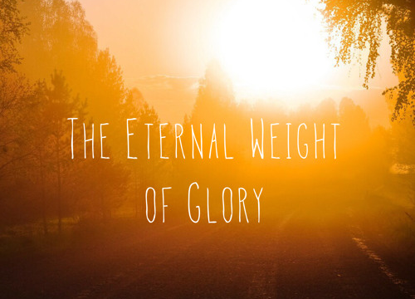
2 Cor. 4:17
¹⁷ For momentary, light affliction is producing for us an eternal weight of glory far beyond all comparison

Slide 118
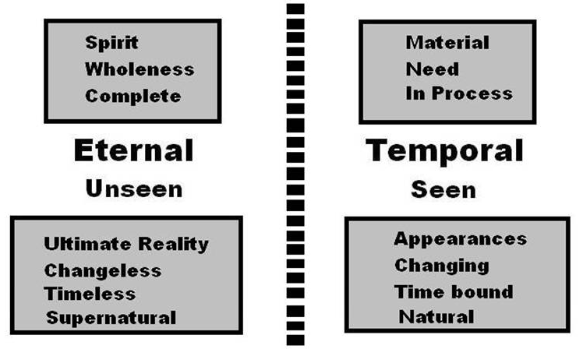
2 Cor. 4:18
¹⁸ while we look not at the things which are seen, but at the things which are not seen; for the things which are seen are temporal, but the things which are not seen are eternal.

Slide 119
Genesis 41:50-52
Joseph’s Family
      Wife-Mother (50)
      First son (51)
      Second son (52)

Slide 120
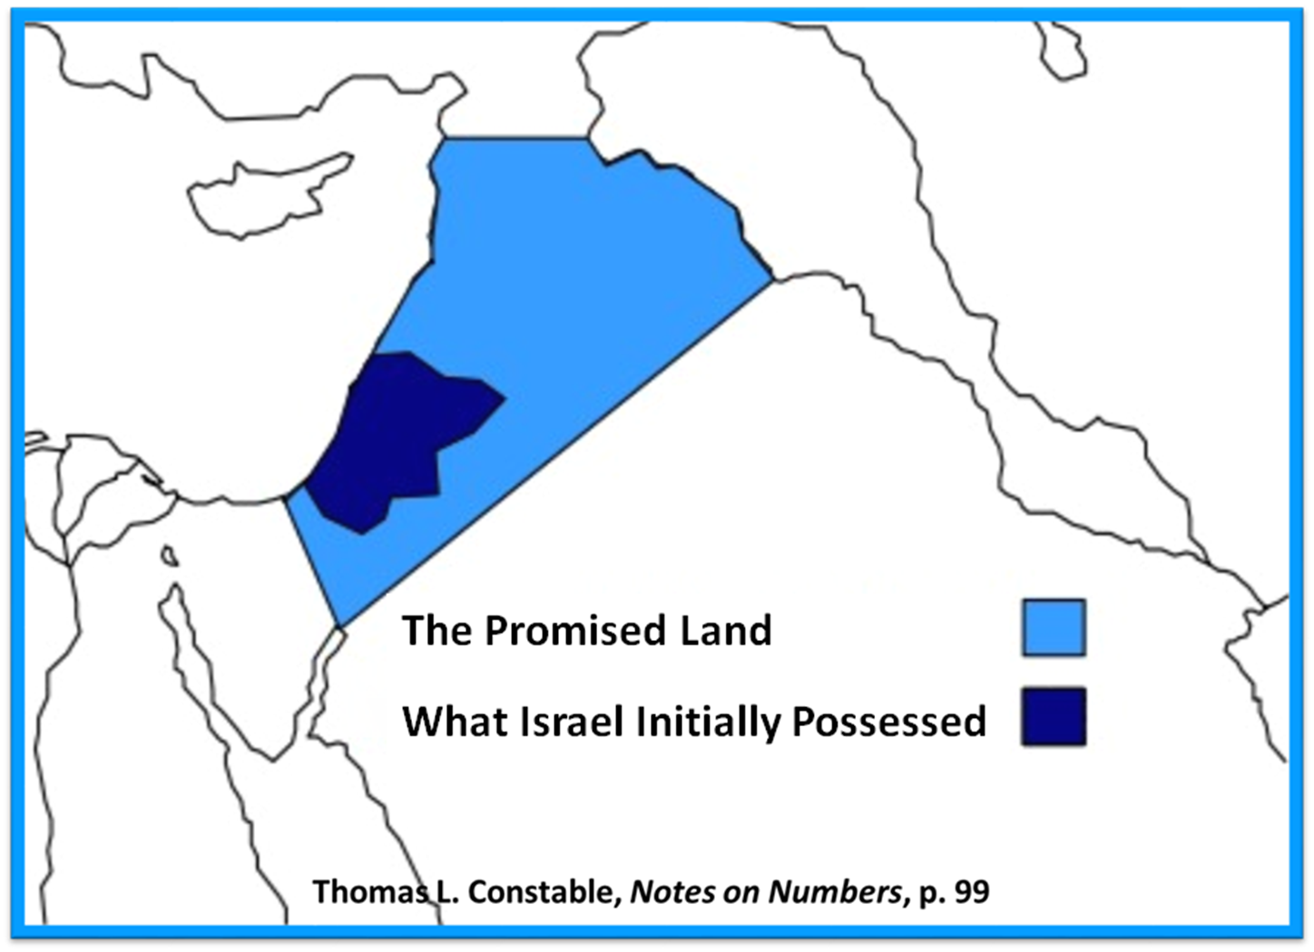

Slide 121
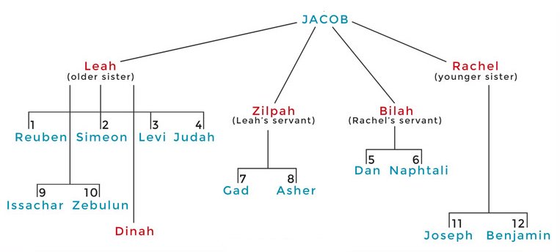

Slide 122
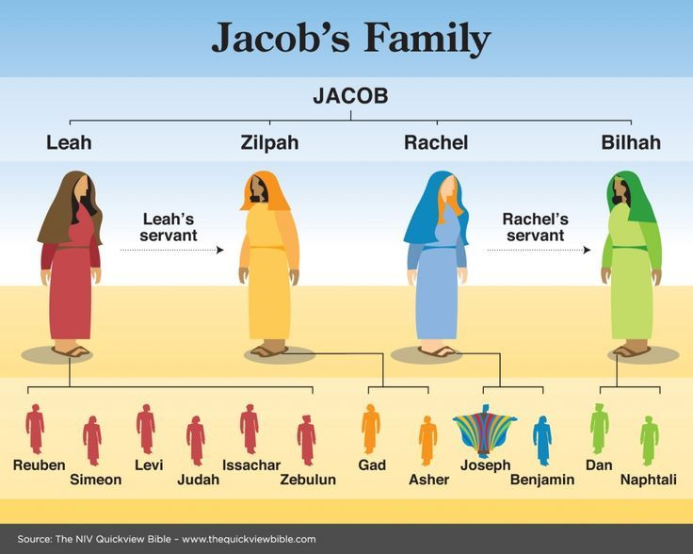

Slide 123
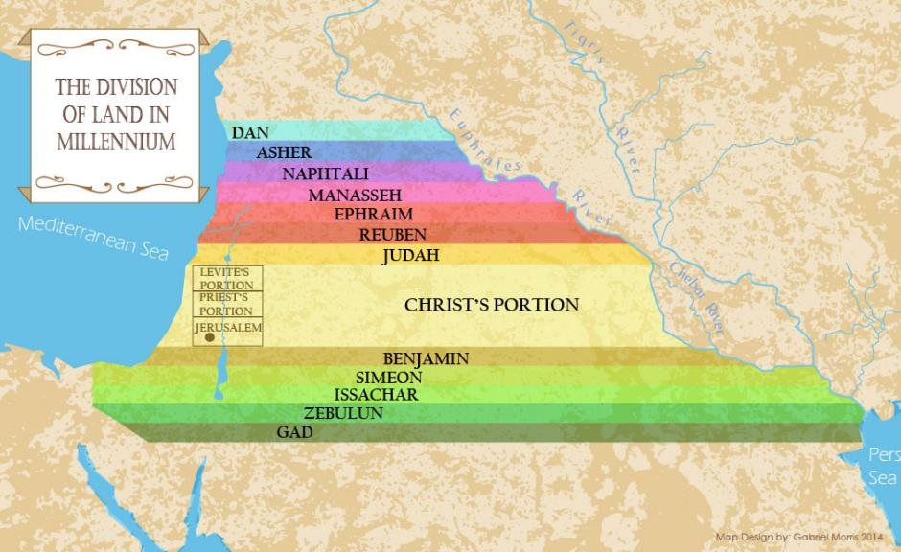

Slide 124
Distinctions Between 144,000 & Multitude
144,000 | MULTITUDE
Revelation 7:1-8 | Revelation 7:9-17
Numbered | Innumerable
Jews | All nations
Sealed | Slain
Sealed before the Tribulation | Converted out of the Tribulation
Hitchcock and Ice, The Truth Behind Left Behind, 77

Slide 125
VI. Genesis 41:46b-57
Joseph’s Activities
    Joseph exercises his authority (46b)
    7 years of plenty (47-49)
    Joseph’s family (50-52)
    7 years of famine (53-54)
    Egyptians’ response (55-56)
    Foreigners’ response (57)

Slide 126
Genesis 41:53-54
7 Years of Famine
      End of fat years (53)
      Beginning of lean years (54)

Slide 127
Genesis 41:53-54
7 Years of Famine
      End of fat years (53)
      Beginning of lean years (54)

Slide 128
Genesis 41:53-54
7 Years of Famine
      End of fat years (53)
      Beginning of lean years (54)

Slide 129


John 13:19; 14:29
“^{13:19} From now on I am telling you before it comes to pass, so that when it does occur, you may believe that I am He… ^{14:29} Now I have told you before it happens, so that when it happens, you may believe.”

Slide 130


Slide 131
VI. Genesis 41:46b-57
Joseph’s Activities
    Joseph exercises his authority (46b)
    7 years of plenty (47-49)
    Joseph’s family (50-52)
    7 years of famine (53-54)
    Egyptians’ response (55-56)
    Foreigners’ response (57)

Slide 132
Genesis 41:55-56
Egyptians’ Response
      Pharoah’s command (55)
      Selling of the grain (56)

Slide 133
Genesis 41:55-56
Egyptians’ Response
      Pharoah’s command (55)
      Selling of the grain (56)

Slide 134
Genesis 41:55
Pharoah’s Command
      Timing (55a)
      Circumstances (55b)
      Command (55c)

Slide 135
Genesis 41:55
Pharoah’s Command
      Timing (55a)
      Circumstances (55b)
      Command (55c)

Slide 136
Genesis 41:55
Pharoah’s Command
      Timing (55a)
      Circumstances (55b)
      Command (55c)

Slide 137
Genesis 41:55
Pharoah’s Command
      Timing (55a)
      Circumstances (55b)
      Command (55c)

Slide 138
Genesis 41:55-56
Egyptians’ Response
      Pharoah’s command (55)
      Selling of the grain (56)

Slide 139
Genesis 41:56
Selling of the Grain
      Statement of fact (56a)
      Joseph responds (56b)
      Joseph responds (56c)

Slide 140
Genesis 41:56
Selling of the Grain
      Statement of fact (56a)
      Joseph responds (56b)
      Joseph responds (56c)

Slide 141

Genesis 7:19-23
They rose greatly on the earth, and all the high mountains under the entire heaven were covered…Every living thing that moved on the earth perished—birds, livestock, wild animals, all the creatures that swarm over the earth, and all mankind. Everything on dry land that had the breath of life in its nostrils died. Every living thing on the face of the earth was wiped out; men and animals and the creatures that move along the ground and the birds of the air were wiped from the earth. Only Noah was left, and those with him in the ark.”

Slide 142
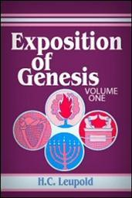
H.C. Leupold
Exposition of Genesis (Grand Rapids: Baker, 1942), vol. 1, p. 301-302.
“… ‘all the high mountains under all the heavens.’ One of these expressions alone would almost necessitate the impression that the author intends to convey the idea of the absolute universality of the Flood…Yet since ‘all’ is known to be used in a relative sense, the writer removes all ambiguity by adding the phrase ‘under all the heavens.’ A double ‘all’ (kol) cannot allow for so relative a sense. It almost constitutes a Hebrew superlative. So we believe that the text disposes of the question of the universality of the flood. By way of objection to this interpretation, those who believe in a limited flood…urge the . . .

Slide 143
H.C. Leupold
Exposition of Genesis (Grand Rapids: Baker, 1942), vol. 1, p. 301-302.
. . . fact that kol is used in a relative sense, as is clearly the case in passages such as Genesis 41:57; Exodus 9:25, 10:15; Deuteronomy 2:25; and 1 Kings 10:24. However, we still insist that this fact could overthrow a single kol, never a double kol, as our verse has it.”

Slide 144

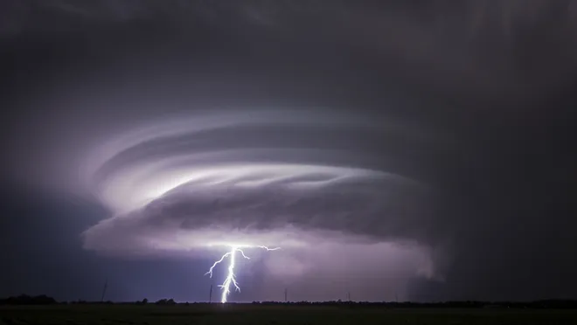
Exodus 9:24 (NIV)
“…It was the worst storm in all the land of Egypt since it had become a nation.”

Slide 145
Genesis 41:56
Selling of the Grain
      Statement of fact (56a)
      Joseph responds (56b)
      Joseph responds (56c)

Slide 146
Genesis 41:56
Selling of the Grain
      Statement of fact (56a)
      Joseph responds (56b)
      Joseph responds (56c)

Slide 147
VI. Genesis 41:46b-57
Joseph’s Activities
    Joseph exercises his authority (46b)
    7 years of plenty (47-49)
    Joseph’s family (50-52)
    7 years of famine (53-54)
    Egyptians’ response (55-56)
    Foreigners’ response (57)

Slide 148
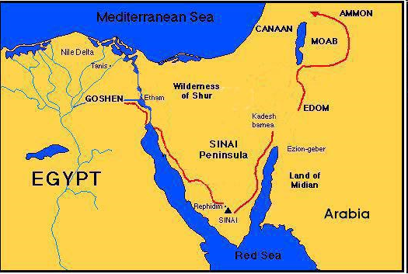

Slide 149
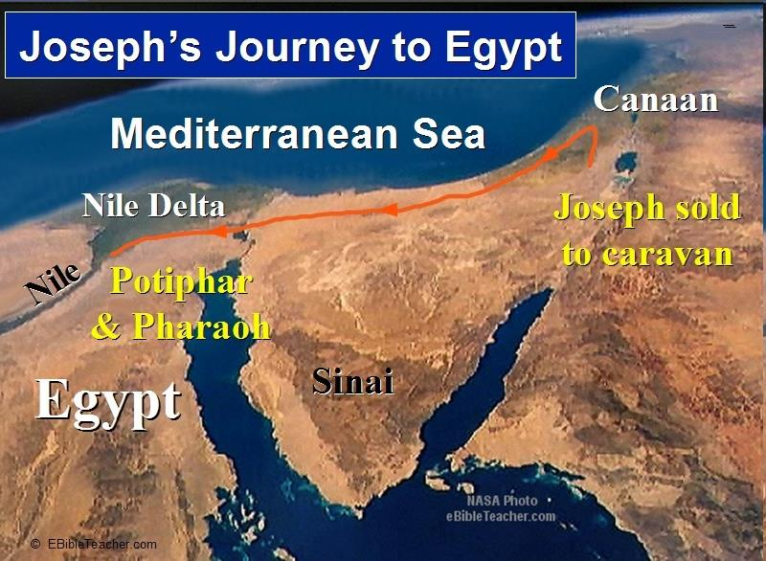

Slide 151
Conclusion

Slide 152
Genesis 41:1-57
Joseph Before Pharoah
  Pharoah’s 2 dreams (41:1-8)
  Butler’s report (41:9-13)
  Joseph before Pharoah (41:14-24)
  Joseph’s interpretation & advice (41:25-36)
  Joseph’s elevation (41:37-46a)
  Joseph’s activities (41:46b-57)

Slide 153
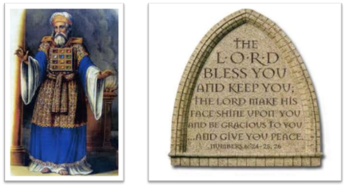
²⁴ The Lord bless you, and keep you; ²⁵ The Lord make His face shine on you, And be gracious to you; ²⁶ The Lord lift up His countenance on you, And give you peace.
Numbers 6:24–26 (NASB95)

