Slide 1
Dr. Andy Woods
Senior Pastor – Sugar Land Bible Church
President – Chafer Theological Seminary

Slide 2
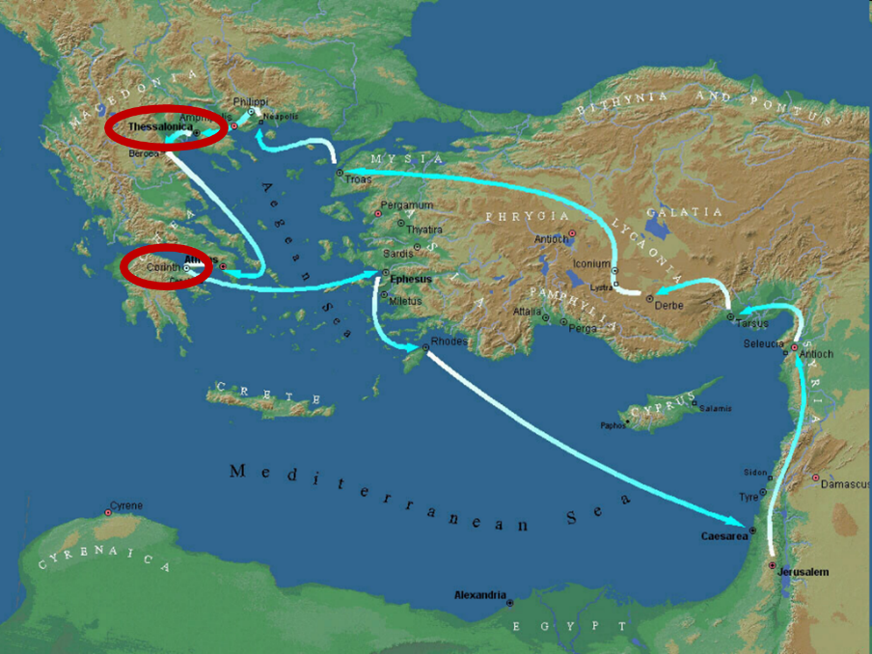

Slide 3
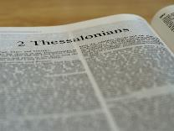
2 Thessalonians 2:1-12
Problem (2:1-2)
Prerequisites for the Day of the Lord (2:3-12)
The departure (2:3a)
Advent of the lawless one (2:3b-4)
Removal of the restrainer (2:5-7)
Destruction of the lawless one (2:8-9)
Destruction of lawless one’s followers (2:10-12)

Slide 4
2 Thessalonians 2:2
“that you not be quickly shaken from your composure or be disturbed either by a spirit or a message or a letter as if from us, to the effect that the day of the Lord [the Tribulation] has come.”

Slide 5
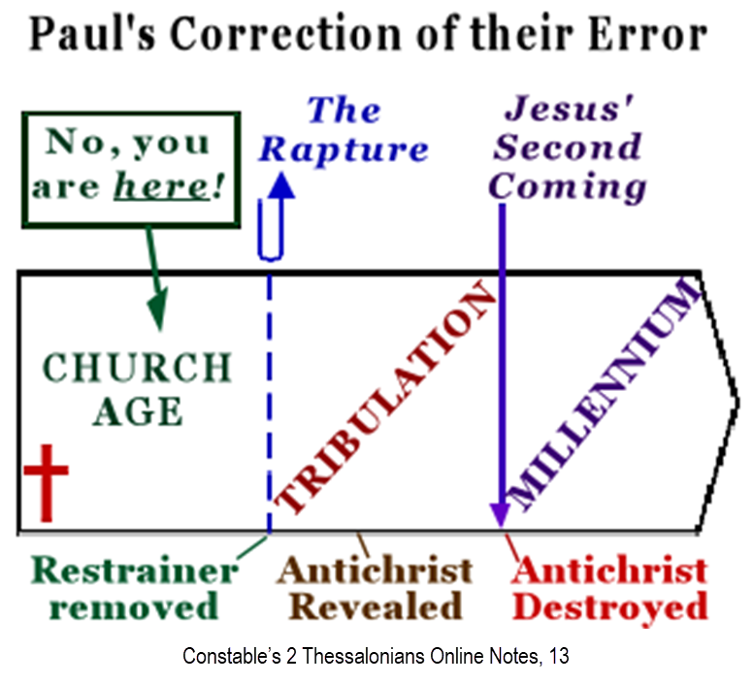

Slide 7
2 Thessalonians 2:1-12
Problem (2:1-2)
Prerequisites for the Day of the Lord (2:3-12)
The departure (2:3a)
Advent of the lawless one (2:3b-4)
Removal of the restrainer (2:5-7)
Destruction of the lawless one (2:8-9)
Destruction of lawless one’s followers (2:10-12)

Slide 8
Contrasting Destiny of the Righteous (2:13-17)
Thanksgiving for their calling (2:13-14)
Exhortation to stand firm (2:15)
Prayer for strength (2:16-17)

Slide 9
2 Thessalonians 2:2
“that you not be quickly shaken from your composure or be disturbed either by a spirit or a message or a letter as if from us, to the effect that the day of the Lord [the Tribulation] has come.”

Slide 10
Ephesians 4:11-16
“¹¹ And He gave some as apostles, and some as prophets, and some as evangelists, and some as pastors and teachers, ¹² for the equipping of the saints for the work of service, to the building up of the body of Christ; ¹³ until we all attain to the unity of the faith, and of the knowledge of the Son of God, to a mature man, to the measure of the stature which belongs to the fullness of Christ. ¹⁴ As a result, we are no longer to be children, tossed here and there by. . .

Slide 11
Ephesians 4:11-16
“. . . waves and carried about by every wind of doctrine, by the trickery of men, by craftiness in deceitful scheming; ¹⁵ but speaking the truth in love, we are to grow up in all aspects into Him who is the head, even Christ, ¹⁶ from whom the whole body, being fitted and held together by what every joint supplies, according to the proper working of each individual part, causes the growth of the body for the building up of itself in love.”

Slide 12
Mark 7:13
“thus invalidating the word of God by your tradition which you have handed down; and you do many things such as that.”

Slide 13
Contrasting Destiny of the Righteous (2:13-17)
Thanksgiving for their calling (2:13-14)
Exhortation to stand firm (2:15)
Prayer for strength (2:16-17)

Slide 14
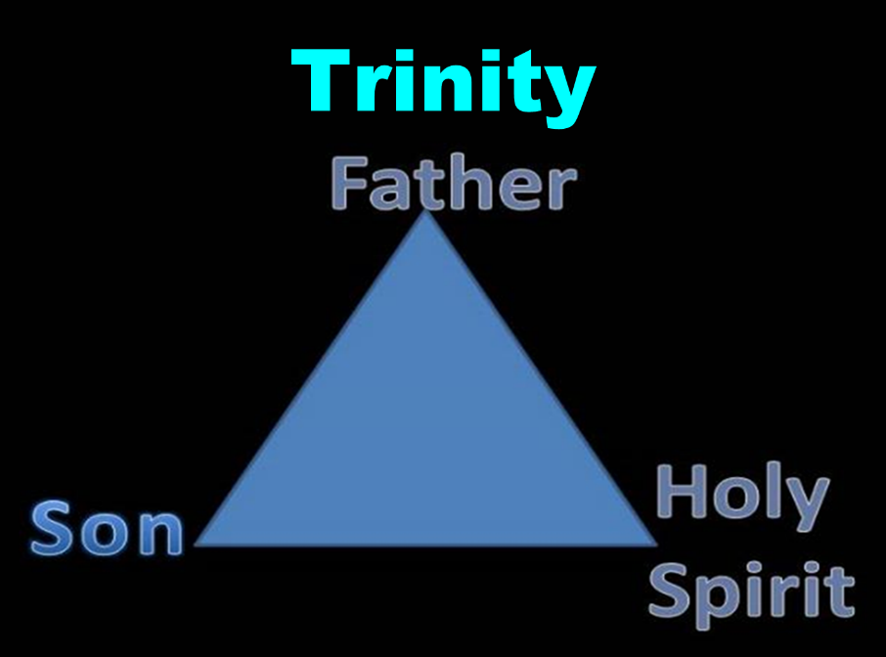

Slide 15
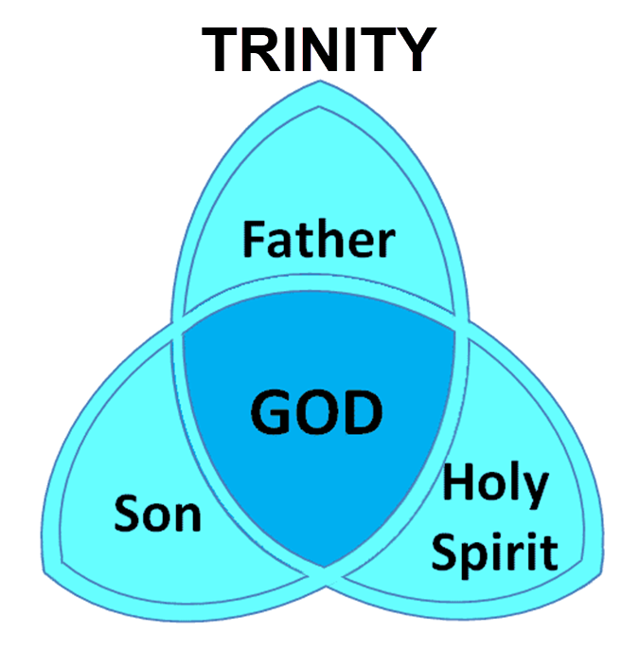

Slide 16
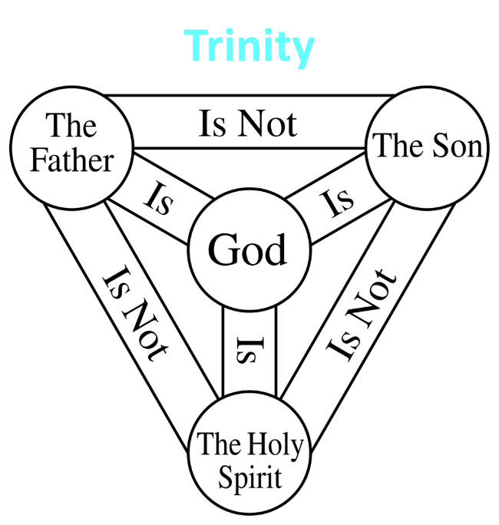

Slide 17
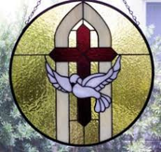
John 14:16-17
¹⁶ I will ask the Father, and He will give you another Helper, that He may be with you forever; ¹⁷ that is the Spirit of truth, whom the world cannot receive, because it does not see Him or know Him, but you know Him because He abides with you and will be in you.

Slide 18
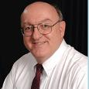
Definition of Eternal Security
“The new birth has given every believer the confident assurance of God’s certain and future blessings. The word ‘hope’ in the Bible does not involve anxious wishing or uncertainty; rather it means a confident assurance of something yet future. Unlike the empty and false hopes of this world-system, God has given believers a ‘living hope’ of guaranteed future blessings ‘by the resurrection of Jesus Christ from the dead’…”
Dennis Rokser, Shall Never Perish Forever, p. 53

Slide 19
2 Thessalonians 2:2
“that you not be quickly shaken from your composure or be disturbed either by a spirit or a message or a letter as if from us, to the effect that the day of the Lord [the Tribulation] has come.”

Slide 20
Structure
1 – Commendation
2 – Correction
3 – Consequences

Slide 21
Consequences of Poor Doctrine (3)
Reciprocal prayer (3:1-5)
Exhortation to discipline the idle (3:6-15)
Conclusion (3:16-18)

Slide 22
Consequences of Poor Doctrine (3)
Reciprocal prayer (3:1-5)
Exhortation to discipline the idle (3:6-15)
Conclusion (3:16-18)

Slide 23
Consequences of Poor Doctrine (3)
Reciprocal prayer (3:1-5)
Exhortation to discipline the idle (3:6-15)
Conclusion (3:16-18)

Slide 24
Consequences of Poor Doctrine (3)
Reciprocal prayer (3:1-5)
Exhortation to discipline the idle (3:6-15)
Conclusion (3:16-18)

Slide 25
Conclusion

Slide 26
Contrasting Destiny of the Righteous (2:13-17)
Thanksgiving for their calling (2:13-14)
Exhortation to stand firm (2:15)
Prayer for strength (2:16-17)

