Slide 1
Genesis 12‒50
Israel’s Birth & Preservation

Slide 2
GENESIS STRUCTURE
Genesis 12-50 (four people)
Abraham (12:1–25:11)
Isaac (25:12–26:35)
Jacob (27–36)
Joseph (37–50)

Slide 3
Genesis 37:2-36 Joseph Sold unto Egypt
Joseph’s coat (37:2-4)
Joseph’s dreams (37:5-11)
Joseph’s pit (37:12-24)
Joseph’s enslavement (37:25-36)

Slide 4
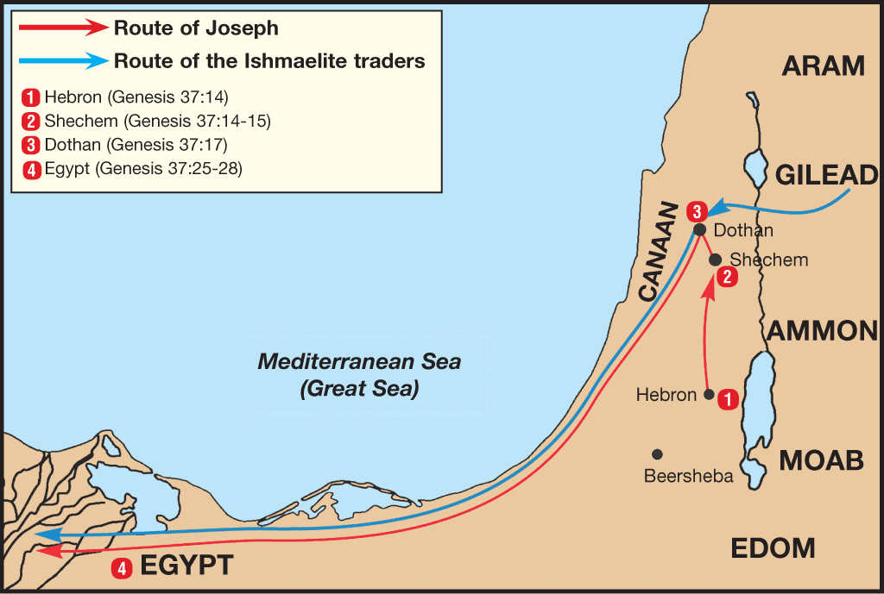

Slide 5
Genesis 38:1-30 Judah & Tamar
Tamar & Judah’s sons (38:1-11)
Tamar & Judah (38:12-26)
Tamar & Judah’s twins (38:27-30)

Slide 6
Genesis 39:1-23 Joseph in Potiphar's House
Blessing (39:1-6)
Temptation & Accusation (39:7-18)
Prison (39:19-23)

Slide 7
Genesis 40:1-23 Joseph in Prison
Imprisonment (40:1-8)
Butler’s dream (40:9-15)
Baker’s dream (40:16-19)
Fulfillment of the dreams (40:20-23)

Slide 8
Genesis 41:1-57 Joseph Before Pharoah
Pharoah’s 2 dreams (41:1-8)
Butler’s report (41:9-13)
Joseph before Pharoah (41:14-24)
Joseph’s interpretation & advice (41:25-36)
Joseph’s elevation (41:37-46a)
Joseph’s activities (41:46b-57)

Slide 9
Genesis 41:1-57 Joseph Before Pharoah
Pharoah’s 2 dreams (41:1-8)
Butler’s report (41:9-13)
Joseph before Pharoah (41:14-24)
Joseph’s interpretation & advice (41:25-36)
Joseph’s elevation (41:37-46a)
Joseph’s activities (41:46b-57)

Slide 10
I. Genesis 41:1-8 Pharoah’s 2 Dreams
First dream (1-4)
Second dream (5-7)
Pharoah’s response (8)

Slide 11
Genesis 41:1-57 Joseph Before Pharoah
Pharoah’s 2 dreams (41:1-8)
Butler’s report (41:9-13)
Joseph before Pharoah (41:14-24)
Joseph’s interpretation & advice (41:25-36)
Joseph’s elevation (41:37-46a)
Joseph’s activities (41:46b-57)

Slide 12
II. Genesis 41:9-13 Butler’s Report
Admission of fault (9)
Prison experience (10-13)

Slide 13
II. Genesis 41:9-13 Butler’s Report
Admission of fault (9)
Prison experience (10-13)

Slide 14
II. Genesis 41:9-13 Butler’s Report
Admission of fault (9)
Prison experience (10-13)

Slide 15
Genesis 41:10-13 Prison Experience
Imprisonment (10)
Dreams (11)
Joseph’s interpretations (12)
Fulfillment (13)

Slide 16
Genesis 41:10-13 Prison Experience
Imprisonment (10)
Dreams (11)
Joseph’s interpretations (12)
Fulfillment (13)

Slide 17
Genesis 41:10-13 Prison Experience
Imprisonment (10)
Dreams (11)
Joseph’s interpretations (12)
Fulfillment (13)

Slide 18
Genesis 41:10-13 Prison Experience
Imprisonment (10)
Dreams (11)
Joseph’s interpretations (12)
Fulfillment (13)

Slide 19
Genesis 41:10-13 Prison Experience
Imprisonment (10)
Dreams (11)
Joseph’s interpretations (12)
Fulfillment (13)

Slide 20
Genesis 41:13 Fulfillment
Butler (13a)
Baker (13b)

Slide 21
Genesis 41:13 Fulfillment
Butler (13a)
Baker (13b)

Slide 22
Genesis 41:13 Fulfillment
Butler (13a)
Baker (13b)

Slide 23
Genesis 41:1-57 Joseph Before Pharoah
Pharoah’s 2 dreams (41:1-8)
Butler’s report (41:9-13)
Joseph before Pharoah (41:14-24)
Joseph’s interpretation & advice (41:25-36)
Joseph’s elevation (41:37-46a)
Joseph’s activities (41:46b-57)

Slide 24
III. Genesis 41:14-24 Joseph Before Pharoah
Joseph before Pharoah (14-16)
First dream (17-21)
Second dream (22-24a)
Pharoah’s conclusion (24b)

Slide 25
III. Genesis 41:14-24 Joseph Before Pharoah
Joseph before Pharoah (14-16)
First dream (17-21)
Second dream (22-24a)
Pharoah’s conclusion (24b)

Slide 26
Genesis 41:14-16 Joseph Before Pharoah
Removal from prison (14)
Pharoah’s request (15)
Joseph’s response (16)

Slide 27
Genesis 41:14-16 Joseph Before Pharoah
Removal from prison (14)
Pharoah’s request (15)
Joseph’s response (16)

Slide 28
Genesis 41:14 Removal from Prison
Removal (14a)
Shaving (14b)
Clothing (14c)

Slide 29
Genesis 41:14 Removal from Prison
Removal (14a)
Shaving (14b)
Clothing (14c)

Slide 30
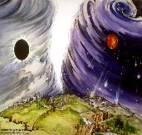
Chronological vs. Adverbial Use of Tacos
“I hope to come to you soon” (1 Tim 3:14) vs. “Leave Jerusalem quickly” (Acts 22:18)
LXX
Isaiah 13:22: “Her fateful time also will soon come”
Isaiah 51:5: “My righteous is near, My salvation has gone forth, And my arms will judge the peoples; The coastlands will wait upon me, And on My arms they will trust.”
Thomas Ice, End Times Controversy, pp.102-108

Slide 31
Preterism Advocates
Recent Preterist Commentators
R.C. Sproul
N.T. Wright
Scott Hahn
J. Massyngbaerde Ford
David Chilton
Hank Hanegraaff
Kenneth Gentry

Slide 32
Genesis 41:14 Removal from Prison
Removal (14a)
Shaving (14b)
Clothing (14c)

Slide 33
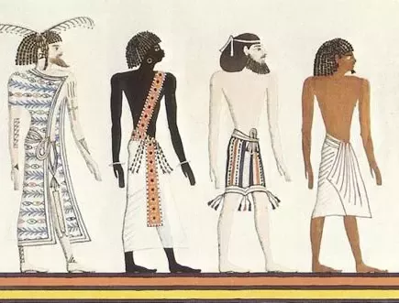
Dr. Arnold G. Fruchtenbaum
The Book of Genesis, 563-64
“Furthermore: and he shaved himself, since Egyptians did not approve of beards. In the Egyptian paintings, Semites are pictured as having beards while the Egyptians are clean shaven.”

Slide 34
Genesis 41:14 Removal from Prison
Removal (14a)
Shaving (14b)
Clothing (14c)

Slide 35
Genesis 41:14-16 Joseph Before Pharoah
Removal from prison (14)
Pharoah’s request (15)
Joseph’s response (16)

Slide 36
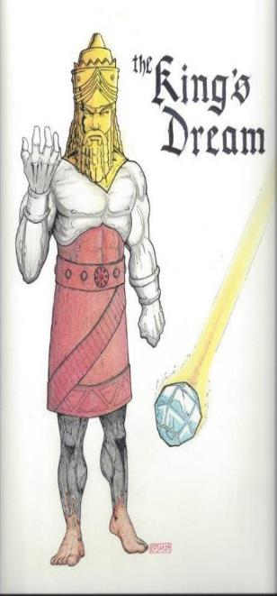
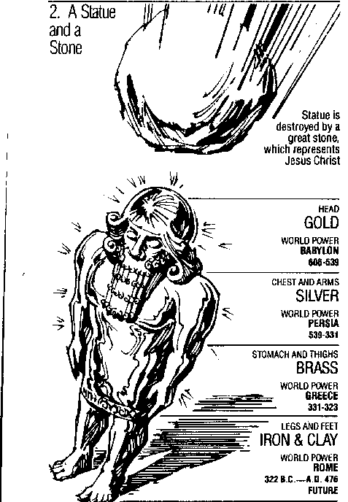
Statue
&
Stone

Slide 37
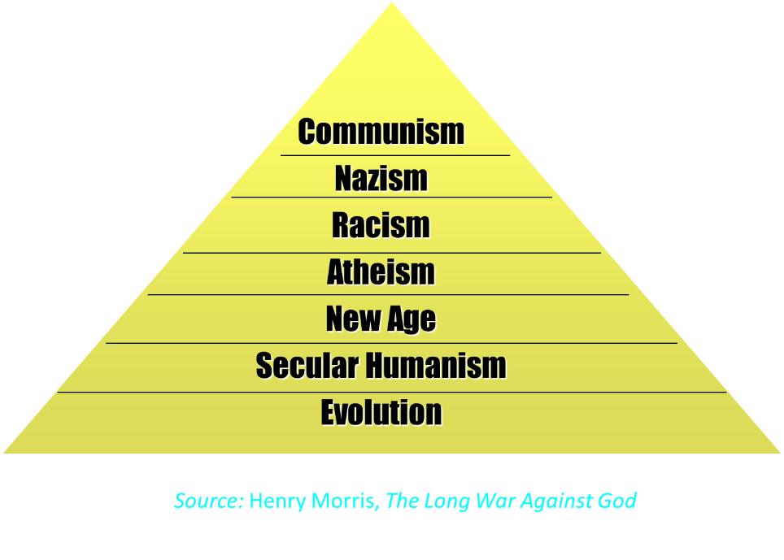

Slide 38
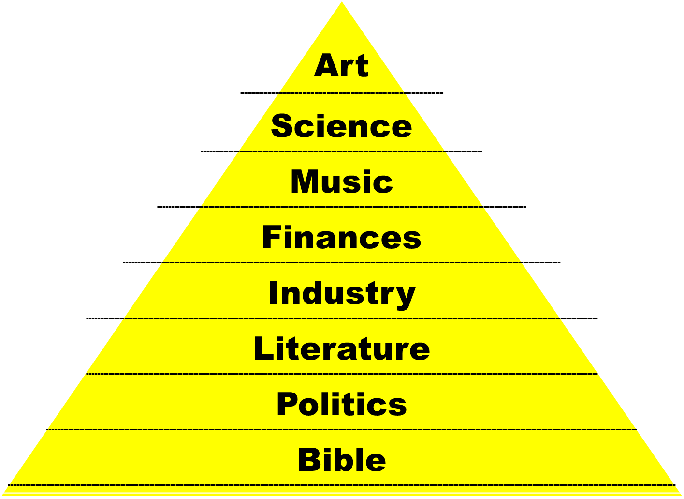

Slide 39
Genesis 41:14-16 Joseph Before Pharoah
Removal from prison (14)
Pharoah’s request (15)
Joseph’s response (16)

Slide 40
Revelation 19:10
“Then I fell at his feet to worship him. But he said to me, ‘Do not do that; I am a fellow servant of yours and your brethren who hold the testimony of Jesus; worship God. For the testimony of Jesus is the spirit of prophecy.’”

Slide 41
III. Genesis 41:14-24 Joseph Before Pharoah
Joseph before Pharoah (14-16)
First dream (17-21)
Second dream (22-24a)
Pharoah’s conclusion (24b)

Slide 42
Genesis 41:17-21 First Dream
Pharoah’s position (17)
Fat cows (18)
Thin cows (19)
Eating (20)
Result (21)

Slide 43
Genesis 41:17-21 First Dream
Pharoah’s position (17)
Fat cows (18)
Thin cows (19)
Eating (20)
Result (21)

Slide 44
Statue
&
Stone

Slide 45
Dr. Arnold G. Fruchtenbaum
The Book of Genesis, 566
“The reason was: for it shall be very grievous. This explains why in the dream, the position of the Pharaoh was by the Nile. The Nile was the lifeline of Egypt since Egypt virtually has no rainfall throughout the entire year. Egypt is dependent upon the periodic flooding of the Nile to moisten the land and the plantings. The Nile will flow in abundance for the first seven years but will recede into inadequacy for the second seven years. That would be the nature of a famine in the land of Egypt: not the withholding of rain, but failure of the Nile to flood.”

Slide 46
The Plagues of Egypt
NO. | DESCRIPTION | SCRIPTURE | Egyptian Deity
1. | Water to Blood | Exod. 7:14-25 | Hapi, Khnum
2. | Frogs | Exod. 8:1-15 | Heqt
3. | Gnats | Exod. 8:16-19 | Set
4. | Flies | Exod. 8:20-32 | Uatchit
5. | Disease on Cattle | Exod. 9:1-7 | Hathor, Apis
6. | Boils | Exod. 9:8-12 | Sekhmet, Serapis
7. | Hail | Exod. 9:13-35 | Seth, Nut
8. | Locusts | Exod. 10:1-20 | Seth, Nut, Osiris
9. | Darkness | Exod. 10:21-29 | Re, Horus, Atum
10. | Death of the First Born | Exod. 12:29-36 | Min, Osiris, Heqt, Isis

Slide 47
Genesis 41:17-21 First Dream
Pharoah’s position (17)
Fat cows (18)
Thin cows (19)
Eating (20)
Result (21)

Slide 48
Genesis 41:17-21 First Dream
Pharoah’s position (17)
Fat cows (18)
Thin cows (19)
Eating (20)
Result (21)

Slide 49
Genesis 41:17-21 First Dream
Pharoah’s position (17)
Fat cows (18)
Thin cows (19)
Eating (20)
Result (21)

Slide 50
Genesis 41:17-21 First Dream
Pharoah’s position (17)
Fat cows (18)
Thin cows (19)
Eating (20)
Result (21)

Slide 51
Statue
&
Stone

Slide 52
III. Genesis 41:14-24 Joseph Before Pharoah
Joseph before Pharoah (14-16)
First dream (17-21)
Second dream (22-24a)
Pharoah’s conclusion (24b)

Slide 53
Genesis 41:22-24a Second Dream
Fat stalks (22)
Thin stalks (23)
Eating (24a)

Slide 54
Genesis 41:22-24a Second Dream
Fat stalks (22)
Thin stalks (23)
Eating (24a)

Slide 55
Genesis 41:22-24a Second Dream
Fat stalks (22)
Thin stalks (23)
Eating (24a)

Slide 56
Genesis 41:22-24a Second Dream
Fat stalks (22)
Thin stalks (23)
Eating (24a)

Slide 57
III. Genesis 41:14-24 Joseph Before Pharoah
Joseph before Pharoah (14-16)
First dream (17-21)
Second dream (22-24a)
Pharoah’s conclusion (24b)

Slide 60
Statue
&
Stone

Slide 61
Genesis 41:1-57 Joseph Before Pharoah
Pharoah’s 2 dreams (41:1-8)
Butler’s report (41:9-13)
Joseph before Pharoah (41:14-24)
Joseph’s interpretation & advice (41:25-36)
Joseph’s elevation (41:37-46a)
Joseph’s activities (41:46b-57)

Slide 62
IV. Genesis 41:25-36 Joseph’s Interpretation & Advice
Joseph’s interpretation (25-32)
Joseph’s advice (33-36)

Slide 63
IV. Genesis 41:25-36 Joseph’s Interpretation & Advice
Joseph’s interpretation (25-32)
Joseph’s advice (33-36)

Slide 64
Genesis 41:25-32 Joseph’s Interpretation
Introduction (25)
Interpretation (26-27)
More detailed information (28-32)

Slide 65
Genesis 41:25-32 Joseph’s Interpretation
Introduction (25)
Interpretation (26-27)
More detailed information (28-32)

Slide 66
Genesis 41:25-32 Joseph’s Interpretation
Introduction (25)
Interpretation (26-27)
More detailed information (28-32)

Slide 67
Genesis 41:26-27 Interpretation
Fat objects (26)
Thin objects (27)

Slide 68
Genesis 41:26-27 Interpretation
Fat objects (26)
Thin objects (27)

Slide 69
Genesis 41:26-27 Interpretation
Fat objects (26)
Thin objects (27)

Slide 70
Genesis 41:25-32 Joseph’s Interpretation
Introduction (25)
Interpretation (26-27)
More detailed information (28-32)

Slide 71
Genesis 41:28-32 Interpretation
God’s revelation to Pharoah (28)
7 years of plenty (29)
7 years of famine (30-31)
God’s decree (32)

Slide 72
Genesis 41:28-32 Interpretation
God’s revelation to Pharoah (28)
7 years of plenty (29)
7 years of famine (30-31)
God’s decree (32)

Slide 73
Statue
&
Stone

Slide 74
Genesis 41:28-32 Interpretation
God’s revelation to Pharoah (28)
7 years of plenty (29)
7 years of famine (30-31)
God’s decree (32)

Slide 75
Genesis 41:28-32 Interpretation
God’s revelation to Pharoah (28)
7 years of plenty (29)
7 years of famine (30-31)
God’s decree (32)

Slide 76
Dr. Arnold G. Fruchtenbaum
The Book of Genesis, 566-67
“Seven-year famines are recorded in Egyptian documents. For example, there is the text from the reign and rule of King Djoser of the Third Dynasty (2700 B.C.): ‘I was in distress on the Great Throne, and those who are in the palace where in the heart’s affliction from a very great evil, since the Nile had not come in my time for a space of seven years. Grain was scant, fruits were dried up, and everything which they ate was short. Every man robbed his companion. They moved without going (ahead). The infant was wailing; the youth was waiting; the heart of the old men was in sorrow; their legs were bent, crouching on the . . .

Slide 77
Dr. Arnold G. Fruchtenbaum
The Book of Genesis, 566-67
…ground, their arms were folded.’ So, seven-year famines are not something merely recorded in Scripture but also in Egyptian documents. This famine would affect indeed the gods of Egypt. For example, it would affect Osiris, a god who had the form of a bull was the god of the Nile. It would also affect Isis, also known as Hathor, who was a goddess in the form of a cow; and she was the goddess of fertility.”

Slide 78
Genesis 41:28-32 Interpretation
God’s revelation to Pharoah (28)
7 years of plenty (29)
7 years of famine (30-31)
God’s decree (32)

Slide 79
IV. Genesis 41:25-36 Joseph’s Interpretation & Advice
Joseph’s interpretation (25-32)
Joseph’s advice (33-36)

Slide 80
Genesis 41:33-36 Joseph’s Advice
Appoint an economic leader (33)
Appoint stewards (34)
Storing (35)
Purpose (36)

Slide 81
Genesis 41:33-36 Joseph’s Advice
Appoint an economic leader (33)
Appoint stewards (34)
Storing (35)
Purpose (36)

Slide 82
Genesis 41:33-36 Joseph’s Advice
Appoint an economic leader (33)
Appoint stewards (34)
Storing (35)
Purpose (36)

Slide 83
Genesis 41:33-36 Joseph’s Advice
Appoint an economic leader (33)
Appoint stewards (34)
Storing (35)
Purpose (36)

Slide 84
Genesis 41:33-36 Joseph’s Advice
Appoint an economic leader (33)
Appoint stewards (34)
Storing (35)
Purpose (36)

Slide 85
Genesis 41:1-57 Joseph Before Pharoah
Pharoah’s 2 dreams (41:1-8)
Butler’s report (41:9-13)
Joseph before Pharoah (41:14-24)
Joseph’s interpretation & advice (41:25-36)
Joseph’s elevation (41:37-46a)
Joseph’s activities (41:46b-57)

Slide 86
V. Genesis 41:37-46a Joseph’s Elevation
Joseph’s response (37-38)
Joseph’s appointment (39-44)
Joseph’s settlement (45-46a)

Slide 87
V. Genesis 41:37-46a Joseph’s Elevation
Joseph’s response (37-38)
Joseph’s appointment (39-44)
Joseph’s settlement (45-46a)

Slide 88
Genesis 41:37-38 Joseph’s Response
Reaction (37)
Rhetorical question (38)

Slide 89
Genesis 41:37-38 Joseph’s Response
Reaction (37)
Rhetorical question (38)

Slide 90
Genesis 41:37-38 Joseph’s Response
Reaction (37)
Rhetorical question (38)

Slide 91
V. Genesis 41:37-46a Joseph’s Elevation
Joseph’s response (37-38)
Joseph’s appointment (39-44)
Joseph’s settlement (45-46a)

Slide 92
Genesis 41:39-44 Joseph’s Appointment
Appointment (39-40)
Extent of authority (41)
Royal garb (42)
Royal chariot (43a)
Royal honor (43b)
Decree of authority (44)

Slide 93
Genesis 41:39-44 Joseph’s Appointment
Appointment (39-40)
Extent of authority (41)
Royal garb (42)
Royal chariot (43a)
Royal honor (43b)
Decree of authority (44)

Slide 94
Genesis 41:39-40 Appointment
Joseph’s abilities (39)
Appointment details (40)

Slide 95
Genesis 41:39-40 Appointment
Joseph’s abilities (39)
Appointment details (40)

Slide 96
Genesis 41:39-40 Appointment
Joseph’s abilities (39)
Appointment details (40)

Slide 97
Genesis 40:40 Appointment Details
Positive (40a)
Negative (40b)

Slide 98
Genesis 40:40 Appointment Details
Positive (40a)
Negative (40b)

Slide 99
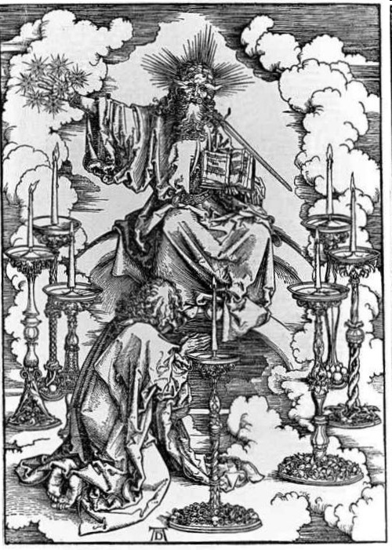
His Body (Rev. 1:14-16)
His hair (14a)
His eyes (14b)
His feet (15a)
His voice (15b)
His right hand (16a)
His mouth (16b)
His face (16c)

Slide 100
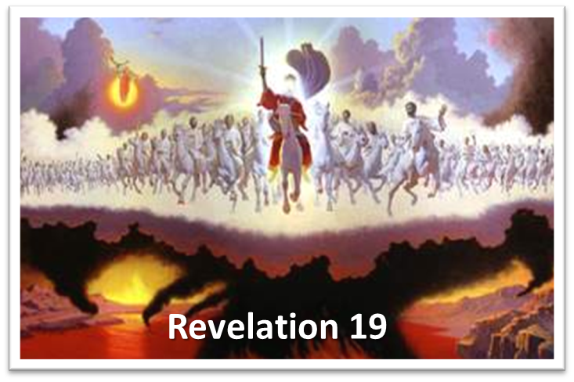
His Activities Revelation 19:15-16
His spoken word (15a)
His smiting of the nations (15b)
His ruling of the nations (15c)
His treading of the winepress (15d)
His rulership as King (16)

Slide 101
Genesis 40:40 Appointment Details
Positive (40a)
Negative (40b)

Slide 102
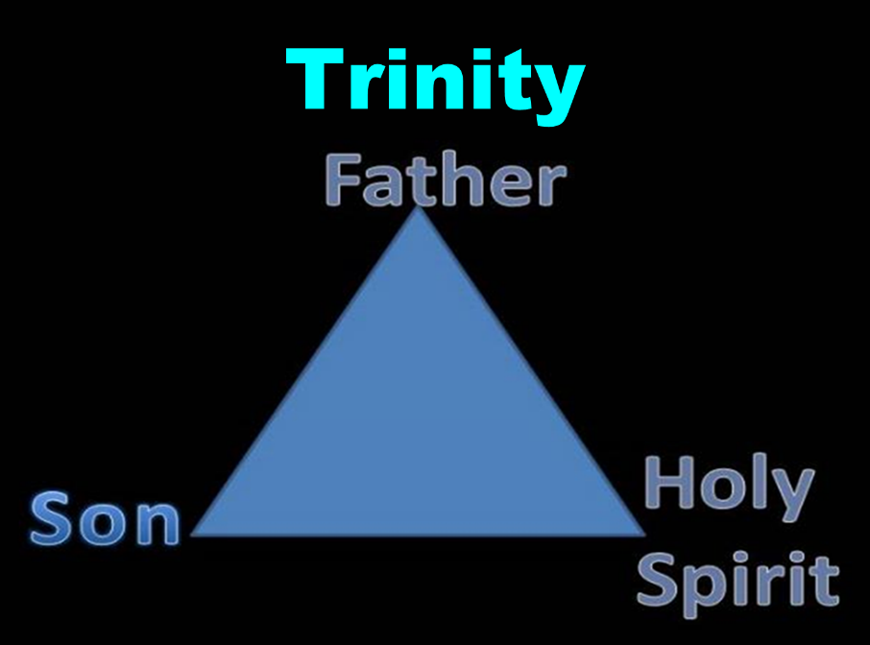

Slide 103
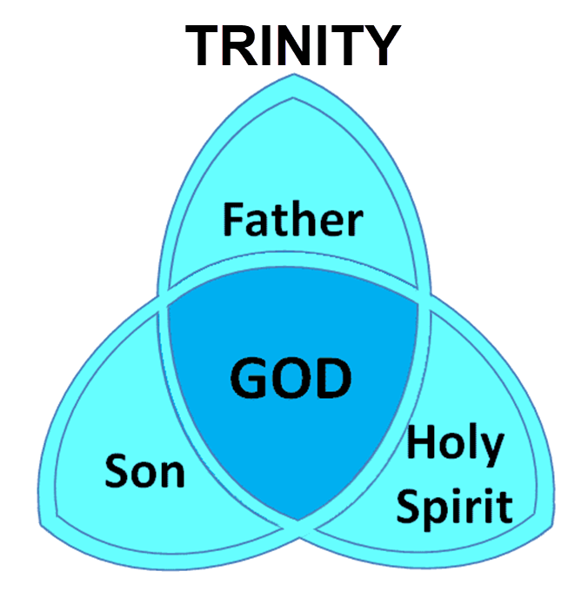

Slide 104
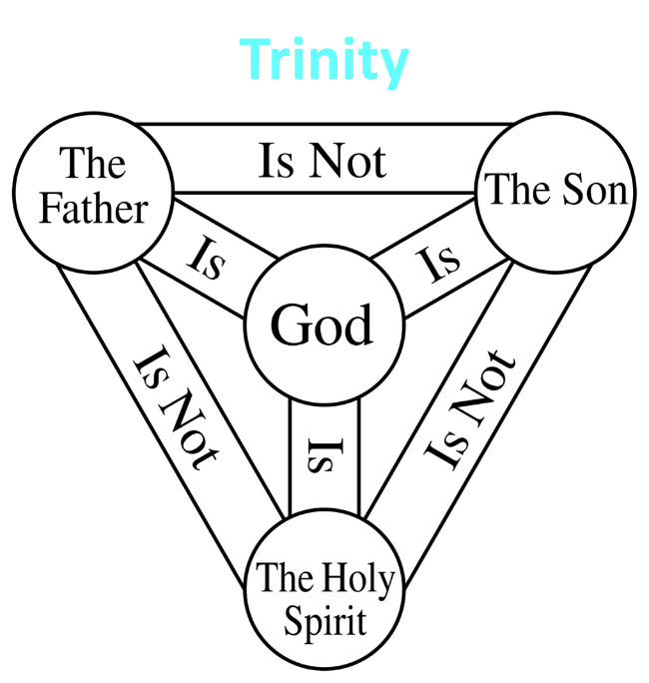

Slide 105
Genesis 41:39-44 Joseph’s Appointment
Appointment (39-40)
Extent of authority (41)
Royal garb (42)
Royal chariot (43a)
Royal honor (43b)
Decree of authority (44)

Slide 106
Dr. Arnold G. Fruchtenbaum
The Book of Genesis, 569
“This was a position of a vizier or a prime minister, and there is a parallel in the records of Thutmose III: ‘Look you to this office of vizier. Be vigilant over everything that is done in it. Behold, it is the support of the entire land.’”

Slide 107
Genesis 41:39-44 Joseph’s Appointment
Appointment (39-40)
Extent of authority (41)
Royal garb (42)
Royal chariot (43a)
Royal honor (43b)
Decree of authority (44)

Slide 108
Genesis 41:42 Royal Garb
Ring (42a)
Clothing (42b)
Chain (42c)

Slide 109
Genesis 41:42 Royal Garb
Ring (42a)
Clothing (42b)
Chain (42c)

Slide 110
Genesis 41:42 Royal Garb
Ring (42a)
Clothing (42b)
Chain (42c)

Slide 111
Dr. Arnold G. Fruchtenbaum
The Book of Genesis, 569
“Second was the clothing: and arrayed him in vestures of fine linen. This, too, is paralleled in the Egyptian accounts. When Rekhmire was appointed vizier, he wrote: ‘I was a noble, the second of the king … It was the first occasion of my being summoned … I went forth … clad in fine linen.’ This was the type of clothing worn by a vizier, a prime minister, someone who was second to the king.”

Slide 112
Genesis 41:42 Royal Garb
Ring (42a)
Clothing (42b)
Chain (42c)

Slide 113
Genesis 41:39-44 Joseph’s Appointment
Appointment (39-40)
Extent of authority (41)
Royal garb (42)
Royal chariot (43a)
Royal honor (43b)
Decree of authority (44)

Slide 114
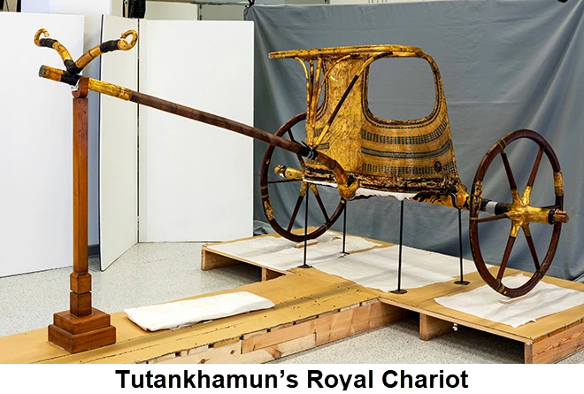
Dr. Arnold G. Fruchtenbaum
The Book of Genesis, 569
“In verse 43a Joseph was given a royal chariot: and he made him to ride in the second chariot which he had; the Hyksos introduced chariots into Egypt.”

Slide 115
Genesis 41:39-44 Joseph’s Appointment
Appointment (39-40)
Extent of authority (41)
Royal garb (42)
Royal chariot (43a)
Royal honor (43b)
Decree of authority (44)

Slide 116
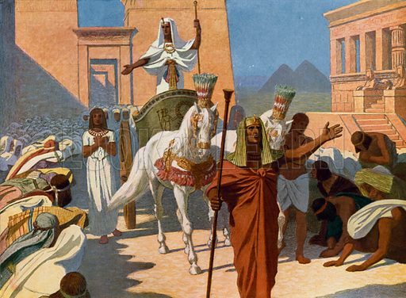
Dr. Arnold G. Fruchtenbaum
The Book of Genesis, 569
“Then, in verse 43b, came the royal honor: and they cried before him, Bow the knee. As Joseph rode in the chariot, heralds were sent out in advance with the command: Bow the knee. This was a practice that is well attested to in Egyptian pictures.”

Slide 117
Genesis 41:39-44 Joseph’s Appointment
Appointment (39-40)
Extent of authority (41)
Royal garb (42)
Royal chariot (43a)
Royal honor (43b)
Decree of authority (44)

Slide 118
V. Genesis 41:37-46a Joseph’s Elevation
Joseph’s response (37-38)
Joseph’s appointment (39-44)
Joseph’s settlement (45-46a)

Slide 119
Genesis 41:45-46a Joseph’s Settlement
Name (45a)
Marriage (45b)
Authority (45c)
Age (46a)

Slide 120
Genesis 41:45-46a Joseph’s Settlement
Name (45a)
Marriage (45b)
Authority (45c)
Age (46a)

Slide 121
Genesis 41:45-46a Joseph’s Settlement
Name (45a)
Marriage (45b)
Authority (45c)
Age (46a)

Slide 122
Genesis 41:45-46a Joseph’s Settlement
Name (45a)
Marriage (45b)
Authority (45c)
Age (46a)

Slide 123
Dr. Arnold G. Fruchtenbaum
The Book of Genesis, 570
“Therefore, a total separation of twenty years existed from the time he had last seen members of his family until they were reunited in Egypt. The Hyksos Period, during which Joseph’s story unfolds, was the two-hundred-year period from 1750 until 1550 B.C. The Hyksos were Semitic rulers that conquered Egypt and ruled during the sixteenth and seventeenth dynasties. Thus, the Pharaoh at the time of Joseph was Semitic. This explains how a Semite such as Joseph could rise to the second highest position in Egypt, which had a Hamitic population.”

Slide 124
GENESIS 10 Outline
Introduction (1)
Japheth's line (2-5)
Ham’s Line (6-20)
Shem’s line (21-31)
Conclusion (32)

Slide 125
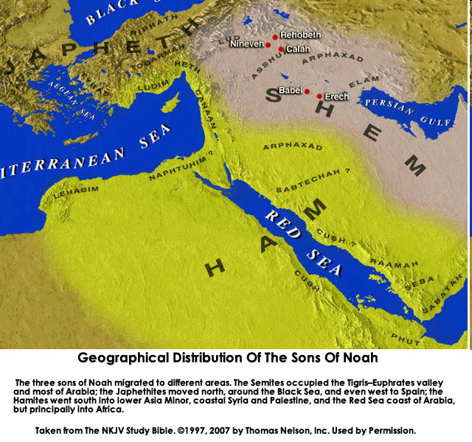

Slide 126
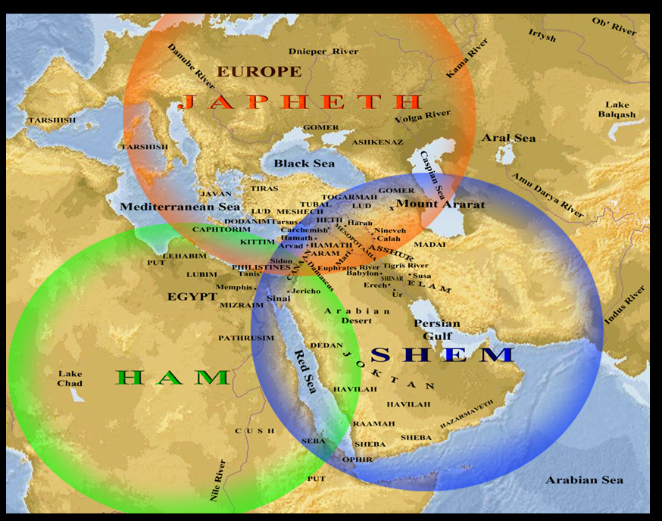

Slide 127
Ham’s Sons (vs. 6)
Cush
Mizraim
Put
Canaan

Slide 128
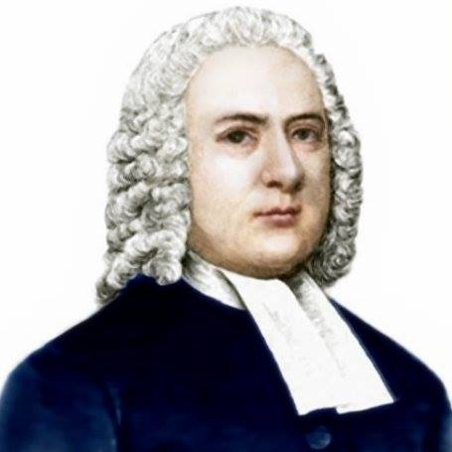
John Gill
Exposition of the Old and New Testaments, 1810
“Mitzraim is a name by which Egypt is frequently called in Scripture, and this man was the father of the Egyptians; and because Egypt was inhabited by a son of Ham, it is sometimes called the land of Ham (Psalm 105:23). The word is of the dual number, and serves to express Egypt, which was divided into two parts, lower and upper Egypt.”

Slide 129
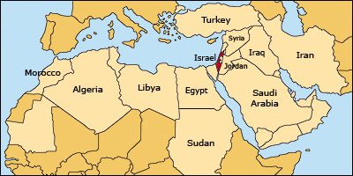

Slide 130
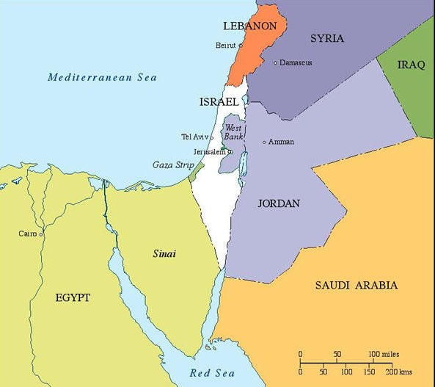

Slide 132
Galatians 4:4
“But when the fullness of the time came, God sent forth His Son, born of a woman, born under the Law.”

Slide 133
Genesis 41:45-46a Joseph’s Settlement
Name (45a)
Marriage (45b)
Authority (45c)
Age (46a)

Slide 134
Genesis 41:1-57 Joseph Before Pharoah
Pharoah’s 2 dreams (41:1-8)
Butler’s report (41:9-13)
Joseph before Pharoah (41:14-24)
Joseph’s interpretation & advice (41:25-36)
Joseph’s elevation (41:37-46a)
Joseph’s activities (41:46b-57)

Slide 135
VI. Genesis 41:46b-57 Joseph’s Activities
Joseph exercises his authority (46b)
7 years of plenty (47-49)
Joseph’s family (50-52)
7 years of famine (53-54)
Egyptians’ response (55-56)
Foreigners’ response (57)

Slide 136
VI. Genesis 41:46b-57 Joseph’s Activities
Joseph exercises his authority (46b)
7 years of plenty (47-49)
Joseph’s family (50-52)
7 years of famine (53-54)
Egyptians’ response (55-56)
Foreigners’ response (57)

Slide 137
VI. Genesis 41:46b-57 Joseph’s Activities
Joseph exercises his authority (46b)
7 years of plenty (47-49)
Joseph’s family (50-52)
7 years of famine (53-54)
Egyptians’ response (55-56)
Foreigners’ response (57)

Slide 138
Genesis 41:47-49 7 Years of Plenty
Abundance of food (47)
Gathering & storing (48)
Record keeping (49)

Slide 139
Genesis 41:47-49 7 Years of Plenty
Abundance of food (47)
Gathering & storing (48)
Record keeping (49)

Slide 140
Genesis 41:47-49 7 Years of Plenty
Abundance of food (47)
Gathering & storing (48)
Record keeping (49)

Slide 141
Genesis 41:47-49 7 Years of Plenty
Abundance of food (47)
Gathering & storing (48)
Record keeping (49)

Slide 142
VI. Genesis 41:46b-57 Joseph’s Activities
Joseph exercises his authority (46b)
7 years of plenty (47-49)
Joseph’s family (50-52)
7 years of famine (53-54)
Egyptians’ response (55-56)
Foreigners’ response (57)

Slide 143
Genesis 41:50-52 Joseph’s Family
Wife-Mother (50)
First son (51)
Second son (52)

Slide 144
Genesis 41:50-52 Joseph’s Family
Wife-Mother (50)
First son (51)
Second son (52)

Slide 145
Genesis 41:50-52 Joseph’s Family
Wife-Mother (50)
First son (51)
Second son (52)

Slide 146
2 Cor. 4:16
¹⁶ Therefore we do not lose heart, but though our outer man is decaying, yet our inner man is being renewed day by day.

Slide 147
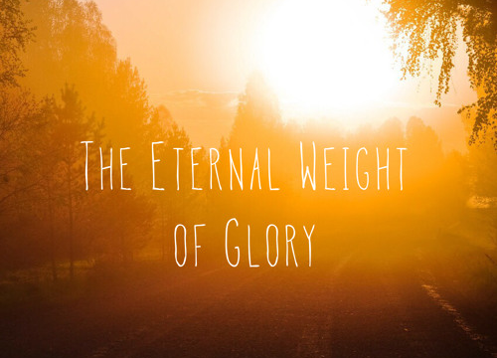
2 Cor. 4:17
¹⁷ For momentary, light affliction is producing for us an eternal weight of glory far beyond all comparison

Slide 148
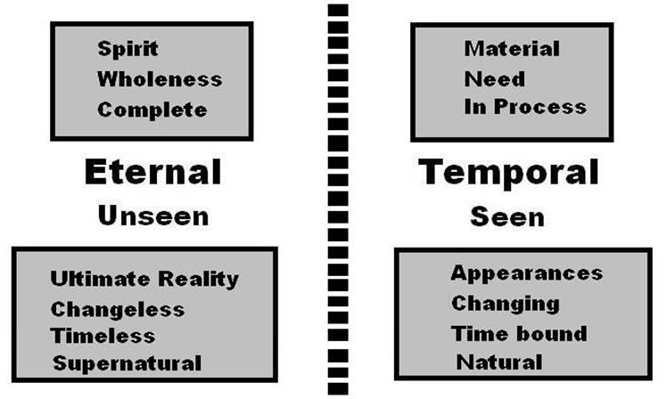
2 Cor. 4:18
¹⁸ while we look not at the things which are seen, but at the things which are not seen; for the things which are seen are temporal, but the things which are not seen are eternal.

Slide 149
Genesis 41:50-52 Joseph’s Family
Wife-Mother (50)
First son (51)
Second son (52)

Slide 150
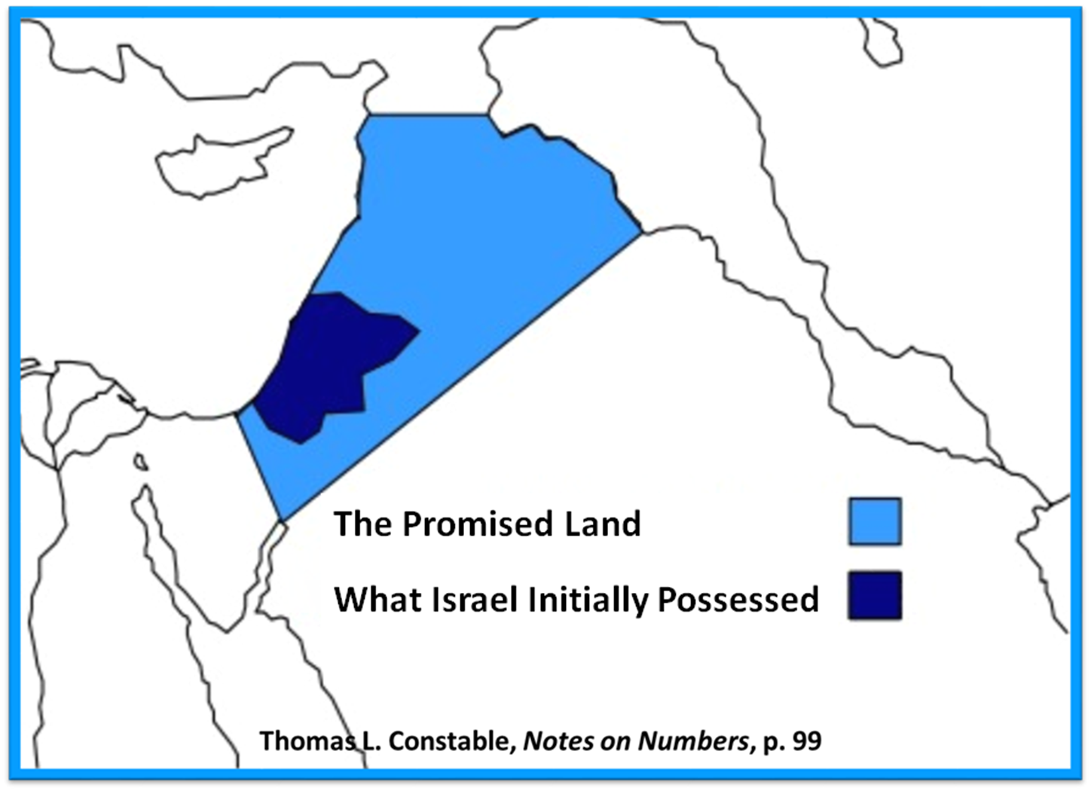

Slide 151
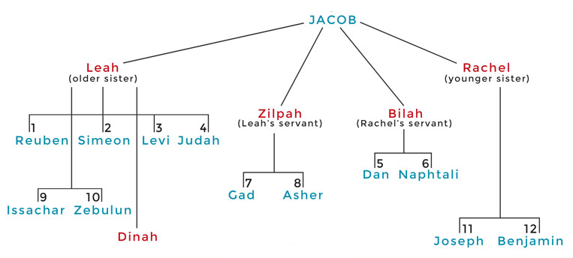

Slide 154
Distinctions Between 144,000 & Multitude
144,000 | MULTITUDE
Revelation 7:1-8 | Revelation 7:9-17
Numbered | Innumerable
Jews | All nations
Sealed | Slain
Sealed before the Tribulation | Converted out of the Tribulation
Hitchcock and Ice, The Truth Behind Left Behind, 77

Slide 155
VI. Genesis 41:46b-57 Joseph’s Activities
Joseph exercises his authority (46b)
7 years of plenty (47-49)
Joseph’s family (50-52)
7 years of famine (53-54)
Egyptians’ response (55-56)
Foreigners’ response (57)

Slide 156
Genesis 41:53-54 7 Years of Famine
End of fat years (53)
Beginning of lean years (54)

Slide 157
Genesis 41:53-54 7 Years of Famine
End of fat years (53)
Beginning of lean years (54)

Slide 158
Genesis 41:53-54 7 Years of Famine
End of fat years (53)
Beginning of lean years (54)

Slide 159
John 13:19; 14:29
“^{13:19} From now on I am telling you before it comes to pass, so that when it does occur, you may believe that I am He… ^{14:29} Now I have told you before it happens, so that when it happens, you may believe.”

Slide 161
VI. Genesis 41:46b-57 Joseph’s Activities
Joseph exercises his authority (46b)
7 years of plenty (47-49)
Joseph’s family (50-52)
7 years of famine (53-54)
Egyptians’ response (55-56)
Foreigners’ response (57)

Slide 162
Genesis 41:55-56 Egyptians’ Response
Pharoah’s command (55)
Selling of the grain (56)

Slide 163
Genesis 41:55-56 Egyptians’ Response
Pharoah’s command (55)
Selling of the grain (56)

Slide 164
Genesis 41:55 Pharoah’s Command
Timing (55a)
Circumstances (55b)
Command (55c)

Slide 165
Genesis 41:55 Pharoah’s Command
Timing (55a)
Circumstances (55b)
Command (55c)

Slide 166
Genesis 41:55 Pharoah’s Command
Timing (55a)
Circumstances (55b)
Command (55c)

Slide 167
Genesis 41:55 Pharoah’s Command
Timing (55a)
Circumstances (55b)
Command (55c)

Slide 168
Genesis 41:55-56 Egyptians’ Response
Pharoah’s command (55)
Selling of the grain (56)

Slide 169
Genesis 41:56 Selling of the Grain
Statement of fact (56a)
Joseph responds (56b)
Joseph responds (56c)

Slide 170
Genesis 41:56 Selling of the Grain
Statement of fact (56a)
Joseph responds (56b)
Joseph responds (56c)

Slide 171
Genesis 7:19-23
They rose greatly on the earth, and all the high mountains under the entire heaven were covered…Every living thing that moved on the earth perished—birds, livestock, wild animals, all the creatures that swarm over the earth, and all mankind. Everything on dry land that had the breath of life in its nostrils died. Every living thing on the face of the earth was wiped out; men and animals and the creatures that move along the ground and the birds of the air were wiped from the earth. Only Noah was left, and those with him in the ark.”

Slide 172
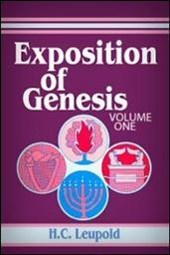
H.C. Leupold
Exposition of Genesis (Grand Rapids: Baker, 1942), vol. 1, p. 301-302.
“… ‘all the high mountains under all the heavens.’ One of these expressions alone would almost necessitate the impression that the author intends to convey the idea of the absolute universality of the Flood…Yet since ‘all’ is known to be used in a relative sense, the writer removes all ambiguity by adding the phrase ‘under all the heavens.’ A double ‘all’ (kol) cannot allow for so relative a sense. It almost constitutes a Hebrew superlative. So we believe that the text disposes of the question of the universality of the flood. By way of objection to this interpretation, those who believe in a limited flood…urge the . . .

Slide 173
H.C. Leupold
Exposition of Genesis (Grand Rapids: Baker, 1942), vol. 1, p. 301-302.
. . . fact that kol is used in a relative sense, as is clearly the case in passages such as Genesis 41:57; Exodus 9:25, 10:15; Deuteronomy 2:25; and 1 Kings 10:24. However, we still insist that this fact could overthrow a single kol, never a double kol, as our verse has it.”

Slide 174
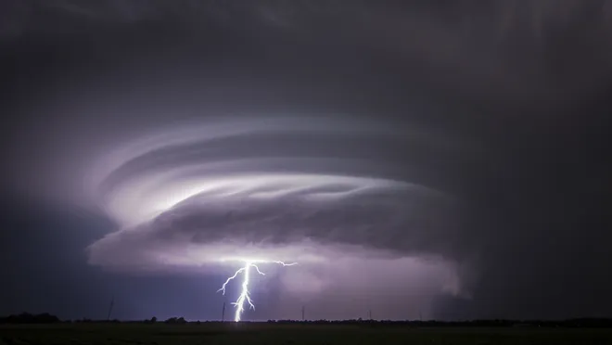
Exodus 9:24 (NIV)
“…It was the worst storm in all the land of Egypt since it had become a nation.”

Slide 175
Genesis 41:56 Selling of the Grain
Statement of fact (56a)
Joseph responds (56b)
Joseph responds (56c)

Slide 176
Genesis 41:56 Selling of the Grain
Statement of fact (56a)
Joseph responds (56b)
Joseph responds (56c)

Slide 177
VI. Genesis 41:46b-57 Joseph’s Activities
Joseph exercises his authority (46b)
7 years of plenty (47-49)
Joseph’s family (50-52)
7 years of famine (53-54)
Egyptians’ response (55-56)
Foreigners’ response (57)

Slide 181
Conclusion

Slide 182
Genesis 41:1-57 Joseph Before Pharoah
Pharoah’s 2 dreams (41:1-8)
Butler’s report (41:9-13)
Joseph before Pharoah (41:14-24)
Joseph’s interpretation & advice (41:25-36)
Joseph’s elevation (41:37-46a)
Joseph’s activities (41:46b-57)

Slide 183
²⁴ The Lord bless you, and keep you; ²⁵ The Lord make His face shine on you, And be gracious to you; ²⁶ The Lord lift up His countenance on you, And give you peace.
Numbers 6:24–26 (NASB95)

