Slide 1
Dr. Andy Woods
Senior Pastor – Sugar Land Bible Church
President – Chafer Theological Seminary

Slide 2
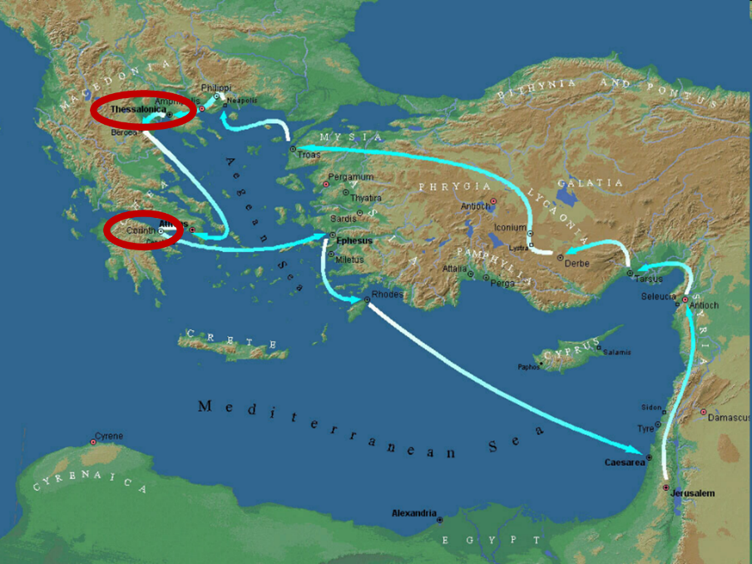

Slide 3
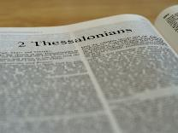
2 Thessalonians 2:1-12
Problem (2:1-2)
Prerequisites for the Day of the Lord (2:3-12)
The departure (2:3a)
Advent of the lawless one (2:3b-4)
Removal of the restrainer (2:5-7)
Destruction of the lawless one (2:8-9)
Destruction of lawless one’s followers (2:10-12)

Slide 4
2 Thessalonians 2:2
“that you not be quickly shaken from your composure or be disturbed either by a spirit or a message or a letter as if from us, to the effect that the day of the Lord [the Tribulation] has come.”

Slide 5
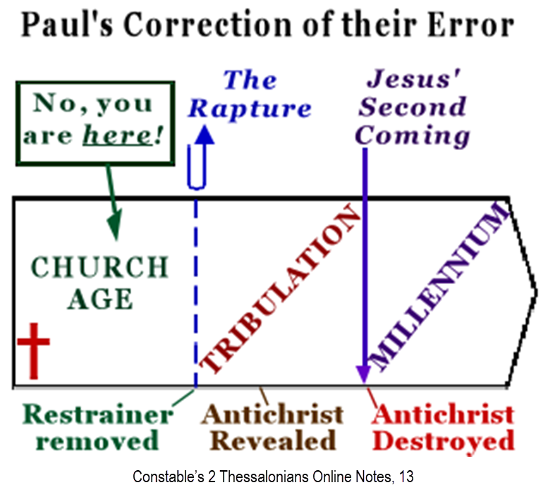

Slide 7
2 Thessalonians 2:1-12
Problem (2:1-2)
Prerequisites for the Day of the Lord (2:3-12)
The departure (2:3a)
Advent of the lawless one (2:3b-4)
Removal of the restrainer (2:5-7)
Destruction of the lawless one (2:8-9)
Destruction of lawless one’s followers (2:10-12)

Slide 8
Contrasting Destiny of the Righteous (2:13-17)
Thanksgiving for their calling (2:13-14)
Exhortation to stand firm (2:15)
Prayer for strength (2:16-17)

Slide 9
Contrasting Destiny of the Righteous (2:13-17)
Thanksgiving for their calling (2:13-14)
Exhortation to stand firm (2:15)
Prayer for strength (2:16-17)

Slide 11
Three Tenses of Salvation
Phase | Justification | Sanctification | Glorification
Tense | Past | Present | Future
Saved from sin’s: | Penalty | Power | Presence
Scripture | Eph 2:8-9; Titus 3:5 | Philip 2:12 | Rom 5:10

Slide 12
2 Peter 1:5-7
⁵ Now for this very reason also, applying all diligence, in your faith supply moral excellence, and in your moral excellence, knowledge, ⁶ and in your knowledge, self-control, and in your self-control, perseverance, and in your perseverance, godliness, ⁷ and in your godliness, brotherly kindness, and in your brotherly kindness, love.

Slide 13
Thomas L. Constable “Notes on 2 Peter,” online: www.soniclight.com, accessed 21 January 2020, 12.
“Unlike other New Testament ethical lists (except Rom. 5:3-5), Peter used a literary device called ‘sorites’ (also called ‘climax’ or gradatio). Sorites (from the Gr. soros, ‘a heap’) is a set of statements that proceed, step by step, to a climactic conclusion through the force of logic or reliance upon a series of indisputable facts. Each new statement picks up the last key word or phrase of the preceding one.”

Slide 14
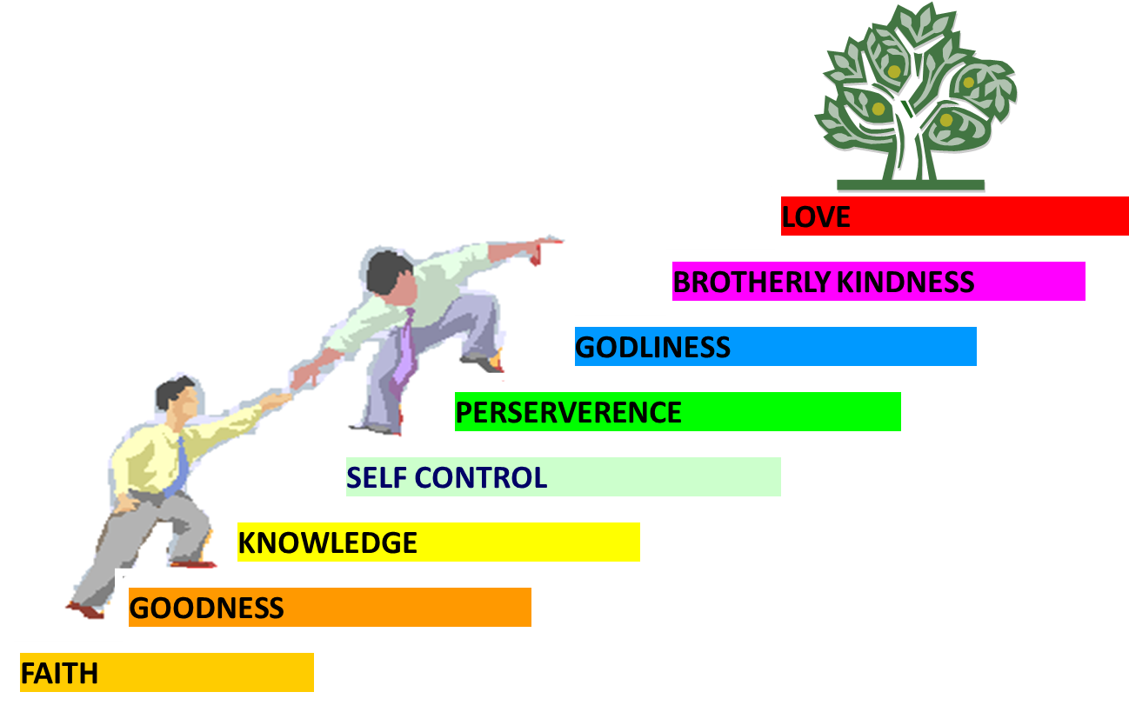
PORTRAIT OF GROWTH 1:5-7

Slide 16
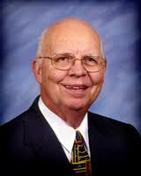
VII. Purposes of the Local Church
Glorify God (Eph 3:21)
Edify the saints (Eph 4:11-16)
Fulfill the Great Commission (Matt 28:18-20)

Slide 17
VII. Purposes of the Local Church
Glorify God (Eph 3:21)
Edify the saints (Eph 4:11-16)
Fulfill the Great Commission (Matt 28:18-20)

Slide 18
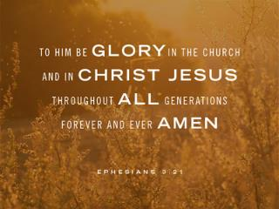
Ephesians 3:21
“to Him be the glory in the church and in Christ Jesus to all generations forever and ever. Amen.”

Slide 19
Dispensational Theology is a System of Theology
Traditional-normative dispensational theology is a system that embodies three essential, fundamental concepts called the sine qua non (lit. “without which is not”):
The consistent use of a plain, normal, literal, grammatical-historical method of interpretation;
Which reveals that the Church is distinct from Israel;
God’s overall purpose is to bring glory to Himself (Eph. 1:6, 12, 14).
Dr. Charles Ryrie, Dispensationalism, pp. 38-41

Slide 20
Dispensational Theology: Doxological Purpose
God’s ultimate purpose for the ages is to glorify Himself. Scripture is not human-centered, as though salvation were the principle point, but God-centered, because His glory is at the center.
The glory of God is the primary principle that unifies all dispensations, the program of salvation being just one of the means by which God glorifies Himself. Each successive revelation of God’s plan for the ages, as well as His dealing with the elect, non-elect, angels, and nations all manifest His glory.
Dictionary of Premillennial Theology, Charles Ryrie, p. 94

Slide 22
Contrasting Destiny of the Righteous (2:13-17)
Thanksgiving for their calling (2:13-14)
Exhortation to stand firm (2:15)
Prayer for strength (2:16-17)

Slide 23
2 Thessalonians 2:2
“that you not be quickly shaken from your composure or be disturbed either by a spirit or a message or a letter as if from us, to the effect that the day of the Lord [the Tribulation] has come.”

Slide 24
Ephesians 4:11-16
“¹¹ And He gave some as apostles, and some as prophets, and some as evangelists, and some as pastors and teachers, ¹² for the equipping of the saints for the work of service, to the building up of the body of Christ; ¹³ until we all attain to the unity of the faith, and of the knowledge of the Son of God, to a mature man, to the measure of the stature which belongs to the fullness of Christ. ¹⁴ As a result, we are no longer to be children, tossed here and there by. . .

Slide 25
Ephesians 4:11-16
“. . . waves and carried about by every wind of doctrine, by the trickery of men, by craftiness in deceitful scheming; ¹⁵ but speaking the truth in love, we are to grow up in all aspects into Him who is the head, even Christ, ¹⁶ from whom the whole body, being fitted and held together by what every joint supplies, according to the proper working of each individual part, causes the growth of the body for the building up of itself in love.”

Slide 26
Mark 7:13
“thus invalidating the word of God by your tradition which you have handed down; and you do many things such as that.”

Slide 27
Contrasting Destiny of the Righteous (2:13-17)
Thanksgiving for their calling (2:13-14)
Exhortation to stand firm (2:15)
Prayer for strength (2:16-17)

Slide 28
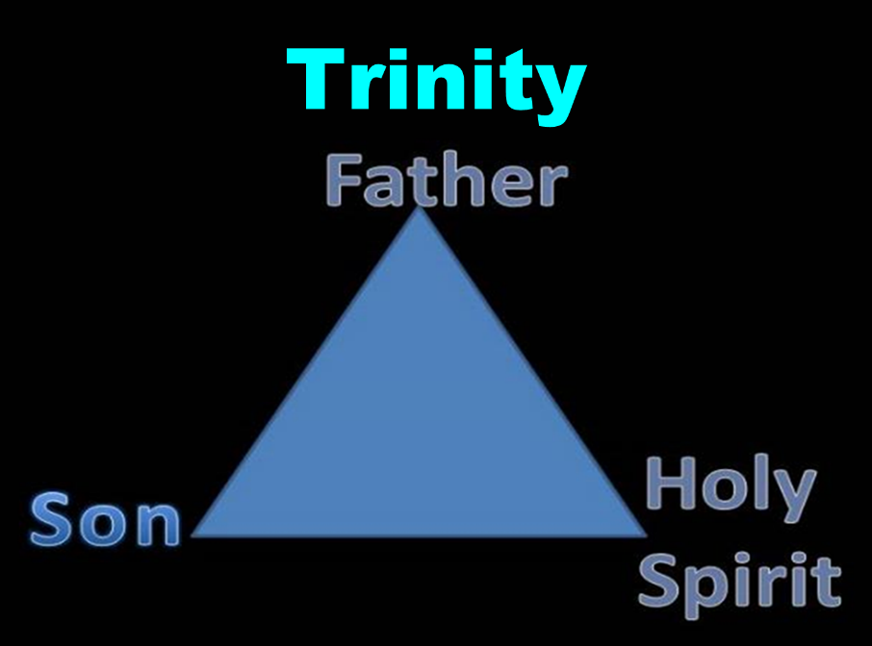

Slide 29
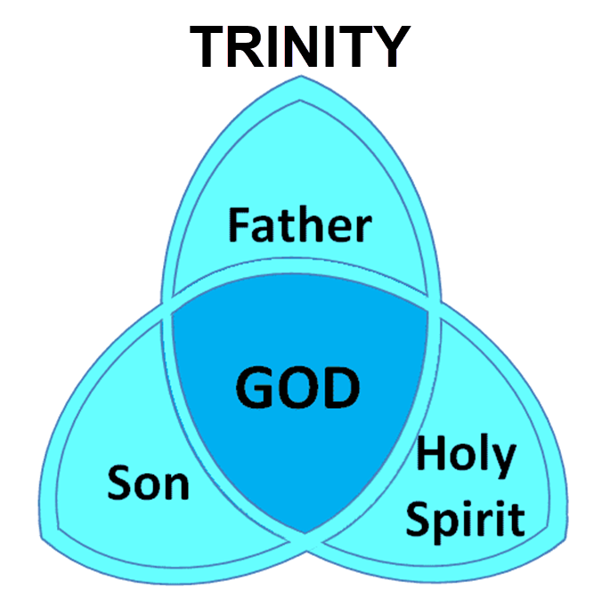

Slide 30
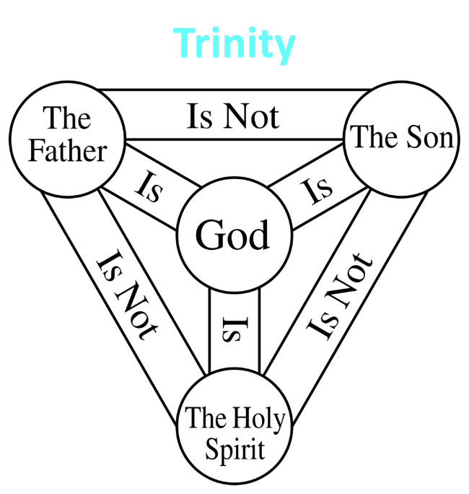

Slide 31
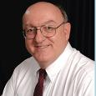
Definition of Eternal Security
“The new birth has given every believer the confident assurance of God’s certain and future blessings. The word ‘hope’ in the Bible does not involve anxious wishing or uncertainty; rather it means a confident assurance of something yet future. Unlike the empty and false hopes of this world-system, God has given believers a ‘living hope’ of guaranteed future blessings ‘by the resurrection of Jesus Christ from the dead’…”
Dennis Rokser, Shall Never Perish Forever, p. 53

Slide 32
2 Thessalonians 2:2
“that you not be quickly shaken from your composure or be disturbed either by a spirit or a message or a letter as if from us, to the effect that the day of the Lord [the Tribulation] has come.”

Slide 33
Structure
1 – Commendation
2 – Correction
3 – Consequences

Slide 34
Consequences of Poor Doctrine (3)
Reciprocal prayer (3:1-5)
Exhortation to discipline the idle (3:6-15)
Conclusion (3:16-18)

Slide 35
Consequences of Poor Doctrine (3)
Reciprocal prayer (3:1-5)
Exhortation to discipline the idle (3:6-15)
Conclusion (3:16-18)

Slide 36
Consequences of Poor Doctrine (3)
Reciprocal prayer (3:1-5)
Exhortation to discipline the idle (3:6-15)
Conclusion (3:16-18)

Slide 37
Consequences of Poor Doctrine (3)
Reciprocal prayer (3:1-5)
Exhortation to discipline the idle (3:6-15)
Conclusion (3:16-18)

Slide 38
Conclusion

Slide 39
Contrasting Destiny of the Righteous (2:13-17)
Thanksgiving for their calling (2:13-14)
Exhortation to stand firm (2:15)
Prayer for strength (2:16-17)

