Slide 2
Acts 8:5-40 Philip’s Ministry
Samaria (8:5-25)
Judea (Acts 8:26-40)

Slide 3
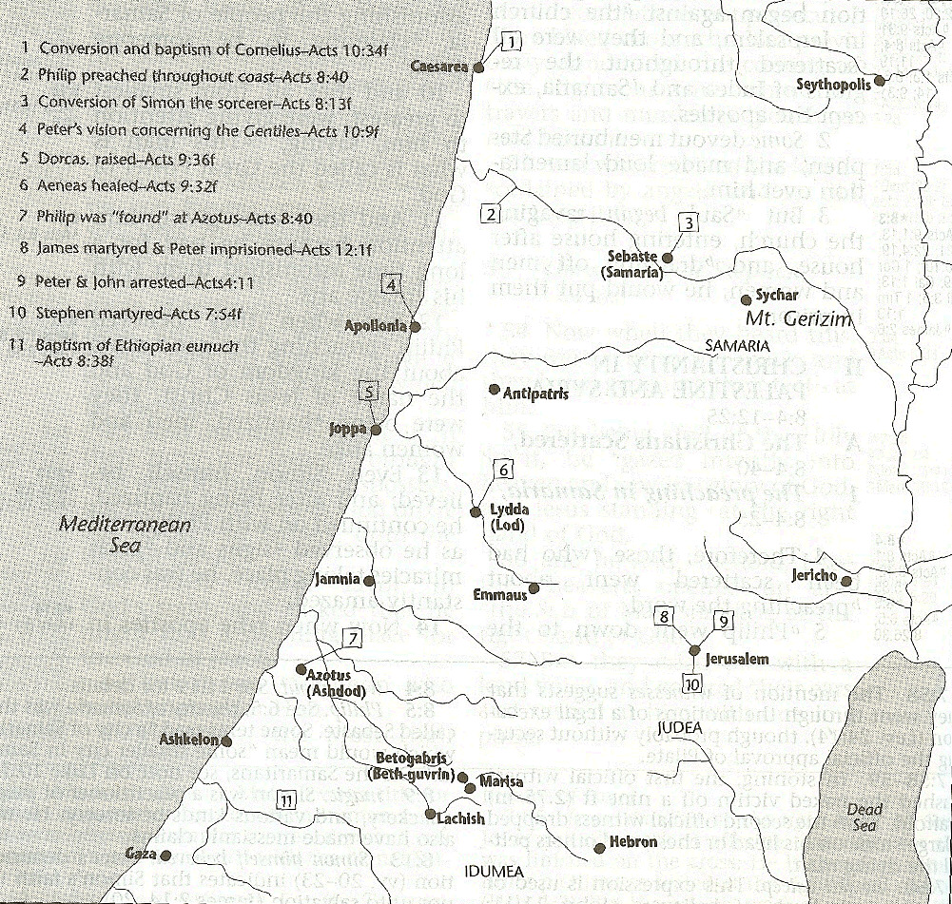

Slide 4
II. Ministry in Judea Acts 8:26-40
Angel directs Philip (26)
Philip’s obedience (27a)
Ethiopian Eunuch’s introduction (27b-28)
Holy Spirit directs Philip (29)
Philip’s witness to the Eunuch (30-35)
Eunuch’s conversion & baptism (36-38)
Philip’s separation from the Eunuch (39)
Philip’s evangelization of the Coastal Plain (40)

Slide 5
Acts 2:47
“praising God and having favor with all the people. And the Lord was adding to their number day by day those who were being saved.” (NASB)
“praising God and having favor with all the people. And the Lord added to the church daily those who were being saved.” (NKJV)

Slide 6
Author | Written | Earliest MSS | Time Span | No. MSS
Cesar | 100 to 44 b.c. | a.d. 900 | 1000 | 10
Plato | 427 to 347 b.c. | a.d. 900 | 1200 | 7
Thucydides | 460 to 400 b.c. | a.d. 900 | 1300 | 8
Tacitus | a.d. 100 | a.d. 1100 | 1000 | 20
Suetonius | a.d. 75 to 160 | a.d. 950 | 800 | 8
Homer (Illiad) | 900 b.c. | a.d. 400 | 500 | 643
New Testament | a.d. 40 to 100 | a.d. 125 | 25 to 50 | 24,000
Cesar | 100 to 44 b.c. | a.d. 900 | 1000 | 10
http://creationrevolution.com/2012/05/should-we-trust-the-bible/

Slide 7
Manuscript Evidence for Ancient Writings
Author | Written | Earliest Fragment/Copy | Time Span in Years | Number of Manuscripts
Cesar | 100 to 44 b.c. | a.d. 900 | 1000 | 10
Plato | 427 to 347 b.c. | a.d. 900 | 1200 | 7
Thucydides | 460 to 400 b.c. | a.d. 900 | 1300 | 8
Tacitus | a.d. 100 | a.d. 1100 | 1000 | 20
Suetonius | a.d. 75 to 160 | a.d. 950 | 800 | 8
Homer (Illiad) | 900 b.c. | a.d. 400 | 500 | 643
New Testament | a.d. 40 to 100 | a.d. 125 | 25 to 50 | 24,000
Information in this chart can be found in various sources. This chart was adapted from: Christian Apologetics, by Norman Geisler, 1976, p. 307; and Evidence That Demands a Verdict, by Josh McDowell, 1979, pp. 42, 43.

Slide 8
II. Ministry in Judea Acts 8:26-40
Angel directs Philip (26)
Philip’s obedience (27a)
Ethiopian Eunuch’s introduction (27b-28)
Holy Spirit directs Philip (29)
Philip’s witness to the Eunuch (30-35)
Eunuch’s conversion & baptism (36-38)
Philip’s separation from the Eunuch (39)
Philip’s evangelization of the Coastal Plain (40)

Slide 9
Sprinkling or Immersion?
Sprinkling? Other words (1 Pet. 1:2; 2 Tim. 4:6)
Immersion?
Christ’s baptism (Matt. 3:16; Mark 1:10)
Ethiopian eunuch's baptism (Acts 8:38-39)
Best symbolizes our union with Christ (Rom. 6:3-5)
Symbolizes a new creation (Gen. 1:6, 9; 2 Pet. 3:5; 2 Cor. 5:17)

Slide 10
Exemption from Death (1 Cor 15:54-56)
Enoch (Gen 5)
Elijah (2 Kings 2)
Christ (Acts 1:11; Rev 12:5)
Philip (Acts 8:39)
Paul (2 Cor 12:2, 4)
John (Rev 4:1-2)
Two witnesses (Rev 11)

Slide 11
1 Thessalonians 4:13-18
¹³ "But we do not want you to be uninformed, brethren, about those who are asleep, so that you will not grieve as do the rest who have no hope. ¹⁴ For if we believe that Jesus died and rose again, even so God will bring with Him those who have fallen asleep in Jesus. ¹⁵ For this we say to you by the word of the Lord, that we who are alive and remain until the coming of the Lord, will not precede those who have fallen asleep. ¹⁶ For the Lord Himself will . . .

Slide 12
1 Thessalonians 4:13-18
…descend from heaven with a shout, with the voice of the archangel and with the trumpet of God, and the dead in Christ will rise first. ¹⁷ Then we who are alive and remain will be caught up [harpazō] together with them in the clouds to meet the Lord in the air, and so we shall always be with the Lord. ¹⁸ Therefore comfort one another with these words."

Slide 13
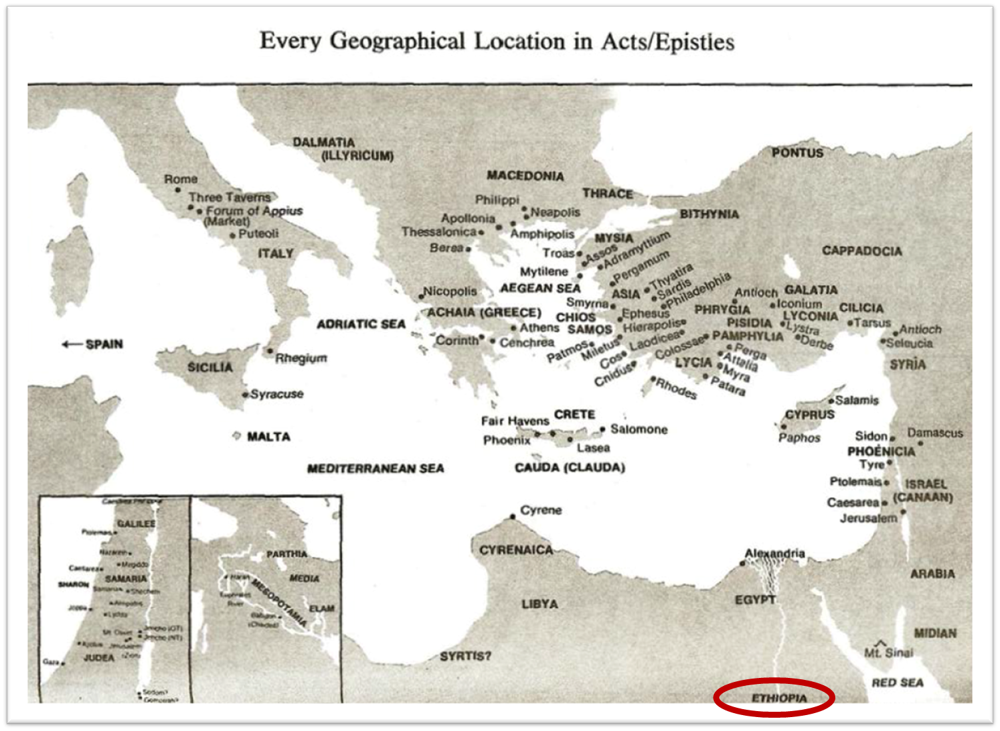

Slide 14
II. Ministry in Judea Acts 8:26-40
Angel directs Philip (26)
Philip’s obedience (27a)
Ethiopian Eunuch’s introduction (27b-28)
Holy Spirit directs Philip (29)
Philip’s witness to the Eunuch (30-35)
Eunuch’s conversion & baptism (36-38)
Philip’s separation from the Eunuch (39)
Philip’s evangelization of the Coastal Plain (40)

Slide 17
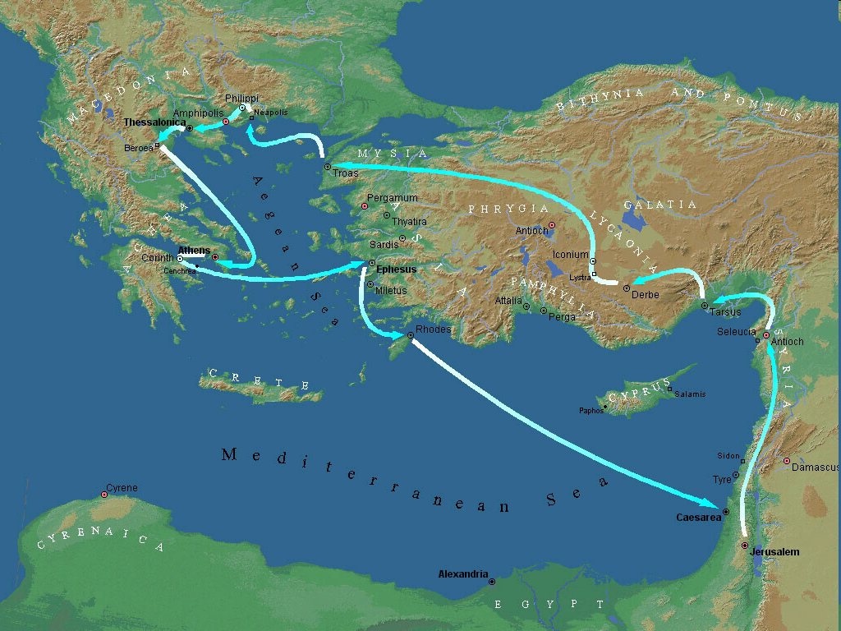
Second Missionary Journey

Slide 18
Conclusion

Slide 19
Acts 8:5-40 Philip’s Ministry
Samaria (8:5-25)
Judea (Acts 8:26-40)

Slide 20
II. Ministry in Judea Acts 8:26-40
Angel directs Philip (26)
Philip’s obedience (27a)
Ethiopian Eunuch’s introduction (27b-28)
Holy Spirit directs Philip (29)
Philip’s witness to the Eunuch (30-35)
Eunuch’s conversion & baptism (36-38)
Philip’s separation from the Eunuch (39)
Philip’s evangelization of the Coastal Plain (40)

