Slide 2
Acts 8:5-40 Philip’s Ministry
Samaria (8:5-25)
Judea (Acts 8:26-40)

Slide 3
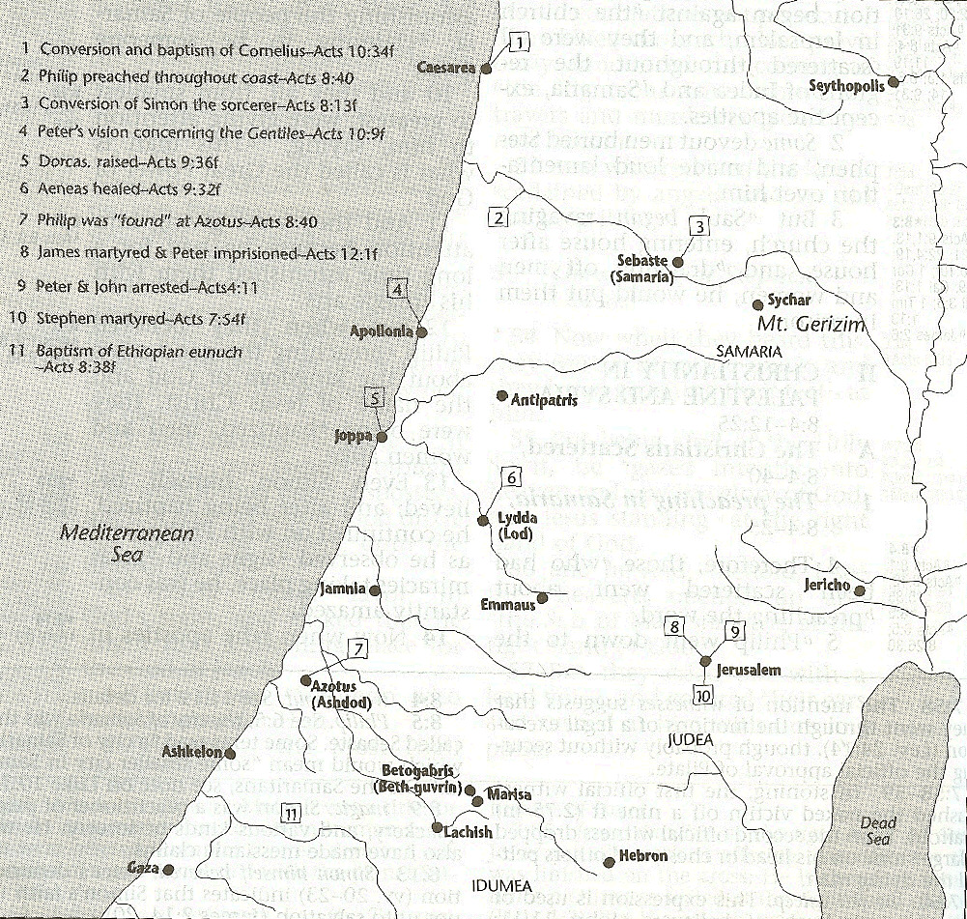

Slide 4
II. Ministry in Judea Acts 8:26-40
Angel directs Philip (26)
Philip’s obedience (27a)
Ethiopian Eunuch’s introduction (27b-28)
Holy Spirit directs Philip (29)
Philip’s witness to the Eunuch (30-35)
Eunuch’s conversion & baptism (36-38)
Philip’s separation from the Eunuch (39)
Philip’s evangelization of the Coastal Plain (40)

Slide 5
Acts 8:30-35 Philip’s Witness to the Eunuch
Philip’s question (30)
Eunuch’s answer (31)
Eunuch's reading (32-33)
Eunuch’s question (34)
Philip’s witness (35)

Slide 6
Acts 8:30-35 Philip’s Witness to the Eunuch
Philip’s question (30)
Eunuch’s answer (31)
Eunuch's reading (32-33)
Eunuch’s question (34)
Philip’s witness (35)

Slide 7
Luke 24:27, 44
“²⁷ Then beginning with Moses and with all the prophets, He explained to them the things concerning Himself in all the Scriptures…⁴⁴ Now He said to them, ‘These are My words which I spoke to you while I was still with you, that all things which are written about Me in the Law of Moses and the Prophets and the Psalms must be fulfilled.’”

Slide 8
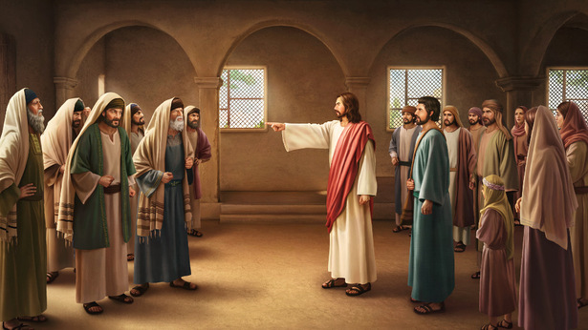
John 5:39, 46
“³⁹ You search the Scriptures because you think that in them you have eternal life; it is these that testify about Me. . .⁴⁶ For if you believed Moses, you would believe Me, for he wrote about Me.”

Slide 9
II. Ministry in Judea Acts 8:26-40
Angel directs Philip (26)
Philip’s obedience (27a)
Ethiopian Eunuch’s introduction (27b-28)
Holy Spirit directs Philip (29)
Philip’s witness to the Eunuch (30-35)
Eunuch’s conversion & baptism (36-38)
Philip’s separation from the Eunuch (39)
Philip’s evangelization of the Coastal Plain (40)

Slide 10
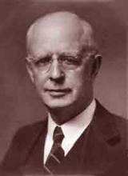
Lewis Sperry Chafer, vol. 7, Systematic Theology (Grand Rapids, MI: Kregel Publications, 1993), 265-66.
Belief – God’s One Condition for Justification
“…because upwards of 150 passages of Scripture condition salvation upon believing only (cf. John 3:16; Acts 16:31).”

Slide 11
Belief – God’s One Condition for Justification
Gen 15:6
Then he believed in the LORD; and He reckoned it to him as righteousness.
John 3:16
For God so loved the world, that He gave His only begotten Son, that whoever believes in Him shall not perish, but have eternal life.
Acts 16:30-31
"Sirs, what must I do to be saved?" They said, "Believe in the Lord Jesus, and you will be saved..."

Slide 12
1 Corinthians 12:13
“For by one Spirit we were all baptized into one body, whether Jews or Greeks, whether slaves or free, and we were all made to drink of one Spirit.”

Slide 13
Sprinkling or Immersion?
Sprinkling? Other words (1 Pet. 1:2; 2 Tim. 4:6)
Immersion?
Christ’s baptism (Matt. 3:16; Mark 1:10)
Ethiopian eunuch's baptism (Acts 8:38-39)
Best symbolizes our union with Christ (Rom. 6:3-5)
Symbolizes a new creation (Gen. 1:6, 9; 2 Pet. 3:5; 2 Cor. 5:17)

Slide 14
II. Ministry in Judea Acts 8:26-40
Angel directs Philip (26)
Philip’s obedience (27a)
Ethiopian Eunuch’s introduction (27b-28)
Holy Spirit directs Philip (29)
Philip’s witness to the Eunuch (30-35)
Eunuch’s conversion & baptism (36-38)
Philip’s separation from the Eunuch (39)
Philip’s evangelization of the Coastal Plain (40)

Slide 15
Exemption from Death (1 Cor 15:54-56)
Enoch (Gen 5)
Elijah (2 Kings 2)
Christ (Acts 1:11; Rev 12:5)
Philip (Acts 8:39)
Paul (2 Cor 12:2, 4)
John (Rev 4:1-2)
Two witnesses (Rev 11)

Slide 16
1 Thessalonians 4:13-18
¹³ "But we do not want you to be uninformed, brethren, about those who are asleep, so that you will not grieve as do the rest who have no hope. ¹⁴ For if we believe that Jesus died and rose again, even so God will bring with Him those who have fallen asleep in Jesus. ¹⁵ For this we say to you by the word of the Lord, that we who are alive and remain until the coming of the Lord, will not precede those who have fallen asleep. ¹⁶ For the Lord Himself will . . .

Slide 17
1 Thessalonians 4:13-18
…descend from heaven with a shout, with the voice of the archangel and with the trumpet of God, and the dead in Christ will rise first. ¹⁷ Then we who are alive and remain will be caught up [harpazō] together with them in the clouds to meet the Lord in the air, and so we shall always be with the Lord. ¹⁸ Therefore comfort one another with these words."

Slide 18
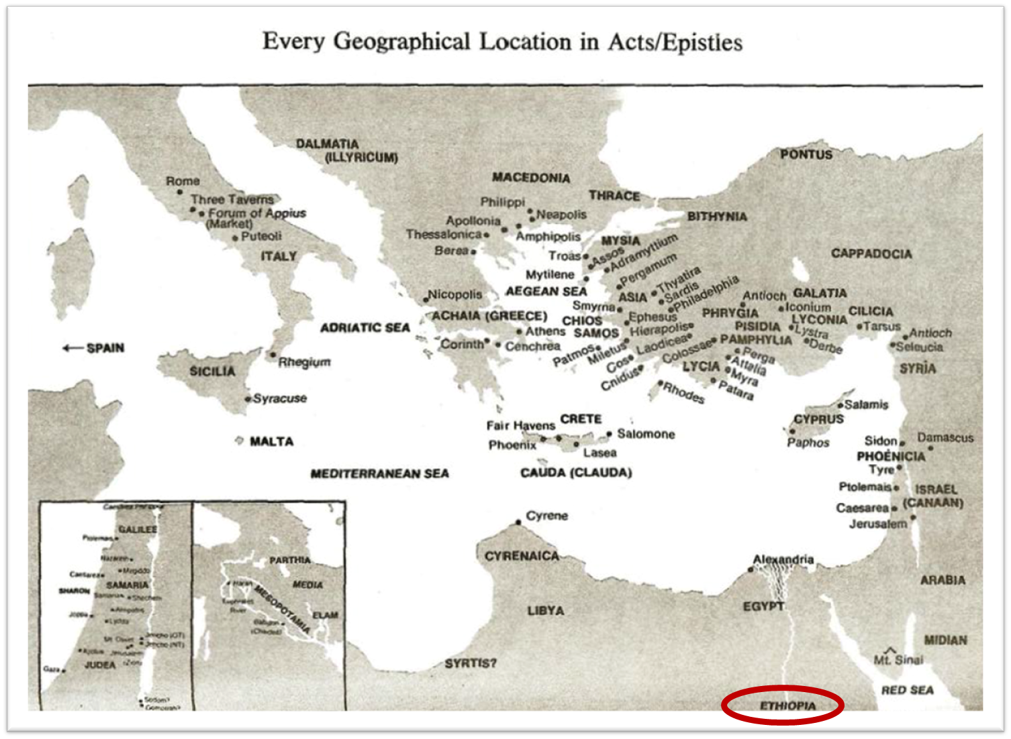

Slide 19
II. Ministry in Judea Acts 8:26-40
Angel directs Philip (26)
Philip’s obedience (27a)
Ethiopian Eunuch’s introduction (27b-28)
Holy Spirit directs Philip (29)
Philip’s witness to the Eunuch (30-35)
Eunuch’s conversion & baptism (36-38)
Philip’s separation from the Eunuch (39)
Philip’s evangelization of the Coastal Plain (40)

Slide 22
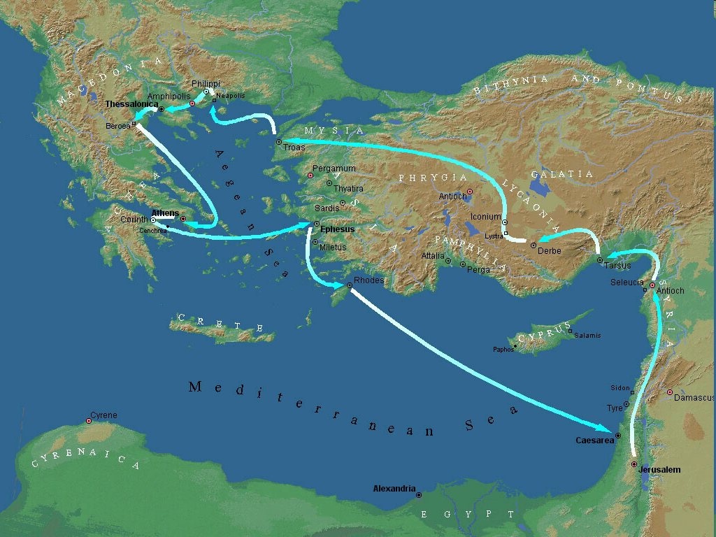
Second Missionary Journey

Slide 23
Conclusion

Slide 24
Acts 8:5-40 Philip’s Ministry
Samaria (8:5-25)
Judea (Acts 8:26-40)

Slide 25
II. Ministry in Judea Acts 8:26-40
Angel directs Philip (26)
Philip’s obedience (27a)
Ethiopian Eunuch’s introduction (27b-28)
Holy Spirit directs Philip (29)
Philip’s witness to the Eunuch (30-35)
Eunuch’s conversion & baptism (36-38)
Philip’s separation from the Eunuch (39)
Philip’s evangelization of the Coastal Plain (40)

