Slide 1
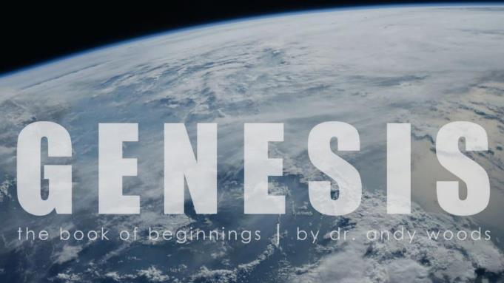
Genesis 12‒50
Israel’s Birth & Preservation

Slide 2
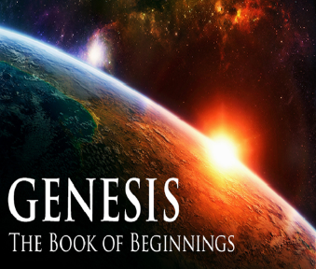
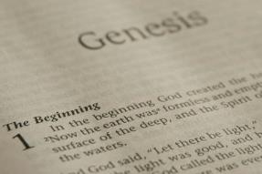
GENESIS STRUCTURE
Genesis 12-50 (four people)
Abraham (12:1–25:11)
Isaac (25:12–26:35)
Jacob (27–36)
Joseph (37–50)

Slide 3
Genesis 37:2-36 Joseph Sold unto Egypt
Joseph’s coat (37:2-4)
Joseph’s dreams (37:5-11)
Joseph’s pit (37:12-24)
Joseph’s enslavement (37:25-36)

Slide 4
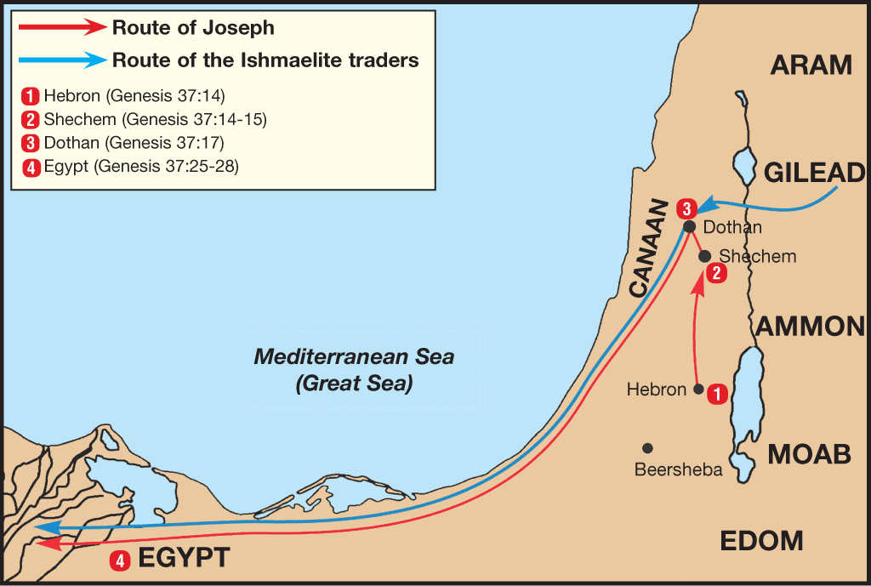

Slide 5
Genesis 38:1-30 Judah & Tamar
Tamar & Judah’s sons (38:1-11)
Tamar & Judah (38:12-26)
Tamar & Judah’s twins (38:27-30)

Slide 6
Genesis 39:1-23 Joseph in Potiphar's House
Blessing (39:1-6)
Temptation & Accusation (39:7-18)
Prison (39:19-23)

Slide 7
Genesis 40:1-23 Joseph in Prison
Imprisonment (40:1-8)
Butler’s dream (40:9-15)
Baker’s dream (40:16-19)
Fulfillment of the dreams (40:20-23)

Slide 8
III. Genesis 40:16-19 Baker’s Dream
Dream (16-17)
Joseph’s interpretation (18-19)

Slide 9
III. Genesis 40:16-19 Baker’s Dream
Dream (16-17)
Joseph’s interpretation (18-19)

Slide 10
Genesis 40:16-17 Dream
Basis for telling the dream (16a)
Dream (16b-17)

Slide 11
Genesis 40:16-17 Dream
Basis for telling the dream (16a)
Dream (16b-17)

Slide 12
Genesis 40:16-17 Dream
Basis for telling the dream (16a)
Dream (16b-17)

Slide 13
Genesis 40:16b-19 Dream
Baskets (16b)
Birds (17)

Slide 14
Genesis 40:16b-19 Dream
Baskets (16b)
Birds (17)

Slide 15
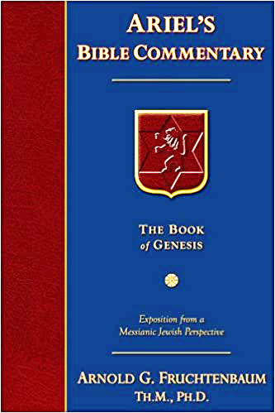
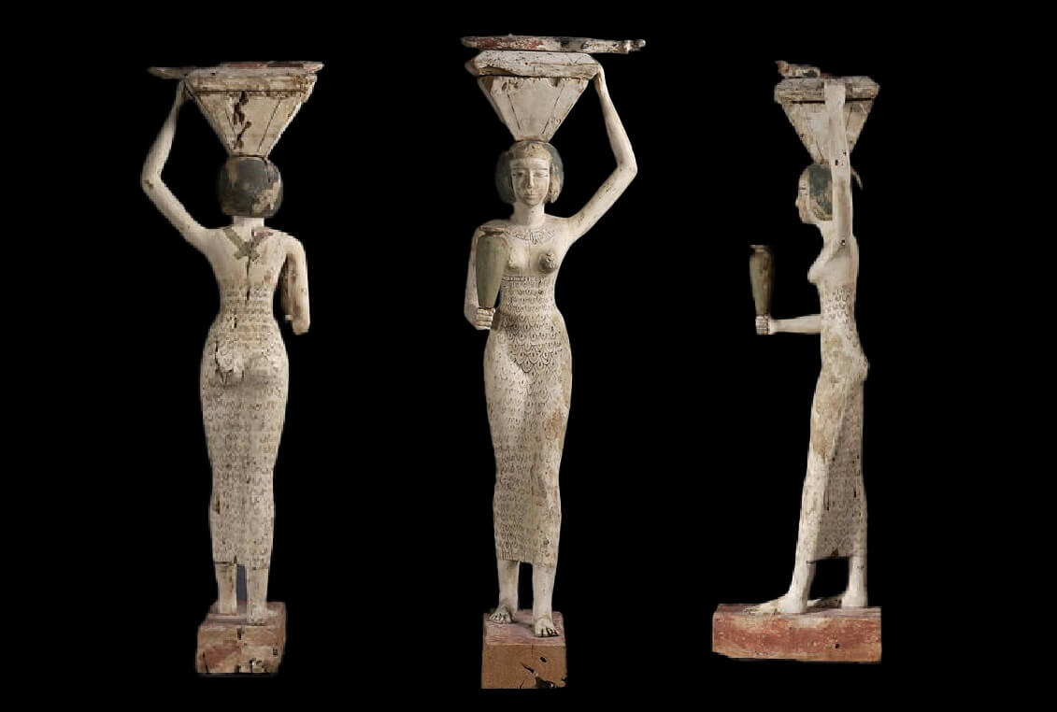
Dr. Arnold G. Fruchtenbaum
The Book of Genesis, 559
“First, in verse 16b: I also was in my dream, and, behold, three baskets of white bread were on my head. Pictorials in Egyptian tombs, where baskets of breads were carried on the head, validate the description.”

Slide 16
Genesis 40:16b-19 Dream
Baskets (16b)
Birds (17)

Slide 17
III. Genesis 40:16-19 Baker’s Dream
Dream (16-17)
Joseph’s interpretation (18-19)

Slide 18
Genesis 40:18-19 Interpretation
Baskets (18)
Birds (19)

Slide 19
Genesis 40:18-19 Interpretation
Baskets (18)
Birds (19)

Slide 20
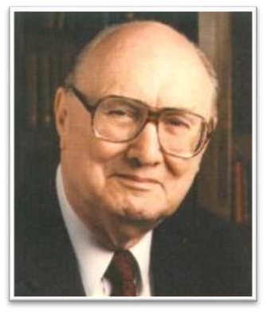
Two Rules of Interpretation
Search the immediate context
Walvoord: 26X
Search the remote context
Old Testament
Thomas: 278 / 404 verses

Slide 21
Genesis 40:18-19 Interpretation
Baskets (18)
Birds (19)

Slide 22
Shaping and Populating (Gen 1:1-31)
Day 1 | Light
Day 2 | Water, sky
Day 3 | Land, vegetation
Day 4 | Luminaries
Day 5 | Sea animals, birds
Day 6 | Land animals, man

Slide 23
Exodus 20:8-11
⁸ “Remember the sabbath day, to keep it holy. ⁹ Six days you shall labor and do all your work, ¹⁰ but the seventh day is a sabbath of the Lord your God; in it you shall not do any work, you or your son or your daughter, your male or your female servant or your cattle or your sojourner who stays with you. ¹¹ For in six days the Lord made the heavens and the earth, the sea and all that is in them, and rested on the seventh day; therefore the Lord blessed the sabbath day and made it holy.”

Slide 24
Exodus 31:15-17
¹⁵ ‘For six days work may be done, but on the seventh day there is a sabbath of complete rest, holy to the Lord; whoever does any work on the sabbath day shall surely be put to death. ¹⁶ ‘So the sons of Israel shall observe the sabbath, to celebrate the sabbath throughout their generations as a perpetual covenant.’ ¹⁷ “It is a sign between Me and the sons of Israel forever; for in six days the Lord made heaven and earth, but on the seventh day He ceased from labor, and was refreshed.”

Slide 25
Dr. Arnold G. Fruchtenbaum
The Book of Genesis, 559
“in other words, the chief baker will be beheaded. In the Hebrew text, the wording is exactly the same here as it was in the case of the butler, but with the butler the head was ‘lifted up’ in restoration; with the baker the head is ‘lifted up’ as punishment in the sense of being beheaded: and he shall hang you on a tree; and the birds shall eat your flesh from off you.”

Slide 26
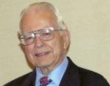
Dr. Roy B. Zuck
Basic Bible Interpretation, p. 215-16.
“﻿Usually a parable, like a sermon illustration, is teaching a single truth. When Jesus explained a number of His parables, He usually…stated one spiritual truth. For example when the man found his one lost sheep, he rejoiced, and Jesus said this illustrates the truth that there is rejoicing in heaven when a sinner repents (Luke 15:7)...He gave one simple spiritual lesson, and made no attempt to see any spiritual significance to the vineyard, the denarius, or the sixth hour, the ninth hour, or the eleventh hour, nor the vineyard foreman…To hunt for meanings in every detail in the parables is to turn them into allegories.”

Slide 27
Revelation 11:8-10
“⁸ And their dead bodies will lie in the street of the great city which mystically is called Sodom and Egypt, where also their Lord was crucified. ⁹ Those from the peoples and tribes and tongues and nations will look at their dead bodies for three and a half days, and will not permit their dead bodies to be laid in a tomb. ¹⁰ And those who dwell on the earth will rejoice over them and celebrate; and they will send gifts to one another, because these two prophets tormented those who dwell on the earth.”

Slide 28
Genesis 40:1-23 Joseph in Prison
Imprisonment (40:1-8)
Butler’s dream (40:9-15)
Baker’s dream (40:16-19)
Fulfillment of the dreams (40:20-23)

Slide 29
IV. Genesis 40:20-23 Fulfillment of the Dreams
Occasion (20)
Butler (21)
Baker (22a)
Joseph’s vindication (22b)
Joseph forgotten (23)

Slide 30
IV. Genesis 40:20-23 Fulfillment of the Dreams
Occasion (20)
Butler (21)
Baker (22a)
Joseph’s vindication (22b)
Joseph forgotten (23)

Slide 31
Genesis 40:20 Occasion
Timing (20a)
Event (20b)
Lifting (20c)

Slide 32
Genesis 40:20 Occasion
Timing (20a)
Event (20b)
Lifting (20c)

Slide 33
Daniel 9:25
“So you are to know and discern that from the issuing of a decree to restore and rebuild Jerusalem until Messiah the Prince there will be seven weeks and sixty-two weeks; it will be built again, with plaza and moat, even in times of distress.”

Slide 34
13) Messiah must present Himself to Israel on March 30, A.D. 33
Daniel 9:25

Slide 35
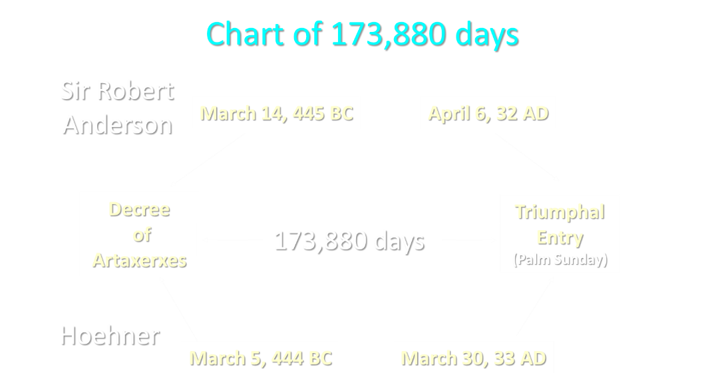

Slide 36
Luke 19:42-44
⁴² saying, “If you had known in this day, even you, the things which make for peace! But now they have been hidden from your eyes…⁴⁴ and they will level you to the ground and your children within you, and they will not leave in you one stone upon another, because you did not recognize the time of your visitation.”

Slide 37
Genesis 40:20 Occasion
Timing (20a)
Event (20b)
Lifting (20c)

Slide 38
Genesis 40:20 Occasion
Timing (20a)
Event (20b)
Lifting (20c)

Slide 39
IV. Genesis 40:20-23 Fulfillment of the Dreams
Occasion (20)
Butler (21)
Baker (22a)
Joseph’s vindication (22b)
Joseph forgotten (23)

Slide 40
IV. Genesis 40:20-23 Fulfillment of the Dreams
Occasion (20)
Butler (21)
Baker (22a)
Joseph’s vindication (22b)
Joseph forgotten (23)

Slide 41
IV. Genesis 40:20-23 Fulfillment of the Dreams
Occasion (20)
Butler (21)
Baker (22a)
Joseph’s vindication (22b)
Joseph forgotten (23)

Slide 43
Matthew 24:1-2
“¹ Jesus came out from the temple and was going away when His disciples came up to point out the temple buildings to Him. ² And He said to them, “Do you not see all these things? Truly I say to you, not one stone here will be left upon another, which will not be torn down.”

Slide 44
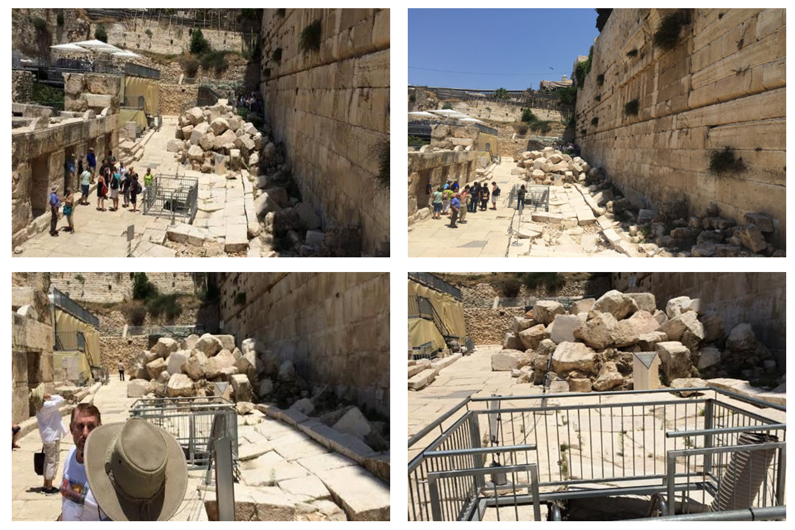

Slide 45
MATT 24 / REV 6 PARALLELS
Prediction | Birth pangs (Matt 24) | Seal judgments (Rev 6)
False Christ | 24:5 | 6:2
War | 24:6 | 6:3-4
Famine | 24:7 | 6:5-6
Death | 24:6-7 | 6:7-8
Martyrs | 24:9-13 | 6:9-11
Earthquakes | 24:7 | 6:12-17
Evangelism | 24:14 | 7:1-9

Slide 46
John 13:19; 14:29
“^{13:19} From now on I am telling you before it comes to pass, so that when it does occur, you may believe that I am He… ^{14:29} Now I have told you before it happens, so that when it happens, you may believe.”

Slide 47
What Happened to Christ’s Disciples?
Disciple | Place | Martyrdom
James the Son of Alpheus | Jerusalem | Clubbed to death
Simon the Zealot | Jerusalem | Martyred
James the Son of Zebedee | Judea (Acts 12:2) | Executed
Thaddeus | Mesopotamia | Beaten to death
Peter | Babylon, Rome | Crucified upside down
Matthew | Parthia (Tehran) | Beheaded
Notes:
109 prophecies…
Peter Stoner – SCIENCE SPEAKS, An Evaluation of Certain Christian Evidences
To fulfill just 8 prophecies =1 X 10 to the twenty-eighth power!
Can we visualize this with an illustration? Suppose we took an atheistic professor, blindfolded him and covered the state of Texas two feet deep with silver dollars. Then we put a check on one of those silver dollars and mixed them up. The odds of one person fulfilling just these eight prophecies would be the same as this atheistic professor selecting the silver dollar upon which we have placed a check, in his first try.
https://www.bereanpublishers.com/the-odds-of-eight-messianic-prophecies-coming-true/

Slide 48
What Happened to Christ’s Disciples?
Disciple | Place | Martyrdom
John | Asia Minor, Patmos, Ephesus | Fried in boiling oil
Philip | E. Turkey | Tortured & crucified
Thomas | India | Speared
Bartholomew | India | Flayed & crucified
Andrew | Ukraine, Russia, Greece | Hanged
Notes:
109 prophecies…
Peter Stoner – SCIENCE SPEAKS, An Evaluation of Certain Christian Evidences
To fulfill just 8 prophecies =1 X 10 to the twenty-eighth power!
Can we visualize this with an illustration? Suppose we took an atheistic professor, blindfolded him and covered the state of Texas two feet deep with silver dollars. Then we put a check on one of those silver dollars and mixed them up. The odds of one person fulfilling just these eight prophecies would be the same as this atheistic professor selecting the silver dollar upon which we have placed a check, in his first try.
https://www.bereanpublishers.com/the-odds-of-eight-messianic-prophecies-coming-true/

Slide 49
2 Peter 1:19-21
“¹⁹ So we have the prophetic word made more sure, to which you do well to pay attention as to a lamp shining in a dark place, until the day dawns and the morning star arises in your hearts. ²⁰ But know this first of all, that no prophecy of Scripture is a matter of one’s own interpretation, ²¹ for no prophecy was ever made by an act of human will, but men moved by the Holy Spirit spoke from God.”

Slide 50
IV. Genesis 40:20-23 Fulfillment of the Dreams
Occasion (20)
Butler (21)
Baker (22a)
Joseph’s vindication (22b)
Joseph forgotten (23)

Slide 51
Dr. Arnold G. Fruchtenbaum
The Book of Genesis, 560
“While on the human side this was ingratitude, on the divine side it was not yet time for Joseph’s release. Joseph had to wait two more years.”

Slide 52
John 14:16-17
¹⁶ I will ask the Father, and He will give you another Helper, that He may be with you forever; ¹⁷ that is the Spirit of truth, whom the world cannot receive, because it does not see Him or know Him, but you know Him because He abides with you and will be in you.

Slide 53
Conclusion

Slide 54
Genesis 40:1-23 Joseph in Prison
Imprisonment (40:1-8)
Butler’s dream (40:9-15)
Baker’s dream (40:16-19)
Fulfillment of the dreams (40:20-23)

Slide 55
²⁴ The Lord bless you, and keep you; ²⁵ The Lord make His face shine on you, And be gracious to you; ²⁶ The Lord lift up His countenance on you, And give you peace.
Numbers 6:24–26 (NASB95)

