Slide 1
Dr. Andy Woods
Senior Pastor – Sugar Land Bible Church
President – Chafer Theological Seminary

Slide 2
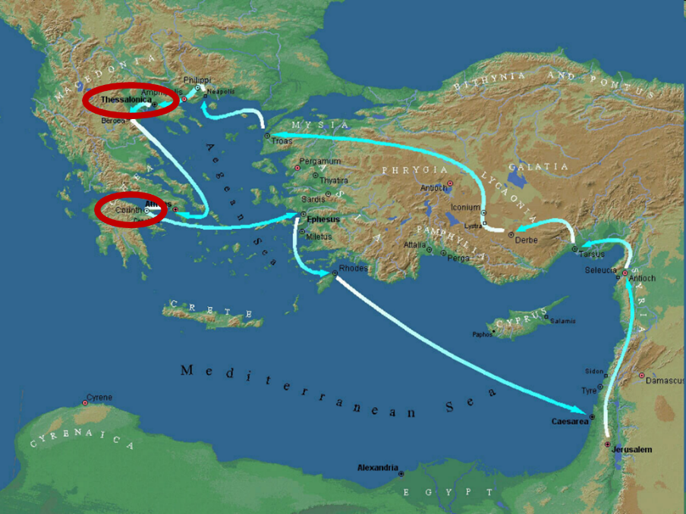

Slide 3
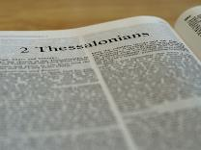
2 Thessalonians 2:1-12
Problem (2:1-2)
Prerequisites for the Day of the Lord (2:3-12)
The departure (2:3a)
Advent of the lawless one (2:3b-4)
Removal of the restrainer (2:5-7)
Destruction of the lawless one (2:8-9)
Destruction of lawless one’s followers (2:10-12)

Slide 4
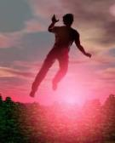
2 Thessalonians 2:2
“that you not be quickly shaken from your composure or be disturbed either by a spirit or a message or a letter as if from us, to the effect that the day of the Lord [the Tribulation] has come.”

Slide 5
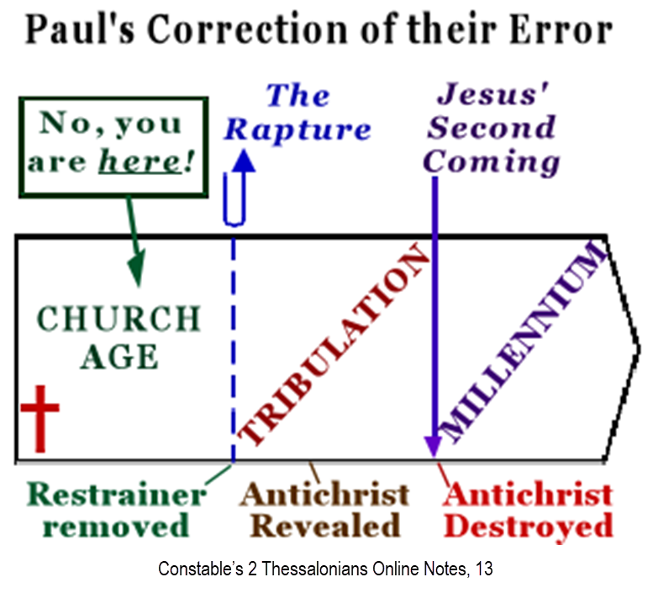

Slide 7
2 Thessalonians 2:1-12
Problem (2:1-2)
Prerequisites for the Day of the Lord (2:3-12)
The departure (2:3a)
Advent of the lawless one (2:3b-4)
Removal of the restrainer (2:5-7)
Destruction of the lawless one (2:8-9)
Destruction of lawless one’s followers (2:10-12)

Slide 8
2 Thessalonians 2:1-12
Problem (2:1-2)
Prerequisites for the Day of the Lord (2:3-12)
The departure (2:3a)
Advent of the lawless one (2:3b-4)
Removal of the restrainer (2:5-7)
Destruction of the lawless one (2:8-9)
Destruction of lawless one’s followers (2:10-12)

Slide 9
2 Thessalonians 2:1-12
Problem (2:1-2)
Prerequisites for the Day of the Lord (2:3-12)
The departure (2:3a)
Advent of the lawless one (2:3b-4)
Removal of the restrainer (2:5-7)
Destruction of the lawless one (2:8-9)
Destruction of lawless one’s followers (2:10-12)

Slide 10
2 Thessalonians 2:1-12
Problem (2:1-2)
Prerequisites for the Day of the Lord (2:3-12)
The departure (2:3a)
Advent of the lawless one (2:3b-4)
Removal of the restrainer (2:5-7)
Destruction of the lawless one (2:8-9)
Destruction of lawless one’s followers (2:10-12)

Slide 11
2 Thessalonians 2:1-12
Problem (2:1-2)
Prerequisites for the Day of the Lord (2:3-12)
The departure (2:3a)
Advent of the lawless one (2:3b-4)
Removal of the restrainer (2:5-7)
Destruction of the lawless one (2:8-9)
Destruction of lawless one’s followers (2:10-12)

Slide 12
2 Thessalonians 2:1-12
Problem (2:1-2)
Prerequisites for the Day of the Lord (2:3-12)
The departure (2:3a)
Advent of the lawless one (2:3b-4)
Removal of the restrainer (2:5-7)
Destruction of the lawless one (2:8-9)
Destruction of lawless one’s followers (2:10-12)

Slide 13
2 Thessalonians 2:10-12 Destruction of the Lawless One’s Followers
The judgment’s cause (10)
The judgment itself (11)
The judgment’s purpose (12)

Slide 14
Acts 17:30-31
“³⁰ Therefore having overlooked the times of ignorance, God is now declaring to men that all people everywhere should repent [metanoeō], ³¹ because He has fixed a day in which He will judge the world in righteousness through a Man whom He has appointed, having furnished proof to all men by raising Him from the dead.”

Slide 15
Scripture’s Four Judgments
NAME | SHEEP AND GOAT | JUDGMENT OF THE JEWS | BEMA SEAT | GREAT WHITE THRONE
SCRIPTURE | Matt 25:31-46 | Ezek 20:33-44 | 1 Cor 3:10-15 | Rev 20:11-15
PLACE | Earth, Jerusalem | Earth, wilderness | Heaven | Earth
AUDIENCE | Gentile Tribulation survivors | Jewish Tribulation survivors | Church Age believers | All unsaved
WHEN | After Tribulation | After Tribulation | After rapture | After Millennium
PURPOSE | Saved Gentiles enter kingdom | Saved Jews enter kingdom | Reward believers | Degree of punishment in hell
EVALUATION | Treatment of Christ’s brethren | Passing under shepherd’s rod | Works taken through fire | Not in the book; judged by books

Slide 17
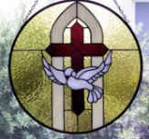
John 3:36
“The one who believes in the Son has eternal life; but the one who does not obey the Son will not see life, but the wrath of God remains on him.”

Slide 18
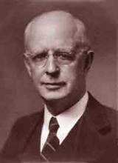
Lewis Sperry Chafer, vol. 7, Systematic Theology (Grand Rapids, MI: Kregel Publications, 1993), 265-66.
Belief – God’s One Condition for Justification
“…because upwards of 150 passages of Scripture condition salvation upon believing only (cf. John 3:16; Acts 16:31).”

Slide 19
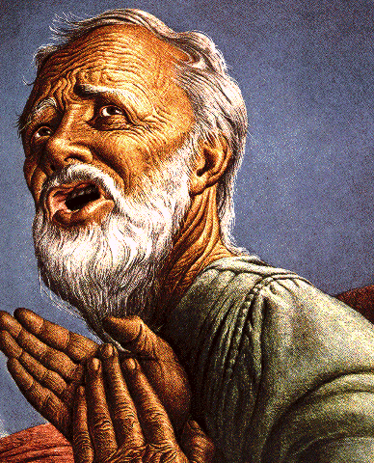
Belief – God’s One Condition for Justification
Gen 15:6
Then he believed in the LORD; and He reckoned it to him as righteousness.
John 3:16
For God so loved the world, that He gave His only begotten Son, that whoever believes in Him shall not perish, but have eternal life.
Acts 16:30-31
"Sirs, what must I do to be saved?" They said, "Believe in the Lord Jesus, and you will be saved..."

Slide 20
2 Peter 1:5-7
⁵ Now for this very reason also, applying all diligence, in your faith supply moral excellence, and in your moral excellence, knowledge, ⁶ and in your knowledge, self-control, and in your self-control, perseverance, and in your perseverance, godliness, ⁷ and in your godliness, brotherly kindness, and in your brotherly kindness, love.

Slide 21
Thomas L. Constable “Notes on 2 Peter,” online: www.soniclight.com, accessed 21 January 2020, 12.
“Unlike other New Testament ethical lists (except Rom. 5:3-5), Peter used a literary device called ‘sorites’ (also called ‘climax’ or gradatio). Sorites (from the Gr. soros, ‘a heap’) is a set of statements that proceed, step by step, to a climactic conclusion through the force of logic or reliance upon a series of indisputable facts. Each new statement picks up the last key word or phrase of the preceding one.”

Slide 22
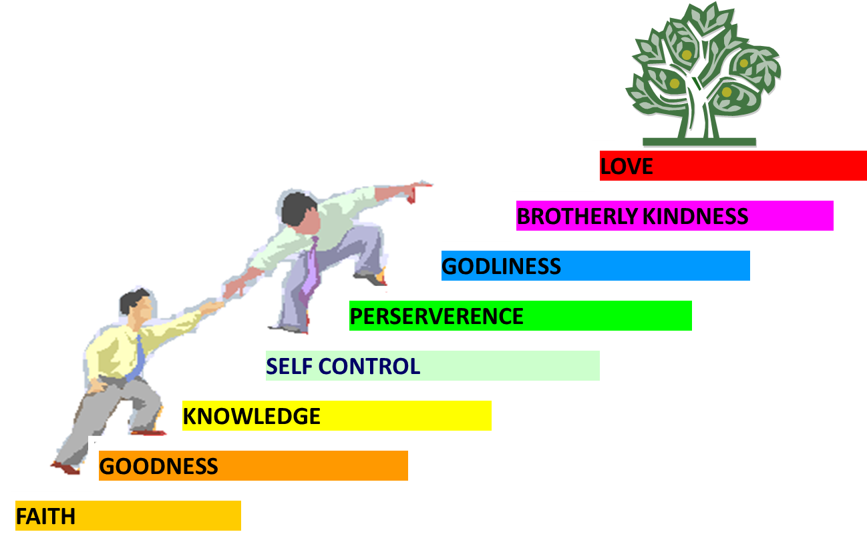
PORTRAIT OF GROWTH 1:5-7

Slide 23
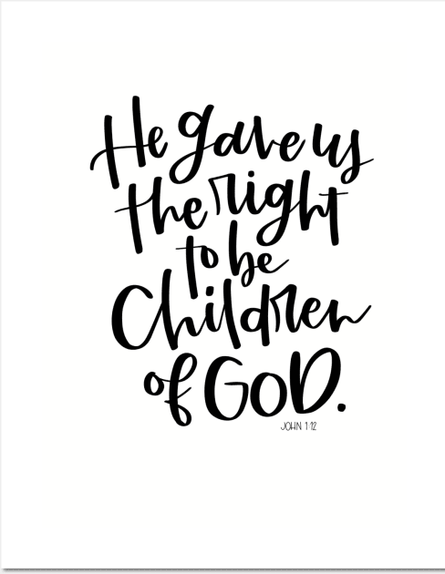
John 1:12
“But as many as received Him, to them He gave the right to become children of God, even to those who believe in His name.”

Slide 24
Distinctions Between 144,000 & Multitude
144,000 | MULTITUDE
Revelation 7:1-8 | Revelation 7:9-17
Numbered | Innumerable
Jews | All nations
Sealed | Slain
Sealed before the Tribulation | Converted out of the Tribulation
Hitchcock and Ice, The Truth Behind Left Behind, 77

Slide 25
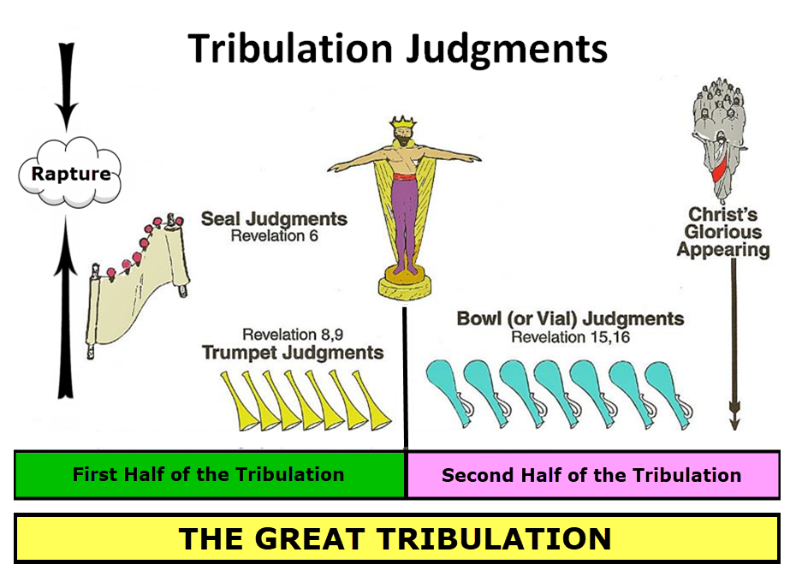

Slide 26
MATT 24 / REV 6 PARALLELS
Prediction | Birth pangs (Matt 24) | Seal judgments (Rev 6)
False Christ | 24:5 | 6:2
War | 24:6 | 6:3-4
Famine | 24:7 | 6:5-6
Death | 24:6-7 | 6:7-8
Martyrs | 24:9-13 | 6:9-11
Earthquakes | 24:7 | 6:12-17
Evangelism | 24:14 | 7:1-9

Slide 27
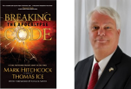
Thomas Ice
“Salvation in the Tribulation,” online: www.pre-trib.org, accessed 20 April 2024, 1.
“…the context of the entire passage relates to what will happen in the forthcoming Tribulation period. The context for when ‘they did not receive the love of the truth’ in verse 10 clearly will be taking place during the Tribulation. The 2nd Thessalonians 2 passage is talking about the response of unbelievers during the Tribulation. If the passage were referring to an unbelieving response prior to the Tribulation, with a result that such a decision would impact one’s destiny during the Tribulation, then the passage would have probably been worded differently in order to convey such a message. Since it is not so configured, then there is no support for the belief that a person’s rejection of the Gospel necessarily seals his fate if he . . .

Slide 28
Thomas Ice
“Salvation in the Tribulation,” online: www.pre-trib.org, accessed 20 April 2024, 1.
…enters the Tribulation. Specific support that verses 8–12 encompass events that will transpire in the Tribulation begins in verse 8, which says, ‘And then that lawless one will be revealed . . .’ In other words, ‘then’ denotes a shift from the current Church Age into a future era: the Tribulation. Nothing in verses 8—12 takes any part of that passage out of the context of the Tribulation. All, in my opinion, would agree that verses 8–9 refer to things the Antichrist will do during the Tribulation. Verse 10 is clearly related to its preceding context and speaks of something that will take place during the Tribulation.”

Slide 29
Conclusion

Slide 30
2 Thessalonians 2:10-12 Destruction of the Lawless One’s Followers
The judgment’s cause (10)
The judgment itself (11)
The judgment’s purpose (12)

Slide 31
2 Thessalonians 2:2
“that you not be quickly shaken from your composure or be disturbed either by a spirit or a message or a letter as if from us, to the effect that the day of the Lord [the Tribulation] has come.”

Slide 32
2 Thessalonians 2:1-12
Problem (2:1-2)
Prerequisites for the Day of the Lord (2:3-12)
The departure (2:3a)
Advent of the lawless one (2:3b-4)
Removal of the restrainer (2:5-7)
Destruction of the lawless one (2:8-9)
Destruction of lawless one’s followers (2:10-12)

