Slide 2
Acts 8:5-40 Philip’s Ministry
Samaria (8:5-25)
Judea (Acts 8:26-40)

Slide 3
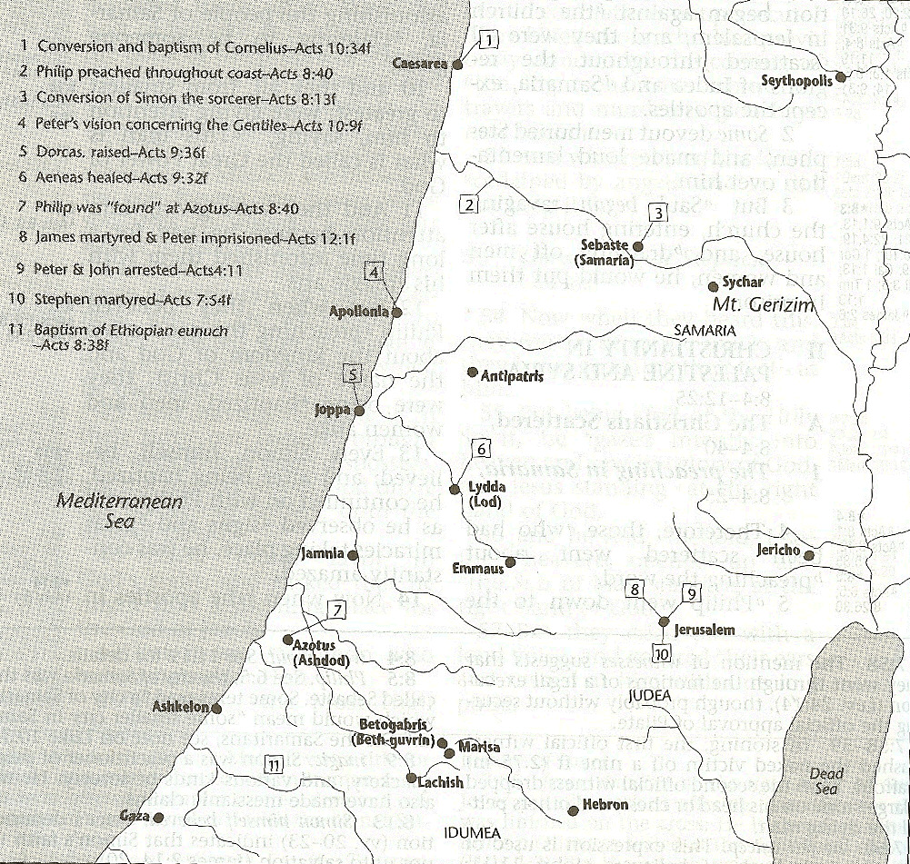

Slide 4
II. Ministry in Judea Acts 8:26-40
Angel directs Philip (26)
Philip’s obedience (27a)
Ethiopian Eunuch’s introduction (27b-28)
Holy Spirit directs Philip (29)
Philip’s witness to the Eunuch (30-35)
Eunuch’s conversion & baptism (36-38)
Philip’s separation from the Eunuch (39)
Philip’s evangelization of the Coastal Plain (40)

Slide 5
II. Ministry in Judea Acts 8:26-40
Angel directs Philip (26)
Philip’s obedience (27a)
Ethiopian Eunuch’s introduction (27b-28)
Holy Spirit directs Philip (29)
Philip’s witness to the Eunuch (30-35)
Eunuch’s conversion & baptism (36-38)
Philip’s separation from the Eunuch (39)
Philip’s evangelization of the Coastal Plain (40)

Slide 8
Stanley D. Toussaint
Bible Knowledge Commentary, p. 374
“Though Luke gave no record of God’s commanding Philip to preach to the Samaritans (v. 5), God did sovereignly direct Philip toward Gaza . . . The highway is referred to as the desert road. The expression may refer to a desert road or a desert city. Ancient Gaza was destroyed in 93 B.C. and the city was rebuilt nearer the Mediterranean in 57 B.C. The old city was called Desert Gaza. The Greek for the angel’s command could be translated, ‘Arise and go to the south to the road . . . that goes down from Jerusalem to Gaza. This is desert.’ This reference to the road in 8:36 may imply that the road, not the city, was in a deserted area.”

Slide 9
II. Ministry in Judea Acts 8:26-40
Angel directs Philip (26)
Philip’s obedience (27a)
Ethiopian Eunuch’s introduction (27b-28)
Holy Spirit directs Philip (29)
Philip’s witness to the Eunuch (30-35)
Eunuch’s conversion & baptism (36-38)
Philip’s separation from the Eunuch (39)
Philip’s evangelization of the Coastal Plain (40)

Slide 10
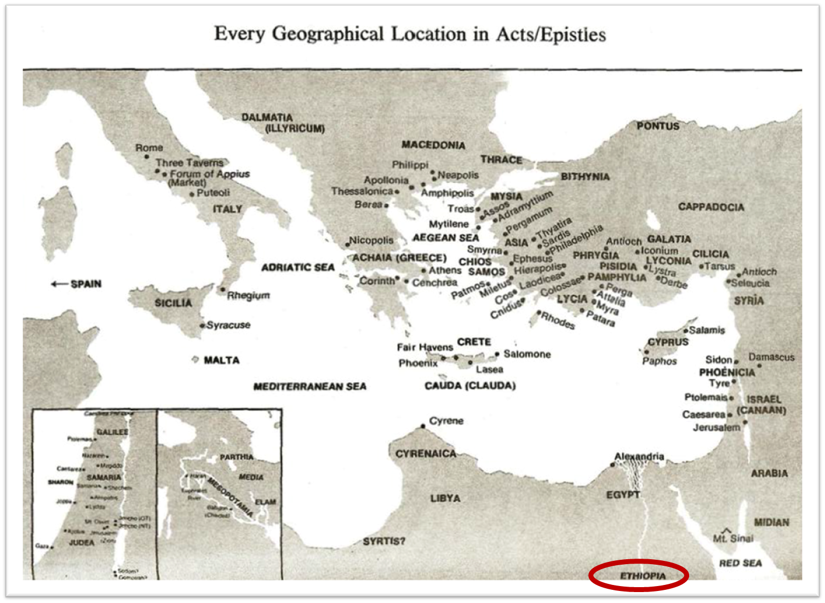

Slide 11
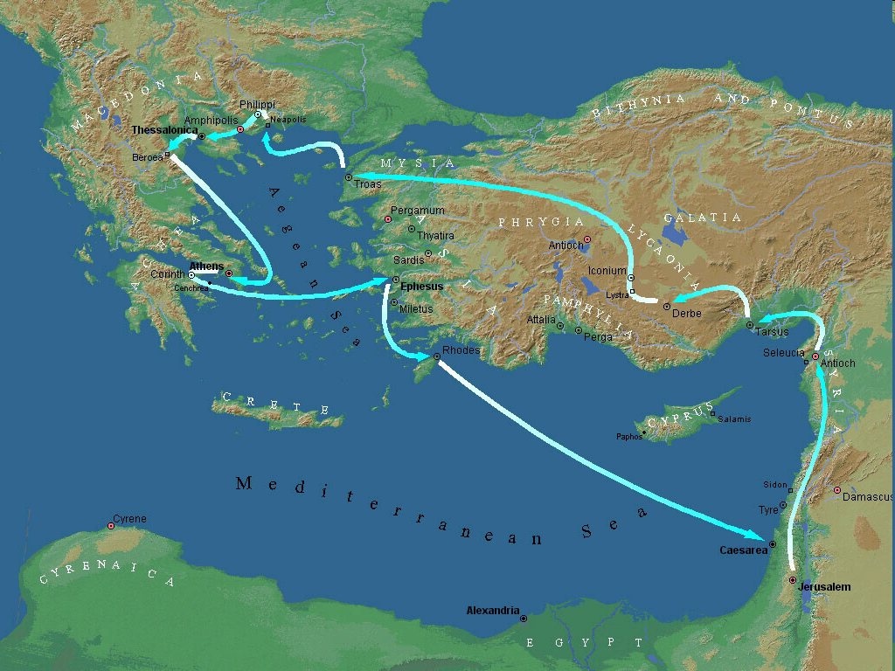
Second Missionary Journey

Slide 12
II. Ministry in Judea Acts 8:26-40
Angel directs Philip (26)
Philip’s obedience (27a)
Ethiopian Eunuch’s introduction (27b-28)
Holy Spirit directs Philip (29)
Philip’s witness to the Eunuch (30-35)
Eunuch’s conversion & baptism (36-38)
Philip’s separation from the Eunuch (39)
Philip’s evangelization of the Coastal Plain (40)

Slide 13
Dr. Arnold G. Fruchtenbaum
The Book of Acts, 200-201
“The text states that he was a eunuch. Eunuchs were often employed by oriental rulers in positions of high office. They were also male servants of female dignitaries, but only placed in such positions after having been castrated... Politically, he was a highly influential official under Candace, queen of the Ethiopians. ‘Candace’ (Kandakēs, in Greek) was not a proper name, but the title of the queen of Ethiopia, much like the word ‘Kaiser’ was the title of the king of Germany and ‘Czar’ was a title of the king of Russia.”

Slide 14
Dr. Arnold G. Fruchtenbaum
The Book of Acts, 200-201
“Because the king of Ethiopia was considered to be a child of the sun and therefore a person too sacred to be involved with secular functions of the royal court, all such duties fell to the queen mother, who had the title of ‘Candace.’ As a result, she was the real power behind the throne, and Ethiopia was a de facto matriarchy. The eunuch was in charge of her treasure, which means he held one of the highest governmental positions. His influence in Ethiopia would therefore have been very considerable.”

Slide 15
II. Ministry in Judea Acts 8:26-40
Angel directs Philip (26)
Philip’s obedience (27a)
Ethiopian Eunuch’s introduction (27b-28)
Holy Spirit directs Philip (29)
Philip’s witness to the Eunuch (30-35)
Eunuch’s conversion & baptism (36-38)
Philip’s separation from the Eunuch (39)
Philip’s evangelization of the Coastal Plain (40)

Slide 16
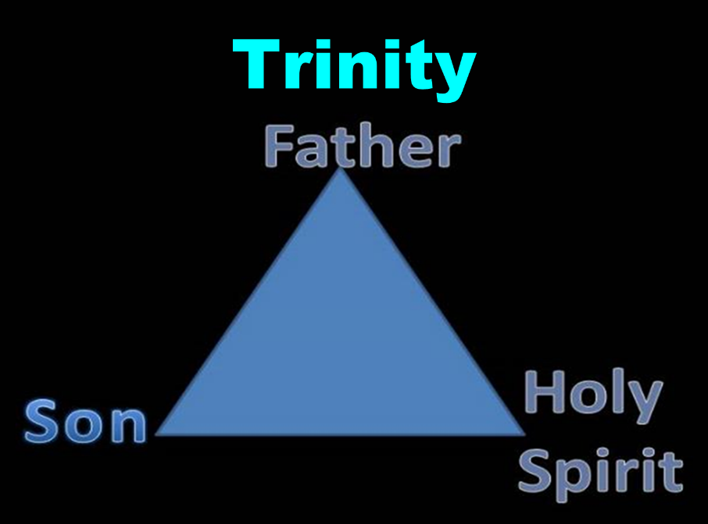

Slide 17
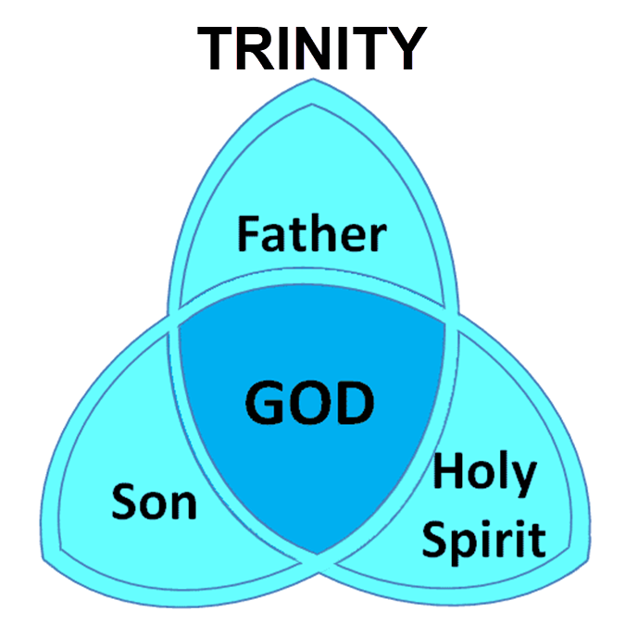

Slide 18
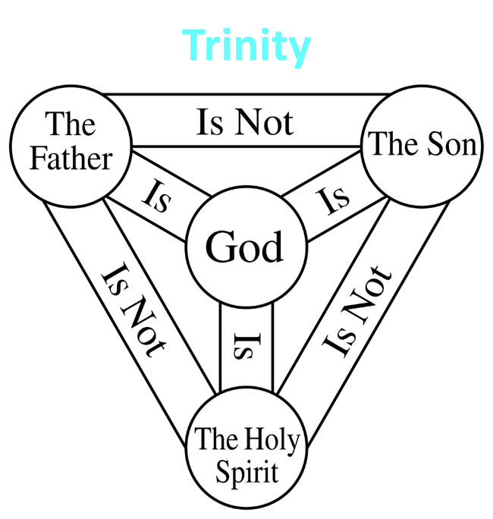

Slide 19
II. Ministry in Judea Acts 8:26-40
Angel directs Philip (26)
Philip’s obedience (27a)
Ethiopian Eunuch’s introduction (27b-28)
Holy Spirit directs Philip (29)
Philip’s witness to the Eunuch (30-35)
Eunuch’s conversion & baptism (36-38)
Philip’s separation from the Eunuch (39)
Philip’s evangelization of the Coastal Plain (40)

Slide 20
Acts 8:30-35 Philip’s Witness to the Eunuch
Philip’s question (30)
Eunuch’s answer (31)
Eunuch's reading (32-33)
Eunuch’s question (34)
Philip’s witness (35)

Slide 21
Acts 8:30-35 Philip’s Witness to the Eunuch
Philip’s question (30)
Eunuch’s answer (31)
Eunuch's reading (32-33)
Eunuch’s question (34)
Philip’s witness (35)

Slide 22
Acts 8:30-35 Philip’s Witness to the Eunuch
Philip’s question (30)
Eunuch’s answer (31)
Eunuch's reading (32-33)
Eunuch’s question (34)
Philip’s witness (35)

Slide 23
Ephesians 4:11-16
“¹¹ And He gave some as apostles, and some as prophets, and some as evangelists, and some as pastors and teachers, ¹² for the equipping of the saints for the work of service, to the building up of the body of Christ; ¹³ until we all attain to the unity of the faith, and of the knowledge of the Son of God, to a mature man, to the measure of the stature which belongs to the fullness of Christ. ¹⁴ As a result, we are no longer to be children, tossed here and there by. . .

Slide 24
Ephesians 4:11-16
“. . . waves and carried about by every wind of doctrine, by the trickery of men, by craftiness in deceitful scheming; ¹⁵ but speaking the truth in love, we are to grow up in all aspects into Him who is the head, even Christ, ¹⁶ from whom the whole body, being fitted and held together by what every joint supplies, according to the proper working of each individual part, causes the growth of the body for the building up of itself in love.”

Slide 25
Acts 8:30-35 Philip’s Witness to the Eunuch
Philip’s question (30)
Eunuch’s answer (31)
Eunuch's reading (32-33)
Eunuch’s question (34)
Philip’s witness (35)

Slide 26
Isaiah 53:3–6
³ He was despised and forsaken of men, A man of sorrows and acquainted with grief; And like one from whom men hide their face He was despised, and we did not esteem Him. ⁴ Surely our griefs He Himself bore, And our sorrows He carried; Yet we ourselves esteemed Him stricken, Smitten of God, and afflicted. ⁵ But He was pierced through for our transgressions, He was crushed for our…

Slide 27
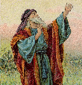
Isaiah 53:3–6
…iniquities; The chastening for our well-being fell upon Him, And by His scourging we are healed. ⁶ All of us like sheep have gone astray, Each of us has turned to his own way; But the Lord has caused the iniquity of us all To fall on Him.

Slide 28
Acts 8:30-35 Philip’s Witness to the Eunuch
Philip’s question (30)
Eunuch’s answer (31)
Eunuch's reading (32-33)
Eunuch’s question (34)
Philip’s witness (35)

Slide 29
Acts 8:30-35 Philip’s Witness to the Eunuch
Philip’s question (30)
Eunuch’s answer (31)
Eunuch's reading (32-33)
Eunuch’s question (34)
Philip’s witness (35)

Slide 30
Luke 24:27, 44
“²⁷ Then beginning with Moses and with all the prophets, He explained to them the things concerning Himself in all the Scriptures…⁴⁴ Now He said to them, ‘These are My words which I spoke to you while I was still with you, that all things which are written about Me in the Law of Moses and the Prophets and the Psalms must be fulfilled.’”

Slide 31
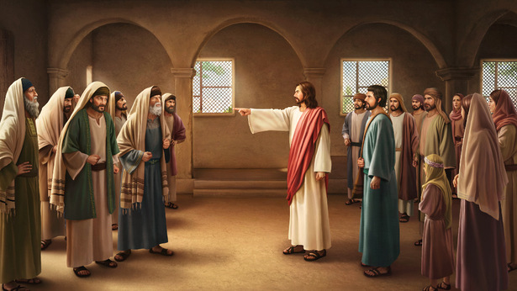
John 5:39, 46
“³⁹ You search the Scriptures because you think that in them you have eternal life; it is these that testify about Me. . .⁴⁶ For if you believed Moses, you would believe Me, for he wrote about Me.”

Slide 32
II. Ministry in Judea Acts 8:26-40
Angel directs Philip (26)
Philip’s obedience (27a)
Ethiopian Eunuch’s introduction (27b-28)
Holy Spirit directs Philip (29)
Philip’s witness to the Eunuch (30-35)
Eunuch’s conversion & baptism (36-38)
Philip’s separation from the Eunuch (39)
Philip’s evangelization of the Coastal Plain (40)

Slide 33
Sprinkling or Immersion?
Sprinkling? Other words (1 Pet. 1:12; 2 Tim. 4:6)
Immersion?
Christ’s baptism (Matt. 3:16; Mark 1:10)
Ethiopian eunuch's baptism (Acts 8:38-39)
Best symbolizes our union with Christ (Rom. 6:3)
Symbolizes a new creation (Gen. 1:6, 9; 2 Pet. 3:5; 2 Cor. 5:17)

Slide 34
II. Ministry in Judea Acts 8:26-40
Angel directs Philip (26)
Philip’s obedience (27a)
Ethiopian Eunuch’s introduction (27b-28)
Holy Spirit directs Philip (29)
Philip’s witness to the Eunuch (30-35)
Eunuch’s conversion & baptism (36-38)
Philip’s separation from the Eunuch (39)
Philip’s evangelization of the Coastal Plain (40)

Slide 35
Exemption from Death (1 Cor 15:54-56)
Enoch (Gen 5)
Elijah (2 Kings 2)
Christ (Acts 1:11; Rev 12:5)
Philip (Acts 8:39)
Paul (2 Cor 12:2, 4)
John (Rev 4:1-2)
Two witnesses (Rev 11)

Slide 36
1 Thessalonians 4:13-18
¹³ "But we do not want you to be uninformed, brethren, about those who are asleep, so that you will not grieve as do the rest who have no hope. ¹⁴ For if we believe that Jesus died and rose again, even so God will bring with Him those who have fallen asleep in Jesus. ¹⁵ For this we say to you by the word of the Lord, that we who are alive and remain until the coming of the Lord, will not precede those who have fallen asleep. ¹⁶ For the Lord Himself will . . .

Slide 37
1 Thessalonians 4:13-18
…descend from heaven with a shout, with the voice of the archangel and with the trumpet of God, and the dead in Christ will rise first. ¹⁷ Then we who are alive and remain will be caught up together with them in the clouds to meet the Lord in the air, and so we shall always be with the Lord. ¹⁸ Therefore comfort one another with these words."

Slide 39
II. Ministry in Judea Acts 8:26-40
Angel directs Philip (26)
Philip’s obedience (27a)
Ethiopian Eunuch’s introduction (27b-28)
Holy Spirit directs Philip (29)
Philip’s witness to the Eunuch (30-35)
Eunuch’s conversion & baptism (36-38)
Philip’s separation from the Eunuch (39)
Philip’s evangelization of the Coastal Plain (40)

Slide 42
Conclusion

Slide 43
Acts 8:5-40 Philip’s Ministry
Samaria (8:5-25)
Judea (Acts 8:26-40)

Slide 44
II. Ministry in Judea Acts 8:26-40
Angel directs Philip (26)
Philip’s obedience (27a)
Ethiopian Eunuch’s introduction (27b-28)
Holy Spirit directs Philip (29)
Philip’s witness to the Eunuch (30-35)
Eunuch’s conversion & baptism (36-38)
Philip’s separation from the Eunuch (39)
Philip’s evangelization of the Coastal Plain (40)

