Slide 1
Law and Grace: An Overview Jim McGowan, Th.D. Sugar Land Bible Church 05-05-2024
…but grace and truth were realized through Jesus Christ - John 1:17
For the Law was given through Moses…
Special thanks to Dr. Vern Peterman for access to his insights and resources.

Slide 2
Session 43 Outline
Review
Purpose, Aim, and Objective
Review Session 42
Relationship, Position, and Blessing – Does It Matter?
Where we’ve been and where we’re going.
Concluding Observations

Slide 3
OUR PURPOSE, AIM AND OBJECTIVE
Law and Grace
…is to Compare and Contrast Law and Grace so as to properly understand these two important themes and how they are related to the life of the New Testament Believer.

Slide 4
C. I. Scofield, D. D.
The Grace of God, The Fundamentals Vol. 3, Chapter VII, p. 98
We have, most of us, been reared and now live under the influence of Galatianism. Protestant theology, alas, is for the most part, thoroughly Galatianized, in that neither law nor grace are given their distinct and separated places, as in the counsels of God, but are mingled together in one incoherent system.
The law is no longer, as in the Divine intent, a ministration of death (2 Cor. 3:7), of cursing (Gal. 3:10), of conviction (Rom. 3:19), because we are taught that we must try to keep it, and that by Divine help we may.
Nor, on the other hand, does grace bring us blessed deliverance from the dominion of sin, for we are kept under the law as a rule of life despite the plain declaration, “Sin shall not have dominion over you: for ye are not under the law, but under grace” (Rom. 6:14). (emphasis mine)

Slide 5
William R. Newell
Romans Verse-by-Verse (p. 274).
Grand Rapids, MI: Christian Classics Ethereal Library.
It is because Reformed theology has kept us Gentiles under the Law,—if not as a means of righteousness, then as “a rule of life,” that all the trouble has arisen. The Law is no more a rule of life than it is a means of righteousness. Walking in the Spirit has now taken the place of walking by ordinances. God has another principle under which He has put his saints: “Ye are not under law, but, under grace! (Rom. 6:14)” (italics mine)
PDF Download Here: https://archive.org/details/Romans_Verse_By_Verse-NewellWR

Slide 6
Henry Ironside
The Continual Burnt Offering: Daily Meditations on the Word of God (p. 265). Neptune, NJ: Loizeaux Brothers.
In Romans 7 we have a man renewed by the Spirit of God, but struggling under law, hoping thereby to subdue or find deliverance from the power of the old Adamic nature. In chapter 8 we have God’s way of deliverance through the death and resurrection of Christ with which the believer is identified before God. The chapter begins with “no condemnation” and ends with “no separation.” All who are in Christ Jesus are accepted in the Beloved and as free from every charge of guilt as He is Himself. He paid our penalty on the cross. Now we are linked up with Him in resurrection, not under law but under grace.

Slide 7
Matthew’s 3-Fold Purpose
Law and Grace: Review - Matthew
To explain:
that Jesus in whom they had believed was the long-awaited Jewish Messiah
why the kingdom had been postponed despite the fact that the king had arrived
the interim program of God during the kingdom’s absence

Slide 8
Matthew and the Kingdom
Law and Grace: Review - Matthew
 | offered
 | rejected
 | postponed Interim program
 | ultimately accepted

Slide 9
Matthew’s Message
Law and Grace: Review - Matthew
Jesus is the predicted Jewish king who ushered in an interim program by building the sons of the kingdom into the Church in between Israel’s past rejection and future acceptance of her king.

Slide 10
Session 43 Outline
Review
Purpose, Aim, and Objective
Review Session 42
Relationship, Position, and Blessing – Does It Matter?
Where we’ve been and where we’re going.
Concluding Observations

Slide 11
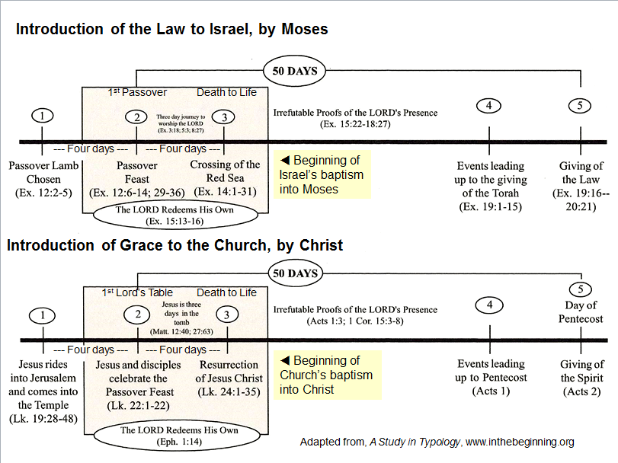
Law and Grace: Review – General

Slide 12
Law and Grace: Review – General
CHARTING THE THREE DIFFERENT GROUPS OF PEOPLE

Slide 13
Law and Grace: Review – General
THE UNIVERSAL KINGDOM OF GOD
God’s rule over, management of, and building of, His creation as King, Administrator, Builder
Psalm 47; 57:11; Jeremiah 23:24; Ephesians 1:10; Hebrews 3:4
Alpha
Omega
Seal Opener
Seated in the heavenlies, and our life on earth
The Messiah, King of Israel, King of kings and Lord of lords over the Gentiles
Creator
The Angel of the Lord
Lamb, Word made flesh
7 year Tribulation
Abraham
Moses
David
Adam
Millennial Kingdom
Noah
Church: Grace
Israel: Mosaic Law
Kingdom Law
Gentiles
World, Flesh, Devil
Flesh

Slide 14
Law and Grace: Review – General

Slide 15
Law and Grace: Review – General

Slide 16
Session 43 Outline
Review
Purpose, Aim, and Objective
Review Session 42
Relationship, Position, and Blessing – Does It Matter?
Where we’ve been and where we’re going.
Concluding Observations

Slide 17
SOME INTRODUCTORY OBSERVATIONS
Law and Grace: Relationship, Position, and Blessing – Does It Matter?
There are important reasons for going through all of these studies:
Much of so-called Christendom teaches a manmade mixture of mini-law and mini-grace.

Slide 18
SOME INTRODUCTORY OBSERVATIONS
Law and Grace: Relationship, Position, and Blessing – Does It Matter?
But when examined closely, we see that God never intended the Law of Moses to be any less than the 613 individual laws.

Slide 19
SOME INTRODUCTORY OBSERVATIONS
Law and Grace: Relationship, Position, and Blessing – Does It Matter?
Likewise, God’s amazing grace is infinitely awesome.

Slide 20
Law and Grace: Relationship, Position, and Blessing – Does It Matter?
IT’S ABOUT WHO YOU’RE INTO...
The Israelites, to whom were given the unabridged set of 613 laws by Moses, were all baptized into Moses in the cloud and the sea.
The Law was good and holy and righteous (cf. Romans 7:12).

Slide 21
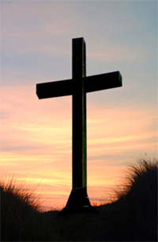
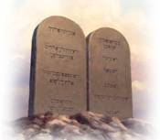
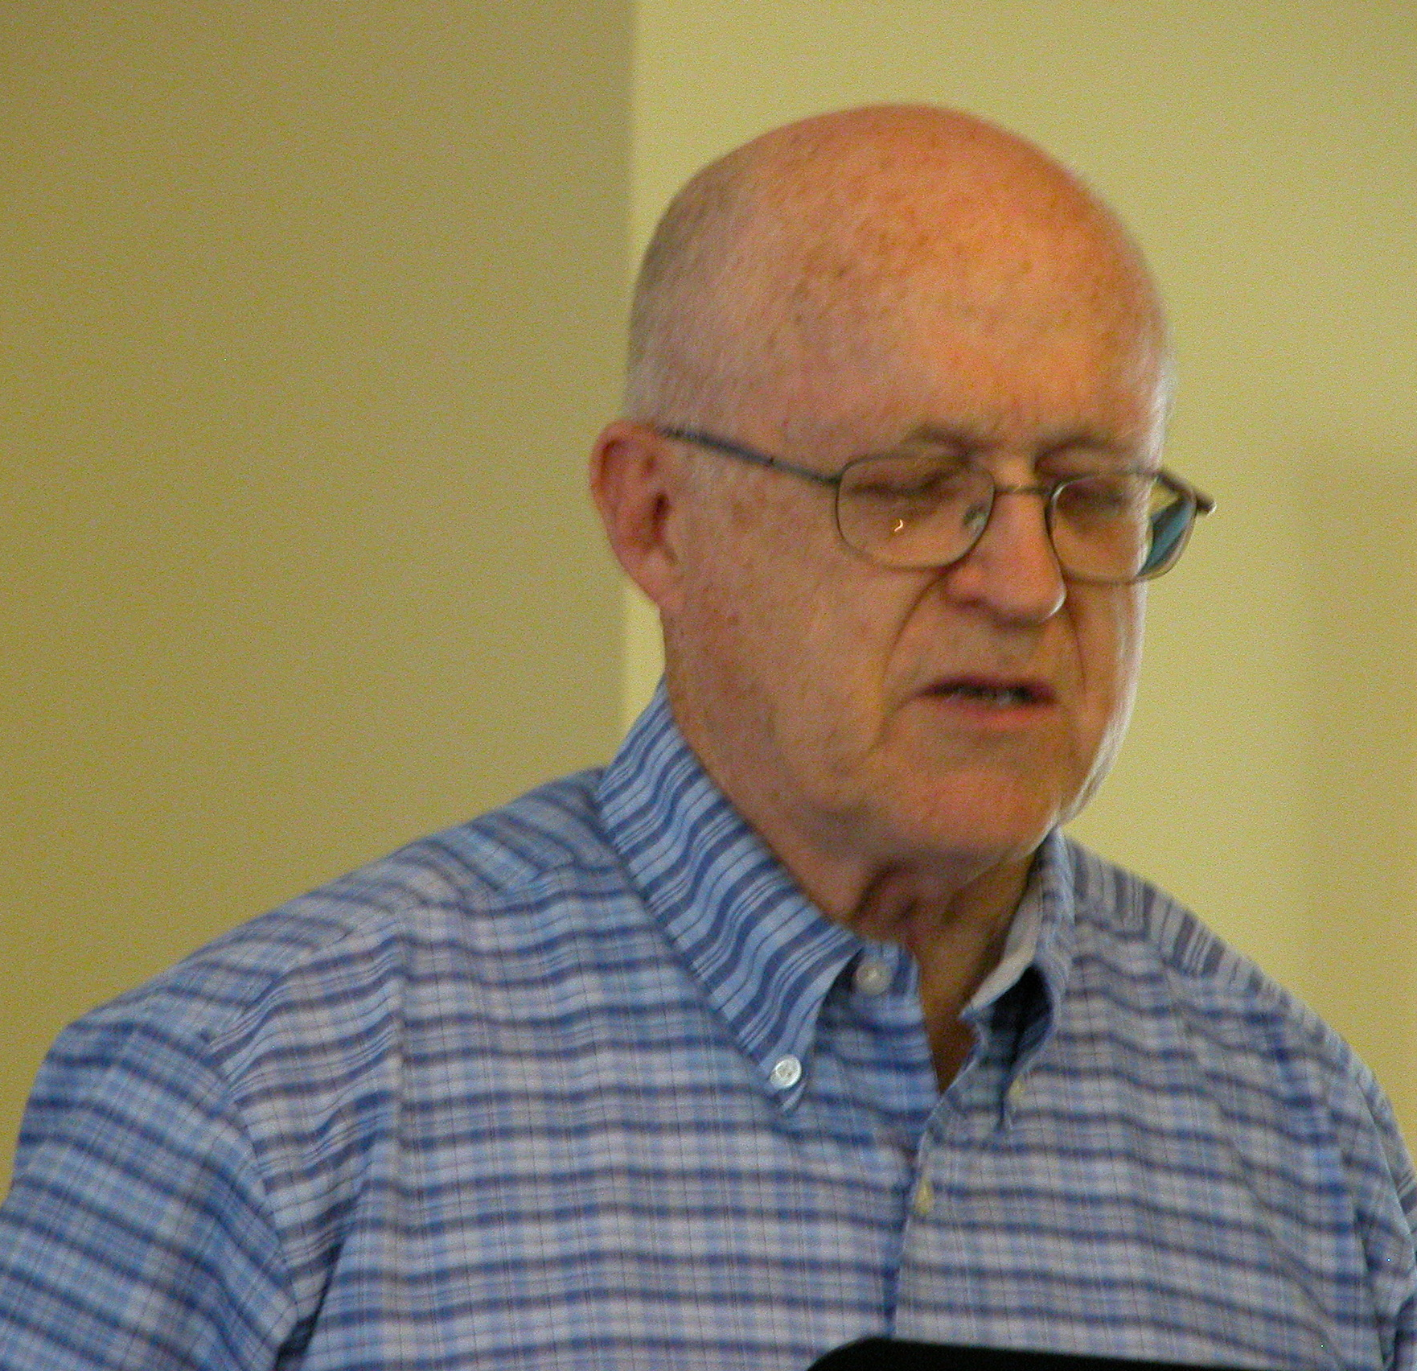
Law and Grace: Relationship, Position, and Blessing – Does It Matter?
IT’S ABOUT WHO YOU’RE INTO...
We who are in the Church have died to the Law of Moses as we have been baptized into Christ, in His death, burial; resurrection, ascension and seating with Him, there in the heavenlies.

Slide 22
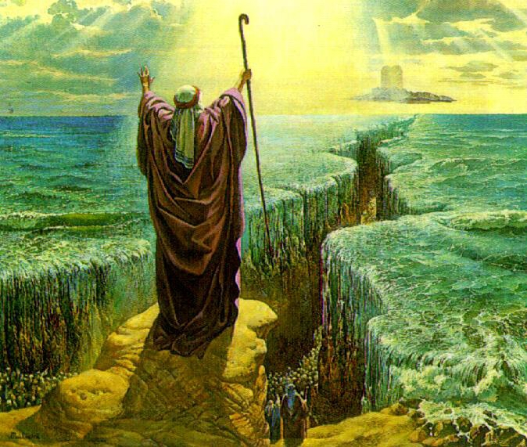
Law and Grace: Relationship, Position, and Blessing – Does It Matter?
WE’RE NOT JUST BEING PICKY; WE’RE LOOKING FOR CLARITY!
The Israelites were given the Law by Moses and baptized into him.

Slide 23
Law and Grace: Relationship, Position, and Blessing – Does It Matter?
WE’RE NOT JUST BEING PICKY; WE’RE LOOKING FOR CLARITY!
We in the Church (the Body of Christ, the Bride), have been baptized into Christ and have died to the Law.

Slide 24
Law and Grace: Relationship, Position, and Blessing – Does It Matter?
WE’RE NOT JUST BEING PICKY; WE’RE LOOKING FOR CLARITY!
Sadly, much of the variation among Christian groups and denominations is in fact, due to the mixing Law and Grace!

Slide 25
Law and Grace: Relationship, Position, and Blessing – Does It Matter?
WE’RE NOT JUST BEING PICKY; WE’RE LOOKING FOR CLARITY!
Is the best we have to offer people a mixture of Law and Grace?

Slide 26
Law and Grace: Relationship, Position, and Blessing – Does It Matter?
WE SEEK CLARITY ABOUT SOME IMPORTANT QUESTIONS!
Who am I and who are we?
Where did we come from and what is our spiritual history?
Where is my and our citizenship, home, and hope, and where and how am I blessed?

Slide 27
Law and Grace: Relationship, Position, and Blessing – Does It Matter?
WE SEEK CLARITY ABOUT SOME IMPORTANT QUESTIONS!
What exactly is the nature of my and our relationship with God, now and on into eternity?
What is the reigning principle governing my life on earth and for all eternity?

Slide 28
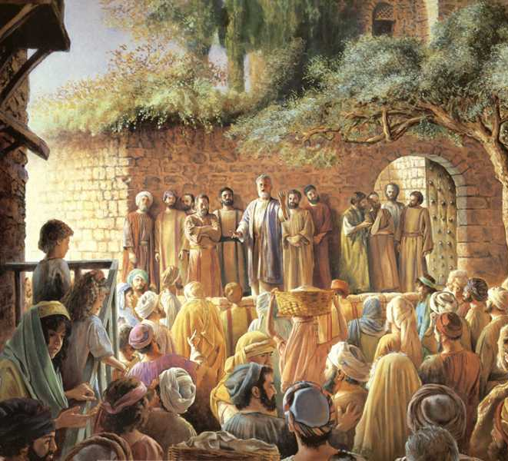
Law and Grace: Relationship, Position, and Blessing – Does It Matter?
WHO AM I AND WHO ARE WE?
We, from the time that we believed the gospel of salvation, were placed into the body of Christ by the Holy Spirit (cf. 1 Corinthians 12:13).
This has been true from Acts 2, and will be until the rapture.

Slide 29
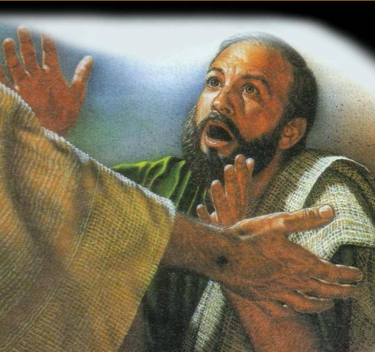
Law and Grace: Relationship, Position, and Blessing – Does It Matter?
WHO AM I AND WHO ARE WE?
Yet, although we have been placed into the body of Christ, the church, we also have an individual and personal relationship with Christ that is unique and unlike another….

Slide 30
Law and Grace: Relationship, Position, and Blessing – Does It Matter?
WHO AM I AND WHO ARE WE?

Slide 31
Law and Grace: Relationship, Position, and Blessing – Does It Matter?
WHERE DID WE COME FROM…WHAT IS OUR SPIRITUAL HISTORY?
Physically, we are descended from Adam and Eve, and though tarnished by Adam’s sin, we still bear the image of God.

Slide 32
Law and Grace: Relationship, Position, and Blessing – Does It Matter?
THE IMAGE AND LIKENESS OF GOD
passage | image | likeness | key point
Gen. 1:26 | X | X | made in God’s image and likeness
Gen. 1:27 | X |  | made in God’s image - male and female
Gen. 5:1 |  | X | made in God’s likeness; summary
Gen. 9:6 | X |  | made in God’s image – so give respect to that image in person
1 Cor. 11:7 | X |  | made in God’s image – woman is the glory of man re: Church
Jam. 3:9 |  | X | made in God’s likeness and a warning about cursing others

Slide 33
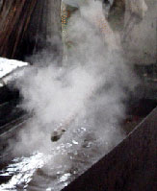
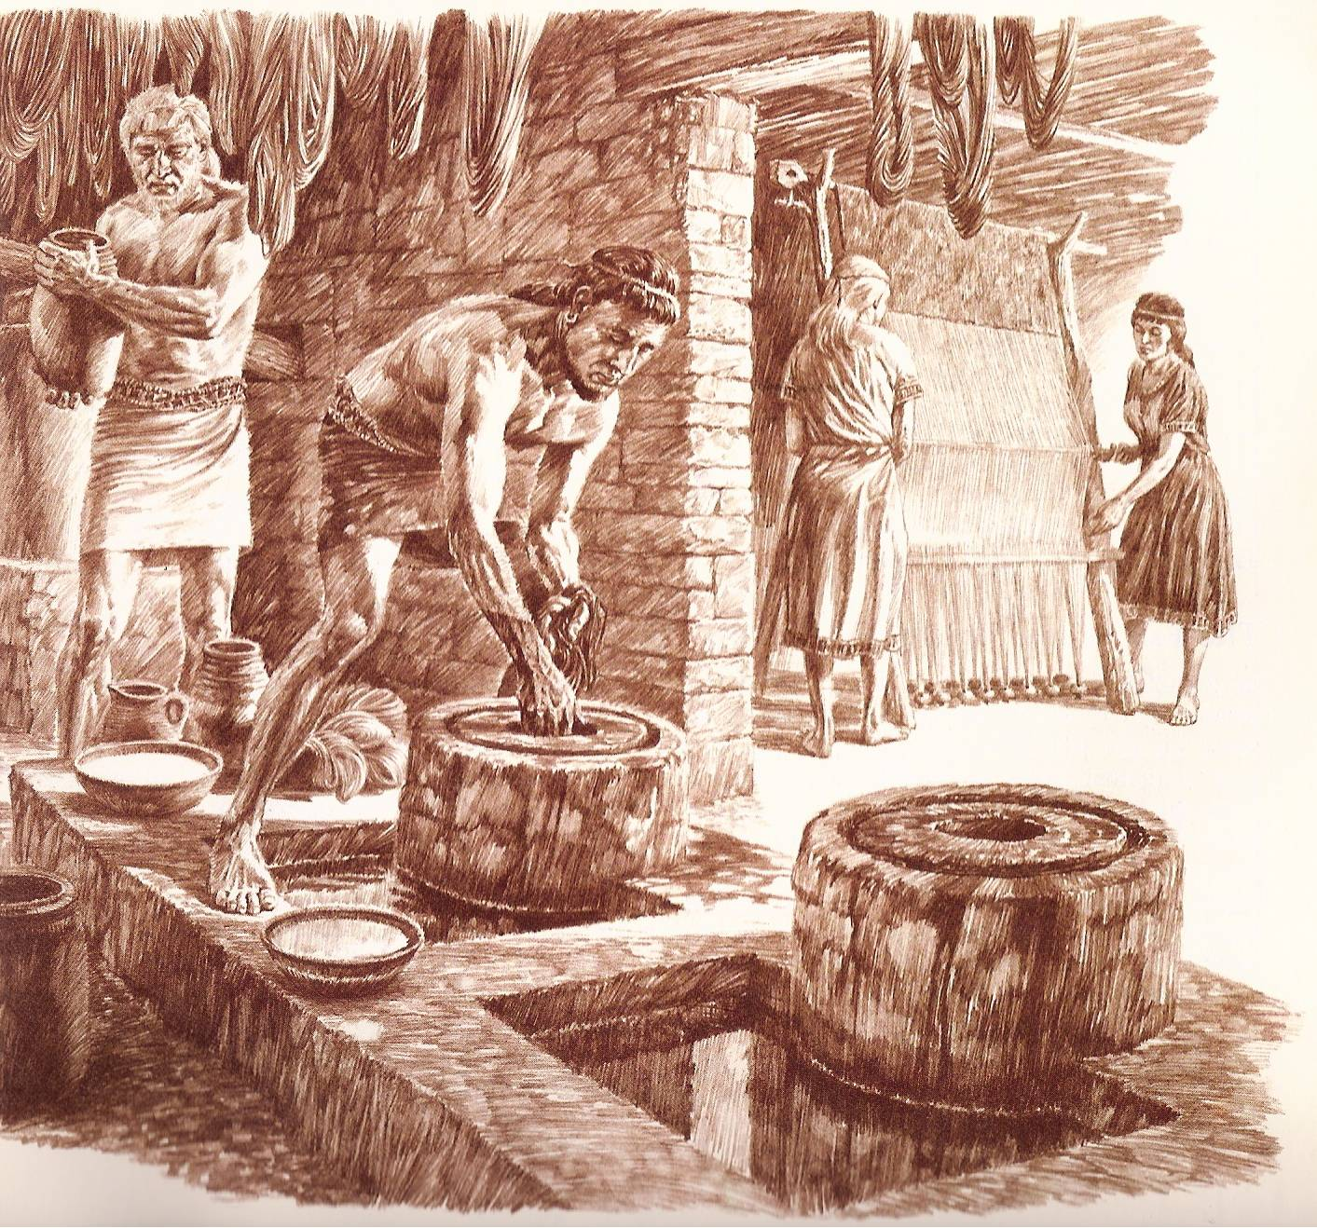
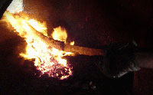
Law and Grace: Relationship, Position, and Blessing – Does It Matter?
WHERE DID WE COME FROM…WHAT IS OUR SPIRITUAL HISTORY?
But when each of us believed, we were taken out of Adam, and were then placed into Christ – identified with Him.

Slide 34
Law and Grace: Relationship, Position, and Blessing – Does It Matter?
WHERE DID WE COME FROM…WHAT IS OUR SPIRITUAL HISTORY?
Being in Christ, a new kind of man, we share His spiritual history, as He died, was buried, raised, ascended and seated.

Slide 35
John 17:24
“Father, I desire that they also, whom You have given Me, be with Me where I am, so that they may see My glory which You have given Me, for You loved Me before the foundation of the world.
1 John 3:2
Beloved, now we are children of God, and it has not appeared as yet what we will be. We know that when He appears, we will be like Him, because we will see Him just as He is.

Slide 36
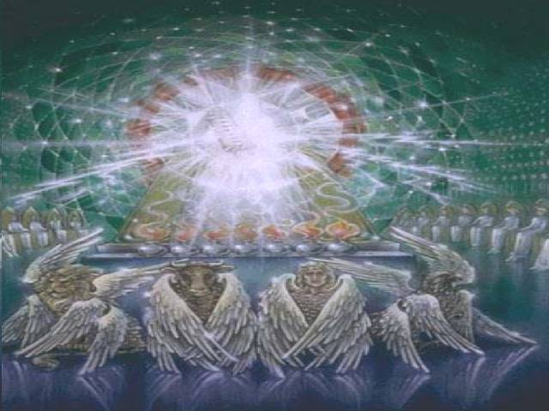
Law and Grace: Relationship, Position, and Blessing – Does It Matter?
HEAVEN’S WHERE WE’RE AT!
There in the heavenlies ‘in Christ’ is where we are blessed. (cf. Eph.1:3)
There in the heavenlies ‘in Christ’ is where we are seated with Him. (cf. Eph. 2:6)

Slide 37
Law and Grace: Relationship, Position, and Blessing – Does It Matter?
HEAVEN’S WHERE WE’RE AT!
There in the heavenlies ‘in Christ’ is where we have our citizenship.
There in the heavenlies ‘in Christ’ is where we are to set our minds.
It is there in the heavenlies ‘in Christ’ where we have our certain hope, untouchable, untarnished.

Slide 38
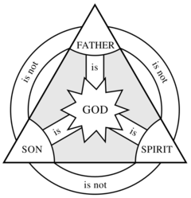
THROUGH CHRIST, WE HAVE RELATIONSHIP WITH THE ETERNAL TRINITY
Law and Grace: Relationship, Position, and Blessing – Does It Matter?
Through Christ we have access to the Father, by means of the Spirit.
And one of the prime truths of our identification with Christ is that it is the eternal basis for intimacy with Him.

Slide 39
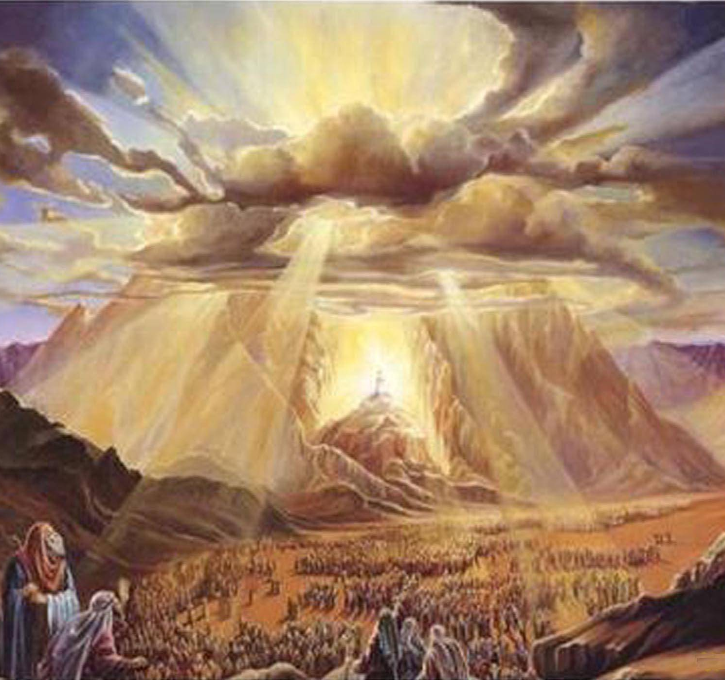
THROUGH CHRIST, WE HAVE RELATIONSHIP WITH THE ETERNAL TRINITY
Law and Grace: Relationship, Position, and Blessing – Does It Matter?
Those baptized into Moses had to keep their distance or die (cf. Ex. 19:10-25),…

Slide 40
THROUGH CHRIST, WE HAVE RELATIONSHIP WITH THE ETERNAL TRINITY
Law and Grace: Relationship, Position, and Blessing – Does It Matter?
…but we who have been baptized into Christ are spiritually and intimately close to Him, and are transformed into His image as we behold Him in the word.

Slide 41
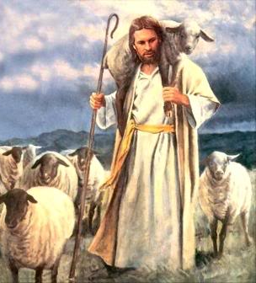
Who are you?
Law and Grace: Relationship, Position, and Blessing – Does It Matter?
You are of the Body of Christ, a church-age saint, of His flock, bought with a price, Christ’s brethren.
You are also God’s child by the adoption of sons (cf. 1 Cor. 12:13; Acts 20:17-38; 1 Cor. 6:2; 7:23).

Slide 42
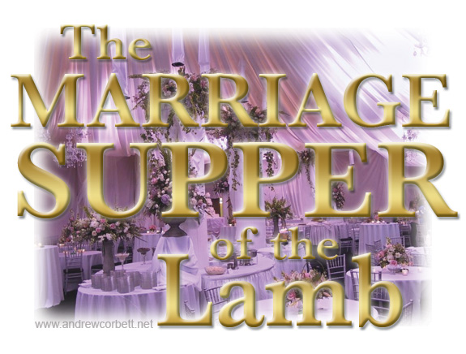
Who are you?
Law and Grace: Relationship, Position, and Blessing – Does It Matter?
From the end of the gospels to the end of the last book of the Bible you are, altogether, the Bride of Christ – human marriage here is the shadow.
Intimacy with Christ now is the prelude to eternal intimacies with Jesus Christ once we are glorified!

Slide 43
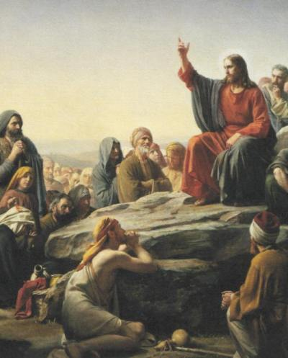
Law and Grace: Relationship, Position, and Blessing – Does It Matter?
We’re saying this because…?
In the context of the Gospel of Matthew, when we read about the kingdom of heaven (i.e., kingdom of God), which refers to the future reign of Christ during the Millennial Kingdom, our place and position in that Coming Kingdom will not be the same as that of the Israelites.

Slide 44
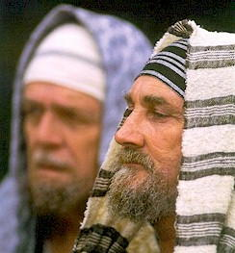
Law and Grace: Relationship, Position, and Blessing – Does It Matter?
Kingdom of God = kingdom of heaven?
The term ‘kingdom of God’ is taken as a synonym for the ‘kingdom of heaven’.
The Jews often used ‘heaven’ as a synonym for God to avoid the risk of taking God’s name in vain.

Slide 45
Law and Grace: Relationship, Position, and Blessing – Does It Matter?
Kingdom of God = kingdom of heaven?
The phrase ‘kingdom of heaven’ only occurs in Matthew while parallel passages in the other gospels (Mark, Luke and John) have ‘kingdom of God’, but no other Bible passage explains or suggests any difference in the use or understood meaning between these terms. Why is this?
Could it be that of the four gospels, Matthew Mark Luke and John, the only one that was uniquely and specifically written directly to the Jews was… Matthew?

Slide 46
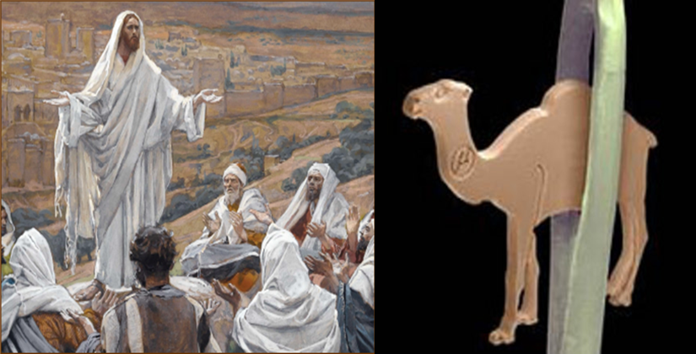
Matthew 19:23-24
“²³ And Jesus said to His disciples, “Truly I say to you, it is hard for a rich man to enter the kingdom of heaven. ²⁴ “Again I say to you, it is easier for a camel to go through the eye of a needle, than for a rich man to enter the kingdom of God.””

Slide 47
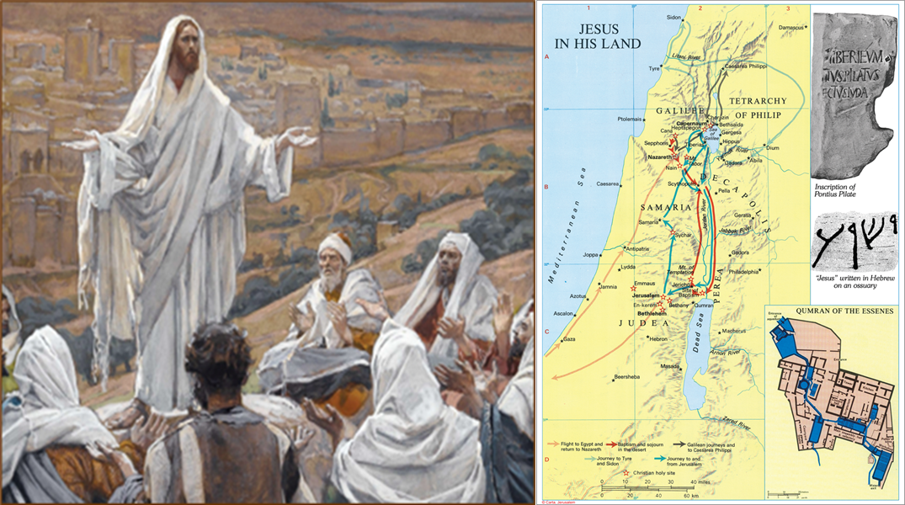
Law and Grace: Relationship, Position, and Blessing – Does It Matter?
We’re saying this because…?
When Christ said that He didn’t come to abolish the Law or the Prophets (cf. Matthew 5:17-19), He was speaking to Israelites in Israel.

Slide 48
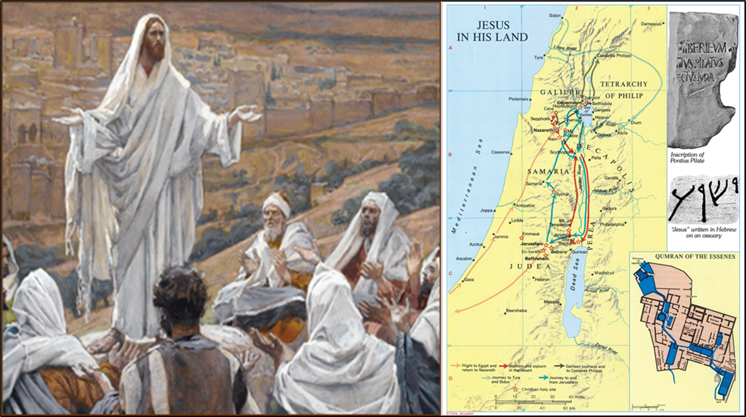
Matthew 5:17–19
¹⁷ “Do not think that I came to abolish the Law or the Prophets; I did not come to abolish but to fulfill. ¹⁸ “For truly I say to you, until heaven and earth pass away, not the smallest letter or stroke shall pass from the Law until all is accomplished. ¹⁹ “Whoever then annuls one of the least of these commandments, and teaches others to do the same, shall be called least in the kingdom of heaven; but whoever keeps and teaches them, he shall be called great in the kingdom of heaven.

Slide 49
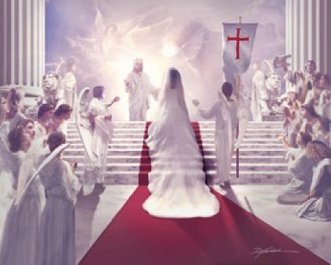
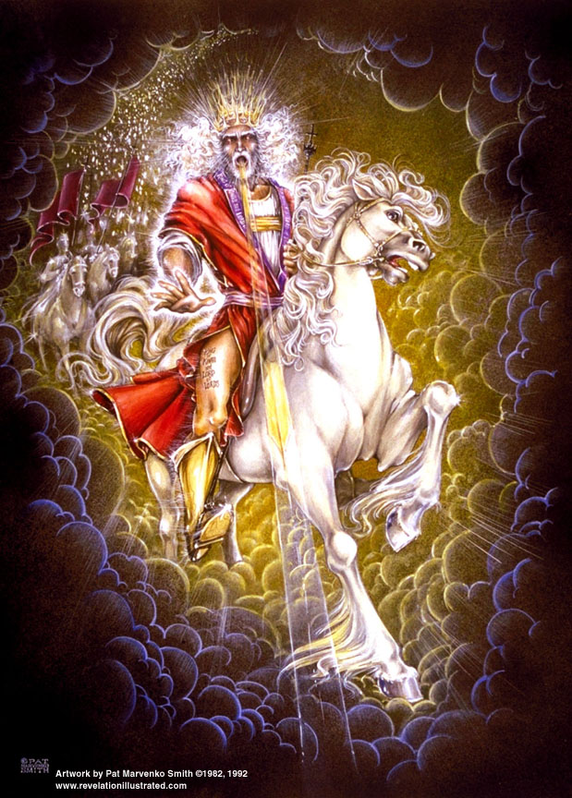
Law and Grace: Relationship, Position, and Blessing – Does It Matter?
We’re saying this because…?
Christ will be the King of Israel and King of kings over the Gentiles, but He will be our groom.

Slide 50
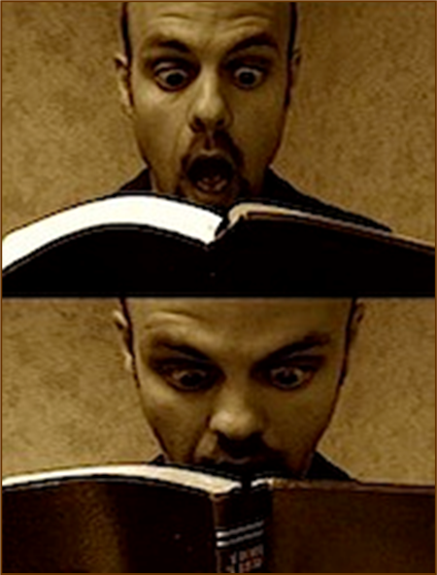
Law and Grace: Relationship, Position, and Blessing – Does It Matter?
THE CHURCH AS THE BRIDE OF CHRIST – TWO ISSUES
Does the Bible teach this and what is the significance of this imagery and symbolism? (cf. Mark 2:19-20; John 3:29; 2 Cor. 11:2; Eph. 5:24-25)

Slide 51
Law and Grace: Relationship, Position, and Blessing – Does It Matter?
IMAGINE THE SURPRISE OF THE DISCIPLES…
In John 14:3, Jesus tells the disciples…

Slide 52
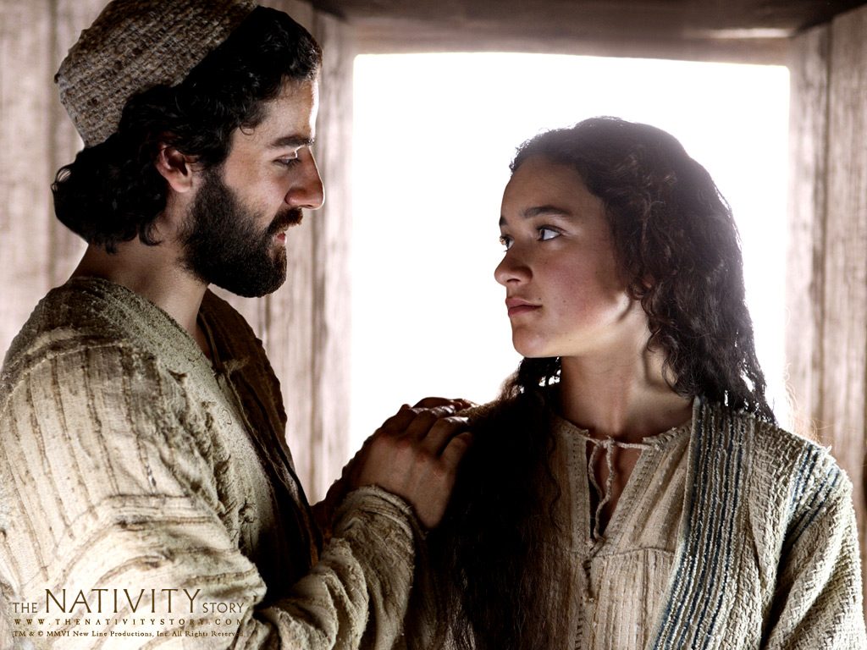
Law and Grace: Relationship, Position, and Blessing – Does It Matter?
IMAGINE THE SURPRISE OF THE DISCIPLES…
These were the sort of words that a Jewish groom would say to his bride once the engagement had taken place and he was going to build a home for them both to live in.
“…I go and prepare a place for you, I will come again and receive you to myself, that where I am, there you may be also.”

Slide 53
Law and Grace: Relationship, Position, and Blessing – Does It Matter?
IMAGINE THE SURPRISE OF THE DISCIPLES…
Jesus, in the middle of His prayer in the Garden of Gethsemane said the following words with us in mind.

Slide 54
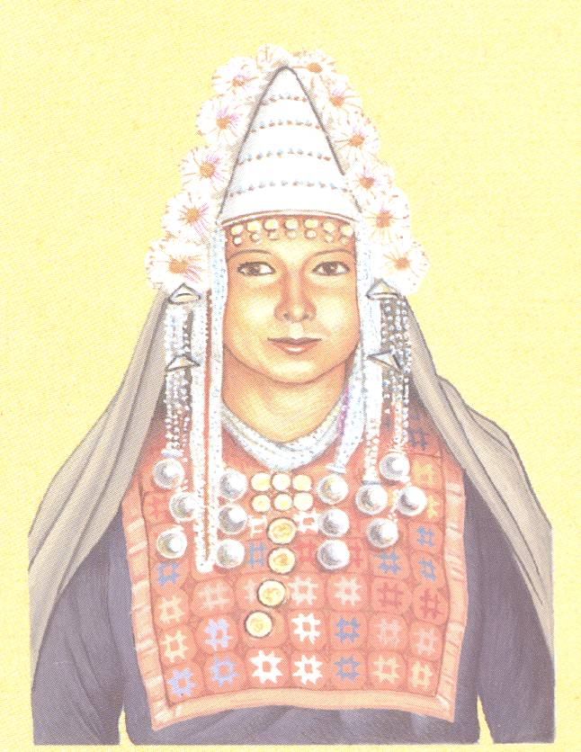
Law and Grace: Relationship, Position, and Blessing – Does It Matter?
IMAGINE THE SURPRISE OF THE DISCIPLES…
In the Jewish wedding customs, from engagement until the time of the wedding, the father was responsible for keeping the bride consecrated, sanctified, and set apart exclusively for her bridegroom.

Slide 55
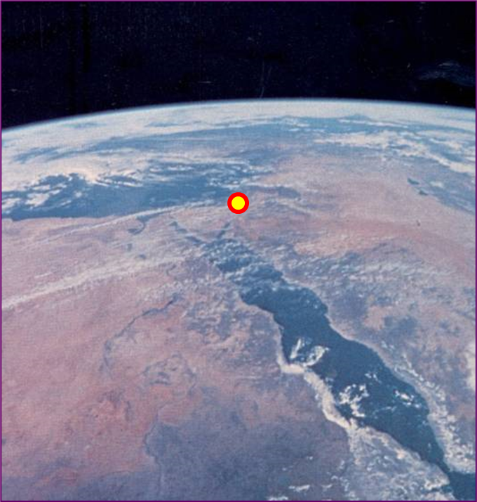
Law and Grace: Relationship, Position, and Blessing – Does It Matter?
GENTILES, ISRAEL AND THE CHURCH
In the kingdom the Gentiles will come to Jesus Christ the Messiah through the people of Israel. (cf. Zech. 8:23)
Christ reigning over the people of Israel in the land of Israel will be the fulfillment of the promised kingdom of God.

Slide 56
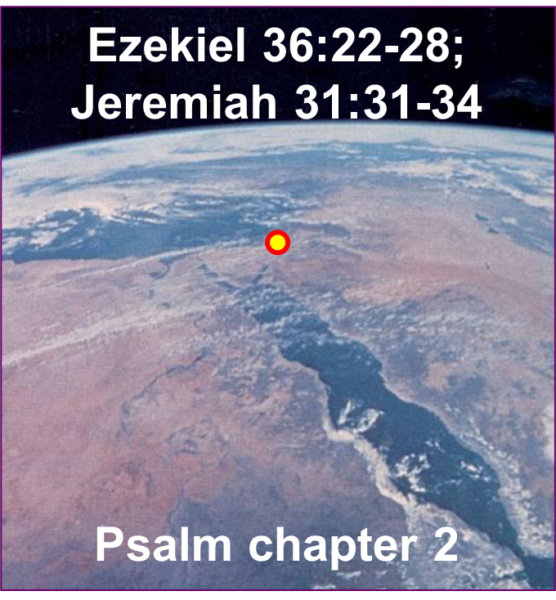
Law and Grace: Relationship, Position, and Blessing – Does It Matter?
GENTILES, ISRAEL AND THE CHURCH
The people of Israel will be indwelt by the Holy Spirit to know and live out Kingdom Law. (cf. Ezekiel 36:22-28; Jeremiah 31:31-34)
The Gentiles will also be ruled under Kingdom Law as is indicated by the Scriptures use of the term, “rod of iron”. (cf. Psalm 2; Rev. 12:5).
But we in the Church will forever be the people of Grace.

Slide 57
Law and Grace: Relationship, Position, and Blessing – Does It Matter?
THE CROSS WAS A CROSSROAD
The Cross does not mean the very same thing for all people of all time. For everyone, Christ’s death on the cross is His death for our sins (cf. 1 John 2:2).

Slide 58
Law and Grace: Relationship, Position, and Blessing – Does It Matter?
THE CROSS WAS A CROSSROAD
But only we in the Church have been crucified with Him.

Slide 59
Law and Grace: Relationship, Position, and Blessing – Does It Matter?
THE CROSS WAS A CROSSROAD
And for Israelites the cross meant the blood ratification of the New Covenant (Jeremiah 31:31-34; Luke 22:20).

Slide 60
Session 43 Outline
Review
Purpose, Aim, and Objective
Review Session 42
Relationship, Position, and Blessing – Does It Matter?
Where we’ve been and where we’re going.
Concluding Observations

Slide 61
Law and Grace: Relationship, Position, and Blessing – Does It Matter?
Grace is and will be the reigning principle

Slide 62
Law and Grace: Relationship, Position, and Blessing – Does It Matter?
Grace is to be our motivation in life!

Slide 63
Law and Grace: Relationship, Position, and Blessing – Does It Matter?
Grace is to be a strengthener

Slide 64
Law and Grace: Relationship, Position, and Blessing – Does It Matter?
God’s grace to us is from His wealth of grace

Slide 65
Law and Grace: Relationship, Position, and Blessing – Does It Matter?
God’s demonstration of grace will occupy us forever

Slide 66
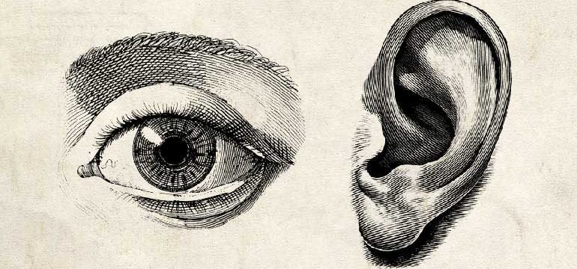
Law and Grace: Relationship, Position, and Blessing – Does It Matter?
1 Corinthians 2:9
“…it is written, “Things which eye has not seen and ear has not heard, And which have not entered the heart of man, All that God has prepared for those who love Him.”
God’s demonstration of grace will occupy us forever

Slide 67
Law and Grace: An Overview Jim McGowan, Th.D. Sugar Land Bible Church 05-05-2024
…but grace and truth were realized through Jesus Christ - John 1:17
For the Law was given through Moses…
Special thanks to Dr. Vern Peterman for access to his insights and resources.

