Slide 1
MOP UP ITEMS FROM THE EVANGELISM WORKSHOP LAST NIGHT
The workshop can be watched at: slbc.org
The handout and all the other materials used last night are available to be downloaded at: TBD
Grace Gospel Press & True Grace Books merged on April 1st 2024. So you can order some of the booksfrom our handout from truegracebooks.com and booklets like John 3:16 Illustrated and many others from duluthbible.org/publications/pages/free-downloads
Notes:
THOUGH THE PARTS OF THE HANDOUT LAST NIGHT THAT I DIDN’T COVER ARE MOSTLY SELF-EXPLANATORY, THERE WAS 1 SECTION WHERE YOU NEED THE ANSWERS AND THEY ARE …

Slide 2
G. LET’S REMEMBER TO HIGHLIGHT THE IMPORTANCE OF:
ABIDING IN CHRIST.
2. PRAYER.
3. YOUR GODLY WALK & TESTIMONY.
4. PRACTICE explaining the Gospel and using the various tools.

Slide 3
FIRSTHAND OBSERVATION & TRAINING –
I highly recommend that you plan to observe others & even participate for several hours or longer {if possible} to gain greater confidence in presenting the Gospel. You can do this at such upcoming venues as:
a) Ft Bend County Fair {Sept. 27-Oct. 6, 2024} – You have the opportunity to first watch & then participate - if desired. The contact person is Mike Adams: 218.244.2166.
b) Georgia National Fair {October 3-12, 2024} – We have used this as a venue to not only present the Gospel to 800 people each of the last 2 years, but to train believers how to present the Gospel. Contact: Bobby Pearson - 218.310.7981.

Slide 4
c) Itasca County Fair, Grand Rapids, Mn. – contact: Shawn Laughlin - 218.259.4124.
d) Scott & Dakota County Fairs {Minneapolis, MN area} – end of July, beginning of August – contact: Dave Knutsen 763.807.7113.
e) Quartzsite, AZ – Tyson Wells Sell-A-Rama – Jan. 17-26, 2025 – contact: Bert Spaeth {218.348.5507} or Nick Kerr {218.220.0935}.
f) Alaska State Fair {August 16-Sept. 2, 2024} – contact: Shawn Laughlin - 218.259.4124.
g) Seward Seamen’s Mission, Seward Alaska – contact: Scott Johnson 218.348.0104.
h) Billings MT Fair {August 9-17, 2024} – contact: Jared Berg 406.876.3727

Slide 5
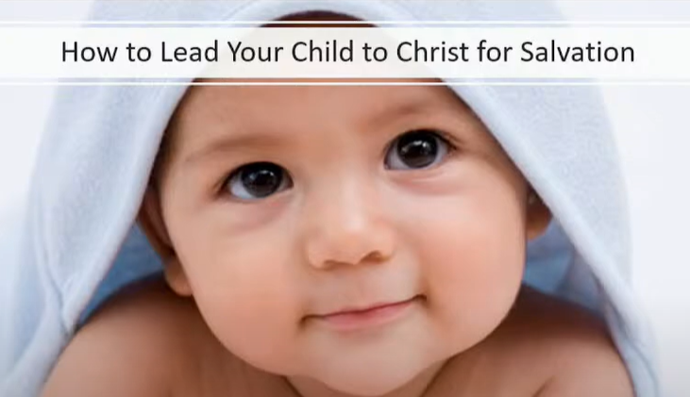
Acquiring CLARITY in CHILD EVANGELISM. These studies can be watched at: Our website: Grace & Truth Bible Church, GA – gracetruthbible.org series: Christian Parenting by the Book:
How to Lead Your Child to Christ for Salvation on You Tube: https://www.youtube.com/watch?v=iZaSs51Hg-0&list=PLLbwHjPL2KVtNwOc7Apb9LzTPvEnZsuZF&index=4 - Sermon Audio with handout: https://www.sermonaudio.com/sermoninfo.asp?SID=21242243435351
How to Help Your Child Grow Spiritually on
You Tube: https://www.youtube.com/watch?v=hun1v4vomHc&list=PLLbwHjPL2KVtNwOc7Apb9LzTPvEnZsuZF&index=5 or on Sermon Audio: https://www.sermonaudio.com/sermoninfo.asp?SID=229242310181323
Notes:
Unfortunately, there is a tremendous amount of confusion when it comes to presenting the Gospel to children.
In a recent message taught at Grace & Truth Bible Church, GA, I covered the 13 principles to know & keep in mind when evangelizing children.
Then I followed up with a message on how to help your child spiritually grow. These studies can be watched at:

Slide 6
K. Incorporating the GOSPEL into PULPIT PREACHING.
Let’s Preach the Gospel. https://tithely-media-prod.s3.us-west-1.wasabisys.com/492276/Lets-Preach-the-Gospel-2017.pdf
Principles on Preaching – Fifteen Principles to Improve Your Expository Preaching - True Grace Books - truegracebooks.com.

Slide 7
Tracts for Jewish Evangelism
While I cannot vouch for all the tracts on these sites, there are some good tracts under:
Jewish Evangelism at https://www.youtube.com/watch?v=llsC8HkNLO0 or under
Gospel Tracts for Jewish Evangelism at https://www.wmoutreach.org/gospel-tracts.
To order printed tracts for Jewish Evangelism by Cynthia Attard: URL. www.frontlineprints.com

Slide 8
Notes:
Ask _____________________________ to pray.

Slide 9
Sugar Land Bible ChurchTx.
Do You Need to Change Your Mind About Repentance? Pt. 2
Dr Dennis Rokser
Sr. Pastor of Grace & Truth Bible Church, GA
Notes:
LET ME INVITE YOU TO OPEN YOUR BIBLES W ME TO 2 COR. 7.
WHEN PAUL & SILAS WERE ASKED BY THE PHILIPPIAN JAILOR THE MILLION DOLLARE QUESTION …

Slide 10
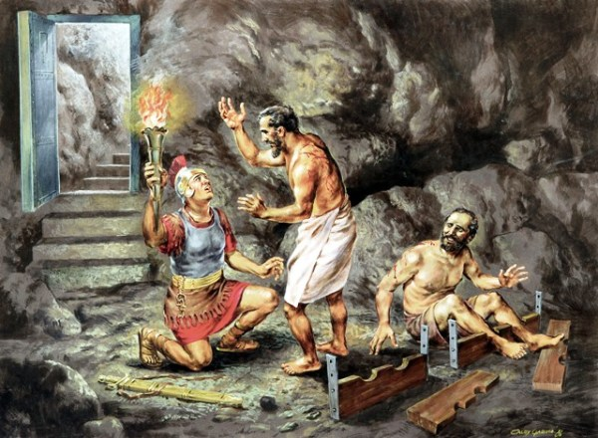
Acts 16:30-31
And he {the jailor} brought them {Paul & Silas} out and said,
"Sirs, what must {dei} I do to be saved?"
31 So they said, "Believe {aorist, active, imperative} on {epi} the Lord Jesus Christ,
and you will be saved {future, passive indicative}
Notes:
DEAR FRIENDS, THIS IS THE ONLY RIGHT RESPONSE TO THE GOSPEL OF JC AND HIS FINISHED WORK.
UNFORTUNATELY, WE ARE HEARING A LOT OF CONFUSION AND SYNCRETICISM ABOUT THIS IMPORTANT ANSWER IN OUR DAY.
IN FACT, IT IS COMMON TO HEAR SUCH THINGS AS ‘YOU NEED TO REPENT OF YOUR SINS AND BELIEVE IN JC TO BE SAVED.”
BUT IS THAT WHAT PAUL & SILAS ANSWERED THE JAILOR? IS THERE 2 CONDITIONS TO BE SAVED OR JUST 1 CONDITION?
AND THIS SHOCKING FOR PEOPLE TO HEAR BUT DID YOU KNOW THAT THE PHRASE ‘REPENT FROM YOUR SINS’ IS NOT EVEN FOUND IN THE BIBLE?
SO WHY ALL THE CONFUSION? ITS BECAUSE OF RELIGIOUS TRADITION, ITS BECAUSE OF A FAILURE TO LOOK AT THE WORD REPENTANCE FROM THE ORIGINAL LANGUAGES IN ITS CONTEXT & USAGE, ITS BECAUSE PEOPLE CONFUSE JUSTIFICATION BEFORE GOD AND PRACTICAL SANCTIFICATION IN TIME, AND ITS BECAUSE THE FLESH WANTS TO ‘DO’ SOMETHING TO BE SAVED.
AND ISN’T THAT THE VERY QUESTION THE JAILOR ASKED… “WHAT MUST I DO … TO BE SAVED?’ WE NATURALLY ARE WIRED FOR A LEGALISTIC APPROACH TO SALVATION BY WORKS, WHICH IS ALSO REINFORCED BY RELIGION – SATAN’S CHIEF TRUMP.
SO LET ME BRIEFLY REVIEW TO BRING EVERYONE UP TO SPEED AND THEN LETS EXPLORE DEEPER SCRIPTURAL CLARITY ON ‘REPENETANCE’.
THE WORD REPENTANCE’ MEANS TO ‘CHANGE YOUR MIND”.

Slide 11
It is important to remember that sorrow can PRECEDE repentance,
ACCOMPANY repentance, or
FOLLOW repentance,
but sorrow is NOT repentance and can occur without any EMOTIONAL element involved.
Repentance is a CHANGE OF MIND!
Notes:
GO NEXT W ME TO LUKE 17.

Slide 12
“In the King James Version, the word repent occurs forty-six times in the Old Testament. Thirty-seven of these times, God is the one repenting (or not repenting). If repentance meant sorrow for sin, God would be a sinner”.
G. Michael Cocoris, Evangelism: A Biblical Approach, (Moody Press, Chicago, IL), pg. 68-69.

Slide 13
8 For even if I made you SORRY {lupeo} with my letter, I do not REGRET it {metamellomia – like Judas, Mt. 27:3; this word is NEVER used in reference to salvation / justification}; though I did regret it {metamellomia}.
For I perceive that the same epistle made you sorry {lupeo}, though only for a while. 9 Now I rejoice, not that you were made sorry {lupeo}, but that your sorrow {lupeo}
LED TO {eis – resulted in} REPENTANCE {metanoia – a change of mind}. For you were made sorry in a godly manner that you might suffer loss from us in nothing.
Notes:
Turn to 2 Cor. 7 – explain CONTEXT – then explain CONTENT
DO YOU SEE THAT SORROW IS NOT REPENTANCE; REGRET IS NOT REPENTANCE;

Slide 14
For godly sorrow PRODUCES repentance {metanoia} leading to {eis} SALVATION {2nd tense; these were believers in Christ},
not to be regretted {ametameletos – no regret or sorrow}; but the sorrow {lupeo} of the world produces death.
Always ask yourself: WHO needs to change their mind {believers? Unbelievers? Nation of Israel?} about WHAT?

Slide 16
6. What does “repentance” NOT mean? REPENTANCE …
a. is not necessarily connected with your “SINS” {context determines what the object of repentance is, and while sometimes believers are told to ‘repent from their sins’, unbelievers are not required to do so for salvation}
b. does not mean ‘SORROW’{though it might lead to or accompany salvation. It is important to remember that sorrow can PRECEDE repentance, ACCOMPANY repentance, or FOLLOW repentance, but sorrow is NOT repentance which requires no EMOTIONAL element involved.
c. It does not mean ‘TURNING FROM SIN’ – for did God turn from His sins when He repented? {He had none!}
d. It does not mean a CHANGE IN BEHAVIOR {though that may or may not be the fruit of it – Luke 17:3-4}
Notes:
GO NEXT W ME TO LUKE 17.

Slide 17
What must be considered in understanding the correct meaning or nuance of “repentance” in any passage?
The CONTEXT, CONTEXT, CONTEXT!
You must always consider “WHO is to change his/her mind and about WHAT?”
Notes:
MUST OBSERVE … WHO IS CHANGING THEIR MIND AND ABOUT WHAT IN THE CONTEXT YOU ARE READING.
FOR EXAMPLE

Slide 18
What is the relationship of “faith” and “repentance”? Are they the same thing?
Repentance and faith are closely related in many contexts, but they are NOT synonomous? NO! {Acts 20:21; Hebrews 6:1; Matt. 12:41, Jonah 3:5; Acts 10:43, 11:17-18}

Slide 19
Acts 20:20-21… "how I kept back nothing that was helpful, but proclaimed it to you, and taught you publicly and from house to house, testifying to Jews, and also to Greeks, repentance toward God and faith toward our Lord Jesus Christ.
Notes:
TSKS CONSTRUCTION
GENERALLY - FAITH TOWARD GOD – REPENTANCE OF A CORRECT UNDERSTANDING OF GOD, MAN, SIN, ETC.
SPECIFICALLY – FAITH TOWARD OUR LJC

Slide 20
While repentance is INHERENT in BELIEVING, faith in Christ is NOT always inherent in REPENTING - depending on the context.
{Like when God repented in the OT; or when believers repent about sins in their lives, etc.}

Slide 21
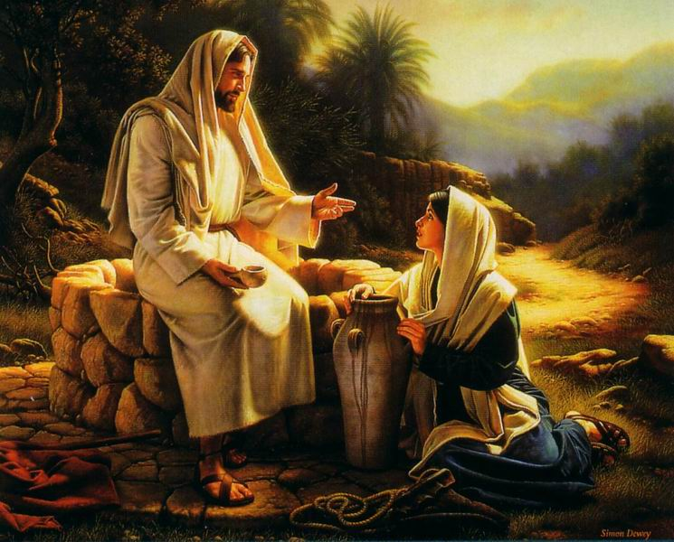
Did Jesus make “sorrow or turning from sin” (adultery) a condition of salvation with Samaritan woman at the well (John 4)?

Slide 23
What is the purpose of the book of John (20:30-31) and how many times is the word “repent / repentance” found in it?
The word “repent / repentance” is not found in John but “believe” is found 99x.

Slide 24
WHAT ULTIMATELY CONDEMNS A SINNER? IS IT A LACK OF HIS REPENTING OR TURNING FROM SIN? NO!
John 3:18 "He who believes in Him is not condemned; but he who does not believe is condemned already, because he has not believed in the name of the only begotten Son of God.

Slide 25
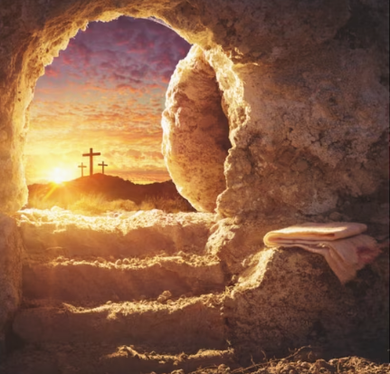
Notes:
PEOPLE ATTACH A LOT OF BAGGAGE TO THE WORD “BELIEVE” LIKE A SPENDING BILL IN CONGRESS.
SO TURN NEXT W ME TO ACTS 11.

Slide 26
Acts 11:14-18 `who will tell you words by which you and all your household will be saved.' 15 "And as I began to speak, the Holy Spirit fell upon them, as upon us at the beginning {Acts 2}. 16 "Then I remembered the word of the Lord, how He said, “John indeed baptized with water, but you shall be baptized with the Holy Spirit.”
17 "If therefore God gave them the same gift {of the Holy Spirit} as He gave us when we believed {aorist, active, participle of pistueo} on {epi} the Lord Jesus Christ, who was I that I could withstand God?"
18 When they heard these things they became silent; and they glorified God, saying, "Then God has also granted to the Gentiles repentance {metanoia to change their mind regarding the Gospel} to {eis – resulting in} life {eternal life}.

Slide 27
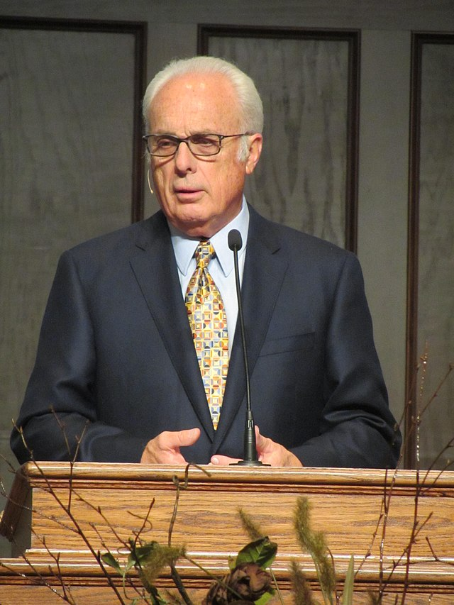
“In other words, there must be a sincere change in one’s lifestyle. One who has genuinely repented will stop doing evil and begin to live righteously. Along with a change of mind and attitude, true repentance will begin to produce a change in conduct.”
John MacArthur, Gospel According to Jesus, 166.

Slide 28
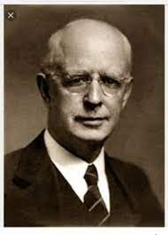
In stark contrast, Lewis Sperry Chafer writes: No unregenerate mind is prepared to deal with the problems of true Christian living. These problems anticipate the new dynamic of the imparted divine nature, and could produce nothing but hopeless discouragement when really contemplated by an unregenerate person.
Salvation: God’s Marvelous Work of Grace, pg. 48

Slide 29
Is man’s “repentance” a “gift” from God? {Acts 11:17-18}
NO, but the opportunity to repent is!
Like the words “believe / faith” which are NOT a gift from God, repentance is a non-meritorious VOLITIONAL response to God’s truth and is repeatedly found in the ACTIVE VOICE because we have a choice in changing our minds or not, as we can resist the truth God is showing us, and too many unbelievers, and even believers, do.

Slide 30
Acts 11:17-18
17 "If therefore God gave them the same gift {of the Holy Spirit} as He gave us when we believed {aorist, active, participle of pistueo} on {epi} the Lord Jesus Christ, who was I that I could withstand God?"
18 When they heard these things they became silent; and they glorified God, saying, "Then God has also granted {aorist, active, indicative of didomi – God granted them what? the opportunity to hear the Gospel} to the Gentiles repentance {metanoia to change their mind regarding the Gospel} to {eis – resulting in} life {eternal life}.

Slide 31
What is the relationship of “repentance” to “salvation” / justification”?
a. There is repentance BEFORE salvation for unbelievers. {Acts 17:30-31}.
Consider the CONTEXT of Acts 17:22ff
Observe the CONTENT of Acts 17:30-31

Slide 32
Acts 17:30-31 "Truly, these times of ignorance God overlooked, but {God} now commands all men {anthropos - Jews & Gentiles} everywhere to repent {pres., active, infin. of metanoeo}
because He has appointed a {coming} day on which He will judge {since He is the sovereign Creator – Romans 1:18-32 – creation & conscience} the world {what will characterize His judgment?} in righteousness {by what means will He judge the world?} by the Man whom He has ordained.
He has given assurance of this to all by raising Him {Jesus Christ} from the dead."

Slide 33
Acts 17:32-34 And when they heard of the resurrection of the dead,
some mocked,
while others said, "We will hear you again on this matter.“
33 So Paul departed from among them.
34 However, some men joined him and believed {aorist, active, indicative of ‘pisteuo’} among them Dionysius the Areopagite, a woman named Damaris, and others with them.

Slide 34
Acts 17:1-4 Now when they had passed through Amphipolis and Apollonia, they came to Thessalonica, where there was a synagogue of the Jews. 2 Then Paul, as his custom was, went in to them, and for three Sabbaths reasoned with them from the Scriptures,
3 explaining and demonstrating that the Christ had to suffer and rise again from the dead, and saying,
"This Jesus {Yeshua}. whom I preach to you is the Christ {Christos / Messiah}" {WHY DIDN’T PAUL BEGIN WITH CREATION?}
4 And some of them were persuaded {aorist, passive, indicative of peitho – they were persuaded by the Scriptures so as to believe};
and a great multitude of the devout Greeks, and not a few of the leading women, joined Paul and Silas.

Slide 35
Notes:
We I say that we do not need to repent from your sins to be saved does not deny the CONTEXT of the Gospel regarding …
THE HOLINESS OF GOD
THE SINFULNESS OF MAN
AND THE WAGES OR PENALTY OF SIN IS DEATH.
IF YOU DO NOT SEE YOURSELF AS A HELPLESS, HOPELESS, HELLBOUND SINNER, WHY WOULD YOU NEED A SAVIOR – WHUCH WE ALL DO.
SO DON’T CONFUSE ME SAYING … YOU DON’T NEED TO REPENT … FROM YOUR SINS … TO BE SAVED … AS IF I’M DENYING THE CONTEXT OF THE GOSPEL, FOR I AM NOT.

Slide 36
What is the relationship of “repentance” to “salvation” / justification”?
a. There is repentance BEFORE salvation for unbelievers. {Acts 17:30-31}.
b. There is repentance AT salvation / justification for those who choose to trust in Jesus Christ alone to save them. {Luke 13:3,5, 24:46-49; Acts 9:1-6. 10:43, 11:17-18}

Slide 37
Luke 13:1-3 There were present at that season some who told Him about the Galileans whose blood Pilate had mingled with their sacrifices. 2 And Jesus answered and said to them, "Do you suppose that these Galileans were worse sinners than all other Galileans, because they suffered such things? 3 "I tell you, no; but unless you repent {pres. act. subj. of metanoeo} you will all likewise perish {future, middle, indicative of apollumi – perish, be lost, not the absence of being but well-being – IN HELL}

Slide 39
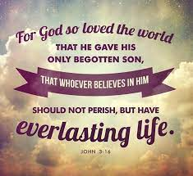
Luke 13:4-5
"Or those eighteen on whom the tower in Siloam fell and killed them, do you think that they were worse sinners than all other men who dwelt in Jerusalem? 5 "I tell you, no; but unless you repent {pres. act. subj. of metanoeo}
you will all likewise perish {future, middle, indicative of apollumi – perish, be lost, not the absence of being but well-being – IN HELL}."
Notes:
COMPARE WITH JOHN 3:16

Slide 40
Acts 9:1-7 Then Saul, still breathing threats and murder against the disciples of the Lord, went to the high priest 2 and asked letters from him to the synagogues of Damascus, so that if he found any who were of the Way, whether men or women, he might bring them bound to Jerusalem. 3 As he journeyed he came near Damascus, and suddenly a light shone around him from heaven. 4 Then he fell to the ground, and heard a voice saying to him, "Saul, Saul, why are you persecuting Me?"
5 And he said, "Who are You, Lord?" Then the Lord said, "I am Jesus, whom you are persecuting. It is hard for you to kick against the goads."
6 So he, trembling and astonished, said, "Lord, what do You want me to do?" Then the Lord said to him, "Arise and go into the city, and you will be told what you must do." 7 And the men who journeyed with him stood speechless, hearing a voice but seeing no one.

Slide 42
“There is no such thing as a salvation that does not acknowledge the lordship of Jesus Christ. Yet, when I have taught that, people have accused me of teaching a works salvation. In fact, in south Florida some years ago, I was often attacked in that regard. People would say, “you are teaching a works salvation because you are saying that you have to confess and repent of your sin, embrace Christ as Lord, and commit your life to be obedient to Him. That’s a works salvation. It adulterates pure grace.” I think that they have a nice motive in trying to maintain the purity of grace, but in so doing I think they have emasculated the doctrine of salvation.” John F. MacArthur, Justified By Faith (Word of Grace Comm., 1984), p. 4.
Notes:
IN CONTRAST TO ACTS 16:31

Slide 43
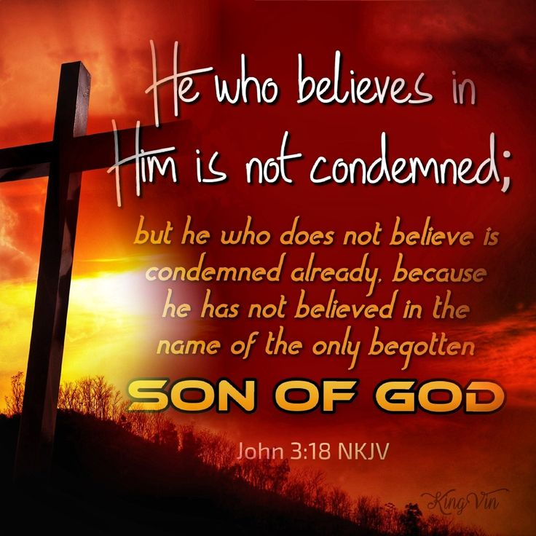

Slide 44
What is the relationship of “repentance” to “salvation” / justification”?
a. There is repentance BEFORE salvation for unbelievers. {Acts 17:30-31}.
b. There is repentance AT salvation / justification for those who choose to trust in Jesus Christ alone to save them. {Luke 13:3,5, 24:46-49; Acts 9:1-6. 10:43, 11:17-18}
c. There is to be ongoing repentance AFTER salvation / justification for believers regarding sin, human viewpoint, false teaching, etc. as part of daily fellowship with God and ongoing spiritual growth. {2 Cor. 7:8-10, 12:20-21; 2 Tim. 2:24-25; Heb. 6:6; Rev. 2:5, 3:3, 19-20}

Slide 45
2 Corinthians 12:19-21 Again, do you think that we excuse ourselves to you? We speak before God in Christ. But we do all things, beloved, for your edification.
20 For I fear lest, when I come, I shall not find you {believers} such as I wish {walking in holiness},
and that I shall be found by you such as you do not wish {having to correct them}; lest there be contentions, jealousies, outbursts of wrath, selfish ambitions, backbitings, whisperings, conceits, tumults;
21 lest, when I come again, my God will humble me among you, and I shall mourn {pentheo – to grieve – 1 Cor. 5:2} for many who have sinned before and have not repented {aorist, active, participle of metanoeo – changed their mind about what?}
of the uncleanness, fornication, and lewdness which they have practiced.

Slide 46
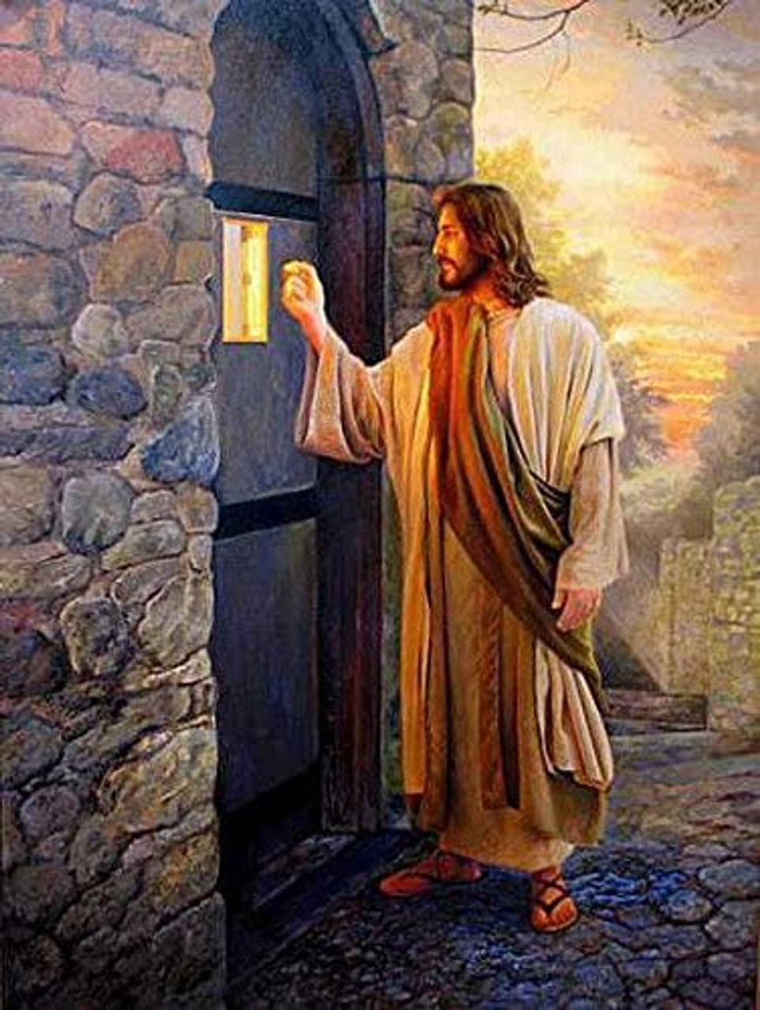
Revelation 3:19-20 "As many as I love {phileo},
I rebuke and {I} chasten {discipline}.
Therefore be zealous {aorist, active, imperative of zeloo} and repent {aorist, active, imperative of metanoeo}.
20 "Behold, I stand at the door and knock. {What door?}
If {3rd} anyone {context – any believer} hears My voice and opens the door, I will come in {eiserchomai} to {pros} him and dine with him, and he with Me.

Slide 47
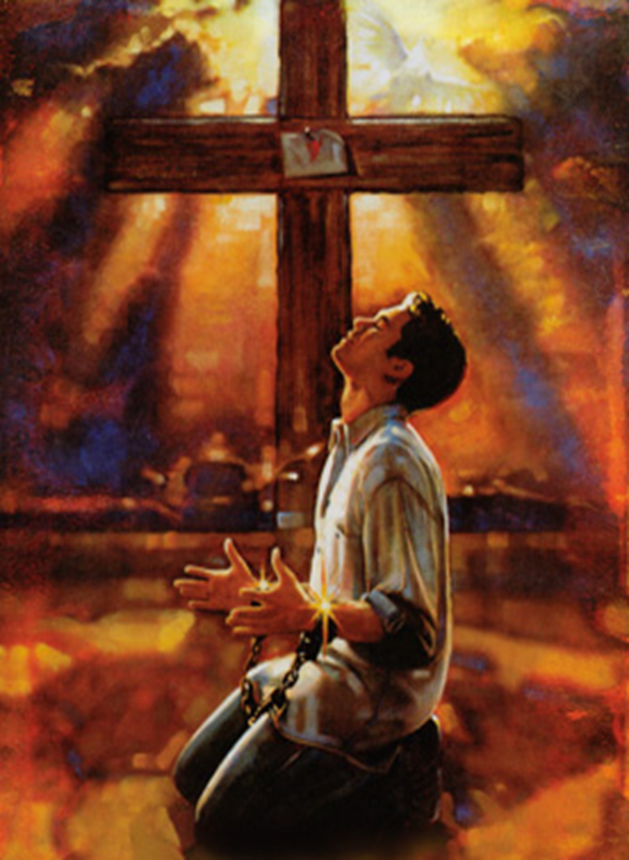
Clarification: The issue at salvation / justification is not “repenting of your sins” {though we have many} but CHANGING YOUR MIND about the SAVIOR who died for your sins so as to TRUST in His finished work ALONE {Luke 13:1-5; John 3:14-18; book of John, Romans, Galatians; 2 Peter 3:9}.

Slide 48
However, repentance ‘from sin’, human viewpoint, self-dependence, etc, does have a place AFTER justification in the believer’s life as part of the process of practical SANCTIFICATION and GROWTH. {2 Cor. 7:8-11; 12:20-21; Rev. 2:5; Romans 12:2}
Romans 12:2 And do not be conformed to this world, but be transformed by the renewing of your mind, that you may prove what is that good and acceptable and perfect will of God.
Hebrews 6:6 if they fall away, to renew them again to repentance, since they crucify again for themselves the Son of God, and put Him to an open shame.

Slide 49
Why Doesn’t The Bible Teach That One Has To “Repent From Their Sins” To Be Saved from Hell?
Because the phrase “repent from you sins” is NOWHERE found in the New Testament.
Because this would require an unbeliever to DO something for salvation and require 2 conditions for salvation.
Because this would rob a person of the absolute assurance of their salvation as he would never know WHAT all his sins were, nor WHEN he had fully repented of them..
Because the sin problem has already been settled once and for all when Christ died on the cross and the condition for salvation is FAITH alone in CHRIST alone.

Slide 50
• What is Acts 2:38 teaching & not teaching?
Let’s examine the historical & immediate CONTEXTS of Acts 2:38.
* What did Jesus Christ tell His disciples in Luke 24:46-49?
46 Then He said to them, "Thus it is written, and thus it was necessary for the Christ to suffer and to rise from the dead the third day,
47 "and that repentance {metanoia – a change of mind – about what?} and remission {forgiveness} of sins should be preached
in {epi} His name {remember this} to all nations {ethnos – all people groups / Jews & Gentiles}, beginning at Jerusalem.
48 "And you are witnesses of these things. 49 "Behold, I send the Promise of My Father {the Holy Spirit} upon you; but tarry in the city of Jerusalem until you are endued with power from on high."

Slide 51
What did Jesus Christ tell His disciples in Matthew 28:18-20?

Slide 52
What did Peter preach in Acts 2:14-36?
He preached the Gospel of Jesus Christ’s death & how God the Father raised Him from the dead and how they had crucified their Messiah.
What was Peter’s conclusion? {2:36}
"Therefore let all the house of Israel know assuredly that God has made this Jesus, whom you crucified, both Lord and Christ.“
How did these Jews unbelievers respond? {2:37}
Now when they heard this, they were cut to the heart {conviction; not regeneration}, and said to Peter and the rest of the apostles, "Men and brethren, what shall we do?"
What are these Jews asking Peter in Acts 2:37, and how does this differ from Acts 16:31?

Slide 53
b. Let’s observe the CONTENT of Acts 2:38:
Then Peter said to them , {Command #1} "Repent {metanoeo, aorist tense, active voice, imperative mood, plural - all of you choose to change your mind – like Luke 24:47; about what or who?}
and {#2} let every one of you {singular; who have changed your minds then} be {water} baptized {baptizo - aorist, passive, imperative, this is a public identification with Jesus Christ; like instructed in Matt. 28:19 – but WHY?}
in {epi – upon, on, resting upon – 2:3 ,17-19, 30, 9:42, 11:17, 16:31, 22:19; like Luke 24:47} the name {4:12, 10:43; like Luke 24:47} of Jesus Christ {His person & finished work}
{Result #1} for {eis} the remission of sins {like Luke 24:47}; and
{Result #2} you shall receive the gift of the Holy Spirit {like Luke 24:48; Acts 1:4-5}.

Slide 54
Let’s COMPARE Scripture with Scripture: Consider Acts 2:41, 2:44, 10:43, 48, 11:17-18
Acts 2:41 Then those who gladly received {to personally accept– by faith} his word {Peter’s message}
were {water} baptized {as a public expression of their faith & identification with Jesus as the Christ};
and that day about three thousand souls were added to them.
Acts 2:44 Now all who believed {present, active, participle if pisteuo} were together, and had all things in common,

Slide 55
d. Let’s CONCLUDE:
Acts 2:38 is Peter’s ANSWER to these Jewish unbelievers’ question as to what they should now DO in light of them having murdered their Messiah which God the Father then raised Jesus Christ from the dead {2:36-37}.
The command & invitation which is given to all would begin with REPENTANCE ABOUT JESUS CHRIST {from unbelief to belief; from rejection to receiving Him by faith as their Savior}, resulting in the forgiveness of their sins & the receiving of the Holy Spirit,
which was then to followed by going from the public rejection to the public identification with Jesus as the Christ via WATER BAPTISM of which some 3000 individuals responded {2:41}.

Slide 56
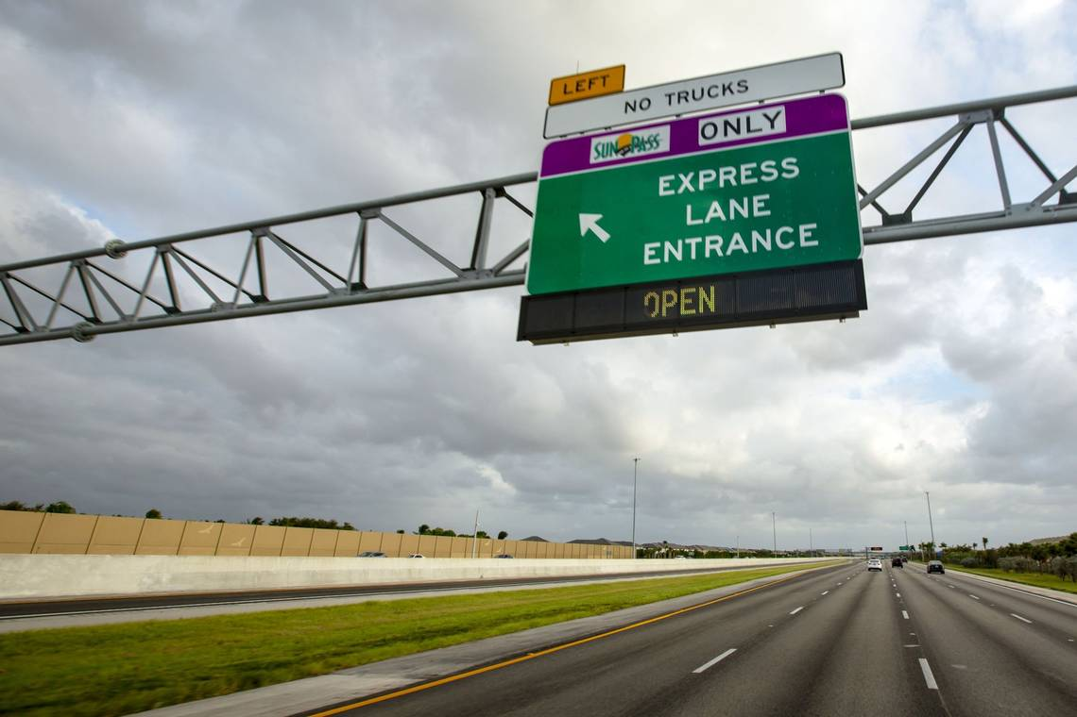

Slide 59
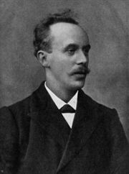
John Harper {May 29, 1872 – April 15, 1912}
Walworth Road Baptist Church, London, England
Notes:
We all know the story. The Titanic, a British passenger liner, struck an iceberg off Newfoundland on the night of April 14-15, 1912, and sank. There is part of that story, however, that is not widely known.
One of the passengers on the Titanic was a godly pastor from Scotland by the name of John Harper. Harper had recently spent three months ministering at the Moody Church in Chicago, during which time the church had experienced one of the most wonderful revivals in its history. He had not been back in Britain long when he was asked to return and continue his ministry. He quickly made arrangements for himself and his six-year old daughter, Nana, to travel back to America on board the Lusitania. However, he decided to delay their departure for one week, so that they could sail on a new ship, the Titanic, which was about to make its maiden voyage.
On Sunday the 14th of April, 1912, the day when the iceberg was struck, the weather was fine, the sea calm. Harper attended the church service for the passengers. Years afterward, his niece reported that later that same afternoon she recalled seeing her uncle speaking individually to people about their souls. It seems he was in the habit of seeking out the lost wherever he went.
The Titanic struck the iceberg at 11:40 p.m. on April 14, 1912. As the call was issued for passengers to vacate their cabins, Harper wrapped his daughter in a blanket, told her that she would see him again one day, and passed her to one of the crewmen. After watching her safely board one of the lifeboats, he removed his life jacket and gave it to another passengers. One survivor distinctly remembered hearing him shout, “Women, children, and the unsaved into the lifeboats!” Harper knew that believers were ready to die but the unsaved were not ready. Harper then ran along the decks pleading with people to turn in faith to Jesus Christ, and with the ship sinking, he called upon the Titanic’s orchestra to play “Nearer, My God, to Thee.” Gathering people around him on deck, he then knelt down, and “with holy joy in his face” raised his arms in prayer. Then, as the ship began to lurch, he jumped into the icy waters and swam urgently to all he could reach, beseeching them to trust in Jesus Christ and be saved. Finally, as hypothermia set in, the body of God’s servant sank beneath the waters and while his soul and spirit passed into the Lord’s presence. John Harper was 39.
Four years later, a young Scotsman by the name of Aguilla Webb stood up in a meeting in Hamilton, Canada, and gave the following testimony:
“I am a survivor of the Titanic. When I was drifting alone on a spar that awful night, the tide brought Mr. John Harper of Glasgow, also on a piece of wreck, near me. ‘Man,’ he said, ‘Are you saved?’ ‘No,’ I said, ‘I am not.’ He replied, ‘Believe on the Lord Jesus Christ and thou shalt be saved.’ The waves bore him away; but, strange to say brought him back a little later, and he said, ‘Are you saved now?’ ‘No,’ I said, ‘I cannot honestly say that I am.’ He said again, ‘Believe on the Lord Jesus Christ, and thou shalt be saved,’ and shortly after he went down; and there, alone in the night, and with two miles of water under me, I believed. I am John Harper’s last convert.”
Apparently, God wanted Webb’s amazing testimony to be shared, because only seven people were plucked from the icy water that night to join the survivors in the lifeboats. Webb was one of them.
In the 1997 blockbuster Hollywood movie “Titanic,” nothing was said about John Harper, but he was truly one of the greatest heroes of the Titanic. In the face of death and drowning, knowing his own soul was secure in the Savior, he was concerned for the souls of others. Life can be gone in the blink of an eye. Eternity is forever. Do you know where you will spend eternity? “Believe on the Lord Jesus Christ and you shall be saved” (Acts 16:31). “For the Son of Man has come to seek and to save that which was lost” (Luke 19:10). ■

